Slide 1
Project Teams
Fall 2012

Slide 2
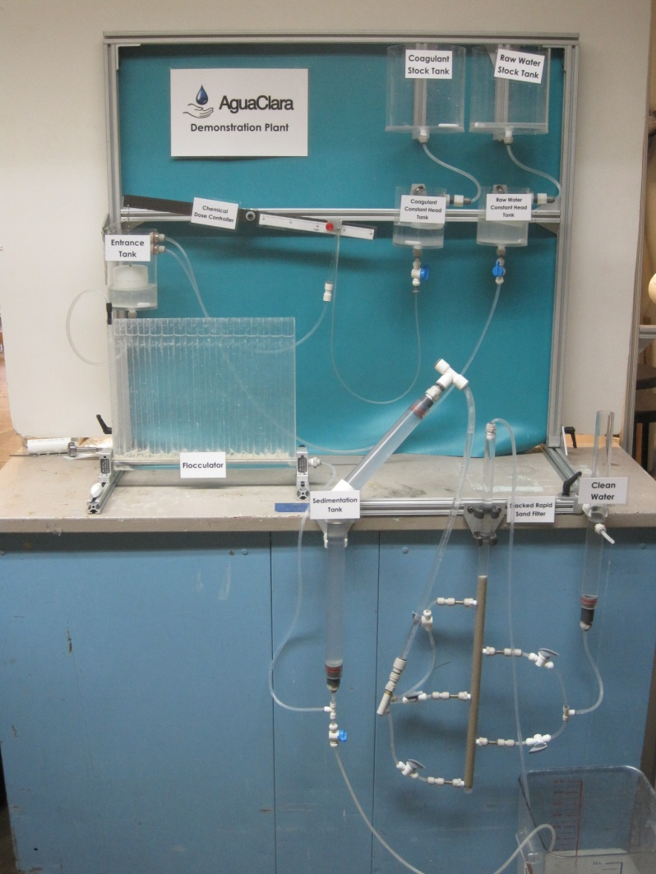


Demo Plant
Goals: Fabricate several demo plants and refine fabrication techniques.
Type of research: fabrication
Skills: fluids, fabrication

Slide 3
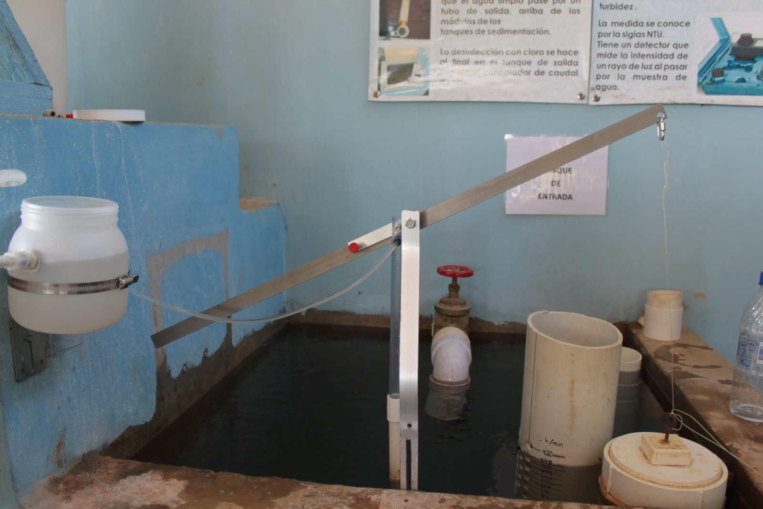
Linear Chemical Dose Controller
The CDC team will built a full scale prototype of the latest design and research possible solutions to problems such as chlorine leaks that occur in Honduras.
Type of research: Lab research, documentation
Skills: fluids, fabrication

Slide 4
Sedimentation Tank Hydraulics
Goals: Determine ideal floc hopper geometry and further knowledge of how to produce stable floc blankets.
Type of research: Lab research
Skills: fluids, experimentation, process controller

Slide 5
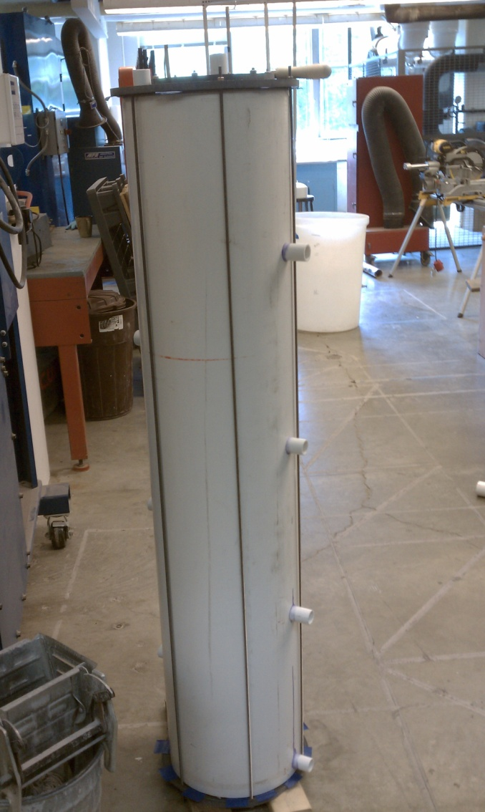
Low Flow Stacked Rapid Sand Filtration
The LFSRSF team will finish fabrication of the filter and conduct extensive hydraulic and performance testing with the goal of deploying the filter to Honduras as soon as possible!
Type of research: Lab research, fabrication
Skills: fluids, fabrication

Slide 6
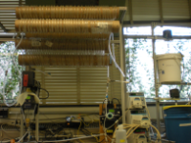
Tube Floc
Experiment with new ways to increase flocculator and rapid mix performance
Lab Experiments, Data Analysis, Research, Fabrication

Slide 7
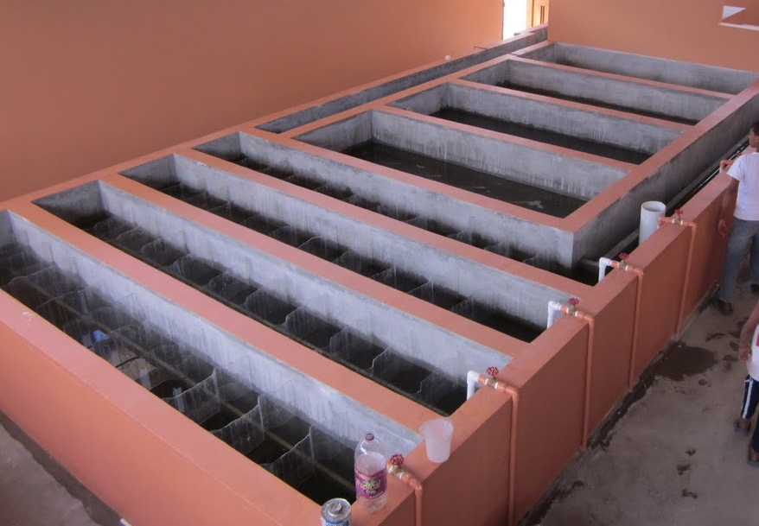
Floc-Sed Optimization
Systems optimization of the AguaClara plant design using a bench scale plant
Should have a detailed knowledge of AguaClara plant design
Lab Experiments, Data Analysis, Research
Notes:
7
7

Slide 8
Floc Filtration
Tamara filter performs better lab filters
Possible explanation: Particles that make it to the filter are flocs not primary particles
Should energy dissipation rate between sed tank and filter be kept low enough to prevent floc breakup?
Lab Experiments, Data Analysis, Research

Slide 9
Turbulent Flocculator
Current flocculator research conducted using a laminar flow tube flocculator, but AguaClara plants use turbulent flow hydraulic flocculators
Design, fabricate, and instrument a new apparatus to test turbulent flow flocculation in the lab
Plumbing Design, Fabrication

Slide 10
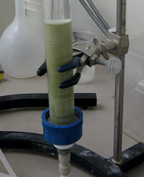
Foam Filtration
Polyurethane foam for emergency water treatment
  Mini-plant complete with
    Input reservoir, LFOM, chemical dose controller, filtration and disinfection tank
Goals!
  Add chemical dose controller
  Method or determining when to
  clean filters
  Deployment to Honduras?!?!
Notes:
10

Slide 11
Coagulant Management
How do you manage coagulant?
  Preparing and testing stock concentrations
  Dosing and injection into raw water
  Immediate performance feedback
Skills needed
  Fluids
  Plumbing design
  Fabrication
  Process controller

Slide 12
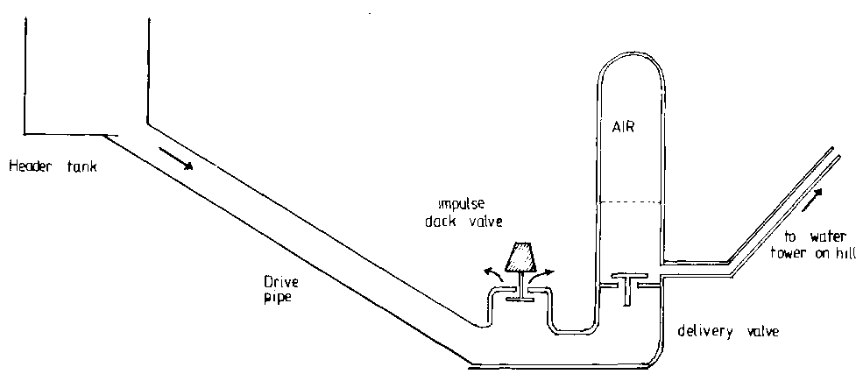
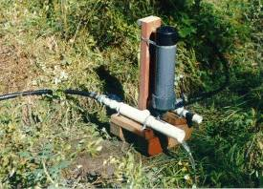
Ram Pump
Ram pump: use a lot of flow to pump a little
  Application – pump treated water for plant service
  Semester goal – improve design from Spring semester
FAO Corporate Document Repository (http://www.fao.org/docrep/s1250e/S1250E1e.htm)
Notes:
12

Slide 13
Ram Pump
Much to do!
  Better stand for pump, rearrange valve layout, air chamber design, test surge pipe, come up with flow measurement, improve connections to/from plant and distribution tank, estimate flows, storage tank needed?, scaling for higher or lower flows…………………………………………………………………………

Slide 14
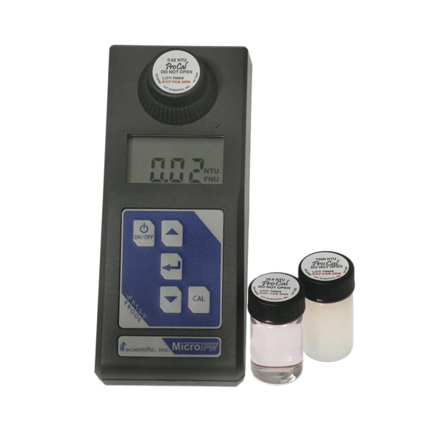
Smartphone Turbidimeter

Slide 15
Smartphone Turbidimeter
$762

Slide 16

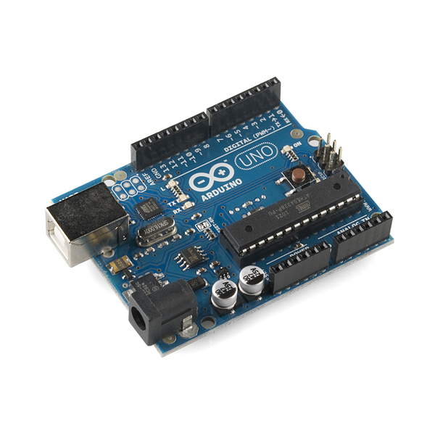

Smartphone Turbidimeter

Slide 17
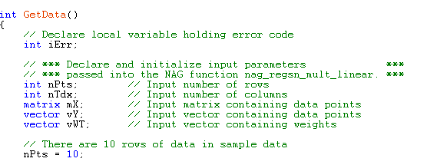
Smartphone Turbidimeter

Slide 18
Smartphone Turbidimeter
We will mostly meet outside of class time
Experience with Android/Arduino programming required
Know someone who might be interested? Put them in touch.
Looking for 1 or 2 students

Slide 19
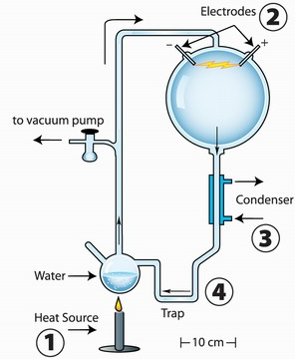
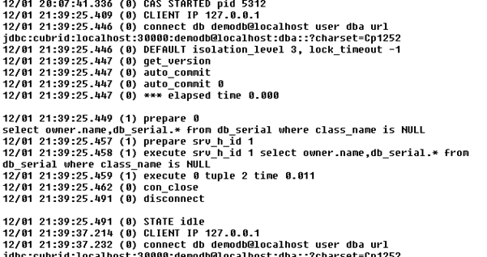
Data Processor Cleanup
Continuously-running experiments produce a large amount of data in log files

Slide 20
Data Processor Cleanup
… Which bogs down the data processor we have written in MathCAD

Slide 21
Data Processor Cleanup
… So we need to analyze the data processor code and see how to make it more efficient (or suggest a different program)

Slide 22
Data Processor Cleanup
This could be a 1-2 week side project for 1 student

Slide 23




Public Relations
Tasks for Fall 2012
Coordinate on-campus team building events
Maintain & update our presence online
Improve transparency & reporting processes
(wiki redesign, blogging)
Recruit team members, graduate student candidates, donors

Slide 24
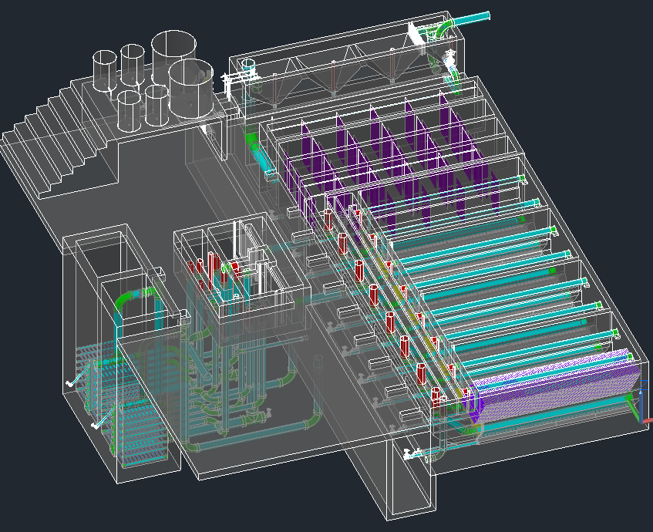
Design Team
Improving and expanding the capabilities of the automated design tool
  Incorporating new research results
  Expanding range of plant flow rates that we can design for
  Sections and details of specific plant components
  And many more important advancements!

Slide 25
Design Team
Desirable (but not required) skills:
  Mathcad, AutoCAD, CEE 4540, Fluid Mechanics, Spanish fluency, engineering design experience

