Slide 1
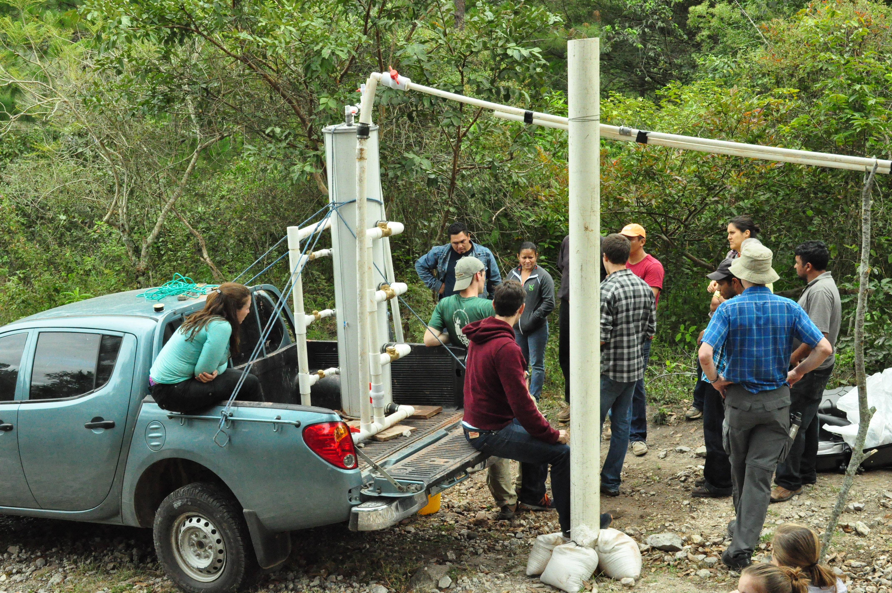
Low Flow Stacked Rapid Sand Filter
Kris, Nadia, Mihir, Rachel

Slide 2
Outline
Background of full scale Low Flow SRSF
Goals for Spring 2013
  Slotted manifold redesign
  Sand drain
  Filter column’s air-tight cap
  Technique to verify sand bed fluidization
  EPA P3 competition
Please be critical of today’s presentation.

Slide 3
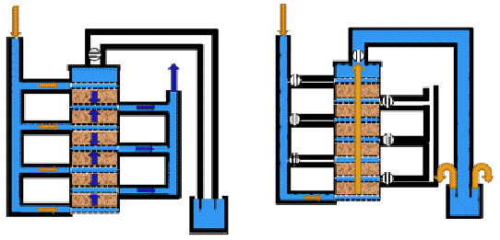
Background of Low Flow SRSF
Applicability to rural communities
Flow path through a SRSF
Demonstration in Honduras (Jan. 2013)

Slide 4
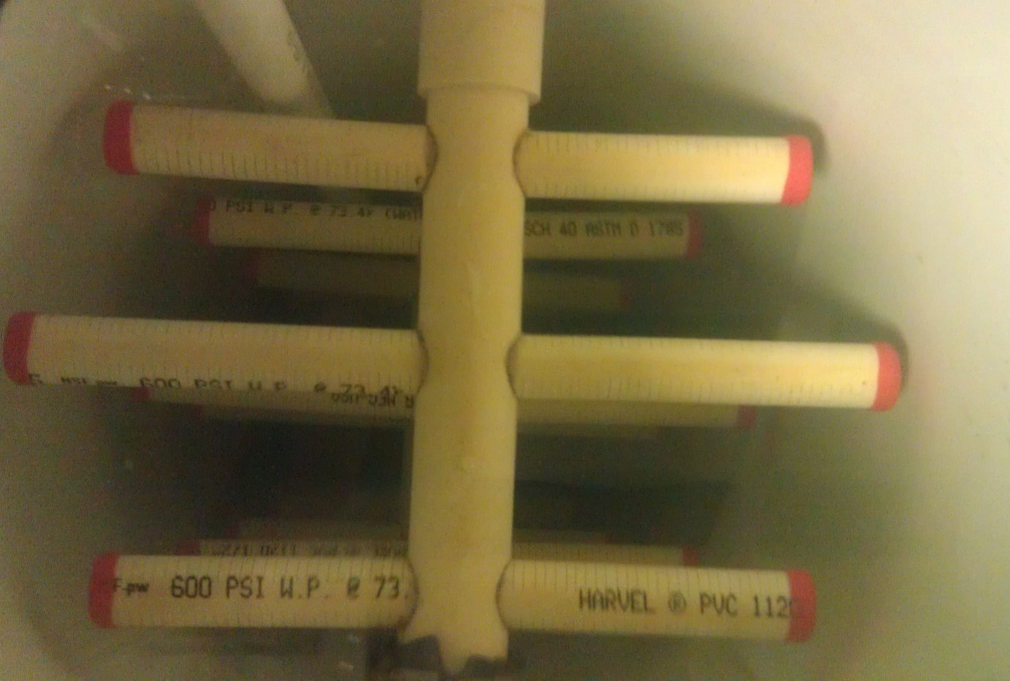
Spring 2013 – Slotted Manifolds
Increase surface area of the connections
1” to ½” center branch diameter

Slide 5
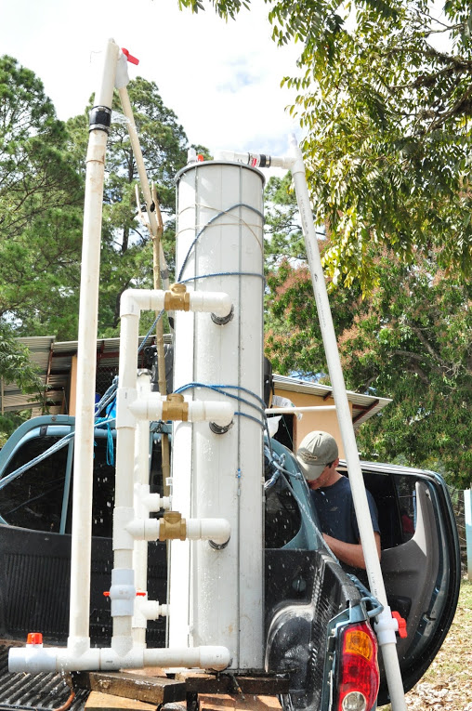
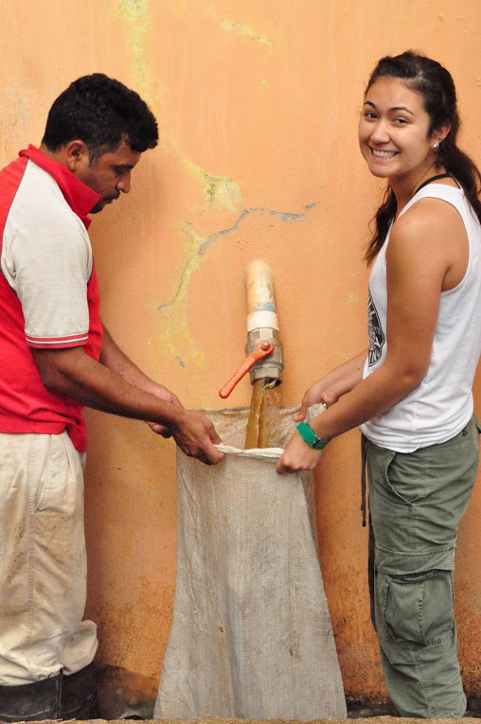
Spring 2013 – Sand Drain

Slide 6
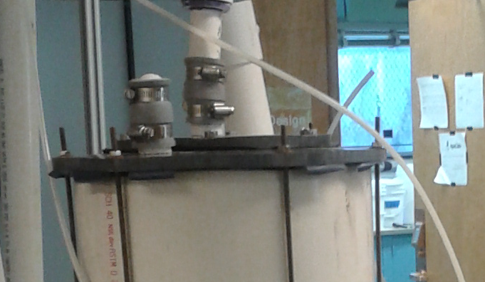
Spring 2013 – Air tight cap & Fluidization
Aluminum vs. PVC cap
Design connection mechanism

Slide 7

Spring 2013 – EPA P3
Phase II proposal for $90k
Fully operational small scale SRSF for display

Slide 8
Questions and Comments?

