Slide 1
LFSRSF
Alexandra Green, Jeanette Liu, Sarah Sinclair, Chenxi Wen, and Lishan Zhu

Slide 2
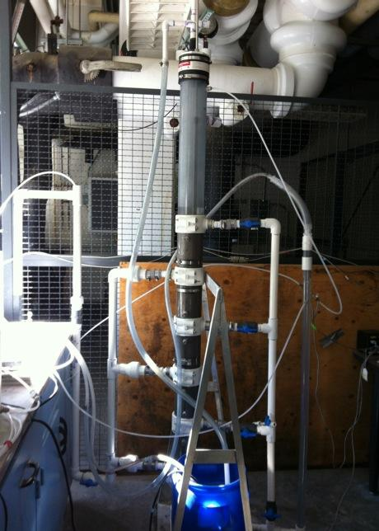
Background Information
What are LFSRSFs?
Previous work
This semester
-We have two teams

Slide 3
Goals for the Semester
Simplified hydraulic controls
Backwash initiator
Sand drain close-off
Construction and operation

Slide 4
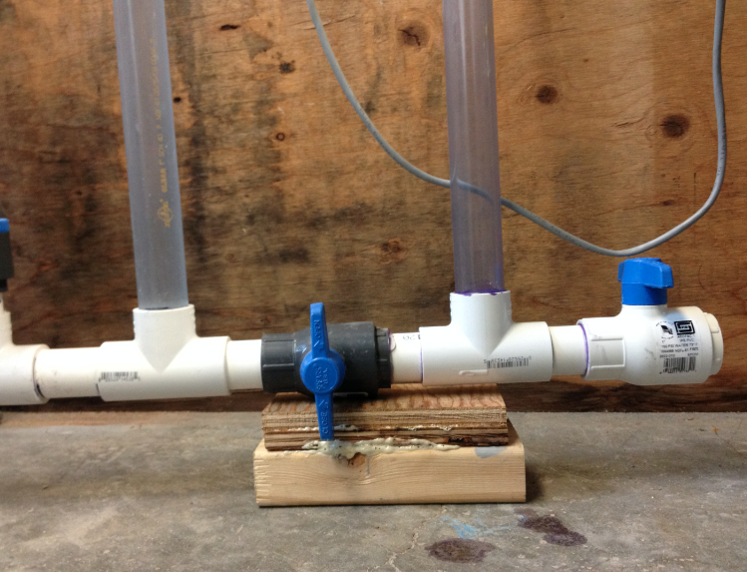
What We’ve Accomplished So Far
4” Testing Model
Backwash Initiator
Summer 2013
  Designed initiator
Manometer
  Support
  Valve

Slide 5
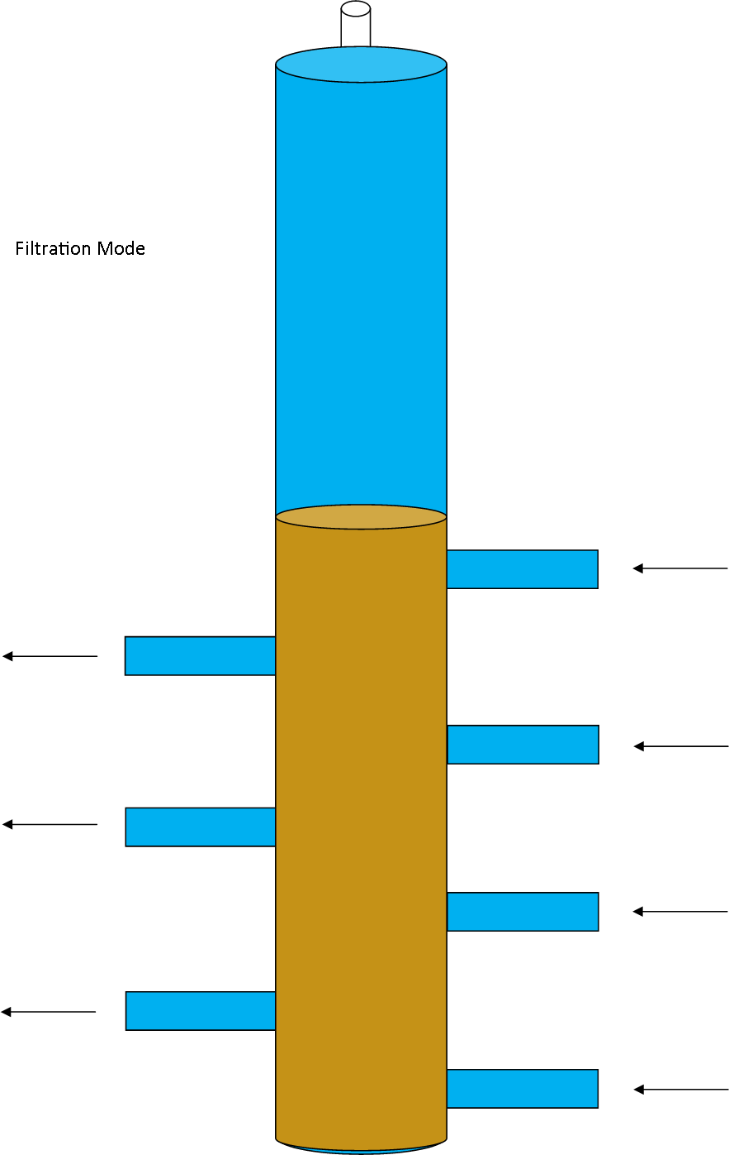

Slide 6
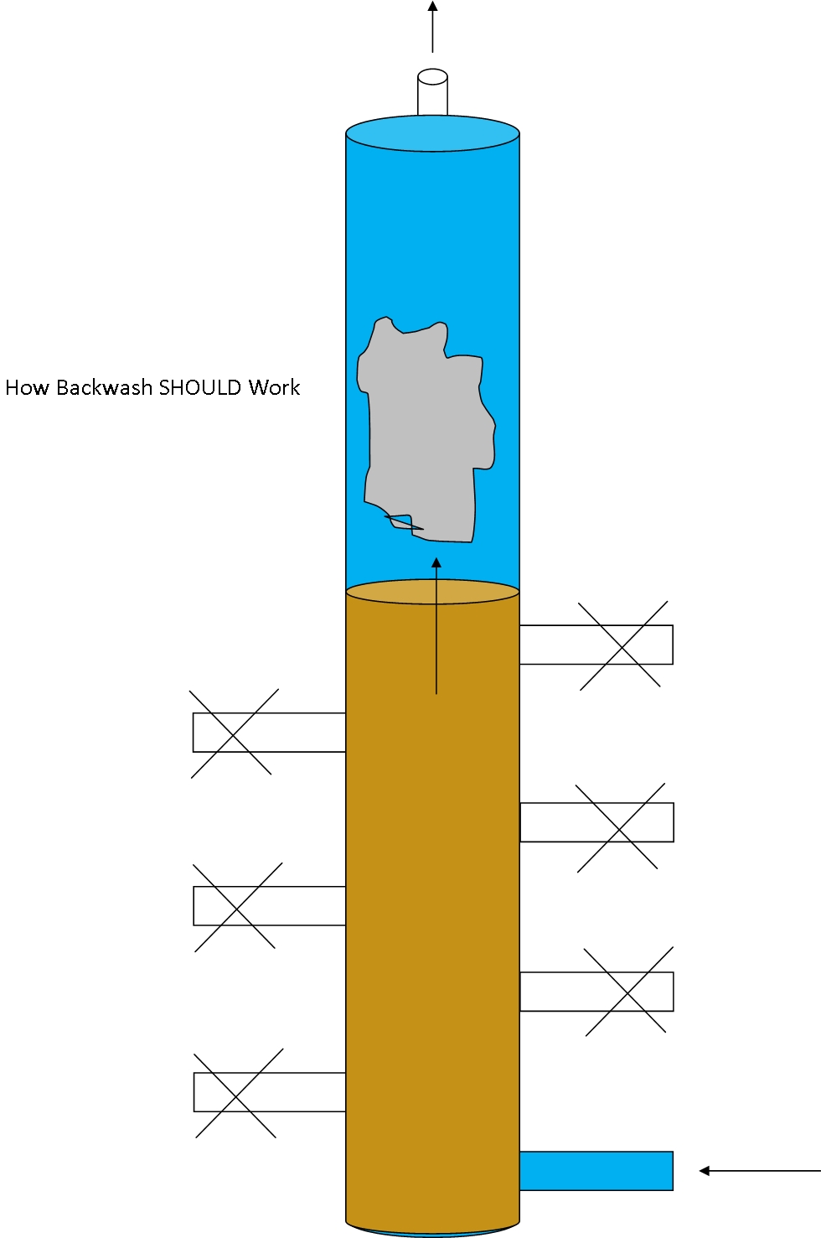

Slide 7
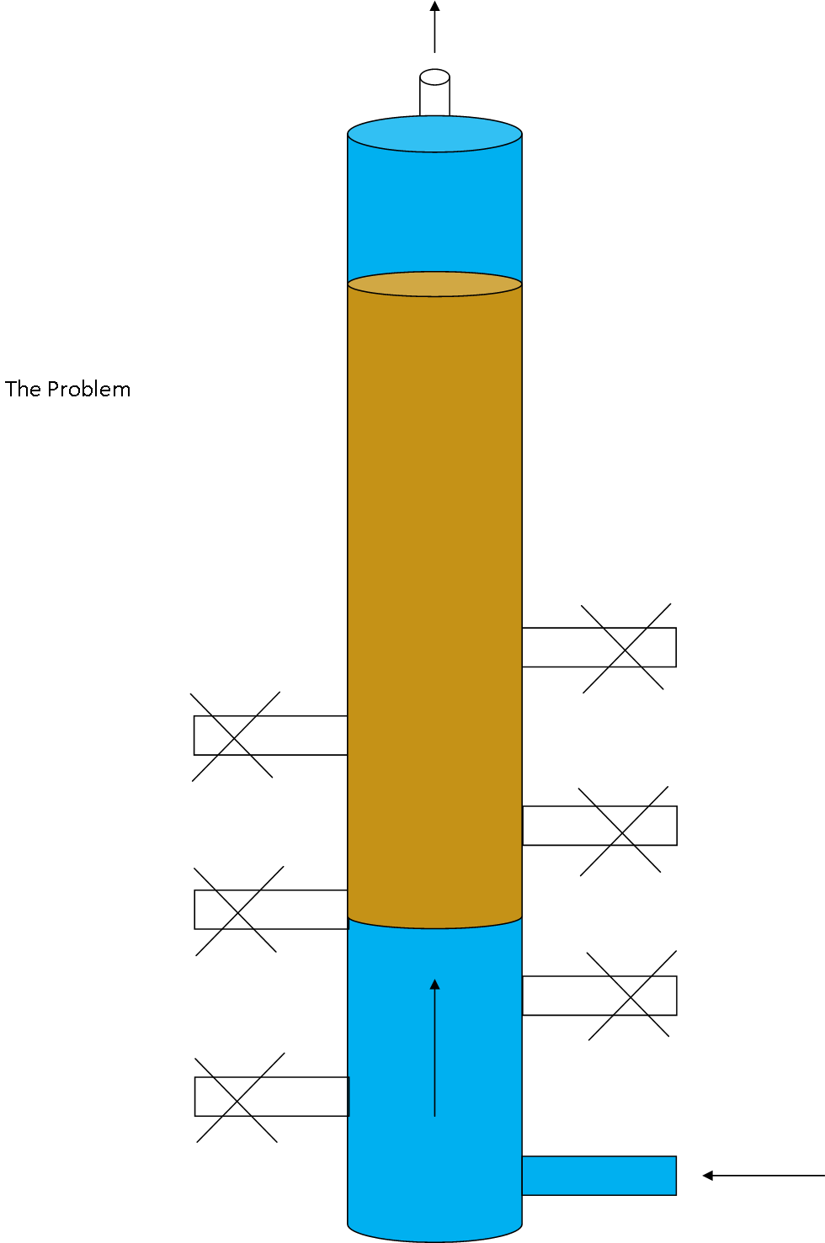

Slide 8
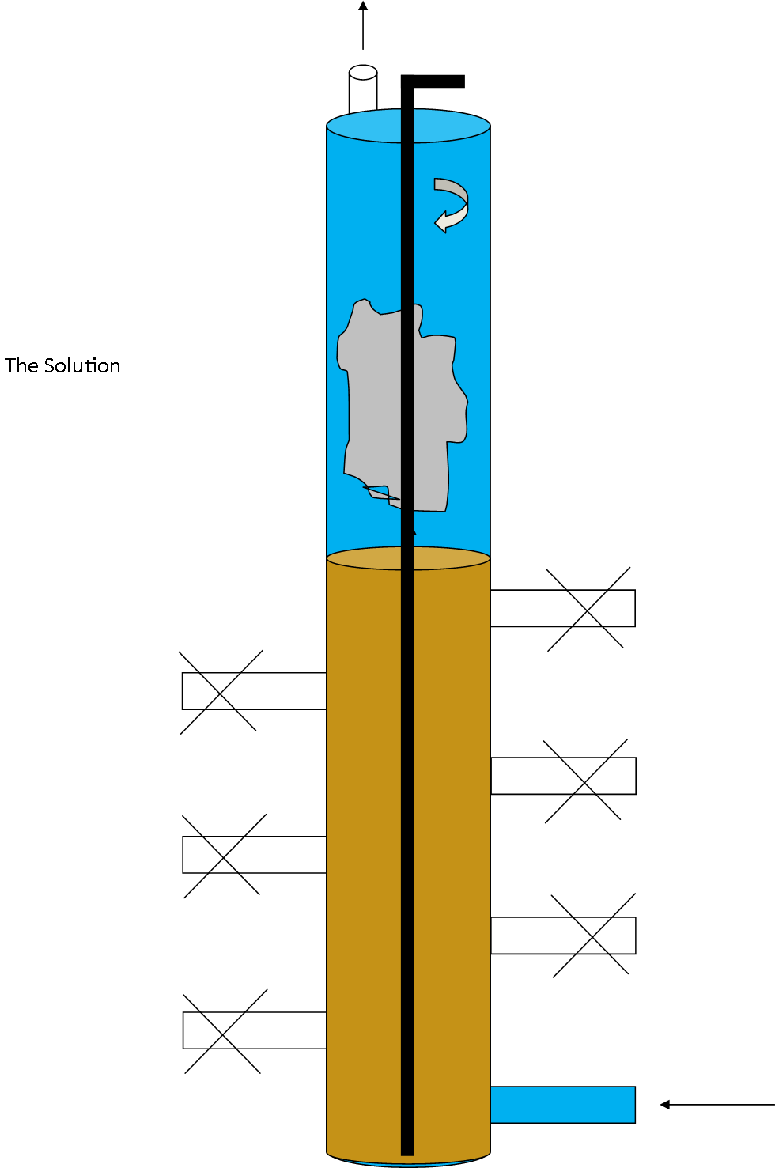

Slide 9
What We’ve Accomplished So Far
4” Testing Model
Backwash Initiator
Summer 2013
  Designed initiator
Manometer
  Support
  Valve
Notes:
This is an intentionally duplicated slide

Slide 10
What We’ve Accomplished So Far
12” Filter Subteam
Why 12”?
Overview of New Filter Design

Slide 12
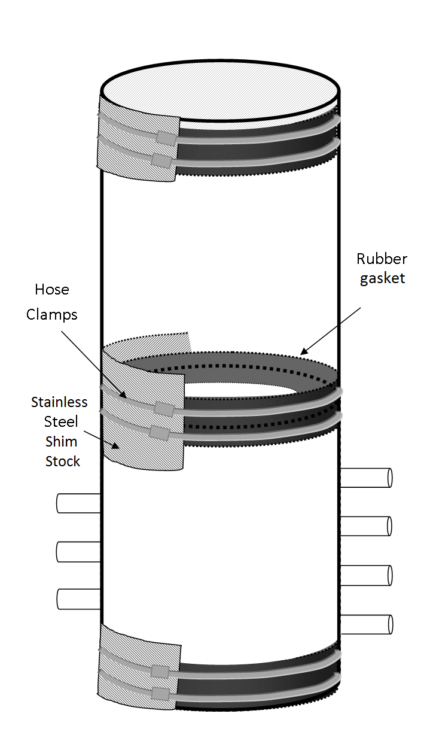
What We’ve Accomplished So Far
12” Subteam: Divided Column
Construction - physical restrictions
Solution: Separate column into two pieces=less distance to reach

Slide 14
What We’ve Accomplished So Far
12” Subteam: Machined Parts
Top/bottom plates
Shim stock
Ordered other parts

Slide 15
What We’ve Accomplished So Far
12” Subteam:
Plate Deflection
Headloss

Slide 16
Future Plans - 4”
Quantify Pressure for Backwash
  Manometer
  Does it have a measurable effect?
Sand Drain Design
  Past failure modes

Slide 17
Future Plans - 12”
  Keep ordering parts!
  Piping sizes

Slide 18

Any Questions?

