Slide 1

Low Flow Stacked Rapid Sand Filter
Kris, Nadia, Mihir, Rachel

Slide 2
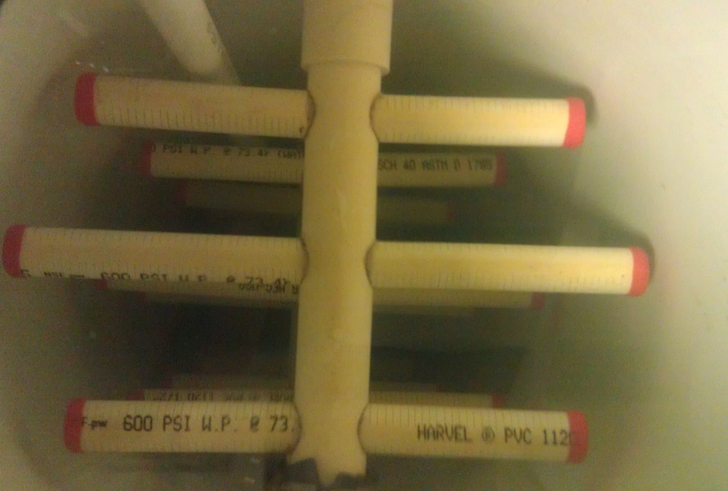
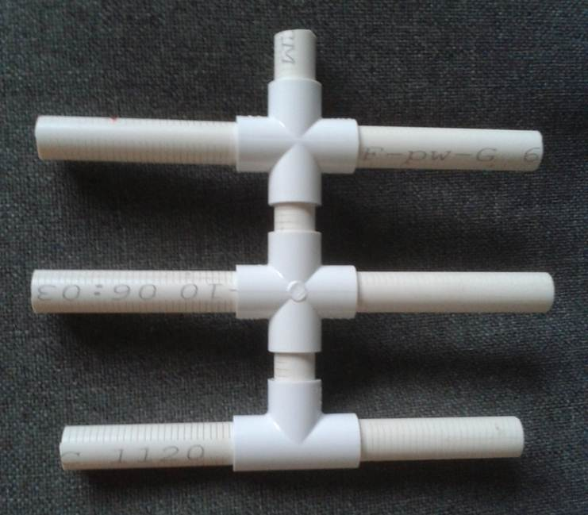

Slotted Manifolds
Increase surface area of the connections
1” to ½” center branch diameter
Notes:
Still need to put caps on. Rachel

Slide 3
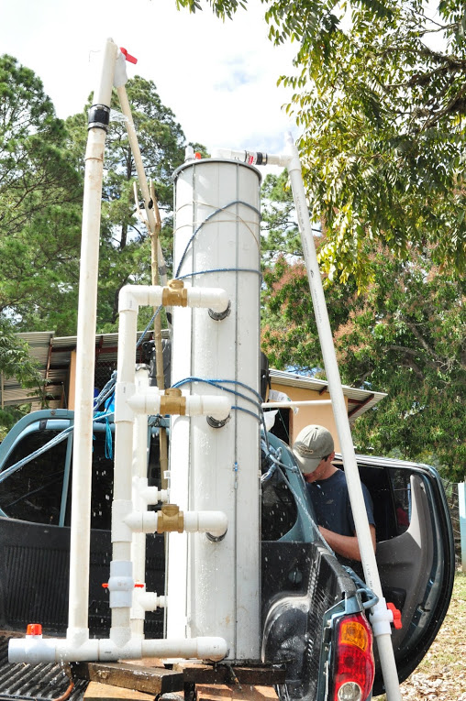
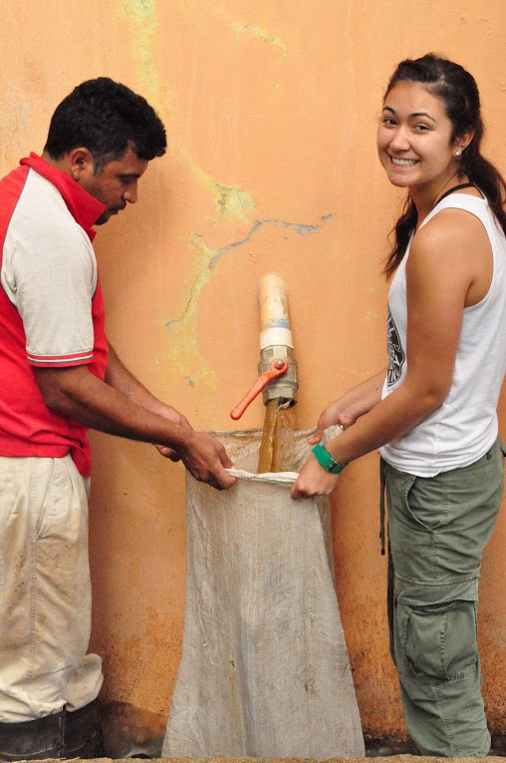
Sand Drain
Height constraints
Excel model for computations
Notes:
Rachel

Slide 4
Sand Drain
Trigonometric Equations
Notes:
Rachel

Slide 5
EPA – Small Scale LFSRSF
Design Considerations
  Depth and no. of layers are same as full scale
  Transparency
  Volume of water → minimize diameter
  Fluidization velocity
  Major (and minor) head losses – filtration & backwash
  Scale down of manifolds
Notes:
Mihir

Slide 6
EPA – Small Scale LFSRSF
Filter Construction
  Slotted manifolds
  Inlet/Outlet connections – push-to-connects
  Bottom and top caps
Frame Construction
  80/20 inverted T
  Constant Head Tank – Hydraulic Testing
    LFOM or no LFOM
    Overflow
Notes:
Kris

Slide 7
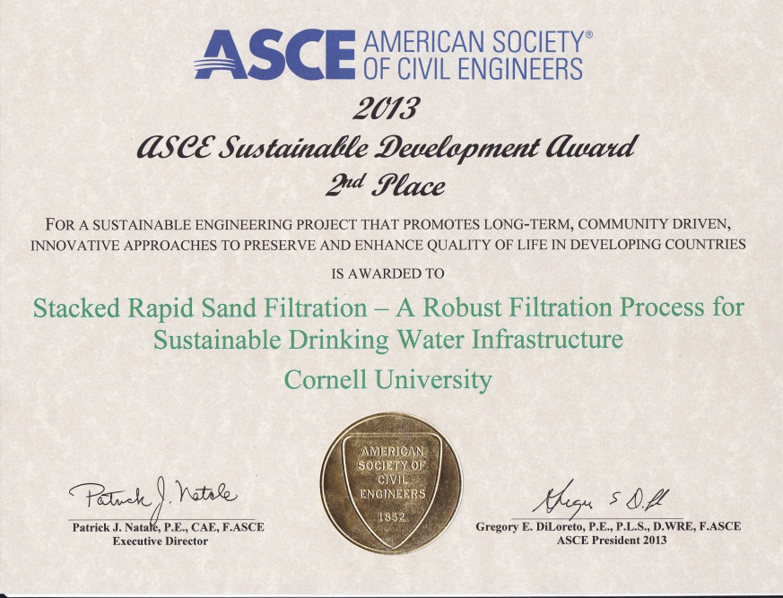
EPA – Small Scale LFSRSF
The EPA P3 Competition
  2 judging sessions
  2nd place for ASCE Sustainability Development Award
  2 interviews - ASCE and AAAS
  Other projects dealing with drinking water treatment
Notes:
(American Association for the Advancement of Science)
Nadia

Slide 8
Future Work
Test manifolds
Construct and test sand drain
Rebuild lab filter
Ease of operation
Ease of construction
Operator manual with Spanish translation
Notes:
Nadia

Slide 9
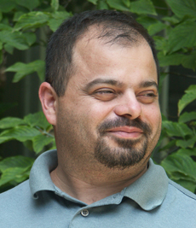
Acknowledgements
Sir Paul Charles

Slide 10
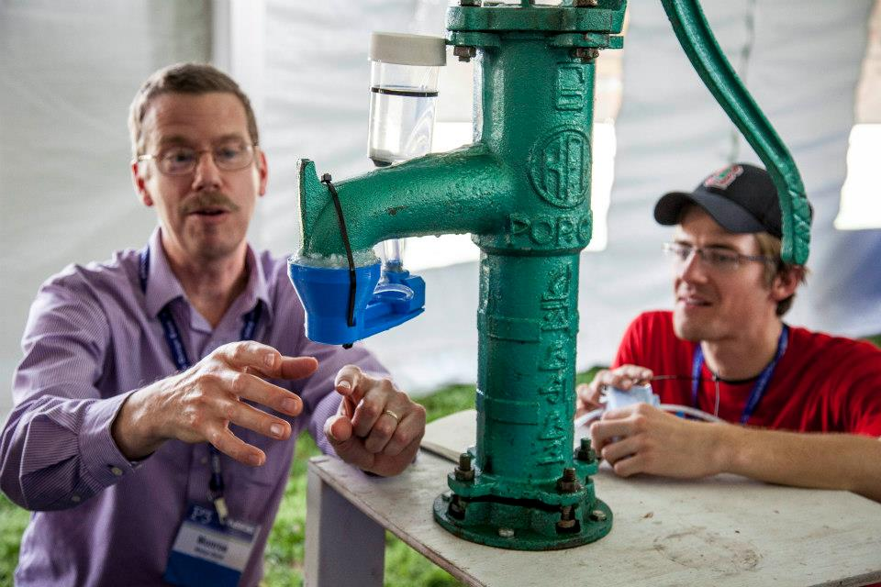
Demo

