Slide 1
Low Flow Stacked Rapid Sand Filter
Dhaval Mehta, Ariel Seidner, Sarah Sinclair, Lishan Zhu
Notes:
Things to get:
Filter.
Trunks with example manifolds.

Slide 2
LFSRSF: Major Semester Objectives
  Adapt SRSF technology to a smaller, circular LFSRSF design for India
  Simplified hydraulic controls
  Fabricate, and document fabrication techniques
  Test filter performance
    Turbidity
    Flow distribution

Slide 3
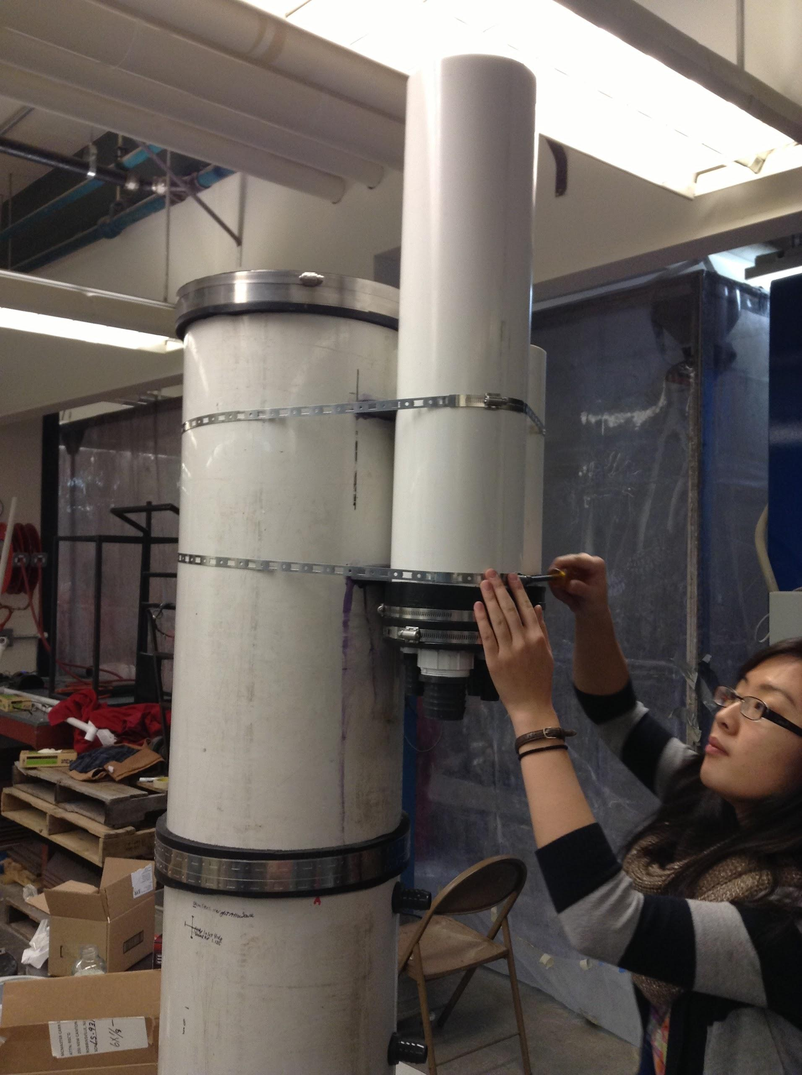
The Filter
What are the filter parts?
Two modes:
  Filtration
  Backwash
What is the path of water/dirt?

Slide 4
LFSRSF Jeopardy!
Fabrication | Slotted Manifolds | Pressure Sensors | Testing | Future Work
Backwash Pipe | Manifold Branches & Caps | Sensor Layout | Filter Column Stability | Pipe Stubs
Hose Clamps and Flexible Tubing | Manifold Trunks | Soldering Valves | Leakage Tests | Sand Drain
Drilling and Milling | Design Algorithm | Tapping Filter Column | Pump and Recycling System | Running Filter

Slide 5
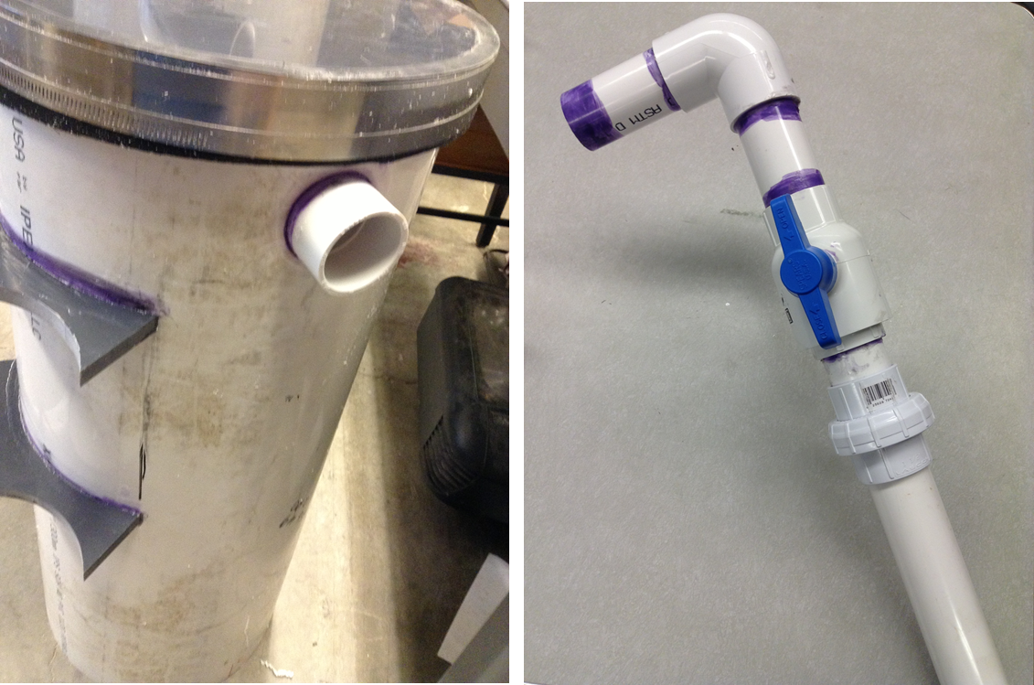
Backwash Pipe

Slide 6
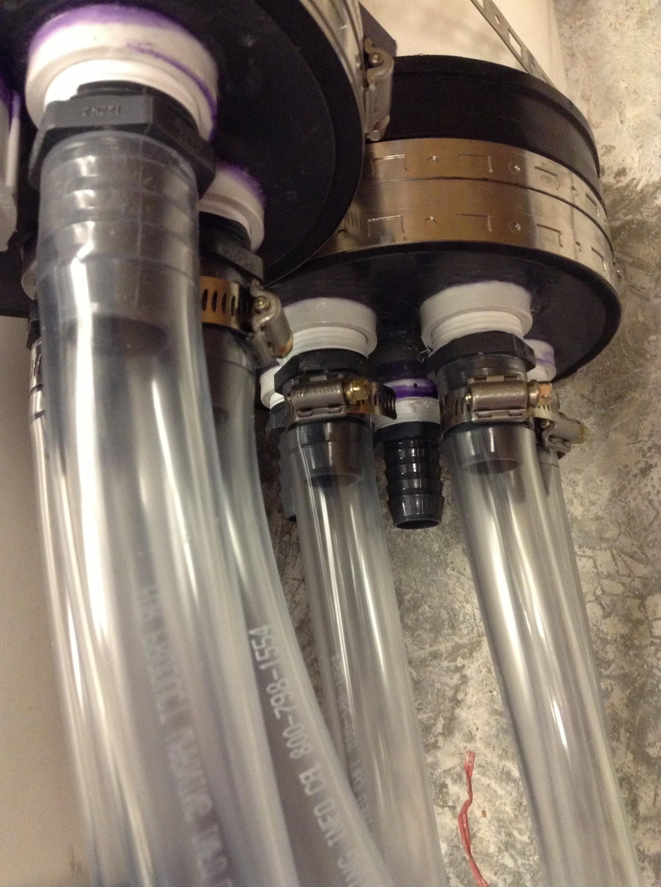
Hose Clamps and Flexible Tubing

Slide 7
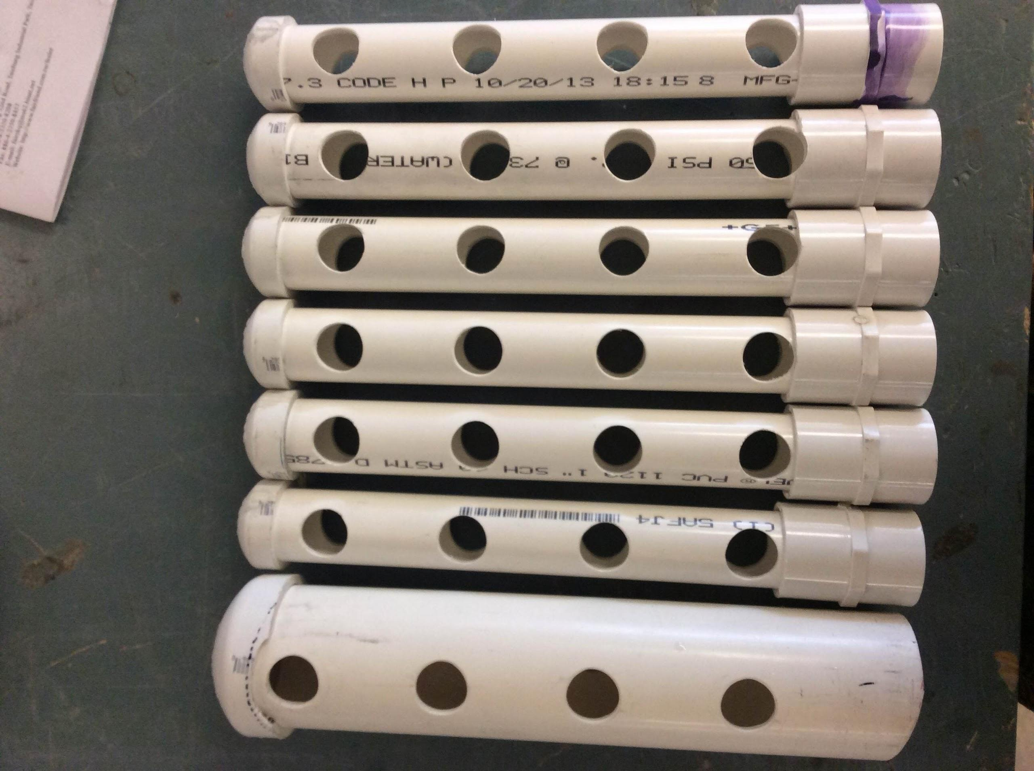
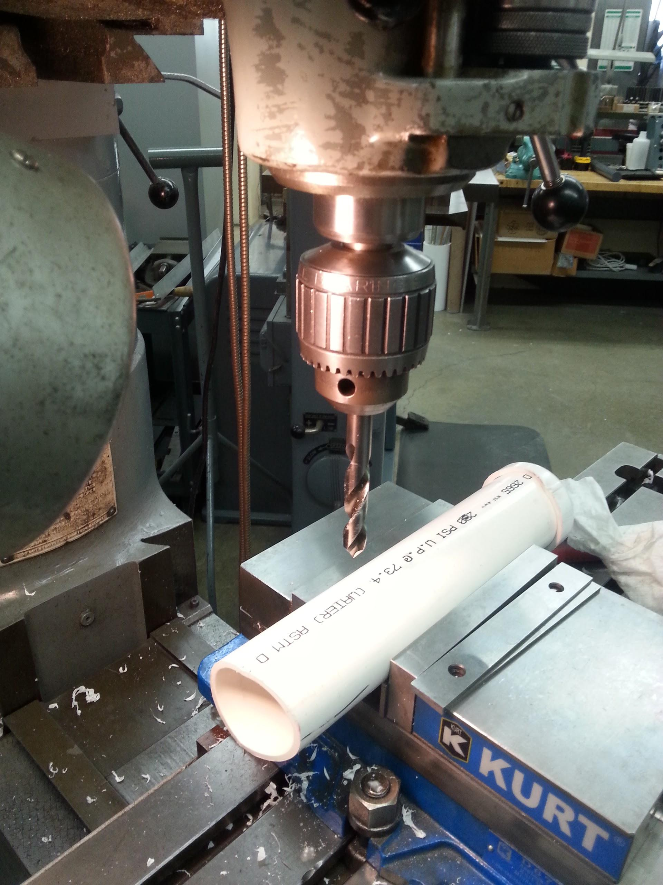
Drilling and Milling

Slide 8
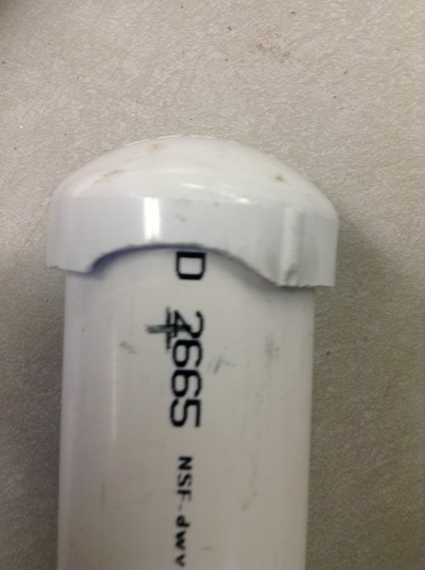
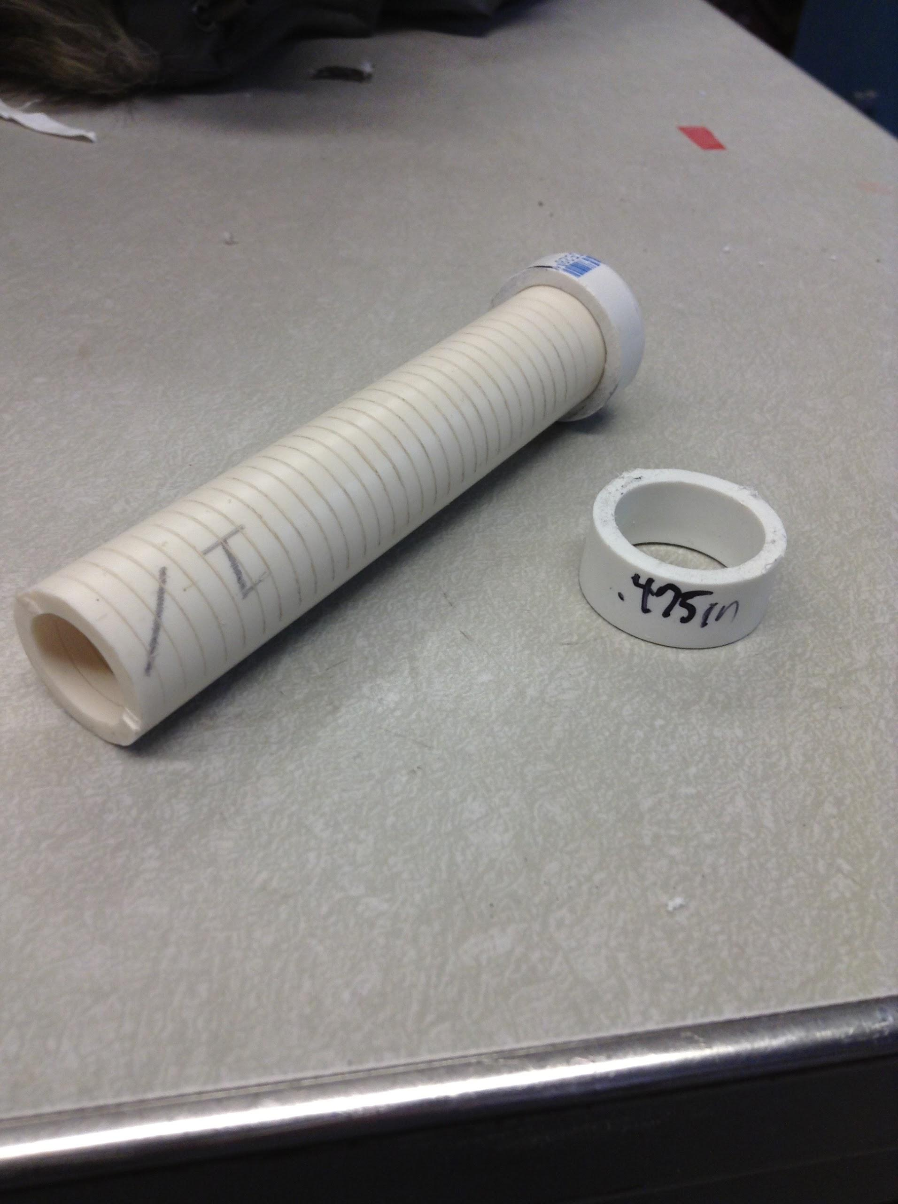
Manifold Branches and Caps

Slide 9
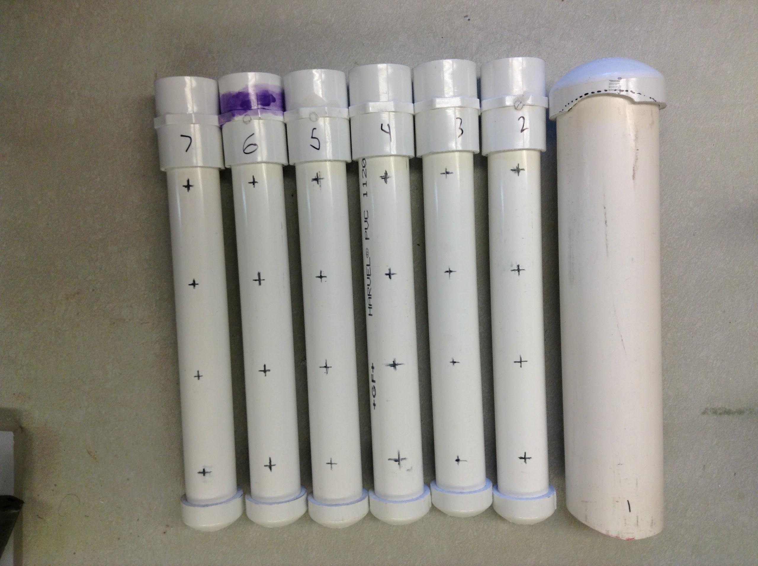
Manifold Trunks

Slide 10
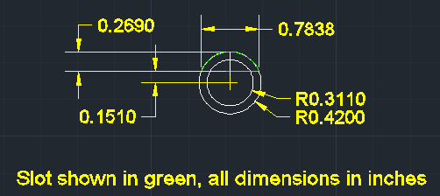
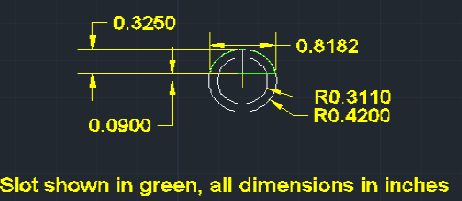
Design Algorithm

Slide 11
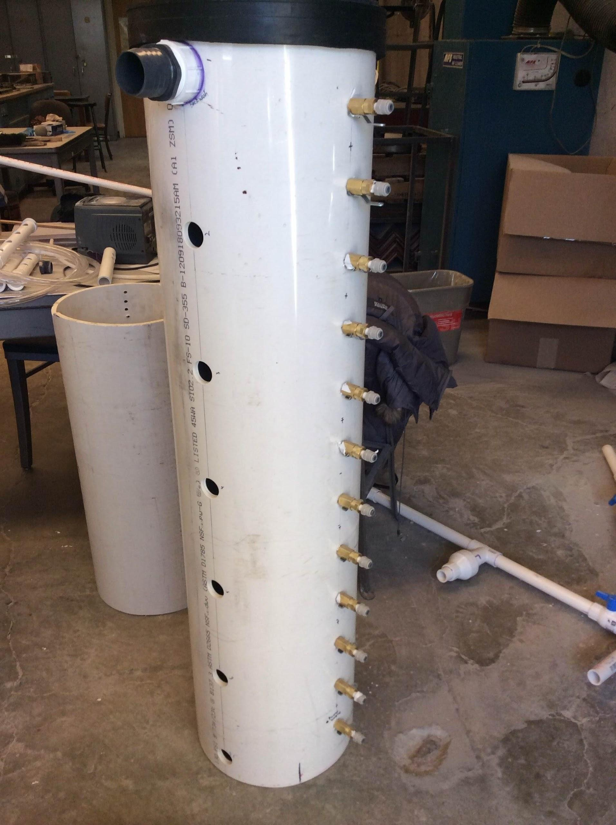
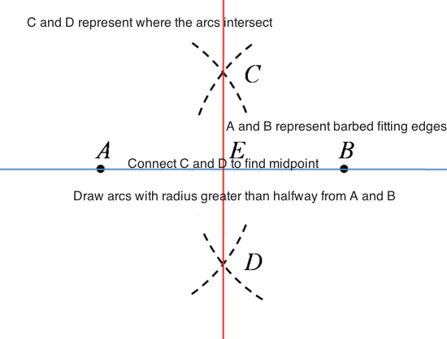
Sensor Layout

Slide 12
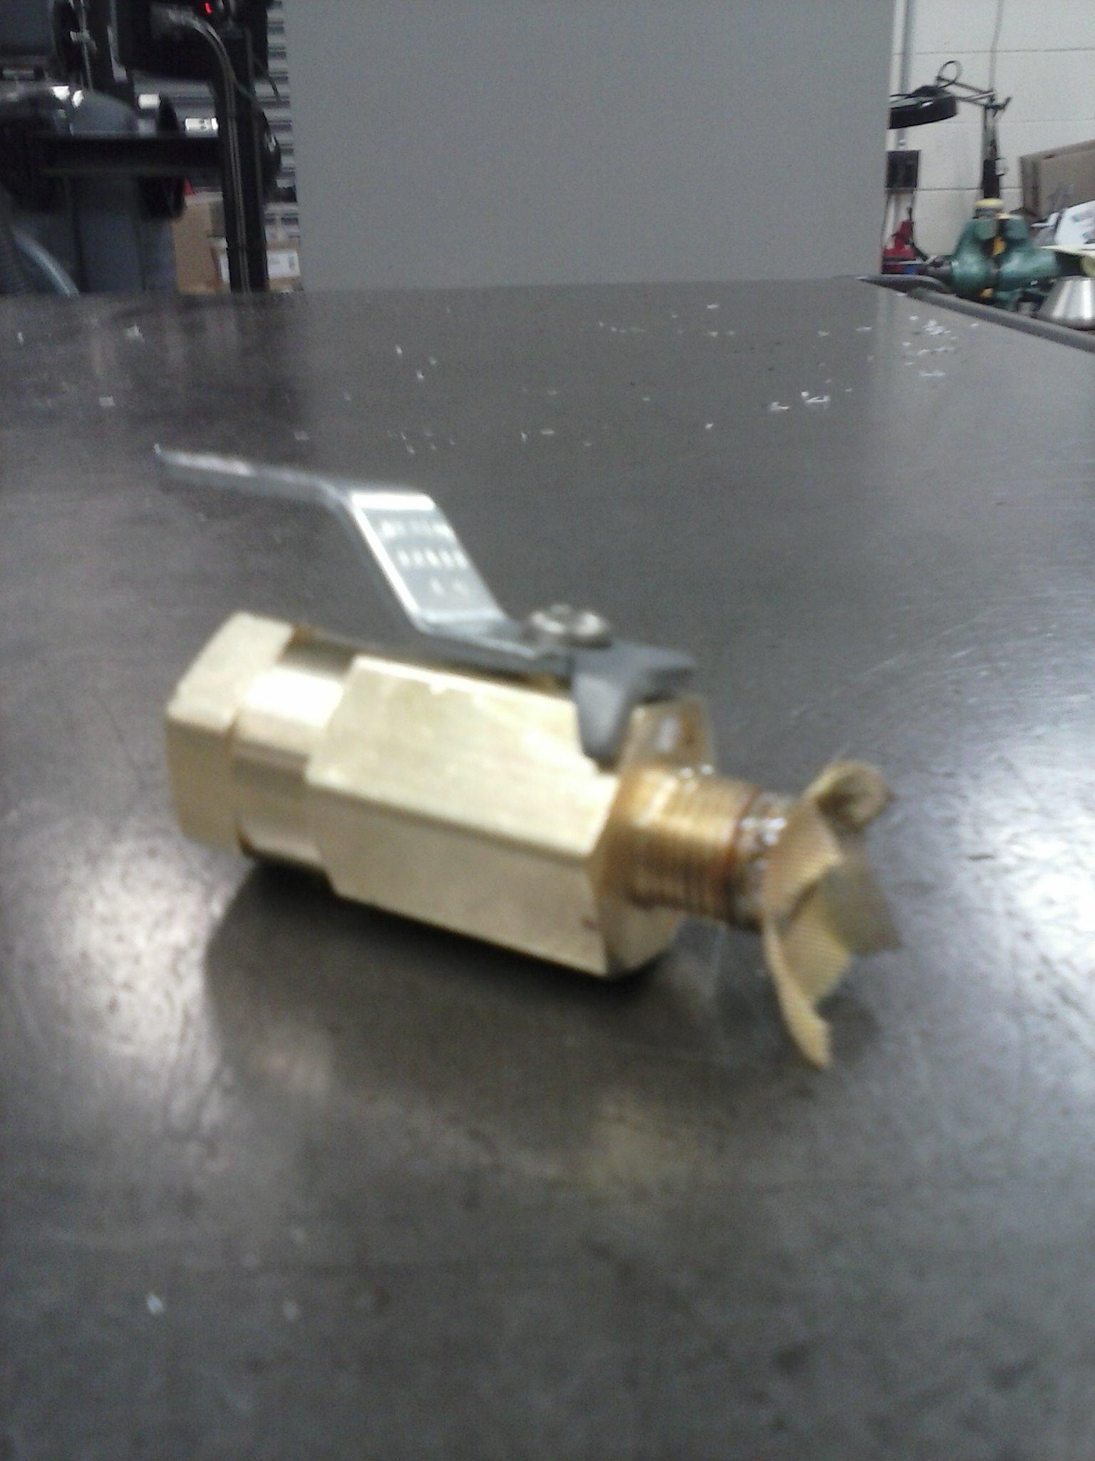
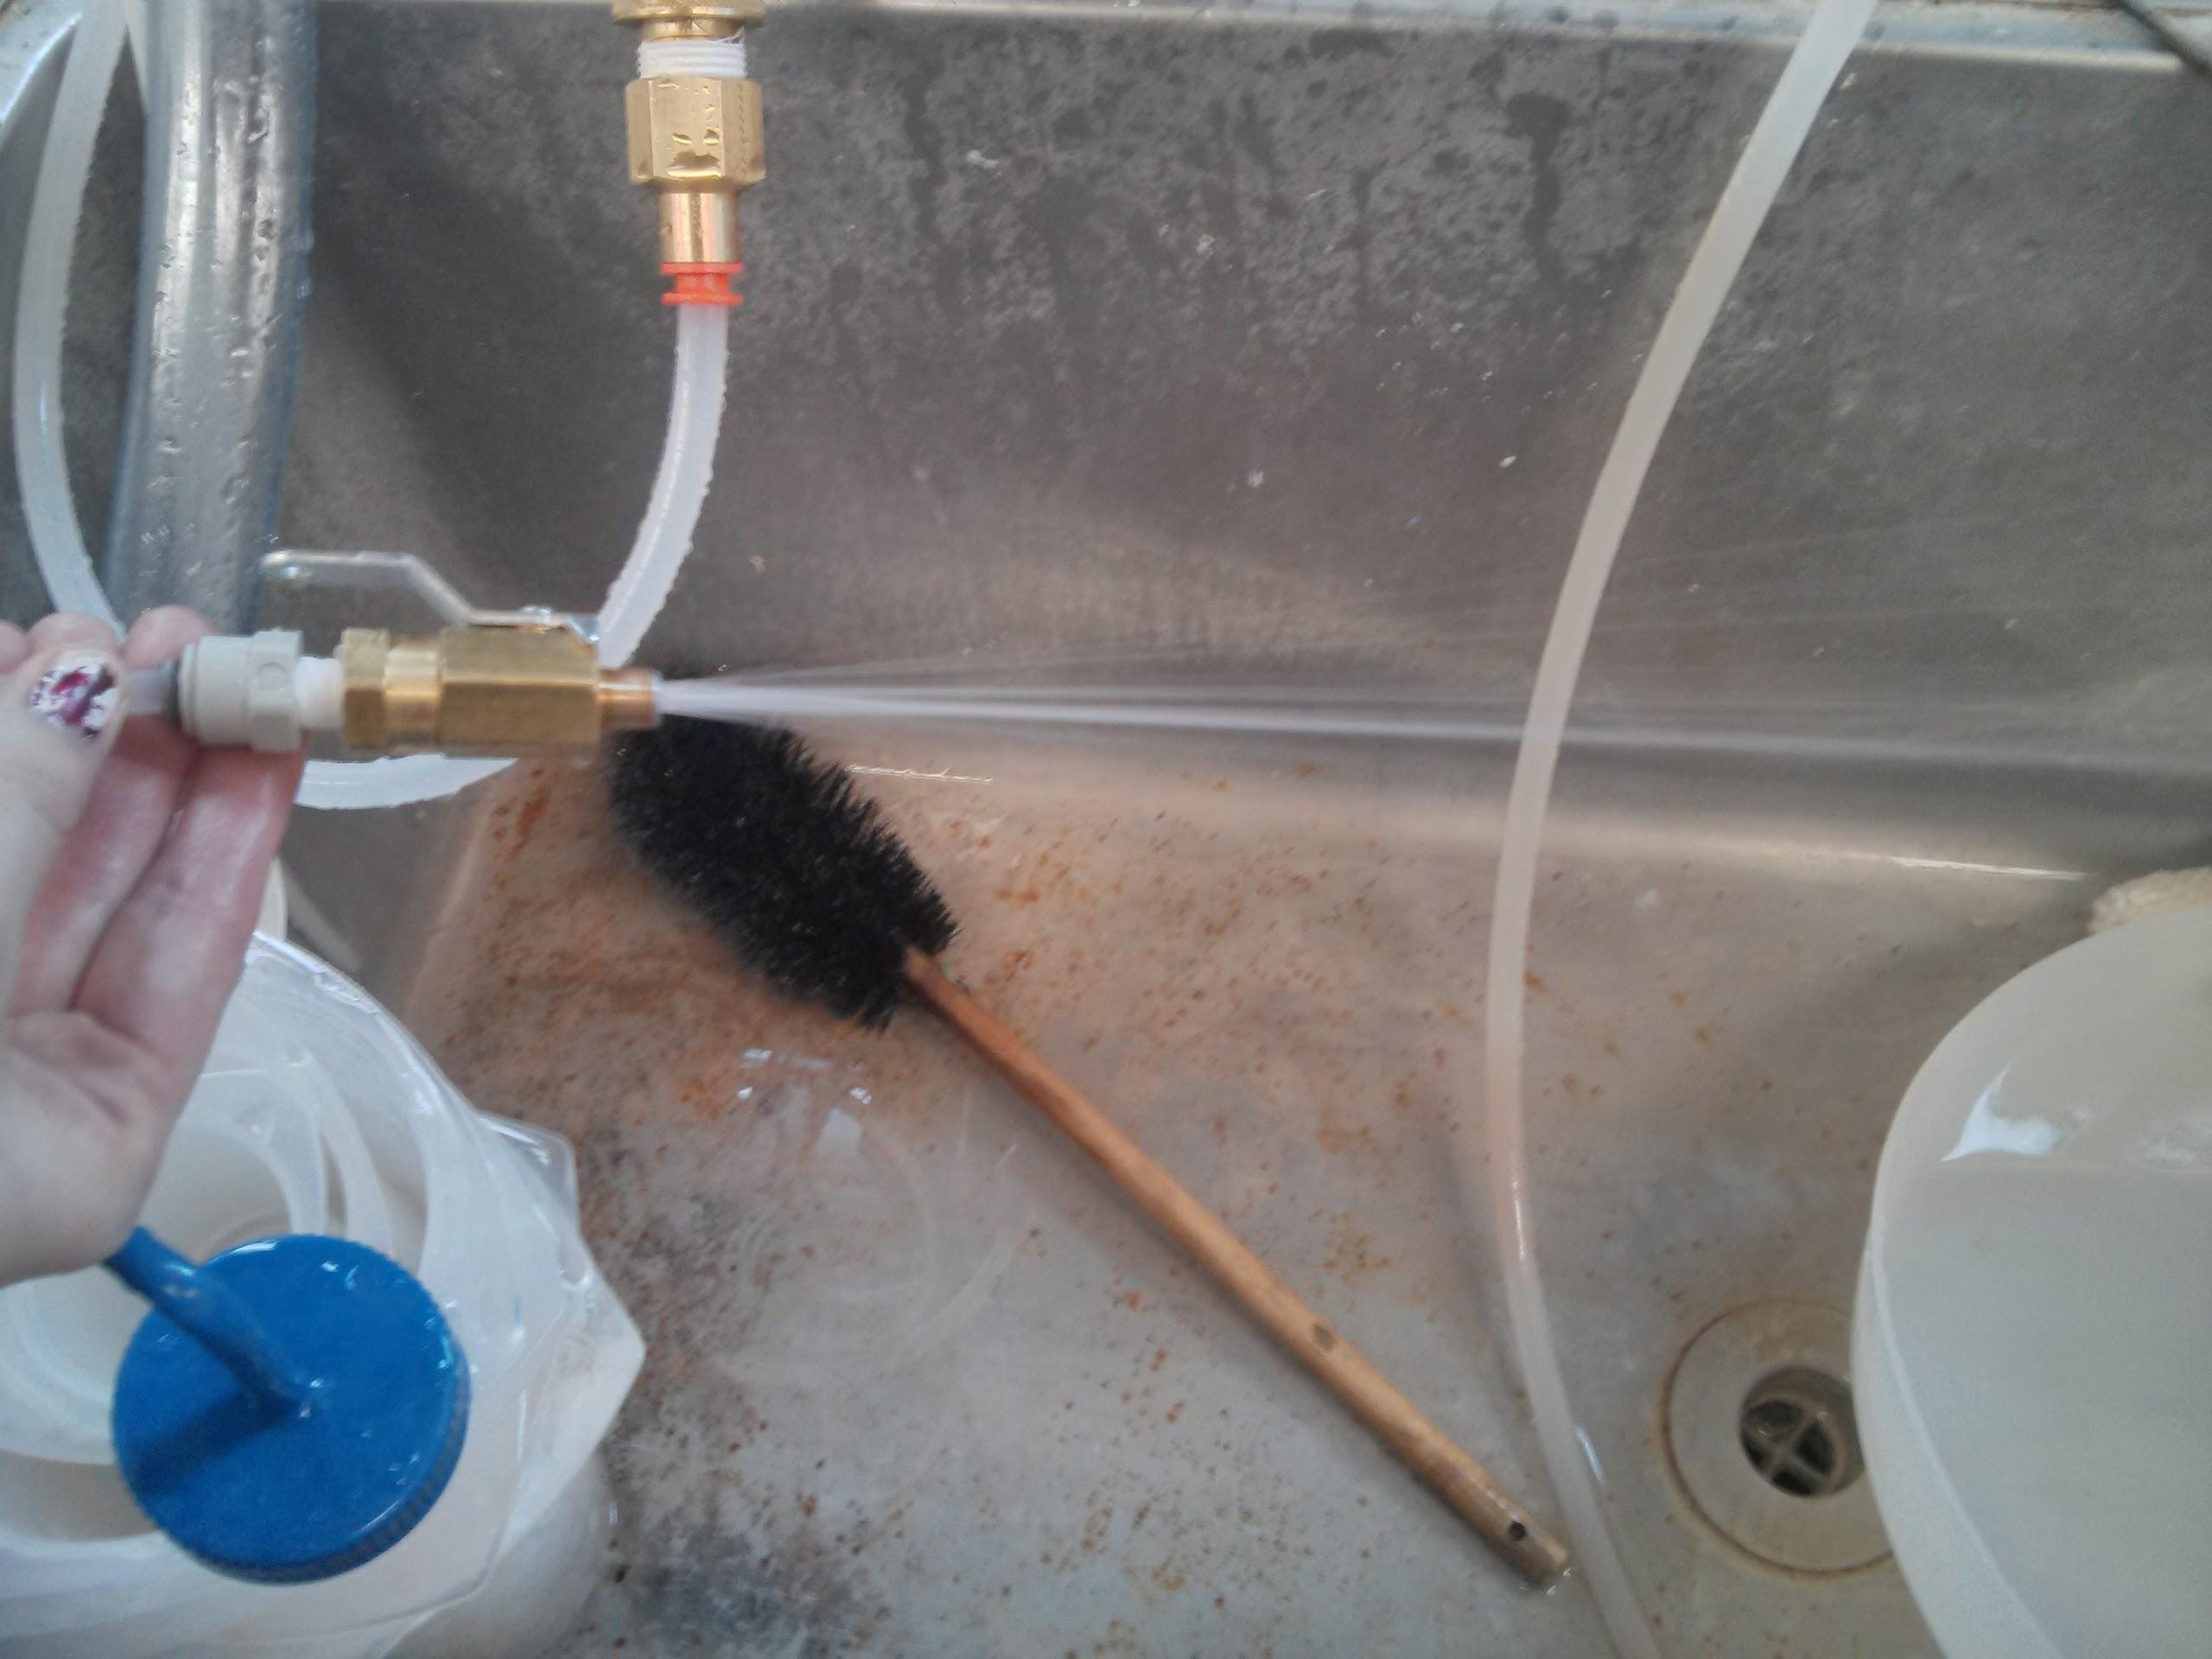
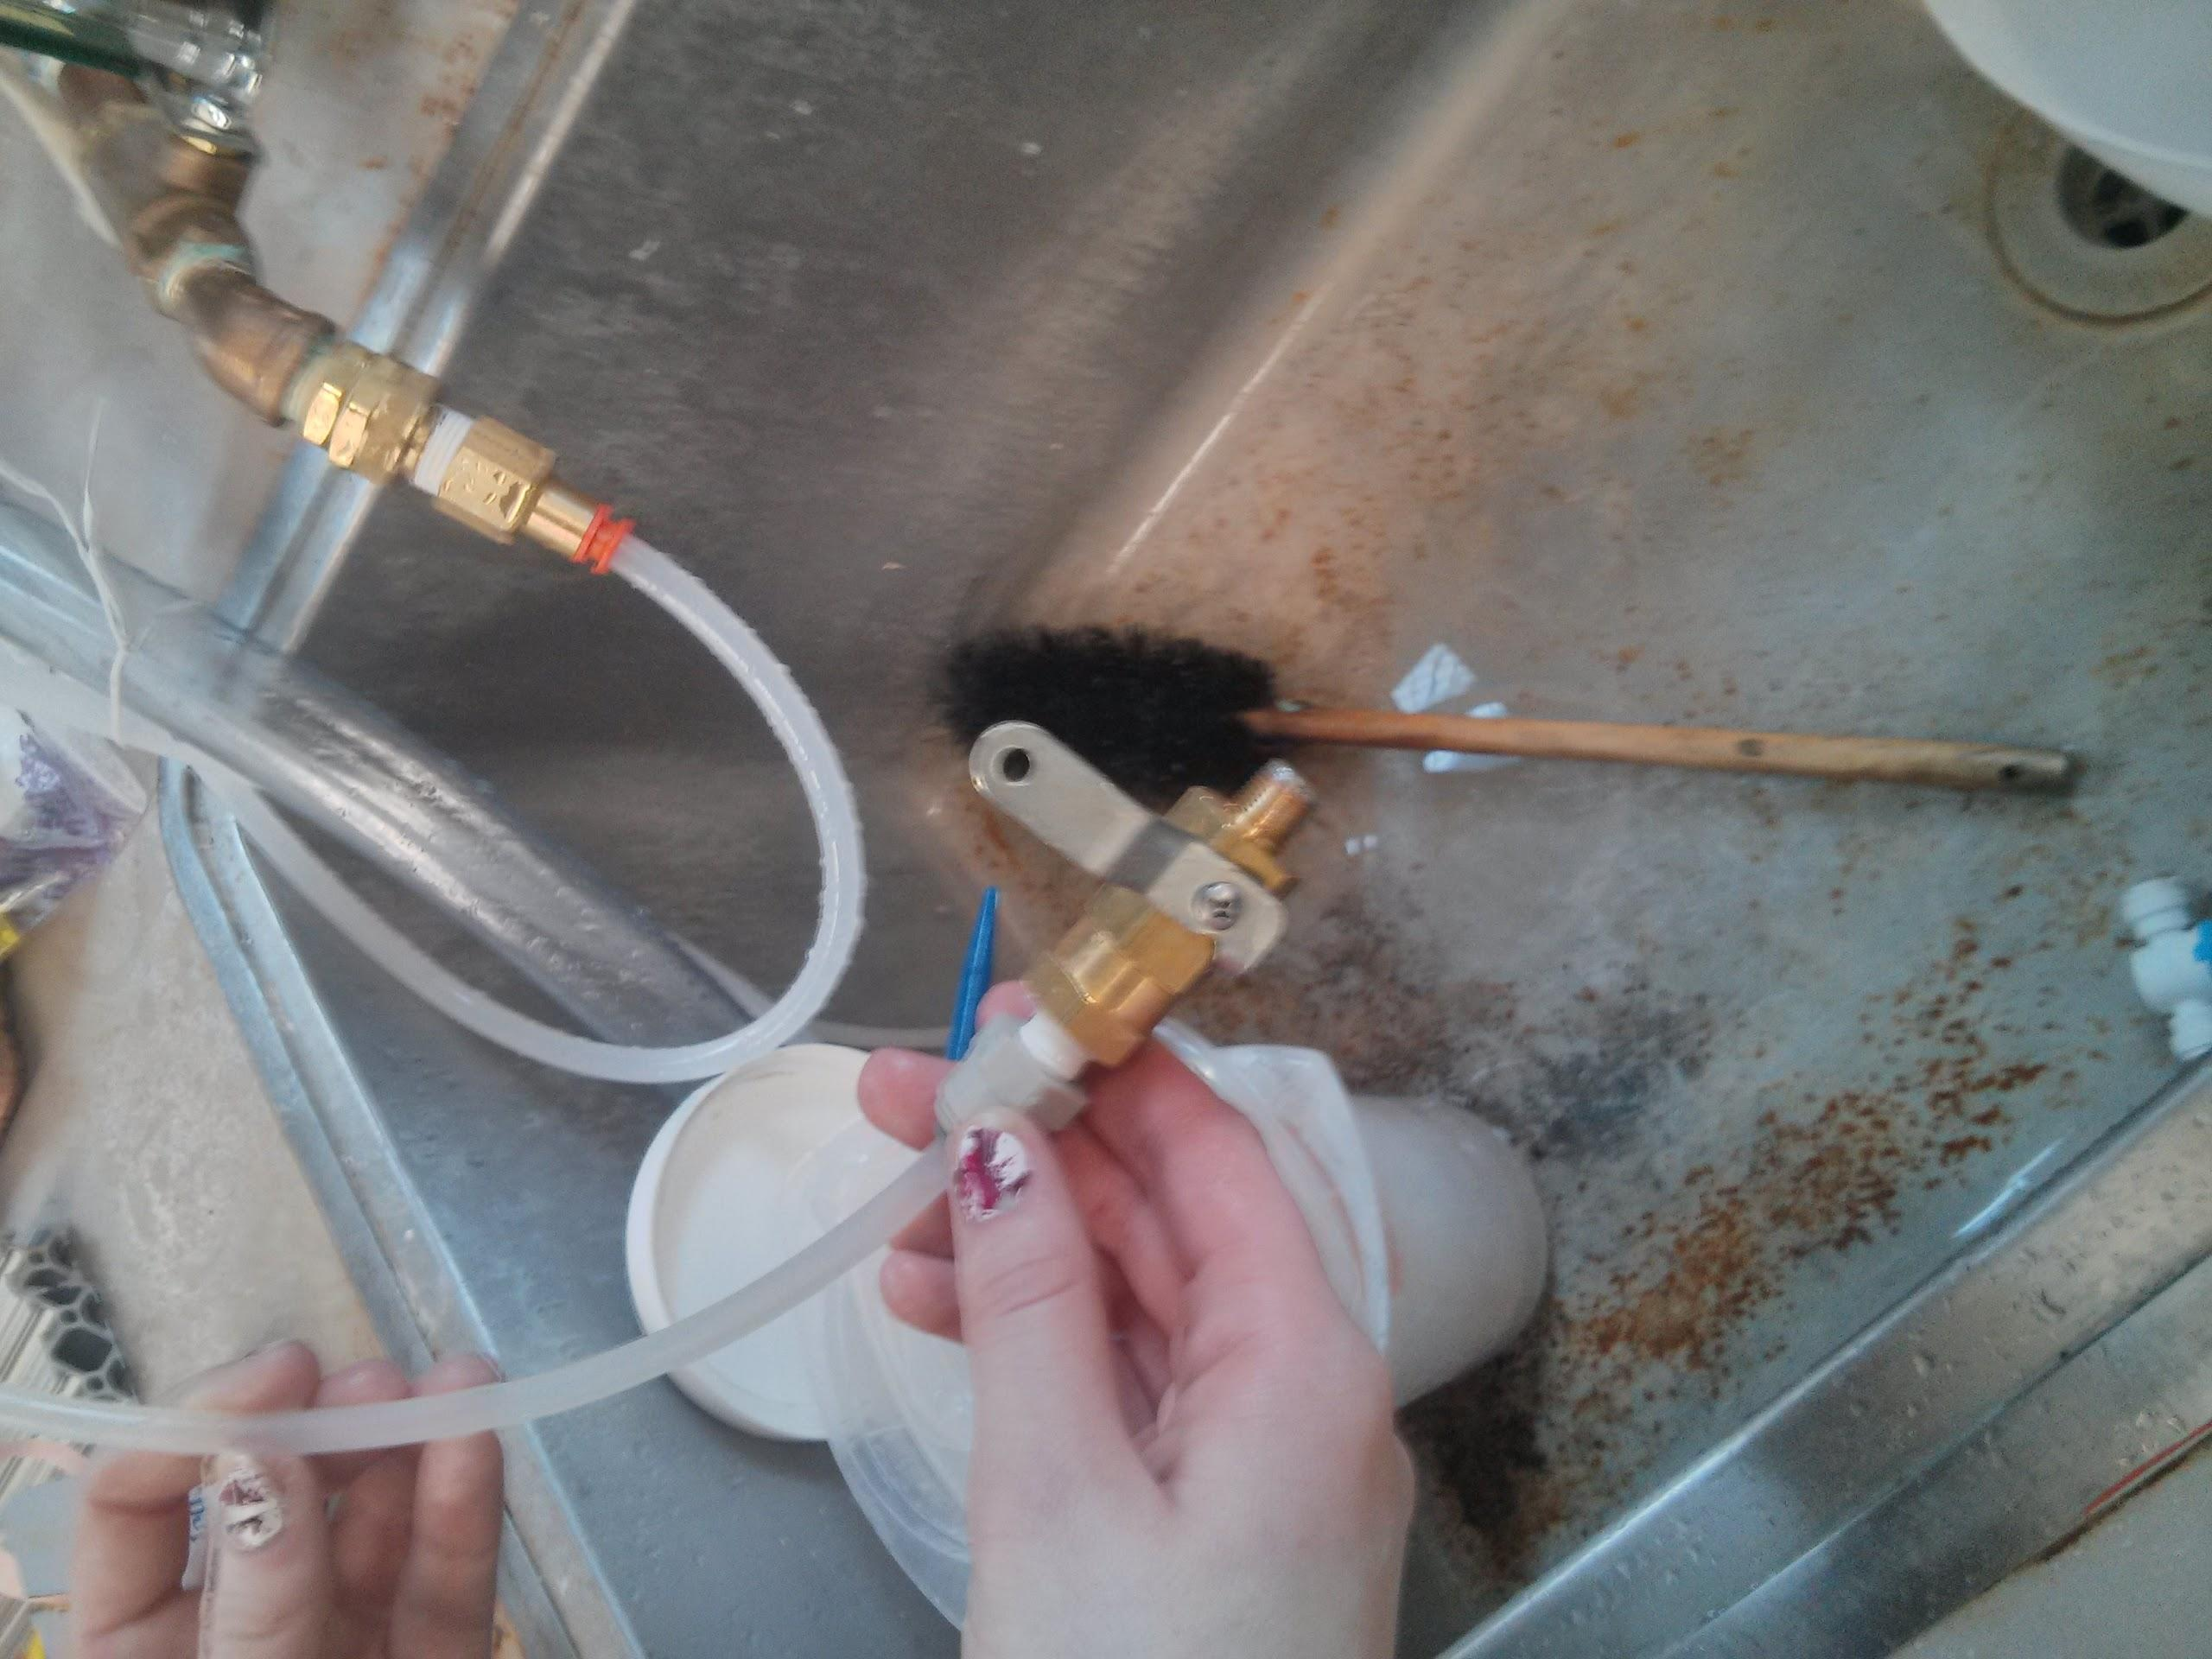
Soldering Valves

Slide 13
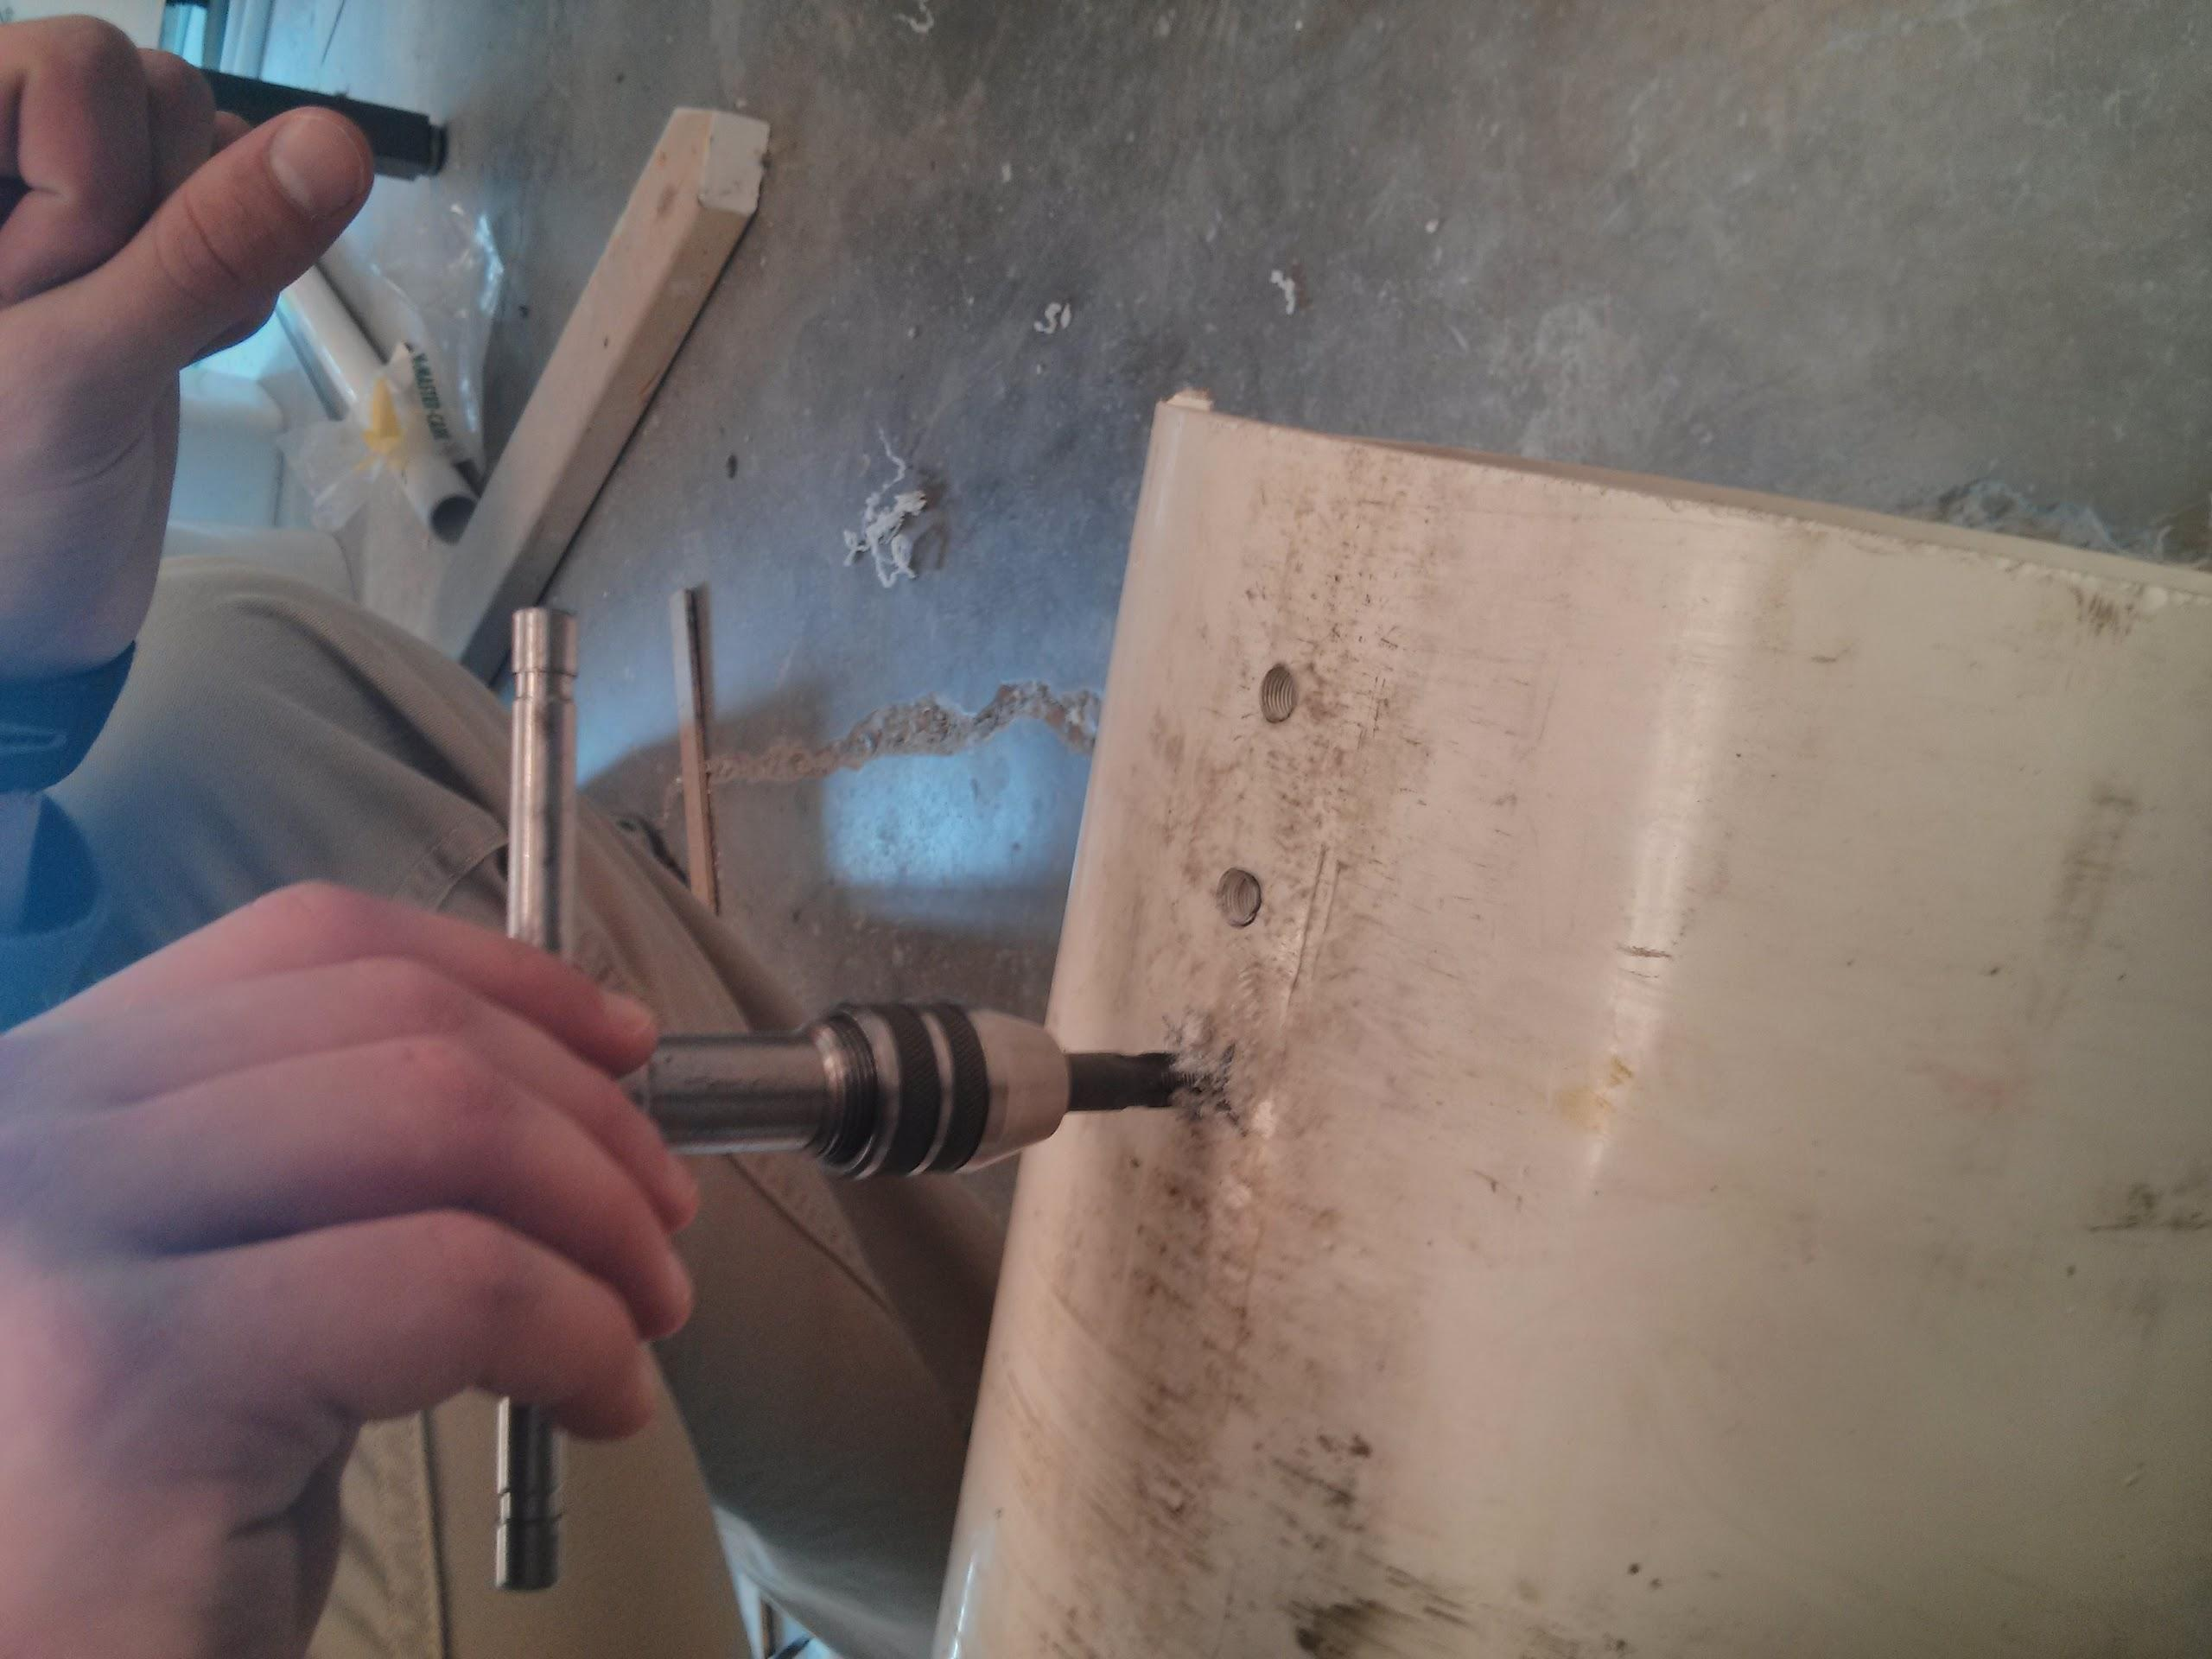
Tapping Filter Column

Slide 14
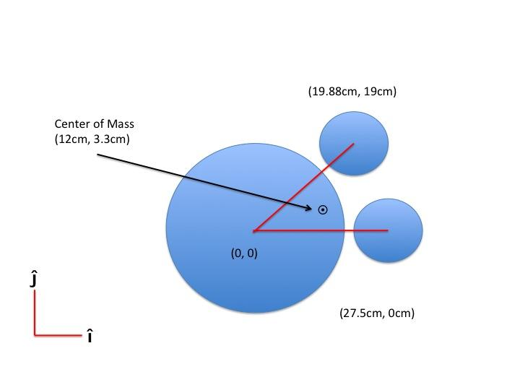
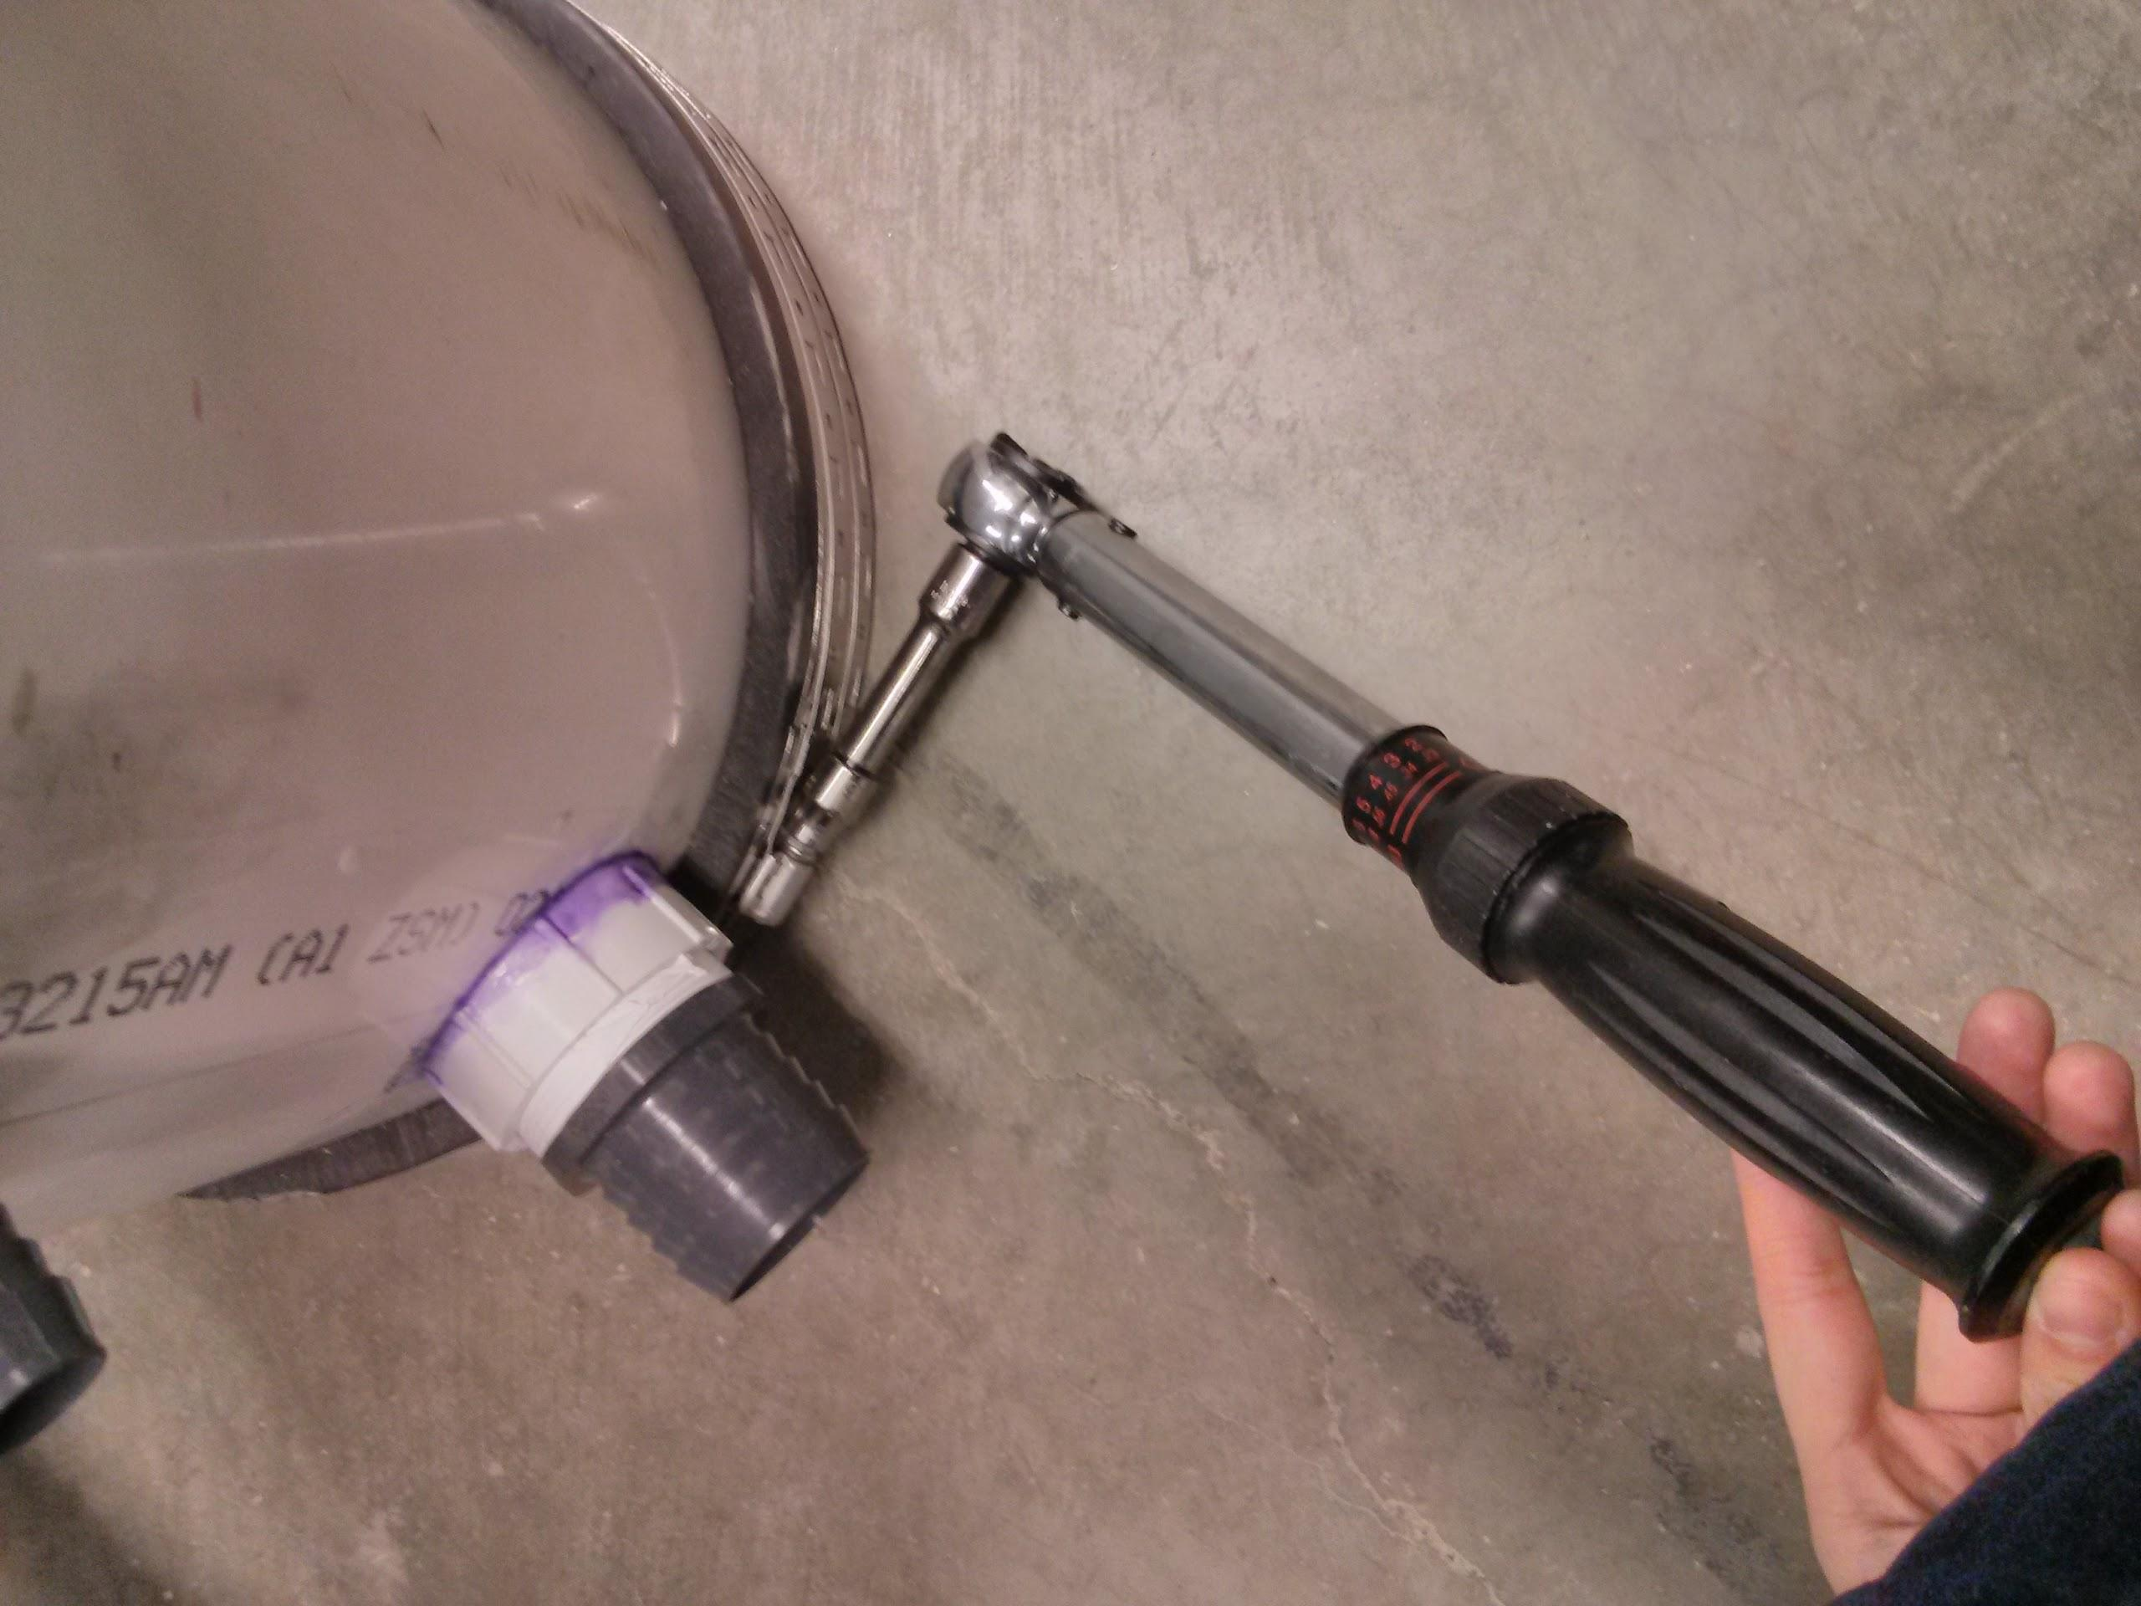
Filter Column Stability

Slide 15
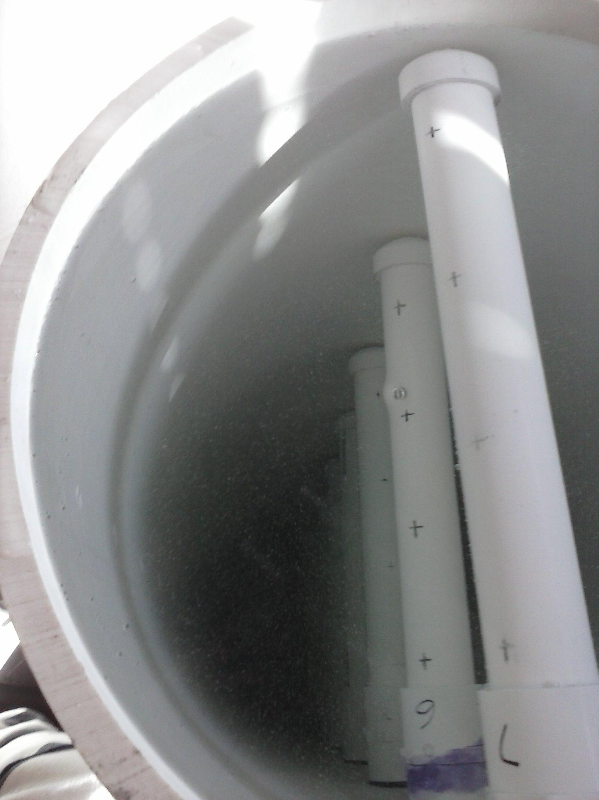
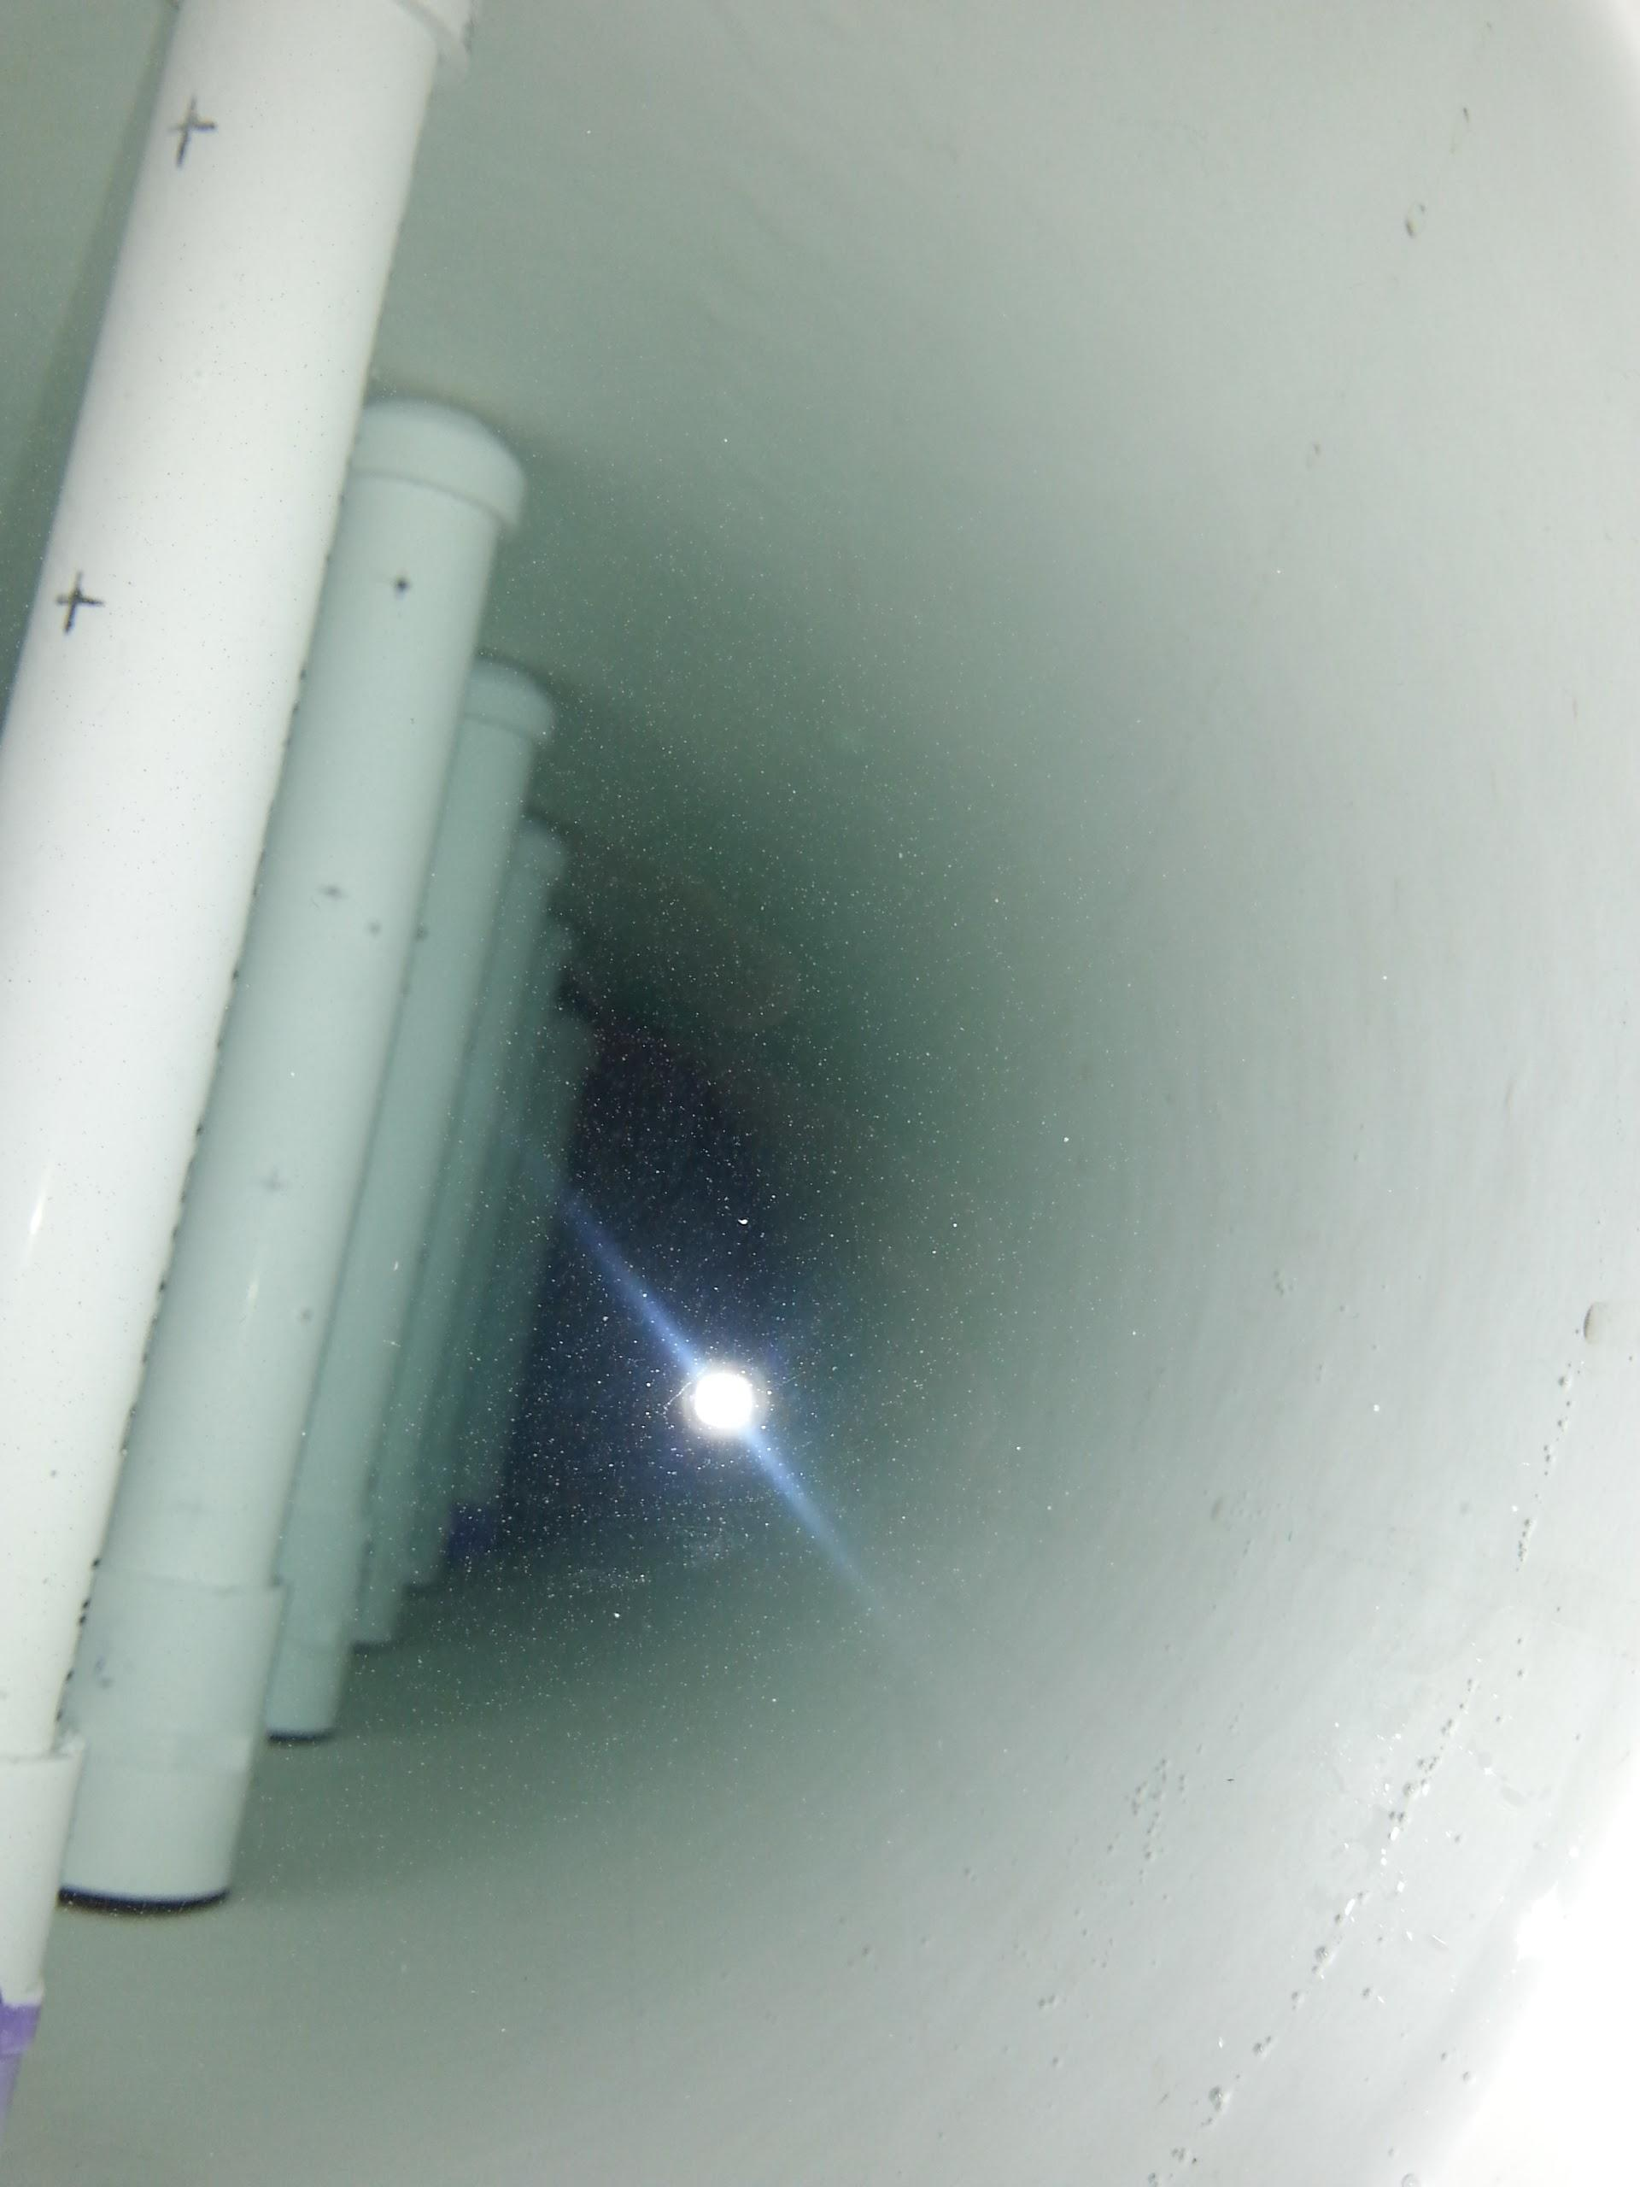
Leakage Tests

Slide 16
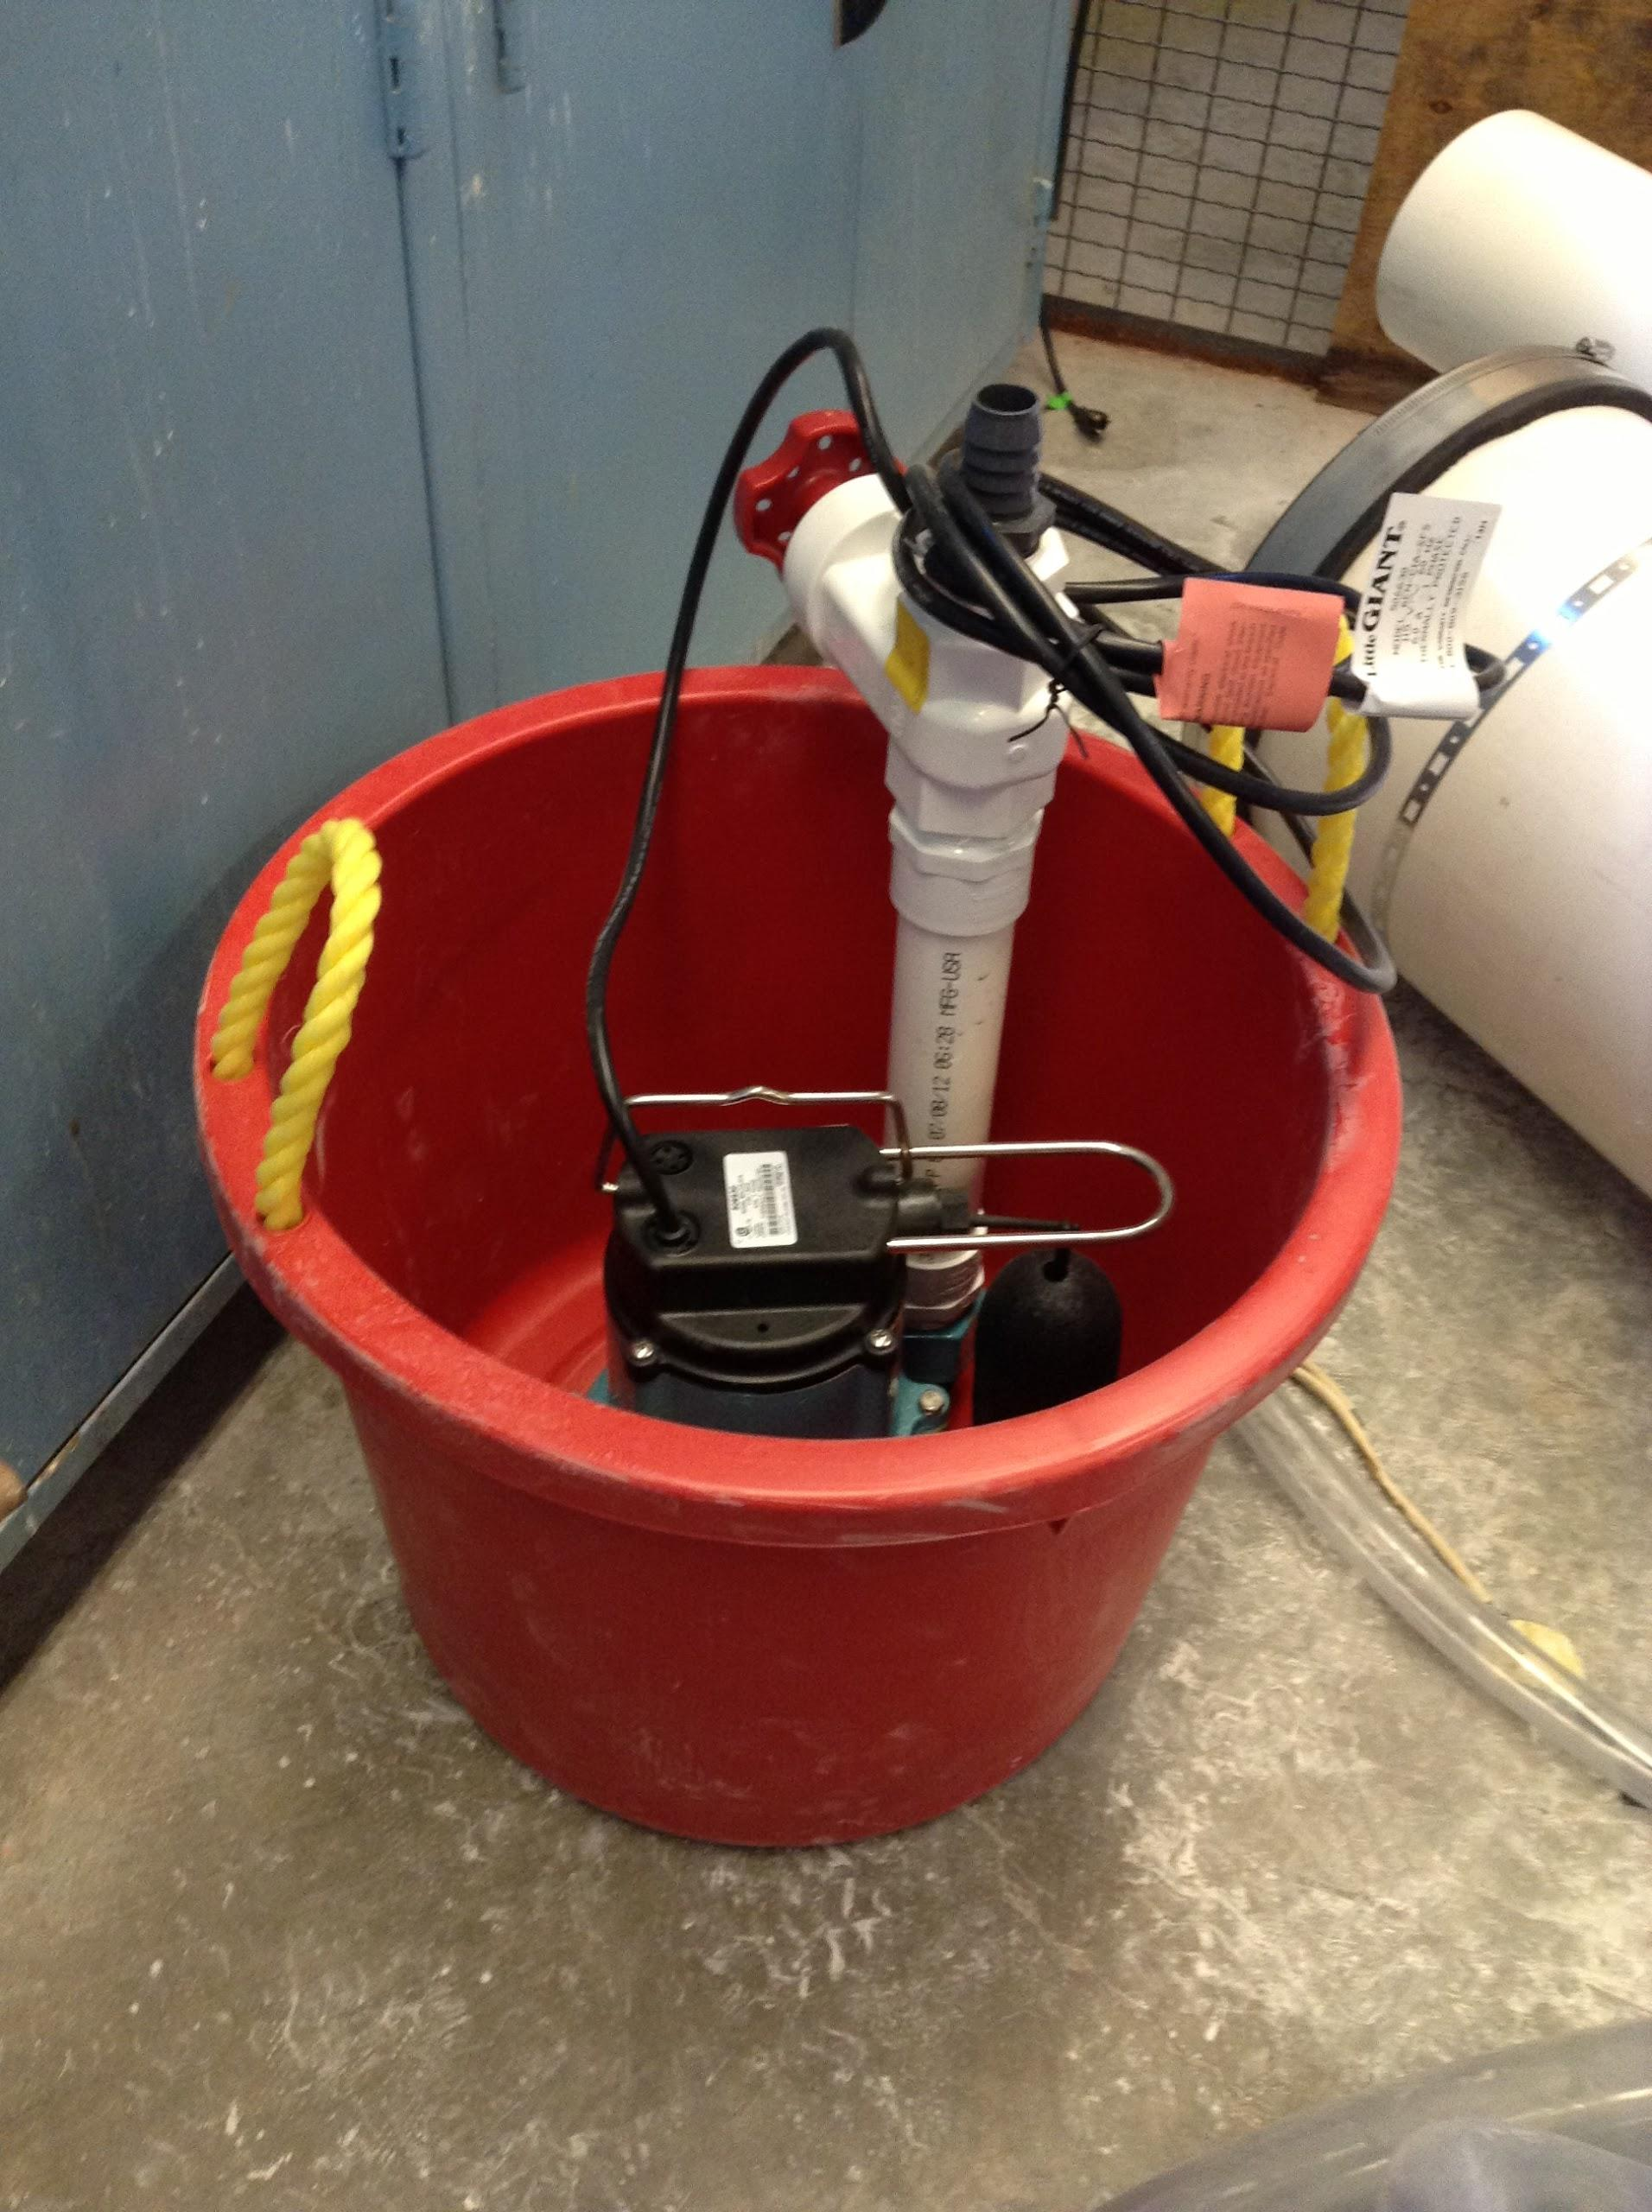
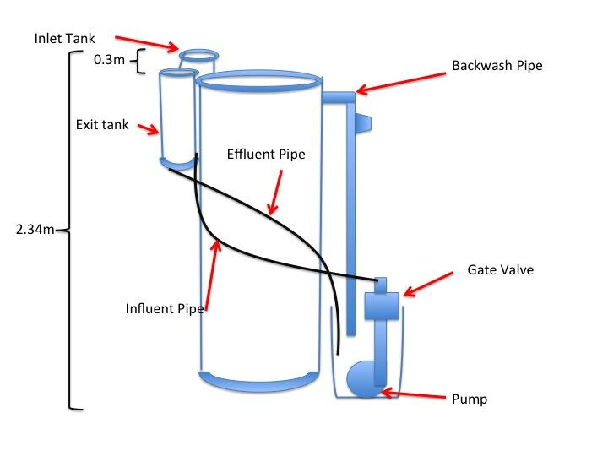
Pump and Recycling System

Slide 17
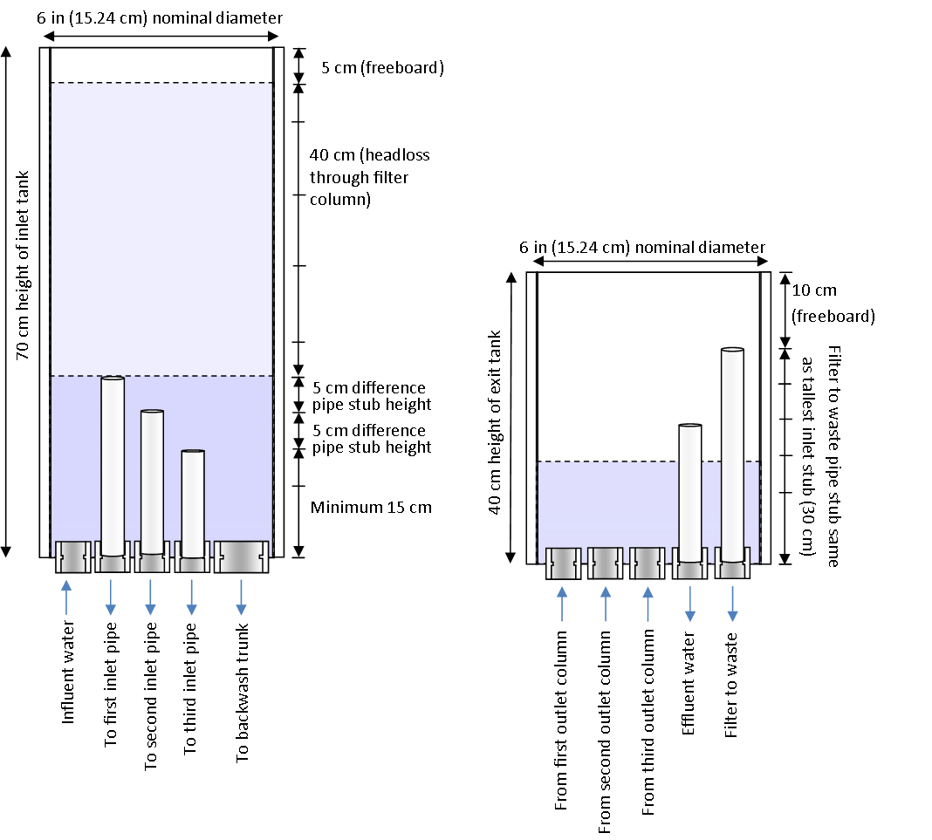
Pipe Stubs

Slide 18
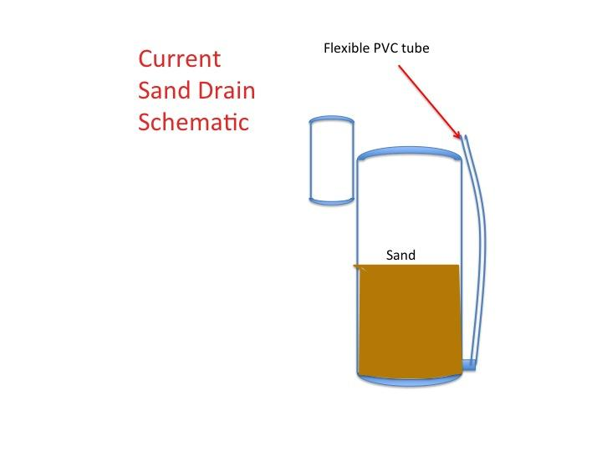
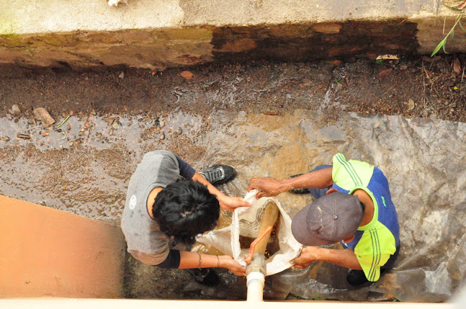
Sand Drain
How could we construct a better sand drain? What mechanism could be used to ensure it does not clog?

Slide 19
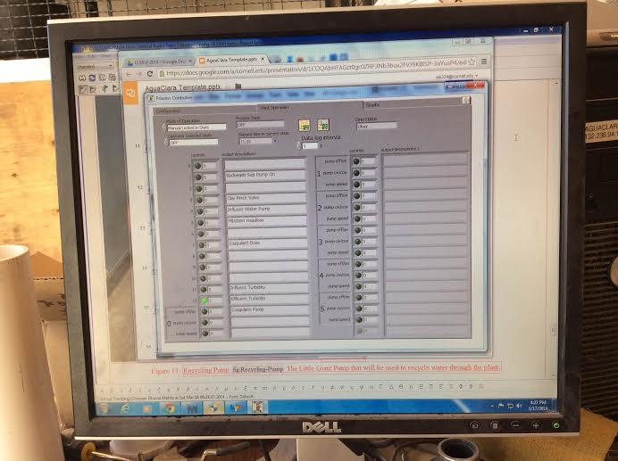
Running Filter

