Slide 1

Low Flow Stacked Rapid Sand Filter
Rachel Proske,
Mihir Gupta, Kris LaPan

Slide 2
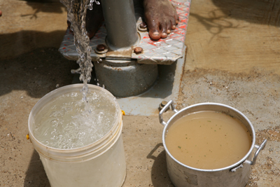

Overview
Introduction
Tasks
  Hydraulic Testing
    MathCAD Model, Fabrication
  Performance Testing
    Methods, Results
Future Work
Notes:
http://www.africare.org/our-stories/passiton/august10.php

Slide 3
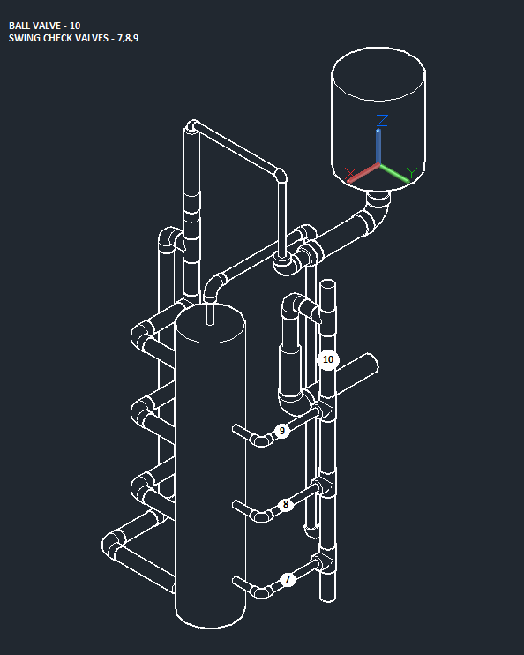
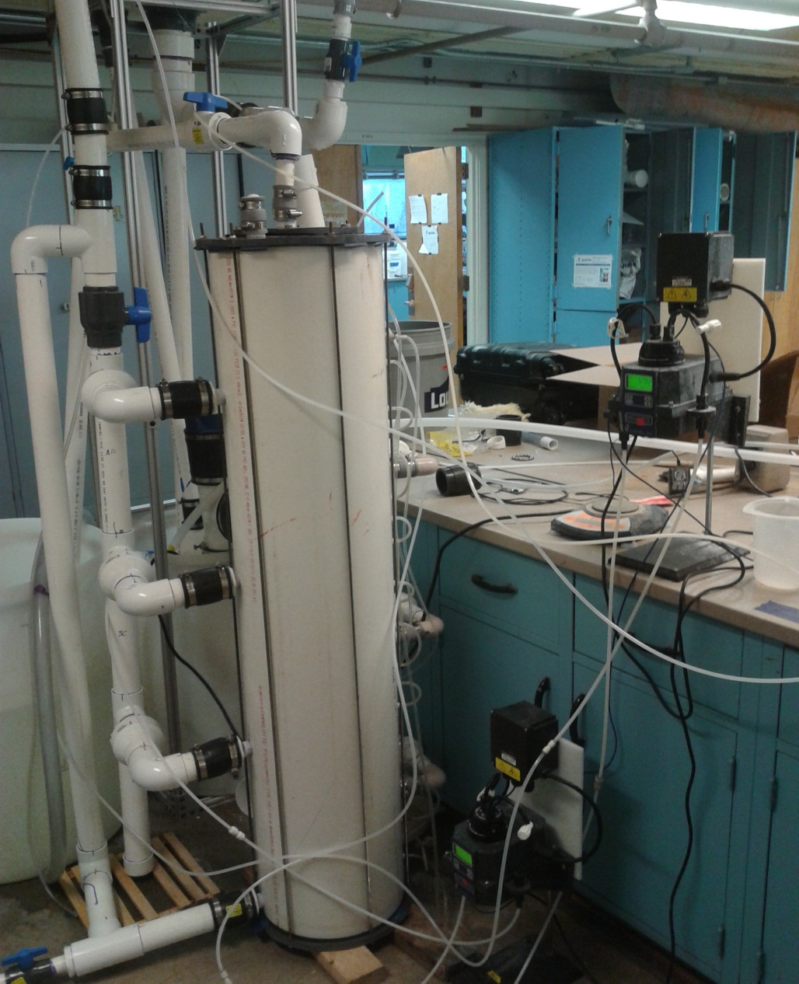
Introduction
Notes:
Will be final process in full treatment system or stand alone treatment. Briefly describe the flow of water and

Slide 4
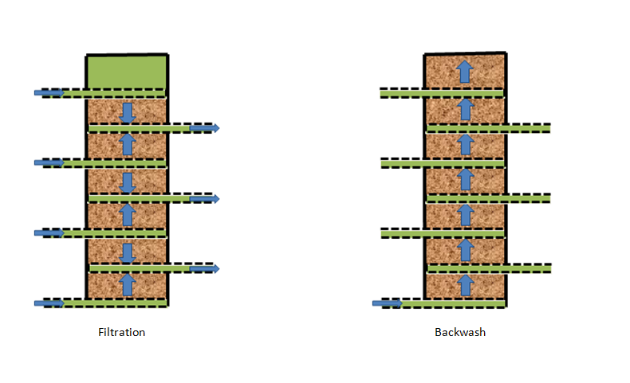
Flow Paths

Slide 5

Hydraulic Testing
MathCAD Model
Head loss determination
Comparison with prototype
Modeling of sand bed
Notes:
http://priceofoil.org/2012/09/17/will-we-ever-wake-up/

Slide 6
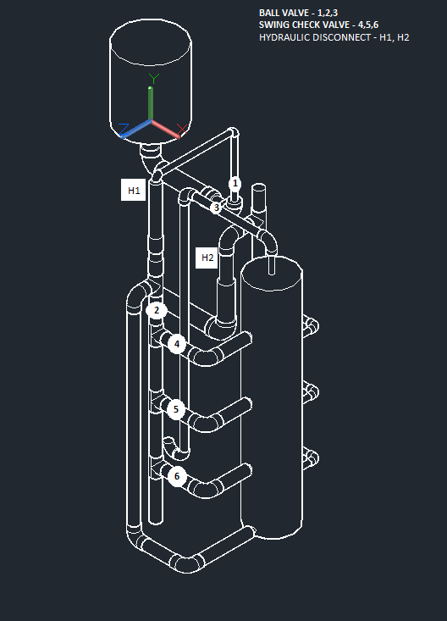
Hydraulic testing
Fabrication Changes
Replaced spring check valves with swing check valves
Enlarged backwash pipe
Installed ball valve before the LFOM
Made prototype airtight

Slide 7
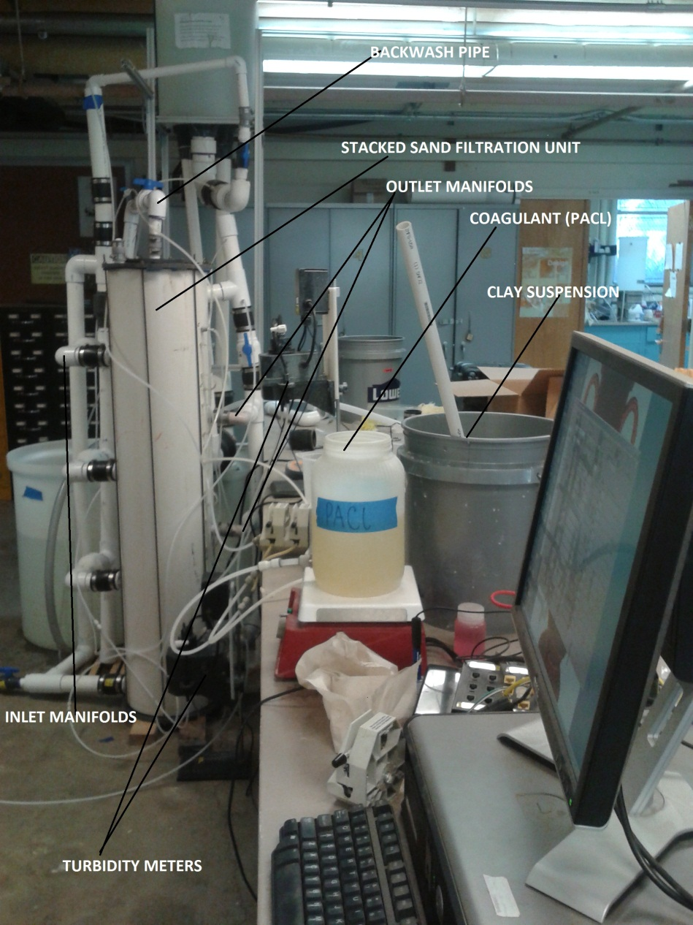
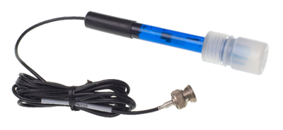
Performance Testing
Methods
Turbidity meters
Process Controllers
pH probe
Notes:
http://sunlightsupply.com/p-14425-nutradip-ph-replacement-probe.aspx

Slide 8
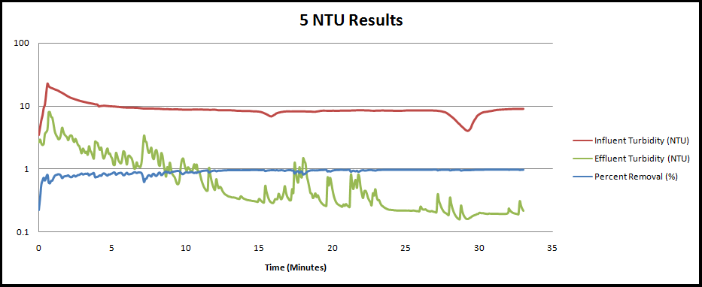
Performance Testing
5 NTU

Slide 9
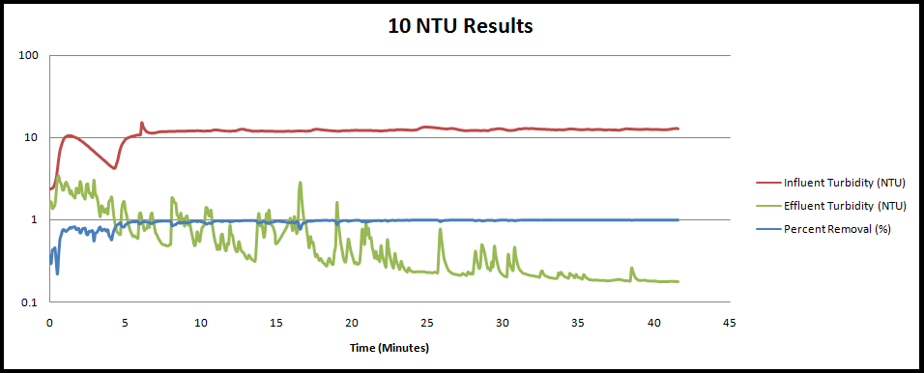
Performance Testing
10 NTU

Slide 10
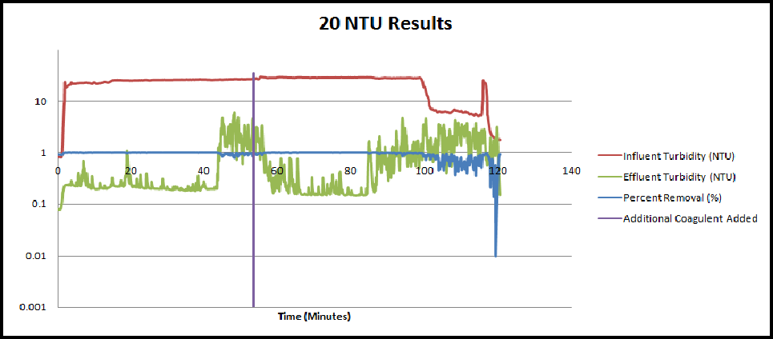
Performance Testing
20 NTU

Slide 11
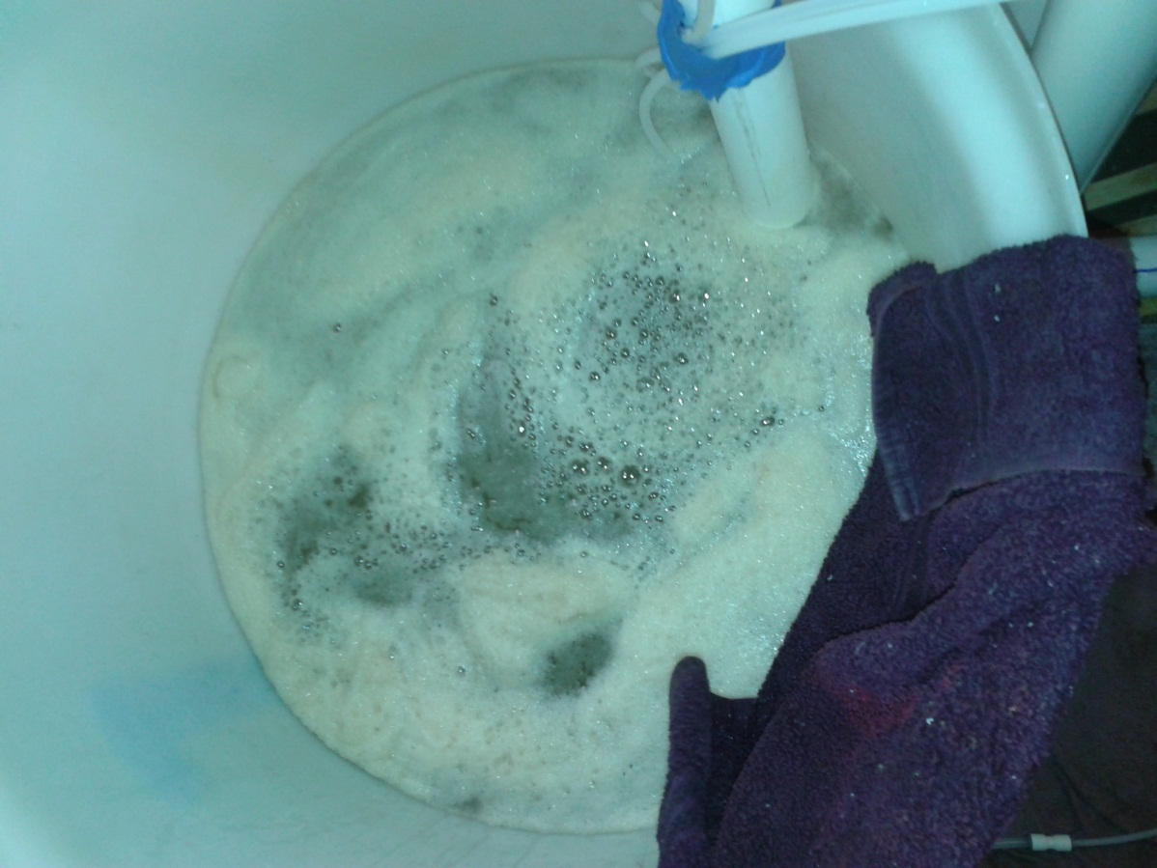
Future Work
MathCAD Model
Data Collection
  Hydraulic Testing
  Performance Testing
Fabrication

Slide 12

Questions?
Notes:
http://framework.latimes.com/2010/06/29/enrique%E2%80%99s-journey/#/0

