Slide 1
EStaRS Filters
Natalie Mottl, Erica Marroquin, Michelle Bowen, Lilly Mendoza

Slide 2
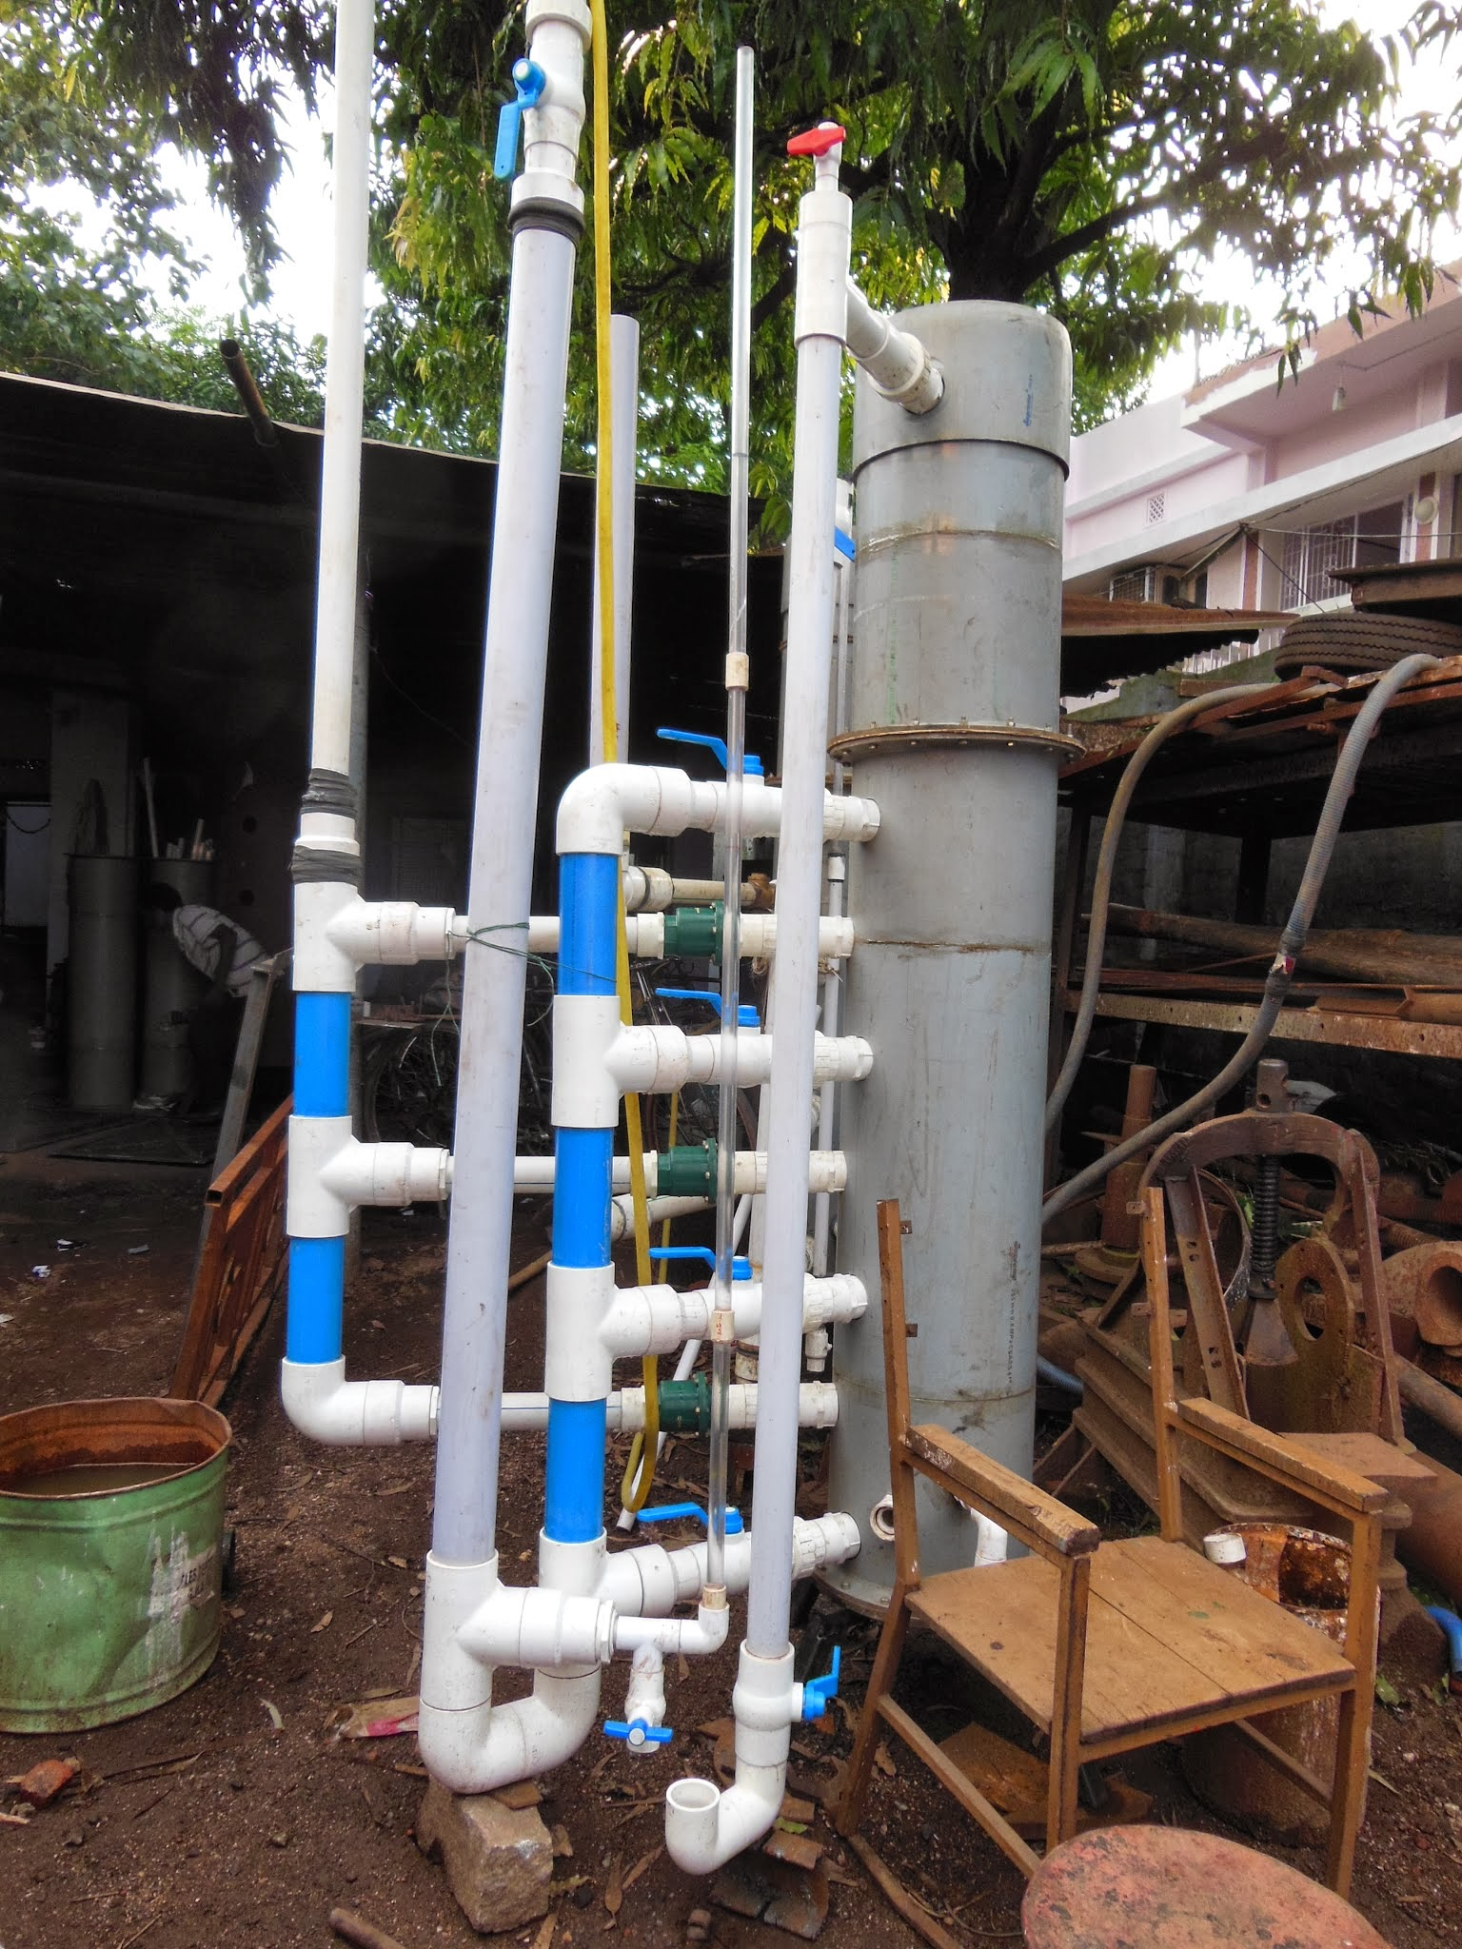
Introduction to EStaRS
EStaRS = Enclosed Stacked Rapid Sand filter
Low flow version of full scale StaRS filter
  StaRS: Q = 10 L/s
  EStaRS: Q = 0.8 L/s
Currently being used in India and soon Honduras
Notes:
Erica

Slide 3
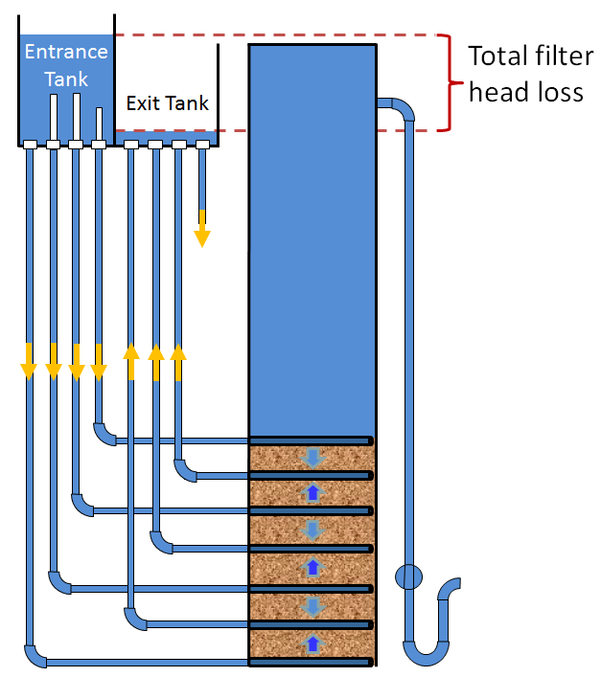
How EStaRS works
Alternative to traditional rapid sand filters, requires less area and no electricity
Used in India to treat well water
One step treatment for low turbidity water
Notes:
Erica - The layering in the filter bed eliminates the need for electricity to backwash the filter. During backwash, the full flow rate of the filter goes through the bottommost inlet, fluidizing the sand bed.

Slide 4
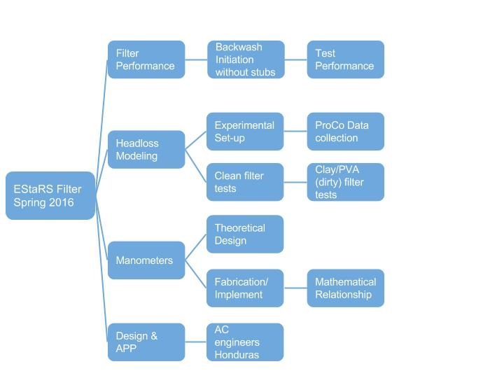
Semester Goals
Headloss
  Model headloss in backwash and filtration
  Measure headloss needed for fluidization
Manometers
  Fluidization of the sand bed?
Notes:
Lilly

Slide 5
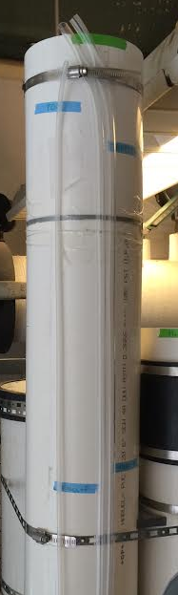
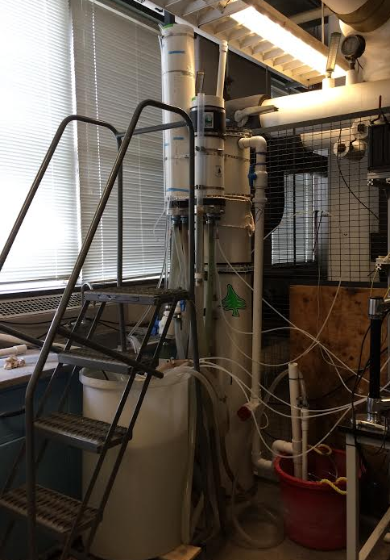
Experimental Set-up
General set-up
Entrance Tank Manometer
Pressure Sensor
Notes:
Lilly

Slide 6
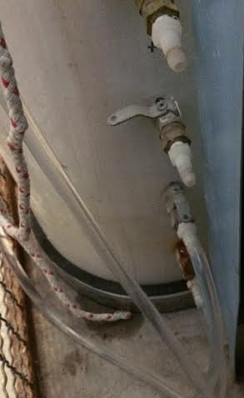
Manometers
Manometers span bottommost layer of sand (two bottom taps)
  Relationship between manometer over layer of sand to fluidization of the bed
Notes:
Natalie

Slide 7
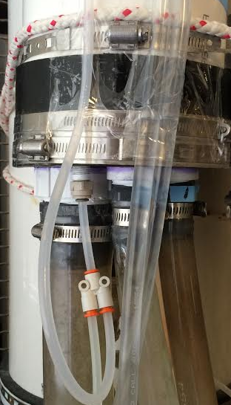
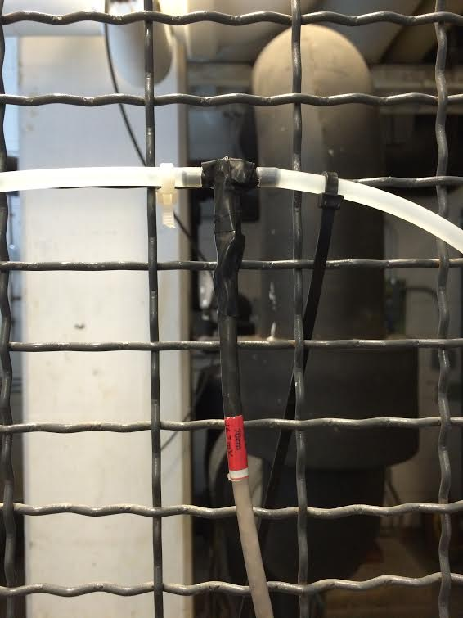
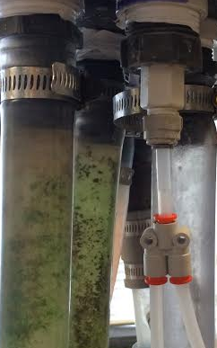
Backwash Headloss
Pressure sensor between entrance and exit tanks
Doesn’t work for backwash
Notes:
Natalie

Slide 8
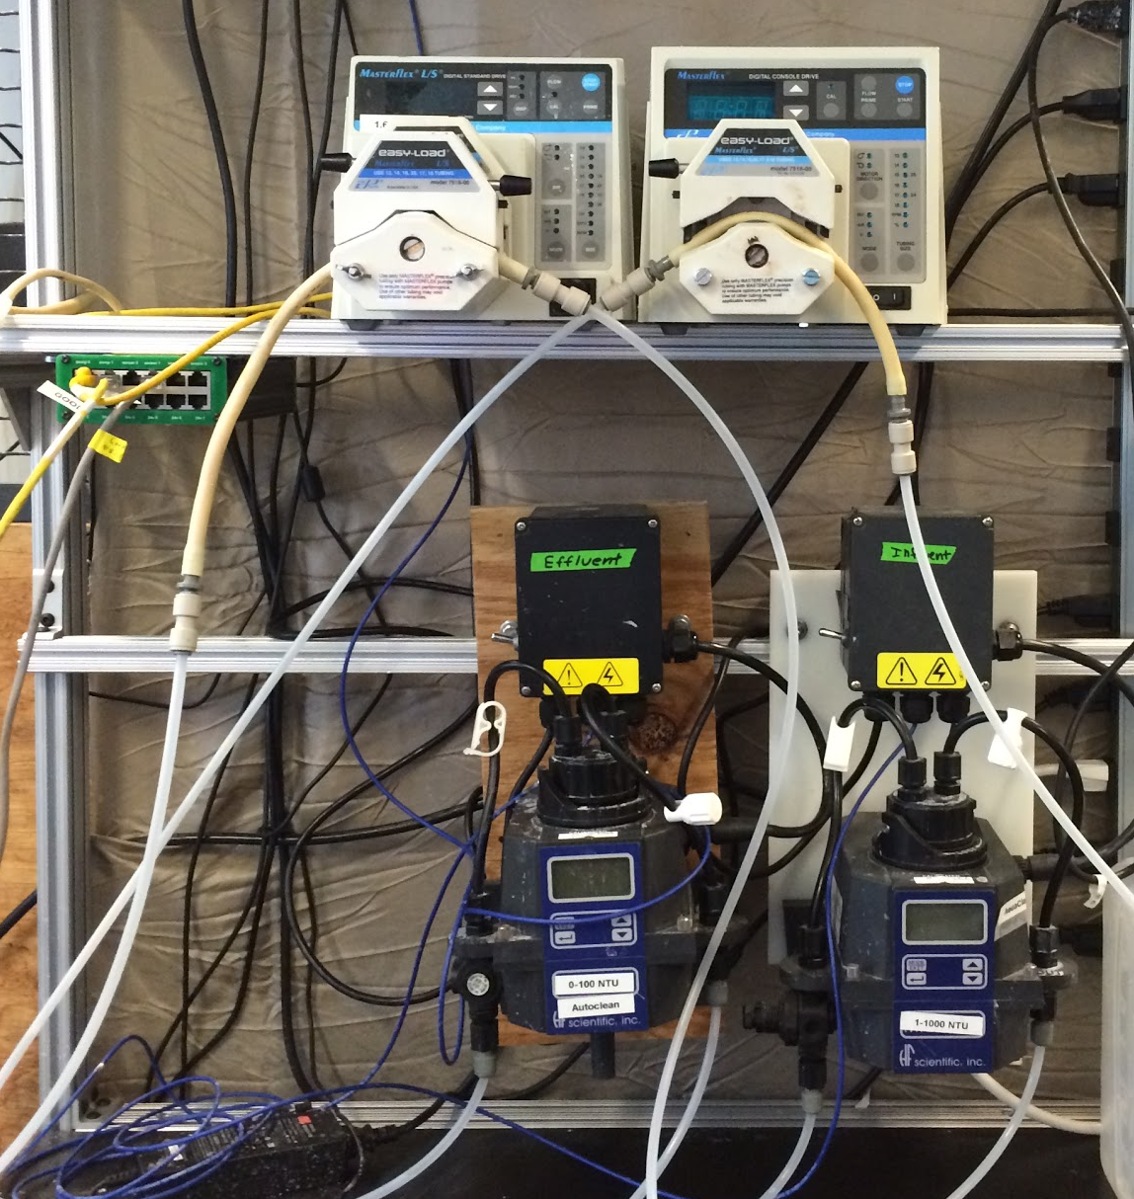
ProCoDA Setup
Data Collection
  Pressure Sensors
  Turbidimeters
Pump Control
  Clay
  Coagulant
  Mathcad
Possibility of PID control
  PID = Proportional Integral Derivative
Notes:
Natalie

Slide 9
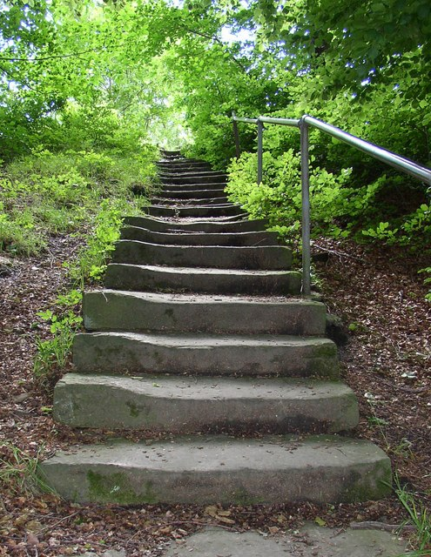
Next steps (in the lab)
Set up a system to measure head loss during backwash
Finalize experimental design for clogged bed tests
Run filter tests, measure head loss, create model
Notes:
Michelle

Slide 10
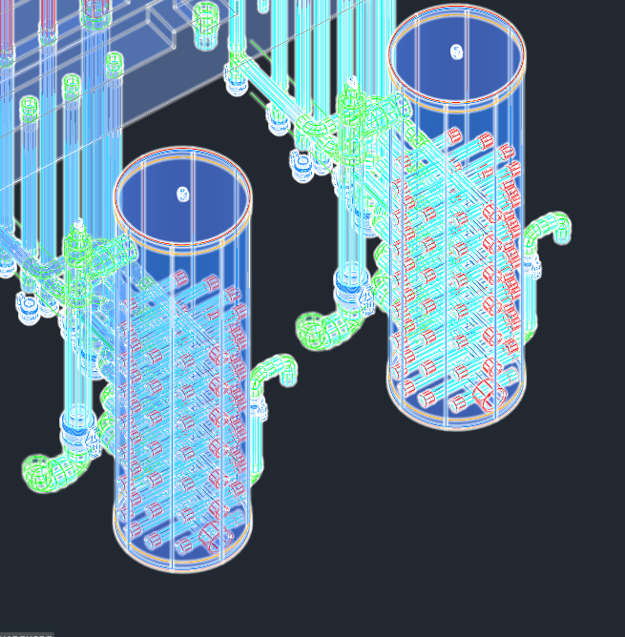
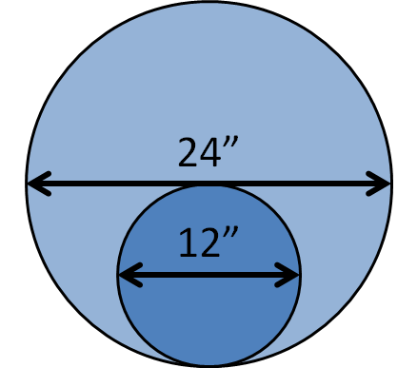
Next steps (in the field)
Honduras
  2’ diameter
  Small villages
  2 designs
Notes:
Michelle

Slide 11

Questions?

