Slide 1
EStaRS Final Presentation
Sarah Bolander
Skyler Erickson
Liza Johnson
Subhani Katugampala
Lilly Mendoza

Slide 2
Semester Objectives
Test Filter Performance
  Develop solution for air bubbles
Design Modifications
  Improve the cap design
  Implement new inlet system

Slide 3
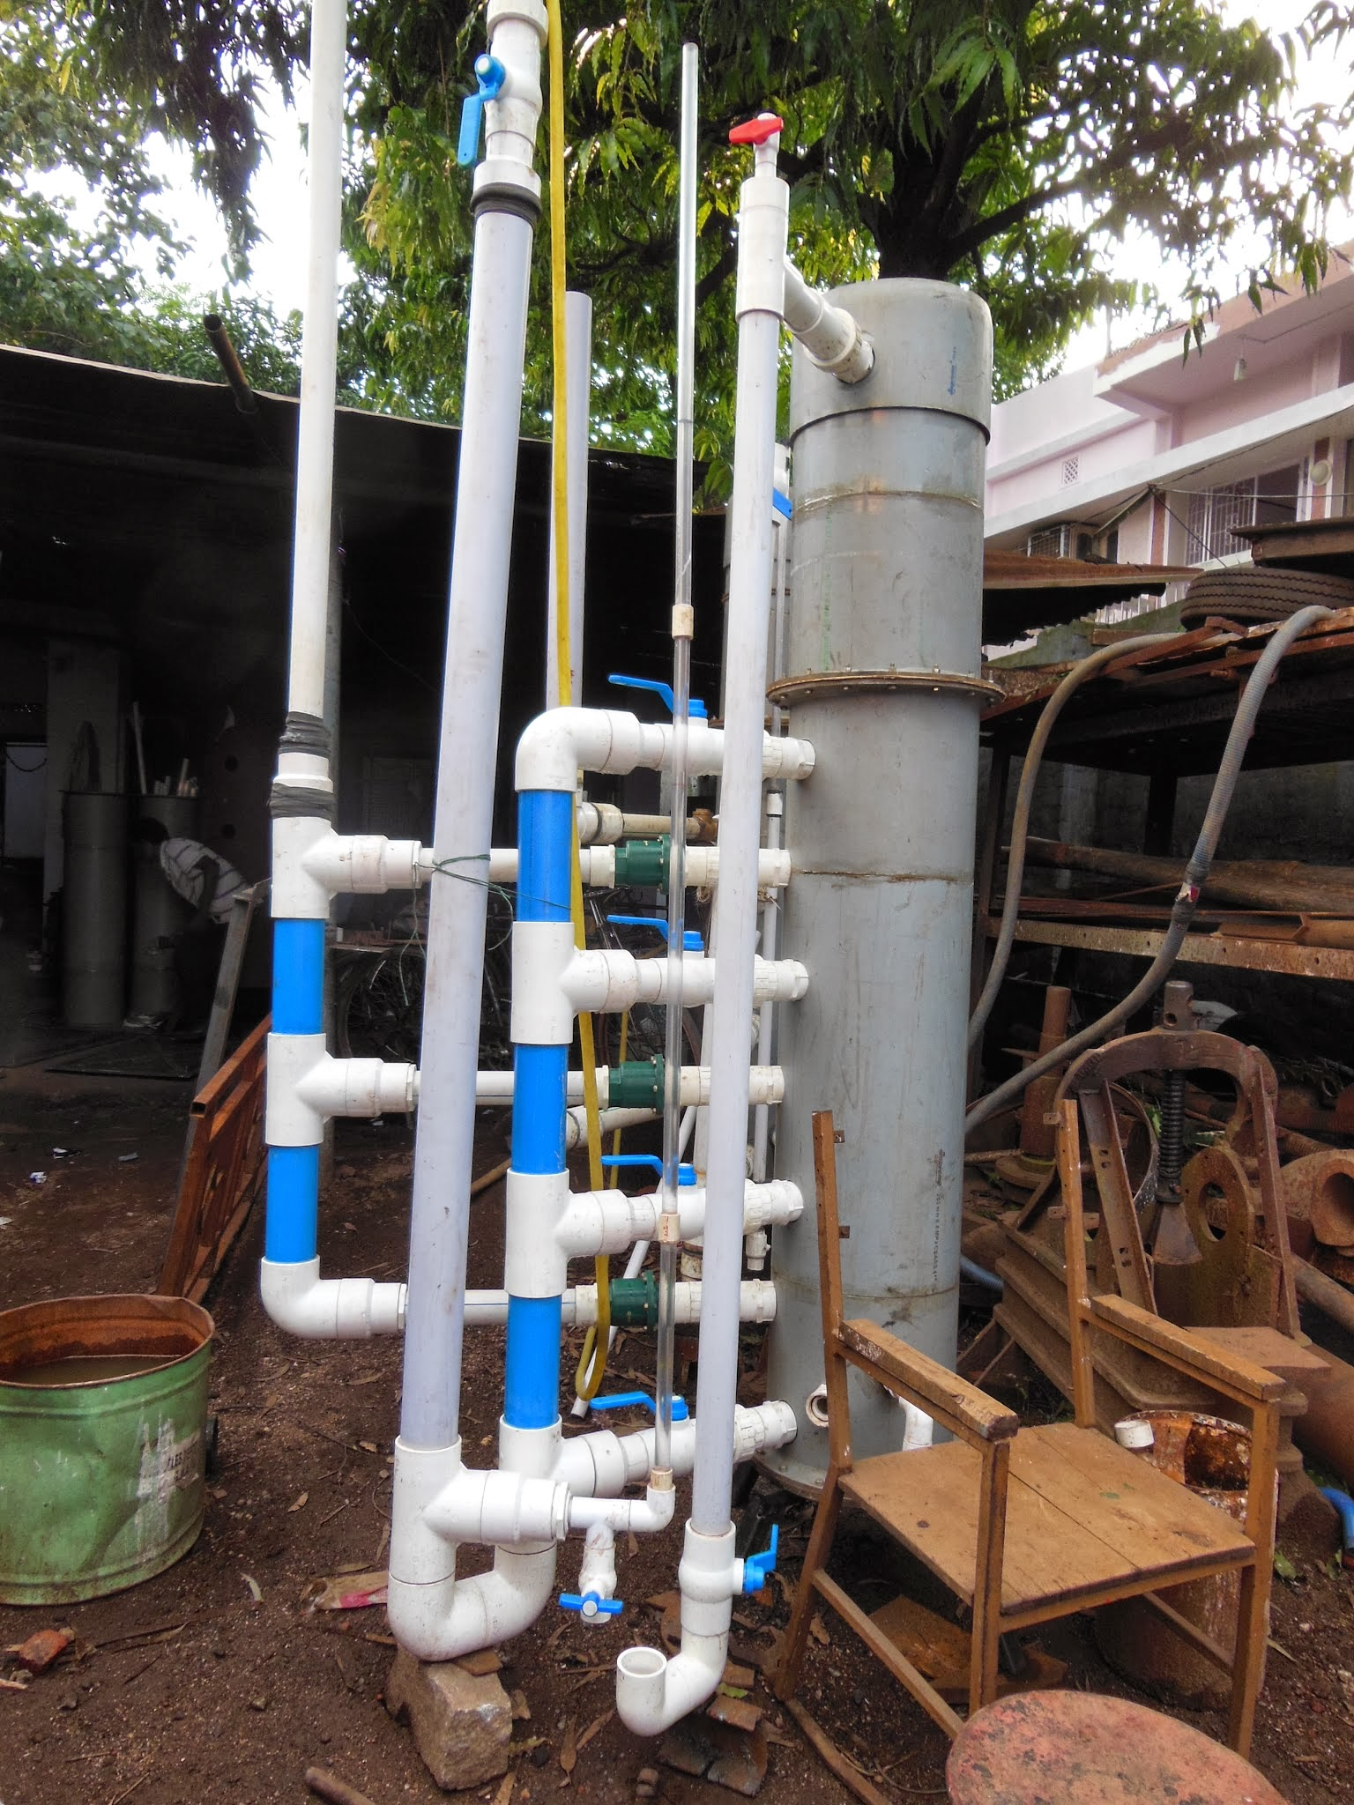
Intro/Background
Enclosed Stacked Rapid Sand Filter
Design flow rate of 0.8 L/s
Currently being implemented in India, where it is being used to treat well water
Ideally a smooth transition from forward filtration to backwash
Requires less space than sand beds and backwash without electricity
Notes:
Lilly

Slide 4
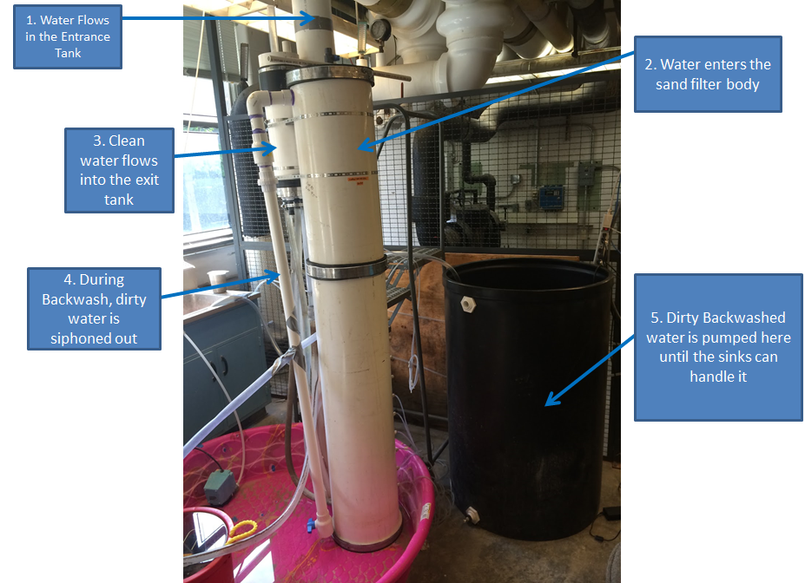
Experimental Setup
Notes:
Lilly

Slide 5
Filter Performance Procedure
Experimental Set-up:
Run the filter with ~25mg/l coagulant at a influent turbidity of 600 NTU with both the cap and siphon closed
Run until the effluent turbidity reaches ~20 NTU
Run backwash
  Plug the exit pipe and pump in clean water
  Open the cap and when water flows out the cap, close it and open the siphon
Notes:
Liza

Slide 6
Performance Conclusions
Positives:
  Successfully ran the filter for 30 minutes while producing an effluent turbidity of ~1NTU
  We are able to repeat this result, which implies our backwash is successful to some degree
Areas to Improve:
  Air bubbles during backwash mode
  Incomplete initiation of backwash
Notes:
Liza

Slide 7
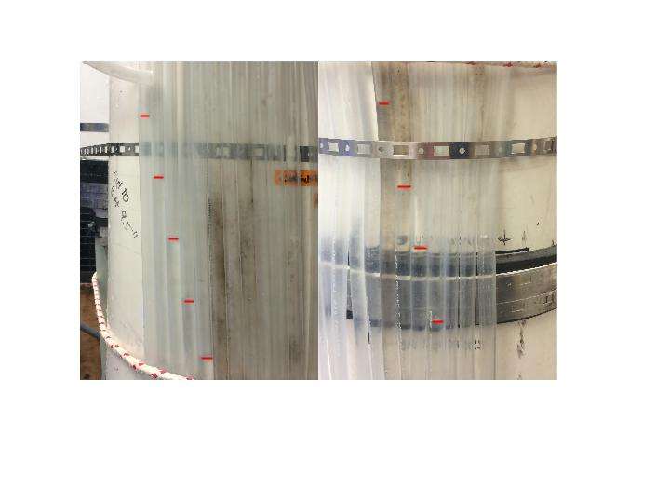
Manometer Conclusions
Consistent bed fluidization by layer
Supporting results that we are able to clean the filter
Notes:
Liza

Slide 8
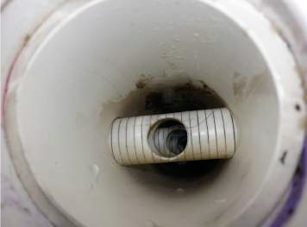
Design Considerations
Cap blowing off
Air bubbles
Modified inlet system
  Fabrication
  Implementation
    possibility for easier fabrication
  Reverse Flow?
Notes:
Lilly-may I introduce this? Like talk about why the need for a new inlet system is needed to cut down costs from fabrication. Also how a decrease on slottered pipes dependence would mean that plants in the field could fix/build filters easier and faster.
Sarah: sounds good to me!

Slide 9
Air Bubbles
Initiation Headloss
Formation possibly due to fountaining effect
Air bubbles present even when entrance to filter is steadily covered
Water level before backwash
Water level during backwash
Influent Water
To 1st inlet pipe
To 2nd inlet pipe
To 3rd inlet pipe
To backwash pipe
Notes:
Subhani

Slide 10
Air Bubbles: Solution
Shorten height of backwash pipe
Place outlet of siphon pipe in a bucket
Elongation of the inlet to the entrance tank
Shortened Backwash Trunk with Two Elbow Joints
Straight Backwash Trunk
Notes:
Subhani
exit tank (and exit weir) was not high enough to ensure top of filter body was filled with water (bc the exit weir was below the top of the filter body and backwash pipe
this meant that the top of filter would always have air when switching from forward to backwash

Slide 11
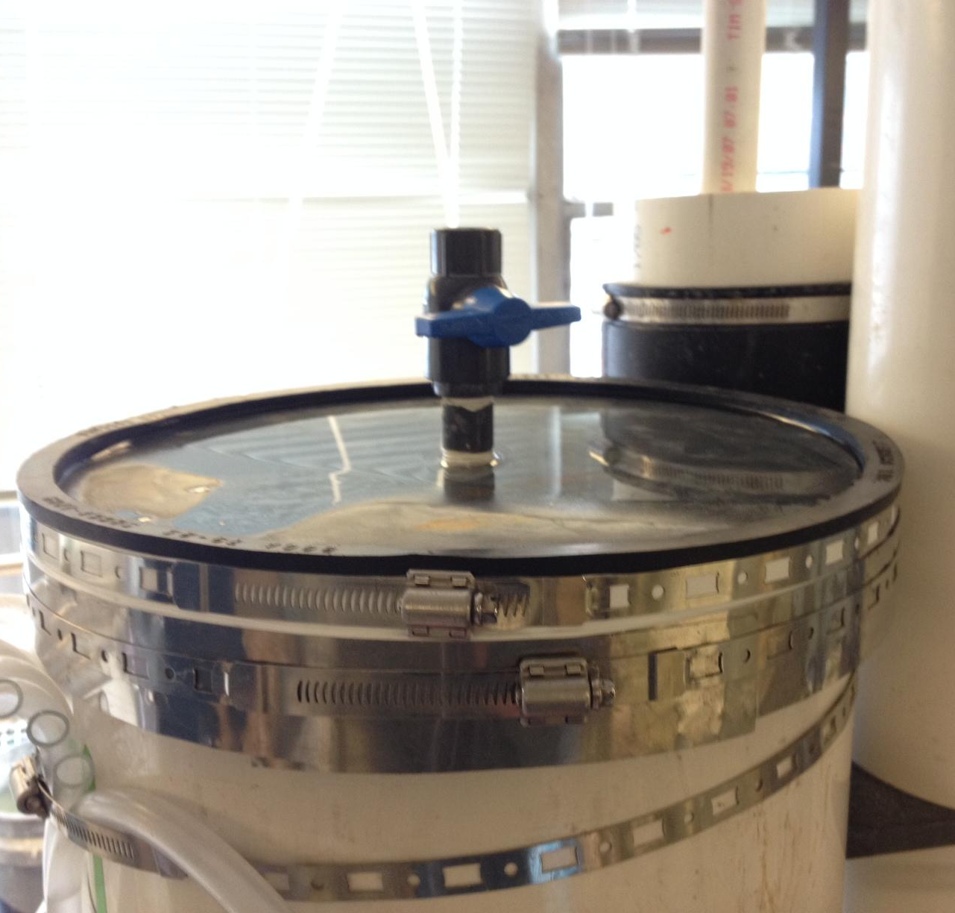
Cap Design
Circular PVC plate with Fernco fitting, stainless steel shim stock, and hose clamps
Top of filter column is not level
Failure: Pop off or leakage
Notes:
Sarah
explain set up
times it popped off: forward filtration
times it leaked

Slide 12
Cap Design: Testing
OLD ASSEMBLY
NEW ASSEMBLY
Hose clamp assembly
  Overlap on shim stock
  Location on rubber fitting
Tested assuming a situation in which all exits to the filter were clogged in forward filtration
hose clamp
circular PVC sheet
teflon tape
shim stock
rubber Fernco fitting
filter column
Notes:
Sarah
explain old assembly
flipping rubber fitting inside out
hose clamp slipping over itself
blank space
slightly above cap

Slide 13
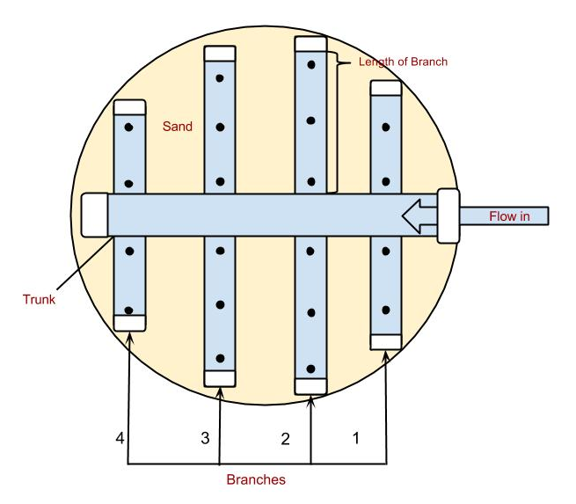
Inlet System: Design
Sizing of orifices set to a backwash head loss of 20 cm
Even flow distribution
Orifice diameters of 0.91 cm and 0.64 cm
Notes:
Sarah
design parameters

Slide 14
Inlet System: Fabrication
Table 1: A table of the values associated with each inlet’s orifices
Inlet | Trunk Diameter (cm) | Total Orifice Area (cm²) | Orifice Diameter (cm)
Top | 2.54 | 6.5 | 0.64
Middle 1 | 2.54 | 13.0 | 0.91
Middle 2 | 2.54 | 13.0 | 0.91
Bottom/Backwash | 5.08 | 6.5 | 0.64
Notes:
Sarah

Slide 15
Inlet System: Operation
System does not support reverse flow
Potential for sand build-up in trunk lines
Consider the relative heights of the filter, entrance, and exit tanks

Slide 16
Big Picture
Develop parallel filter system with modular units
Develop a field test for checking for backwash fluidization
Continue to push towards a more modular filter design that can be widely produced
Refined operator procedure for operation with orifice inlets
Notes:
Skyler

Slide 17

Questions?

