Slide 1

EStaRS Filter
Susan McGrattan
Environmental Engineering, ‘17
sjm353@cornell.edu
Victoria Zhang
Chemical Engineering, ‘19
vxz3@cornell.edu
Liza Johnson
Environmental Engineering, ‘17
eaj68@cornell.edu
Mikel Aurteneche
Civil Engineering, ‘18
ma962@cornell.edu
Research | Fall 2016
Notes:
https://www.overleaf.com/6206032njsrsc#/20796226/
https://confluence.cornell.edu/display/AGUACLARA/Enclosed+Stacked+Rapid+Sand+Filtration

Slide 2
Background

Slide 3
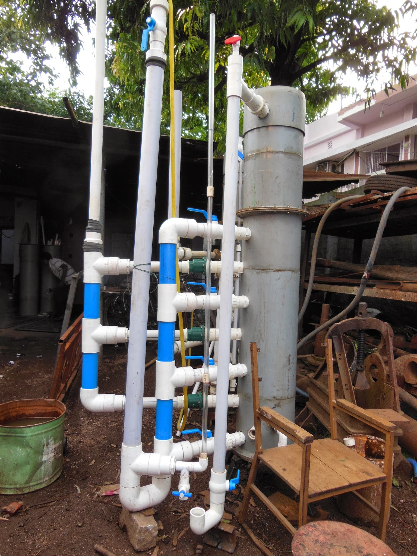
EStaRS: low flow sand filter
Acts as a stand alone filtration system
Cost effective for flow rates < 6 L/s (~0.8 L/s)
Used in small communities such as rural villages in India
  Expand to Honduras
EStaRS Filter | Research | Fall 2016
Notes:
EStaRS filter stands for enclosed stacked rapid sand filter
The AguaClara water treatment system is designed to use sand filtration as the last stage of treatment
More recently, AguaClara has been working to build a stand alone sand filtration system that can operate at much lower flow rates called Enclosed Stacked Rapid Sand (EStaRS) filters.
The goal of these smaller scale filters is to provide water treatment in places where is it not practical to implement a full­scale AguaClara treatment plant, such as in the rural villages of India where the filter provides water to villages of around 600 people.

Slide 4
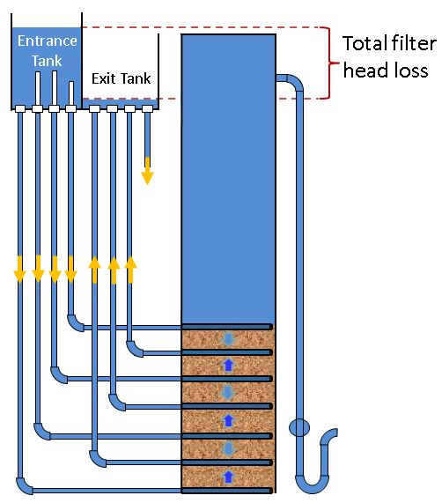
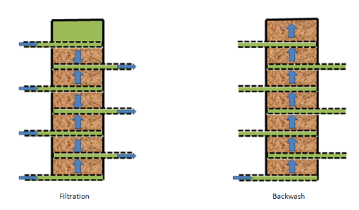
Forward filtration and backwash
EStaRS Filter | Research | Fall 2016
Notes:
Forward filtration:
Water flows into the inlet pipes during filtration and either flows upward or downward where dirt particles get trapped in the sand into the nearest outlet pipe
slotted outlet pipes keep sand from getting into effluent water
Backwash:
open bottom inlet & backwash pipe at top of tank (where water will exit) so that the backwash outlet acts as a siphon where water will flow upwards through the filter through pressure buildup, fluidizing the bed
inexpensive and electricity-free means to remove particles & efficient means to backwash the filter
Requires less water for backwash than traditional methods.

Slide 5
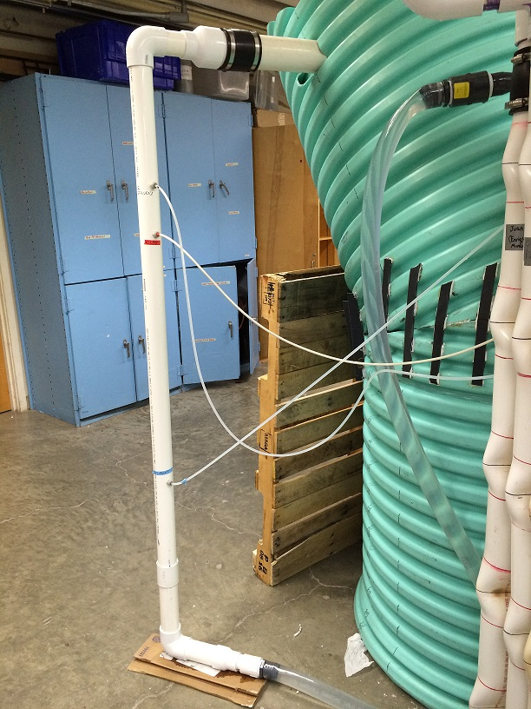
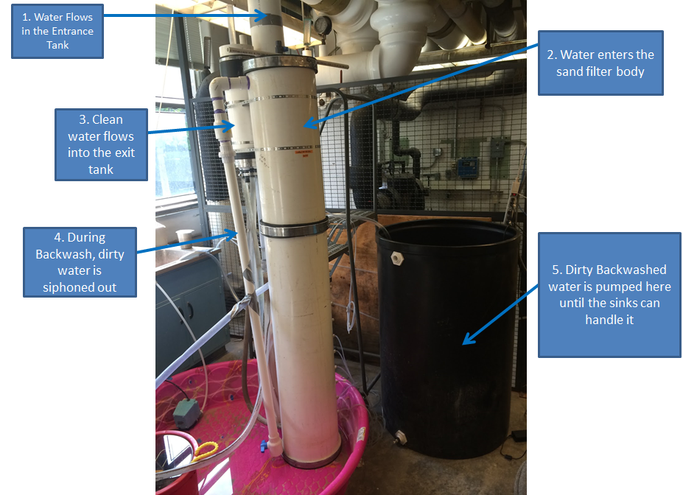
Need new design compatible with 1 L/s plant
Objective: scale down existing filter
1 L/s sed tank will feed into EStaRS entrance
EStaRS Filter | Research | Fall 2016
Notes:
Feed will be where outlet manifold of 1 L/s plant is
Will be cost effective, made of accessible materials, and simple design and operation.

Slide 6
MathCAD
Notes:
Susan

Slide 7
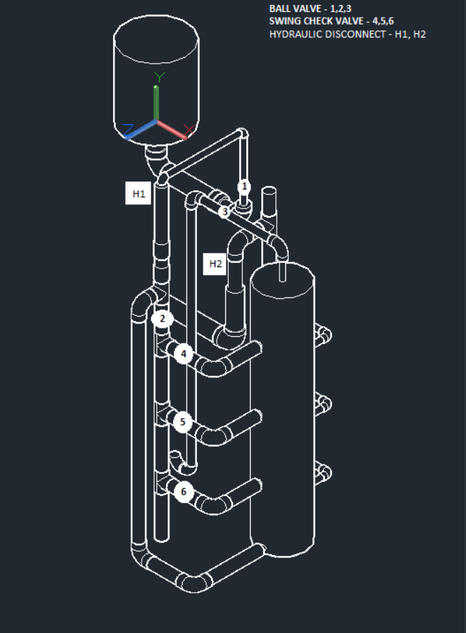
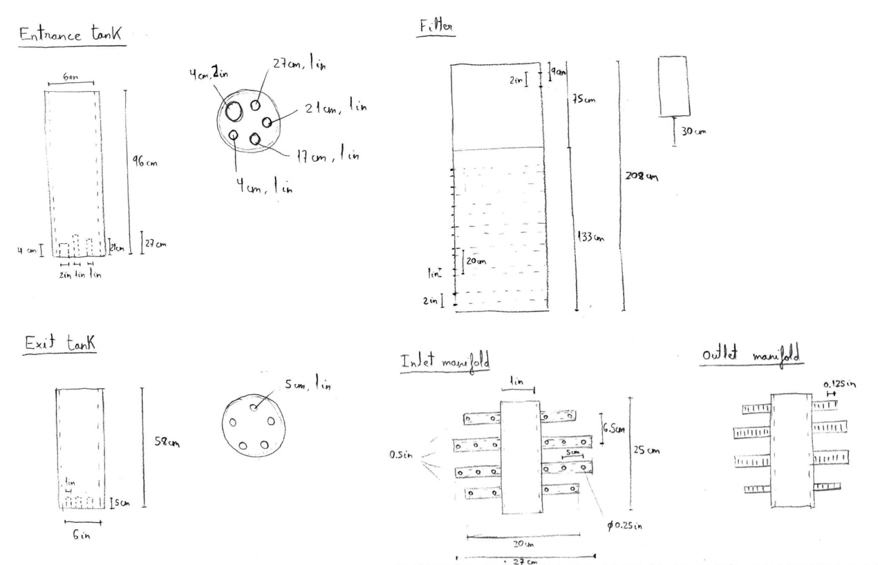
Disassembly of existing filter
EStaRS Filter | Research | Fall 2016
Notes:
Better understanding of inner workings
Establish size relationships between components
Pictures: old autocad drawing and sketches of parts

Slide 8
Two options for shortening filter
Reduce Sand Layer Height
Reduce Number of Layers
✓ One filter
→ Modular 1 L/s plant
✗ Layers too small
→ Inadequate filtration
✓ Layers same height
→ Adequate filtration
✗ 2 filters
→ Not modular
✗ Backwash velocity too low
→ More complex backwash system
EStaRS Filter | Research | Fall 2016

Slide 9
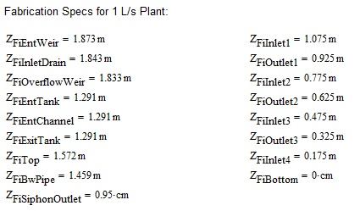

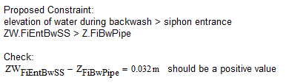
MathCAD model calculates filter dimensions and head loss
Constraints
Elevation Results
EStaRS Filter | Research | Fall 2016

Slide 10
AutoCAD

Slide 11
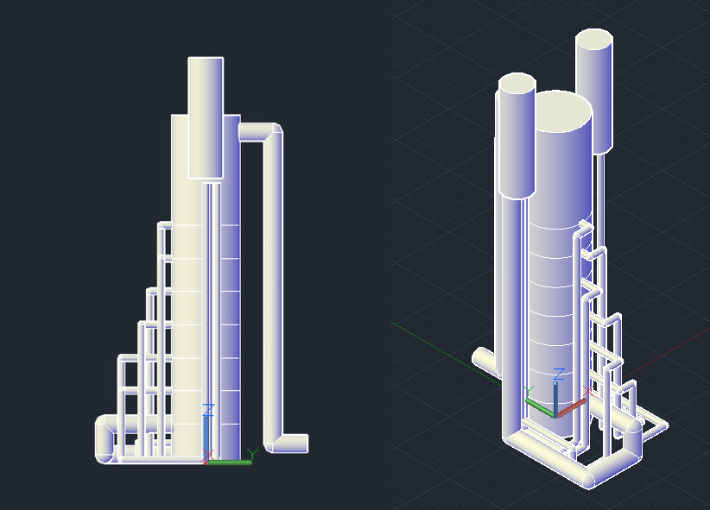
Designing the new filter
Used the dimensions from the Mathcad file in order to determine:
  inlet/outlet elevations
  siphon height
  pipe diameters
  entrance/exit tank elevations/heights
EStaRS Filter | Research | Fall 2016
Notes:
Liza -
After a lot of back and forth between different design options, we determined that decreasing the height or the number of layers could be detrimental to the performance of the filter. So finally, we determined the filter could keep the 20cm layers and was short enough to be fed into by the 1 L/s plant
The next step was to enter in our new parameters onto mathcad in order to determine the various dimensions of the filter such as the inlet/outlet elevations, the siphon height, pipe diameters, and entrance/exit tank elevations and heights.
By drawing these dimensions in the Autocad filter, we could then move onto the next step of switching to non-flexible tubing

Slide 12
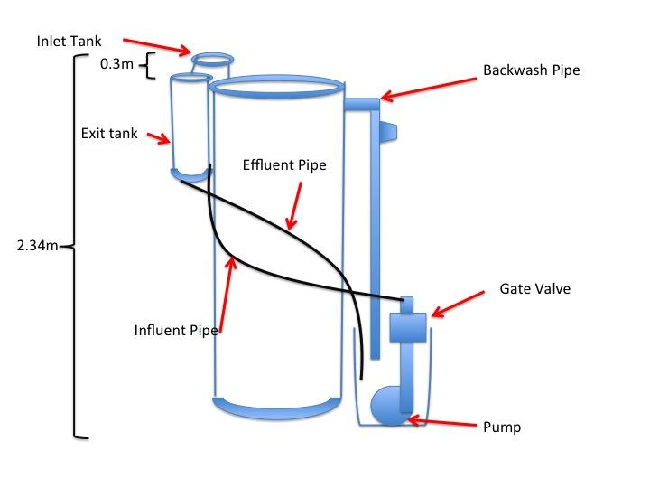
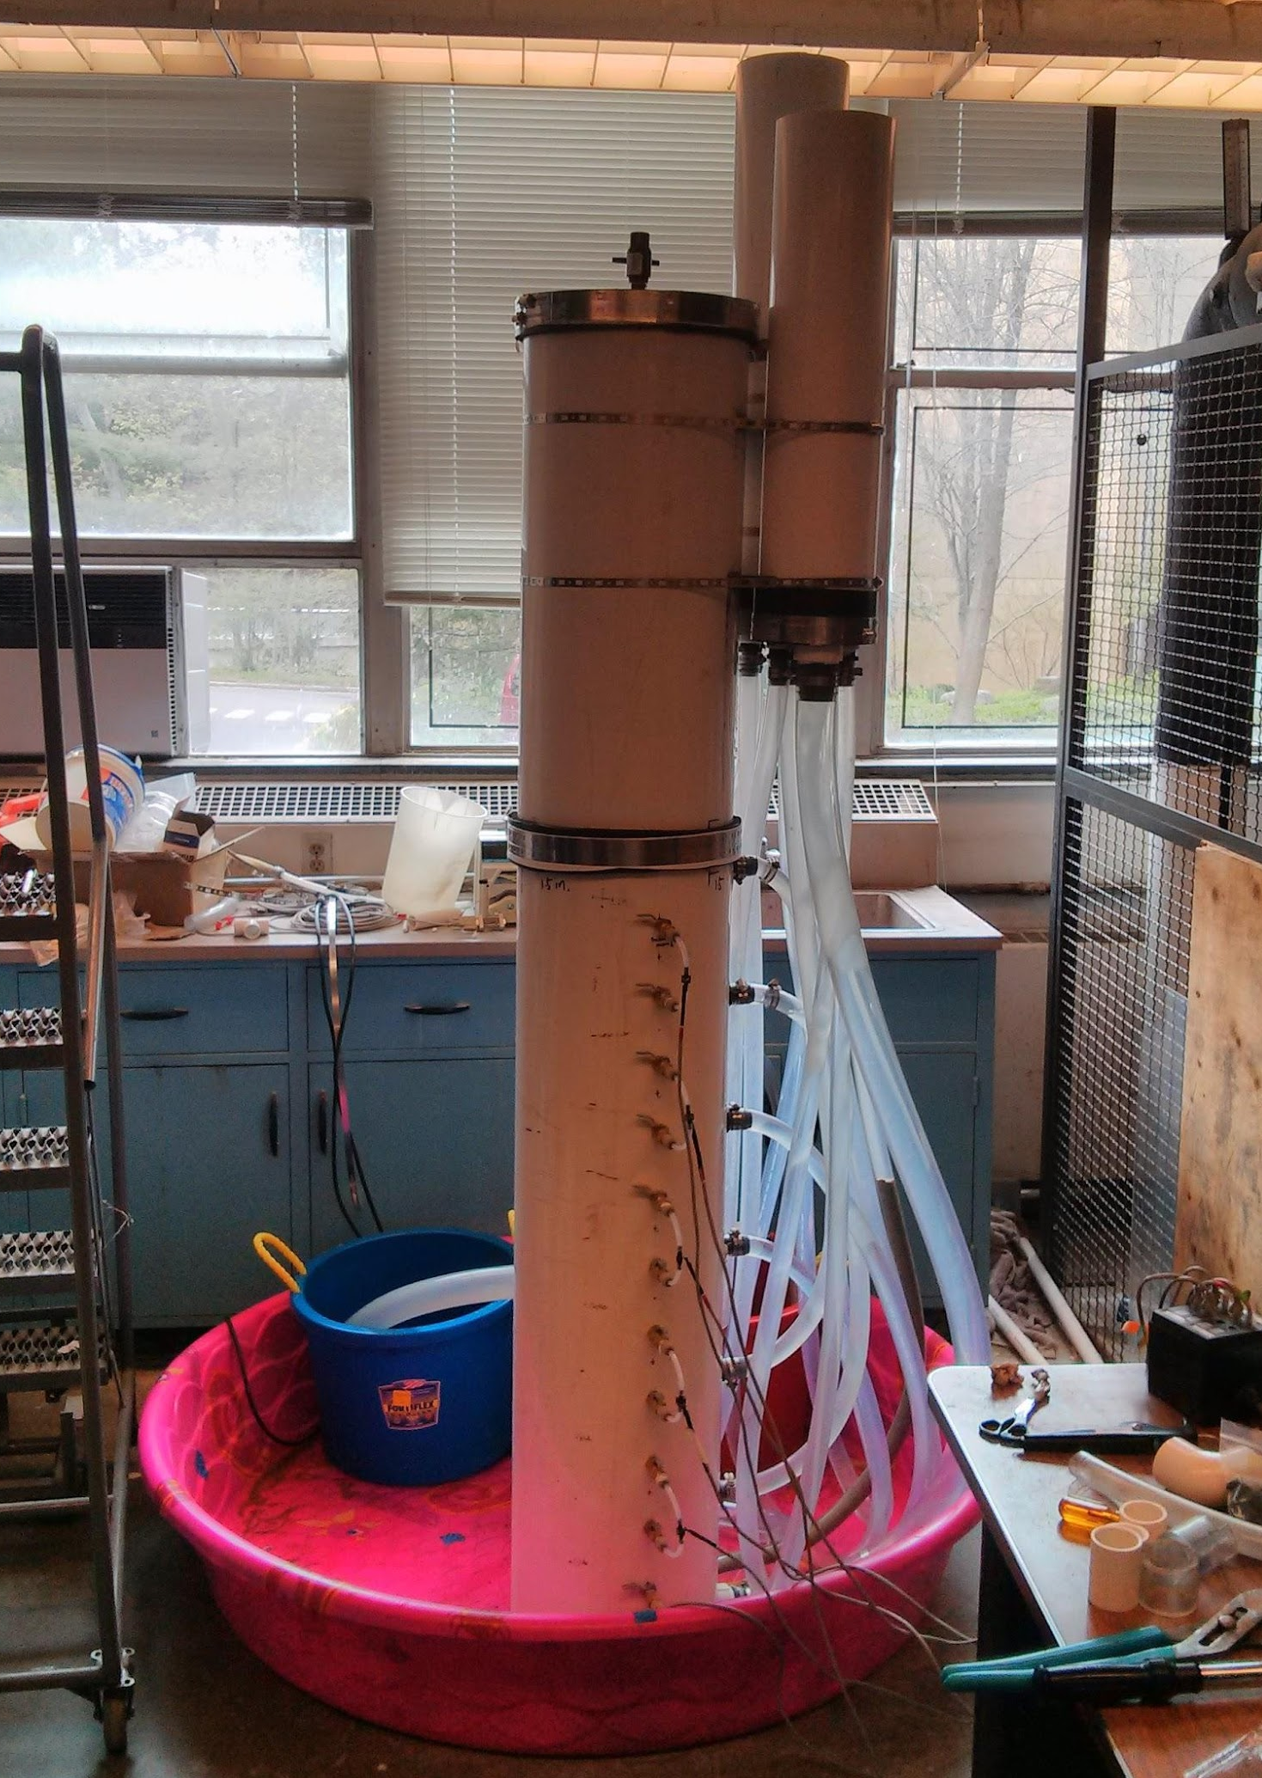
Comparison to old design
EStaRS Filter | Research | Fall 2016
Notes:
Liza -
These two diagrams and pictures show the previous design of the filter. Compared to our filter, the largest differences are the total height of the filter, the elimination of flexible tubing, and the orientation of the entrance tank, exit tank, and backwash pipe.

Slide 13
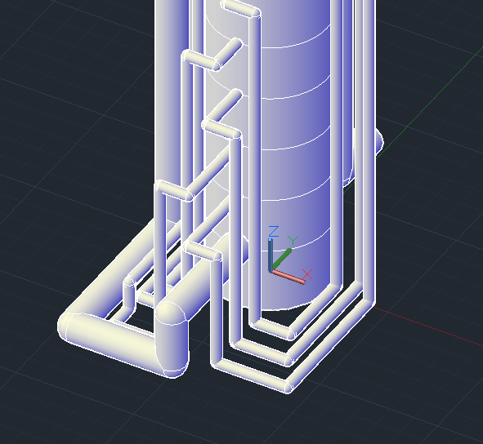
Making the switch to non-flexible tubing
Switching to non-flexible tubing for ease of construction and durability
Challenges:
  To make sure that all inlet and outlet pipes reached ground level
  Make sure the pipes do not intersect
  Make sure elbows are properly settled and tight
EStaRS Filter | Research | Fall 2016
Notes:
Liza -
As shown in the diagram above, the switch to non-flexible tubing involved a careful design in Autocad. There were several challenges faced in the design of this, including making sure that all inlet and outlet pipes reached ground level. This is necessary because otherwise, air is able to get sucked into the filter through the pipes. In addition, we had to ensure that we were able to lay out these pipes in a way that they did not intersect with each other and that it was possible to do this given the pipe diameters and elevations that we had to work with. The diagram above shows the pipework detail, with the right showing the pipes going to the exit tank, and the left showing the pipes coming from the entrance tank.
When fabricating the filter, we must ensure that all elbows are properly settled and tight.

Slide 14
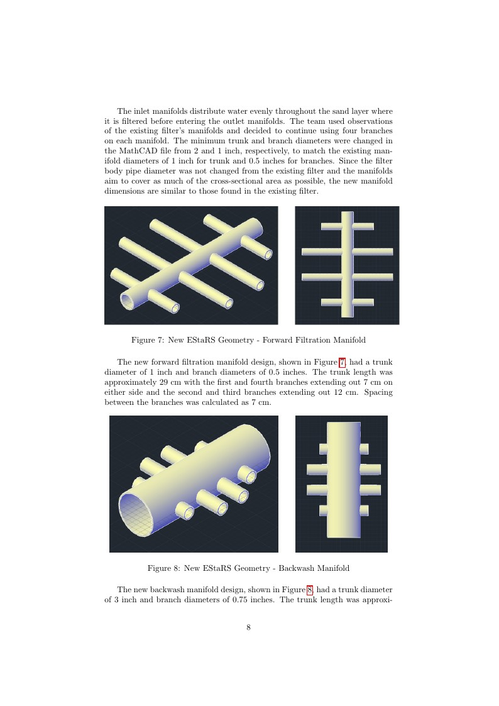
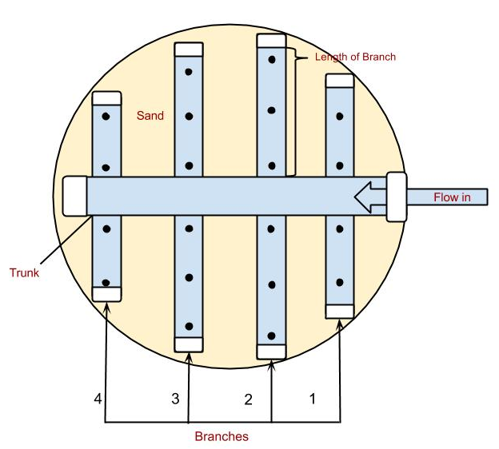
Resizing the manifolds to meet new constraints
Similar to ones in existing filter
Same diameter and number of branches
EStaRS Filter | Research | Fall 2016
Notes:
Mikel-
Deconstructed the filter to see what was inside
Need to design the branches to meet the required flow
Inlets- holes - relying on gravity/surface tension to keep the sand out of the orifices
Outlets - slotted pipes
--- considering a design change in the inlet manifolds - either a pipe within a pipe or a shield to do a better job preventing sand from entering the inlet- greater surface tension
For the new filter, we initially thought we would need to make the inlet branches closer together to utilize a greater percentage of the sand, as we thought we were going to reduce the filter layer height. However, we did not end up needing to reduce the filter layer heights, so the manifolds remained very similar to those in the previous EStaRs filter

Slide 15
Future Work

Slide 16
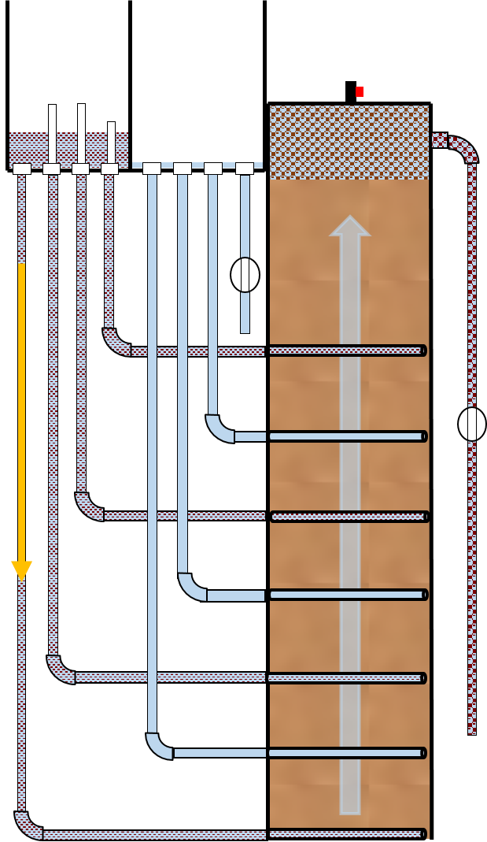
Future work: fabrication
Structural stability study of the filter
Begin constructing the filter
  extract dimensional data from our Mathcad and AutoCAD files
Make fabrication choices:
  Ease of construction
  Glass sights
EStaRS Filter | Research | Fall 2016
Notes:
Future works - Mikel
Although we had initially intended to complete the fabrication of the filter by the end of this semester, unfortunately we had several setbacks. However, we were able to successfully obtain all the dimensions necessary to complete the filter.
Dimensions we determined/designed are all in the mathcad and autocad files - these include all the elevations, heights, and diameters of the filter as well as the layout and pipe sizes of the new clear, hard plastic inlet/outlet pipes

Slide 17
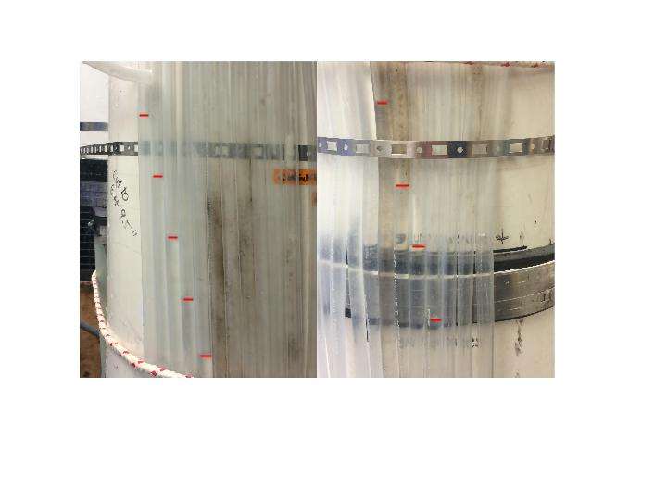
Future tasks for next semester
Challenges:
  Is backwash successful?
    Fluidization is not visible through closed, opaque filter column
    Manometers?
    Glass sights?
  Difficulty of fabricating manifold slots without sand entering
EStaRS Filter | Research | Fall 2016
Notes:
Mikel
After the fabrication of the filter and in addition to what was mentioned in the future works section, there are a few more things that future teams should analyze
Fluidization is necessary to clean the sand bed, because fluidization removes the collected contaminants from the filter.
Since it is so difficult to see if the sad bed is fluidized, this was an issue this semester's EStaRS filter team decided to address. Right now, plant operators backwash filters for an extended, set period of time. Knowing if the sand bed is fluidized can cut back on backwash time and ensure that filter performance is maintained over longer periods of time.
http://makeagif.com/y1ZHbF
Manometers
during backwash, if the bed is fluidized, the height difference of the water in the different manometer is equal to the sand filter layer height

Slide 18

Questions and Recommendations
Susan McGrattan
Environmental Engineering, ‘17
sjm353@cornell.edu
Victoria Zhang
Chemical Engineering, ‘19
vxz3@cornell.edu
Liza Johnson
Environmental Engineering, ‘17
eaj68@cornell.edu
Mikel Aurteneche
Civil Engineering, ‘18
ma962@cornell.edu
EStaRS Filter | Research | Fall 2016

Slide 19
Appendix
Slides
EStaRS Filter | Research | Fall 2016
Notes:
From this point on, add any slides with figures that will help support your thesis. You might pull these figures from your Final Report.

Slide 20
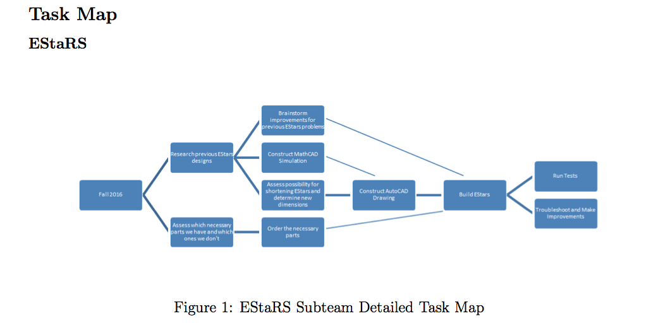
Task Map
EStaRS Filter | Research | Fall 2016

Slide 21
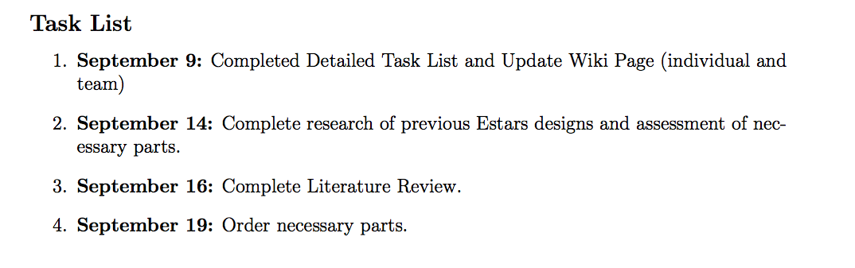
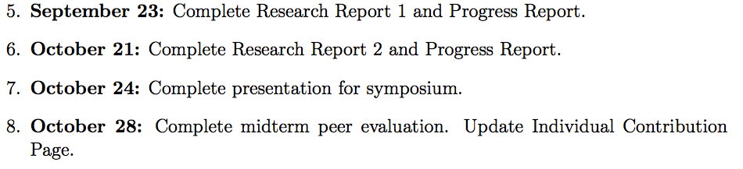
General Timeline
EStaRS Filter | Research | Fall 2016

Slide 22
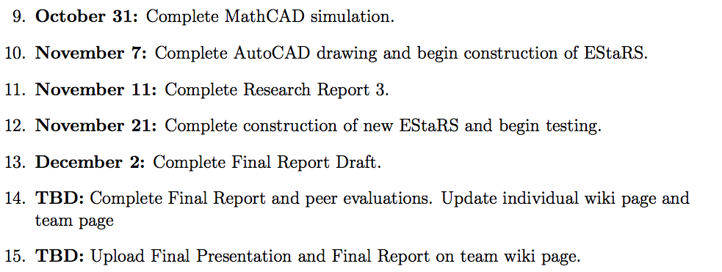
General Timeline
EStaRS Filter | Research | Fall 2016

