Slide 1

Turbulent Flocculator
Felice Chan, Greta Schneider-Herr, Amanda Rodriguez and Brooke Pian

Slide 2

Introduction
Turbulent flow in full-scale flocculators
Current research limited to laminar flow
Notes:
greta

Slide 3
Goals
Model full-scale turbulent system with changing energy dissipation rates
Ability to change the dissipation rates for full customization and testing
Notes:
greta

Slide 4
Initial Design
Three energy dissipation rates
100m length
Extrusion Company that can extrude any size of piping to any specification
Notes:
greta

Slide 5
Refined Goals
Design a new apparatus to test turbulent flow flocculation at a lab scale.
  Raw water turbidity and flow control
  Mechanism for creating turbulence
  FReTA to measure residual turbidity
Notes:
greta

Slide 6
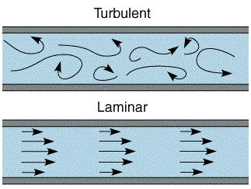
Background Information
Turbulent Flow vs. Laminar Flow
Reynolds Number: dimensionless number that characterizes flow
  Laminar: Re < 2300
  Transition: 2300 < Re < 4000
  Turbulent Re > 4000
Notes:
greta

Slide 7
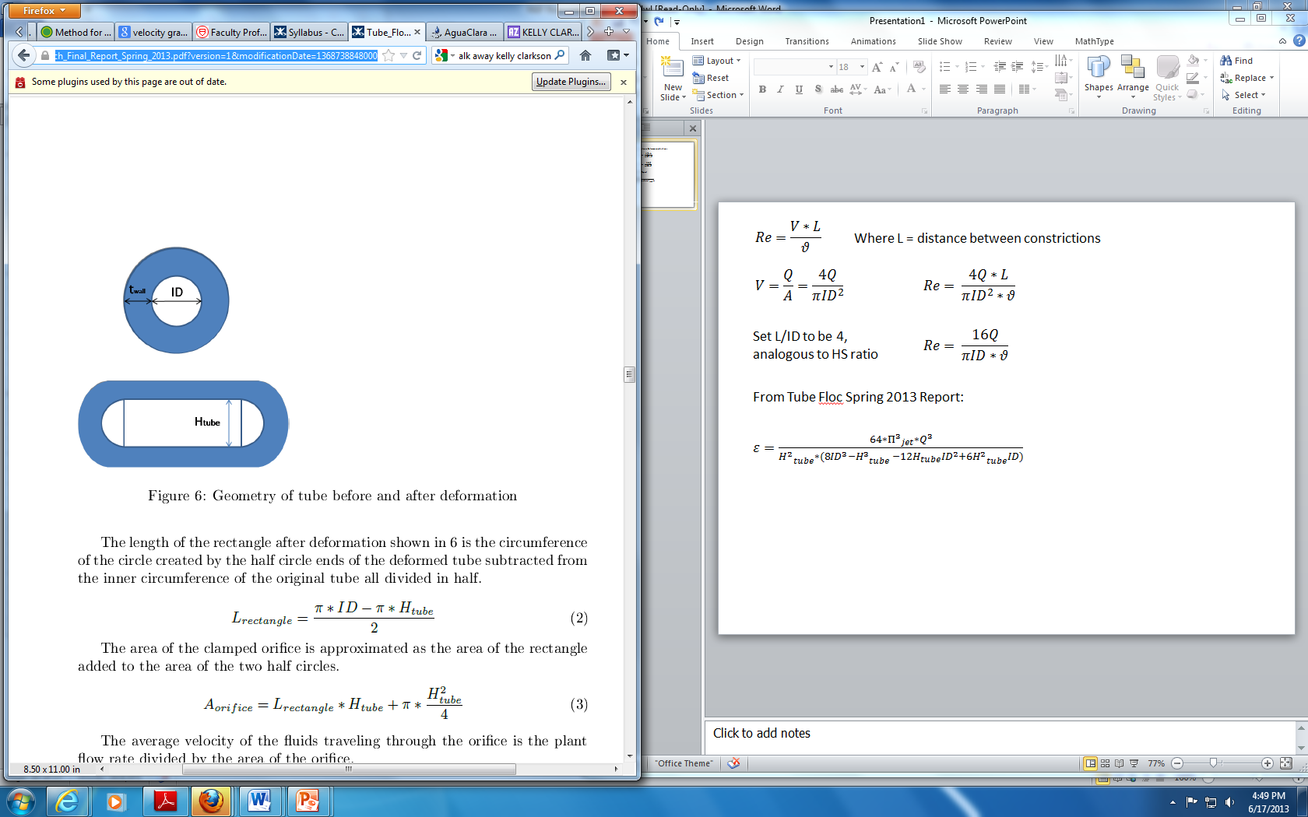
Equations
Using an energy dissipation rate of 30 mW/kg...
Height of Constricted Tube
Plant Flow Rate
Inner Diameter of Tube
Notes:
amanda
Area of constricted tube is 60% of the area of the original tube.

Slide 8
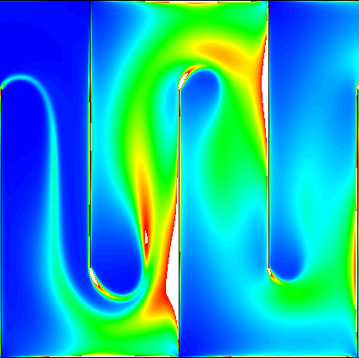

H/S Ratio
Mimic flow contraction
After the bend, a distance of 6s is required for full expansion
H/S Ratio is related to this distance.
H
S
60%
40%
Notes:
Amanda

Slide 9
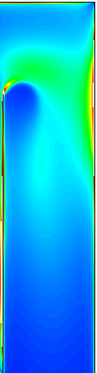

Why H/S = 5
Flocculator Efficiency
This space with very low energy dissipation rate doesn’t contribute much
H/S = 4
H/S = 10
Notes:
Amanda

Slide 10
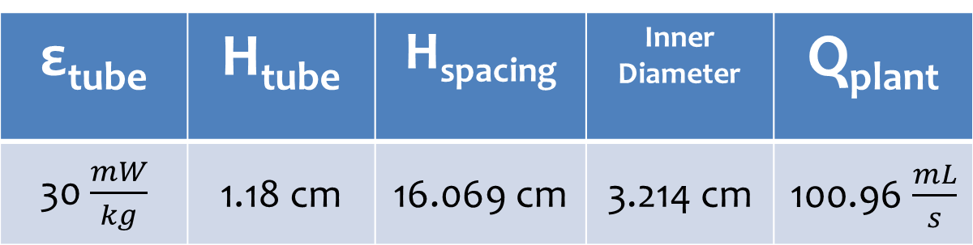
Calculations
Equations modified from a square flocculator channel
ε_{tube} | H_{tube} | H_{spacing} | Inner Diameter | Q_{plant}
30 $\frac{mW}{kg}$ | 1.18 cm | 16.069 cm | 3.214 cm | 100.96 $\frac{mL}{s}$
Notes:
brooke

Slide 11
Collision Potential
Different levels of influent turbidity and a range of collision potentials for the whole flocculator
Notes:
brooke

Slide 12
Equations
Number of Constrictions
Collision Potential
Per Space
Length of Flocculator
Notes:
Brooke

Slide 13
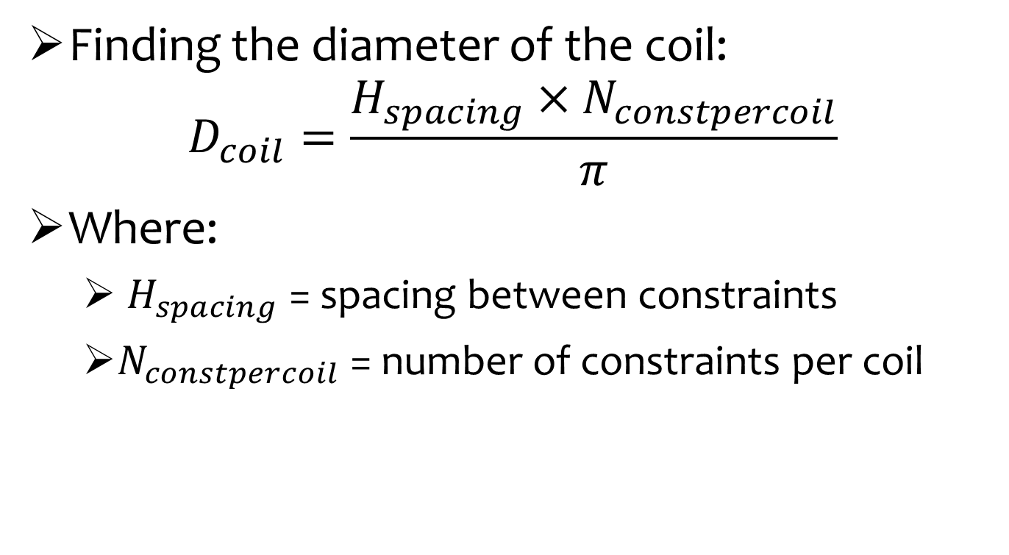
Equations
Finding the diameter of the coil:
$$D_{coil}=\frac{H_{spacing}×N_{constpercoil}}{π}$$
Where:
  $H_{spacing}$ = spacing between constraints
  $N_{constpercoil}$ = number of constraints per coil
Notes:
brooke

Slide 14
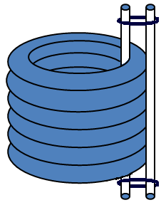
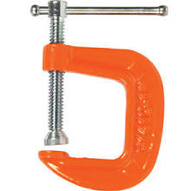
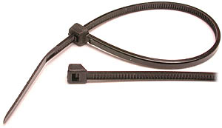
Constriction Types
Notes:
amanda

Slide 15
Flocculator Dimensions
Parameter | Ψ = 75m^{2/3} | Ψ = 100m^{2/3}
Number of Constrictions | 263 | 351
Length of Flocculator | 42.34 m | 56.51 m
Residence Time | 5.7 min | 7.6 min
Number Constrictions per Coil = 12 Diameter of Coil = 0.614 m
Number of Coils | 22 | 29.25
Unconstricted Height | 0.85 m | 1.13 m
Constricted Height | 1.10 m | 1.47 m
Change in Height | 0.25 m | 0.34 m
Notes:
felice

Slide 16
Building the Flocculator
ID tube: 3.214 cm
H_{tube}: 1.18 cm
Change of Height of system: 0.34 m
Notes:
Felice

Slide 17
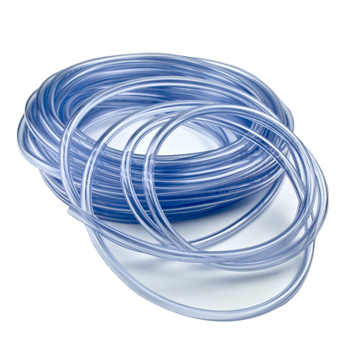
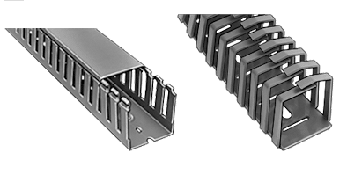
Materials
Ordered clear PVC tubing from US Plastics
  1.25 in diameter, 1/8 inch wall tubing
  60 m of tubing
Called McMaster Carr and they are sending free samples of wiring ducts
Notes:
Felice

Slide 18
Future Work
Finalize support structure design
Build the apparatus!
  Figure out plumbing in lab
  How to divert effluent flow without floc breakup
Imaging method to measure floc size
Ultimately…to better understand turbulent flocculation and improve AguaClara technologies!
Notes:
Felice

Slide 19

Questions?

