Slide 1

Turbulent Flocculator
Felice Chan, Greta Schneider-Herr, Amanda Rodriguez and Brooke Pian

Slide 2
Brief Review
Goal: Design a new apparatus to test turbulent flow flocculation at a lab scale.
  Raw water turbidity and flow control
  Mechanism for creating turbulence
  FReTA to measure residual turbidity

Slide 3
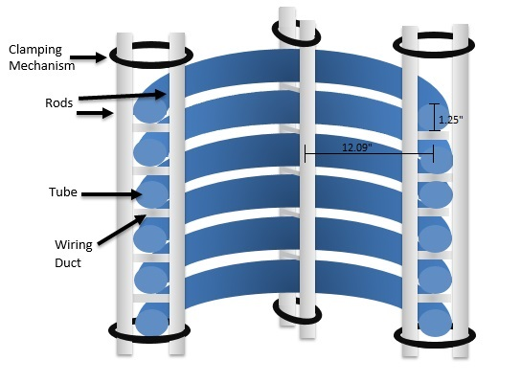
Brief Review
Energy Dissipation Rate: 30 mW/Kg
Inner Diameter: 1.25 inches
Collision Potential: 100m^{2/3}
Length of Flocculator: 56.35 m
Residence Time: 7.546 minutes
Diameter of coil: 0.614 m
Number of Coils: 29.26
Unconstricted Height: 1.125 m
Constricted Height: 1.464 m

Slide 4
Additional Materials to Consider
The team still has a number of materials to purchase before the flocculator can be built
  Thin walled rigid tubing to connect pieces of flocculator
  Rigid Tubing for Clamping
  Hose Clamps to clamp the rods together
  Wiring Ducts to hold coils
  Solenoid Valve for flow

Slide 5
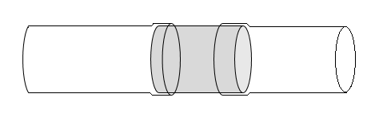
Thin Walled Rigid Tubing
Tubing for flocculator came in four separate pieces
To connect them the flexible tubing will be stretched over a rigid tube with the same inner diameter.
Flexible Tubing
Rigid Tube to connect

Slide 6
Rigid Tubing for Clamping
To create the constrictions rigid tubing of about the same inner diameter as the flocculator (1.25 inches) must be purchased
Name | ID (in) | Thickness (in) | Price of 6 ft
Ultra-Corrosion-Resistant Architectural Aluminum | 1.37 | 0.065 | 23.38 (**sold in lengths of 8 feet)
High-Pressure Welded Steel Tubing | 1.12 | 0.065 | 22.98
Multipurpose Aluminum Tubing | 0.834 | 0.083 | 37.53

Slide 7
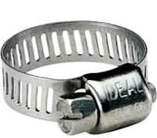
Hose Clamps
Hose clamps may be used to hold the rods for clamping together.
Name | Clamp ID range (in) | Package Quantity | Price ($)
Worm-Drive Hose and Tube Clamps | 3.31-4.25 | 10 | 11.05
Worm-Drive Hose and Tube Clamps with Nonslip screw | 3-4 | 10 | 10.43

Slide 8
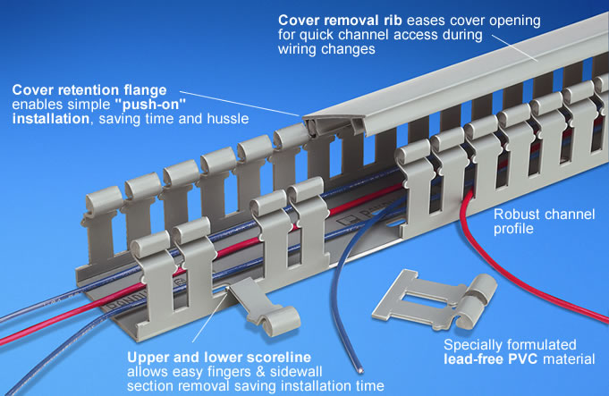
Wiring Ducts
Determined that snapping out two “fingers” from the wiring duct fits the tubing.
PVC Wire Duct, Length of 6”6’, $38.33 per wiring duct

Slide 9
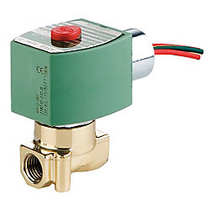

Solenoid Valve
Calculated orifice diameter for solenoid valve to be 3.456 mm
Need to measure flow from solenoid valve from the sink in lab to determine whether we actually need a new solenoid valve.

Slide 10
Other things to Consider…
As water exits the flocculator, we need to figure out how to (and how much to) divert flow to tube settlers, imaging, and the sink
Because the flocculator will require so much water…recycle?
Notes:
That would require building the rest of the plant…

Slide 11
Future Work
Measure force required to compress tube to determine which rigid tube can be used for clamping.
Use structural analysis to determine which tube to purchase.
Find thin walled tubing for connecting parts of flocculator
Measure flow from solenoid valve to determine whether another one needs to be purchased

Slide 12
Future Work
Order materials and build the flocculator
Figure out how to image flocs as they leave the flocculator to determine size
Consider building the rest of the AguaClara Plant…

Slide 13

Questions?

