Slide 1
Turbulent Tube Flocculator
Felice Chan, Ana Oliveira,
Stephen Jacobs, Jon Christensen
Notes:
Stephen

Slide 2
Project Goals
Current Flocculator
Developments
Problems
Future Work

Slide 3
Project Goals
Design, build, and test a lab scale turbulent tube flocculator
Utilize SWaT to settle flocs and measure effluent turbidity
Better understand flocculation processes
Notes:
Felice

Slide 4
Anticipated Experiments
Floc break up theory
Notes:
Jon

Slide 5
Project Goals
Current Flocculator
Developments
Problems
Future Work

Slide 6
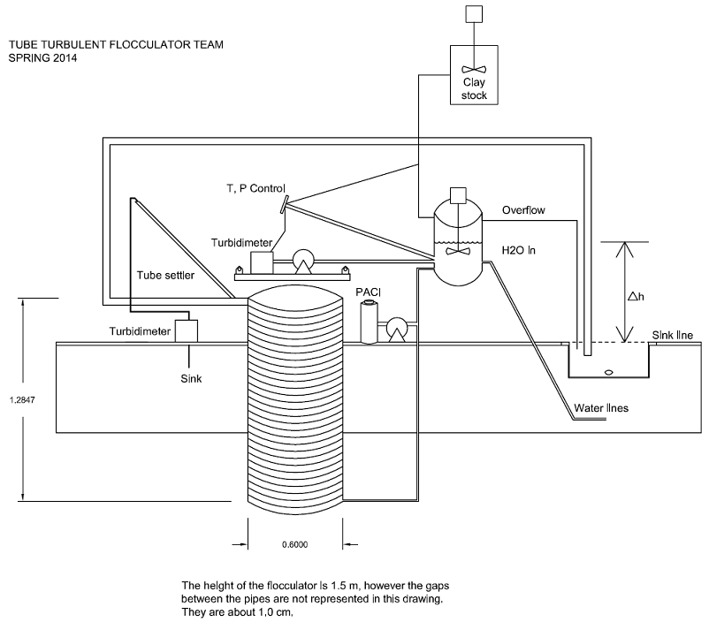
Current Set up
Notes:
Ana

Slide 7
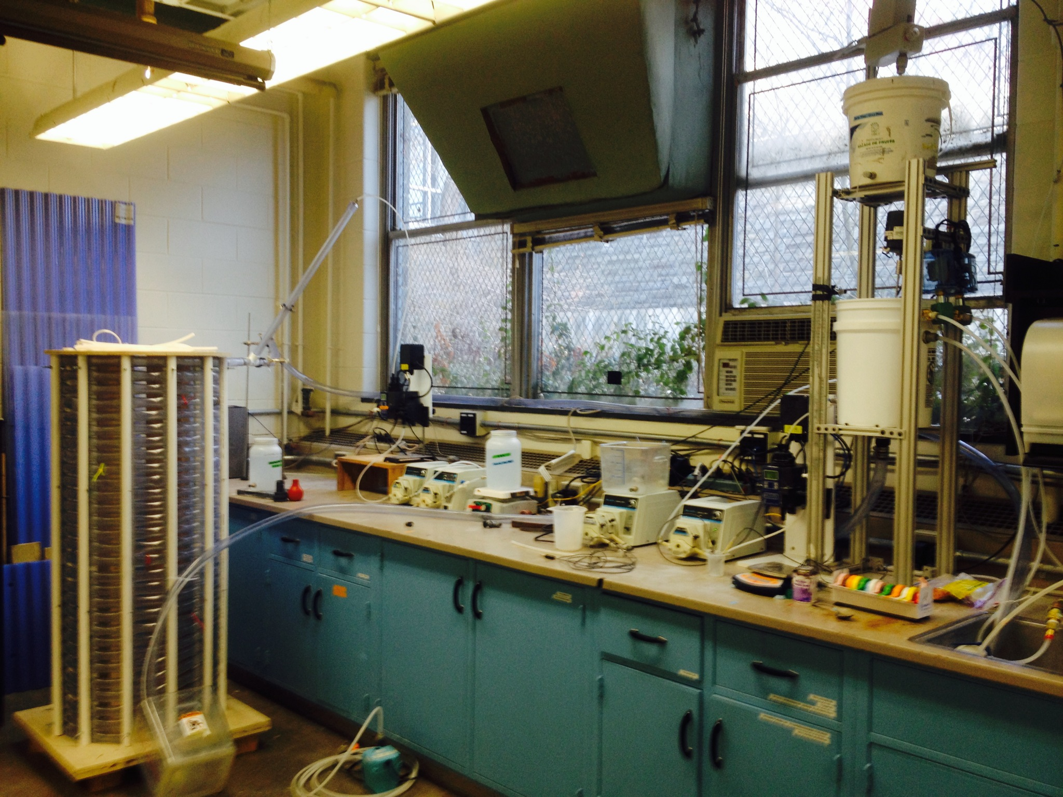
Current Flocculator
Notes:
Ana

Slide 8
Project Goals
Current Flocculator
Developments
Problems
Future Work
Notes:
Stephen

Slide 9
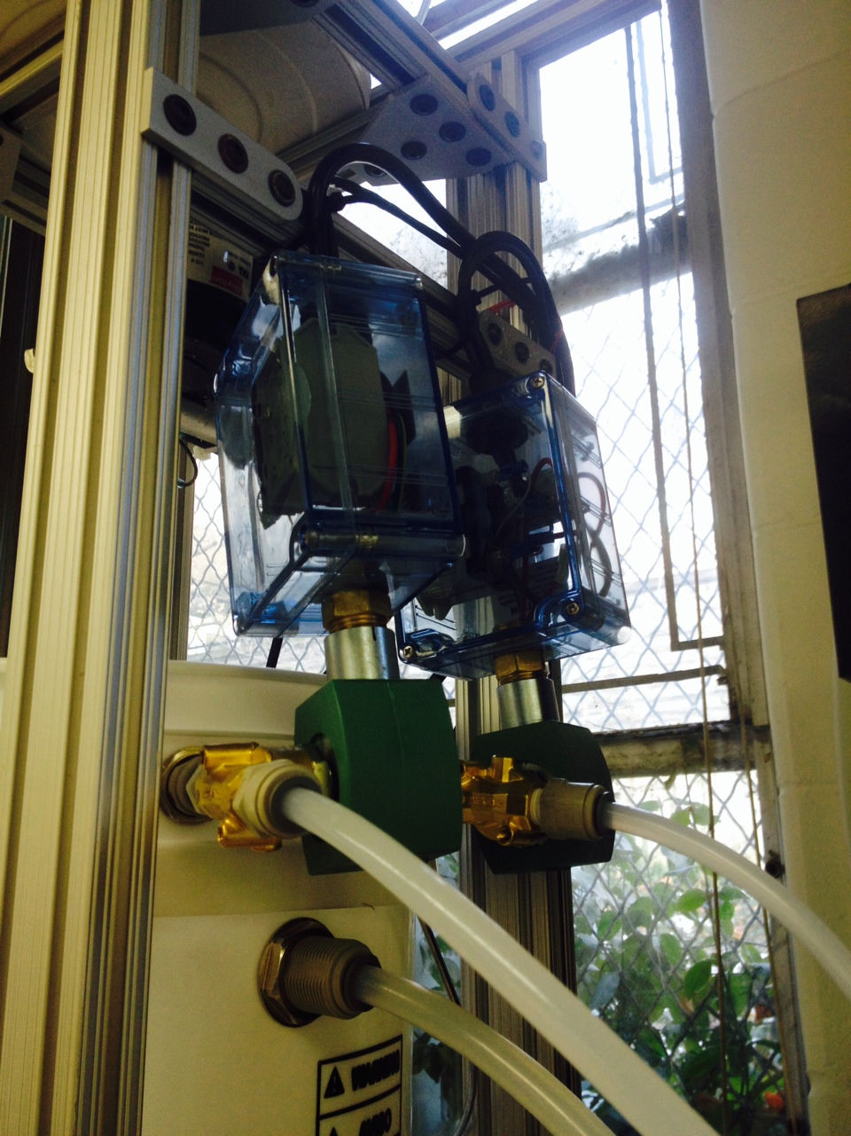
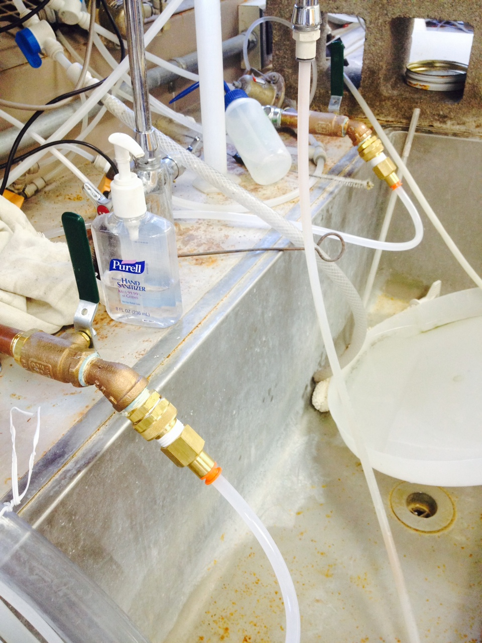
Hot/Cold Water Lines
Notes:
Stephen

Slide 10
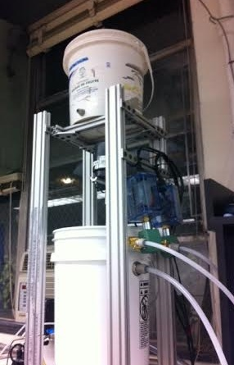
Head Tank Tower
Clay mix tank/pinch valve
Head tank
Hot/cold solenoid valves
Influent turbidity loop
Sensors:
  Temperature
  Pressure
Notes:
Stephen

Slide 11
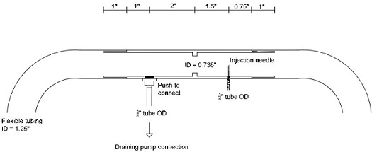
Rapid Mix Module
Notes:
Felice

Slide 12
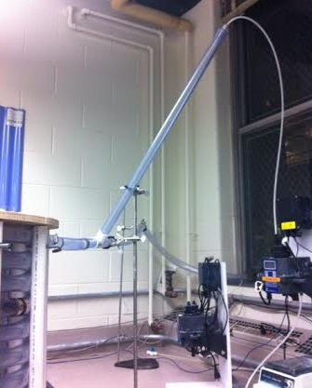
Settled Water Turbidity (SWaT)
Notes:
Felice

Slide 13
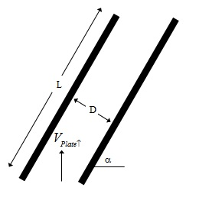
SWaT Dimensions
Parameter | Value
Length | 86 cm
Inner Diameter | 1.049 in
Angle | 60°
Capture Velocity | 0.12 mm/s
Flow rate | 1.002 mL/s
Notes:
Felice

Slide 14
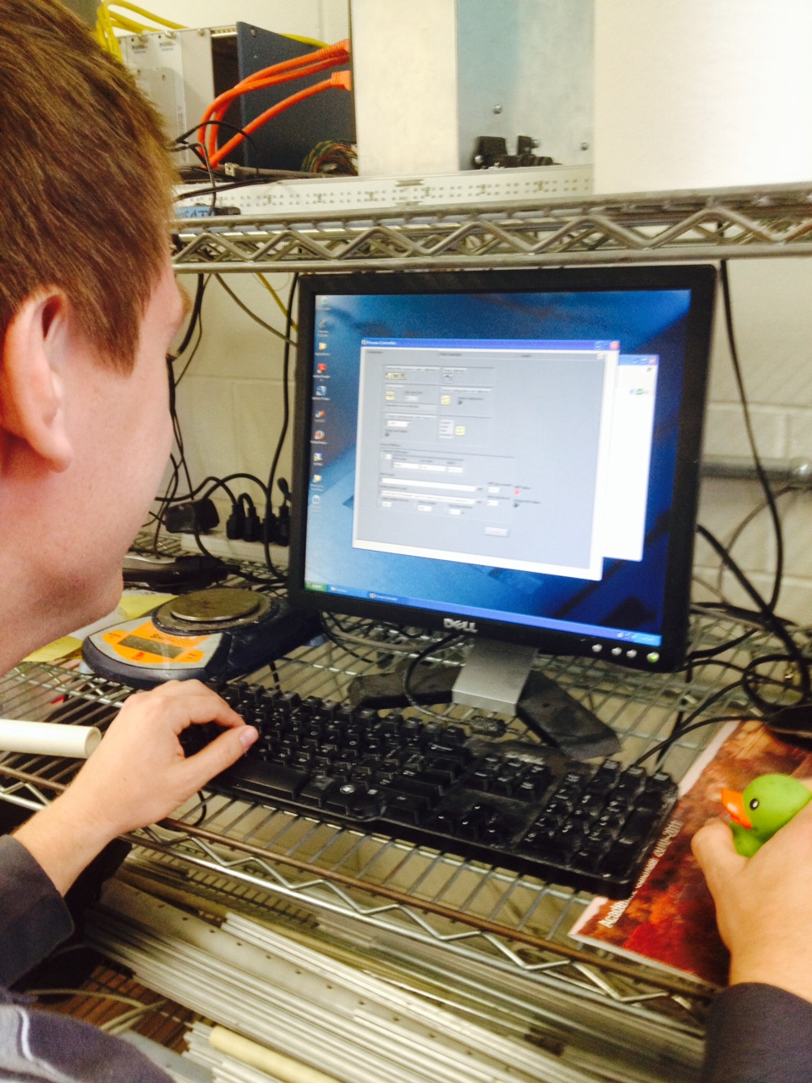
Process Controller
Preliminary program finished
Measures:
  Pressure of head tank
  Temperature
  Turbidity
Controls pinch valve, solenoid valves, pumps
Notes:
Jon

Slide 15
Project Goals
Current Flocculator
Developments
Problems
Future Work

Slide 16
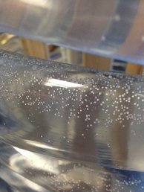
Current Problems
Problem:
Air bubbles/gaps
Causes:
Local high/low points
Shallow grade
Notes:
Stephen

Slide 17
Our Solution
Empty flocculator
Loosen the outer compressors
Fill up flocculator
Tighten the outer compressors
Problem: time consuming, not completely effective, does not remove small bubbles
Notes:
Stephen

Slide 18
Any Suggestions? Discuss.

Slide 19
Project Goals
Current Flocculator
Developments
Problems
Future Work

Slide 20
Future Work: Fabrication
Design structure to keep angle of SWaT constant
Finish making the rapid mix unit with coagulant needle insertion
Notes:
Ana

Slide 21
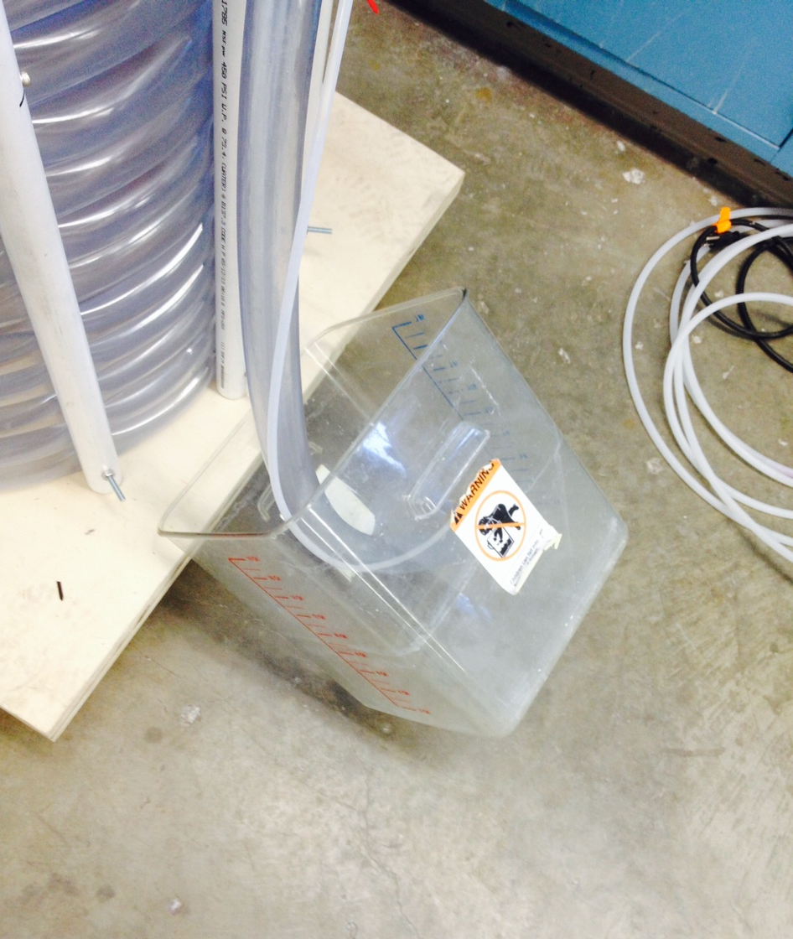
Future Work (cont.)
Problem:
Emptying the flocculator
Solution:
Fabricate outlet from rapid mix unit to a pump to the sink
Notes:
Ana

Slide 22
Future Work (cont.)
Finish process controller programming
Bug test process controller
Run experiments
Design the fluidized bed flocculator
Notes:
Jon

Slide 23

Questions

