Slide 1
Turbulent Tube Flocculator
Felice Chan, Ana Oliveira,
Stephen Jacobs, Jon Christensen

Slide 2
Project Goals
Design, build, and test a lab scale turbulent tube flocculator
Parameters:
  Raw water turbidity
  Coagulant
  Flow rate
  Effluent turbidity

Slide 3
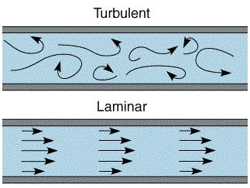
Turbulent vs. Laminar Flow

Slide 4
Design from Summer 2013
Parameter | Dimension
Inner Diameter of Tube | 1.25 in
Diameter | 0.614 m
Number of Coils | 30
Constricted Height | 1.464m
Residence Time | 7.546 min
Energy Dissipation Rate | 30 mW/kg
Collision Potential | 100m^2/3

Slide 5
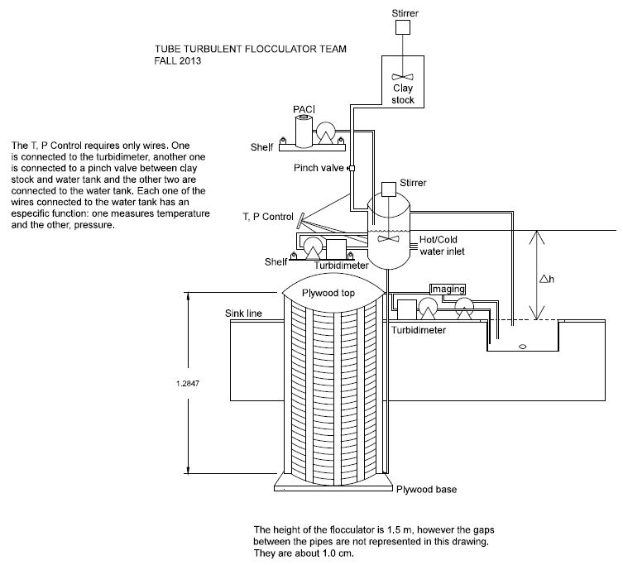
Flocculator Design

Slide 6
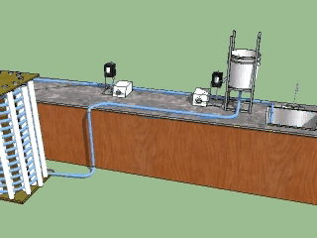
3D Model

Slide 7
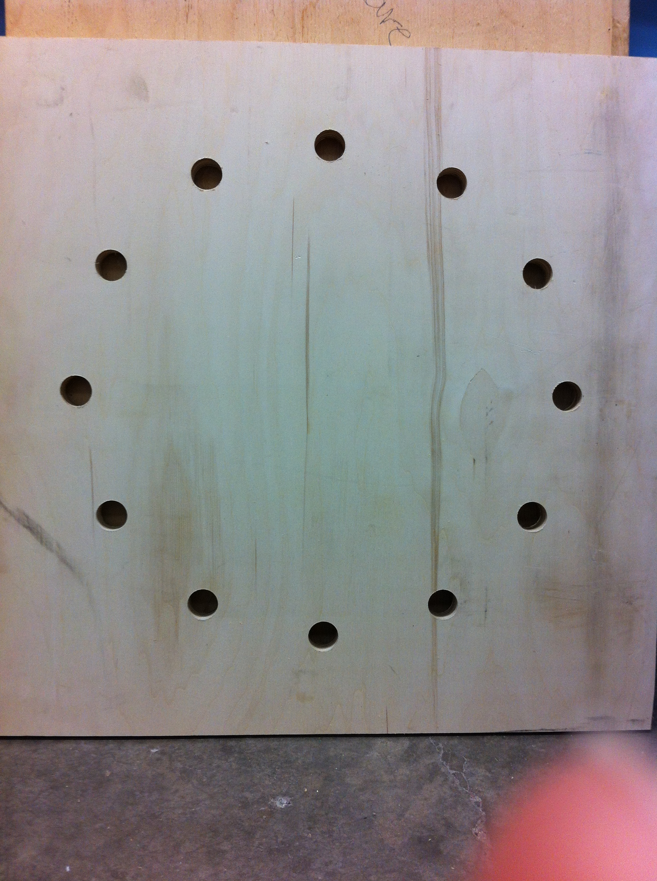
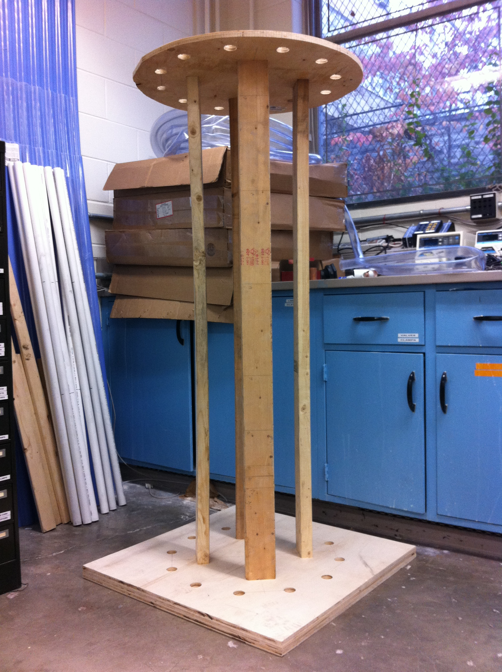
Base and Structure
Notes:
Problem: Supporting Flocculator (tipping)
Solution: 2x4s
Bottom: 30’’x30’’x1’’
Top: Circular, 0.50’’ thick

Slide 8
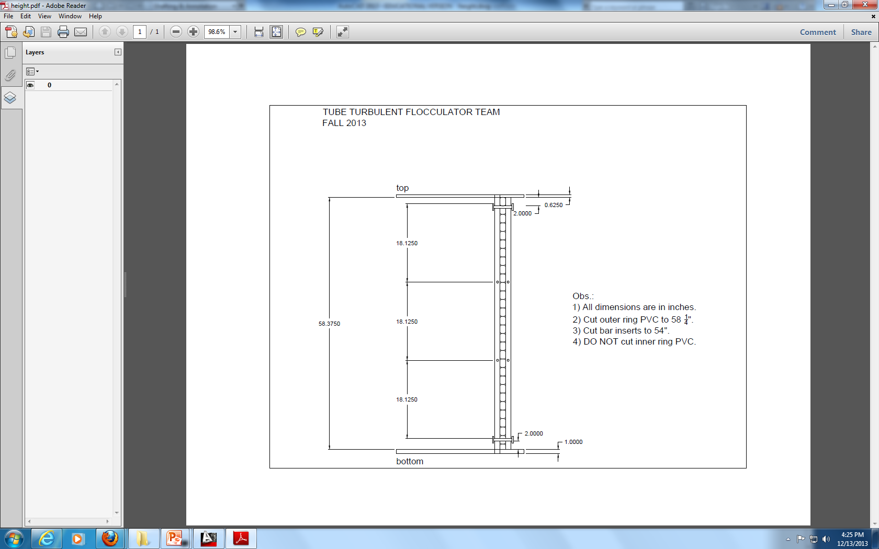
Drilling PVC/Metal

Slide 9
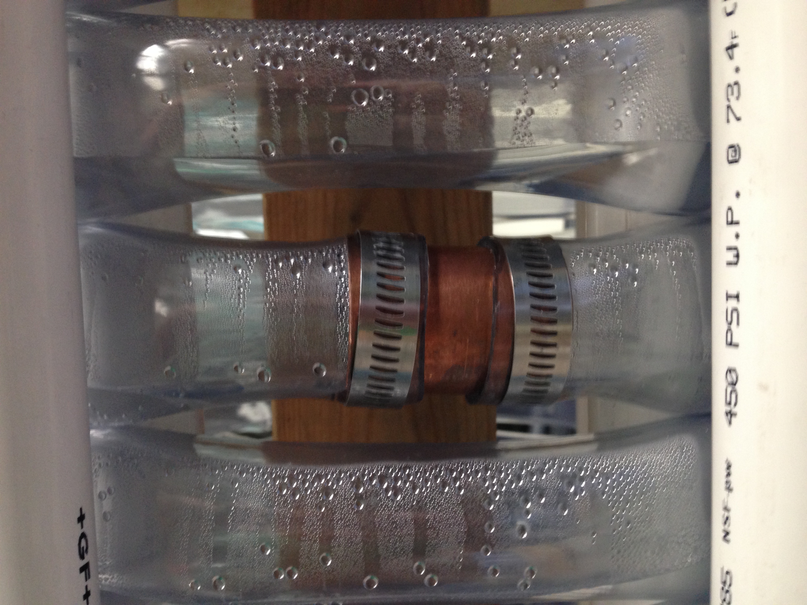
Flexible Tubing
Wrapped around the inner ring of PVC
Thin copper tubing used for connections and secured with hose clamps

Slide 10
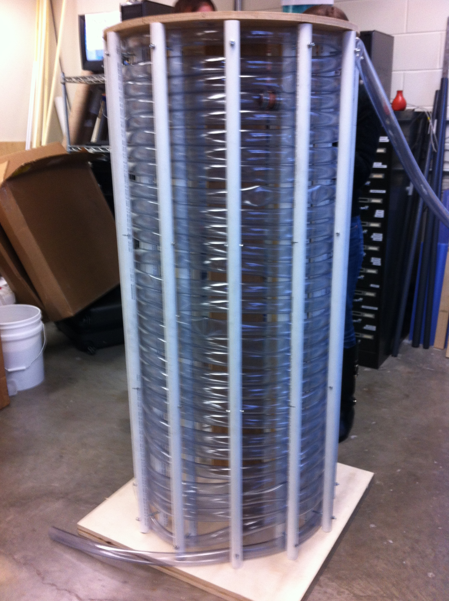
Assembling the Flocculator
Bolt outer ring of PVC
Adjust constriction
Space out and correct bends in flexible tubing

Slide 11
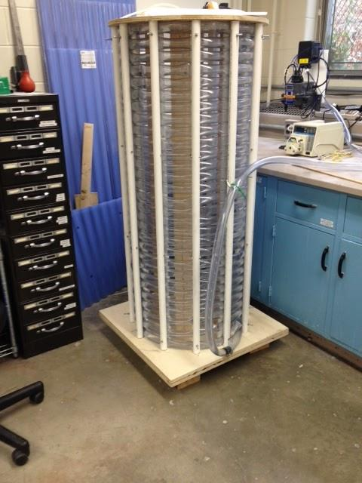
Current Flocculator
Apparatus built
Initial tests performed
  Air bubbles
  Leaking

Slide 12
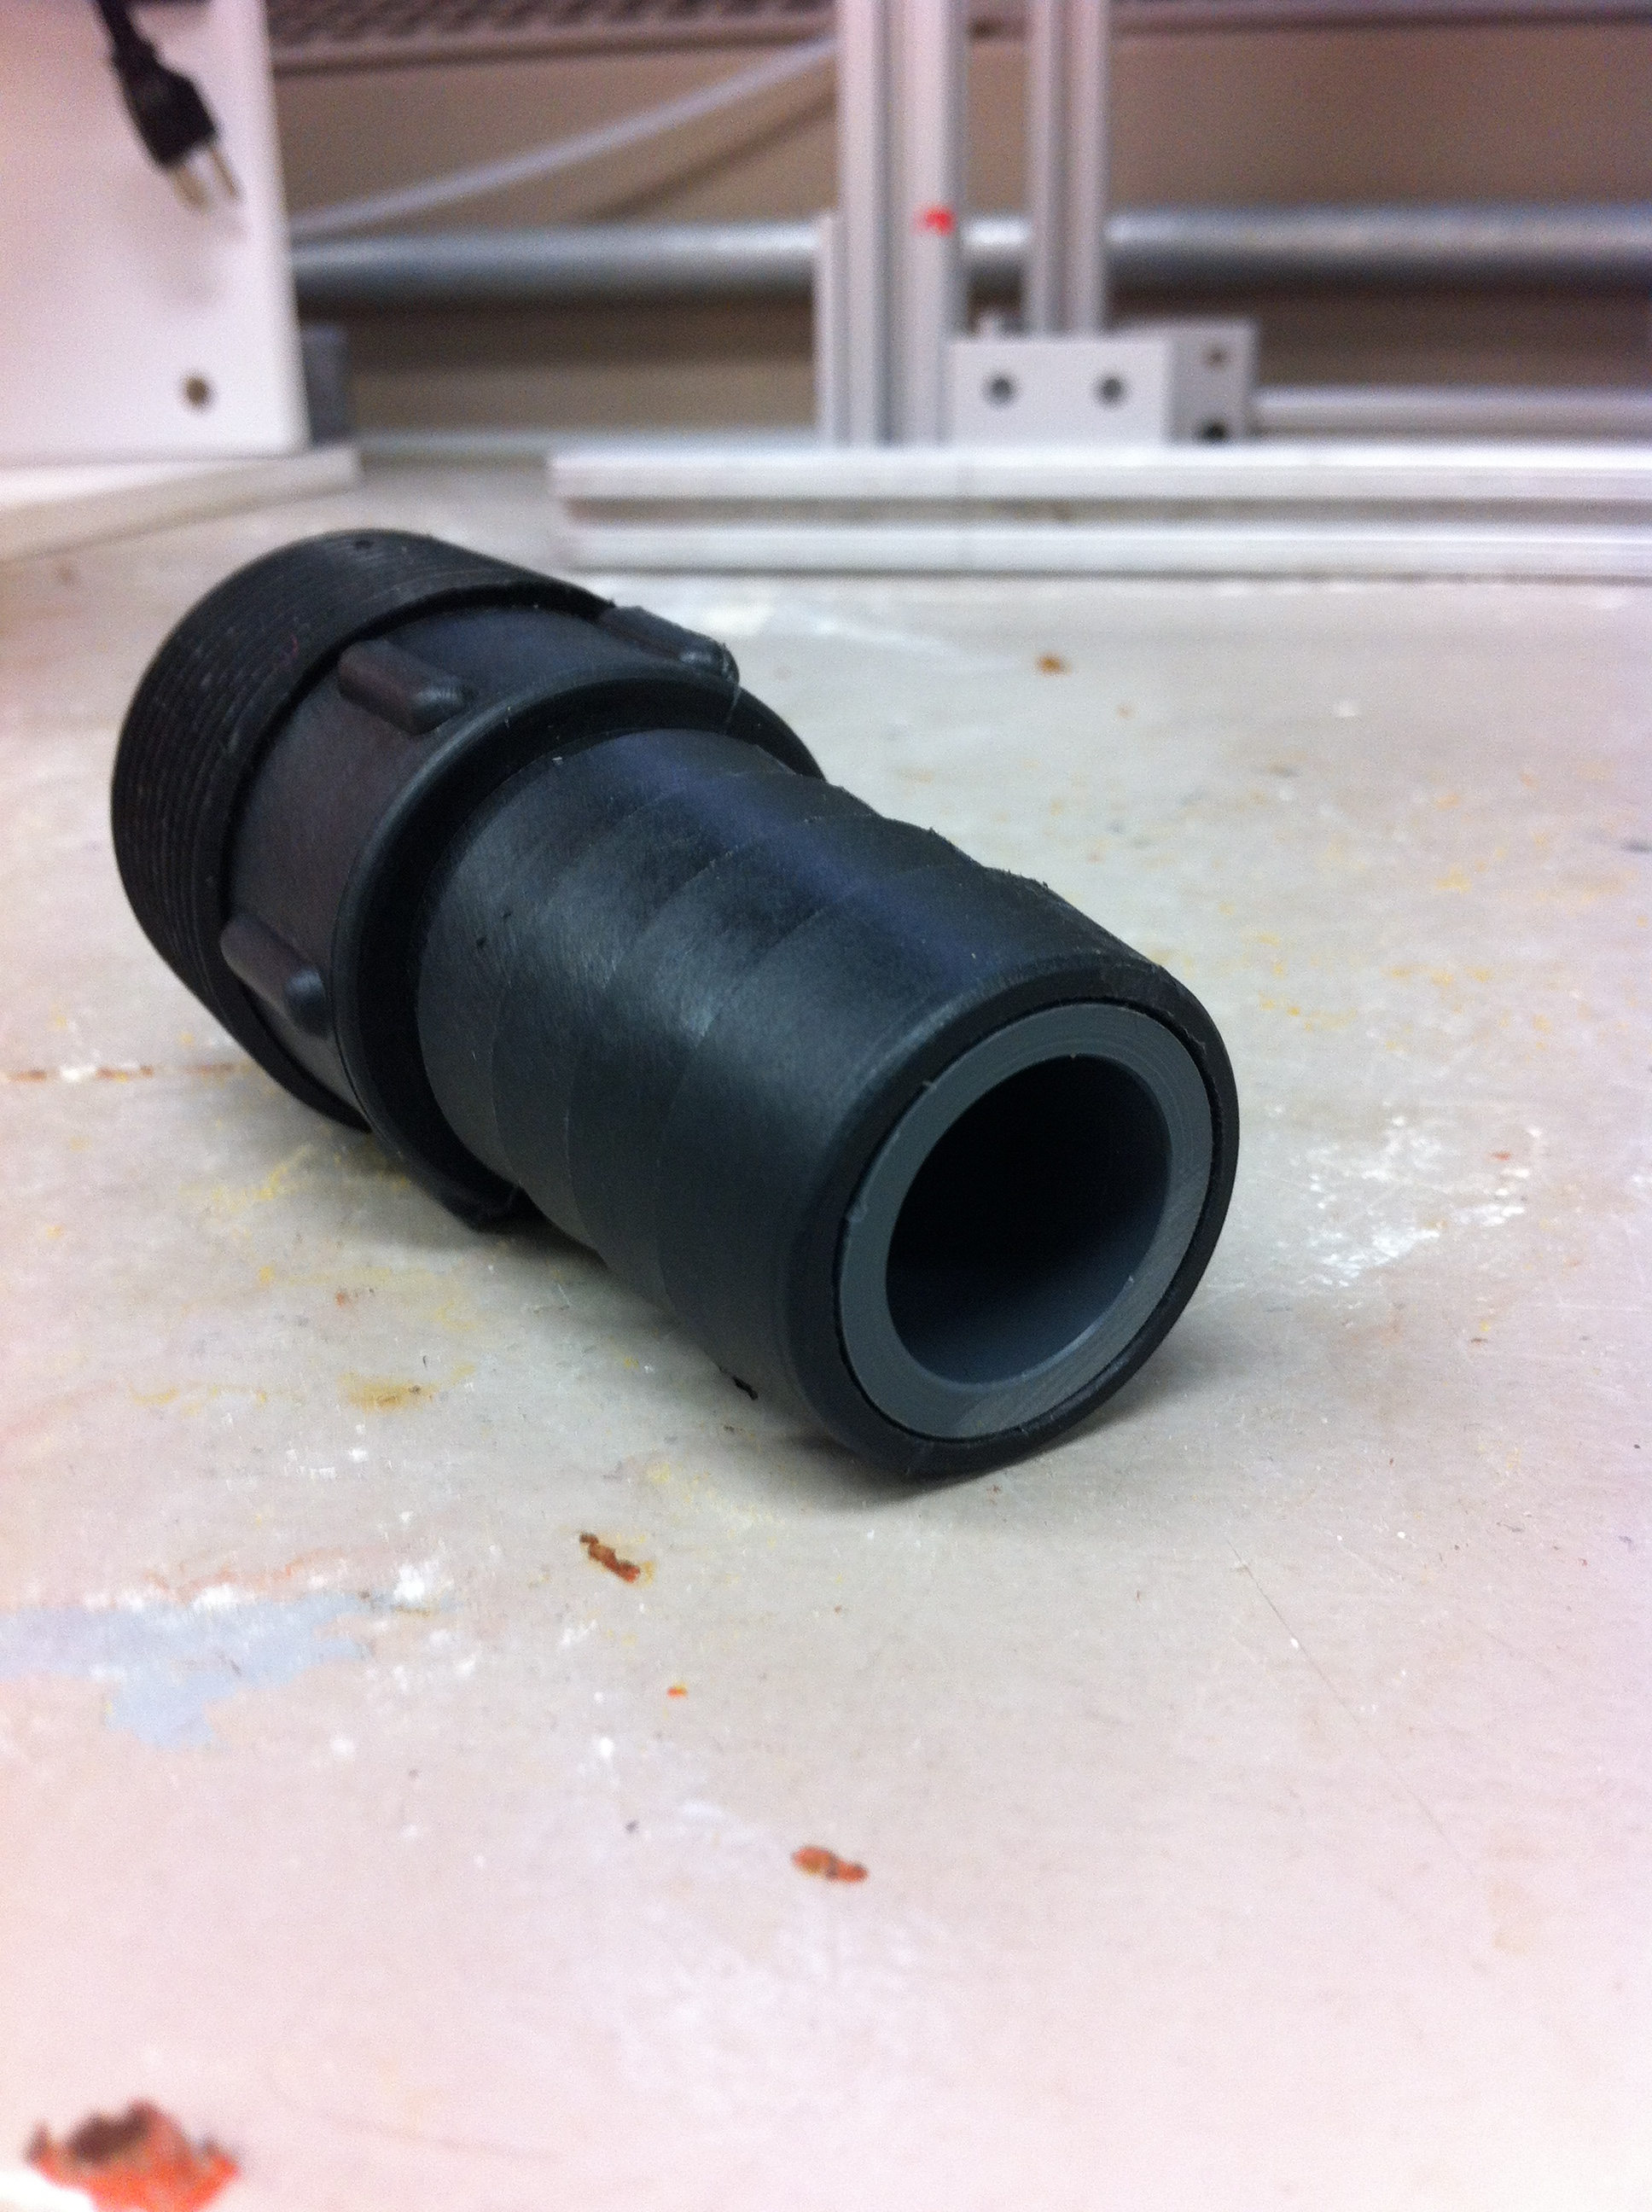
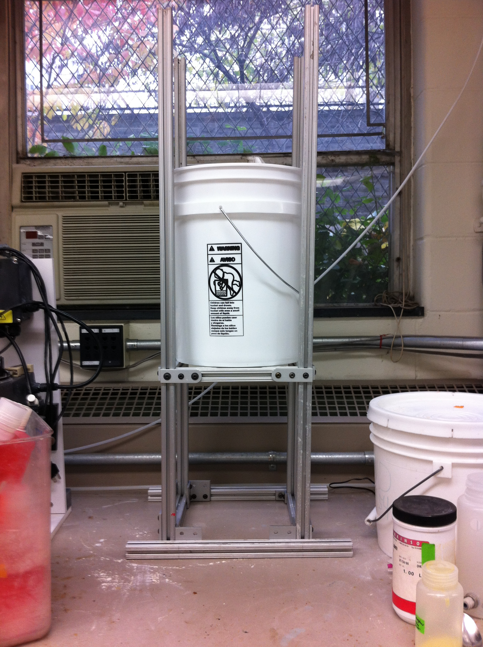
Additional Assembly
Head tank
Coagulant stock
Rapid mix unit
Tube settler
Downstream data collection

Slide 13
Current Problems
Kinks/bends in tubing
Emptying flocculator
  Potential Solution: tank at end with centrifugal pump to sink
Air bubbles
  Potential Solution: do not constrict tubes until flocculator is full with water

Slide 14
Future Work
Process Controller
  Flow Rate
  Coagulant Dose
  Turbidimeter data
  Calibrate turbidimeters
Run experiments!

Slide 15
Future Experiments
Control temperature, pressure and influent turbidity
Measure effluent turbidity, floc size distribution, and pC*
Varying coagulant dose and constrictions
Notes:
Floc Breakup Theory
Laminar vs Turbulent differences

Slide 16
Potential Conclusions
Test current flocculation models
Floc breakup theory
  Grow flocs big?
  or break them up periodically?
Notes:
Optimize floc size for pC* (what conditions remove the most colloids from solution?). A high energy dissipation rate is expected to increase collision frequency, creating larger flocs more quickly, but can also break up large flocs in the process. Ideally, the flocs would be less than the maximum (terminal) size reached in the flocculator so that they can grow by capturing other colloidal particles in the water, but not too small as to increase the residual turbidity of the water.

Slide 17


Questions?

