Slide 1
Turbulent Tube Flocculator
Felice Chan, Ana Oliveira,
Stephen Jacobs, Jon Christensen
Notes:
Stephen

Slide 2
Turbulent Tube Flocculator
Project Goals
Current Flocculator
Developments
Experiments
Future Work
Notes:
Stephen

Slide 3
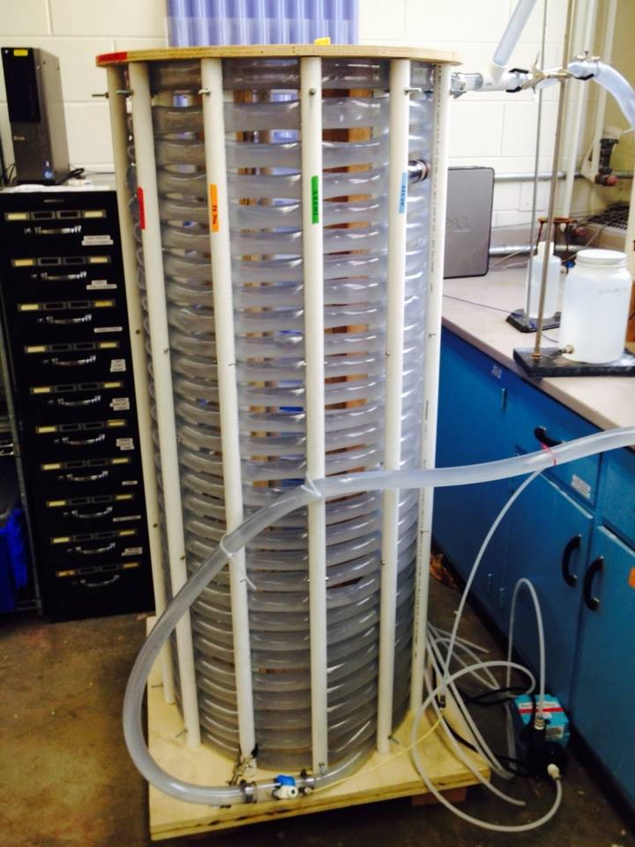
Goals
Build SWaT
Set Up Process Controller
Troubleshoot Flocculator
Collect and Analyze Data
Notes:
Stephen

Slide 4
Turbulent Tube Flocculator
Project Goals
Current Flocculator
Developments
Experiments
Future Work
Notes:
Stephen

Slide 5
Fall 2013
Notes:
Stephen

Slide 6
Turbulent Tube Flocculator
Project Goals
Current Flocculator
Developments
Experiments
Future Work
Notes:
Stephen

Slide 7
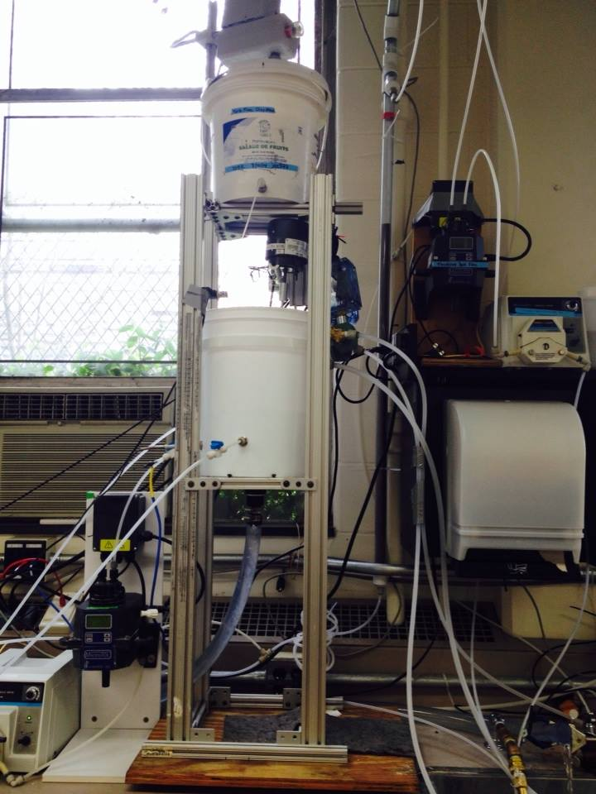
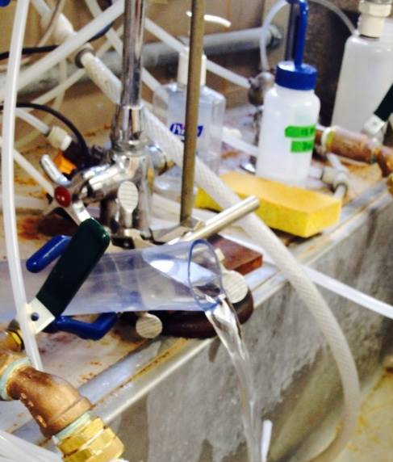
Flow Control
H = 78 cm
Q = 100 mL/s
Notes:
Stephen

Slide 8
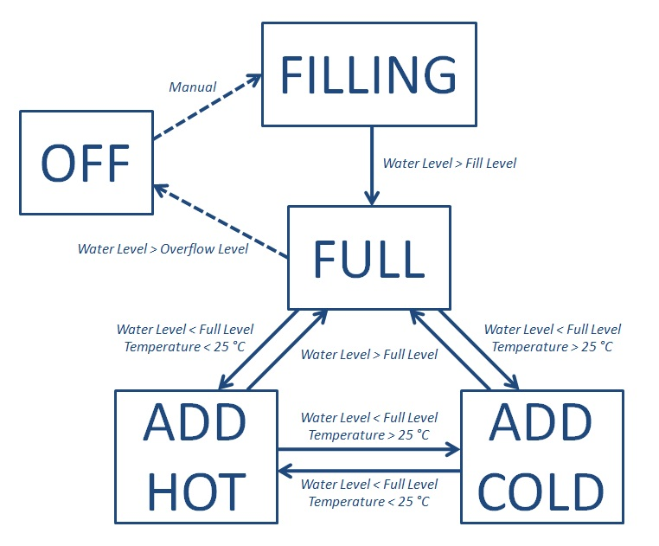
Flow Control
Notes:
Stephen

Slide 9
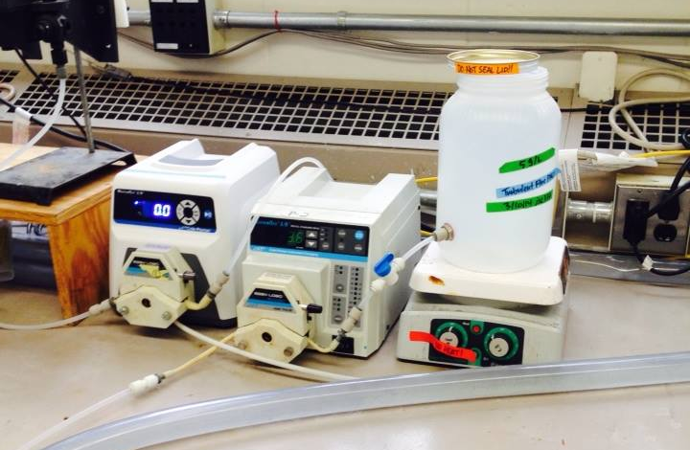
Coagulant
Notes:
Ana

Slide 10
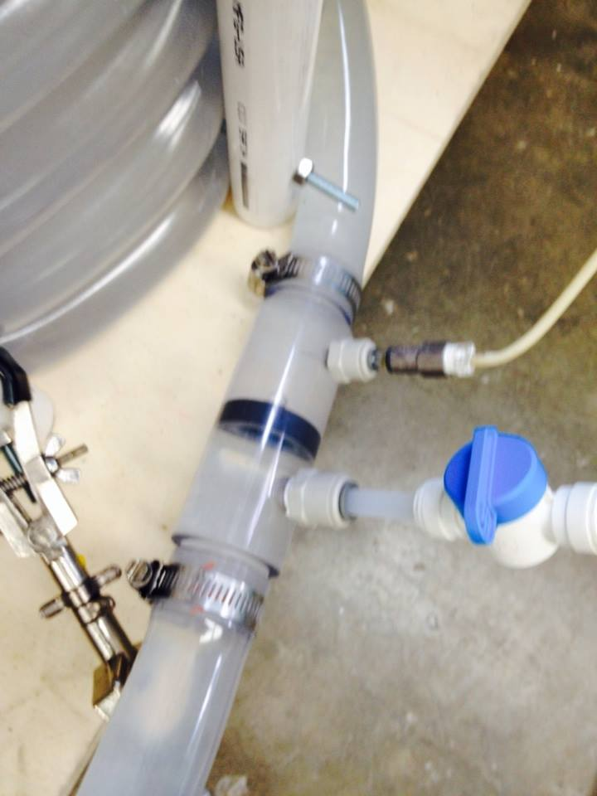
Rapid Mix and Drain
Injection Needle
Rapid Mix Orifice
Drain Pump Outlet
Notes:
Ana

Slide 11
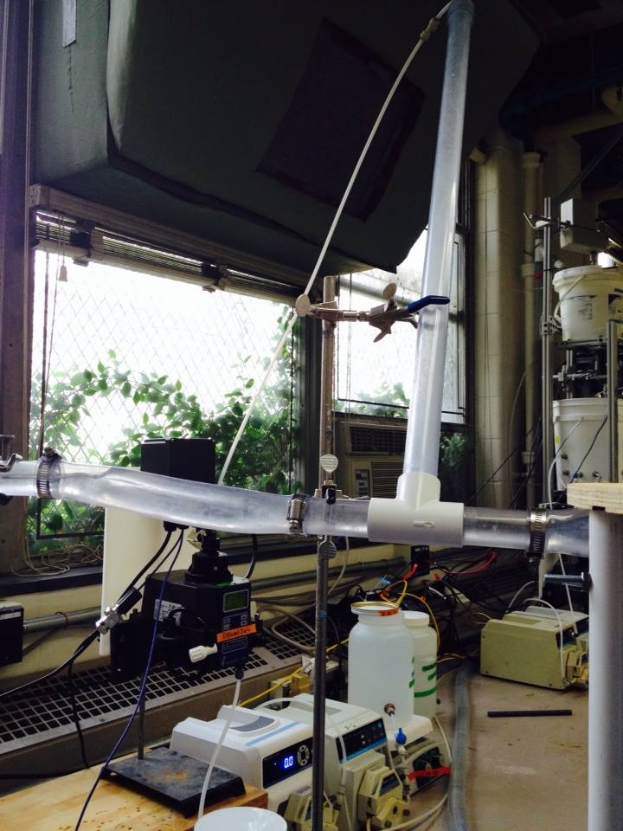
Settled Water Turbidity Unit
Tube Settler
Effluent Turbidity
Notes:
Ana

Slide 12
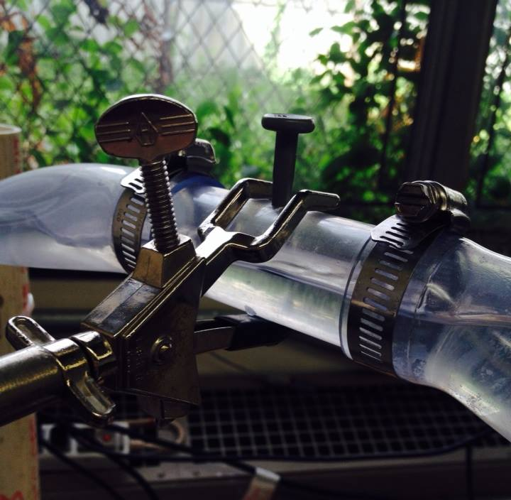
Air Release
Notes:
Ana

Slide 13
Turbulent Tube Flocculator
Project Goals
Current Flocculator
Developments
Experiments
Future Work
Notes:
Felice

Slide 14
Turbidity
Coagulant Dose = 10 mg/L
Notes:
Felice

Slide 15
pC* = -log( Eff(t+θ) / Inf(t) )
Influent Turbidity = 50 NTU
Coagulant Dose = 10 mg/L
Notes:
Felice

Slide 16
Turbulent Tube Flocculator
Project Goals
Current Flocculator
Developments
Experiments
Future Work
Notes:
Felice

Slide 17
Future Work
Setup modifications
  Raise the head tank to achieve flow with air pocket
  Pump clay with a peristaltic pump
  Replace injection needle with larger tubing
Continue to run experiments to measure pC*
Develop standard experimental procedure for consistent results
Notes:
Felice
*Future experiments will vary influent turbidity and coagulant dose.

Slide 18
Fluidized Bed Flocculator
Felice Chan, Ana Oliveira,
Stephen Jacobs, Jon Christensen
Notes:
Jon

Slide 19
Fluidized Bed Flocculator
Project Goals
Developments
Future Work
Notes:
Jon

Slide 20
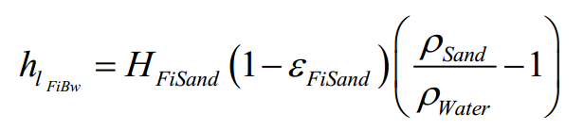
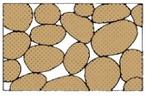
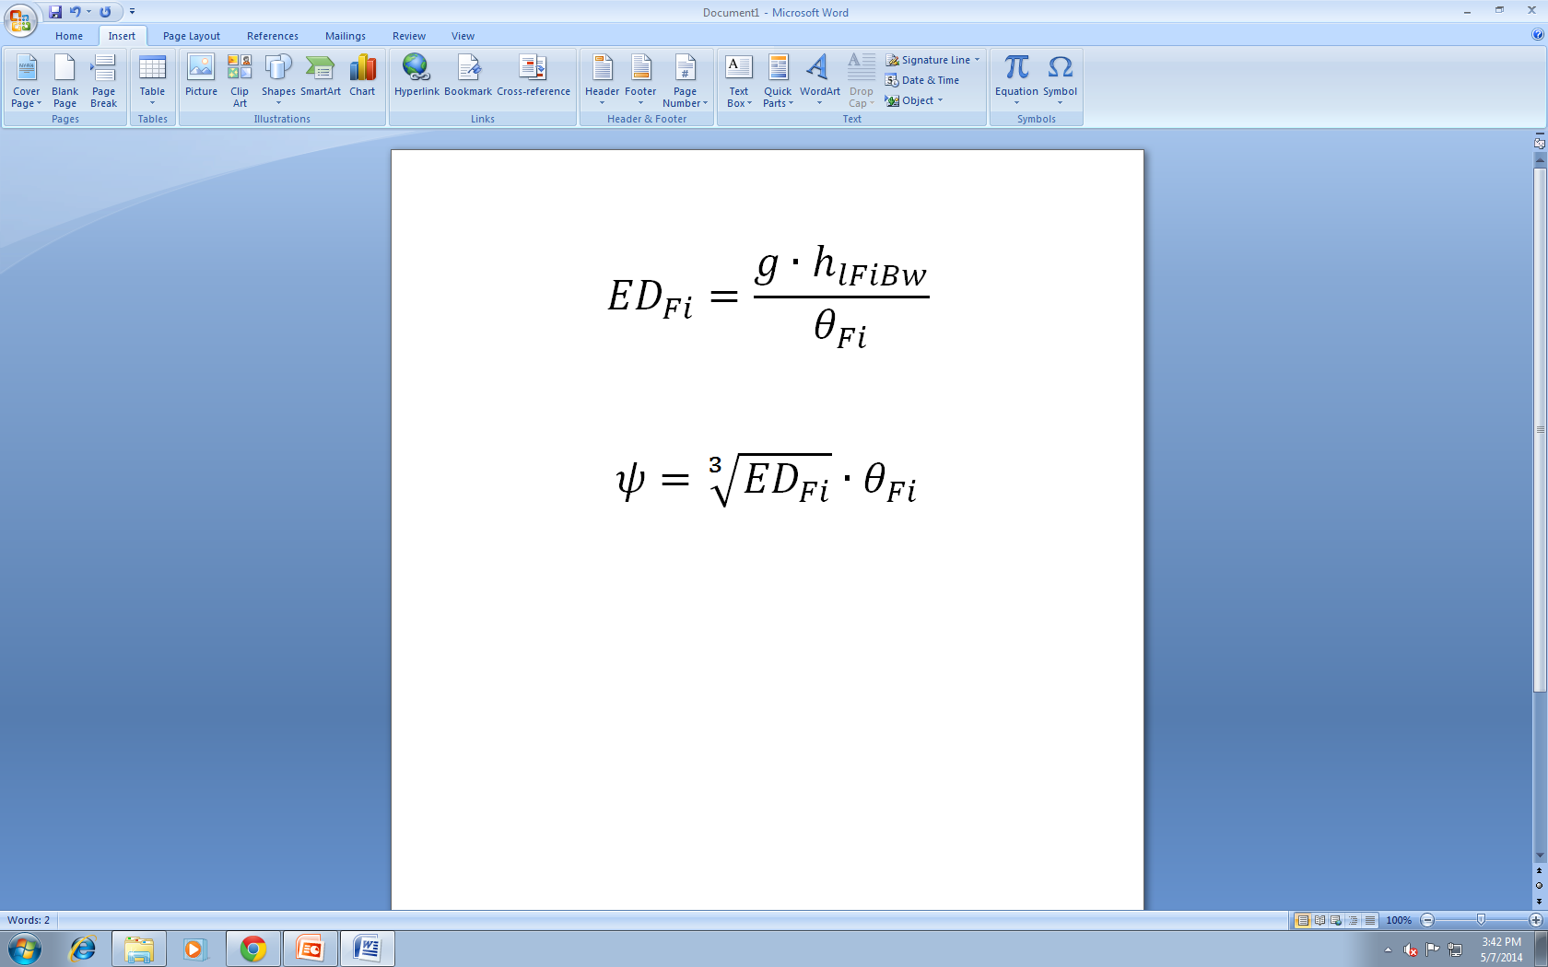
Theory
Notes:
Felice
*Future experiments will vary influent turbidity and coagulant dose.

Slide 21
Fluidized Bed Flocculator
Project Goals
Developments
Future Work
Notes:
Jon

Slide 22
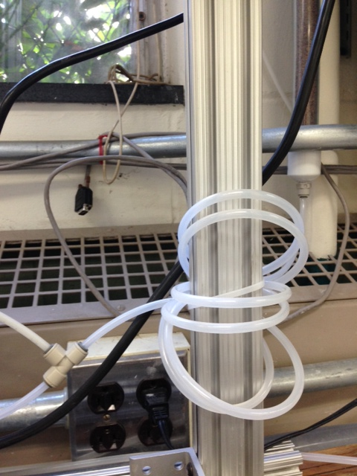
Rapid Mix
Influent
Coagulant
Clay Solution
Notes:
Jon

Slide 23
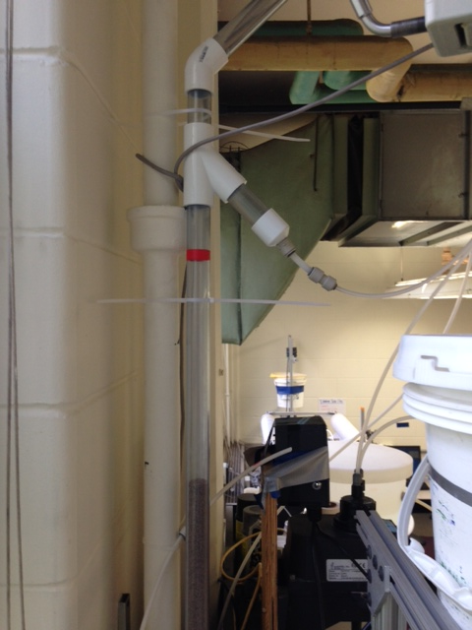
Fluidized Sand Bed
SWaT
Waste
Fluidized Height
Sand Column
Notes:
Jon

Slide 24
Fluidized Bed Flocculator
Project Goals
Developments
Future Work
Notes:
Jon

Slide 25

Questions
Notes:
Teamwork!

