Slide 1
Turbulent Tube Flocculator
Felice Chan, Mingze Niu, William Pennock

Slide 2
Background
Previous Work and Semester Goals
Apparatus Updates
Future Goals
Notes:
William

Slide 3
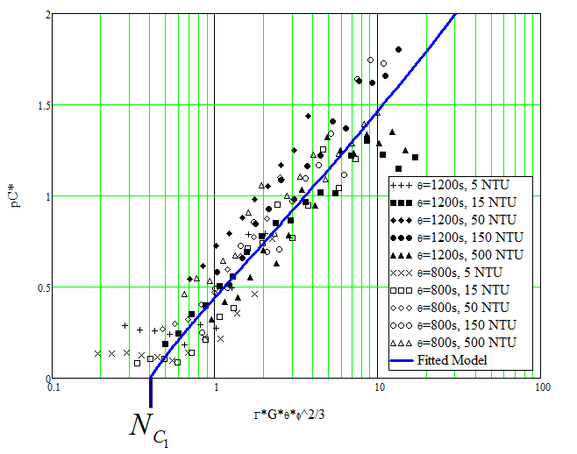
Background
Notes:
William

Slide 4

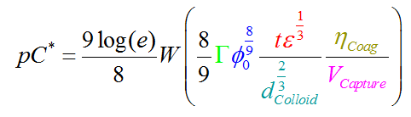
Background
Turbulence
Notes:
William

Slide 5
Background
Previous Work and Semester Goals
Apparatus Updates
Future Goals
Notes:
Felice

Slide 6
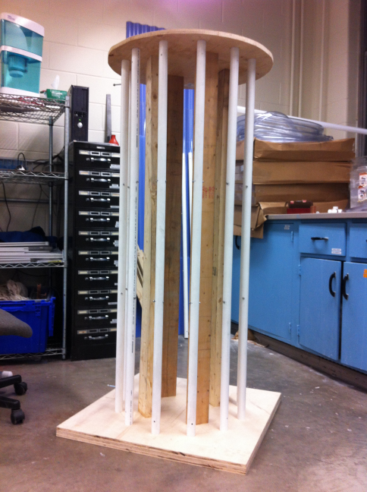
Previous Teams
Summer 2013: Designed Flocculator
Fall 2013: Construction of Flocculator
Spring/Summer 2014: Modifications to apparatus
Notes:
Felice

Slide 7
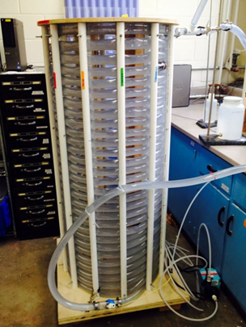
Semester Goals
Modify apparatus
Improve method file
Experiments!
Figure : Flocculator from Spring 2014
Notes:
Felice
Test system performance
Test with range of influent turbidities and coagulant doses.
Vary capture velocity in tube settler

Slide 8
Background
Previous Work and Semester Goals
Apparatus Updates
Future Goals
Notes:
Felice

Slide 9
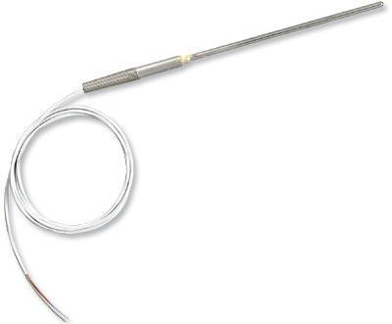
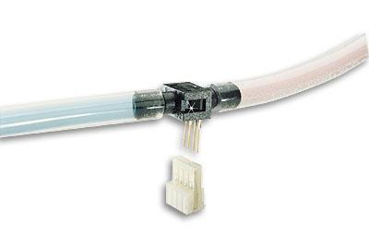
Process Controller Updates
Incorporated “Water Temperature-Depth Control” function into method file.
  Monitors temperature and depth of water in head tank in one state.
  Matches water temperature to air temperature
Notes:
Felice
matches the water temperature to the air temperature in the room to prevent density currents in the tube settler

Slide 10
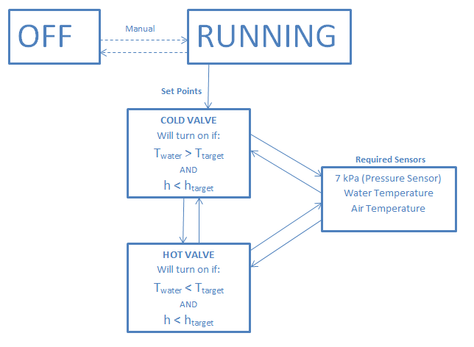
Notes:
Felice

Slide 11
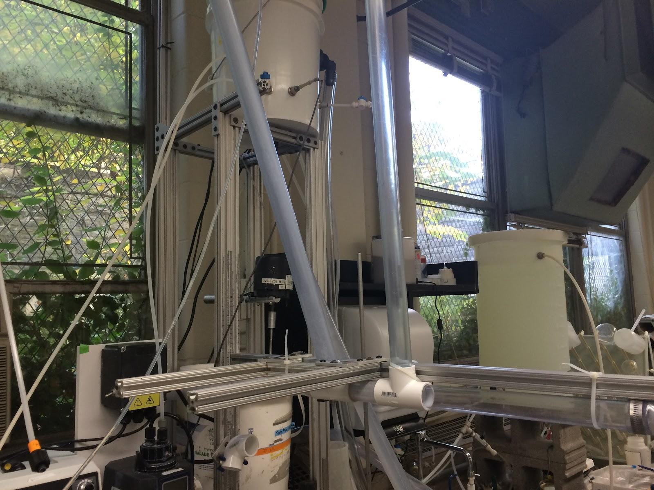
Apparatus Changes
Notes:
Mingze
introduction: make changes to apparatus

Slide 12
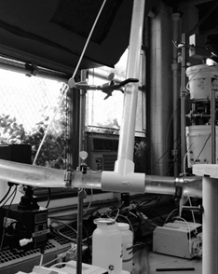
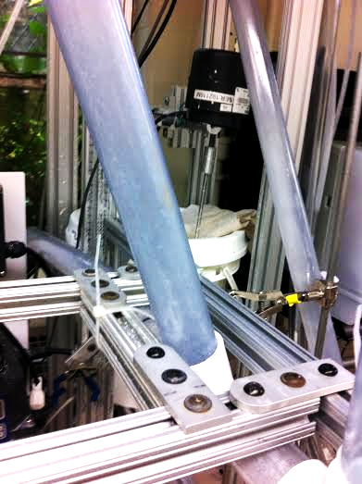
SWaT Updates
Need to keep SWaT at constant 60 degrees
Before:
After:
Notes:
Mingze
add slider adjustable and also more stable ziptie, 60 degree mathcad check correct

Slide 13
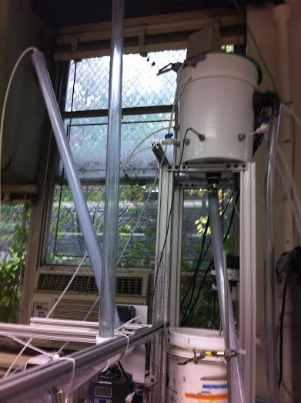
Air Release
Minimum height of air release = height of water in constant head tank
Notes:
Mingze
add air release, before swat get air out of it, keep particle stays settle and keep air bubble from coming into turbidity meter, constant head tank

Slide 14
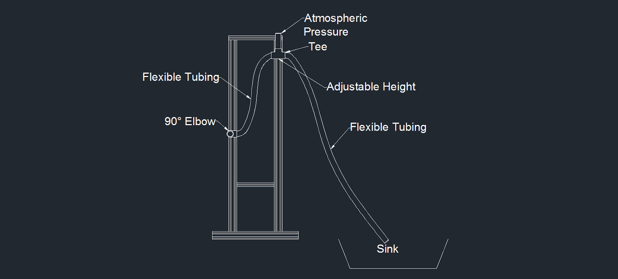
Effluent Drain
Notes:
Mingze
90 degree pipe into pic, adjustable height meet flow rate we want, tube is flexible, free fall right means difference between tee and tank, determine flow rate

Slide 15
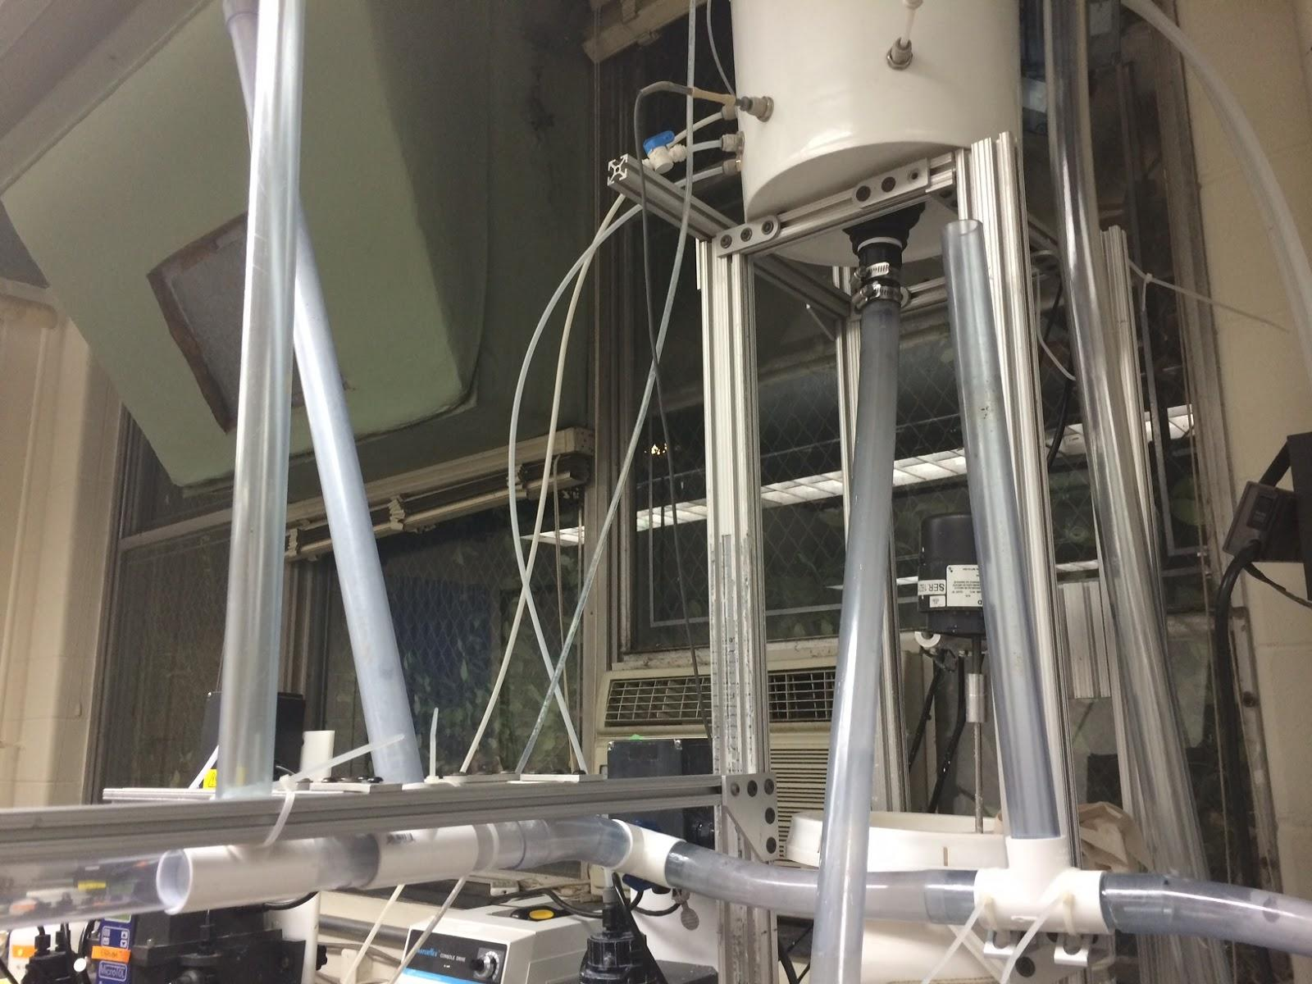
Effluent Drain
Notes:
Mingze
picture, detail

Slide 16
Background
Previous Work and Semester Goals
Apparatus Updates
Future Goals
Notes:
William

Slide 17
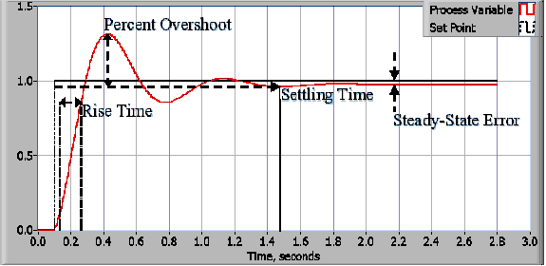
PID Control System
Improve the PID control for influent turbidity
http://www.ni.com/white-paper/3782/en/
Notes:
William

Slide 18
Experiments
Vary:
  Influent turbidity: 5, 15, 50, 150, 500 NTU
  Coagulant dose: Varies by turbidity
  Capture velocity: 0.06, 0.12, 0.25, 0.5, 1.0 mm/s
Notes:
William

Slide 19

Questions?
Notes:
William

