Slide 1

Floc Filtration
Weiling Xu
Xiao Cui

Slide 2
Outline
Introduction
Experimental Setup
Equal Flow Calibration
Flow Free to Choose its own Path
Future work
Notes:
Setup of the experiment
Tests that we have run: results/discussion
Combined all the results: energy dissipation rate vs. performance

Slide 3

Introduction
Upflow system
Goal:
Understand the filtration process
especially the hydraulics characteristics
Notes:
possibility to scale it according to the needs in the field, having a clearer understanding behind the filtration process, especially what are the hydraulics characteristics if different sand grains are implemented, is an important step.

Slide 4
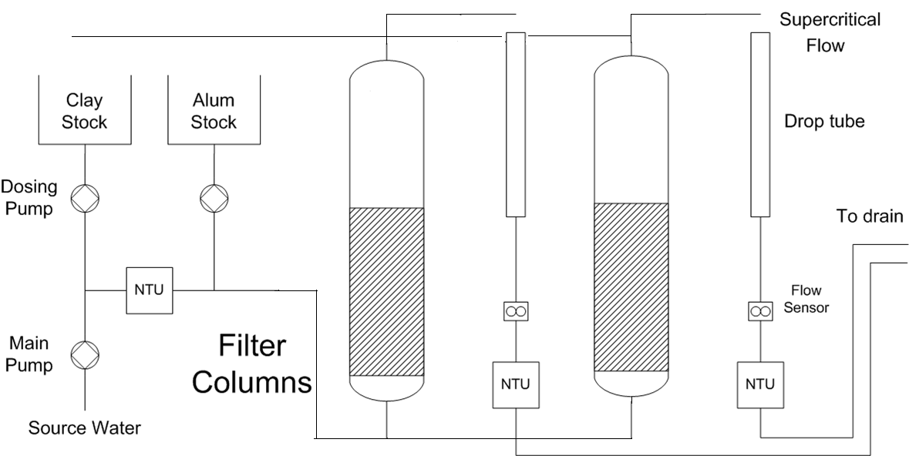
Experimental Setup
Setup
Filtration Mode

Slide 5
Experimental Setup
Setup
Backwash Mode

Slide 6
Equal Flow Calibration
Setup
  Two pump heads
  One inlet to each column
  Equal amount of sand in each column
  at the beginning
by trial and error.

Slide 7
Equal Flow Calibration
  Tapping——eliminate the air
  Addition of sand (1 cm Headloss = 1 gram sand)
  Vibrator—— same compactness of both filter columns and improve the uniformity (But necessary?)
by trial and error.

Slide 8
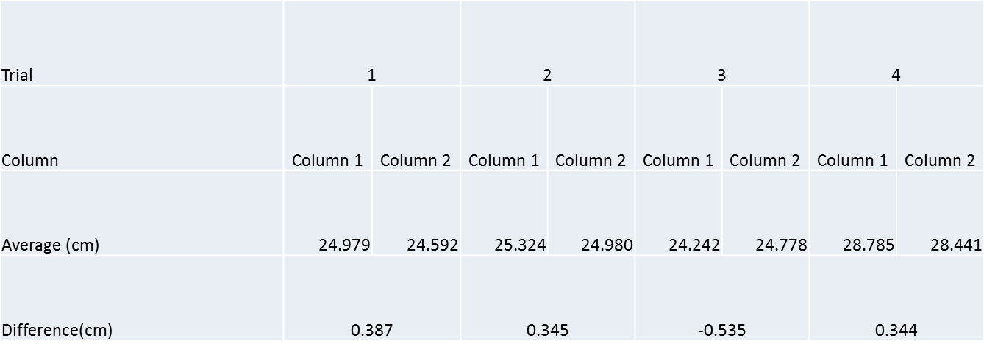
Equal Flow Calibration
Results (BAD ones)
1) Headloss for both columns with Tapping and Addition of Sands to the filter column with less headloss

Slide 9
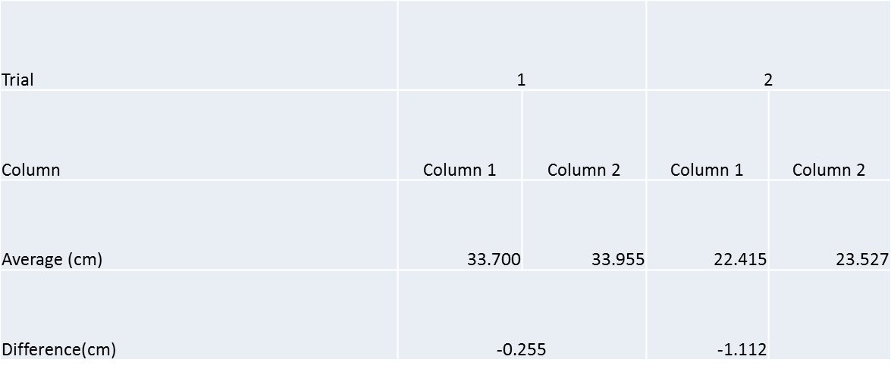
Equal Flow Calibration
Results (BAD ones)
2) Headloss for both columns with Vibrator and Addition of Sands

Slide 10
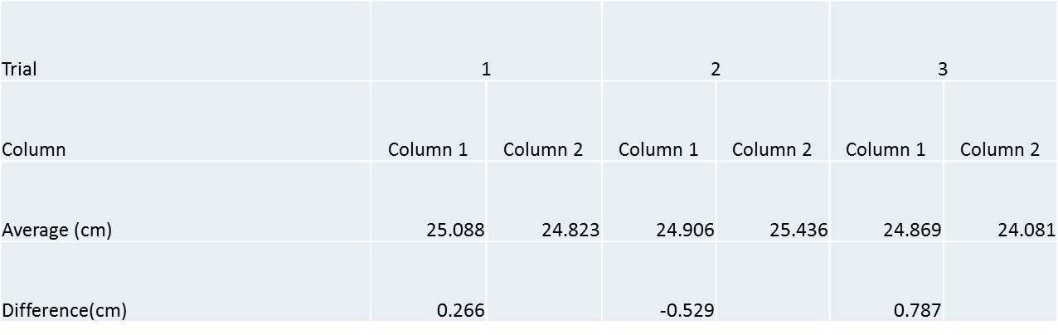
Equal Flow Calibration
Results (BAD ones)
3) Headloss for both columns with Vibrator only

Slide 11
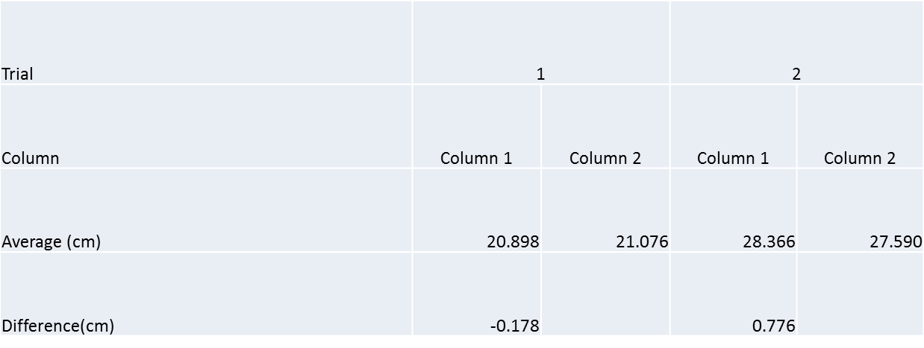
Equal Flow Calibration
Results (BAD ones)
4) Headloss for both columns without Tapping or Addition of sands

Slide 12
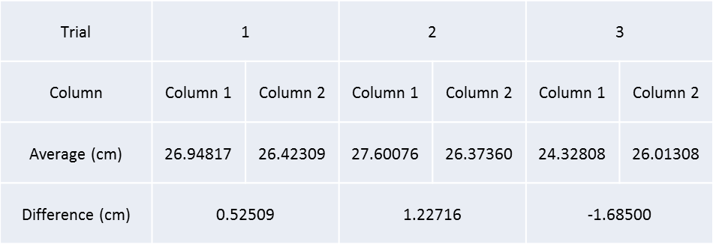
Equal Flow Calibration
Results (BAD ones)
5) Headloss for both columns with Backwash and without Addition of Sands (1 inlet, 1 pump head)

Slide 13
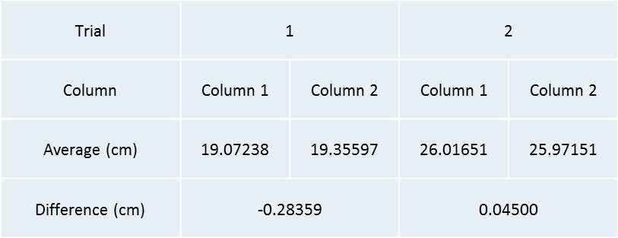
Equal Flow Calibration
Results (BAD ones)
6) Headloss for both columns with Backwash and Addition of Sands (1 inlet, 1 pump head)

Slide 14
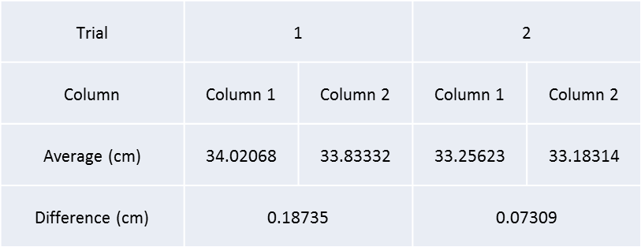
Equal Flow Calibration
Results (GOOD one!)
Headloss for both columns with Backwash (1 inlet, 2 pump heads)

Slide 15
Flow Free to Choose its own Path
One inlet
Same conditions in both filter columns
Expecting:
  Even flow distribution among the filter columns

Slide 16
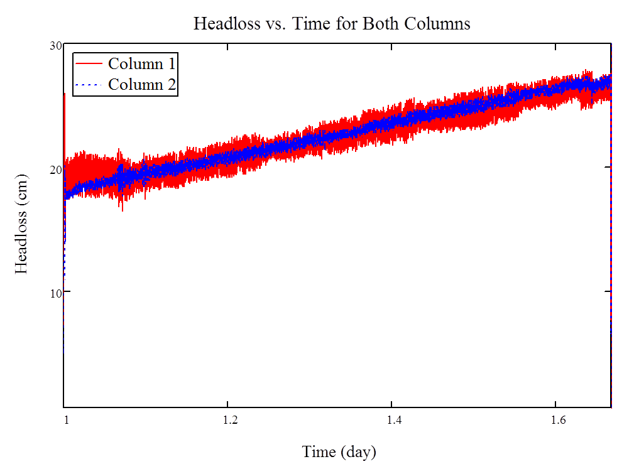
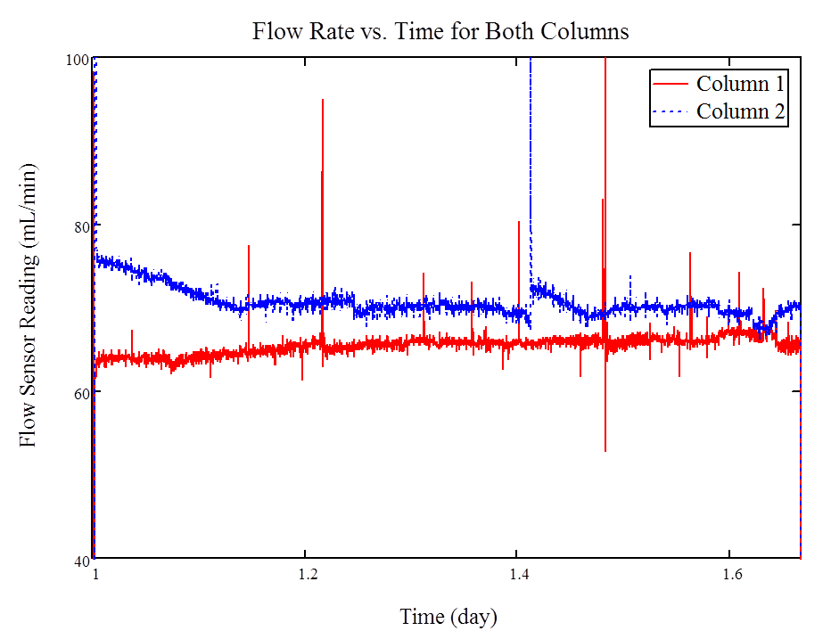
Flow Free to Choose its own Path
1st trial with clay and alum

Slide 17
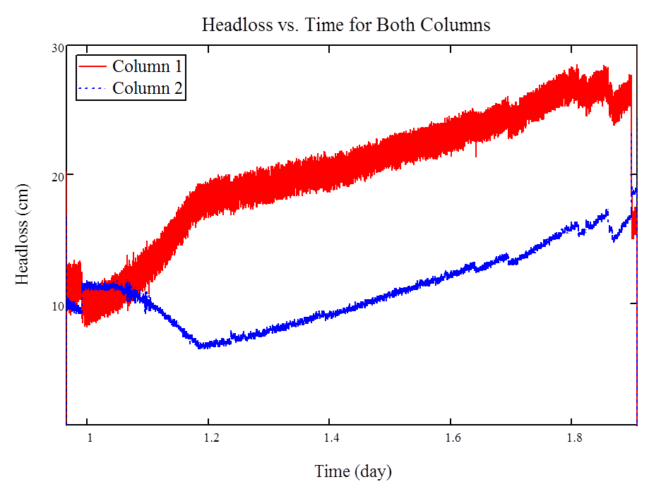
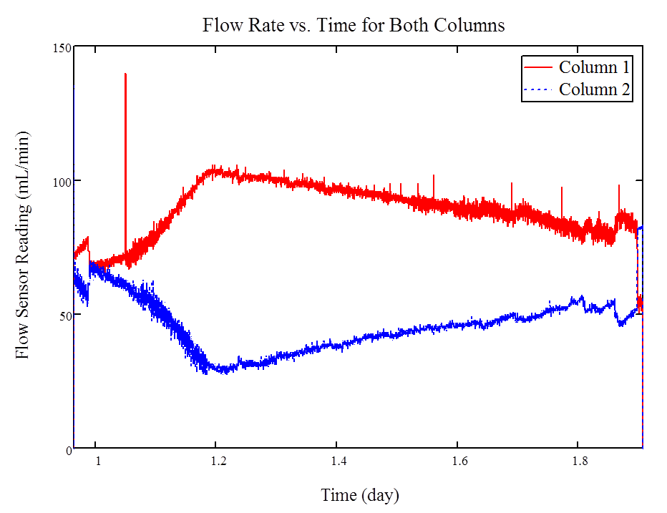
Flow Free to Choose its own Path
2nd trial with clay and alum

Slide 18
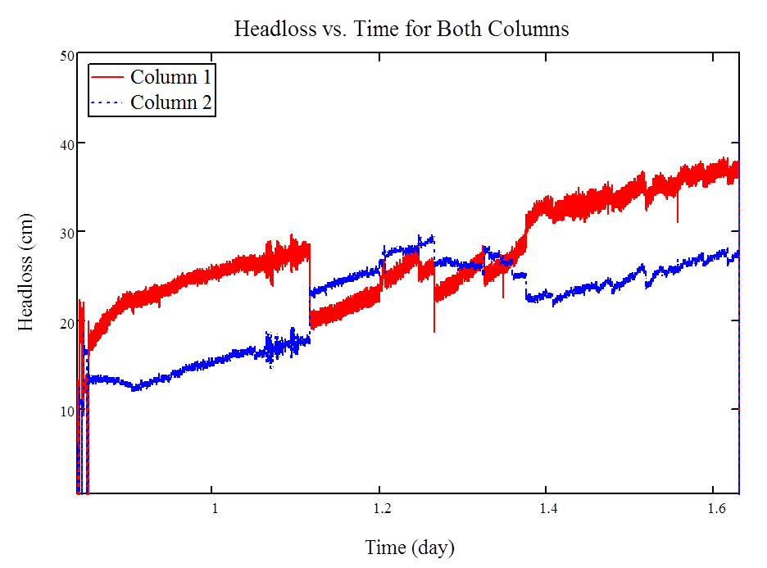
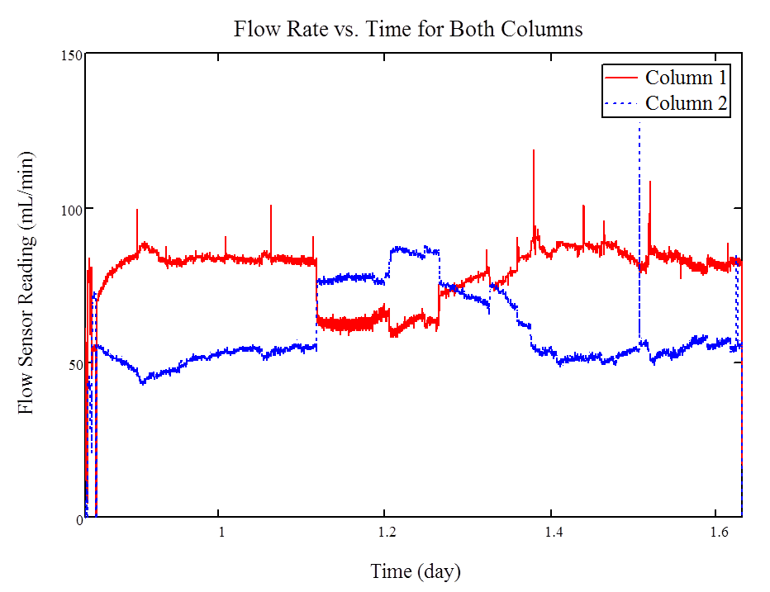
Flow Free to Choose its own Path
3rd trial with clay and alum

Slide 19
Flow Free to Choose its own Path
Conclusion
  Flow distribution may depend on whether the influent is up flow or down flow
  Depth filtration dominates
    flow distribution proportionates to the head loss in the filter bed

Slide 20
Future Work
More experiments are needed
Improve current setup
  Clay particles deposit before entering the filter columns
  Air trapped in the system

Slide 21
Thank You!
Questions???

