Slide 1
Coagulant Management
Madeline Haas, Rudra Koul, and John Newman

Slide 2
Introduction
Efficiency
Ease of use
Accurate measurements
Notes:
We want the coagulant to efficiently mix into solution so that its properties can be used to their full advantage within our plants. If coagulant precipitates out of solution, that coagulant is not being used towards flocculation and it may also clog the system.

Slide 3
Precipitation in Dosing Tubes
Problem in Atima plant
The causes are unknown
Precipitate can lead to clogs and lost time due to cleaning

Slide 4
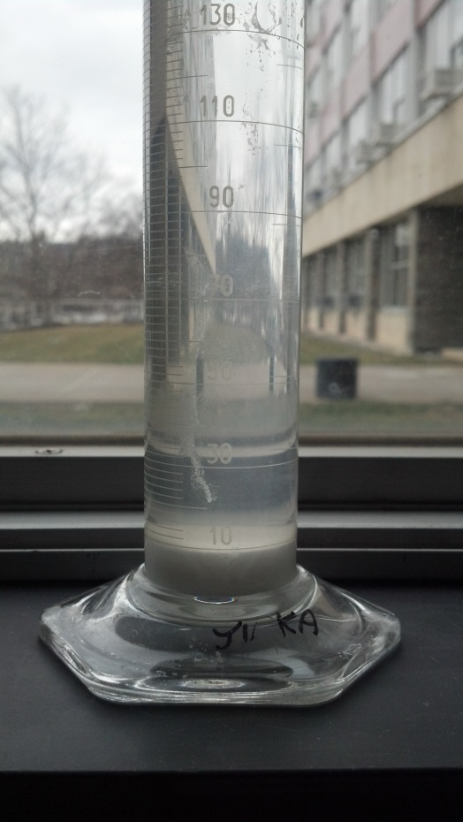
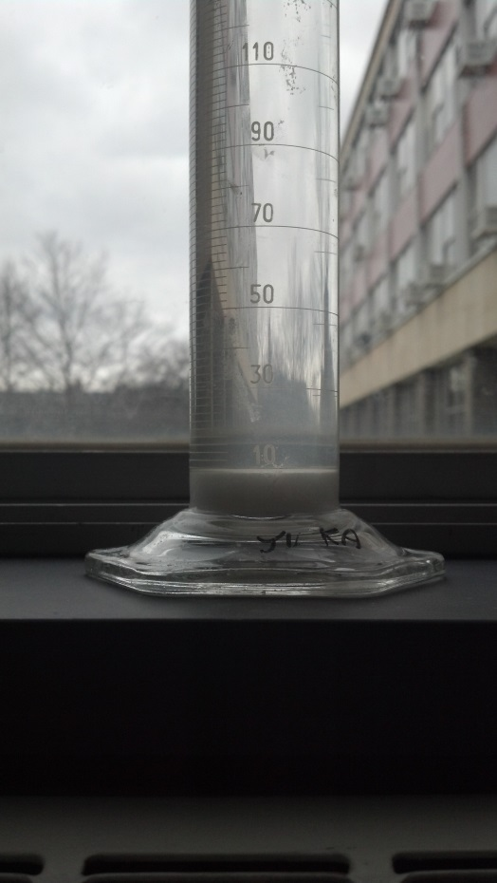
Current Experiments
A solution of Alum was mixed and left to set
Before
After Four Days

Slide 5
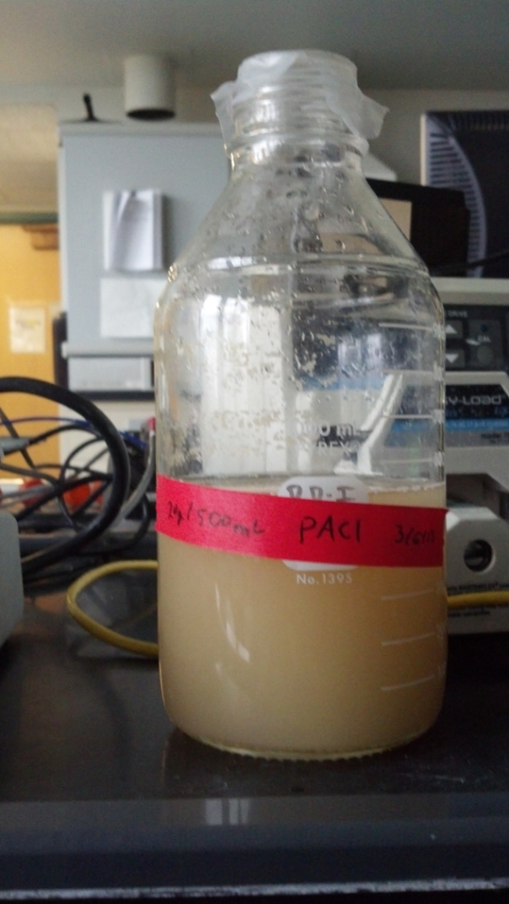
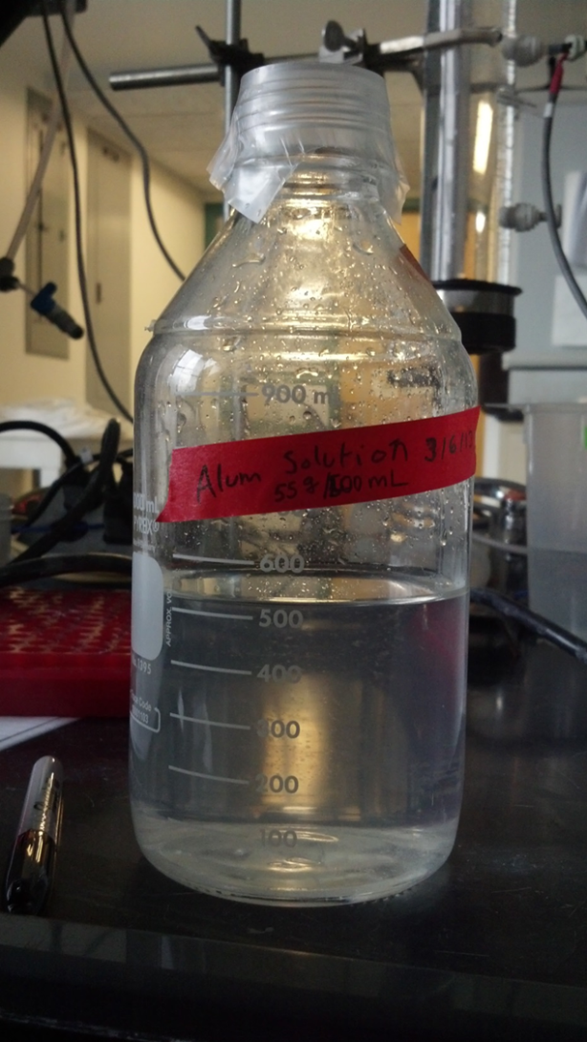
Current Experiments Continued
A solution of PACl
A solution of Alum

Slide 6
Next Steps
Mix coagulant solutions with contaminated water to determine if precipitate is premature flocculation
May need to obtain more information from Atima

Slide 7
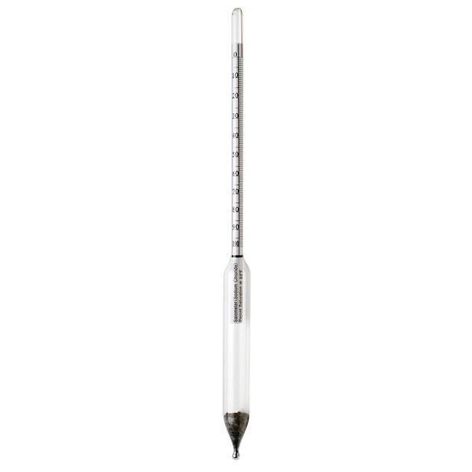
Hydrometer
Used to measure the specific gravity of a substance, i.e., the ratio of the substance’s density to the density of water
A commercial hydrometer is the most economic choice
Purchased two from McMaster Carr

Slide 8
Next Steps
A hydrometer needs to be delivered to Honduras via Drew
A large graduated cylinder needs to be purchased or constructed in order to use the hydrometer properly

Slide 9
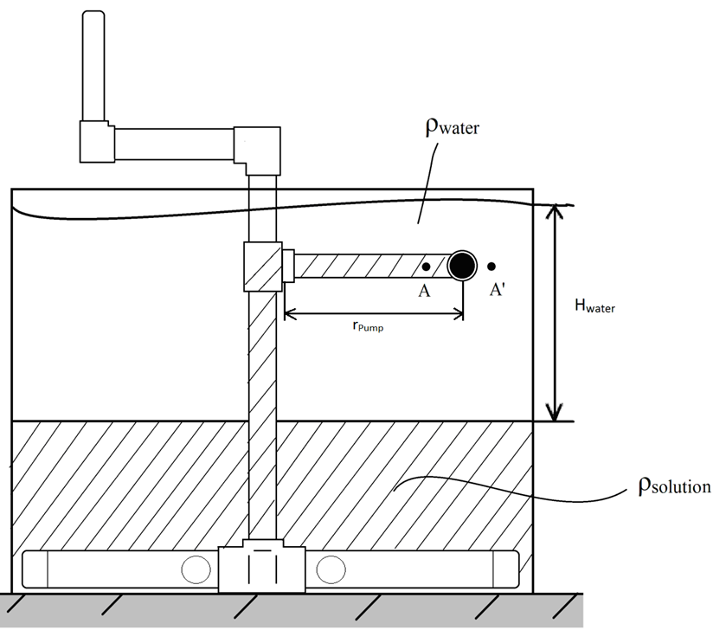
More Efficient Mixing Methods
A centrifugal pump needs to be built, tested, and optimized
Design methods that utilize the water flow itself

Slide 10
Injection of Coagulant
Low head loss causes coagulant to precipitate on delivery tube walls
Design a system that allows injection of coagulant into the center of the water flow

Slide 11
Suggestions?
Other potential causes of precipitate?
Building a centrifugal pump?
Water power?
Efficient injection methods?

Slide 12
Questions?

Slide 13
Thank you!

