Slide 1

Coagulant Management
Spring 2013
Madeline Haas, Rudra Koul,
Jack Newman

Slide 2
Spring 2013 Challenges
Density Measurements
Hydrometer
Stock Tank Centrifugal Pump System
Fabrication of Injection Point
Notes:
*part of the density measurement challenge was to develop a Mathcad function relating density as a function of concentration...but technically density is dependent on only temperature and pressure.

Slide 3

Density Measurements: Alum and PACl
Alum
  Given: ρ = 1327 kg/m³
PACl
  Measured the mass of a 36 g/100 mL solution using a simple method
  Results: ρ = 1200 kg/m³
Notes:
Density only changes with temperature and/or pressure

Slide 4
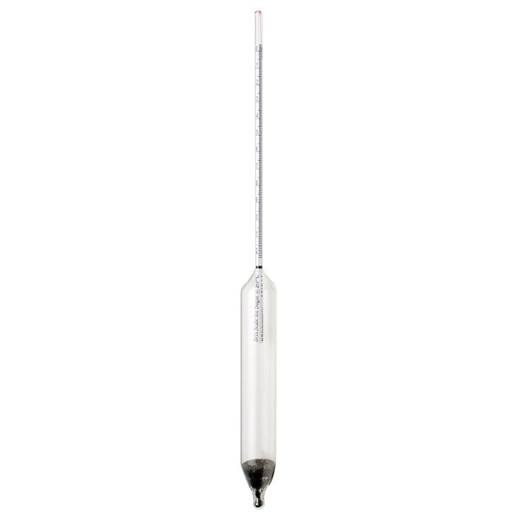
Hydrometer Selection
Glass vs. Plastic
Specific Gravity Range
Price Ranges: $15-$100+

Slide 5

Hydrometer Selection: Best Option for an AguaClara Plant
Plastic Hydrometer from Krackler Scientific, Inc.
Specific gravity range: 1.200-1.420

Slide 6
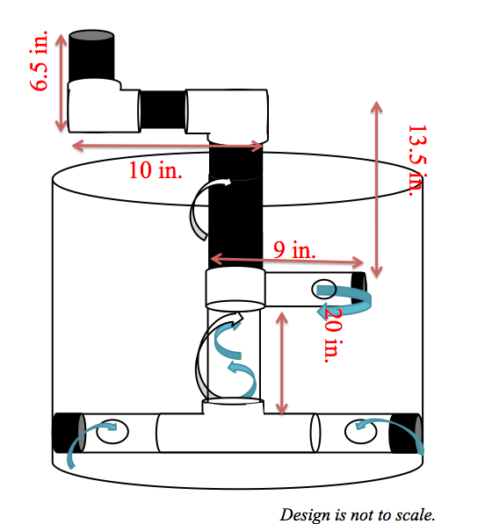
Centrifugal Pump: Current Design

Slide 7
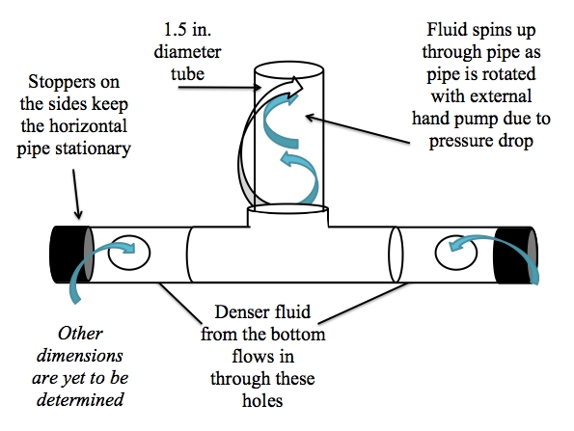
Centrifugal Pump Components

Slide 8
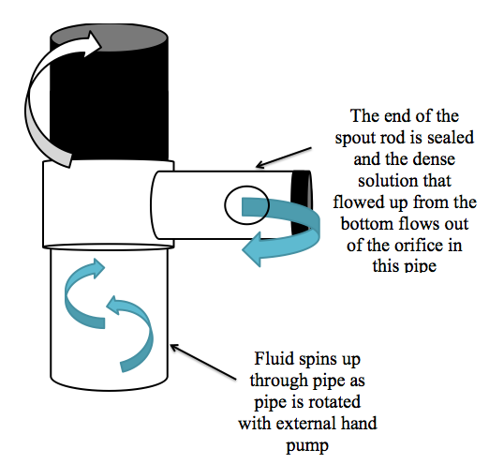
Centrifugal Pump Components

Slide 9
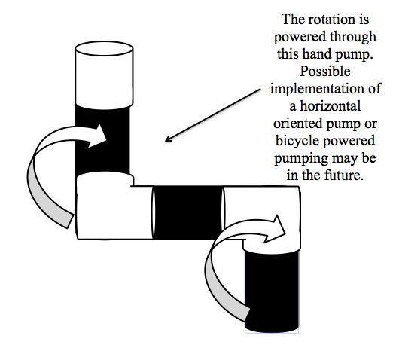
Centrifugal Pump Components

Slide 10
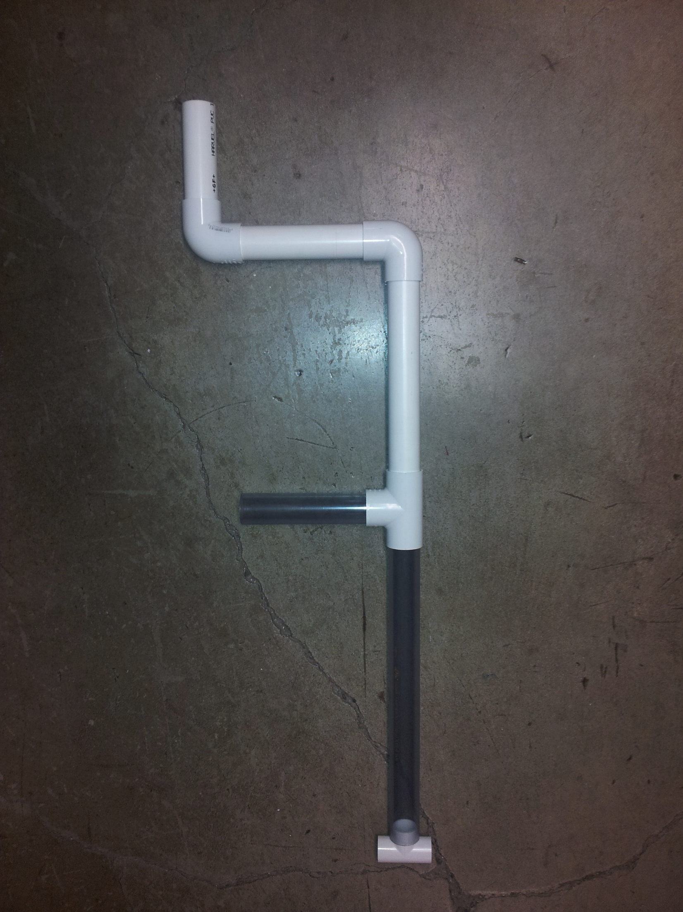
Centrifugal Pump Components

Slide 11
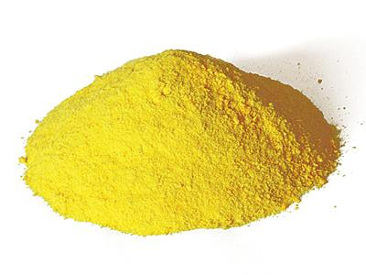
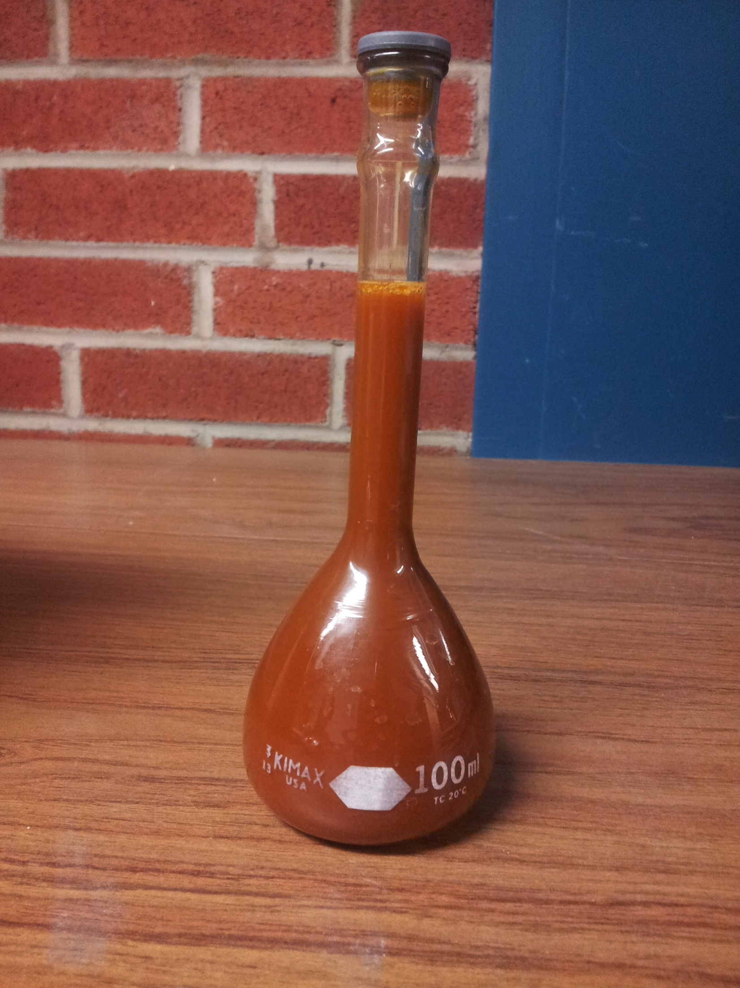
PACl: The Main Focus
Most AguaClara plants utilize PACl
More cost efficient compared to alum

Slide 12
Centrifugal Pump: PACl Calculations
Constraints
  Maximum power output of average human: 75W
  Drag force of horizontal pipe
  Energy dissipation >= 1 W/kg

Slide 13





Centrifugal Pump: PACl Calculations

Slide 14
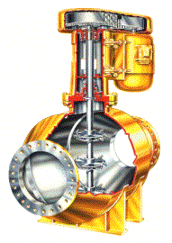
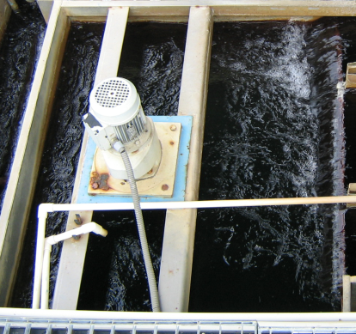
Power, height, and G
**From CEE 4540 Rapid Mix Lecture
“velocity gradient” caused by mixing
Reactor volume
Power required
Power required to lift water
Equivalent potential energy measured as a height used for mixing
Equivalent potential energy as a function of G
Notes:
from Environmental Engineering: A Design Approach by Sincero and Sincero. 1996. page 267

Slide 15
Centrifugal Pump: PACl Calculations
Selected maximum speed applied to pump: 30 rpm
  Drag force requires 3.54 W
  Pumping requires 64.692 W
  Sum under the 75 W maximum

Slide 16
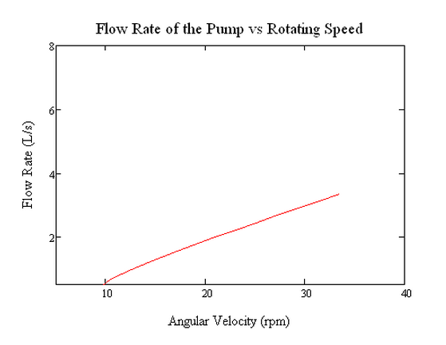
Centrifugal Pump: PACl Calculations

Slide 17
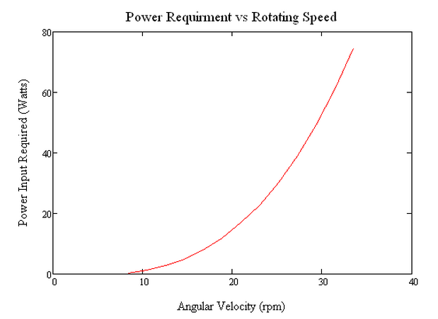
Centrifugal Pump: PACl Calculations

Slide 18
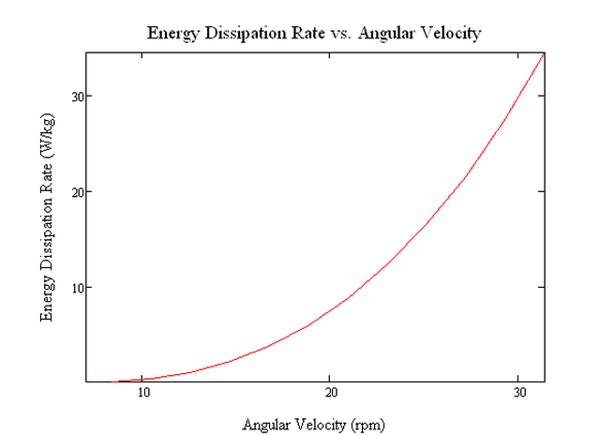
Centrifugal Pump: PACl Calculations
Notes:
Energy dissipation: minimum is 1

Slide 19
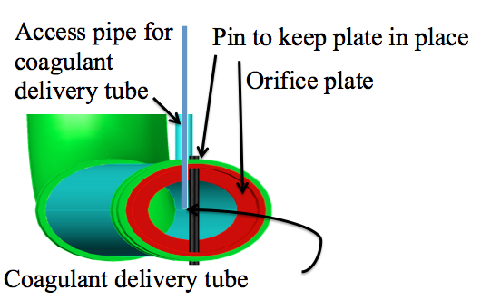
Injection Point: Preliminary Design
Design By Monroe Weber-Shirk

Slide 20
Injection Point: Fabrication Ideas
What is needed:
  Access pipe
  Rigid coagulant delivery tube
Failure Modes:
  Flow oscillations inside delivery tube
  Inefficient mixing
Notes:
**Access pipe needs to be corrosion resistant
*Injection tube needs to also be corrosion resistant
**For mixing to be efficient, it needs to be injected at the center of the flow

Slide 21



Injection Point: Fabrication Ideas
Access pipe made out of a thin PVC pipe, attached to rapid mix pipe
Delivery tube easily removable and stable
Strong, non-corrosive injection point
The orifice plate would be a high
strength, corrosion resistant
washer

Slide 22
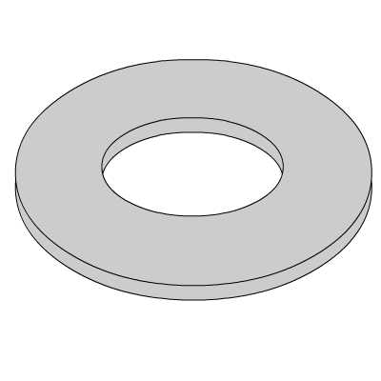
Injection Point: Fabrication Ideas
Another idea for the design of the delivery tube and access pipe
One washer to ensure that the delivery tube stays in the middle of flow
Delivery Tube
Top down view of access pipe
Overall

Slide 23

Semester Setbacks
Mistakenly spent time on an already completed challenge
Parts took time to come in

Slide 24

Future Work
Fully fabricate and test an injection point
Fully fabricate and test centrifugal pump system
  improve upon fabrication method

Slide 25

Questions?

