Slide 1
MALT Committee
Year End Review
2012
MALT = Mann Learning Technologies Committee

Slide 2
Our Objective
To identify new technology-based services for the library, especially those technologies that focus on meeting patron needs outside the classroom
Coordinate the implementation of such technologies in specific spaces throughout the library
This year’s focus…
the Bissett Space!

Slide 3
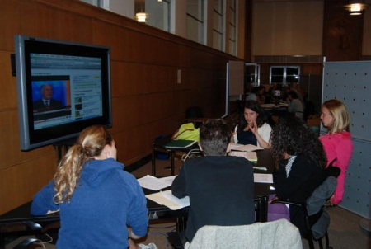
What did we need to know?
Bissett Collaborative Space
Current use
Space preferences
Collaboration
Technologies
Notes:
Do students use the Bissett Space? How?
What type of space or environment for collaboration do they prefer? What spaces on or off campus do they currently use and why?
How do they collaborate with one another on group projects and how would they like to collaborate in an ideal world?
What do they find difficult about collaborating?
Are they using any mobile devices for their research or group work?
What other technology do they currently use and what technology would they like to see in the Bissett Space?
Technology

Slide 4
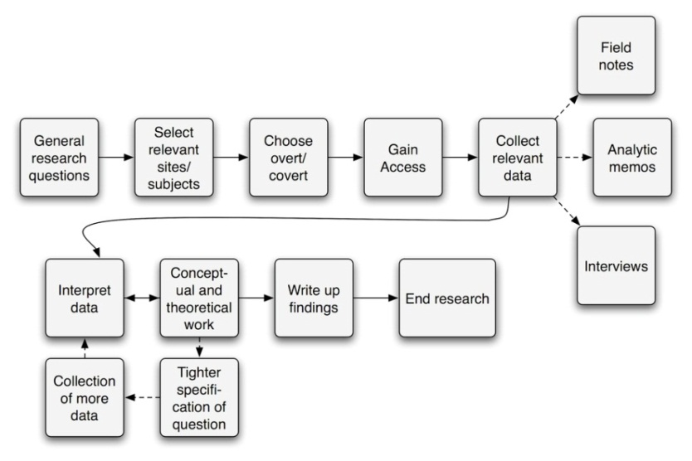
How did we get the information?
  IRB for multiyear study
Human subjects and interview training
Future ethnographic user studies
Review of other institutions & “shopping”
sladner on Flickr

Slide 5
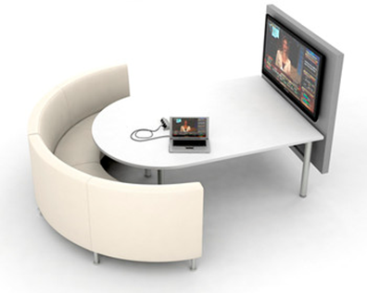
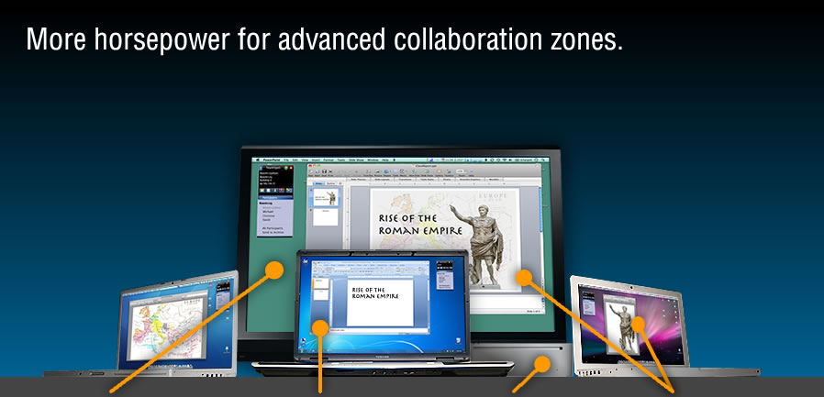
How did we get the information?
  Student interviews on collaborative work
  Agati furniture demo & survey
  Collaborative software research - TeamSpot demo, survey & usability testing
  Bissett Space observations
Agati
TeamSpot

Slide 6
What did we find out?
Staff TeamSpot Usability Testing
Student TeamSpot Usability Testing
TeamSpot & Bissett Furniture Survey
Interview & Observation Highlights
Notes:
Staff TeamSpot Usability Testing
Steep learning curve
Technical issues – confusing system messages and feedback, lack of mobile device compatibility, PC/Mac compatibility
Better instructions/signage
Student
Lots of little glitches, especially network congestion & PC/Mac compatibility
Steep learning curve
More instruction needed
Confusion with pop-ups and other TeamSpot initiated instructions
Group dynamic issues
Interview & Observation
Comfortable furniture
Whiteboards, whiteboards, & more whiteboards 24 of 29 wanted more whiteboards
2-4 person group size
They love GoogleDocs (and dropbox)
LCD screens are crucial for group work and presentation practice
Noise level too high
Reservation system
Presentation practice space
Like the newness of Mann
Frequency & type of group project depends of major and college and there are different needs for different types of group work
TeamSpot Survey
39 of 61 respondents said yes (some with caveats)
Better instructions/signage needed
Technical issues including Mac/PC compatibility, non-functionality
Bissett Furniture Survey
26 of 29 respondents said yes to the Agati furniture.
24 of 29 wanted more whiteboards
Concern over noise and privacy
Whiteboard markers
Footrests
Bissett Space Signage

Slide 7


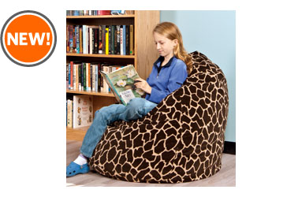
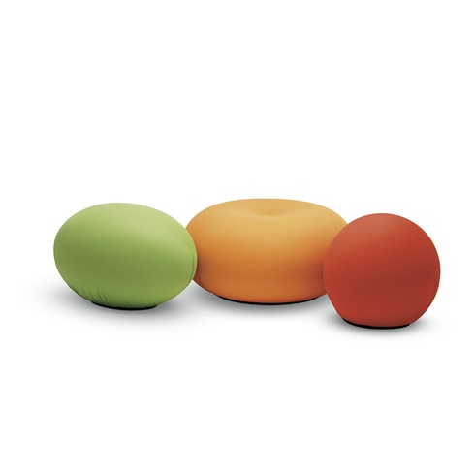
Interesting observations
Low tech vs. high tech
Variety of comfortable furniture
Workspace needs dependent on program
Notes:
64% of students were interested in using TeamSpot for their group projects but still highly favored GoogleDocs even though they report issues with GoogleDocs
2-4 group size
Different needs depending on program and type of work (lower need for group work than we expected; maybe need to target particular programs and explore futher; some programs have their own spaces)

Slide 8

Next steps
Privacy & noise
Reservation system
Presentation space
Lighting

Slide 9
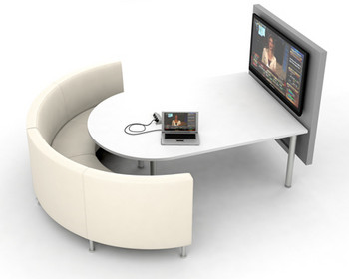
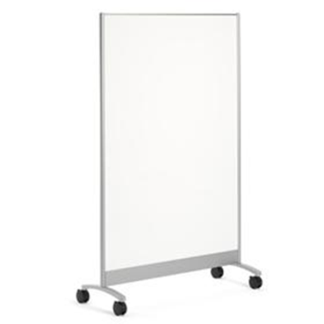
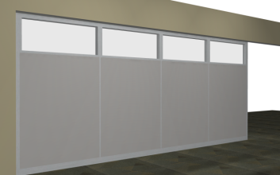
On Our Wishlist

Slide 10
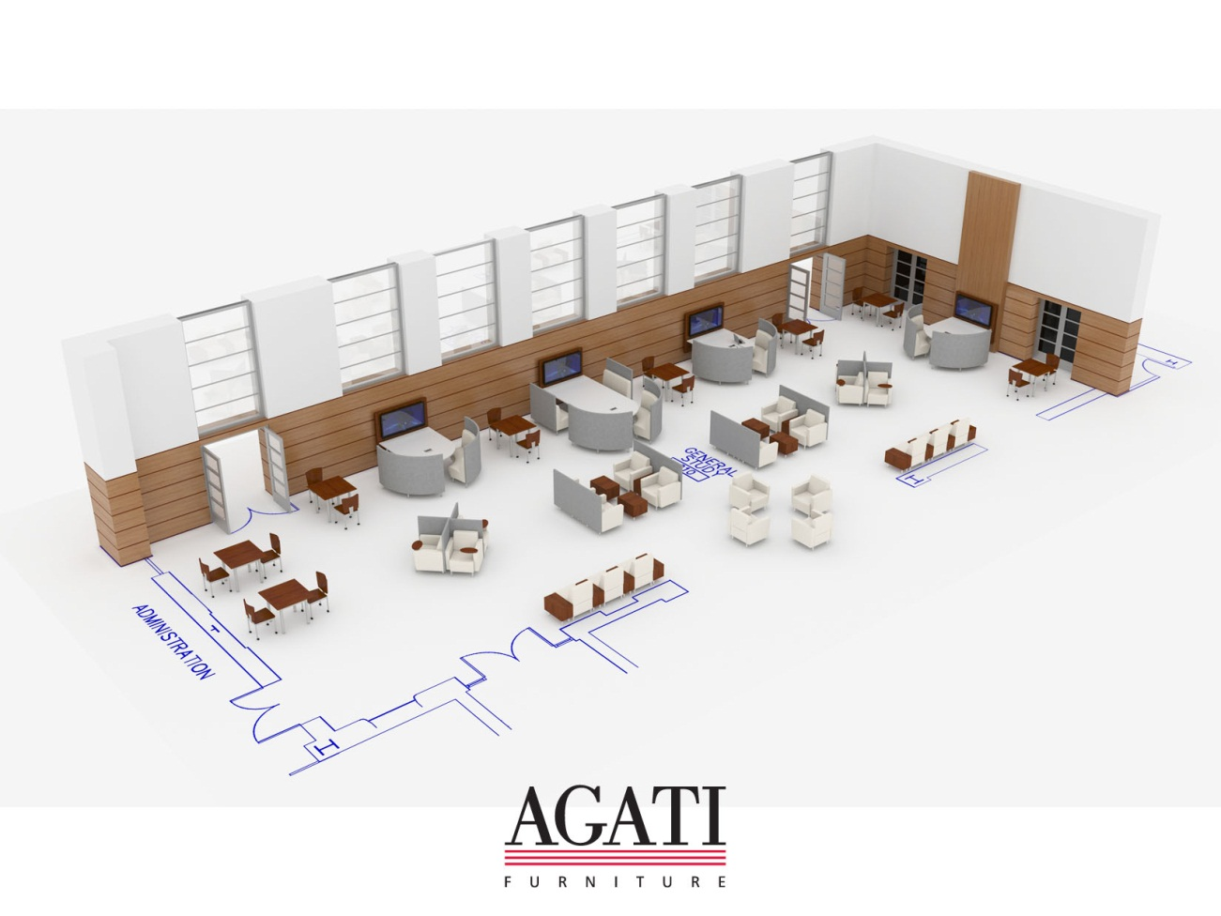
The future
?

