Slide 1
“Stakes in the Ground”
Guiding principles and structures → consistency of quality and form

Slide 2
Stake 1: Backward Design
  Be clear about learning goals
  Standards Fellow expertise
  Sense of importance Realism
  Complementarity

Slide 3
Stake 2: 5E Learning Cycle
Engage
Explore
Explain
Elaborate
Evaluate
1 or 2 key concepts or principles

Slide 4
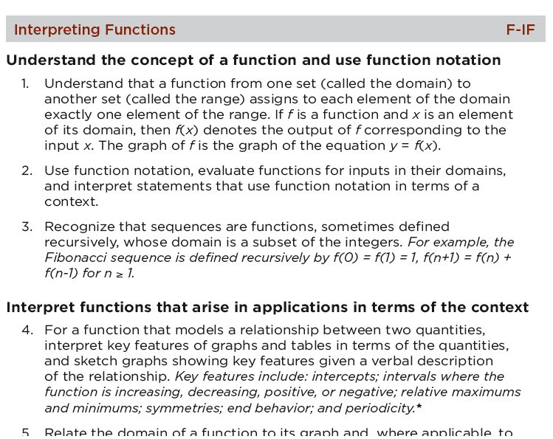
Example
End goal: Co-authored curriculum on functions
Review Common Core Standards for math content

Slide 5
Example
Expertise and interest in connections between algebraic expressions and their graphs
→ module on function transformations
Realistic?
Complementary?
Interesting/important?
  “If your calculator were broken, could you graph a seemingly complex function without laboriously plotting points?”

Slide 6
Example
Given the graph of f(x), the graph of f(x+c), where c is a constant, looks like this: f(x) is shifted c units to the left if c > 0 and c units to the right if c < 0
For example, given the graph of y = x², the graph of y = (x-4)² is the same graph shifted 4 units to the right.

Slide 7
Example
Pair up with a classmate.
(a) Graph y = x² below.
(b) Graph y = -x² below.
(c) Describe the relationship between the two graphs.
(d) Choose another “basic” function that we’ve studied and graph it below.
(e) Put a negative sign in front of your function and graph it below.
(f) Do these two graphs have the same relationship to each other as (a) and (b) do?
Etc.

Slide 8
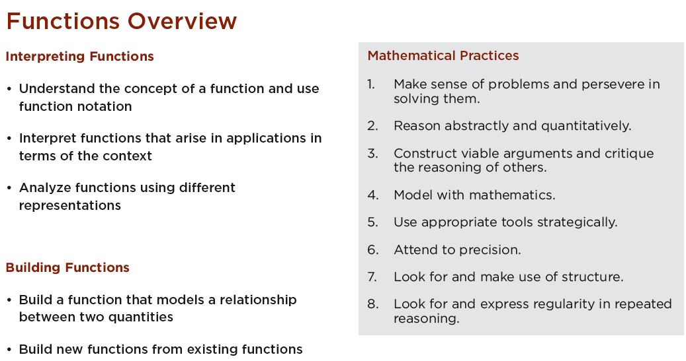
Example

Slide 9
Where Are We Now?
WHAT YOU HAVE
Each team has a focal topic.
  Complementary
  Prelim articulation of key concepts and info that fall under topic
  Question(s) to frame your topic
  Overarching question for curriculum
WHAT YOU NEED TO DO (by July 30)
Flesh out your content; think about the most logical order for students to engage with that content
Determine which concepts/principles might be discoverable via low-tech activity that engages students in scientific/ engineering thinking
Design the activity

