Slide 1
Ware chp 3
Overview of cardiac radiography

Slide 2
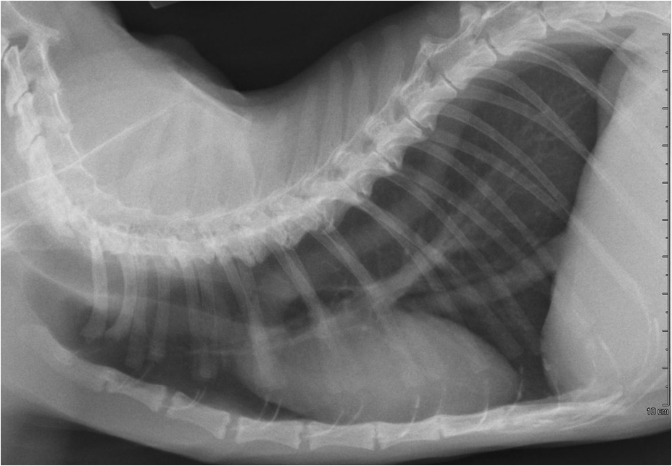
The abnormality identified by the white arrows indicates: (select all that apply)
a) The cat could have systemtic hypertension
b) The abnormality is likely secondary to improper patient positioning
c) The cat could die suddenly from the cardiac anomaly that caused this
abnormality
d) The cat has HCM
e) The cat could be normal
This abnormality is called:__________________________________________

Slide 3
The abnormality identified by the white arrows indicates: (select all that apply)
a) The cat could have systemtic hypertension
b) The abnormality is likely secondary to improper patient positioning
c) The cat could die suddenly from the cardiac anomaly that caused this
abnormality
d) The cat has HCM
e) The cat could be normal
This abnormality is called:_wavy or redundant thoracic aorta_______

Slide 4
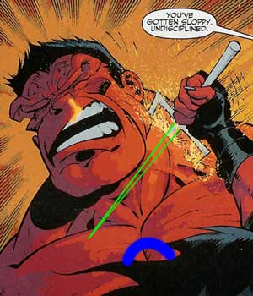
PS…
When you search google for images of “redundant cat aorta”…
The connection is unclear…

Slide 5
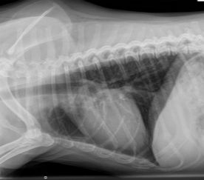
2
3
1
4
Dogs with left-sided congestive heart failure typically develop pulmonary edema in which area first?

Slide 6
2
3
1
4
Dogs with left-sided congestive heart failure typically develop pulmonary edema in which area first?
#3 - Perihilar

Slide 7
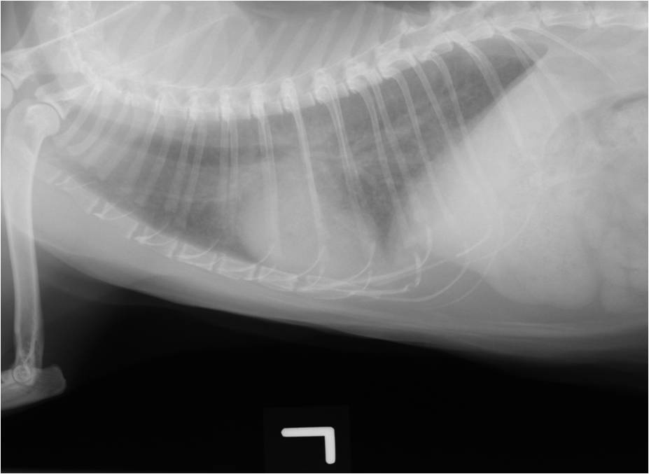
A
Which of the following images could not be from a cat in left-heart failure?

Slide 8
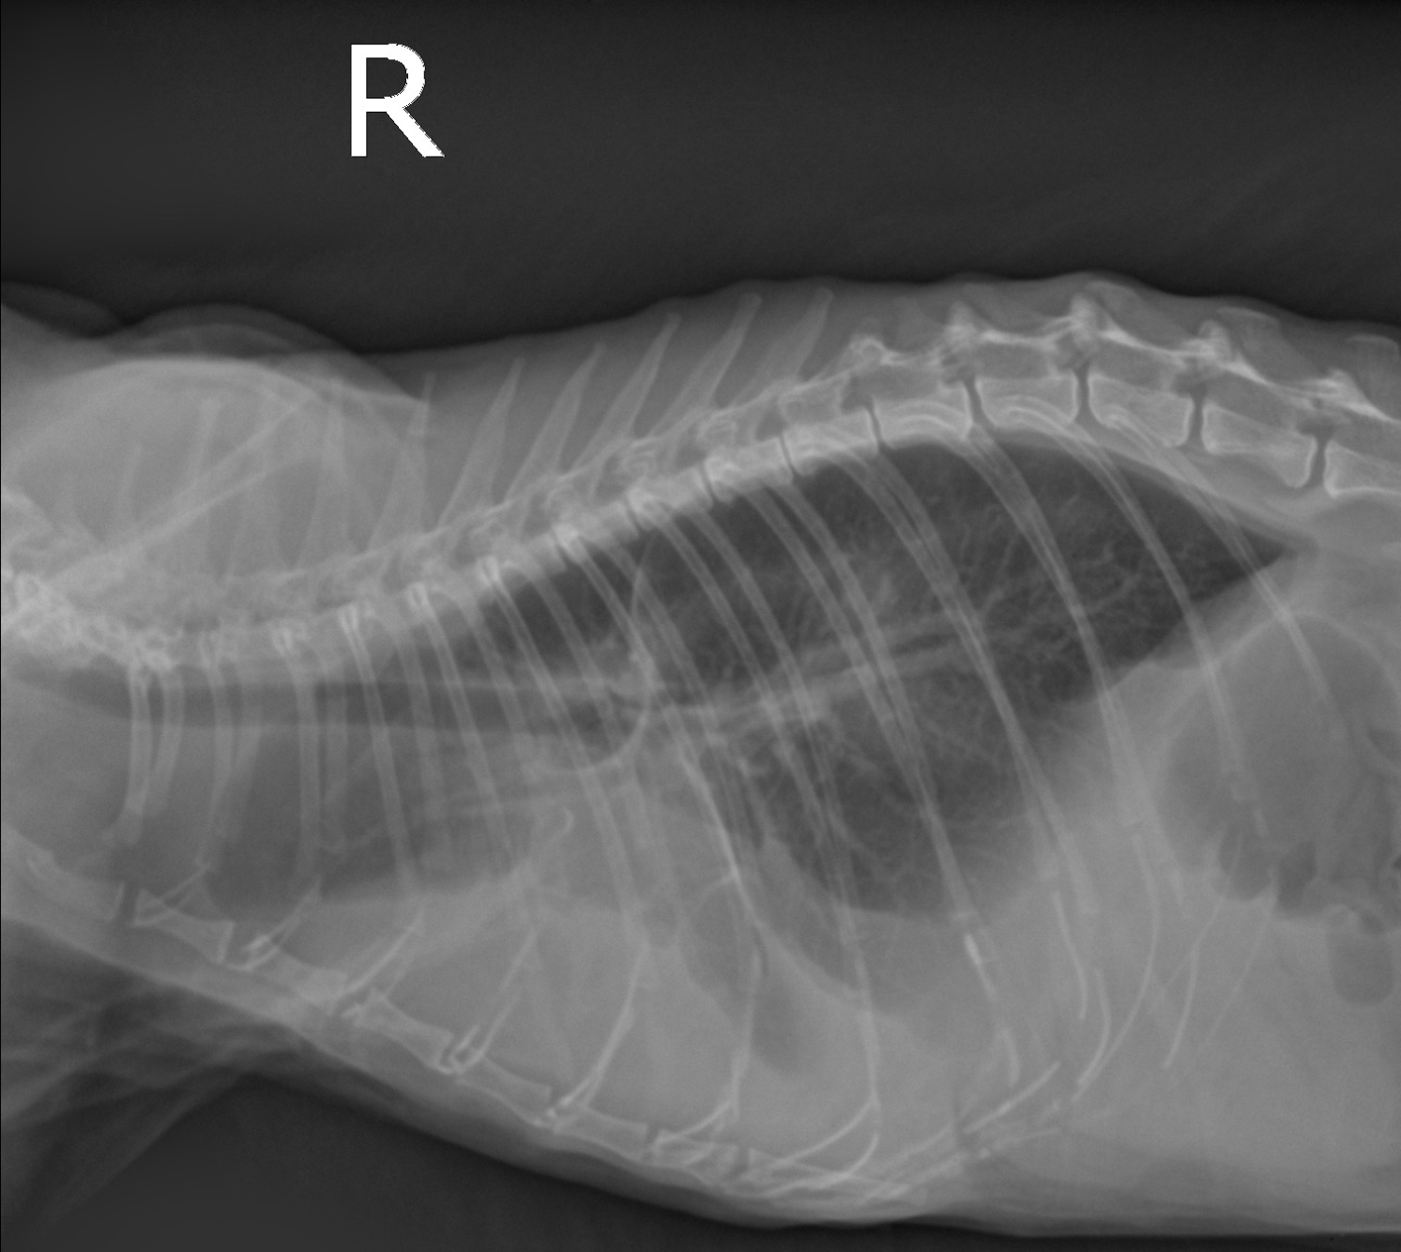
B
Which of the following images could not be from a cat in left-heart failure?

Slide 9
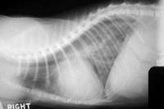
C
Which of the following images could not be from a cat in left-heart failure?

Slide 10
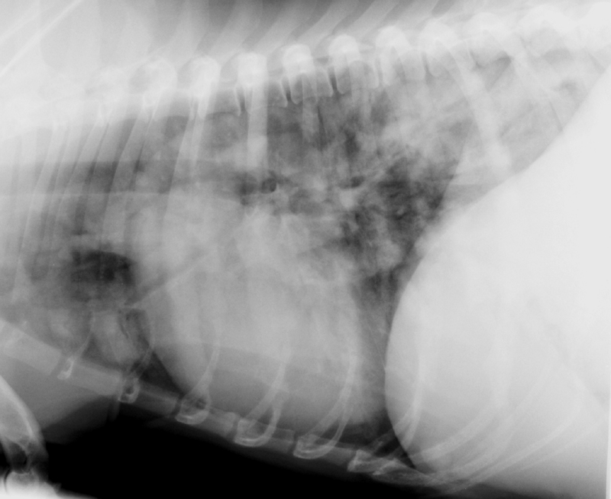
D
Which of the following images could not be from a cat in left-heart failure?

Slide 11

A
B
C
D
Which of the following images could from a cat in left-heart failure?
a) Image A
b) Image B
c) Image C
d) Image D
e) All of the above; cats do what they want B*%$@’s

Slide 12
A
B
C
D
Which of the following images could from a cat in left-heart failure?
a) Image A
b) Image B
c) Image C
d) Image D
e) All of the above; cats do what they want B*%$^@’s

Slide 13

This is Fluffy…
He appears to be evil (narrow eyes), is in respiratory distress, and will bite you..
You hear a grade 3/6 right apical murmur so you take radiographs

Slide 14
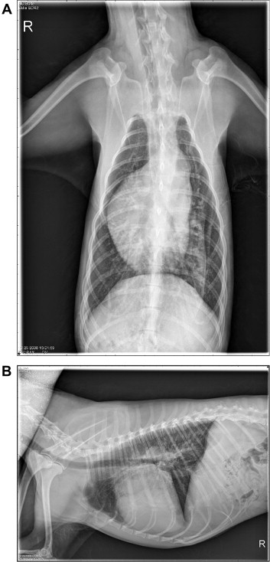
Fluffy has enlargement
Of which chamber?

Slide 15
Fluffy has enlargement
Of which chamber?
Right ventricular
enlargement

Slide 16
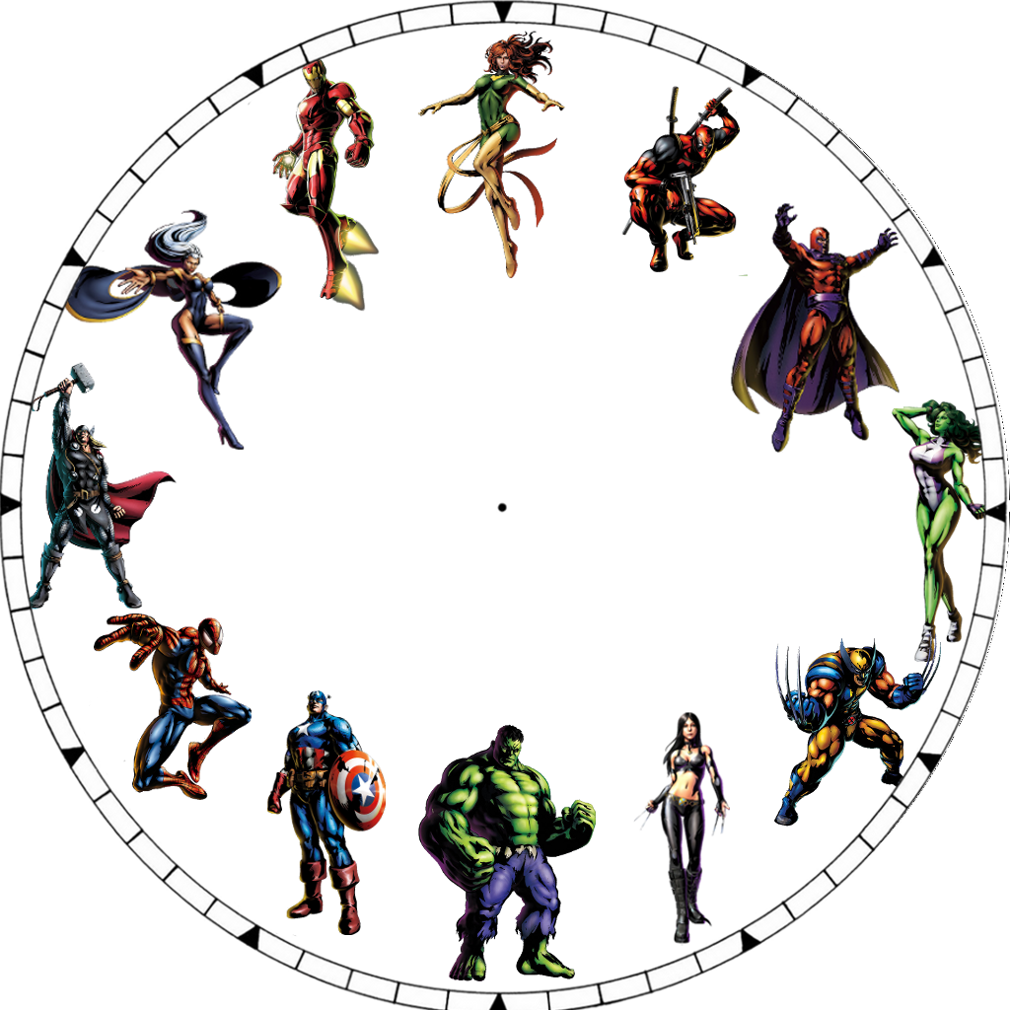
Label this Marvel™ clock face with cardiac enlargment patterns seen on a V/D…
A
B
F
C
E
D

Slide 17
Label this Marvel™ clock face with cardiac enlargment patterns seen on a V/D radiograph…
MPA
Ao
RA
LAu
RV
LV

