Slide 1
Pulmonary Thromboembolism
Jillian DiFazio, DVM
Emergency and Critical Care Resident
December 17, 2012

Slide 2
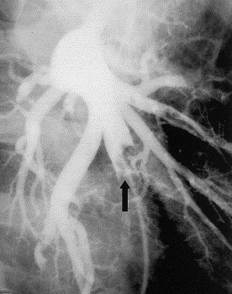
Outline
Definitions
Incidence
Predisposing conditions
Pathogenic sequelae
Clinical signs and physical exam
Diagnostics
Therapy
Prognosis
http://ars.els-cdn.com/content/image/1-s2.0-S089579670400016X-gr1.jpg

Slide 3
Definitions
Pulmonary thromboembolism: Obstruction of a pulmonary vessel(s) by a thrombus
Primary pulmonary thrombosis: Obstruction by local thrombus formation
Pulmonary embolism: Obstruction by translocation of a thrombus from elsewhere in the vascular system
Notes:
Pulmonary thrombosis and embolism are difficult to differentiate and the pathophysiologic sequelae are similar; therefore, most individuals refer to them collectively as pulmonary thromboembolism. Pulmonary embolism is thought to be more common than primary pulmonary thrombosis in veterinary species.

Slide 4
Incidence
True incidence unknown
0.9% prevalence rate in dogs over a 10 year period
0.06% prevalence rate in cats over a 24 year period
Notes:
Based on retrospective studies
Retrospective of 29 dogs admitted to a referral institution with confirmed postmortem PTE: antemortem suspicion in 11/17 dogs (65%) with compatible signs of a PTE; but suspected in only 11/29 (38%) with actual PTE diagnosis- Johnson LR, Lappin R, Baker DC: Pulmonary thromboembolism in 29 dogs: 1985-1999. JVIM 1999; 13 (4): 338-345.
Retrospective of 29 cats admitted to a referral institution with confirmed postmortem PTE: antemortem suspicion in 4/16 cats (25%) with compatible signs of a PTE: but suspected in only 4/29 (14%) with actual PTE diagnosis- Norris CR, Griffey SM, Samii VF: Pulmonary thromboembolism in cats: 29 cases (1987-1997). JAVMA 1999; 215 (11): 1650-1654.
Suggested incidence rate in cats from retrospective: Schermerhorn T, Pembleton-Corbett JR, Kornreich B: Pulmonary thromboembolism in cats. JVIM 2004; 18 (4): 533-535.
Prevalence rates are likely underestimates d/t low index of suspicion for occurrence as well as rapid clot lysis
50% of canine thrombi lyse within 3 hours of death therefore making prevalence rates based on necropsy difficult to interpret
Thrombi lyse rapidly d/t greater net plasminogen activator activity, greater platelet lytic activity and secretion of plasminogen activator from the endothelium

Slide 5
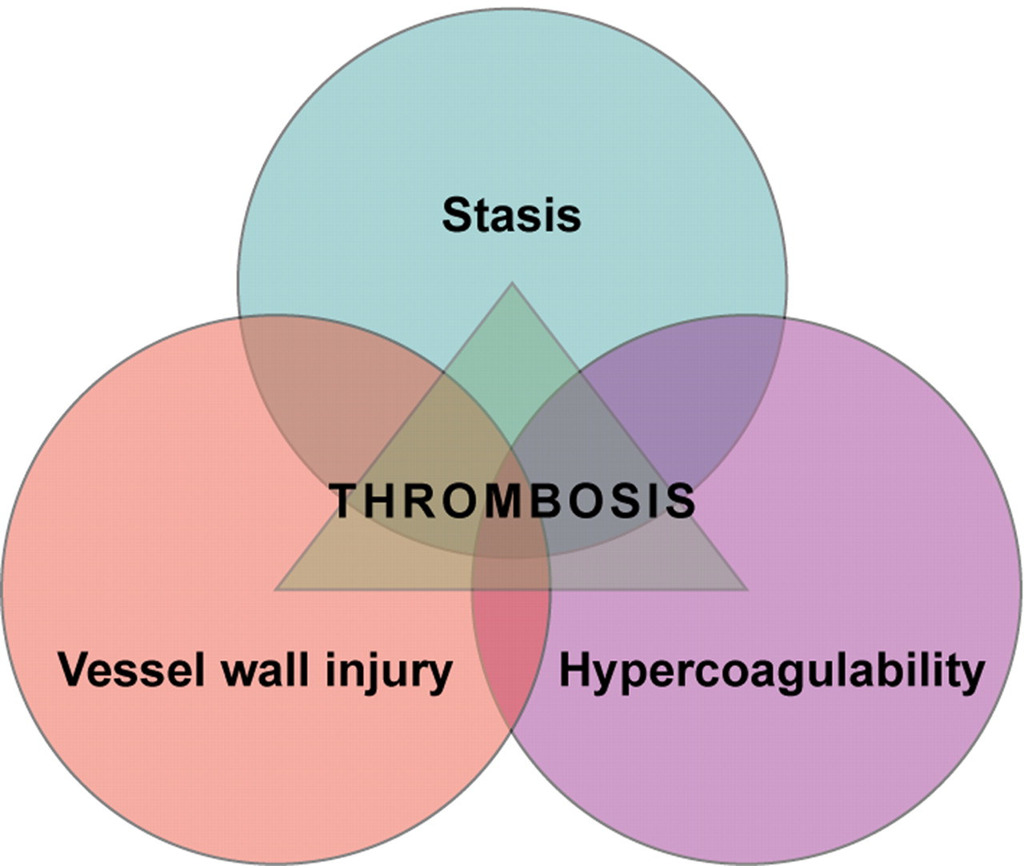
Predisposing Conditions
http://bloodjournal.hematologylibrary.org/content/114/6/1138/F1.large.jpg
Notes:
PTE has been associated with numerous conditions and disease states in both dogs and cats. When considering how these disease states predispose patients to pTE, all of them can be characterized according to how they impact on Virchow’s triad namely hypercoagulability, blood flow stasis, or endothelial injury.
With respect to PTE in humans, the most important component of Virchow’s triad is hypercoagulability, which occurs in >25% of patients with PTE. The majority of diseases that predispose to PTE in dogs and cats also confer hypercoagulable states.

Slide 6
Predisposing Conditions
Endocrine disease
Corticosteroid administration*
Protein-losing nephropathy/enteropathy*
Dirofilariasis*
Disseminated intravascular coagulation*
IMHA*
Pancreatitis*
Neoplasia*
Sepsis*
Surgery
Trauma*
Endocarditis
Indwelling venous catheters*
Feline infectious peritonitis*
Myocardial disease
Blastomycosis
Notes:
Asterik indicates also a predisposing condition in cats
Mechanism for predisposition hypercoagulability for all except indwelling venous catheter with blood flow stasis and endothelial injury contributing to predisposition in a variety of the conditions listed
Majority (59% and 64%) of dogs diagnosed with PTE in retrospective studies had >1 predisposing condition, while all 29 cats in one study had a predisposing condition (Norris study) and 15/16 cats had a predisposing condition (Schermerhorn study) approximately ½ (47%) of the cats had multiple predisposing processes present- Johnson LR, Lappin R, Baker DC: Pulmonary thromboembolism in 29 dogs: 1985-1999. JVIM 1999; 13 (4): 338-345.
LaRue MJ, Murtaugh RJ: Pulmonary thromboembolism in dogs- 47 cases (1986-1987). JAVMA 1990; 197 (10): 1368-1372.
Norris CR, Griffey SM, Samii VF: Pulmonary thromboembolism in cats: 29 cases (1987-1997). JAVMA 1999; 215 (11): 1650-1654.
Cemented 82% dogs 1 study vs. non-cemented 0 dogs thr
Imha- thromboembolic disease diagnosed in 20/25 dogs- carr study jvim 2007; thrombocytopenia, hyperbilirubinemia, hypoalbuminemia carried increased risk
Of causes, neoplasia most common in cats in both studies, cardiac disease also in norris
Neoplasia, imha, sepsis, pln most common dogs

Slide 7
Pathophysiologic Sequelae
Hypoxemia
  V/Q mismatch
    Small airway constriction, reduced surfactant, development of pulmonary edema and atelectasis
  Diffusion impairment
  Intrapulmonary shunt
Secondary hyperventilation
Notes:
Reduced surfactant d/t reduced delivery of surfactant components to the type II pneumocytes
Loss of surfactant leads to transudation of fluid into alveoli resulting in pulmonary edema
Pulmonary edema may also develop in non-embolized regions d/t increased hydrostatic pressure coupled with increased microvascular permeability induced by humoral factors like lipooxygenase pdts from activated neutrophils
Rarely pulmonary infarction and pleural effusion will result from complete occlusion of distal pulmonary vascular branches

Slide 8
Pathophysiologic Sequelae
Cardiovascular consequences variable
  Increased pulmonary vascular resistance
    >60% pulmonary vasculature occlusion before any change in pulmonary vascular resistance reduces arterial flow
    Reflex vasoconstriction d/t hypoxia, humoral factor release from activated platelets, neurogenic reflexes
  Pulmonary hypertension
  Increased right ventricular afterload
  Ventricular interdependence
Notes:
In healthy dogs
Right ventricular afterload results in right ventricular concentric hypertrophy eventually
Severe, acute increases in afterload will result in right ventricular dilation and dysfunction
As the right ventricle dilates, the interventricular septum will shift resulting in poor filling and diastolic distensibility (ventricular interdependence)
Results in poor cardiac output and forward flow failure in the severe, acute PTE
If patient survives and has residual pulmonary hypertension then can see signs of backward failure

Slide 9
Clinical Signs
Highly variable, inconsistent, nonspecific
Tachypnea, increased respiratory effort, depression
Coughing, hemoptysis, cyanosis, syncope, collapse, sudden death
Notes:
PTE should be suspected in the patient with no history of cardiopulmonary disease that presents with acute respiratory distress, particularly if that patient has a predisposing condition

Slide 10
Physical Examination
Harsh lung sounds, crackles
Muffled ventral lung/cardiac sounds
Tachycardia
Split or loud S2
Signs of forward failure: poor pulse quality, pale mucous membranes, prolonged capillary refill time
Signs of backward failure: ascites, hepatomegaly, pleural effusion, jugular venous distension

Slide 11
Diagnostics
Minimum database
Assessment of coagulation
Imaging

Slide 12
Minimum Database
Complete blood cell count
Chemistry
Urinalysis
Arterial blood gas
  Hypoxemia
  Hypocapnia
  Increased alveolar-arterial oxygen tension gradient
Notes:
CBC/Chem/UA are typically of limited value in the diagnosis of PTE
Serum cbc/chem/ua may be useful to identify predisposing conditions
In retrospective study 80% of dogs were hypoxemic, 47% were hypocapnic and 100% had an increased alveolar-arterial gradient; blood gas values for cats not reported- Johnson LR, Lappin R, Baker DC: Pulmonary thromboembolism in 29 dogs: 1985-1999. JVIM 1999; 13 (4): 338-345.
Poor oxygen responsiveness documented in 4/9 dogs in retro study above
Degree of hypoxemia is directly proportional to the extent of thromboembolic occlusion
Humans with a confirmed PTE who have an A-a gradient>53 have a poor prognosis

Slide 13
Coagulation Assessment
Utility of standard panel questioned
  PT and aPTT usually normal
    Prolongations noted in PT and PTT in 2/6 and 6/6 cases, respectively in cats
  Antithrombin levels decreased with hypercoagulable states
    Decreased levels associated with risk of thrombosis
      <50-75% associated with moderate risk, <30-50% associated with immediate/marked risk
  FDPs
    Non-specific
Notes:
Norris CR, Griffey SM, Samii VF: Pulmonary thromboembolism in cats: 29 cases (1987-1997). JAVMA 1999; 215 (11): 1650-1654.
AT inhibits factors II, IX, X, XI, XII
Decreased either as a result of consumption or decreased with underlying predisposing cause
%’s extrapolated from humans
FDPs and d-dimers are markers of fibrinolysis
D-dimers more specific as marker of fibrinolysis of cross-linked fibrin---marker of physiologic or pathologic fibrin formation

Slide 14
Coagulation Assessment
D-dimers
  Rapid, accurate bedside ELISA assays in human medicine
    In patients with a low clinical probability assessment, further diagnostics based on result of ELISA assay
  Semiquantitative latex agglutination assay sensitivity of 100% and specificity of 97% in dogs
  Diagnosis of thromboembolic disease in critically ill dogs
    Sensitivity 36% and specificity 98.5% using cutoff value >2000ng/mL
    Sensitivity 80% and specificity 94% using cutoff value >1000ng/mL
    Sensitivity 100% and specificity 70% using cutoff value >500ng/mL
  Overlap between thromboembolic disease, DIC and hemorrhage using point of care ELISA in dogs
Notes:
Stokol T, Brooks MB, Erb HN, et al: D-dimer concentrations in healthy dogs and dogs with disseminated intravascular coagulation. Am J Vet Res: 2000; 61 (4): 393-398.
Immunoturbidometric assay- 85% sensitivity and 77% specificity in dogs in same study
Study in critically ill dogs- Nelson OL, Andreasen C: The utility of plasma D-dimer to identify thromboembolic disease in dogs. JVIM 2003; 17 (6): 830-834.
From this study as a screening test using D-dimer with cutoff of 1000 best suited for assessing dogs with index of suspicion of PTE
Disadvantage of latex agglutination is time it takes to get value
Griffin A, Callan MB, Shofer PS, et al: Evaluation of a canine D-dimer point-of-care test kit for use in samples obtained from dogs with disseminated intravascular coagulation, thromboembolic disease, and hemorrhage. Am J Vet Res 2003; 64 (12): 1562-1569.
Experimentally- Ben S, Ni S, Shen H, et al: The dynamic changes of LDH isoenzyme 3 and D-dimer following pulmonary thromboembolism in canine. Thromb Res 2007; 120 (4); 575-583.
D-dimer significantly elevated at 30 minutes of induction of PTE and remain significantly elevated at 24 hours
Greatest at 2 hours and were >2000 at 1 and 2 hours.

Slide 15
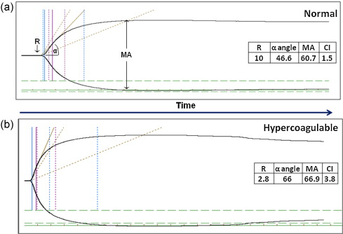
Diagnostics
Thromboelastography/thromboelastometry
  Have not been used in PTE studies in veterinary medicine
    Ability to illustrate hypercoagulability and predisposition to PTE likely better than antithrombin and d-dimer assays
http://ars.els-cdn.com/content/image/1-s2.0-S1569904812001735-gr2.jpg
Notes:
In human medicine, recent study demonstrated elevated MA on admission in trauma patients predisposes to eventual PTE formation

Slide 16
Imaging
Thoracic radiography
Pulmonary angiography
Nuclear medicine
Echocardiography
CT angiography
MRI

Slide 17
Thoracic Radiography
Confirm the suspicion of PTE
Report the effects of thrombosis
Demonstrate the lesion extent and location
Identify complications of PTE
Rule out other differentials for respiratory distress
Notes:
Suter in 1984 outlined 5 key objectives for assessing thoracic radiographs in suspected PTE cases

Slide 18
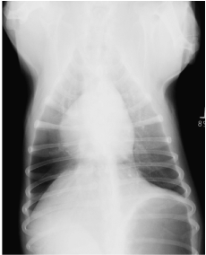
Thoracic Radiography
Pulmonary infiltrates
Regional oligemia or hypovascular areas (Westermark sign)
Pulmonary infarction- pleural based, wedge-shaped density
Pleural effusion
Pulmonary arterial dilation
Lobar vein or artery attenuation
Right-sided cardiomegaly
Notes:
Pulmonary infiltrates- interstitial to alveolar pattern representing areas of edema, atelectasis, hemorrhage or infarction- most common finding
Westermark sign rare; best seen on VD- represents areas of reduced blood flow distal to sites od thromboembolic occlusion

Slide 19
Thoracic Radiography
Most animals will have abnormal findings
  Only 9-27% of dogs with PTE have normal radiographs
  13/14 cats with PTE had abnormalities noted in one study; 5/5 cats in another
Suspect PTE in respiratory distress patient with normal radiographs
Suspect PTE in respiratory distress patient with abnormal radiographs inadequately explained by other disease
Notes:
Johnson LR, Lappin R, Baker DC: Pulmonary thromboembolism in 29 dogs: 1985-1999. JVIM 1999; 13 (4): 338-345.
LaRue MJ, Murtaugh RJ: Pulmonary thromboembolism in dogs- 47 cases (1986-1987). JAVMA 1990; 197 (10): 1368-1372.
Fluckiger MA, Gomez JA: Radiographic findings in dogs with spontaneous pulmonary thrombosis or embolism. Vet Radiol 1984; 25 (3): 124-131.
Schermerhorn T, Pembleton-Corbett JR, Kornreich B: Pulmonary thromboembolism in cats. JVIM 2004; 18 (4): 533-535.
Norris CR, Griffey SM, Samii VF: Pulmonary thromboembolism in cats: 29 cases (1987-1997). JAVMA 1999; 215 (11): 1650-1654.

Slide 20
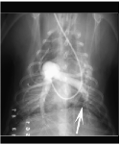
Pulmonary Angiography
Intraluminal filling defects
Abrupt pulmonary arterial termination
Complete absence of arterial branches (pruning)
Regional loss of vascularity, asymmetric blood flow, tortuous pulmonary arteries, premature tapering
Notes:
Previous gold standard for diagnosing PTE prior to CT angiography
Selective pulmonary angiography involves rapid bolus injection of contrast directly into the pulmonary artery via a PA catheter
A normal scan essentially rules out a PTE
Typically performed under GA d/t PA catheterization (though reported in awake dogs)
Can perform non-selective angiography in patients that don’t want to place under GA- injected via a wide-bore jug cath- less sensitive because contrast medium dilution + superimposition of structures

Slide 21
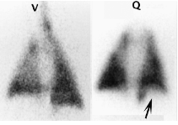
Nuclear Medicine
Perfusion scan
  Photopenic wedges-shaped, pleural based defect with a lobar/segmental distribution
Ventilation scan
Thoracic radiography
Notes:
Radionuclide blood labelling to evaluate pulmonary perfusion and radionuclide labelling of inspired air to evaluate ventilation enables areas of V/Q mismatch to be identified
Perfusion scanning is performed using an IV injection of technetium-labelled macroaggregated albumin that is distributed in proportion to pulmonary blood flow
Inhomogenous distribution
Ventilation scans uncommonly performed in patients in respiratory distress
Can compare perfusion scans with thoracic rads alone to identify pathology on chest rads that could be contributing to changes in perfusion noted on perfusion scan
CT has signfiicantly reduced the number of V/Q scans being performed in humans
Downfall- hot after

Slide 22
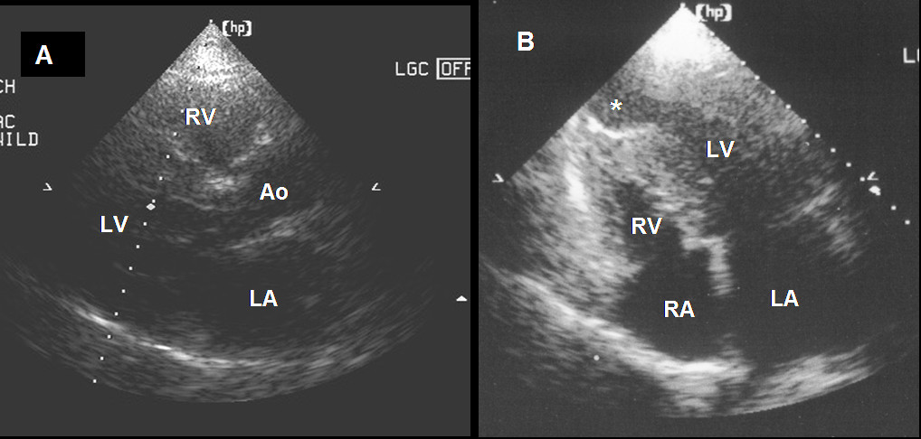
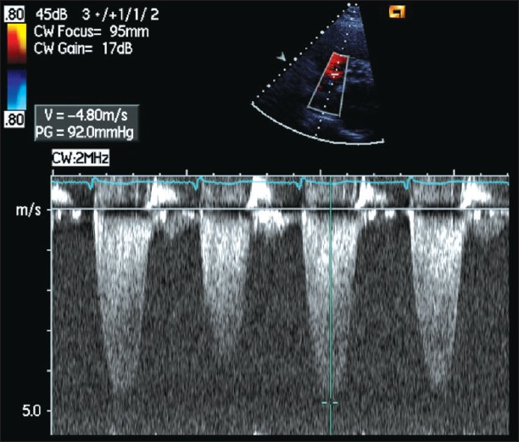
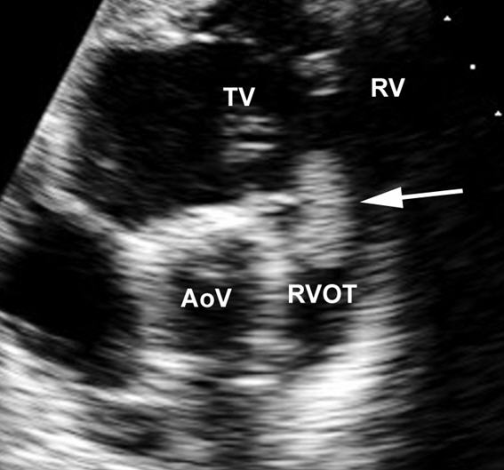
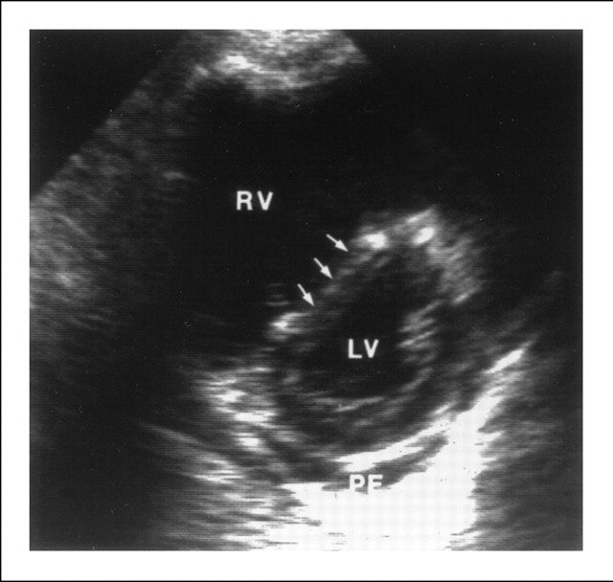
Echocardiography
Right ventricular dilation and hypokinesis
Ventricular septal flattening
Left ventricular diastolic dysfunction
Pulmonary hypertension
Right ventricular hypertrophy
Patency of the foramen ovale
Visualization of thrombus
McConnell sign
http://www.pvrireview.org/articles/2009/1/3/images/PVRIReview_2009_1_3_180_54760_u3.jpg
http://www.cardiovascularultrasound.com/content/figures/1476-7120-4-15-2-l.jpg
https://annals.org/data/Journals/AIM/20006/12FF1.jpeg
http://journal.nzma.org.nz/journal/120-1261/2709/content01.jpg
Notes:
Allows identification of cardiac or RV outflow tract thrombosis and also the cardiovascular consequences of PTE
It is a safe, noninvasive imaging technique that provides rapid assessment
In one study 94% human patients with angiographically confirmed PTE had echocardiographic abnormalities
Other studies have shown that up to 20% of patients have normal scans, therefore, not recommended as a routine imaging technique
Not recommended as a routine imaging technique in humans; still 47-74% of patients with PTE have echo performed
Most useful in patients with severe, acute PTE and cardiogenic shock
30% occlusion of pulmonary vasculature- cutoff to see consistent changes in humans’ RV function
McConnell sign- moderate to severe hypokinesis of entire right ventricular free wall EXCEPT apex- sens of 77% and spec for 94% for diagnsois fo PTE

Slide 23
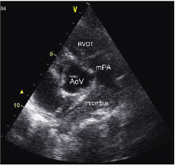
Echocardiography
Primarily used to visualize thrombus in veterinary patients
May be used to visualize cardiac manifestations of PTE
  17% of dogs in retrospective on PTE evaluated with echo
    2/5 had cardiac changes
Use to rule out cardiac causes of respiratory distress
Notes:
Lacks specificity, but safe,noninvasive and relatively accessible
Johnson LR, Lappin R, Baker DC: Pulmonary thromboembolism in 29 dogs: 1985-1999. JVIM 1999; 13 (4): 338-345.

Slide 24
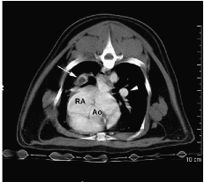
CT Angiography
Very high sensitivity and specificity for detecting PTEs
Directly identifies thrombus as filling defect
Permits visualization to fifth generation of PA branches
Notes:
Early studies of spiral CT angiography detection of PTE in humans reported very high sensitivity (100%) and specificity values (96%). Two human reports from 2000 demonstrated consistently high sensitivity (87%) and specificity (91%) values.
Particularly good at detecting main, lobar and segmental pulmonary arterial thrombi
Poor sensitivities when subsegmental PA thrombi included (86%); very rare (only 6% of human cases) confined to subsegmental vessels
Rapid test
Largely replaced pulmonary angiography and nuclear scintigraphy
Tidwell SA, Graham JP, Peck JN, et al: Incidence of pulmonary embolism after non-cemented total hip arthroplasty in eleven dogs: computed tomographic pulmonary angiography and pulmonary perfusion scintigraphy. Vet Surg 2007; 36(1): 37–42.

Slide 25
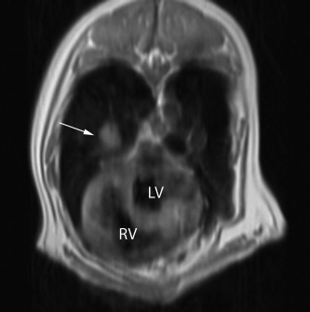
MRI
Safe, noninvasive
Permits direct thrombus visualization
Requires general anesthesia
http://ars.els-cdn.com/content/image/1-s2.0-S1090023308004127-gr4.jpg
Notes:
Safe, noninvasive
Requires GA
Via a heavily T1-weighted image

Slide 26
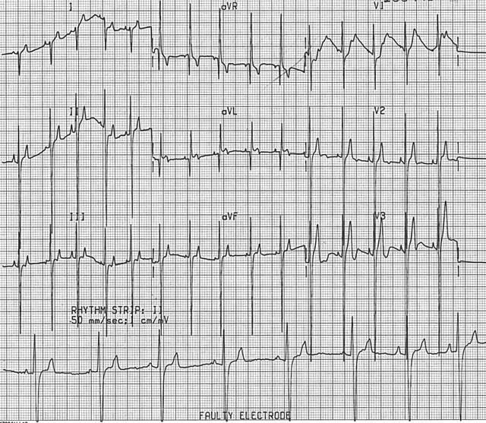
Other Diagnostics
Electrocardiography
  Changes uncommon in acute PTE
  Sinus tachycardia most common
  With severe pulmonary hypertension may see changes
    Right axis deviation
    Increased S wave amplitude in leads I and II
    Increased T wave amplitude
    Tall, narrow P waves
http://www.ovc.uoguelph.ca/ClinStudies/courses/Public/Cardiology/Images/Right%20Ventricular%20Enlargement%20in%20the%20Dog.jpg
Notes:
ST most common associated with sympathetic stim secondary to hypotension or hypoxemia
Tall, narrow P waves= P pulmonale secondary to right atrial

Slide 27
Other Diagnostics
Troponins
  In humans, echocardiographic right ventricular dysfunction secondary to PTE is associated with increased cTn
    Meta-analysis revealed that humans with PTE and elevated cTn are at an increased risk of short-term death
Notes:
Cardiac troponins are highly specific for myocardial cell injury
Experimentally evaluated in dogs- troponin values correlated with pulmonary vascular resistance
Evaluated clinically in dogs with heartworm infection- also correlated

Slide 28
Diagnostic Approach
Identify patient at risk
Thoracic radiography
Arterial blood gas analysis
Echocardiography
CT angiography, pulmonary angiography or nuclear scintigraphy
Coagulation assessment to identify patients at risk
Notes:
In rare cases, diagnosis may be made with use of thoracic radiography and ABG alone

Slide 29

Therapy
Supportive care
Treatment of underlying disease
Thrombolytic therapy
Thromboembolic therapy
http://i1.cpcache.com/product/626157295/stop_the_clot_t.jpg?height=380&width=380

Slide 30
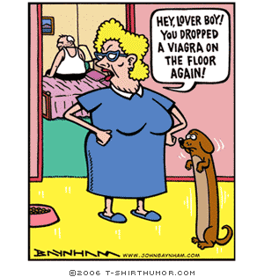
Supportive Care
Oxygen therapy
Mechanical ventilation if indicated
Maximize oxygen delivery
  Judicious, targeted fluid therapy
  Vasopressors if indicated
  Red blood cells if indicated
Bronchodilators
Positive inotropes
Venodilator therapy
Pulmonary arterial vasodilatory therapy
Notes:
Should mech ventilation be required, efforts should be made to increase positive intrathoracic pressure as little as possible; positive intrathoracic pressure will have a detrimental impact on pulmonary vascular resistance, worsening cardiovascular effects of PTE
Maximize perfusion to maximize oxygen delivery
Use care with fluids b/c if rv overdistension, then impaired lv filling and ultimately cardiac output and coronary perfusion
Bronchodilators may be beneficial- in addition to bronchodilation bronchodilators like theophylline may induce pulmonary vasodilation, as well as reduce resp muscle fatigue and improve diaphragmatic contractility
Positive inotropes may be considered in cardiogenic shock; however may increase PA pressures and of course increase susceptibility to arrhythmias
Venodilator therapy may be useful to treat reflex pulmonary vasoconstriction which contributes to PVR in PTE
Nitric oxide has been shown to decease mean pulmonary artery pressure in canine models and in humans
Sildenafil (specific phosphodiesterase 5 inhibitor)- causes selective pulmonary arterial vasodilation, thereby attenuating pulmonary hypertension

Slide 31
Thrombolytics
Streptokinase*
Anisoylated plasminogen streptokinase complex (anistreplase)
Urokinase*
Tissue-plasminogen activator (t-PA, alteplase)*
Modified recombinant t-PA (reteplase and tenecteplase)
Notes:
Therapeutic thrombolysis involves the administration of supraphysiologic doses of plasminogen activators systemically or locally at the site of thrombosis
Thrombolytic agents increase the conversion of plasminogen to plasmin and help to overcome plasmin inhibition by plasminogen activator inhibitor-1
Can reverse the effects of pulmonary hypertension and right sided heart failure by inducing rapid thrombus dissolution, prevent ongoing neurohumoral factor release, improve systemic and pulmonary hemodynamics and reduce the likelihood of recurrence
These agents vary in their pharmacokinetics, thrombolytic activity, and fibrin specificity (preference for fibrin-bound versus circulating plasminogen). Fibrin-specific thrombolytics have increased clot lysis efficacy, a longer duration of activity, and a reduced risk of hemorrhage compared with less specific agents.

Slide 32
Streptokinase
Purified streptococcal protein
Binds plasminogen promoting conversion to plasmin
Not fibrin-specific
Used effectively in 4 dogs with thrombosis and one dog with PTE
Use associated with increased mortality in cats with ATE
Notes:
Because not fibrin-specific, readily binds circulating plasminogen
Moore KE, Morris N, Dhupa N, et al.: Retrospective study of streptokinase administration in 46 cats with arterial thromboembolism. J Vet Emerg Crit Care 2000; 10(4):245–257.
Ramsey CC, Burney DP, Macintire DK, et al. Use of streptokinase in four dogs with thrombosis. J Am Vet Med Assoc 1996;209(4):780–785.
Whelan MF, O’Toole TE. The use of thrombolytic agents. Comp Contin Edu Prac Vet 2007; 29(8):476–482.
Johnson LR, Lappin R, Baker DC: Pulmonary thromboembolism in 29 dogs: 1985-1999. JVIM 1999; 13 (4): 338-345.

Slide 33
Urokinase
Produced commercially from cultured neonatal kidney cells
Directly converts plasminogen to plasmin
More fibrin-specific than streptokinase
Use reported in 1 dog with PTE
Use described in 12 cats with ATE (42% survival rate)
Notes:
But still may bind circulating plasminogen
Not associated with significant hemorrhage in ATE study
Whelan MF, O’Toole TE, Chan DL, et al: Retrospective evaluation of urokinase use in cats with arterial thromboembolism. J Vet Emerg Crit Care 2005; 15(S1):S8.
Whelan MF, O’Toole TE, Chan DL, et al: Retrospective evaluation of urokinase use in dogs with thromboembolism (4 cases): 2003– 2004. J Vet Emerg Crit Care 2005; 15(S1):S8.

Slide 34
T-PA
Directly converts plasminogen to plasmin
Fibrin-specific
Alteplase (recombinant form of human t-PA) derived from mammalian cell culture
  Shortest half-life
  Use described in 6 cats with ATE (50% survival)
  Use described in 1 dog with ATE
  Used in experimental models of PTE
Modified recombinant forms of t-PA (reteplase, tenecteplase) have longer half-lives
Notes:
Pion PD: Feline aortic thromboemboli and the potential utility of thrombolytic therapy with tissue plasminogen activator. Vet Clin North Am Small Anim Pract 1988; 18(1):79–86.
Clare AC, Kraje BJ: Use of recombinant tissue-plasminogen activator for aortic thrombolysis in a hypoproteinemic dog. J Am Vet Med Assoc 1998; 212(4):539–543.
Shiffman F, Ducas J, Hollett P, et al: Treatment of canine pulmonary hypertension with recombinant tissue plasminogen activator. Circulation 1988; 78(1):214–220.

Slide 35
Thrombolytics
No specific recommendations in veterinary medicine
American College of Chest Physicians
  Most humans with PTE do not require thrombolytics
May be indicated in hemodynamically unstable acute PTE
Alteplase therapy recommended
Notes:
Lunsford KV, Mackin AJ: Thromboembolic therapies in dogs and cats: an evidence-based approach. Vet Clin Small Anim 2007; 37(3):579–609.
33/108 patients with massive PTE receive thrombolytics based on results from the International Cooperative Pulmonary Embolism Register

Slide 36
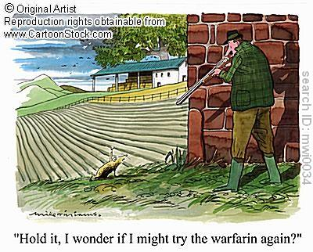
Thromboembolic Therapy
Parenteral anticoagulants
Oral anticoagulants
Parenteral antiplatelet agents
Oral antiplatelet agents
Notes:
Goals of therapy
Minimize thrombus propagation
Prevent recurrence of PTE

Slide 37
Parenteral anticoagulants
Unfractionated heparin (UFH)*
Low-molecular-weight heparin (LMWH)*
Synthetic selective FXa inhibitors*
  Fondaparinux
Injectable direct thrombin inhibitors (DTI)
  Argatroban
  Lepirudin
  Melagatran
Notes:
Rapidly initiated parenteral anticoagulants are the foundation of treatment in human acute PTE
*- evaluated for tx/prevention in humans with PTE

Slide 38
Unfractionated Heparin
Complexes with and amplifies antithrombin activity
  Heparin:AT complexes inhibit FIIa and FXa; IXa, XIa, XIIa, XIII also inhibited
Variation in the distribution of heparin molecules in UFH leads to variation in biologic effects and pharmacokinetics
Monitor with aPTT or ACT to achieve therapeutic activity and minimize risk
  Recommend prolongation of the aPTT to 1.5-2.5 times baseline value
Notes:
Thrombin inactivation prevents firin formation and reduces thrombin-induced platelet activation
IV administration titrated to a predefined aPTT endpoint remains the most widely used strategy for the initial management of PTE in humans
IV UFH or SC LMWH are appropriate for the treatment of acute nonmassive PTE in humans as recommended by the Seventh ACCP Conference on Antithrombotic and Thromboembolic Disease

Slide 39
Low-Molecular-Weight Heparins
Produced from UFH by chemical/enzymatic depolymerization
Developed to have more consistent biologic effects and pharmacokinetics than UFH
  In humans LMWHs have a predictable dose response and longer half-life
    Intermittent dosing possible without routine anti-FXa monitoring in humans
  SQ administration possible in dogs with therapeutic anti-FXa levels able to be achieved
  Pharmacokinetics in cats less predictable; high doses often required
Notes:
No studies have evaluated efficacy of LMWH in the resolution of naturally occurrin ptE in dogs or cats
Enoxaparin or dalteparin

Slide 40
Fondaparinux
Synthetic, selective, antithrombin-dependent indirect FXa-inhibitor with no anti-FIIa activity
Evaluated in a large randomized trial of humans with acute PTE (UFH vs. fondaparinux)
  No difference in bleeding risk
  Fewer PTE recurrences with fondaparinux
No studies in veterinary medicine

Slide 41

Oral anticoagulants
Warfarin*
FXa inhibitors (rivaroxaban and apixaban)
Direct thrombin inhibitor (dabigatran and ximelagatran)
http://alpinevetshospital.com/clients/6363/images/photo_38__1_1.JPG
Notes:
Ximelagastran resulted in hepatoxicity and adverse cardiovascular events--- withdrawn
Currently no Fxa inhibtiros or DTIs are approved

Slide 42
Warfarin
Therapeutic vitamin K1 agonist
  Acts by inhibiting Vitamin K epoxide reductase, thereby preventing recycling
  Prevents carboxylation of FII, FVII, FIX, FX
  Inhibits vitamin K-dependent anticoagulants proteins C/S
Narrow therapeutic index and hemorrhage possible risk
Therapy adjusted to achieve a PT prolongation of 1.25-2x baseline or anti-FXa activity between 0.35-0.7 U/mL
Notes:
Short-term heparinization is recommended during initation of warfarin therpapy d/t hypercoagulability

Slide 43
Oral Antiplatelet Agents
Thromboxane synthesis inhibitors
  Aspirin
Thienopyridine P₂Y₁₂ ADP receptor antagonists
  Clopidogrel, ticlopidine
Notes:
Oral antiplatelet agents are used mostly for longterm maintenance preventative potentially in conjunction with anticoagulants

Slide 44
Oral Antiplatelet Agents
Aspirin
  Irreversibly acetylates platelet COX-1, inhibiting
  Produces an antithrombotic state over a wide dosing range
  0.5mg/kg PO Q24hrs for dogs, 5mg per cat Q72hrs for cats
Thienopyridines
  Clopidogrel causes cumulative platelet inhibition
  In humans, marginally more effective than aspirin; often used in conjunction with
  Eagerly awaiting the results of the FATCAT study
Notes:
Inhibition of COX-1 inhibits the enzymes and prevents conversion of AA to prostaglandin H2, precursor for thromboxane A2 in platelets which induces aggregation
Concerns over myelotoxicity associated with ticlopidine has led to it being superseded by clopidogrel
Specific recommendations regarding aspirin and clopidogrel in PTE cannot be made in vet med due to lack of evidence

Slide 45
Injectable Antiplatelet Agents
α_{IIb}β₃ integrin receptor antagonists
  Abciximab*
  Tirofiban
  Eptafibatide
Notes:
Only abciximab has been used safely in cats
Eptifibatide causes fatal cardiotoxicity- should not be used

Slide 46
Other Preventative Therapies
Surgical thrombectomy
Minimally invasive techniques
  Balloon dilatation or angioplasty
  Vascular stenting
  Embolic trapping devices
  Pharmacomechanical thrombectomy (PMT) devices
Notes:
Surgical thrombectomy has only been sporadically reported in the veterinary liter- ature.15,16 A study of dogs with adrenal tumors and tumor-induced thrombi in the vena cava reported that adrenalectomy and thrombectomy resulted in acceptable outcomes.15 Another case report documented that a cat with primary hyperaldosteronism and caval thrombus was successfully manage by surgical thrombectomy.16 To the author ’s knowledge, surgical arterial thrombectomy has not been reported in the veterinary literature.
Balloon dilatation or angioplasty of atherosclerotic lesions have been performed for a number of years in human medicine (Figure 1). Angioplasty has been used to plasty clots up against vessel walls thus quickly restoring patency. This technique has mostly been applied to smaller caliber vessels over short segments. Examples of vessels where this technique may be applied include deep vein thrombosis of the femoral or popliteal veins. Some concerns regarding the use of this procedure include reocclusion of the vessel, espe- cially if the patient remains hypercoagulable, and pulmonary embolism during the angioplasty or peri- operatively.14,19,20 In patients at high risk of pulmonary emboli, a caval filter can be placed.
The placement of an endovascular stent in people increases long-term patency rates.21,22 Another novel approach is the use of drug eluting balloons. Recently, the antiproliferative agent paclitaxel has been used to coat angioplasty bal- loons to reduce restenosis following balloon dilatation of peripheral artery disease secondary to atherosclero- sis.22
To date, a case report describes 2 dogs that presented with pace- maker-induced thrombosis of the cranial vena cava that were successfully treated with catheter-directed thrombolysis and balloon dilatation.22
Various nitinol-based vascular stents have been devel- oped to treat both arterial and venous peripheral vas- cular disease including thrombosis in people (Figure 2). Stents are nonthrombogenic and do not appear to be associated with an increased risk of thrombosis at the implantation site; however, as they are often used in hypercoagulable patients, anticoagulants possibly in combination with thrombolytics are most often used.19,20,2
In small animal patients, there are no published re- ports of the use of stents specifically to treat thrombo
arious devices ranging from baskets to ‘spider-like’ endovascular implants have been developed in people to trap emboli and prevent them from reaching the lungs. This is particularly important with caval im- plants in the presence of deep vein thrombosis. Once trapped, emboli can undergo fibrinolysis.29,30 The most commonly used embolic trapping devices are vena cava filters, which are placed in 3–11% of people with deep vein thrombosis
0 Filters are most commonly inserted fluoroscopically into the caudal vena cava just under the lowest renal vein in order to trap emboli emanating from the femoral or popliteal veins; how- ever, they may also be placed in the cranial vena cava. Filters can be placed either through the jugular vein or through the femoral vein depending on the desired site of deployment and the size of the patient. Filters must be placed down stream from the clot.29–33 These devices can be permanent or retrieved once the thrombotic disease is under control. Filters can be made of nitinol or stainless steel and are biocompatible and non- thrombogenic. Some complications reported with these filters include migration and tearing or the perforation of the cava.
PMT can be divided into wall contact devices and non- wall contact devices. A nonwall contact device, the Angiojet system,b has undergone evaluation in a small number of cats.11 The Angiojet system emits high ve- locity saline jets that are directed backwards from the tip of the device to outflow channels creating a local- ized low-pressure zone (Venturi-Bernoulli effect). These flow jets generate a vacuum force that draws the thrombus back into the catheter. The jets break the thrombus into small fragments that are propelled into the lumen of the catheter and aspirated. Aspiration of these fragments is meant to remove the thrombotic de- bris without their embolization.11,20,32 The device must be inserted into the affected vessel and advanced until it reaches the clot and therefore may be size restrictive in some patients. The smallest catheter available for the Angiojet is 4-Fr. Although this system has been used successfully in cats with distal aortic thromboem- bolism, reperfusion injury was reported following thrombectomy.11 50% survival rate. In human medicine, instead of using saline flush, there are recommendations to use tissue plasminogen activator in the flush to improve thrombolysis at the clot and distal to it.20,32 This com- bined approach may improve outcome.
PMT can be divided into wall contact devices and non- wall contact devices. A nonwall contact device, the Angiojet system,b has undergone evaluation in a small number of cats.11 The Angiojet system emits high ve- locity saline jets that are directed backwards from the tip of the device to outflow channels creating a local- ized low-pressure zone (Venturi-Bernoulli effect). These flow jets generate a vacuum force that draws the thrombus back into the catheter. The jets break the thrombus into small fragments that are propelled into the lumen of the catheter and aspirated. Aspiration of these fragments is meant to remove the thrombotic de- bris without their embolization.11,20,32 The device must be inserted into the affected vessel and advanced until it reaches the clot and therefore may be size restrictive in some patients. The smallest catheter available for the Angiojet is 4-Fr. Although this system has been used successfully in cats with distal aortic thromboem- bolism, reperfusion injury was reported following thrombectomy.11 In human medicine, instead of using saline flush, there are recommendations to use tissue plasminogen activator in the flush to improve thrombolysis at the clot and distal to it.20,32 This com- bined approach may improve outcome.

Slide 47
Prognosis
Guarded
  Challenge of diagnosis
  Delay in initiation of appropriate of therapy
  Potential ineffectual therapeutic concentrations of antithrombotic medications achieved
Notes:
Exact numbers unfortunately are not available
Most of the retrospective studies are based on necropsy-confirmed diagnosis of PTE and therefore deducing rates for prognosis are difficult

Slide 48
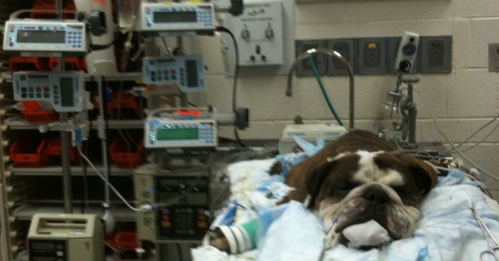
Questions?

Slide 49
References
Ben S, Ni S, Shen H, et al: The dynamic changes of LDH isoenzyme 3 and D-dimer following pulmonary thromboembolism in canine. Thromb Res 2007; 120 (4); 575-583.
Clare AC, Kraje BJ: Use of recombinant tissue-plasminogen activator for aortic thrombolysis in a hypoproteinemic dog. J Am Vet Med Assoc 1998; 212(4):539–543.
Fluckiger MA, Gomez JA: Radiographic findings in dogs with spontaneous pulmonary thrombosis or embolism. Vet Radiol 1984; 25 (3): 124-131.
Goggs R, Benigni L, Fuentes VL: Pulmonary thromboembolism. JVECC 2009; 19 (1): 30-52.
Griffin A, Callan MB, Shofer PS, et al: Evaluation of a canine D-dimer point-of-care test kit for use in samples obtained from dogs with disseminated intravascular coagulation, thromboembolic disease, and hemorrhage. Am J Vet Res 2003; 64 (12): 1562-1569.
Johnson LR, Lappin R, Baker DC: Pulmonary thromboembolism in 29 dogs: 1985-1999. JVIM 1999; 13 (4): 338-345.
LaRue MJ, Murtaugh RJ: Pulmonary thromboembolism in dogs- 47 cases (1986-1987). JAVMA 1990; 197 (10): 1368-1372.
Moore KE, Morris N, Dhupa N, et al.: Retrospective study of streptokinase administration in 46 cats with arterial thromboembolism. J Vet Emerg Crit Care 2000; 10(4):2
Nelson OL, Andreasen C: The utility of plasma D-dimer to identify thromboembolic disease in dogs. JVIM 2003; 17 (6): 830-834.
Norris CR, Griffey SM, Samii VF: Pulmonary thromboembolism in cats: 29 cases (1987-1997). JAVMA 1999; 215 (11): 1650-1654.
Pion PD: Feline aortic thromboemboli and the potential utility of thrombolytic therapy with tissue plasminogen activator. Vet Clin North Am Small Anim Pract 1988; 18(1):79–86.
Ramsey CC, Burney DP, Macintire DK, et al. Use of streptokinase in four dogs with thrombosis. J Am Vet Med Assoc 1996;209(4):780–785.
Schermerhorn T, Pembleton-Corbett JR, Kornreich B: Pulmonary thromboembolism in cats. JVIM 2004; 18 (4): 533-535.
Shiffman F, Ducas J, Hollett P, et al: Treatment of canine pulmonary hypertension with recombinant tissue plasminogen activator. Circulation 1988; 78(1):214–220.
Stokol T, Brooks MB, Erb HN, et al: D-dimer concentrations in healthy dogs and dogs with disseminated intravascular coagulation. Am J Vet Res: 2000; 61 (4): 393-398.
Tidwell SA, Graham JP, Peck JN, et al: Incidence of pulmonary embolism after non-cemented total hip arthroplasty in eleven dogs: computed tomographic pulmonary angiography and pulmonary perfusion scintigraphy. Vet Surg 2007; 36(1): 37–42.
Whelan MF, O’Toole TE. The use of thrombolytic agents. Comp Contin Edu Prac Vet 2007; 29(8):476–482
Whelan MF, O’Toole TE, Chan DL, et al: Retrospective evaluation of urokinase use in cats with arterial thromboembolism. J Vet Emerg Crit Care 2005; 15(S1):S8.
Whelan MF, O’Toole TE, Chan DL, et al: Retrospective evaluation of urokinase use in dogs with thromboembolism (4 cases): 2003– 2004. J Vet Emerg Crit Care 2005; 15(S1):S8.

