Slide 1
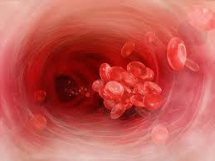
Viscoelastic Coagulation
Monitoring
Dr. April Blong
November , 2012
Cornell University

Slide 2
Plan
History and background
Why viscoelastic testing is different
Viscoelastic testing options
  Sonoclot
  ThromboelastographyTM
  ThromboelastometryTM
Questions

Slide 3
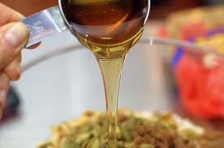
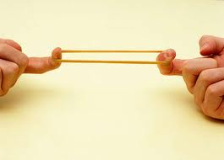
What is viscoelasticity?
Viscosity
  Ability of a fluid to resist shear flow and strain when stress is applied
  “Fluidity” of movement
  Affected by hematocrit
Elasticity
  Ability of a material to return to its original shape after being deformed by stress
  “Firmness”
  Affected by platelets and fibrin
A material that exhibits both elastic and viscous properties

Slide 4
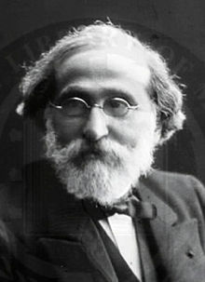
History
1889 – Georges Hayem
  Hematologist & physician in Paris
  Changes in blood viscosity during clotting could be used to test coagulation function
  Leçons de therapeutique vol 1-5
  “Therapeutic Lessons”
  Free from B&N for your Nook

Slide 5
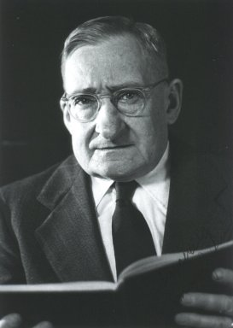

Traditional testing
PT
  1935 – Dr. Armand Quick
  Add tissue factor & Ca++ ….wait
PTT
  1953 – University of North Carolina Chapel Hill
  Add phospholipid, activator, and Ca++….wait
ACT
  1966 – Dr. Paul Hattersley
  12 g diatomacious earth and stir bar…wait
End when the first fibrin strands form

Slide 6
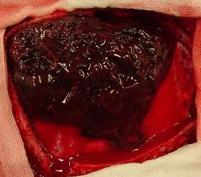
Importance
But in real life coagulation continues….
  Kinetics of clot development
  Clot strength
  Clot retraction
  Fibrinolysis
How do we measure these things?

Slide 7

Back to History…
1910 – Koffman
  Introduced the coaguloviscometer
  Detected viscous changes in blood during coagulation
1923 – Kugelmass
  Alternative viscosimeter
  Bases of modern thromboelastograph

Slide 8
Advantages
Many sample options
  PPP, fresh WB, citrated WB
Rapid turn around
  Most information within 30 minutes or less
  Normal fibrinolysis may take longer
Small sample volumes
Can detect hypercoagulability
Measures global clot formation in real-time

Slide 9
Advantages
No studies show direct correlation between conventional testing and perioperative blood loss
  Not developed for prediction of hemorrhage or to predict transfusion therapy
Clotting is induced under low shear conditions
  Similar to in vivo venous clotting
Useful for guiding transfusion and anti-thrombotic therapy
And…

Slide 10
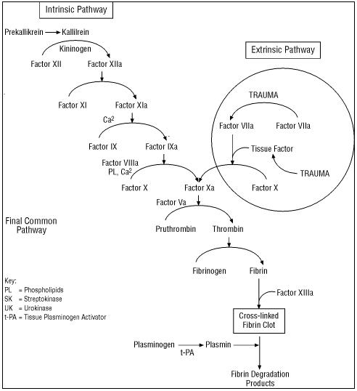
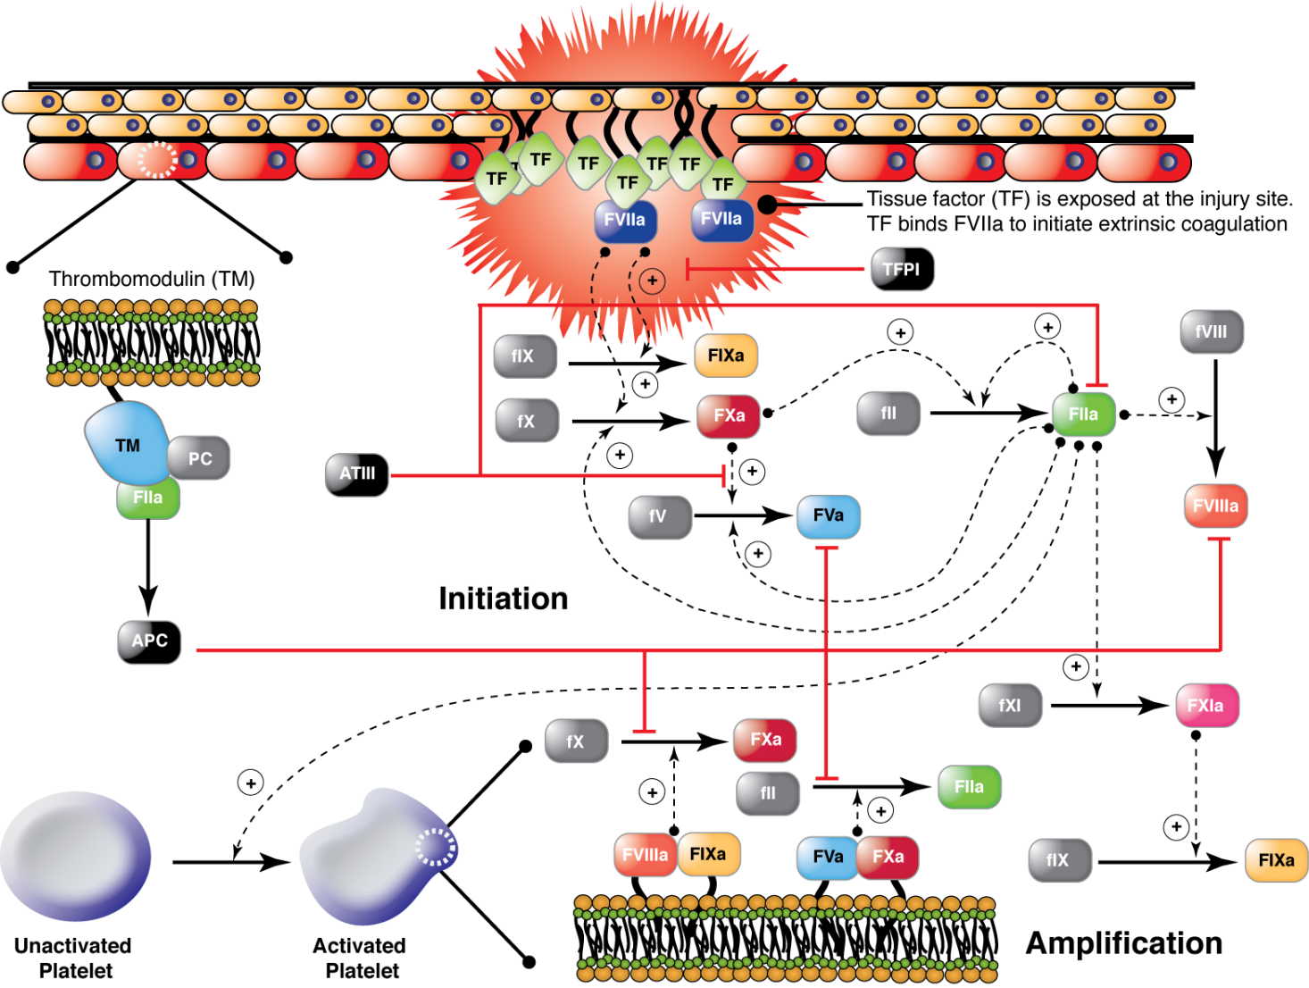
In vivo coagulation is very complex
  Platelets
  TF bearing cells
  Microparticles
  Endothelium
Traditional coagulation tests performed with plasma
More “global” assessment of coagulation

Slide 11
Disadvantages
Most are at least somewhat insensitive to aspirin therapy
  Activators result in generation of thrombin - may mask effects of anti-thrombotic agents
Variations in hematocrit
  Polycytemia → hypocoagulable
  Anemia → hypercoagulable
  Most ill pets do not have normal Hct
Cannot compare different methods, sample types, activators
  Production of FXIIa via contact activation
Endothelium still not involved
Lack of standardization
  Between labs, types and amount of activator, ect
Normal ranges?

Slide 12
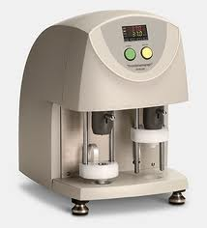
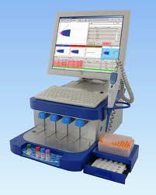
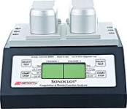
Viscoelastic options
Sonoclot
ThromboelastographyTM
ThromboelastrometryTM

Slide 13
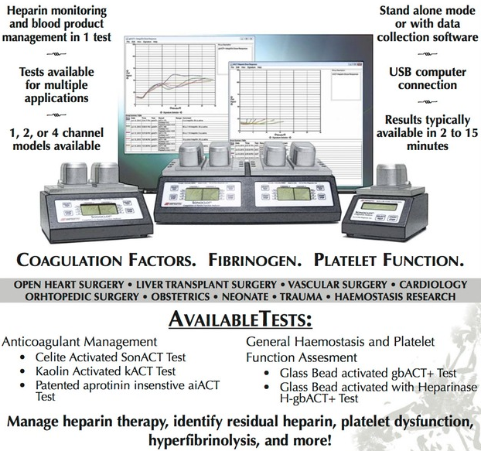
Sonoclot®

Slide 14
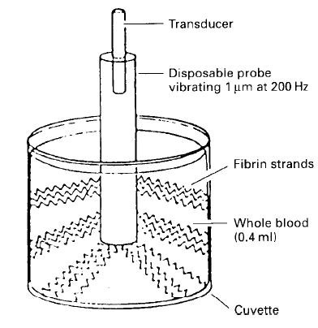
Sonoclot®
1975 – von Kaulla
Made by Sienco, Colorado, USA
Output = Sonoclot Signature
  Signature ViewerTM software
Hollow plastic probe oscillates up and down
  Moves 1 μm @ 200 Hz
Sample – 0.4 ml

Slide 15
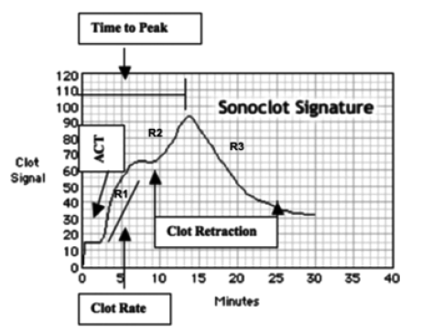
SonACT or onset time
  Time until upward deflection of 1 mm
  Start of fibrin formation
R1 or Clot Rate
  Slope indicates rate of fibrin formation
  Can indentify hypercoagulability
  Management of anticoagulant therapy

Slide 16
“Shoulder”
  Variably present
  Lag then the start of clot contraction
R2
  Represents platelet action resulting in contraction, further fibrin formation, & fibrin polymerization
  Platelet function (PF) calculated from this value

Slide 17
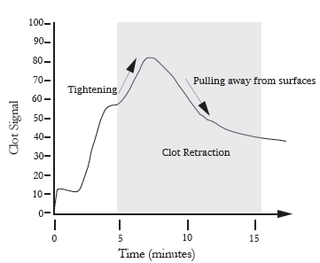
R3
  Platelet retraction and the clot is pulling away from the cuvette walls
  Reflection of platelet number and function
Peak
  Represents completion of fibrin formation
  Time to peak (TP) is related to the rate of conversion of fibrinogen→fibrin (platelet fx)
  Amplitude (PCS) is related to [fibrinogen]

Slide 18
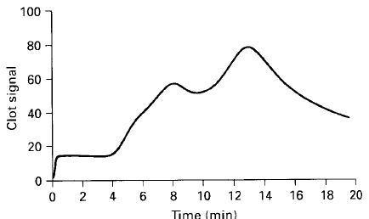
Normal signature

Slide 19
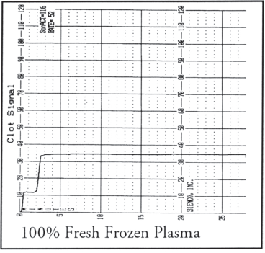
Fresh frozen plasma
Firbrin gel forms quickly
No retraction

Slide 20
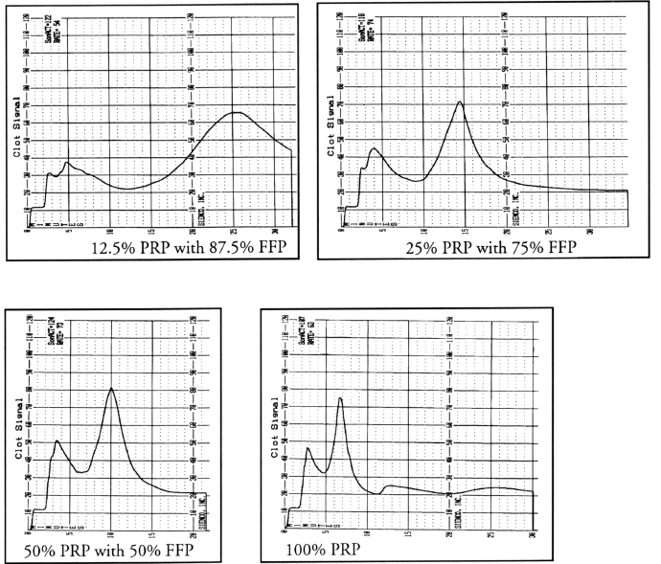
Adding platelets
As the plt count increases, the rate of clot retraction increases
Amplitude does not change

Slide 21
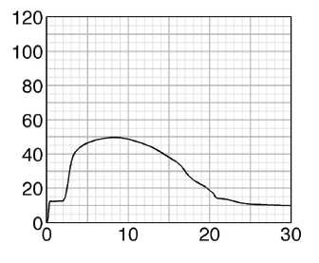
Hyperfibrinolysis
Fibrinolysis only seen when it is increased
Platelet function is reduced
No rise as normally seen with clot retraction
As fibrin dissolves R3 falls smoothly back to near zero

Slide 22
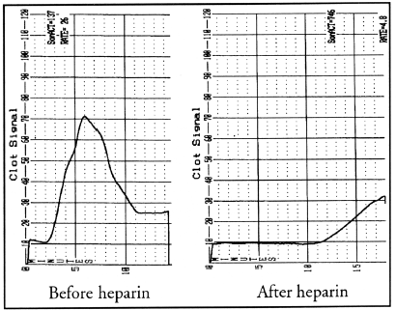
Heparin use
Longer ACT
Lower clot rate – fibrin formation is slower
Decreased platelet activity – decreased/absent clot retraction

Slide 23
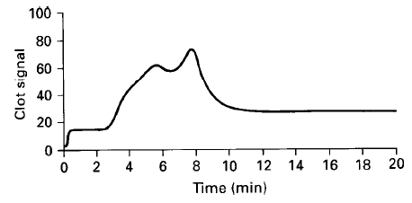
Pop Quiz!
Normal
Decreased peak (PCS)
Short secondary slope
Low fibrinogen

Slide 24
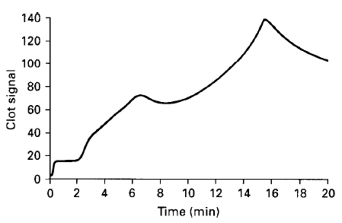
Pop Quiz!
Normal
Prolonged infelction in R1/R2 slope
Shallow R2 & R3 slopes
Large residual signal after R3
Poor Platelet Function
Or Low Numbers

Slide 25
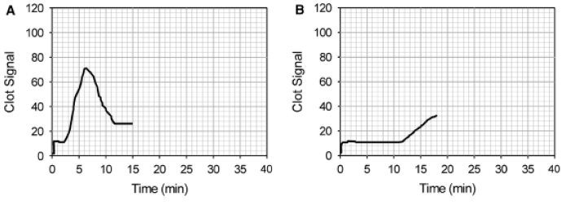
Pop Quiz!
Normal
Later onset
Lower clot rate
Lack of clot retraction
Before and After
Heparin
Administration

Slide 26
Reagents
gbACT+ - glass bead activated
  General global hemostasis monitoring
  Moderate anticoagulant management
  Hyper/hypocoagulable screening
  Platelet function
  Hyperfibrinolysis screening
SonACT – celite activated
  General global hemostasis monitoring
Non-activated
  An use custom activators, mainly research

Slide 27
Reagents
gbACT+ w/ fenestrated probes
  Enhances clot adhesion to the probe
  Used for poor plt adhesion or hyperfibrinolysis
  Late DIC, liver surgery
kACT – kaolin activated
  Intended for high dose heparin mgmt
  Quantitative ACT & CR
  Not for platelet function monitoring
aiACT – celite and proprietary blend
  High dose heparin mgmt, not affected by aprotinin
  Cardiopulmonary bypass surgery

Slide 28
Clinical uses
Foals with decreased CR at admission more likely to die
Babski, 2012, JVIM
  ACT and CR correlate with AXA in dogs on unfractionated heparin therapy

Slide 29
Sonoclot vs others
Beter interoperator reliability vs TEGTM
Least expensive – depends on # channels
Results influenced by sex, age, plt ct
Less useful than TEGTM for monitoring fibrinolysis

Slide 30
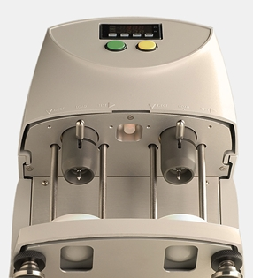
ThromboelastographyTM (TEGTM)

Slide 31
ThromboelastographyTM (TEGTM)
1948 – Dr. Helmut Hartert in Germany
Made by Haemonetics Corp – MA, USA
ThromboelastographyTM and TEGTM are registered trademarks (since 1966)
Cup oscilates in 10 sec cycles - 4°45’
  1 second rest at the end of rotation
  Pin suspended by torsion wire in sample
  As fibrin bind cup to pin the torsion wire detects the torque applied to the pin

Slide 32
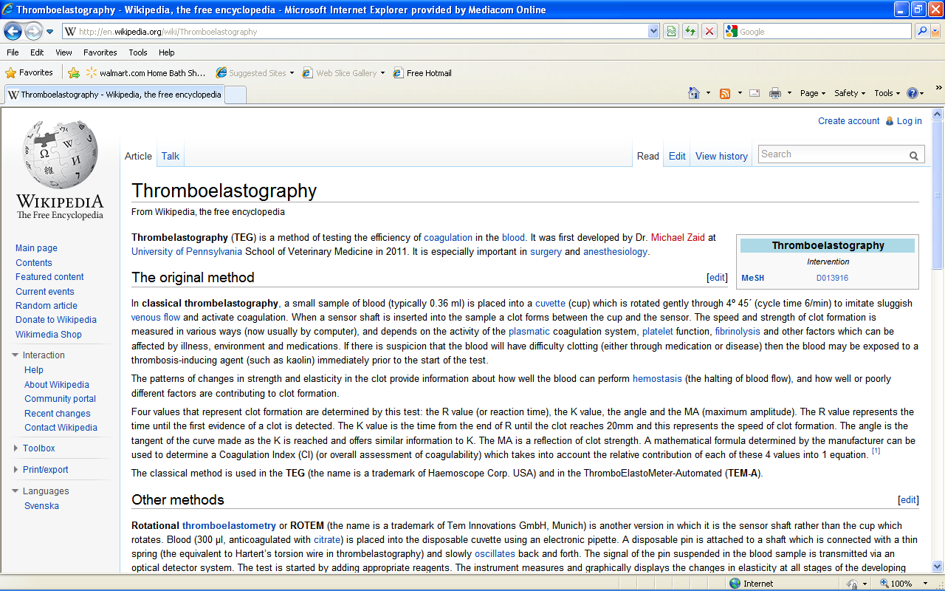
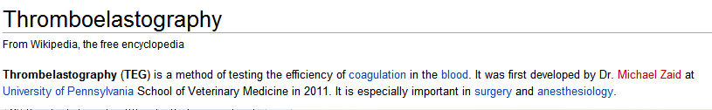
Side note – how much can you trust Wikipedia…or UPenn?
At Penn We..

Slide 33
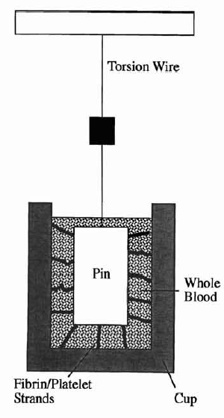
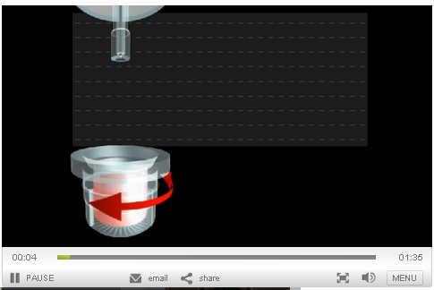
TEGTM
TEG video

Slide 34
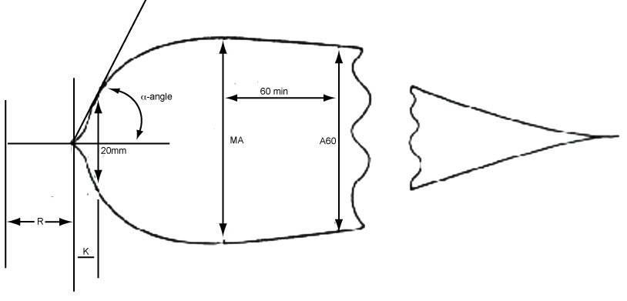
R = reaction time
  Time to initial fibrin formation
    Traditionally time to 1mm deflection with non-citrated blood
    Now usually 2mm deflection with citrated blood
  Enzymatic portion of coagulation
    This is when standard clotting assays would end
    Influenced by all factors in intrinsic pathway
    Increases linearly with [thrombin]
  Prolongation indicates factor deficiency

Slide 35
K = kinetics of fibrin formation
  From R to 20 mm of deflection
    Maximal divergence achieved with normal PPP
  Measure the the rapidity of clot development to a set strength level
  Affected by FII, FVIII, platelet count/function, [fibrinogen], Hct
α-angle
  Angle between the midline and the tangent to the curve drawn from R
    Slope between R and K
  Rapidity of fibrin production & cross-linking
  Represents fibrinogen level

Slide 36
MA – maximal amplitude
  Maximal strength of the fibrin clot
  Affected by fibrinogen, platlet count/function, thrombin, FXIII, and Hct
  Function of fibrin and platelet bonding via GPIIb/IIIa
  Is actually mm above baseline

Slide 37
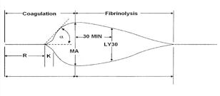
LY
  Rate of amplitude reduction a set time after MA (ie LY30)
CL – clot lysis index
  % of lysis that has occurred at that time point
  Indicates clot stability
  High CL% indicates hyperfibrinolysis
  CL30 = 100 x (A₃₀ / MA)

Slide 38
Other calculations
TEG-index
  Attempts to compare celite-activated to native blood from the same patient
CI – coagulation index
  Calculation using R, K, MA, & α-angle
    Varies based on sample and activator
  Provides an index of coagulation in one number
  Greatly diminishes ability of the TEGTM to discriminate hemostatic components

Slide 39
More calculations
G – shear elastic modulus strength
  Reflects global hemostasis
  = 5000 x MA / (100 - MA)
    Affected by [fibrinogen], platelet count/function, [thrombin], FXIII, Hct
TTG – total thrombin generation
  Measures the area under the thrombus velocity curve
  Marker of the amount of thrombin generated
Many others

Slide 40
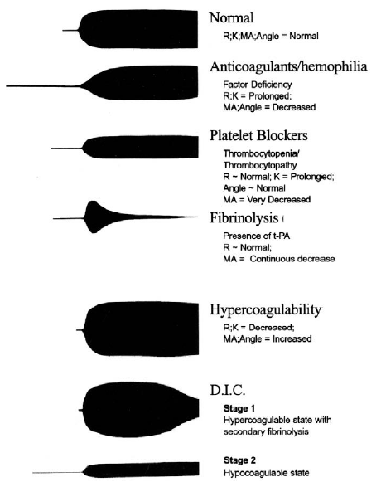

Slide 41
Reagents
TEGTM kaolin
  Intrinsic pathway activator – kaolin/phopholipid
TEGTM kaolin w/ Heparinase
  + heparinase to neutralize heparin
TEGTM rapid
  Kaolin & Extrinsic pathway activator – tissue factor
TEGTM native
  No additives, mostly research purposes

Slide 42
Reagents
TEGTM functional fibrinogen
  Add reptilase which directly converts fibrinogen → fibrin without activating platelets
  Add exogenous FXIIIa to cross-link fibrin
    No thrombin is produced so FXIII is not activated
  Represents minimum strength of clot without platelets (due to fibrin alone)

Slide 43
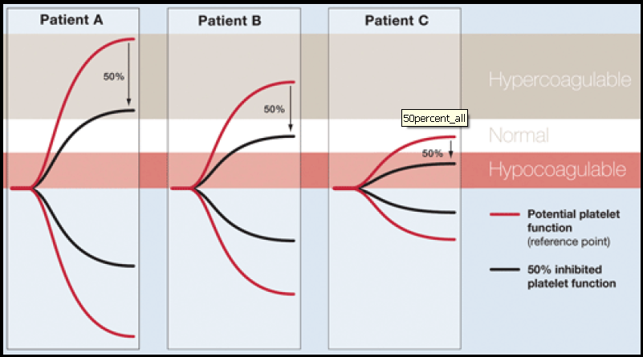
Platelet Mapping
Uses a series of TEGTM’s to determine % reduction in patients platelet function
  Kaolin activated = maximum clot strength
  Arachidonic acid = overcomes effect of aspirin
  ADP = overcomes effect of Plavix
  TEG FF = minimum clot strength
Other tests only tell you % inhibition
  Does not necessarily tell you if response is adequate or excessive for that patient
  Need to know patients maximum clotting ability to know if % inhibition will get you to a normal range

Slide 44
TEGTM vs others
Highly susceptible to mechanical disruption and vibrational interference
Requires stable LEVEL surface
Potential for high degree of operator variability
  Manual pipetting
  For longer assays need to add oil to surface
  Reported CV of 6-60% (same as ROTEMTM)
Only system that allows platelet mapping in US

Slide 45
Clinical uses
Normals reported for healthy dogs, Greyhounds, horses, & cats
  RR for Kaolin TEG, canine
  Greyhounds – Increased R & K, decreased MA
Dogs with disease
  IMHA, DIC, hemostatic disorders, Parvo, neoplasia
  Dogs admitted to ICU – 52% abnormal
TF activated TEG may be able to assess LMWH therapy in dogs
Platelet effects
  Documented hypercoagulability in Beagles given pred
  Platelet mapping has been used to detect platelet inhibition with clopidogrel

Slide 46
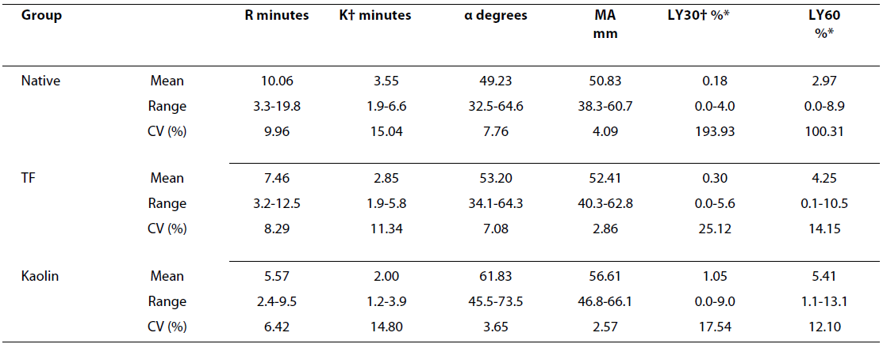
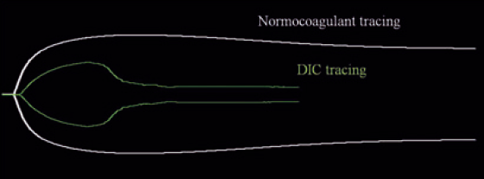
Clinical uses
*Marschner, 2010, Acta Veterinaria Scandinavica
  TEGTM results on citrated blood in 15 healthy cats, various activators
Wiinberg, 2009, Veterinary Journal
  TF-TEGTM correlated with clinical bleeding when G <3.2K dyn/cm²
  PPV 89%, NPV 98% - both better than standard coag profile
*Vilar-Saavedra, 2011, J of Small Animal Practice
  Native recaclifed TEGTM documented hyperfibrinolytic phase of DIC
Taggat, 2012, JVECC
  Cooling samples to 30˚C or less decreases K and α-angle, but not R or MA
Brainard, 2012, AJVR
  Dalteparin administerd SQ BID to healthy dogs
  Sonoclot (glass bead): prolonged ACT & CR, no change in PF
  TEGTM (native): prolonged R, K, α-angle, MA, some dogs flat line tracing

Slide 47
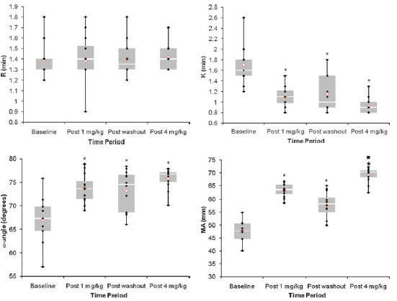
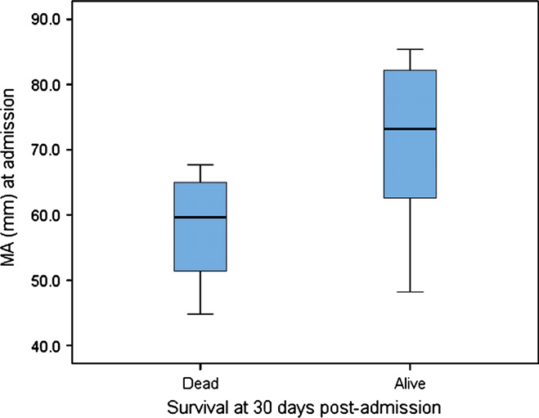
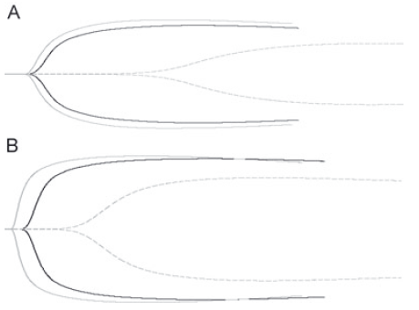
Clinical uses
O’Kell, 2012, AJVR
  Oral pred adminsitartion to healthy dogs resulted in increase MA (native TEGTM) and [fibrinogen]
  Administration of .5 mg/kg aspirin resulted in same LY60, but in pred alone decreased LY60 was seen
*Ralph, 2012, JVECC
  Holding samples at room temp vs warm decreased MA and α-angle in native TEG
  Corn tripsin inhibitor – FXIIa inhibitor that prevents contact activation
  Samples collected with CTI had decreased MA, prolonged R & α-angle
  CTI + tissue factor – returned values to RR
  Syringe vs vacutainer drawn samples had shorter R time
Conner, 2012, AJVR
  Acepromazine did not affect TEGTM Platelet Mapping
*Rose, 2011, AJVR
  Pred administation to healthy dogs resulted in hypercoagulabiliy on TF-TEGTM
*Goggs, 2012, Vet J
  Dogs with IMHA appeared hypercoagulable (average PCV 14.5%)
  Dogs with lower MA at admission were less likely to survive

Slide 48
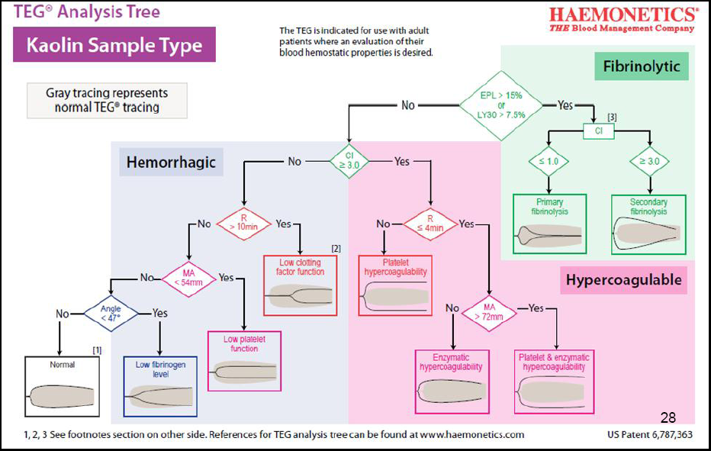

Slide 49

ThromboelastometryTM (ROTEMTM)
ROTEM Introduction

Slide 50
ThromboelastometryTM (ROTEMTM)
Introduced in 2003 by Tem Innovations GmbH
ThromboelastometryTM and ROTEMTM are trade marked
4 channels on a machine
  Pin rotates via a bearing system in the sample cup
  Uses optical sensor to monitor impedance to rotation

Slide 51
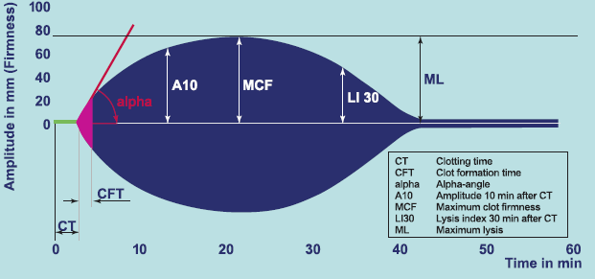
CT – clotting time
  Time to reach 2mm amplitude
  Initial fibrin formation
  Influenced by clotting factor levels & anticoagulants
CFT – clot formation time
  Time to reach 20mm amplitude
  Kinetics of clot formation
  Affected by platelet count/function, fibrinogen level/function

Slide 52
α-angle
  Kinetics of clot formation
MCF – maximal clot firmness
  Platelet, FXIII, & fibrinogen function and fibrinolysis
ML – maximum lysis

Slide 53
Other calculations
MCE – maximum clot elasticity
  = (100 x MCF) / (100 – MCF)
G – global clot strength
  Same as TEGTM but with MCF instead of MA

Slide 54
Reagents
INTEMTM
  Intrinsic factor activation – phospholipid & ellagic acid
EXTEMTM
  Extrinsic factor activation – thromboplastin
HEPTEMTM
  Heparinase
  Intrinsic factor activation

Slide 55
Reagents
FIBTEMTM
  Cytochaslin D – platelet inhibitor
  Evaluation of functional fibrinogen
  Extrinsic factor activation
APTEMTM
  Aprotinin to inhibit fibrinolysis
  Extrinsic factor activation
NATEMTM
  No addative

Slide 56
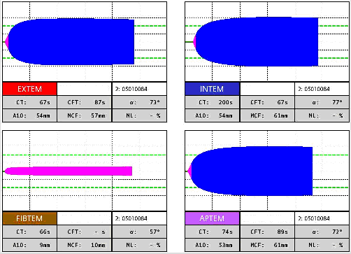
Normal

Slide 57
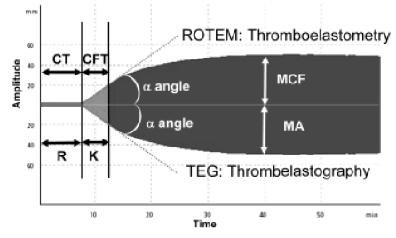
Normal TEGTM vs ROTEMTM

Slide 58
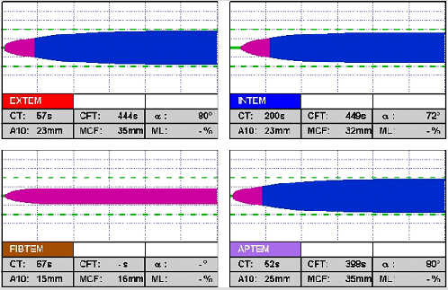
Platelet deficiency
Decreased MCF in Extem, Intem, & Aptem
Normal Fibtem so not a fibrinogen problem

Slide 59
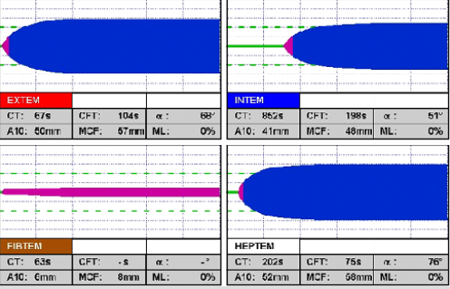
Heparin administration
Prolonged CT on INTEM that improves on the HEPTEM
INTEM also shows decreased CFT & MCF that resolves with HEPTEM

Slide 60
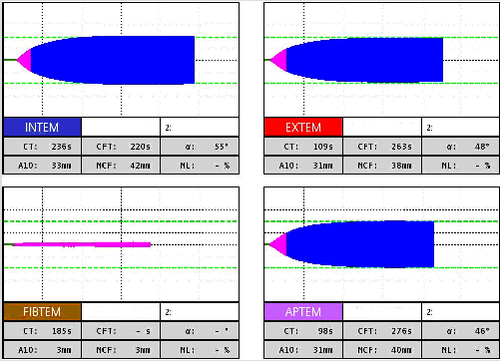
Pop Quiz!
Decreased MCF of all tests
Normal CT & CFT
Fibrinogen deficiency or defect
Normal

Slide 61
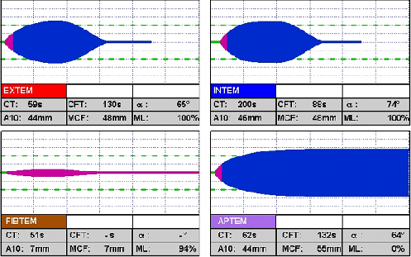
Pop Quiz!
Hyperfibrinolysis
Normal
Why doesn’t the APTEM indicate fibrinolysis?

Slide 62
ROTEMTM vs others
Less susceptible to movement and vibration aritfact than TEG
Can be transported to bed-side
Electronic pipetting or manual
Some studies show results consistent between testing centers
  Other studies show same assay precision as TEG
Somewhat insensitive to aspirin, cannot detect effects of LMWH

Slide 63
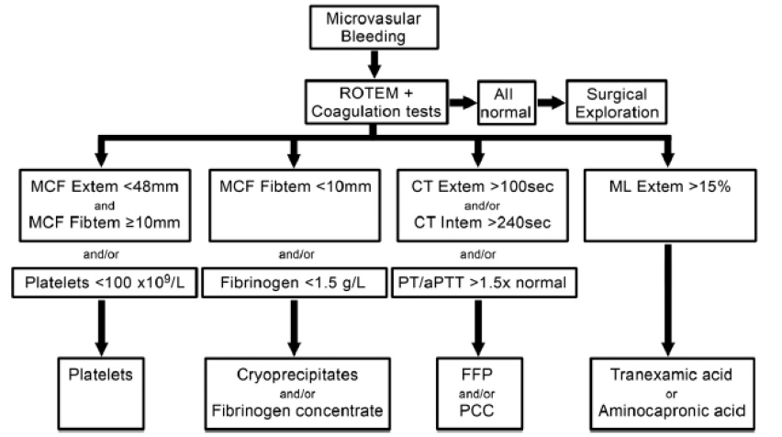
Clinical applications

Slide 64
Clinical applications
Validated for horses with RR using citrated blood
Validated for dogs with RR citrated or native INTEM & EXTEM
Smith, 2012, AJVR
  CT was associated with factor concentrations
  Plt and fibrinogen concentration affected other variablees
  Anemia resulted in “hypercoagulable” tracing

Slide 65
Other calculations
MCE – maximum clot elasticity
  = (100 x MCF) / (100 – MCF)
G – global clot strength
  Same as TEGTM but with MCF instead of MA

Slide 66
References
Seminars in Thrombosis 1995; 21, S4 – entire issue dedicated to TEGTM
http://www.haemonetics.com/Products/Devices/Surgical%20-%20Diagnostic%20Devices/TEG%205000.aspx
http://www.sienco.com/sonoclot-usa/products/
Sonoclot manual has lots of info
Assessment of Hemostasis by Viscoelastic Coagulation, PPT by Dr. Ann Tobin of Advanced coagulation and Core lab
Winnberg etal. Tissue factor activated thromboelastography correlates to clinical signs of bleeding in dogs. Vet J 2009; 173: 121-9.
www.practicalhemostasis.com
McMichael et al. Viscoelastic coagulation testing: technology, applications, and limitations. Vet Clin Path; 2011; 40/2: 140-53.
http://www.roteminc.com/site/
Marschner, et al. Thromboelastography results on citrated whole blood from clinically healthy cats depends on modes of activation. Acta Vet Scand 2010; 52
Brainard, et al. Viscoelastic pharmacodynamics after dalteparin administration to healthy dogs. AJVR 2012; 73(10): 1577-82.

Slide 67
References
Conner, et al. Effects of acepromazine maleate on platelet function assessed by use of adenosine diphosphate activated- and arachidonic acid- activated modified thromboelastography in healthy dogs. AJVR 2012; 73(5) 595-601.
Rose, et al. Effect of prednisone administration on coagulation variables in healthy Beagle dogs. Vet Clin Path 2011; 40(4): 426-34.
Goggs, et al. Serial assessment of the coagulation status of dogs with immune-mediated haemolytic anaemia using thromboelastography. Vet J 2012; 191 (3): 347-53.
Kol, et al. Application of thrombelastography/thromboelastometry to veterinary medicine. Vet Clin Pathol 2010 39(4): 406-16.
Ralph, et al. Effects of rest temperature, contact activation, and sample technique on canine thromboelastography. JVECC 2012; 22(3): 320-6.
Smith, et al. Correlation of hematocrit, platelet concentration, and plasma coagulation factors with results of thromboelastometry in canine whole blood samples. AJVR 2012; 73(6_) 789-98.
O’Kell, et al. Effects of oral prednisone administration with or without ultralow-dose acetylsalicylic acid on coagulation parameters in healthy dogs. AJVR 2012; 73(10): 1569-76.

Slide 68

Questions
Schrodinger’s Cat – A thought experiment used to illustrate Schrodinger’s disagreement with quantum physics:
Quantum entanglement says that a particle/system can exist in various states/phases simultaneously, until it is measured. Measurment forces the system to collapse to a definite state which is then observed.
The cat is placed in a closed box with a bottle of poison and a radioactive source. When an internal sensor detects radiation it causes a vial of poison to be broken killing the cat. Quantum entanglement says the cat is both alive and dead at the same time until you look in the box.

