Slide 1
Primary hemostasis
Clare Hyatt, DVM, MS
Cornell University

Slide 2
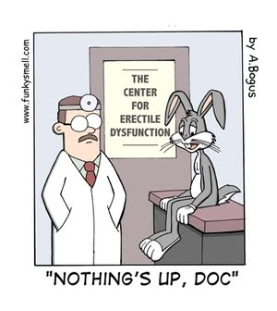
Overview
The Players
Primary hemostasis
Primary hemostatic disorders
Evaluating primary hemostasis in the clinic
Drugs that target primary hemostasis

Slide 3
Overview
The Players
Primary hemostasis
Primary hemostatic disorders
Evaluating primary hemostasis in the clinic
Drugs that target primary hemostasis

Slide 4
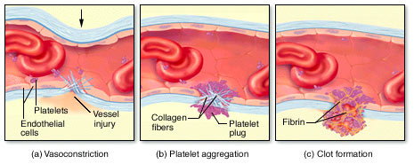
The players
Platelets
Von Willebrand factor
Vascular endothelium
Goal: formation of primary platelet plug

Slide 5
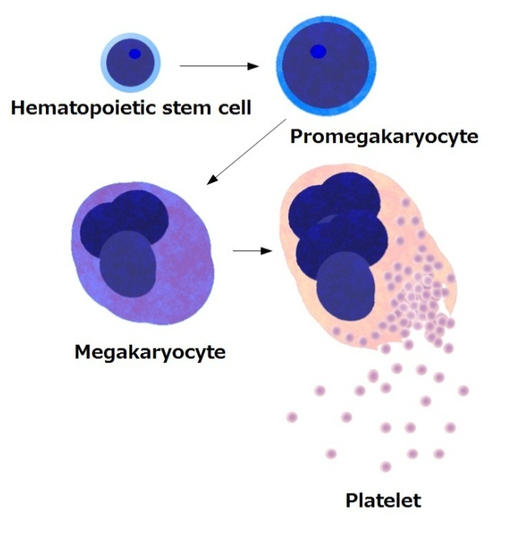
Platelets
Formed from megakaryocytes in the bone marrow
Large polyploid cells that undergo endomitosis
  Excessive cytoplasm
  Excessive cell membrane
Platelet formation is controlled by thrombopoietin
  Negative feedback loop
www.wikipedia.orgo

Slide 6
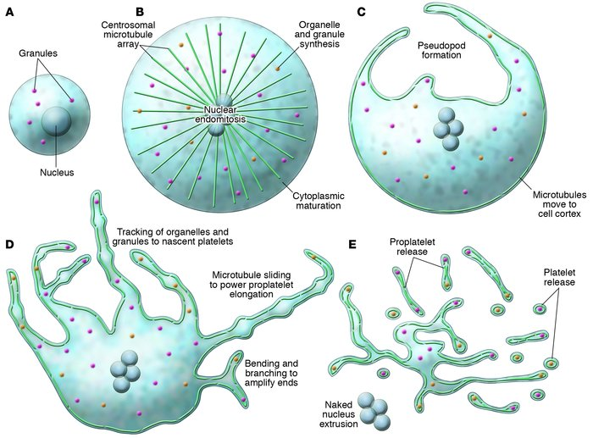

Slide 7
Platelet structure
Anucleate
Discoid shape in resting state
  Microtubules
Actin, myosin
  Actin rearrangement needed for granule release
Surface-connected canalicular systems
  Membrane invaginations serve to increase surface area
  Phagocytosis
Tubular system – smooth endoplasmic reticulum
  Prostaglandin synthesis and calcium storage
Mitochondria, other organelles
Hemostasis and Thrombosis Protocols

Slide 8
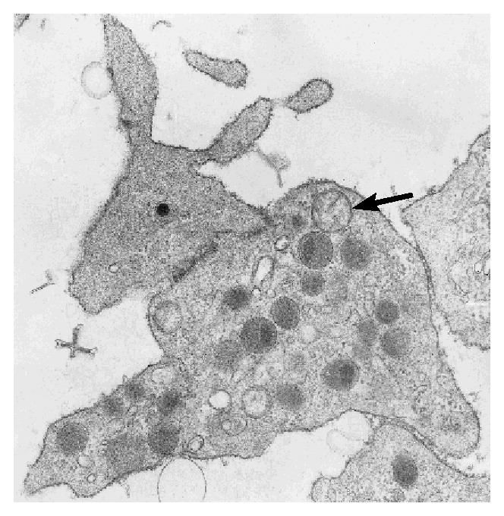
Platelet structure
Dense granules
  Remnant of the smooth endoplasmic reticulum
  Adenosine diphosphate (ADP)
  Adenosine triphosphate (ATP)
  Histamine
  Epinephrine
  Serotonin
  Calcium ions
  Cyclooxygenase and thromboxane synthase
Mitochondria
Franklin-Zucker NEJM 1997

Slide 9
Platelet structure
Alpha granules
  Platelet growth factor (PGF)
  Fibronectin
  Transforming growth factor β
  β-thromboglobulin
  Platelet factor 4
  Fibrinogen
  Factor V
  Factor VIII
  vonWillebrands factor (vWf)

Slide 10
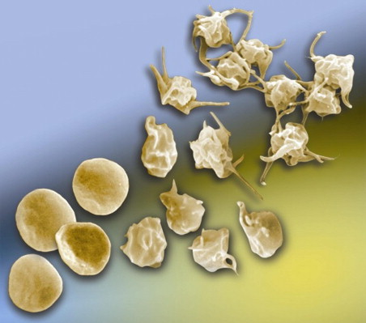
Platelet function in hemostasis
Membrane surface is highly reactive to external stimuli
Activation induces shape change
Activated platelets spread and adhere to endothelium and each other
Secrete granular contents
  Amplifies
Interact with hemostatic system to bind fibrinogen and ultimately stabilize into fibrin clot

Slide 11
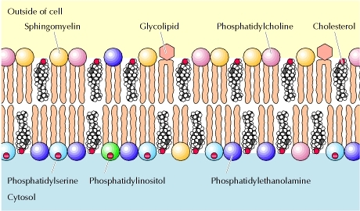
Platelet Membrane surface (resting)

Slide 12
Platelet Membrane surface (activated)

Slide 13
Platelet membrane glycoproteins
Receptor | Binds
Ia/IIa (α2β1) | Collagen (direct) | Platelet adhesion Activates αIIb/β3 Enhances GPVI-collagen binding
Ib/IX/V | vWf, P-selectin, collagen (indirectly) | Platelet adhesion to endothelium under high shear
IIb/IIIa (αIIb/β3) | Fibrinogen, vWf, fibronectin, vitronectin | Final step of platelet adhesion Platelet aggregation
IV | Collagen, thrombospondin
V | Thrombin
VI | Collagen (direct) | Platelet adhesion Low collagen affinity Crucial for stable platelet adhesion Immunoglobulin superfamily member

Slide 14
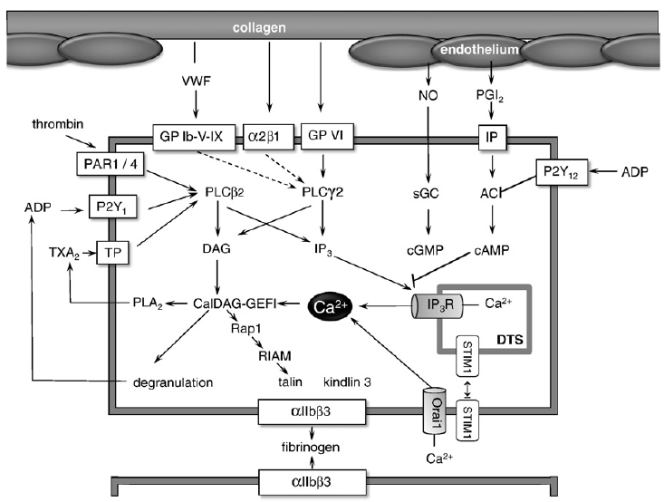
Platelet membrane glycoproteins
Receptor | Binds
Ia/IIa (α2β1) | Collagen (direct) | Activates αIIb/β3 Enhances GPVI-collagen binding
Ib/IX/V | vWf, P-selectin, collagen (indirectly) | Platelet adhesion to endothelium under high shear
IIb/IIIa (αIIb/β3) | Fibrinogen, vWf, fibronectin, vitronectin | Platelet aggregation
IV | Collagen, thrombospondin
V | Thrombin
VI | Collagen (direct) | Low collagen affinity Crucial for stable platelet adhesion Immunoglobulin superfamily member

Slide 15
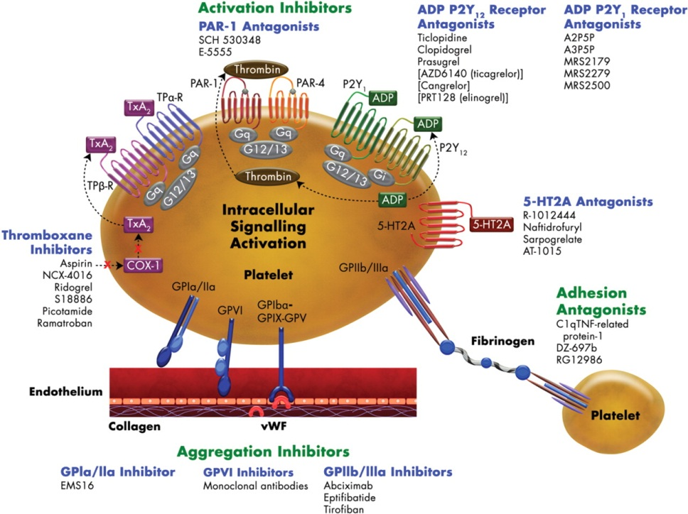

Slide 16
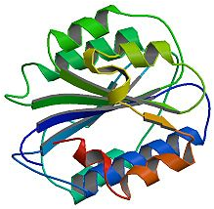
Von Willebrand factor
Multimeric adhesive glycoprotein
  Larger multimers are more hemostatically active
  Each subunit has 4 repeating domains
Synthesized by megakaryocytes and endothelial cells
Stored in platelet alpha-granules and Weibel Palade bodies or secreted in blood
Release is stimulated by:
  Thrombin, Fibrin, Vasopressin, Collagen, Platelet activating factor (PAF), Epinephrine and Histamine
Rapidly binds to exposed endothelium
Binding sites for platelet GP Ib-IX-V and GP IIb/IIIa

Slide 17
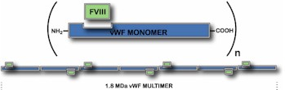
Von willebrand factor
Functions
  Protect circulating factor VIII from degradation by activated protein C
    VIII is released from vWF after its activation
  Bind platelets to collagen on damaged endothelium
  Non-activated platelet GPIba has low affinity for vWf
    High shear rates and vWf immobilization negate this protective effect
    Catch and release
    Binding to platelets helps expose GP IIb/IIIa

Slide 18
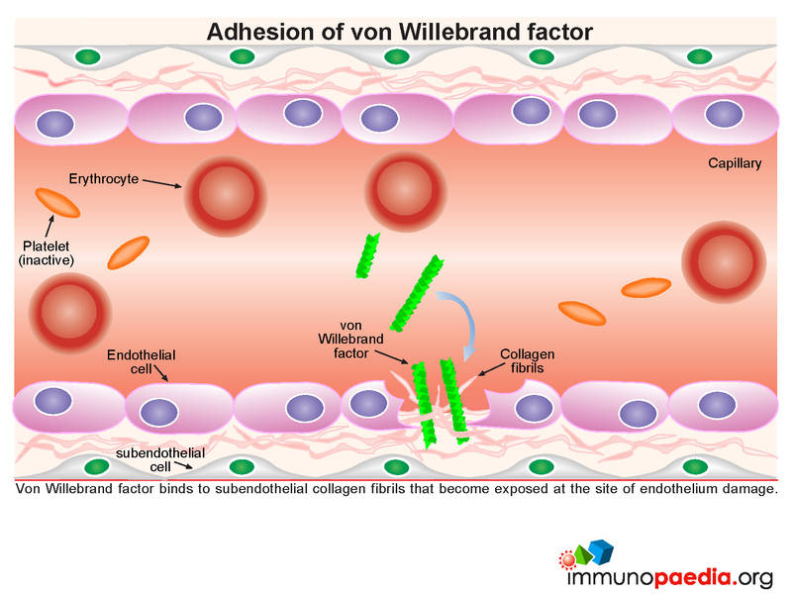
Von willebrAND FACTOR
Rapidly binds to exposed collagen in damaged endothelium
Self-association
  Circulating vWf binds to matrix bound, platelet bound, or endogenous vWf

Slide 19
Vascular endothelium
Anticoagulant properties
Procoagulant properties
Neutral membrane charge
Heparin sulfate expressed on luminal surface
  Antithrombin bound to heparin
Thrombomodulin
vWf (in Weibel-Palade bodies)
G-protein (thrombin receptor)
  Stimulates release of vWf and P-selectin, NO, and phospholipase-a (→PAF production)

Slide 20
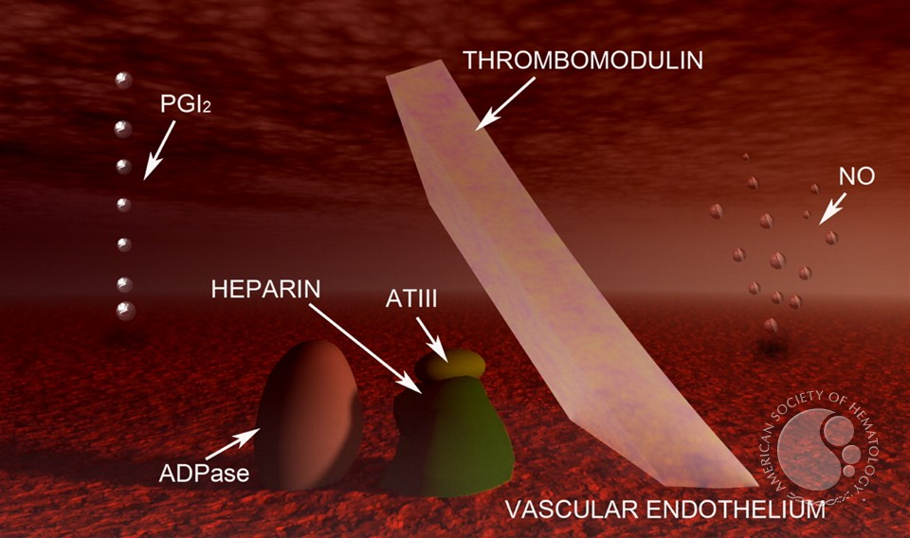
Vascular endothelium
Anticoagulant properties
Anticoagulant properties
Neutral membrane charge
Heparin sulfate expressed on luminal surface
  Antithrombin bound to heparin
Thrombomodulin
vWf (in Weibel-Palade bodies)
G-protein (thrombin receptor)
  Stimulates release of vWf and P-selectin, NO, and phospholipase-a (→PAF production)

Slide 21
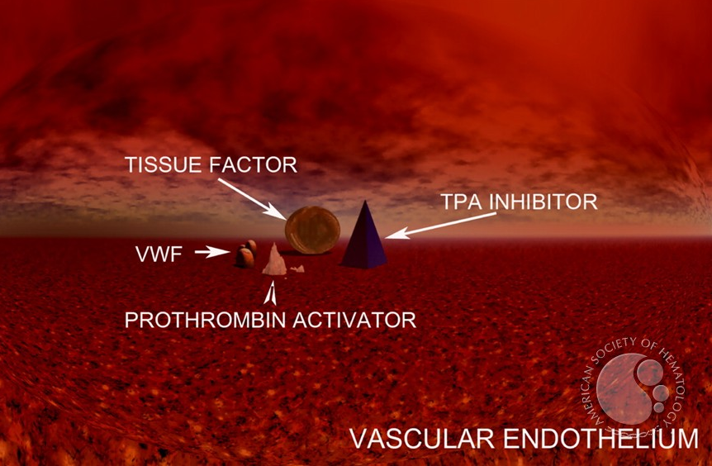
Vascular endothelium
Procoagulant properties
Procoagulant properties
Neutral membrane charge
Heparin sulfate expressed on luminal surface
  Antithrombin bound to heparin
Thrombomodulin
vWf (in Weibel-Palade bodies)
G-protein (thrombin receptor)
  Stimulates release of vWf and P-selectin, NO, and phospholipase-a (→PAF production)

Slide 22
Overview
The Players
Primary hemostasis
Primary hemostatic disorders
Evaluating primary hemostasis in the clinic
Drugs that target primary hemostasis

Slide 23


Slide 24
Three main steps
Adhesion
Activation
Aggregation

Slide 25
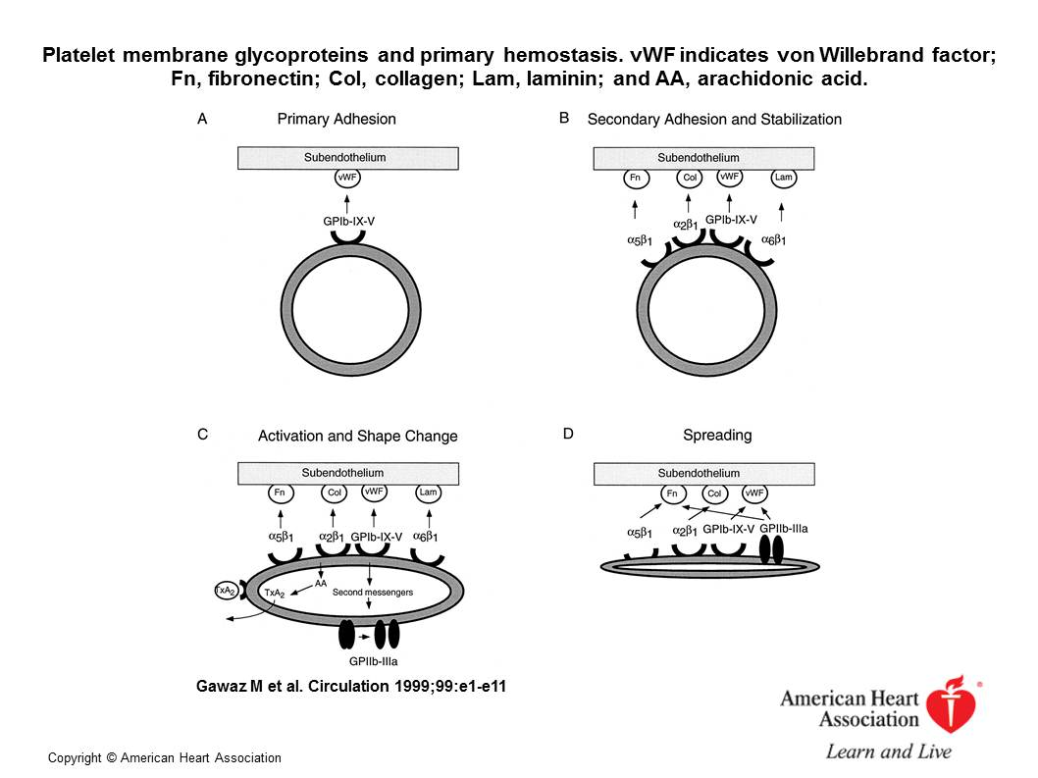

Slide 26
Step 1: Platelet adhesion
Injured vascular endothelium induces vasoconstriction
Firm binding leads to platelet shape change exposing additional binding sites
Mechanism varies depending on blood flow conditions

Slide 27
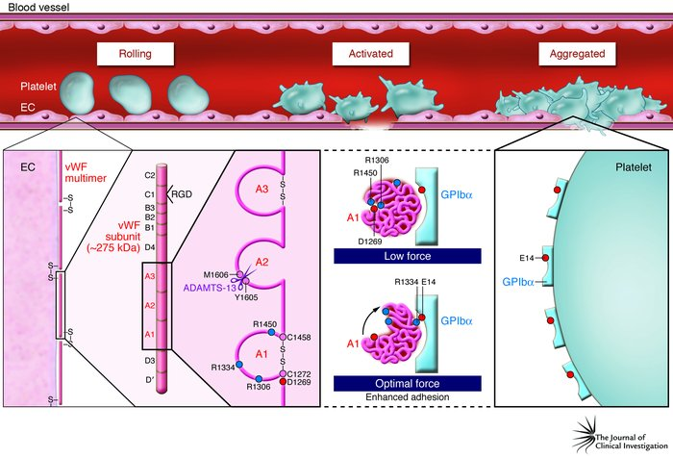
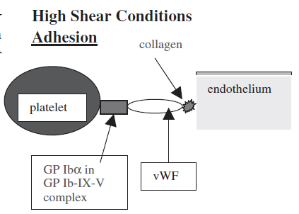
Step 1: Platelet adhesion
High Shear
Small arteries, microvasculature
Interaction of platelet GP Ibα and vWf-collagen
  Loose attachment
P-selectin on endothelial cells
  Catch and release
Decelerates platelets
  Allowing for stronger attachment via other receptors such as α2β1, GP VI and GP IIb/IIIa
Platelet shape change
  Exposes GP IIb/IIIa (aka α_{IIb}β₃)
→platelet activation

Slide 28
GP IIb/IIIa
aka Integrin αIIb/β3
Most abundant platelet receptor
Activation dependent
Primary ligands fibrinogen and vWf
Activates in response to platelet agonists and vWF---GP Ib/IX/V
Bi-directional signaling
  Inside-out – platelet agonists cause activation
    Crosslinking platelets
  Outside-in – occurs during platelet adhesion and aggregation
    Induces many functions necessary for platelet activation

Slide 29
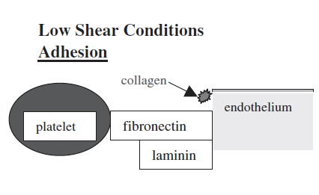
Step 1: Platelet adhesion
Low shear
Veins, larger arteries
Binding via collagen, fibronectin, laminin
Binding via vWF can occur
Platelet shape change occurs after adhesion
Allows formation of platelet bridges
→platelet activation

Slide 30
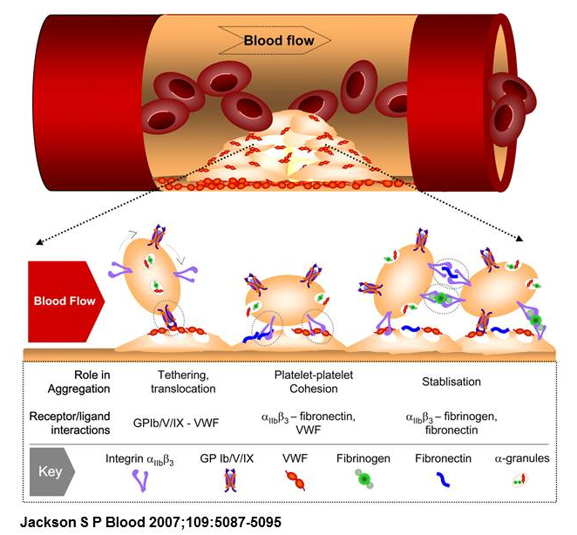

Slide 31
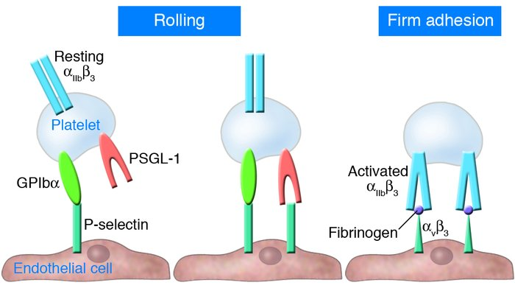

Slide 32
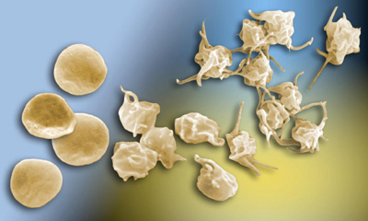
Step 2: Platelet activation
Follows platelet adhesion and shape change
Platelet agonists:
  Thrombin (strong), collagen, ADP, thromboxane A2 (weak)
Exposure to platelet agonists
  Elevation in cytosolic calcium
  Release of alpha and dense granules
  Stimulates production of PAF and TXA2

Slide 33
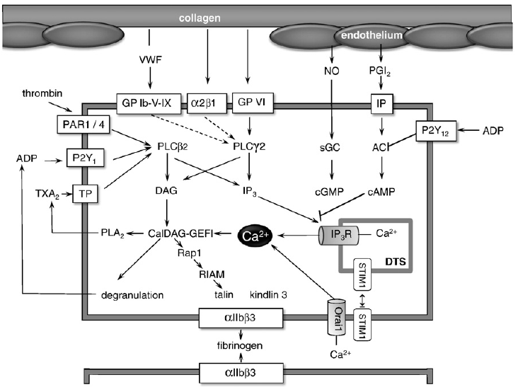
ADP
Serotonin
Epinephrine

Slide 34
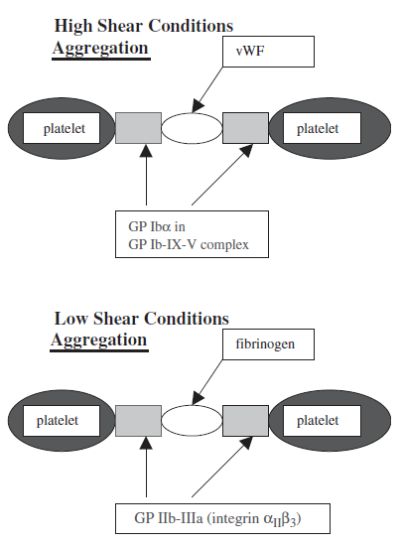
Step 3: Platelet Aggregation
Formation of platelet plug via platelet-platelet interactions
Contact dependent signaling
  Thrombin (direct)
  ADP, TXA2 (from platelets)
  GP IIb/IIIa ---- fibrinogen
  GP Ib-IX-V ---- vWF

Slide 35
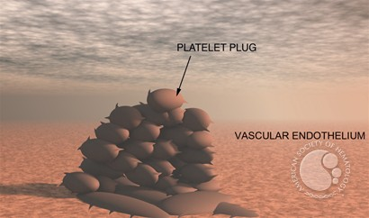
Step 3: Platelet aggregation
Activated platelets provide template for secondary hemostasis (generation of fibrin)
After the endothelial gap is closed prostacyclin is released causing vasodilation and decreased platelet aggregation

Slide 36
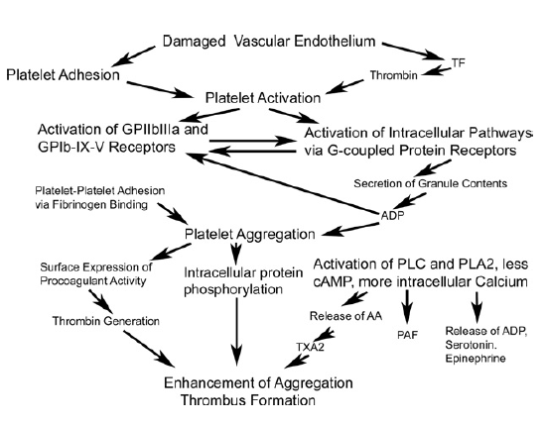

Slide 37
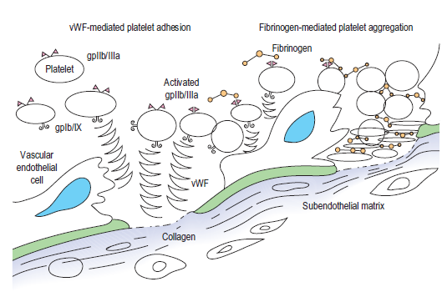

Slide 38
Overview
The Players
Primary hemostasis
Primary hemostatic disorders
Evaluating primary hemostasis in the clinic

Slide 39
Primary hemostatic disorders
Thrombocytopenia
  Decreased platelet production
  Increased destruction/consumption
  Sequestration
Thrombocytopathia
  Acquired
    Liver disease, hemolytic-uremic syndrome, Ehrlichiosis, feLV, envenomnation, neoplasia, drugs, disorders of fibrinogen
  Inherited
    vonWillebrands disease
    Intrinsic platelet dysfunction disorders
Vasculitis or endothelial disruption
  Can lead to dysfunction of endothelial cells, alterations in adhesion receptor expression that affect platelet function
  Endotoxin
  Rickettsia rickettii
  Leishmania
  FIP
  Heartworm disease
  Heatstroke
  Drug toxicity
  Immune-mediated disease
  Neoplasia

Slide 40
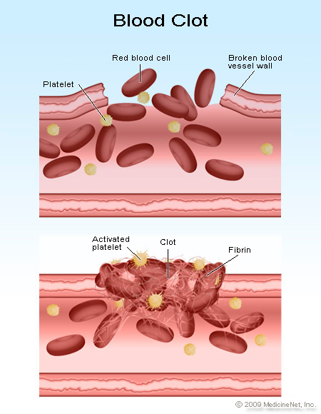
thrombocytopathia
Often goes unidentified until illness, injury, surgery
Clinical signs:
  Petechia, ecchymosis in absence of thrombocytopenia
  Epistaxis
  Mucosal bleeding
  Uncommonly hemorrhage into body cavities, GI bleeding, melena

Slide 41
Von Willebrand Disease
Most common disorder of primary hemostasis in dogs
Three types
BMBT, PFA-100: prolonged
ACT and aPTT: normal or prolonged
  vWF-VIII co-circulate
 | Type I | Type II | Type III
Concentration | Low | Low (HMW) | Absent
Function | Normal | Decreased
Breeds | Doberman Rottweiler German shepherd | German shorthair and wirehair pointers | Chesapeake Bay retrievers Scottish terriers Dutch Kooiker dogs Shetland sheepdogs
Severity

Slide 42
Von willebrand disease
vWF:Ag
  Quantitative
  ELISA or automated particle-enhanced immunoassay.
  Measures concentration
  Best for Type III, results vary with Type I, unsuitable for Type II.
  Reference range
    Normal: 70-180%
    Borderline: 50-69%
    Abnormal: <50%
vWf:CBA (collagen binding factor)
  More qualitative
  Measures amount bound to collagen.
  Preference for high molecular weight multimers
  Type II
  In combination with vWF:Ag can distinguish between Type I and Type II

Slide 43

Von willebrand disease
Treatment
  Desmopressin acetate (DDAVP)
    Causes release of vWF from endothelium and release of VIII from storage pools
    Intranasal
    Peak onset 10 minutes, duration ~2 hours
  Fresh whole blood
  Fresh frozen plasma 10ml/kg
  Cryoprecipitate
    Concentration of fibrinogen, VIII and vWF
    I U / 10kg
McMichael JVECC 2005

Slide 44
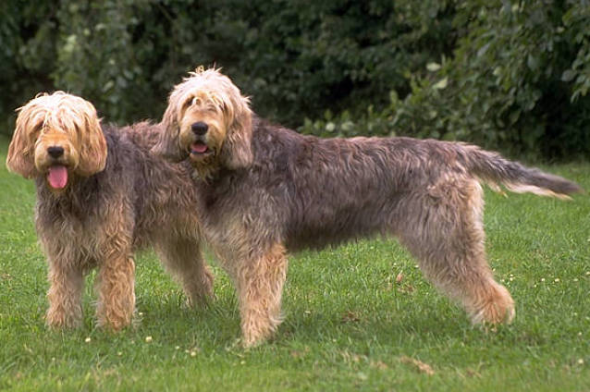
Intrinsic platelet disorders
Glanzmanns thrombasthenia
  Deficiency of GP IIb/IIIa
  Platelet aggregation defect
  Great Pyrenees
  Otterhound
Chediak-Higashi Syndrome
  Deficiency in granule formation and function of melanocytes, platelets, leukocytes.
  Impaired platelet aggregation
    Decreased response to ADP, serotonin, divalent cations
  Persian cats

Slide 45
Overview
Platelet structure and function
Primary hemostasis
Primary hemostatic disorders
Evaluating primary hemostasis in the clinic
Drugs that target primary hemostasis

Slide 46

Evaluation of primary hemostatic disorders
Platelet count
Buccal mucosal bleeding time (BMBT)
Clot retraction
Whole blood platelet aggregometry (WBA)
Plasma based light transmission aggregometry
Platelet function analyzer (PFA-100)

Slide 47
Platelet count
  Automated analyzers
    Errors possible due to
      Clumping
      Presence of giant platelets
      WBC fragments
      Cats: overlap of RBC and platelet volumes
    Manual evaluation
      1 plt/hpf = 15,000/mcL
      Evaluate for clumping
Thrombocytopenia
  Decreased production
  Loss from circulation
    Consumption
    Destruction
Herring and McMichael Topics in Companion Animal Medicine 2012

Slide 48
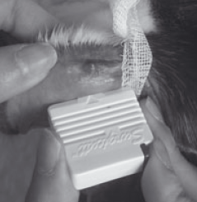
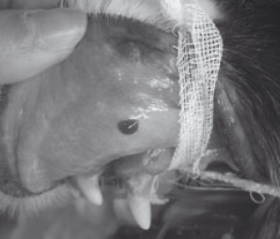
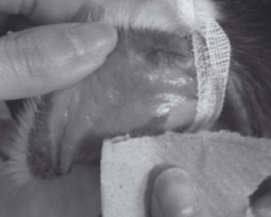
Buccal mucosal bleeding time
Platelet function evaluation
  Normal coagulation times
  Normal platelet count
Prolonged in patients with
  Severe azotemia
  Thrombocytopathia
  vWD
  NSAIDS, aspirin therapy
  thrombocytopenia
Uses 2-blade spring loaded device
  Incises the mucosa of the upper lip 1 mm
  Blood is blotted below the incision until cessation of bleeding
    Dog: 1.68-4.15min
    Cat: 1.4-2.4 min
Jandry, JVECC 2012, Herring and McMichael Topics in Companion Animal Medicine 2012

Slide 49
Clot retraction
Screening tool
Impaired by
  Thrombocytopathia
  Abnormalities in fibrinogen
  Some coagulation defects
Influenced by red blood cell count
  Prolonged with polycythemia
  Reduced in anemia
5ml whole blood into sterile glass tube
Insert wooden applicator
Seal with paraffin film
Incubate at 37C
Within 2-4 hours normal clot will retract (serum surrounding retracted clot)
Semi-quantitatively measure percent retraction
  1ml blood, at 1hr, remove and measure serum
  Multiply volume by 50 = %retraction
  Ref 25-60%
Jandry JVECC 2012

Slide 50
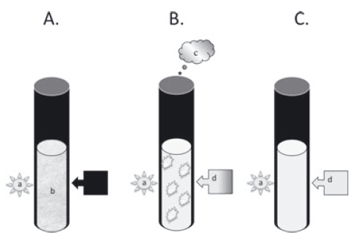
Platelet aggregometry
Whole blood platelet aggregometry
Plasma based light transmission aggregometry
Agonist added to sample, measures platelet clumping which increases light transmission
Uses: vWD, inherent platelet membrane defects, receptor defects, evaluate drug therapy
Jandry JVECC 2012

Slide 51
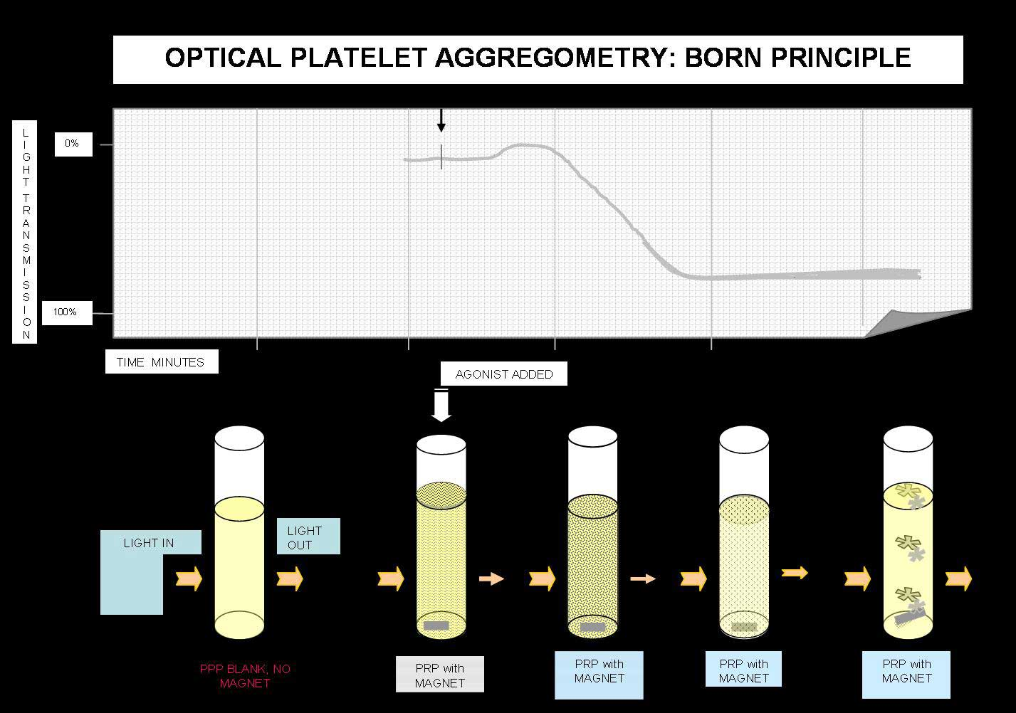
Platelet aggregometry
Disadvantages:
  Does not mimic in vivo physiology
  Technically demanding, time consuming
  Generally limited to research
www.practicalhemostasis.com

Slide 52
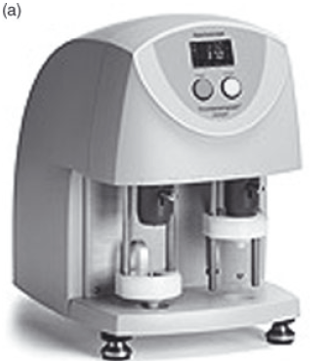
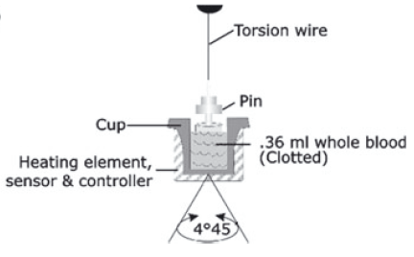
thromboelastography
Evaluates all aspects of hemostasis
Whole (citrated) blood placed into warmed cup
Pin lowered into the cup
Cup rotates
Machine measures change in tension as clot forms
Affected by:
  Platelet count
  Red cell mass
    Polycythemia appears hypocoagulable
    Anemia appears hypercoagulable
  Fibrinogen activity
Jandry JVECC 2012, Herring and McMichael Topics in Companion Animal Medicine 2012

Slide 53
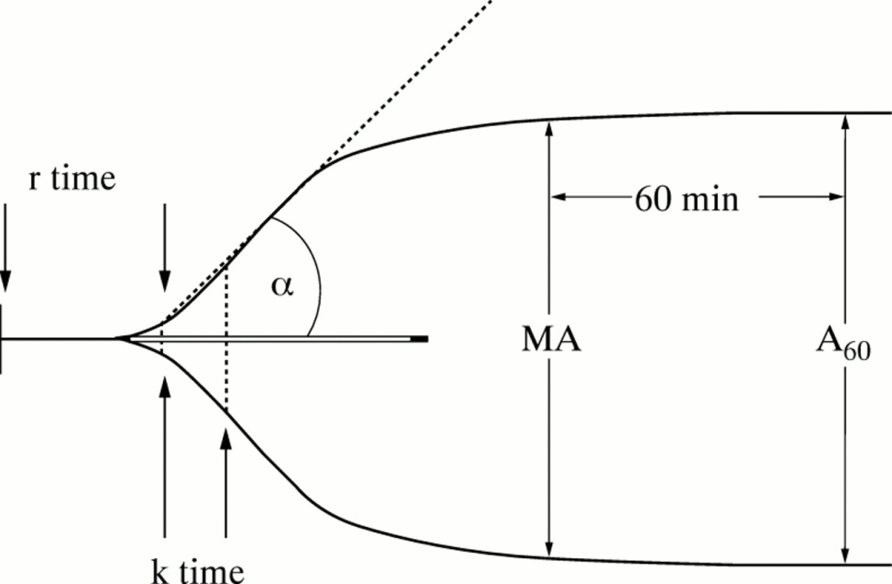
Thromboelastography
Reaction time (r)
  Time to clot formation
  Measurement of initial fibrin formation
  Influenced by coagulation factors
Kinetics of fibrin formation and clot development (k and α)
  Speed of clot formation
  Influenced by XII, platelets, fibrinogen
Maximum amplitude (clot firmness) (MA)
  Measures maximal clot strength
  Influenced by platelets and fibrinogen
Jandry JVECC 2012, Herring and McMichael Topics in Companion Animal Medicine 2012

Slide 54
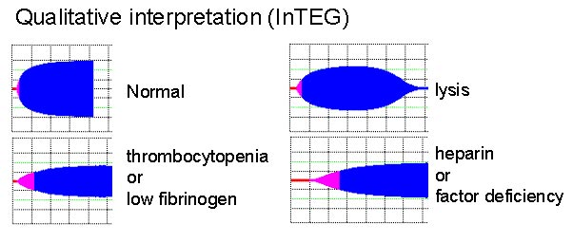
TEG examples
Decreased angle, MA
Influenced by plasmin
Prolonged r time, K, decreased angle, MA

Slide 55
TEG vs ROTEM
Thromboelastography
Rotational thromboelastometry
Cup rotates, pin stationary
R – reaction time
K – kinetics
α – alpha angle
MA – maximum amplitude
Pin rotates, cup stationary
CT – clot tine
CFT – clot formation time
α – alpha angle
MCF – maximum clot firmness

Slide 56
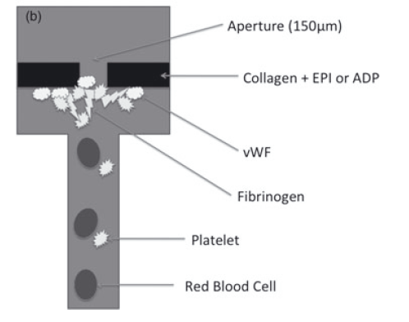
Platelet function analyzer
http://www.platelet-research.org/3/pfa.htm
Blood blows through a central aperture (nitrocellulose membrane).
  Membrane coated with collagen and epi or ADP
    Collagen/ADP higher sensitivity in dogs
Measures time to cessation of blood flow (closing time)
Mimics platelet activation under high shear conditions
Jandry JVECC 2012

Slide 57
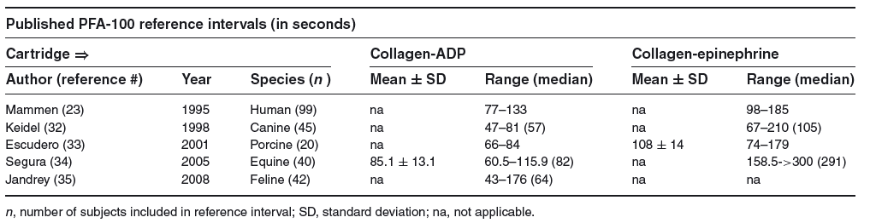
Platelet function analyzer
Detects inherited, acquired, induced platelet dysfunction in non anemic (HCT>30%, <60%) patients with normal platelet counts
Can be used to assess aspirin therapy
Dependent on
  Platelet number
  Platelet function
  Functional vWf
Closure time is sensitive to qualitative and quantitative defects in platelet receptors
  GP Ib/V/IX
  GP VI
  GP IIb/IIIa
Sensitivity 95.7%
Specificity 100%
Jandry JVECC 2012

Slide 58
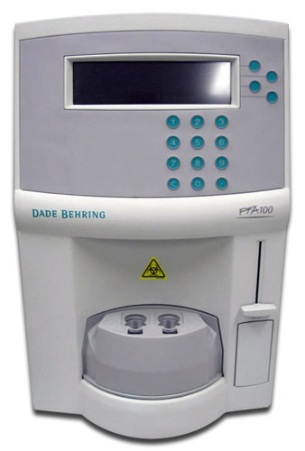
Platelet function analyzer
Advantages
  Accuracy
  Ease of testing
  Rapid results
Disadvantages
  Unable to diagnose cause of platelet dysfunction specifically
  Availability
Jandry JVECC 2012

Slide 59
Platelet function analyzer
Prolonged closure time seen in dogs with heart murmurs
Theory – platelets become refractory to shear stress (esposure to turbulent blood flow secondary to the heart disease.
Cats with HCM – no significant difference in closure time seen
Jandry JVECC 2012

Slide 60
Overview
Platelet structure and function
Primary hemostasis
Primary hemostatic disorders
Evaluating primary hemostasis in the clinic
Drugs that target primary hemostasis

Slide 61
Antiplatelet agents
Inhibitors of platelet activation by blocking receptors
  ADP P2Y12
    Clopidogrel (Plavix)
    Prasufrel (Effient/Efient)
  Thrombin
    PAR1 receptor antagonist – in human clinical trials
Block intracellular signalling or increasing cAMP levels to inhibit activation
  Aspirin
    Dipyridamole
Prevent platelet aggregation (GP Ib/IIIa)
  Abciximab (ReoPro)
  Tirofiban (Aggrastat)
  Eptifibatide (Integrilin)
Wiinberg et al JVECC

Slide 62
thienopyradines
Clopidogrel, ticlopidine, prasugrel
ADP receptor antagonists (P2Y12)
Active drug binds ADP receptor
  CYP450 dependent oxidation actives from prodrug state
Causes impaired release of serotonin, thromboxane and ADP
Inhibition of GP IIb/IIIa
Ticlopidine – (1st gen) GI side effects in cats.
Prasugrel – (3rd gen)
Ticagrelor (reversible)
Wiinberg et al JVECC

Slide 63
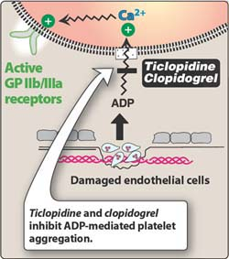
clopidogrel
ADP receptor antagonist
Irreversible
Cats:
Decreased platelet aggregation in response to serotonin and collagen
Prolonged BMBT
No adverse effects noted
Dogs:
Rapid inhibition 60 minutes post administration
Increased risk of bleeding when combined with aspirin in humans, not identified (yet) in veterinary medicine
Genetic resistance seen in people
Wiinberg et al JVECC

Slide 64
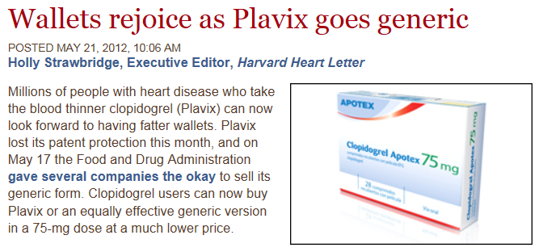
Clopidogrel

Slide 65
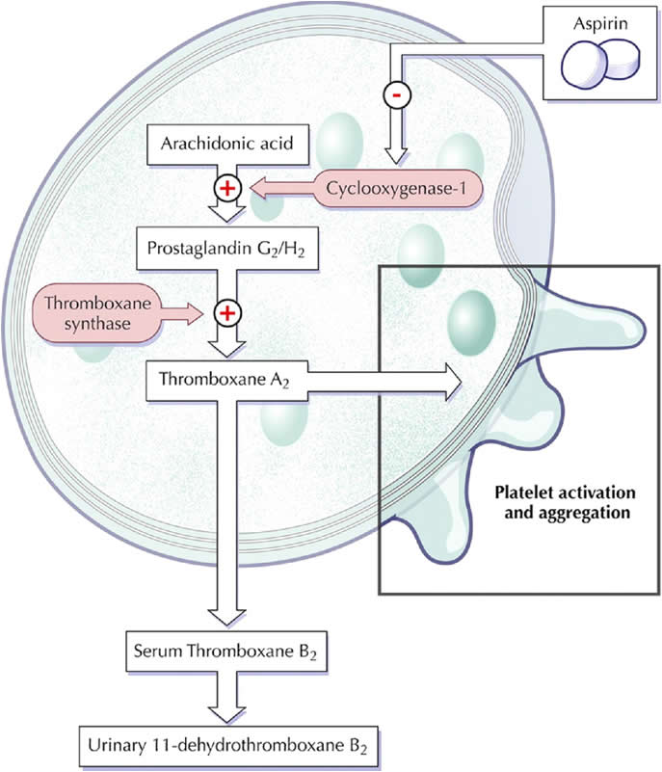
Aspirin (acetylsalicylic acid)
Direct intracellular platelet inhibitor
Thromboxane inhibitor
  Irreversible cyclooxygenase inhibition
  Low doses thought to spare endothelial prostacyclin production (endogenous platelet inhibitor)
Does not completely inhibit platelet activation
  Thrombin
Wiinberg et al JVECC

Slide 66
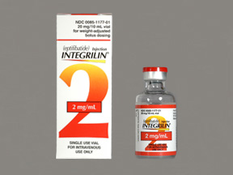
GP Iib/iiia inhibitors
Abciximad, tirofiban, eptifibatide (rattlesnake protein derivatfiive)
Intravenous only
Human medicine:
During percutaneous coronary intervention
Bleeding relatively common
Drug-induced thrombocytopenia
Wiinberg et al JVECC

Slide 68
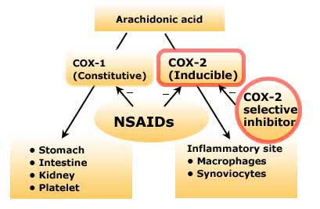
NSAIDs
Studies have shown prolonged closure time with COX-2 selective NSAIDS
  Carprofen, meloxicam, deracoxib
High interdog variability
Differences between epi and ADP agonists
Clinical significance?
Mullins et al Vet Anes Analg 2012

Slide 69
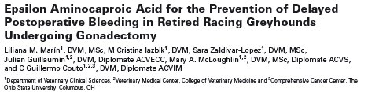
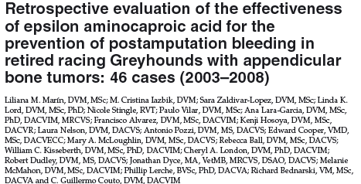
Aminocaproic acid
Tranexamic acid
Antifibrinolytic agents
Used to help stop bleeding after injuries or surgery
Low cost
Wide safety margin
Greyhounds are hypothesized to have enhanced or early fibrinolysis as they have a tendency to develop delayed post-op bleeding.
Decreased post-op bleeding
TEG indicated increased clot strength
Less bleeding in those treated with aminocaproic acid

Slide 70

Summary
Primary hemostasis is adhesion, activation and aggregations of platelets leading to formation of a platelet plug
It requires activatible platelets, functional vonWillebrand factor to occur
There are several ways, mostly in vitro, to evaluate primary hemostasis
Several disease conditions can alter primary hemostasis, the most common of which is vonWillebrand disease

Slide 71



Slide 72
