Slide 1

Pancreatitis
Board review September 2012
Val Madden

Slide 2
Acute vs Chronic
Chronic pancreatitis more common than acute
Chronic ; lymphocytic infiltration (61.5%), fibrosis (48.6%) and atrophy (30.8%)
Acute; Neutrophilic inflammation (30.8%), necrosis (28.4%), peri-pancreatic fat necrosis (28.8%), edema lesions (9.6%)

Slide 3
Overview
Inflammatory infiltration of the pancreas
No well defined classification
Acute: inflammation not associated permanent changes
Chronic: assoc with fibrosis and atrophy

Slide 4
Either one may be neutrophilic or lymphocytic /plasmacytic
Either can be associated with systemic or local complications
Chronic form tends to be more mild
Acute: Veterinary literature reports mortality rates in dogs ranging from 27 to 42%

Slide 5
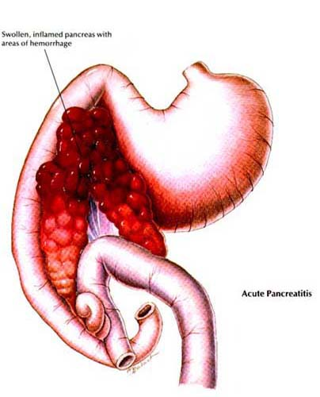
Starting with acute ….

Slide 6
Scoring system
Several developed for humans
- Ranson, Modified Glasgow, APACHE II, APACHE O
- Based on clinical and lab parameters, age,
pre-existing health issues
- Used to monitor disease progression and
response to treatment
Veterinary (Ruaux and Atwell)
- Relating pancreatic enzyme concentration to an organ
score (based on # of extrapancreatic organs showing compromise)
- Dogs with score of 3 or greater → 50% mortality rate
- Suggest MOF is a poor prognostic indicator
- Limitations; further studies require
Notes:
Limitations: No imaging or histopath criteria. Criteria used to determine organ score were not specific or sensitive for individual organs (ie, elevated enzymes)

Slide 7
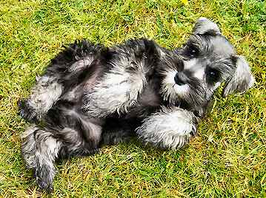
Common Breeds
Table • 282-1 -- Rate of Pancreatitis in Major Dog Breeds in the United States BREED RATE P VALUE
Miniature Schnauzer 4.52% p < 0.0001
Shetland Sheepdog 2.34% p < 0.0001
Yorkshire Terrier 2.10% p < 0.0001
Miniature Poodle 1.69% p < 0.0001
Bichon Frise 1.60% p < 0.0001
Samoyed 1.56% p = 0.0007
Standard Poodle 1.56% p < 0.0001
Miniature Pinscher 1.40% p = 0.032
Maltese 1.39% p = 0.0035
Shih Tzu 1.19% p = 0.0014
Pomeranian 1.18% p = 0.028
Toy Poodle 1.18% p = 0.012
Miniature Dachshund 1.18% p = 0.041
Basset Hound 1.15% p = 0.045
Dachshund 1.13% p = 0.005
Mastiff 0.0% p = 0.004
Chesapeake Bay Retriever 0.0% p = 005
Akita 0.0% p = 0.001
Newfoundland 0.05% p = 0.0006
English Setter 0.15% p = 0.015
American Staffordshire Terrier 0.16% p = 0.003
Bulldog 0.17% p = 0.0002
Australian Cattle Dog 0.18% p = 0.006
German Shepherd Dog 0.18% p < 0.0001
Great Dane 0.20% p = 0.001
Chinese Shar-Pei 0.24% p = 0.007
Pekingese 0.28% p = 0.02
Chow Chow 0.30% p = 0.01
Greyhound 0.35% p = 0.02
Boxer 0.35% p = 0.0004
Doberman Pinscher 0.35% p = 0.0007
Rottweiler 0.36% p < 0.0001
German Shorthair Pointer 0.36% p = 0.045
Golden Retriever 0.38% p < 0.0001
Australian Shepherd 0.40% p = 0.01
Labrador Retriever 0.47% p < 0.0001

Slide 8
Etiology
Cause – unknown
Dietary indiscretion ? High fat diet?
Stimulation of pancreatic secretion via excessive release of CCK
Iatrogenic infusion of CCK results in pancreatic hyperstimulation
Hypertriglyceridemia (cause vs effect);
Study showing it Is a risk factor in schnauzers and humans
Bile reflux
Infectious? Majority of cases are considered sterile
Generally only see bacteria in those with pancreatic abscesses
Endocrinopathies

Slide 9
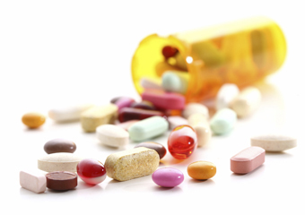
Continued …
Drugs:
azathioprine, L-asparaginase, estrogen, furosemide, KBr, sulfonamides, tetracyclines, thiazide diuretics and vinca alkaloids, steroids
Zinc toxicosis
Hypercalcemia (rare)
Obese animals
- inappropriate diet
- chronic inflammation
Ischemia/reperfusion

Slide 10
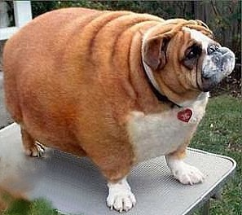
Risk factors to be associated with fatal AP in dogs include
- Obesity
- Diabetes mellitus
- Hyperadrenocorticism
- Hypothyroidism
- Prior GI disease
- Epilepsy
Consideration of these factors for scoring

Slide 11
Other causes documented in humans
Pancreatic obstruction in humans biliary calculi, sphincter spasm, edema of the pancreatic duct or duodenal wall, neoplasia, parasites, trauma, surgical trauma, reflux of duodenal juice into pancreatic duct
Ischemia secondary to anesthesia
Pancreatic ischemia during shock/dehydration Documented in humans with renal failure secondary to dehydration
Bacterial
Associated with a negative outcome
Hereditary documentation in humans mutations of trypsinogen gene or serine protease inhibitor gene
Immune component
small population that respond to steroids
Notes:
Ischemia secondary to anesthesia is more likely to result in pancreatitis than from surgical handling
Bacterial component → negative outcome; (suggesting that 25-50% who die from acute pancreatitis do so from secondary bacterial complications)
Humans → immune component (small population that respond to steroids); not demonstrated in vet med, although come chronic lymphocytic/plasmacytic ones may respond to steroids (29)

Slide 12
Pathogenesis Overview
Traditional thought – pancreatitis develops as a consequence of auto digestion resulting from premature zymogen activation within the acinar cells.
Develops when there is excessive activation of trypsin and other pancreatic proteases within the pancreas that overwhelms local safe guards within the acinar cell and anti-proteases in the circulation
Autodigestion then stimulates an inflammatory reaction that leads to local and systemic complications
Many different conditions may lead to autodigesiton
Various inciting causes….
Notes:
Experimental models – hyperstimulation, pancreatic duct obstruction, pancreatic ischemia, intraductal injection of bile/fatty acids or enzymes → unknown if these factors play a role in development of disease

Slide 13
Inciting causes of autodigestion….
Initial activation may be cause by:
- oxidative stress
- hypotension
- most inciting causes are undetermined
it is worsened by a low acinar pH and high
intracytosolic calcium concentrations
Notes:
Indication of autodigestion → decreased secretion of pancreatic juice followed by fusion of lysosomes and zymogens for form large vacuoles → a decrease in pH of these vacuoles and/or activation of zymogens by lysosomal enzyme mediated hydrolysis leads to active digestive enzymes that lead to destruction of acinar cells. Autodigestion then stimulates an inflammatory reaction that leads to local and systemic complications

Slide 14
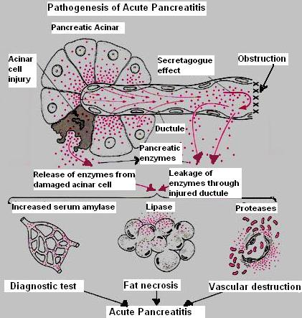
After initial production of active pancreatic enzymes… local inflammation ensues
Activation of complement → production of chemokines
Acinar destruction → cytokine release
Neutrophil and Macrophage migration → subsequent production of ROS and NO contributes to ongoing inflammation

Slide 15
Studies in animal models
Administration of cholecystokinin analogue (cerulean), IV, SC or IP → mild self limiting pancreatitis
Dietary models → choline deficient diet with ehtionine → severe necrotizing pancreatitis; good for studying acute form
Ethanol administration, gene knockout, immune modulation → harder to do
High dose arginine administration → dose dependent pancreatic necrosis

Slide 16
Pathophysiology

Slide 17

Normal Safe Guards

Slide 18
Digestive enzymes stored as inactive zymogens
- Normally only become activated after secretion into the the
duodenum
- trypsinogen
- chymotyrpsinogen kallikreinogen
- pro-elastse
- pro-carboxypeptidase
- pro- phospholaipase A2)
Zymogen granules remain physically separated from lysosomes granules in membrane bound organelles
Normally become active when contact enteropeptidase in the duodenum
Notes:
Pancreatic secretory trypsin inhibitor is produced and stored in the same location as digestive enzymes
Anti-proteases

Slide 19
Pancreatic secretory trypsin inhibitor (PSTI) –aka SPINK1
- Synthesized and secreted with trypsinogen
- Immediate inhibition should trypsin become activated
within the cell
Unidirectional flow of pancreatic juice
Anti-proteases in the blood
- Alpha 1 proteinase inhibitor
- Alpha antityrpsin
- Alpha 2 macroglobulins
- Scavenge active proteases released into systemic circulation

Slide 20
Initiating cellular events
Activation of trypsinogen → trypsin within the acinar cells
“Secretory block” → zymogen granules are NOT secreted into the intestinal lumen for degradation by enterokinase
Apical block (secretory block) results in colocalization of zymogen granules and lysosomal proteases
→ activation of tryspsinogen by local proteases
- cathespin B protease
Colocalization is main initiating step
Notes:
one study did administration of cathespin B inhibitor, which significantly decreased development of pancreatitis, but did not stop it

Slide 21
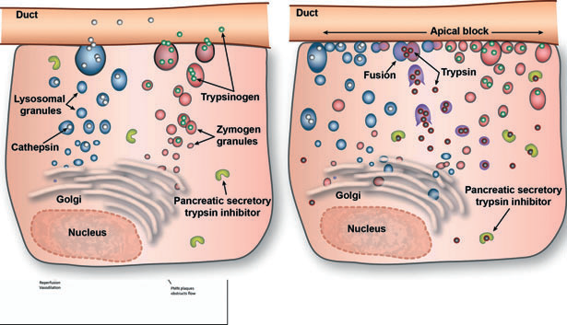

Slide 22
The role of pH and calcium in colocalization
Low pH in the acinar cell aids in colocalization
Calcium in the cytosol acts with CCK as an intracellular messenger for the release of lysosomal proteases
Study: blockade of calcium signaling within cells stops production of
trypsinogen activation peptide
Notes:
Note: hypotension has been demonstrated to initiate activation of trypsin before appearance of proteases (thus indicating there are other mechanisms involved in the premature activation of trypsin)
Calcium: tyrpsinogen activation also appears to require intracytosolic calcium in some experiments

Slide 23
Continued….
activated enzymes overwhelm PSTI → damage to the acinar cell
PLA2 → hydrolysis of membrane phospholipids
Elastase → degradation of elastin in blood vessels
Chymotrypsin → activation of xanthine oxidase → oxidative damage
Lipase → fat hydrolysis

Slide 24

Take home message
premature activation of trypsin within the acinar cells is dependent on intracellular pH and calcium and can be induced by a variety of causes
Notes:
Causes: (ie. hypotension and may be exacerbated by genetic abnormalities in local safe guards (humans)) http://imgc.allpostersimages.com/images/P-473-488-90/21/2144/5KBCD00Z/posters/adriano-bacchella-three-king-charles-cavalier-spaniel-adults.jpg

Slide 25
Migration of neutrophils in response to chemotactic factors → local inflammation
Release inflammatory mediators and free radicals
Mediators mainly released by neutrophils and macrophages ( TNFa, IL-1, IL-2, IL-6, IL-8, IL-10, interferon a, INFB, NO, PAF) ….. This will come later….

Slide 26
Recruitment of Neutrophils and production of ROS
Vasodilation of blood vessels, increased capillary permeability
Migration of granulocytes to affected tissue and swelling of tissue cells
Neutrophils contain oxidizing agents (ROS):
- superoixide (-O2)
- hydrogen peroxide (H2O2),
- hydroxyl anions (-OH)
→ direct cell toxicity
ROS Also increase cellular and vascular permeability
ROS enhance expression of inflammatory mediators released by leukocytes

Slide 27
Chemokines: recruit leukocytes to areas of injury
2 families:
1. CXC
2. CC
1. CXC → potent neutrophil attractors (Ex I-L8)
I-L8 and other chemokines mediate expression of ICAM and selectins on the endothelial surface to allow adhesion of neutrophils
Neutrophils follow a chemokine gradient into pancreatic tissue
Notes:
I-CAM knockout mice are protected to some extent from development of acute pancreatitis
Neutrophils follow a chemokine gradient into pancreatic tissue; they initially accumulate peri-vascularly → edema production and permeability changes → move into the pancreatic body

Slide 28
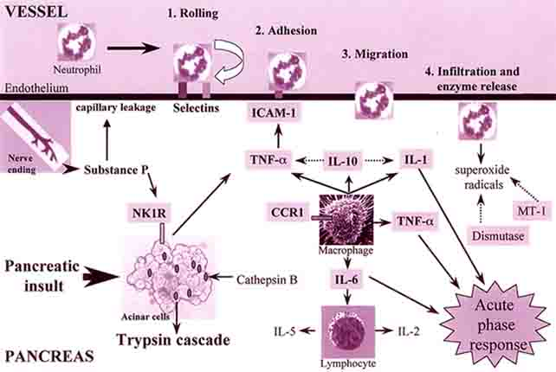

Slide 29
Neutrophils implicated in a shift from apoptsis to necrosis
Necrotic cells release contents of their cytosol into the extracellular space → profound inflammatory response
Necrosis is linked to pancreatic microcirculation and is proportional to the degree of oxidative stress
Vasoactive mediators contribute to development of necrosis (endothelin 1, PLA-2)

Slide 30

Take home message
Neutrophil migration into the pancreas is directly stimulated by activated trypsin and chemotrypsin and indirectly by upregulation of ICAM-1 by inflammatory mediators (esp IL-8).
Neutrophils perpetuate and inflammatory state and are involved in the progression from apoptosis to necrosis within the pancreas

Slide 31
NO and oxidative stress
Functions:
- regulates pancreatic exocrine secretion
- promotes capillary integrity
- inhibits leukocyte adhesion
- modulates pancreatic microvascular blood flow
NO acts as both and pro and anti- inflammatory mediator

Slide 32
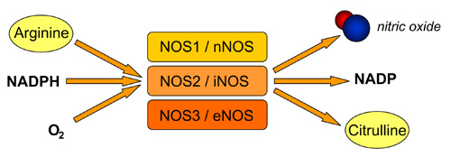
isoforms
eNOS (vascular endothelium)
nNOS (neurons)
iNOS (macrophages)

Slide 33
NOS effects
Decreased circulation → increased concentration of NO → vasodilation (regional)
If this persists, MT function is impaired → NO becomes peroxynitrite (oxidant that causes lipid peroxidation, protein nitration, DNA damage and cell necrosis)
NO can directly produce ROS → increasing oxidative stress
NO can cause increased oxidative stress and/or hypotentsion

Slide 34
Effects continued
Possible protective effect by increasing blood flow in the pancreas
In the pancreas eNOS, nNOS → constitutive expression that stimulate low levels of NO production (calcium dependent enzymes)
eNOS down regulated during later stages of severe pancreatitis
iNOS → does not require calcium. Results in Large amounts of NO throughout the body
IL-8 increases expression of iNOS
iNOS is increased in proportion to disease severtiry
nNOS may amplify neurogenic inflammation mediated by substance P
Notes:
In the pancreas eNOS, nNOS → constitutive expression (calcium dependent enzymes)

Slide 35
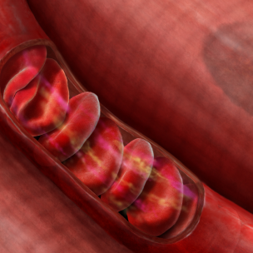
Blood flow

Slide 36
Circulation and perfusion disturbances
The pancreas is susceptible to ischemia (especially when splanchnic circulation is decreased)
Hypovolemia
→ disturbed pancreatic microcirculation
→ contribution to inflammatory state

Slide 37
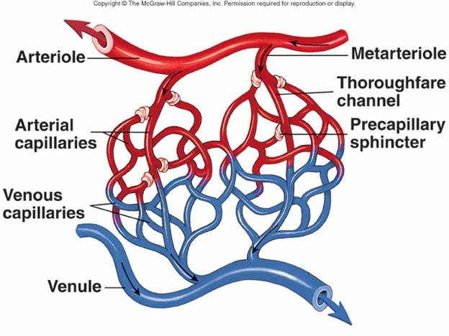
Pancreatic microcirculation
Disturbed circulation with pancreatitis
Animal models; vasoconstriction appears to be an early event in pancreatitis

Slide 38
Disturbed pancreatic microcirculation
Multi factorial
Increased permeability resulting from inflammatory cytokines and microthrombi formation
Increased permeability:
→edematous changes in acinar cells
→ further migration of inflammatory cells
Necrotizing pancreatitis
→ progressive reduction in capillaries after acinar
cell injury
→ not reversible

Slide 39
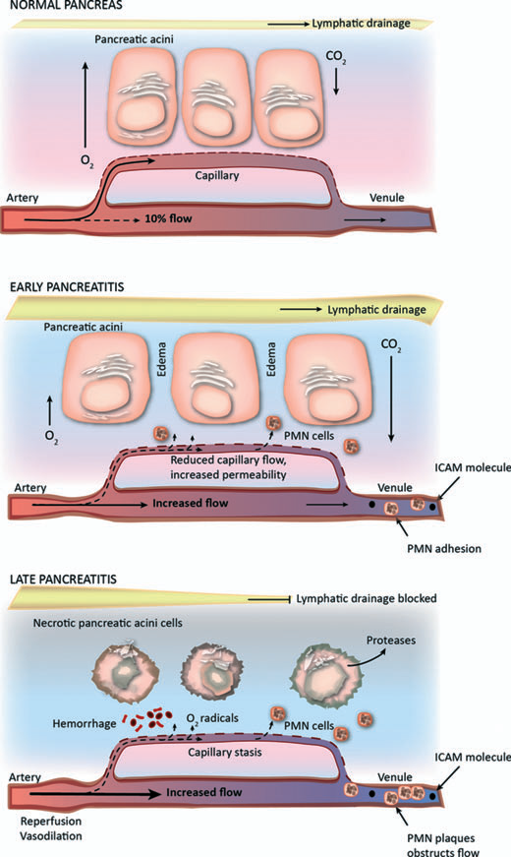

Slide 40
Kallin-kallikrein system:
Early → pancreatic proteases activate the kallikrein system
Pancreas normally has a high tissue concentration of kallikrein (stored as prekellikrein)
Pancreatic kallikrein → releases kallidin
Plasma kallikrein → releases bradykinin

Slide 41
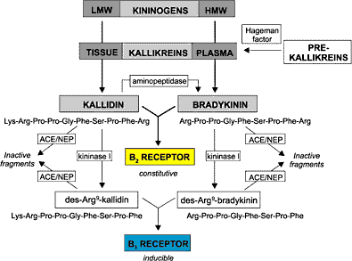
Kinins
vasodilation of arteries and increased capillary permeability → edema
activators of nociceptive neurons
attract cytotoxic factors to tissues
enhance production of prostaglandins
Short half life

Slide 42
effects mainly modulated via B2 receptors that are constitutively expressed in tissues
B2 receptor antagonists experimentally appear to have beneficial effects on pancreatic blood flow, necrosis and survival in models of necrotizing pancreatitis

Slide 43
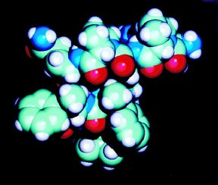
Substance P
Substance P - Mediates pain and vascular permeability
May play a role in pancreatitis
Mouse models
- up regulation of NK-1 receptors and amount
of substance P in acute pancreatitis
- substance P related to lung injury;
genetic deletion of NK-1 receptors was
protective against systemic effects of
pancreatitis
NO and substance P may act synergistically to enhance pain and inflammation
Notes:
Substance P (peptide produced by nerve endings); binds to NK1 receptors . Mediates pain and vascular permeability.

Slide 44
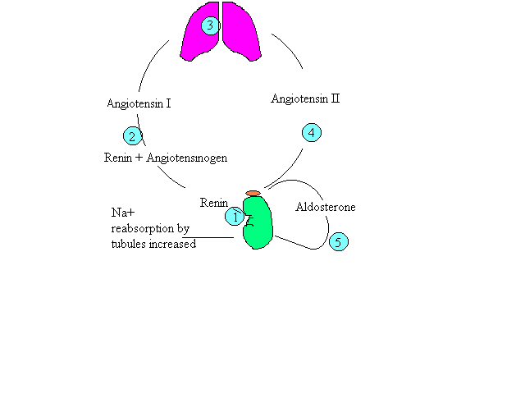
Renin angiotensin System
May play a role in the initiation and perpetuation of
inflammation in pancreatitis
angiotensin II receptors identified in the vascular and
ductular endothelium in rodents
Expression of genes encoding these receptors and
metabolites shown to be upregulated in acute
pancreatitis

Slide 45
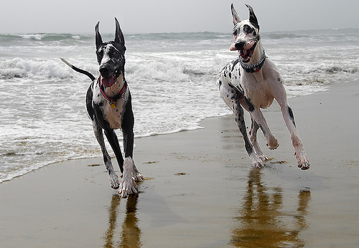
The cytokine storm

Slide 46
Intro
Cytokines
- small proteins produced in response to stimuli
- act to up or down regulate various aspects of
the inflammatory process
Many are produced by the T cells to drive or facilitate a Th1 or Th2 immune response
- Th1: Mediate cellular immunity
Activate neutrophils, macrophages and NK cells
- Th2: Mediate humoral immunity
B cell activation or recruitment of eosinophils

Slide 47
Initiating step of this process in pancreatitis is the activation of NF-kB, which is a transcription factor that modulates the expression of most cytokines
This also stimulates production of adhesion molecules and iNOS
Notes:
In people there a high expression of NK-kB has been identified in peripheral mononuclear cells in people with acute pancreatitis and correlates with the development of systemic complications (6)

Slide 48
Major players
TNF a
- produced by acinar cells
- synergistic with other cytokines
- promotes adhesion via ICAM-1
IL-1
- synergistic with TNF a
- production requires IL-1B and two IL-1 receptors
- production is mediated by caspases (which also
produce other inflammatory cytokines such as IL-8)

Slide 49
IL1-B
- facilitates neutrophil migration
- associated with the development of systemic inflammation
- Initiates transcription of ICAM-1 and NF-kB further
perpetuating the inflammatory cascade
- plays a role in early initiation of progression of acute
pancreatitis
- Effects are counteracted by an IL-1 receptor antagonist
Caspases
- mediates production of certain cytokines
- favors necrosis (over apoptosis) compared
with TNF a mediated inflammation
- worsens severity of pancreatitis

Slide 50
IL-6:
- produced by mononuclear cells, endothelial cells and
fibroblasts
- produced in response to stimulation by TNFa and IL-1B - some studies suggest negative correlation with
prognosis in humans
IL-8:
- involved with neutrophil actions
- negative correlation with prognosis in humans
demonstrated
Notes:
IL1-B plays a role in early initation of progression of acute pancreatitits; (IL-1 knockout mice did not develop pancreatitis)

Slide 51
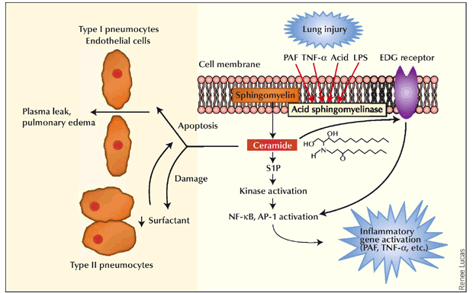
PAF: produced by neutrophils. Associated with lung injury in humans.
Notes:
PAF: Associated with lung injury in humans. Blockade in humans led to a reduction in lung associated injury, but did not improve mortality overall

Slide 52
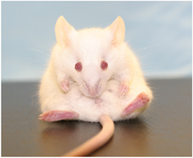
IL-10: anti-inflammatory effect. Favors a shift to Th2 cytokine profile and down regulates NF-kB transcription. Used as a pre-treatment in a mouse model
- decreased iNOS
- increased TGF-B1 which correlated
with an increase in apoptosis as
opposed to necrosis
- limited success in treatment of
humans

Slide 53

Take home message
There is a large number of complex interdependent cytokines produced in acute pancreatitis
Targeting a single cytokine is likely to be ineffective in modulating disease

Slide 54
Factors involved in perpetuation of disease…
Hypovolemia:
splanchnic circulation is sacrificed → perpetuation of inflammatory state
- Decreased splanchnic circulation →
increased oxygen extraction from
systemic circulation (up to 90%)
- Prolonged oxygen extraction >70%
may lead to regional ischemia
Notes:
Hypovolemia: vomiting, diarrhea

Slide 55
Intestinal ischemia:
- Increased permeability and mucosal
acidosis
- Increased enterocyte apoptosis and decreased
nutrient transport of intestinal epithelial cells
- Increased bowel permeability leads to further
cytokine release

Slide 56
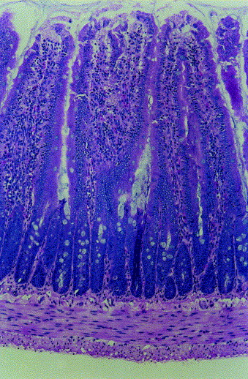
Gut contribution to an inflammatory state
“Gut starter model”
- Neutrophils are primed during re-perfusion
of the ischemic intestine
- Neutrophils then provoked by exposure to
endotoxin in systemic circulation
- Primed neutrophils then affect distant organs
“Gut motor model”
- Disruption of intestinal barrier
- Translocation of bacteria and inflammatory
cells into the portal and lymphatic system
- Activation of downstream immune cells
Notes:
Gut starter model – neutrophil activation mediated by PLA2

Slide 57
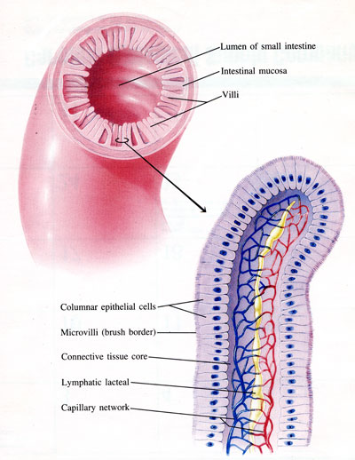
Xanthine oxidase
- Produced on reperfusion of the intestines
- Free radical production
- Increased oxidative stress
- Perpetuation of the inflammatory process
Blood flow in the villi:
- Countercurrent blood flow in villi
- Susceptible to hypoxic injury
- Disruption of intestinal barrier followed by reperfusion
→ may be the initiator or perpetuator of distant
inflammation by a variety of mechanisms

Slide 58
Clinical signs
Acute
- Weakness, depression
- Vomiting
- Diarrhea
- Dehydration
- Abdominal pain - most consistent clinical signs in humans (90%) (ref16)
- Febrile
- Jaundice
- Respiratory distress
- Coagulopathy
- Arrhythmias
- Shock
- Other: Cavitary effusions

Slide 59

Diagnostics

Slide 60
Clinical Pathology
Variable findings
Most common finding reported on CBC (59%) in dogs with severe pancreatitis is thrombocytopenia (mostly mild)
Leukocytosis with a left shift
Chemistry may show elevated liver enzymes
Azotemia and electrolyte shifts due to dehydration
Azotemia from renal failure secondary to severe pancreatitis
Hypoalbuminemia
Hypocalcemia:
- Hypoalbuminemia
- Saponification of fat
Transient proteinuria
- Glomerular damage from pancreatic enzymes

Slide 61
Markers for pancreatitis
2 categories
Markers of trypsinogen activation
- increase early in disease
- peak in 1-2 days
- rapid degradation
- may be early indicators for severity
- TAP, CAPAP
Markers of inflammation
- C-reactive protein, cytokines
Notes:
Trypsinogen acivation peptide: TAP release into abdominal cavity or urine (normally released into the duodenum). Elevations used for severity prediction and prognostic indicator as it tends to be more elevated insevere disease. Not widely used
Carboxypeptdase B activation peptide

Slide 62
Markers for Pancreatitis
Assays for pancreatic enzymes and zymogens in serum or urine
Amylase and lipase activities
Serum trypsin like immunoreactivity (cTLI)
Pancreatic lipase immunoreactivity (cPLI)
Trypsin-a1-protease inhibitor complexes
Serum and urine trypsinogen activation peptide

Slide 63
Markers continued…
Lipase and amylase are non specific
- 50% of dogs with elevations in one or both do not
have pancreatitis (49).
- 50% with pancreatitis have normal amylase and lipase
Plasma, serum or urine TAP
- not very sensitive
Trypsinogen a1 proteinase inhibitor complexes also non sensitive
cTLI
- good for diagnosing EPI
- Due to the short half life of trypsinogen and trypsin, this test is insensitive for
diagnosing pancreatitis.

Slide 64
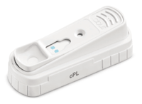
Markers continued…
cPLI
- Specific immuno assay for pancreatic lipase
- Quantifies pancreatic lipase
Spec CPL
- Sensitivity 86.5-96.3%, specificity 66.3-77%
SNAP CPL
- Sensitivity 91.5-941%, specificity 71.1-77.5%
- Highly sensitive and is good for ruling out pancreatitis
- Abnormal SNAP CPL should be followed up by a Spec CPL

Slide 65
Interpretation of Spec and SNAP
Higher sensitivity for diagnosing acute pancreatitis than serum amylase or lipase
Positive Spec or SNAP has a good positive predictive value in patients likely to have disease
Both have good negative predictive value in patients unlikely to have disease

Slide 66
C-reactive protein
Acute phase protein
Production mediated by TNF, IL-1, IL-6
May have prognostic value as it was found to be significantly higher in dogs with severe AP (necrosis), compared with mild disease
Gold standard for predicting severity
Sensitivity and specificity of predicting necrosis > 80%
Study: (Holm, Rozanski, Freeman. JVECC 14(3) 2004. PP 183-186)
- CRP elevated early, levels declined rapidly, however
were still higher than compared with controls
- May be useful in monitoring progression and
response to therapy
May not reach prognostically useful values until later in disease?
Further studies required
Notes:
In humans, the degree of pancreatic necrosis and presence of bacterial infection are 2 important factors in determining the development of MOF and mortality
May not reach prognostically useful levels until later in disease? (Holm, Chan, Rosanski); levels are most reliably detected 48hrs after the onset of symptoms

Slide 67
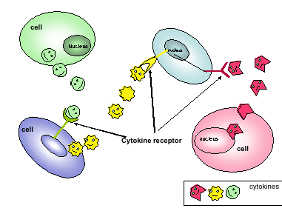
Cytokines
- Elevated early
- Limited assays available

Slide 68
Imaging
Standard Radiographs
- Ground glass appearance in right cranial abdomen
- Widening of the angle between the pyloric antrum and proximal
duodenum
- Loss of gastric symmetry: Displacement of the stomach to the left
and duodenum to the right
- Thickening of the descending duodenal wall
- Study showed radiographic changes in only 24% of dogs
with fatal AP
Notes:
Ultrasound Recent study revealed 50% of pancreatic surgical lesions were missed with ultrasound
Echogenicity changes decreased echogenicity indicates necrosis Hyperechogenicity indicates pancreatic fibrosis (chronic).Peri- pancreatic hyerechogenicity is also common.
CT; necrosis = areas of lack of contrast enhancement. Scoring system

Slide 69
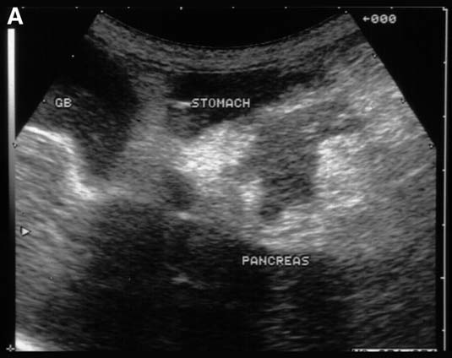
Ultrasound:
- Sensitivity 70% (ref 35)
- Enlarged hypoechoic pancreas
with a bright peripancreatic
mesentery → Edema, hemorrhage,
necrosis
- Recent study revealed 50% of
pancreatic surgical lesions were
missed with ultrasound
- Serial evaluations are useful

Slide 70
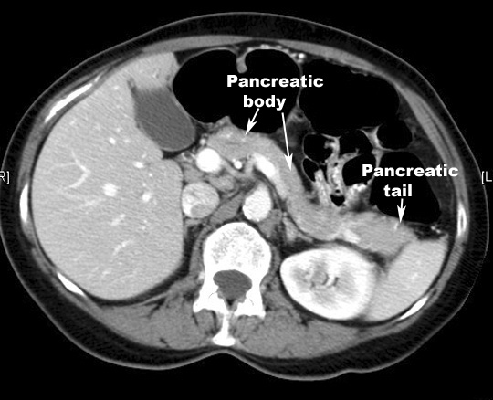
Imaging continued
CT
- Contrast enhanced CT most useful modality in humans
- High sensitivity and positive predictive value for detecting necrosis
- Morbidity and mortality strongly associated with degree of necrosis
- May lack sensitivity in dogs and cats due to small pancreas size?
- Cost, availability, interpretation,
anesthesia
MRI – no reports in dogs

Slide 71
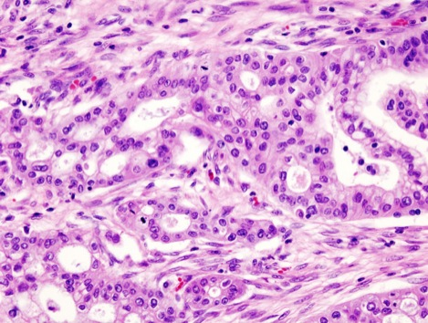
Cytology
Ultrasound guided FNA
- acute; may see acinar cell necrosis and
neutrophillic inflammation
Pancreatic biopsy
- gold standard
- lesions may be patchy or focal
- histologic lesions of the exocrine pancreas are common,
thus the presence of infiltrates may not always be
significant
- Areas of necrosis and inflammation are highly suggestive in
patients with signs of pancreatitis
- Lack of lesions does not rule out pancreatitis

Slide 72
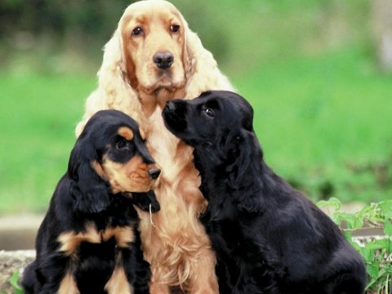
Therapy

Slide 73
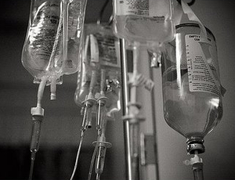
Treat the inciting cause
- Most cases are idiopathic
- Try to identify potential causes
* hypertryglyceriedemia
* hypercalcemia
* drugs
Supportive care
- Aggressive fluid therapy is mainstay
- Correct fluid, acid base and electrolytes to avoid
systemic complications
- Systemic complications have a negative impact on
outcome
Notes:
Aggressive fluid therapy is mainstay (as in humans).

Slide 74
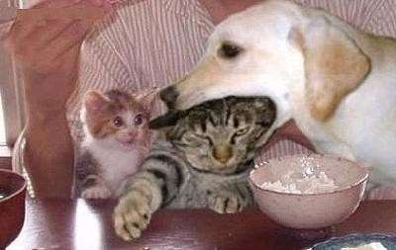
Nutrition
Use to think NPO for 3-4 days
- “pancreatic rest” (no feedback to stimulate pancreatic secretion, protecting
against further autodigestion)
- If not vomiting, there is no evidence to suggest this is beneficial
- Evidence in humans shown feeding improves outcome
Catabolic state, increased metabolic demands, Ileus
Fasting has detrimental effects on the gut
- mucosal atrophy, enterocyte apoptosis, changes in secretion
composition, break down of the GI barrier and increased permeability
Role of the gut in amplification of systemic inflammation
- Intraluminal nutrition shown to decrease inflammation in experimental
models
Notes:
Reason to feed: evidence that feeding is important to counter balance the catabolic effects of pancreatitis
Studies have show no real “pancreatic feedback” in dogs. Models suggest exocrine secretions are reduced with inflammation anyways
J-tubes : provides nutrients to areas devoid of cells that secrete CCK, thus doe not increase pancreatic secretions
Septic complications with TPN

Slide 75
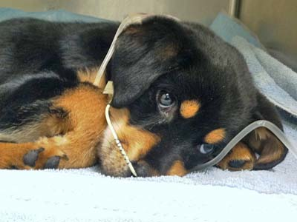
Feeding:
- Promotes intestinal mucosal
regeneration
- May minimize ileus
- May decrease splanchnic cytokine
production, decrease catabolism
Routes of feeding:
- TPN/PPN
- Jejunostomy tubes
- G-tubes
- NE/NG tubes
Humans:
- Evidence of benefits of early EN over PN
- Fewer infectious complications, improved
outcome, shorter hospital stay
- Current recommendation: Early EN with severe pancreatitis →
reduction in mortality and infectious complications. J-tubes or N-J
tubes area ideal (nutrients delivered to areas devoid of CCK producing cells)
Notes:
TPN: catheter releated sepsis. Study in JVIM with dogs showed more vomiting with PN group
Humans: fewer infectious complicti

Slide 76
Plasma administration
Plasma (FFP, whole blood)
Advocated to replenish anti-proteases
- Alpha 2 macroglobulin; scavenger protein for activated proteases in the serum
- Documented decreased levels in humans/dogs with pancreatitis
- Consumption of all available macroglobulins → DIC, MOF
- Human literature; no evidence of improved outcome with FFP
- No correlation between levels of alpha macroglobulin and severity of disease
- No proven benefit of administration of FFP to increase anti protease levels
Systemic inflammatory response primarily related to cytokines, so changes in protease levels may not have a significant effect on outcome
Notes:
Humans: no improved outcome; but did see higher levels of alpha macroglobulin
Humans: no difference in morbidity or survival in those receiving FFP

Slide 77
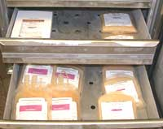
Provides coagulation factors
Provides albumin
Study: JVECC 19(6),209. P617-622
- no benefit of FFP
- Higher mortality rate in dogs who
received FFP
Recommendation:
- Use in patients with coagulopathy/DIC

Slide 78
Pain control
Anti-emetics:
- 5-HT3 antagonist; Dolasetron, ondansetron
- NK1 antagonist; Cerenia
- Metoclopramide ??
Antibiotics:
- Only in those with proven infection or high suspicion of in infectious cause
- Clindamycin, chloramphenicol, ciprofloxacin, metronidazole in humans
Anti-inflammatory agents:
- No data in dogs
- No benefits demonstrated in humans
Notes:
Metoclopramide ?? (effect on splanchnic perfusion is questionable, so may not be best choice

Slide 79
Other therapies…
Administration of protease inhibitors:
- aprotinin, platelet activating factor inhibitors
- failure to be effective in clinical trials in humans (non in dogs)
- does not address cytokine component of inflammatory response
- No clear benefit of providing anti-proteases in plasma in dogs
- Recommendations to use FFP in patients with a documented coagulopathy
Anti-secretory agents:
- Goal to minimze pancreatic secretions
- Anticholinergics, glucagon, somatostatin, calcitonin
Selenium
Dopamine
Notes:
Only platelet activating factor inhibitors and selenium have been demonstrated to work (ref 62). Dopamine has demonstrated its use in cats if given within 12hours of the initiating condition (64). Dogs may benefit from dopamine during anesthesia to prevent pancreatic hypoperfusion
Humans: necrosis associated with a poor outcome. Infection accociated with MOF

Slide 80
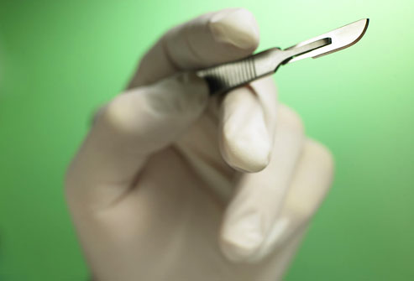
Surgical intervention
- Human patient with > 50% necrosis?
(questionable if sterile)
- In sterile cases, reserved for those who fail
to respond to aggressive medical management
- No extensive veterinary studies
- Veterinary recommendations for surgery
- Documented infection
- Failure to respond to medical management
- Cases where diagnostic confirmation is necessary

Slide 81
Peritoneal lavage
- Removal of substances from peritoneal cavity
(ie. Trypsins, kinins)
- No longer recommended in humans
- Early canine study documented positive
results

Slide 82
Complications:
Acute Kidney Injury:
- Secondary to hypovolemia, ischemia,
coagulopathy and inflammation
- Aggregation of neutrophils in glomeruli
- Endotoxin may promote renal vasoconstriction
DIC, Cardiac arrhythmias
- Mediated by systemic inflammatory cascades
secondary to pancreatitis
MOF
Acute lung injury
- Major complication in people
- Associated with PAF
- PLA-2, TNFa, IL-1B may play a role

Slide 83
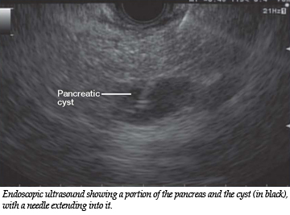
Complications continued…
Chronic, relapsing pancreatitis
- Subsequent development of EPI
Area of necrosis that may become a nidus for infection
- Pancreatic abscess
- More so in humans
Pancreatic fluid accumulations
- Cyst
- Pseudocyst
- These are chronic
Fluid in the canine pancreas is generally acute and sterile in nature

Slide 84
Prognosis
Variable depending on severity of disease and other organ systems affected
Guarded?
- No specific criteria for predicting outcome

Slide 85
References
Ettinger, S.J. Textbook of Veterinary Internal Medicine 7th ed. Saunders Elsevier. 3251 Riber Port Lane. St Louis Missouri 63043.
Freeman, L.M., Labato, M.A., Rush, J.E., Murtaugh. Nutritional Support in Pancreatitis: A Retrospective Study. Journal of Veterinary Emergency and Critical Care 5(1), pp 32-41
Holm, J.L., Chan, D. L. and Rosanski. Acute pancreatitis in dogs. Journal of Veterinary Emergency and Critical Care. 13(4) 2003, pp 201-213
Holm, J.L., Rozanski, E. A., Freeman, L. M. and Webster, C.R. C-reactive protein concentrations in canine acute pancreatitis. Journal of Veterinary Emergency and Critical Care. 2004; 14(3), pp 183-186
McCord, K. ., Morley, P.S. , Armstrong, J., Simpson, K., et. Al. A Multi-Institutional Study Evaluating the Diagnostic Utility of the Spec cPL and SNAP cPL in Clinical Acute Pancreatitis in 84 Dogs. J Vet Intern Med 2012;26:888-896

Slide 86
References continued…
Mansfield, C.S. Pathophysiology of Acute Pancreatitis: Potential Applications from Experimental Models and Human Medicine to Dogs. J Vet Intern Med 2012;26:875-887
Mansfield, C.S., James, J.M., et al. A Pilot Study to Assess Tolerability of Early Enteral Nutrition via Esophagostomy Tube Feeding in Dogs with Severe Acute Pancreatitis. J Vet Intern Med 2011;25:419-425
Simpson, K., Lamb, C. Acute Pancreatitis in the dog. Companion Animal Practice. 1995. 17. pp 328-337
Simpson, K. Update on pancreatitis in dogs. G-Gastroenterology. 2006. pp 382-389
Steiner, J.M. Diagnosis of pancreatitis. The Veterinary Clinical of Small Animal Practice. 2003; 33 pp 1181-11195
Weatherton, L.K., Streeter, E.M. Evaluation of fresh frozen plasma adminsitration in dogs with pancreatitis: 77 cases (1995-2005). Journal of Veterinary Emergency and Critical Care. 2009; 19(6), pp 617-62

