Slide 1
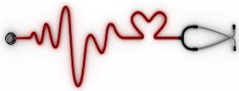
Infective Endocarditis
Clare Hyatt, DVM, MS
Resident, Emergency/Critical Care
Cornell University

Slide 2

Infective Endocarditis
Pathogenesis
Predisposing factors
Causative agents
Clinical presentation
Sequela
Diagnosis
Treatment
Prognosis

Slide 3
Infective Endocarditis
Pathogenesis
Predisposing factors
Causative agents
Clinical presentation
Sequela
Diagnosis
Treatment
Prognosis

Slide 4
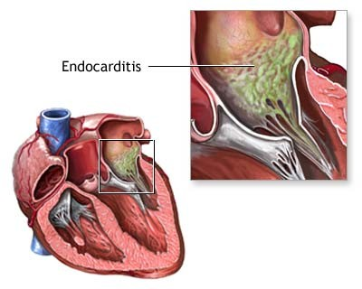
Infective Endocarditis
Disease caused by microbial invasion into the endothelium of the heart valves or the endocardium
Low prevalence in dogs
Very rare in cats

Slide 5

Pathogenesis
Endothelial surface of heart normally resistant to microbial invasion
Three basic steps
  Endothelial damage
  Platelet-fibrin deposition that allows for bacterial colonization
  Bacterial adherence to coagulum

Slide 6
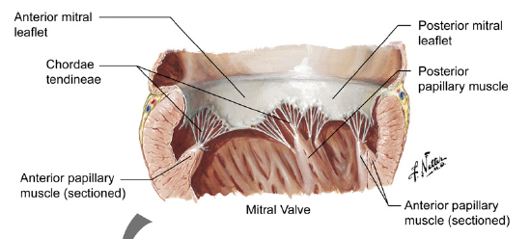
Pathogenesis
Lesions develop in the regions of highest blood flow
  Atrial side of mitral valve
  Ventricular side of aortic valve
Mechanical lesions can promote bacterial seeding
  Subaortic stenosis, cardiac catheterization

Slide 7
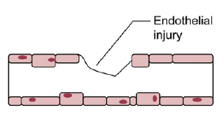
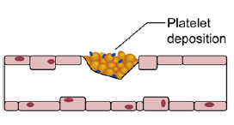
Pathogenesis
Following disruption of the endothelium, coagulation is triggered
  Extracellular matrix proteins, thromboplastin, and tissue factor
  A coagulum forms on damaged endothelium
    Fibrinogen, fibrin, platelet proteins
    Avidly binds bacteria

Slide 8
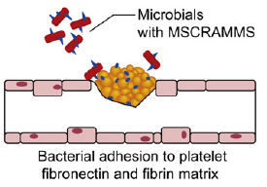
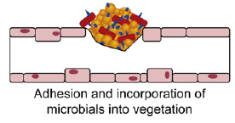
Pathogenesis
Inflammation induces endothelial cell expression of integrins – bind bacteria and fibrinectin
Adherence of bacteria mediated by microbial surface components recognizing adhesive matrix molecules (MSCRAMMS) – staphylococcus and streptococcus

Slide 9
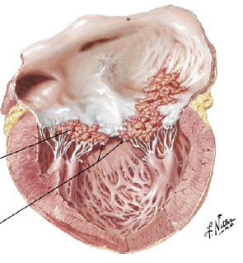
Pathogenesis
Bacteria trigger tissue factor production
  Induce platelet aggregation leading to larger vegetative lesion
  Streptococcus spp produce surface glucans and dextran to facilitate binding to coagulum
Shields bacterium from host defenses
Bacteria can excrete enzymes that destroy valvular tissue and chordae tendinae
Staphylococcus and Bartonella may become internalized

Slide 10
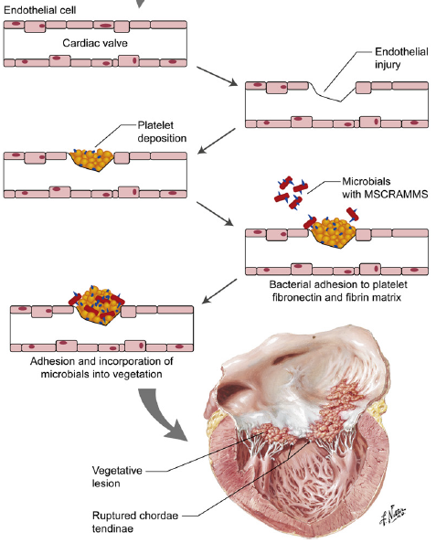

Slide 11
Infective Endocarditis
Pathogenesis
Predisposing factors
Causative agents
Clinical presentation
Sequela
Diagnosis
Treatment
Prognosis

Slide 12
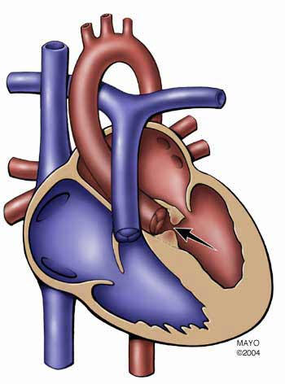
Accepted predisposing factors
Subaortic stenosis
Bacteremia
Endothelial disruption
JAVMA 2006 – no definitive predisposing causes identified

Slide 13
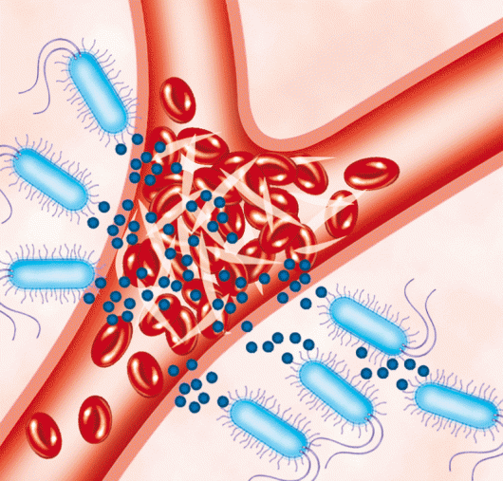
Predisposing factors
Subaortic stenosis
  Causes turbulent blood flow, damage to ventricular side of aortic valve leaflets
Bacteremia
  Necessary for development
  Diskospondylosis
  Prostatitis
  Pneumonia
  UTI
  Pyoderma
  Periodontal disease
  Long-term indwelling central venous catheters

Slide 14
Predisposing factors
Immunosuppression – controversial
  JAVMA 2006 – 30% had acquired defects of innate or adaptive immunity
    Neoplasia, barrier disruption, hepatic disease, hyperadrenocorticism
  JVIM 2004 – 1/18 had recent immunosuppressive drugs
  JAVMA 1982 – 38% of dogs received steroids
Myxomatous valvular degeneration
  Unlikely predisposing cause

Slide 15
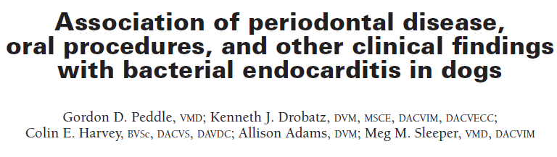
Dental surgery and endocarditis
NSD between dogs with endocarditis and case control dogs – evidence of oral infection
NSD between dogs with endocarditis and case control dogs in terms of recent dental or surgical procedure
No evidence to suggest an association between endocarditis and dental /oral surgical procedures

Slide 16

Dental surgery and endocarditis
Case report – 9y MC Rat Terrier
Presented with three week history of fever, anorexia, weight loss following dental prophylaxis (no abx)
Echo – vegetative lesion mitral valve
Blood cultures – Strep. bovis
Patient died

Slide 17
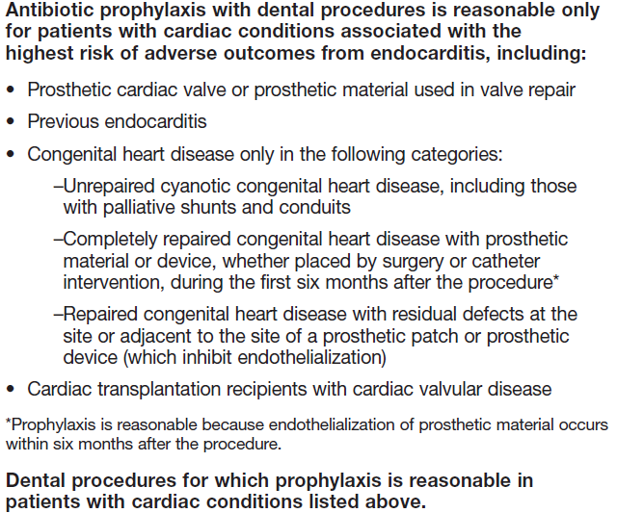
AHA 2007 Endocarditis prophylaxis guidelines

Slide 18
Infective Endocarditis
Pathogenesis
Predisposing factors
Causative agents
Clinical presentation
Sequela
Diagnosis
Treatment
Prognosis

Slide 19
Causative agents
Staphylococcal spp
  Aureus, intermedius, coagulase positive/negative
Streptococcal spp
  Canis, bovis, b-hemolytic
E. coli
Corynebacterium
Pseudomonas
Erysipelothrix rhusiopathiae
Enterobacter
Pasteurella
Proteus
Bordetella avium-like organism
Actinomyces turicensis
Bartonella

Slide 20
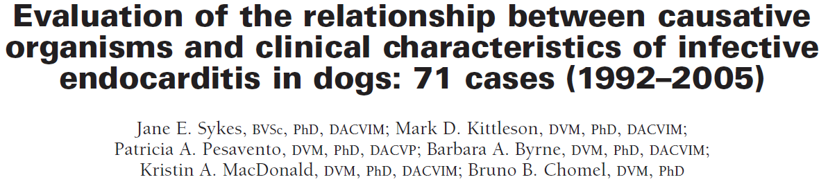
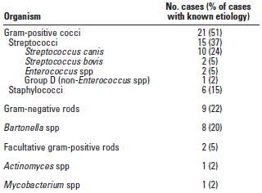
Causative agents
53% had negative blood cultures
  Bartonella

Slide 21
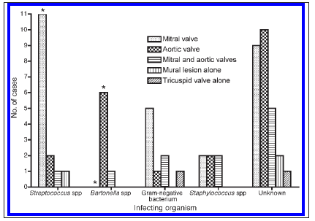
Location of lesion by causative organism

Slide 22
Causative agents - human
Streptococci (60-80%)
Staphylococci (20-35%)
Gram negative bacteria (1.3-13%)
Less common:
  Fungi - Aspergillus
  Gram-positive rods
  Anaerobes
  Brucella
  Coxiella
  Bartonella
  Chlamydophila
  Mycobacterium
  Pseudomonas
  HACEK (Haemophilus, Actinobacillus, Cardiobacter, Eikenella, Kingella)

Slide 23
Infective Endocarditis
Pathogenesis
Predisposing factors
Causative agents
Clinical presentation
Sequela
Diagnosis
Treatment
Prognosis

Slide 24
Clinical presentation
Vague, non-specific
Lethargy
Weakness
Weight loss
Lameness
Anorexia
Vomiting
Respiratory abnormalities

Slide 25
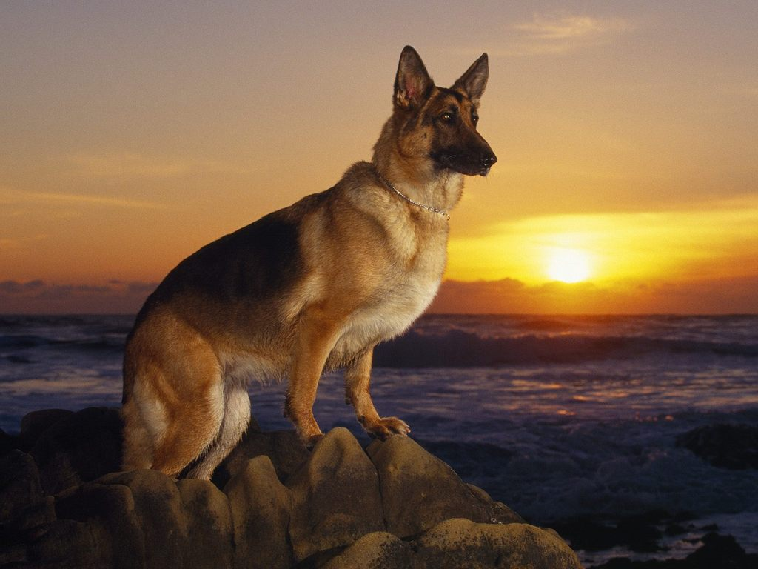
Signalment
Medium to large breed dogs
Male > Female
German shepherd predisposed

Slide 26
Physical examination
Relative to underlying cause or sequela (variable)
Fever common but not required
  Less common with Bartonella
Signs of sepsis in severely affected animals
Murmur (often “new”)
Bounding femoral pulses
  With severe aortic insufficiency
Lameness
Joint pain/swelling
Neurologic signs
  Ataxia, CP deficits, vestibular signs
Arterial thromboembolism
  Right thoracic limb or pelvic limbs

Slide 27
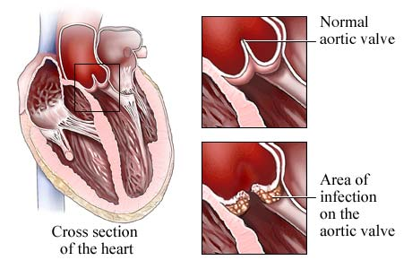
Cardiac murmur
89-96% of cases
New, changing
Mitral valve
  Mitral regurgitation
    Left apical systolic murmur
Aortic valve
  Aortic insufficiency
    Soft diastolic basilar murmur
  Subaortic stenosis
    Systolic basilar ejection murmur

Slide 28
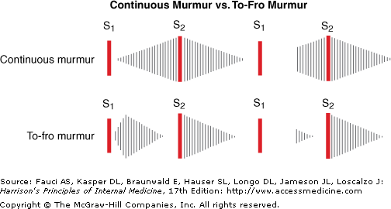
Cardiac murmur
“To-and-Fro” murmur
  Combination systolic (ie SAS or MR) and diastolic murmur (AI)

Slide 29
Infective Endocarditis
Pathogenesis
Predisposing factors
Causative agents
Clinical presentation
Sequela
Diagnosis
Treatment
Prognosis

Slide 30
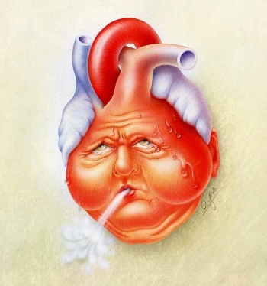
Sequela
Congestive heart failure
Immune-mediated disease
Thromboembolism
Hypertrophic osteopathy

Slide 31
Congestive heart failure
Most common sequela of IE
Aortic insufficiency → increased LVEDV LVEDP
Mitral regurgitation, rupture of cordae tendinae, valvular erosion → increased LVEDP
Most cause fulminant pulmonary edema
Often occur prior to left atrial enlargement
Can see as distended pulmonary veins in absence of marked cardiomegaly
Chronic and severe AI and MR → volume overload of the left heart, increased LVEDD and LA diameter

Slide 32
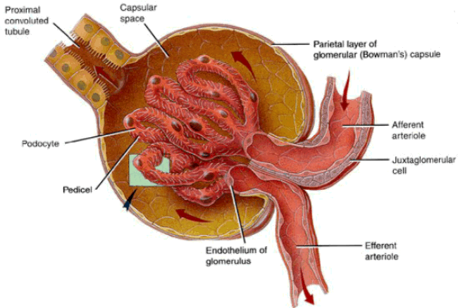
Immune mediated disease
IgM, IgG, Complement immune complexes secondary to high antibody titers to causative agents
Polyarthritis 75%
Glomerulonephritis 36%

Slide 33
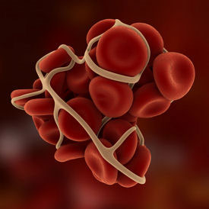
Thromboembolism
Common sequela seen at necropsy
  Septic 70%, aseptic 80%
Mitral > aotric
Kidney, spleen
Myocardium, brain, systemic arteries
Vascular encephalopathy uncommon in dogs
  Middle cerebral artery → brain ischemia → possible ischemic necrosis
Clinical signs in people vary from headache to major neurological deficits

Slide 34
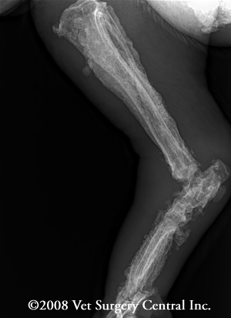
Hypertrophic osteopathy
Rare
Increased blood flow to extremities
Platelet clumps detach from vegetative lesion and obstruct a peripheral artery → plt-derived growth factor increases vascular permeability →chemotactic
Triggers overgrowth of vascular connective tissue and subsequent fibrochondroid metaplasia and subperiosteal new bone formation

Slide 35
Infective Endocarditis
Pathogenesis
Predisposing factors
Causative agents
Clinical presentation
Sequela
Diagnosis
Treatment
Prognosis

Slide 36

Diagnosis
Challenging
Combination of diagnostics and clinical suspicion
Duke criteria

Slide 37
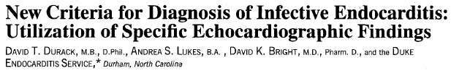
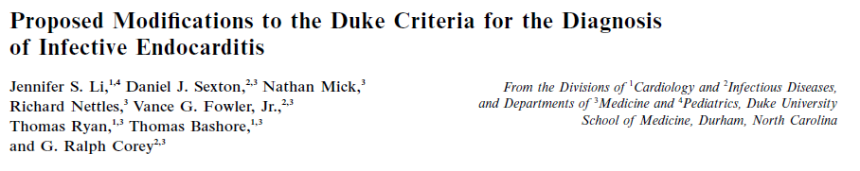

Slide 38
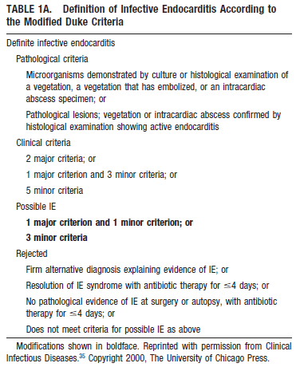
Modified Duke Criteria
Proposed 1994
Revised 2000

Slide 39

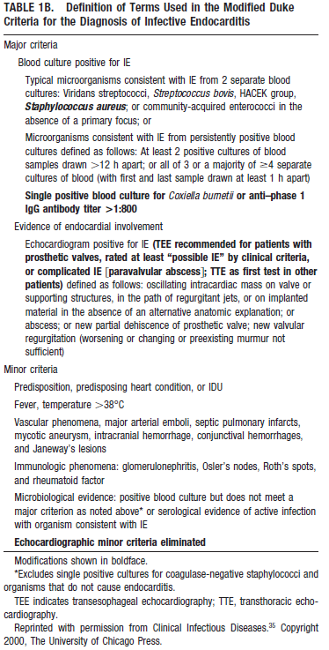

Slide 40
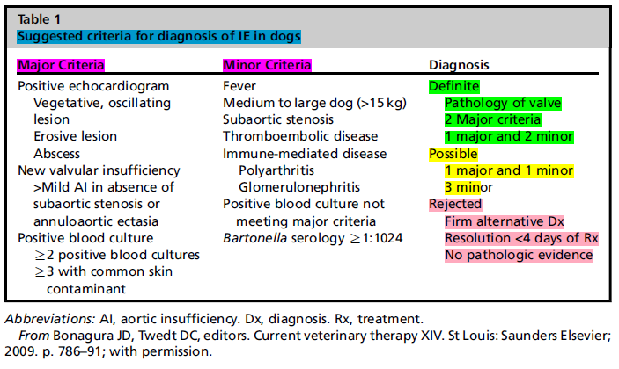

Slide 41
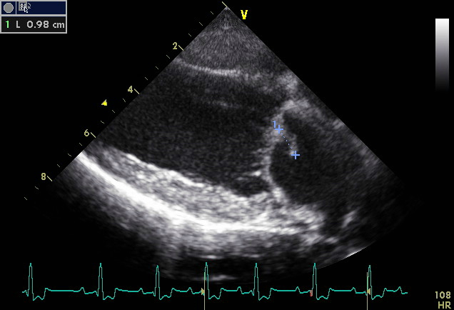
Diagnostics
CBC
Chemistry
Urinalysis
Urine culture
Urine protein:creatinine ratio
Thoracic radiographs
Electrocardiogram
Echocardiogram
Blood cultures
Joint fluid analysis
Infectious disease testing
And when all else fails….Necropsy

Slide 42
Clinicopathologic abnormalities
Complete blood count:
  Leukocytosis
    Mature neutrophilia, monocytosis
  Mild to severe thrombocytopenia
  Mild regenerative anemia
Chemistry:
  Hypoalbuminemia
  Elevations in hepatic enzymes
  Azotemia – renal or prerenal

Slide 43
Clinicopathologic abnormalities
Coagulation testing
  Elevated D-dimers or FDP’s
  Hyperfibrinogenemia
Urinalysis:
  Proteinuria
  Urine protein:creatinine ratio
Urine culture
  JAVMA 2006 – 3/42 dogs with suspected endocarditis had growth of same organism as blood cultures

Slide 44
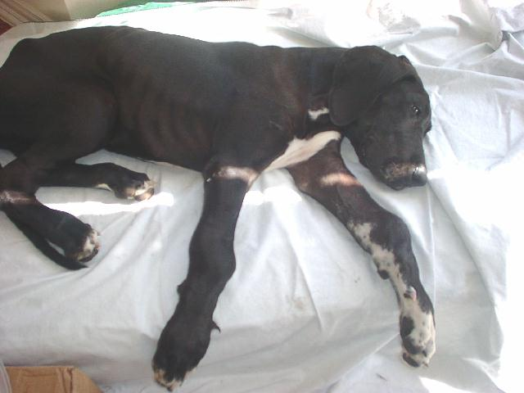
Joint fluid analysis
Indicated in dogs with lameness or joint swelling
Most commonly sterile suppurative inflammation
Immune-mediated polyarthritis

Slide 45
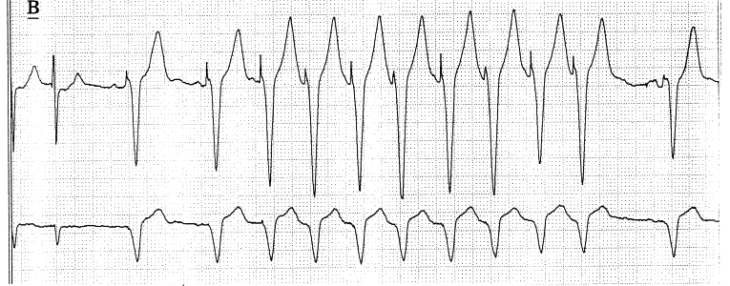
Electrocardiogram
Normal
Ventricular arrhythmias
Supraventricular tachycardia
Third-degree AV block
Atrial fibrillation

Slide 46
Echocardiogram
Should be performed in all cases of suspected IE
  Class I, LOE A
Transthoracic vs transesophageal
  TTE: children, low suspicion, TEE unavailable.
    Will not definitively exclude vegetations or abscesses, but will ID high risk patients
  TEE: Superior imaging. Recommended if: TTE imaging insufficient (COPD, previous thoracic surgery, obesity), secondary to negative TTE if clinical suspicion high or patient at risk for complications.
  Either could produce false negatives
  False positives can be cause by previous valve scarring, severe myxomatous changes

Slide 47
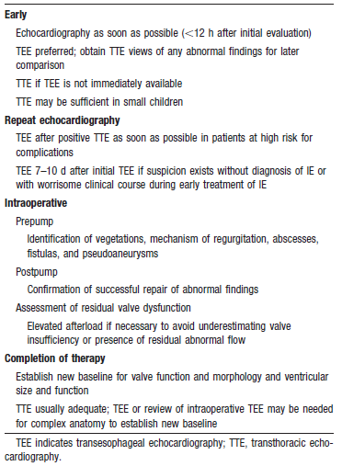
AHA recommendations echocardiogram

Slide 48
Echocardiogram
Hyperechoic, irregular shaped mass
Oscillating: mobile, independent of the underlying valve structure
Aortic, mitral valves
Valvular insufficiency
  Mitral regurgitation
  Aortic insufficiency – red flag!!
LAE, eccentric hypertrophy in chronic cases
Abscess in myocardium

Slide 49
Echocardiogram
SAS
  Narrowing of LVOT on 2D imaging
  Velocity measurements can determine severity
  Associated with eccentric hypertrophy, LAE and mild to moderate myocardial failure in chronic cases
Valvular changes must be differentiated from myxomatous valvular degeneration
  Less proliferative, may prolapse
  Lacks the vegetative appearance

Slide 50
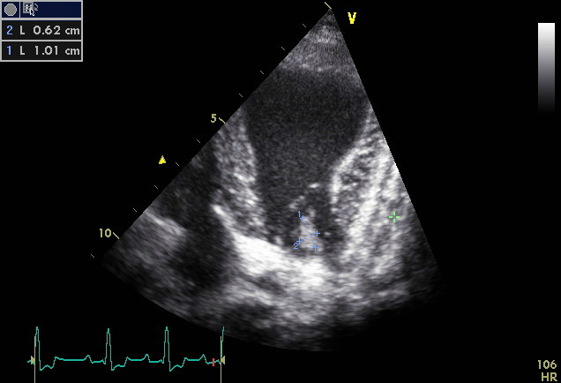
Echocardiogram
Mitral valve leaflet vegetative lesions, prolapse

Slide 51
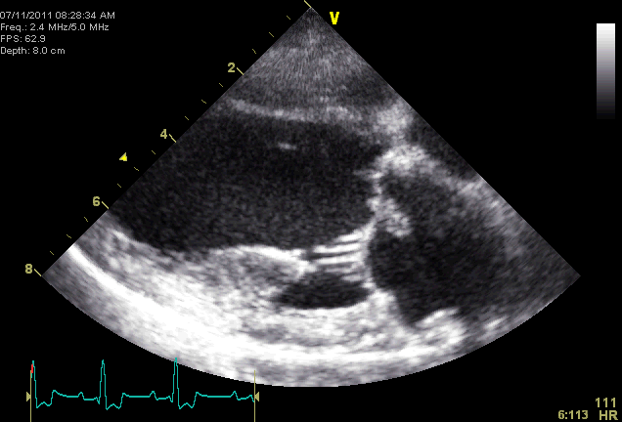
Longitudinal view
Mitral valve

Slide 52
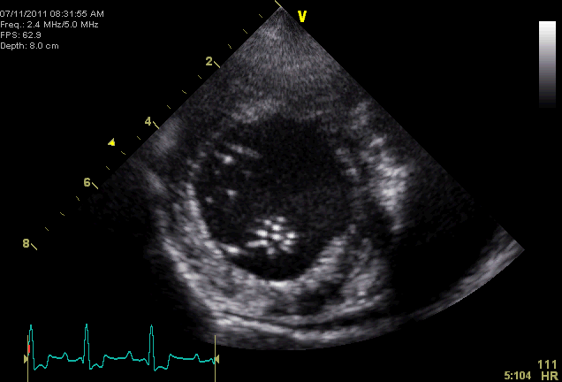
Mitral valve
Short axis view

Slide 53
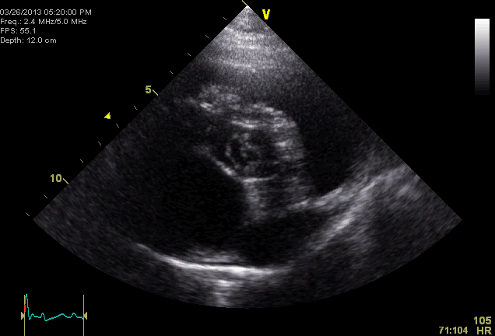
Short axis view
Aortic valve

Slide 54
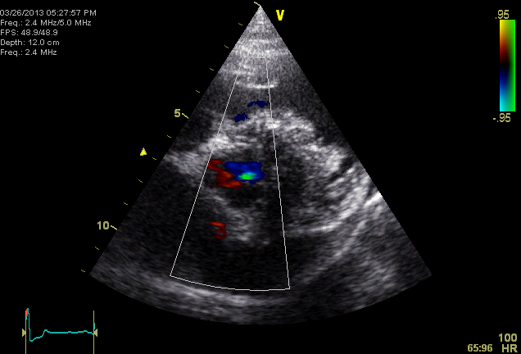

Slide 55
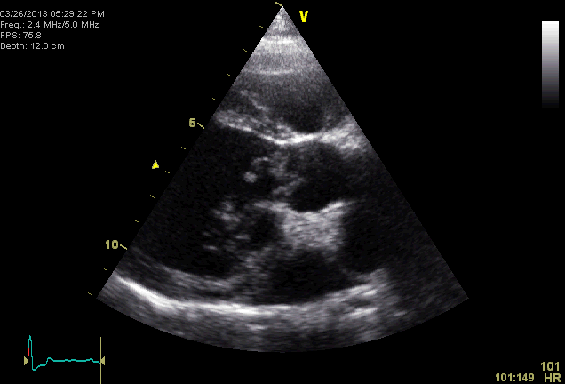
Longitudinal view
Aortic outflow

Slide 56
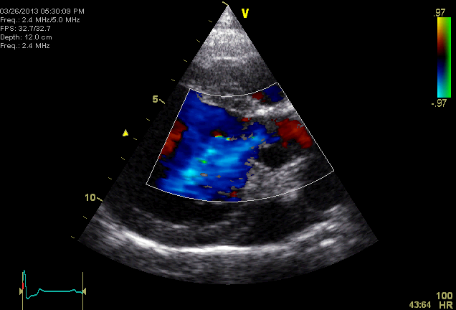
Color flow
Aortic outflow

Slide 57
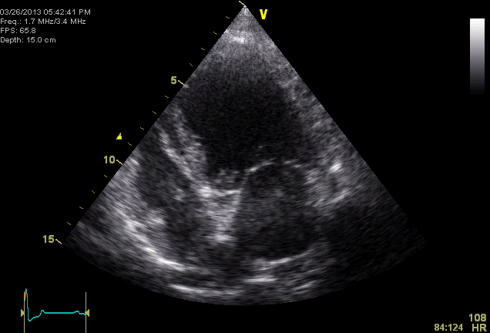
4 chamber view

Slide 58
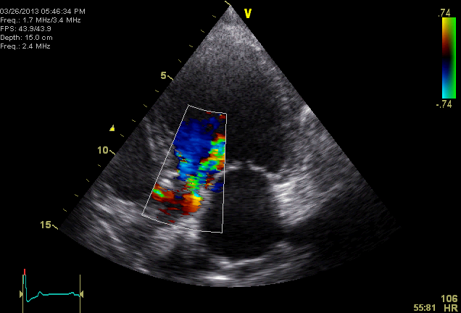
Aortic valve

Slide 59
Thoracic radiographs
Pulmonary edema ~50%
Non-cardiogenic edema ~25%
  Pulmonary hemorrhage
  pneumonia
Without LAE in acute cases
  LAE, LVE develop over weeks
Pulmonary venous distension with normal heart size

Slide 60
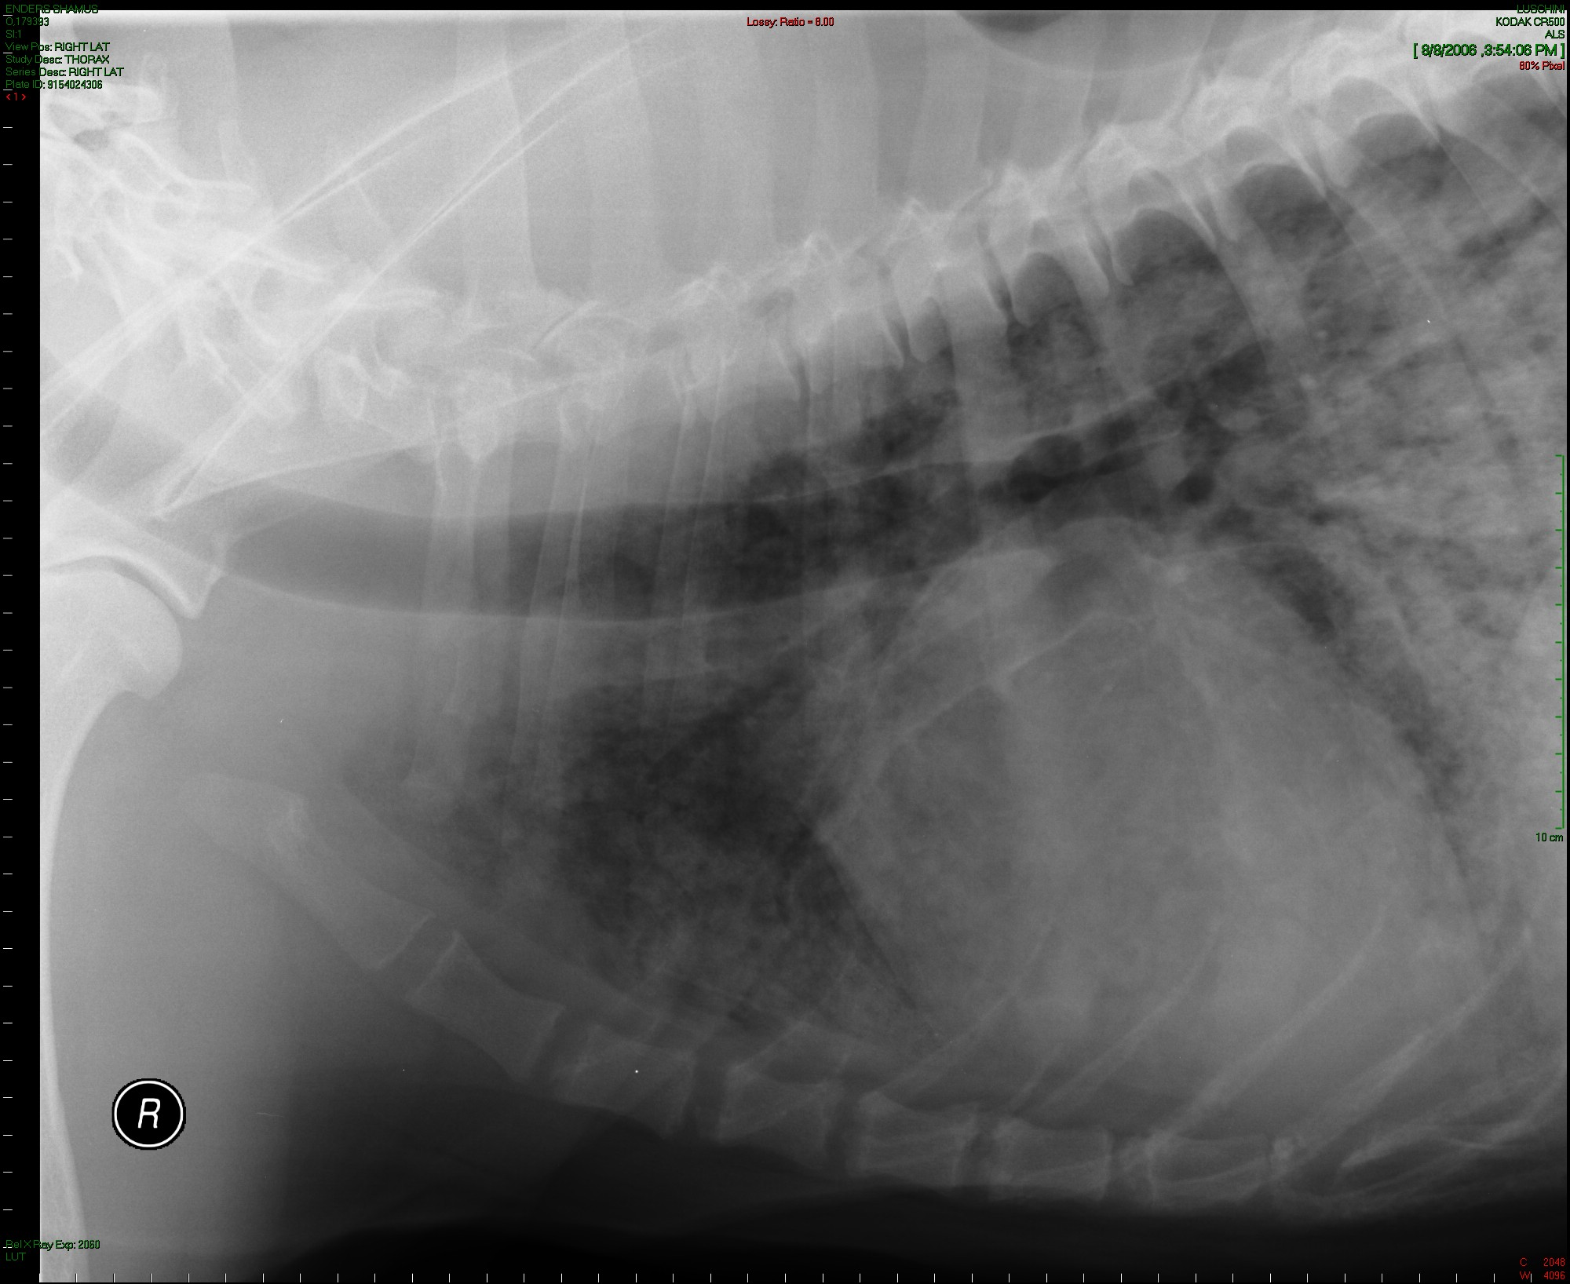
Thoracic radiographs
St. Bernard
Necropsy confirmed endocarditis
Alveolar pattern

Slide 61
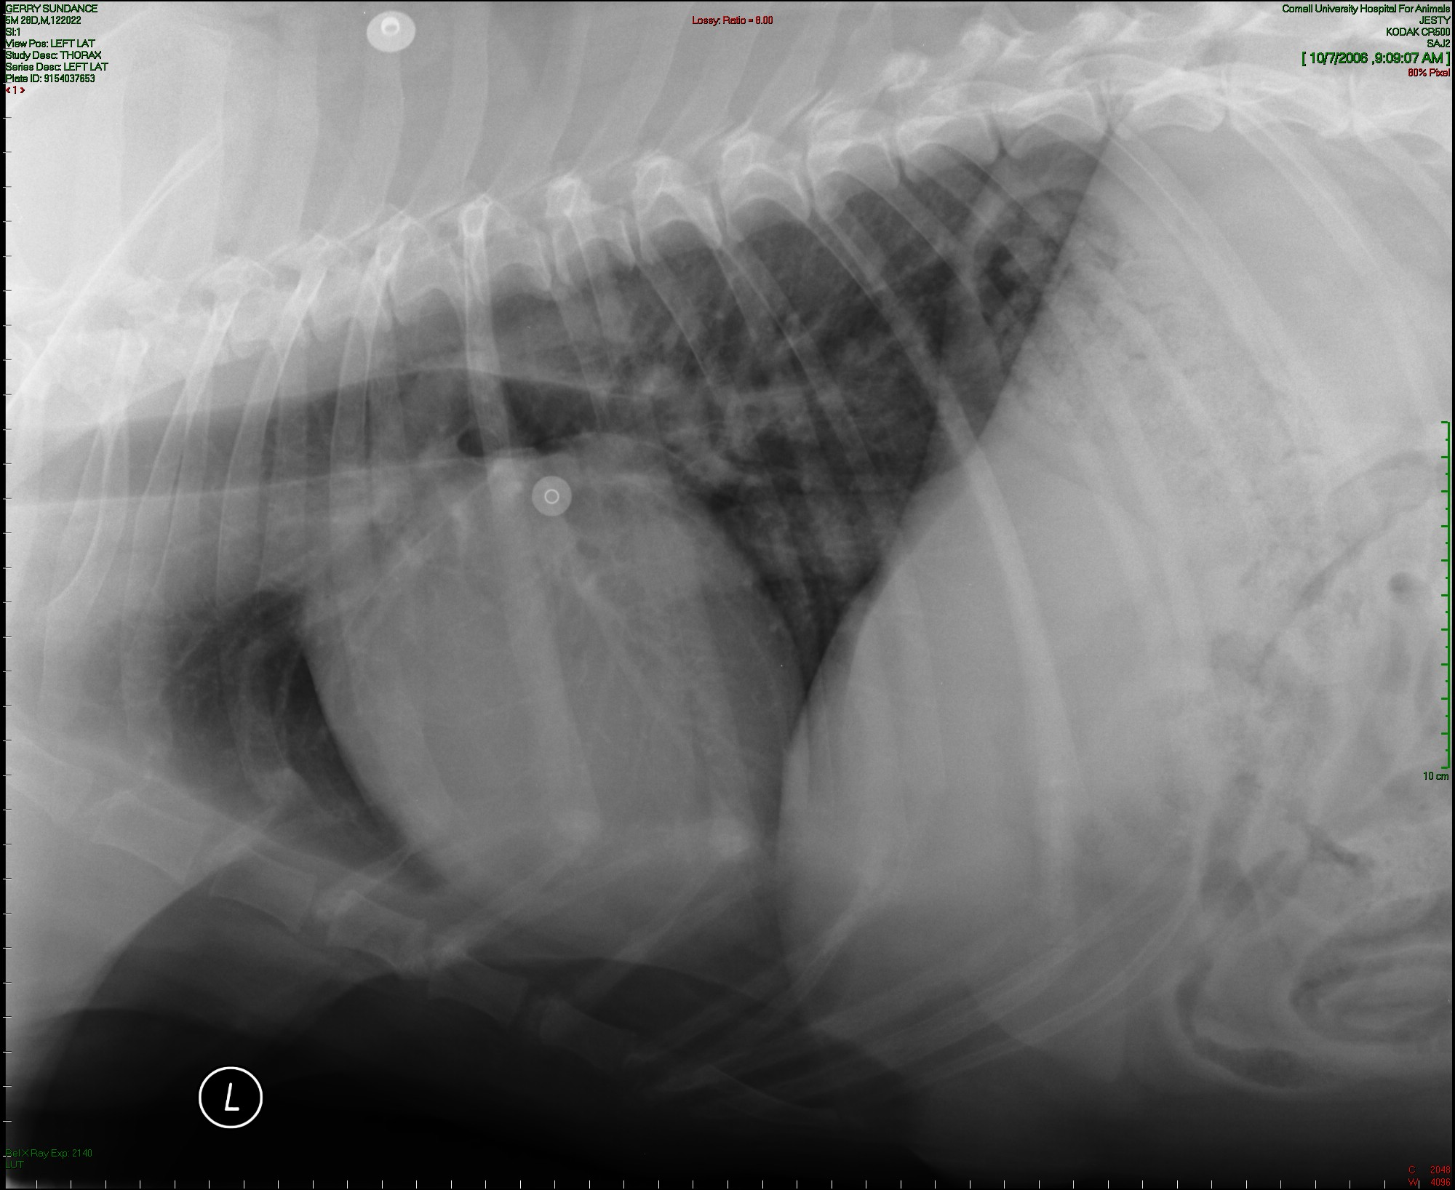
Thoracic radiographs
10.5y MI GRT
Dyspnea
Aortic valve endocarditis
Caudodorsal alveloar pattern

Slide 62
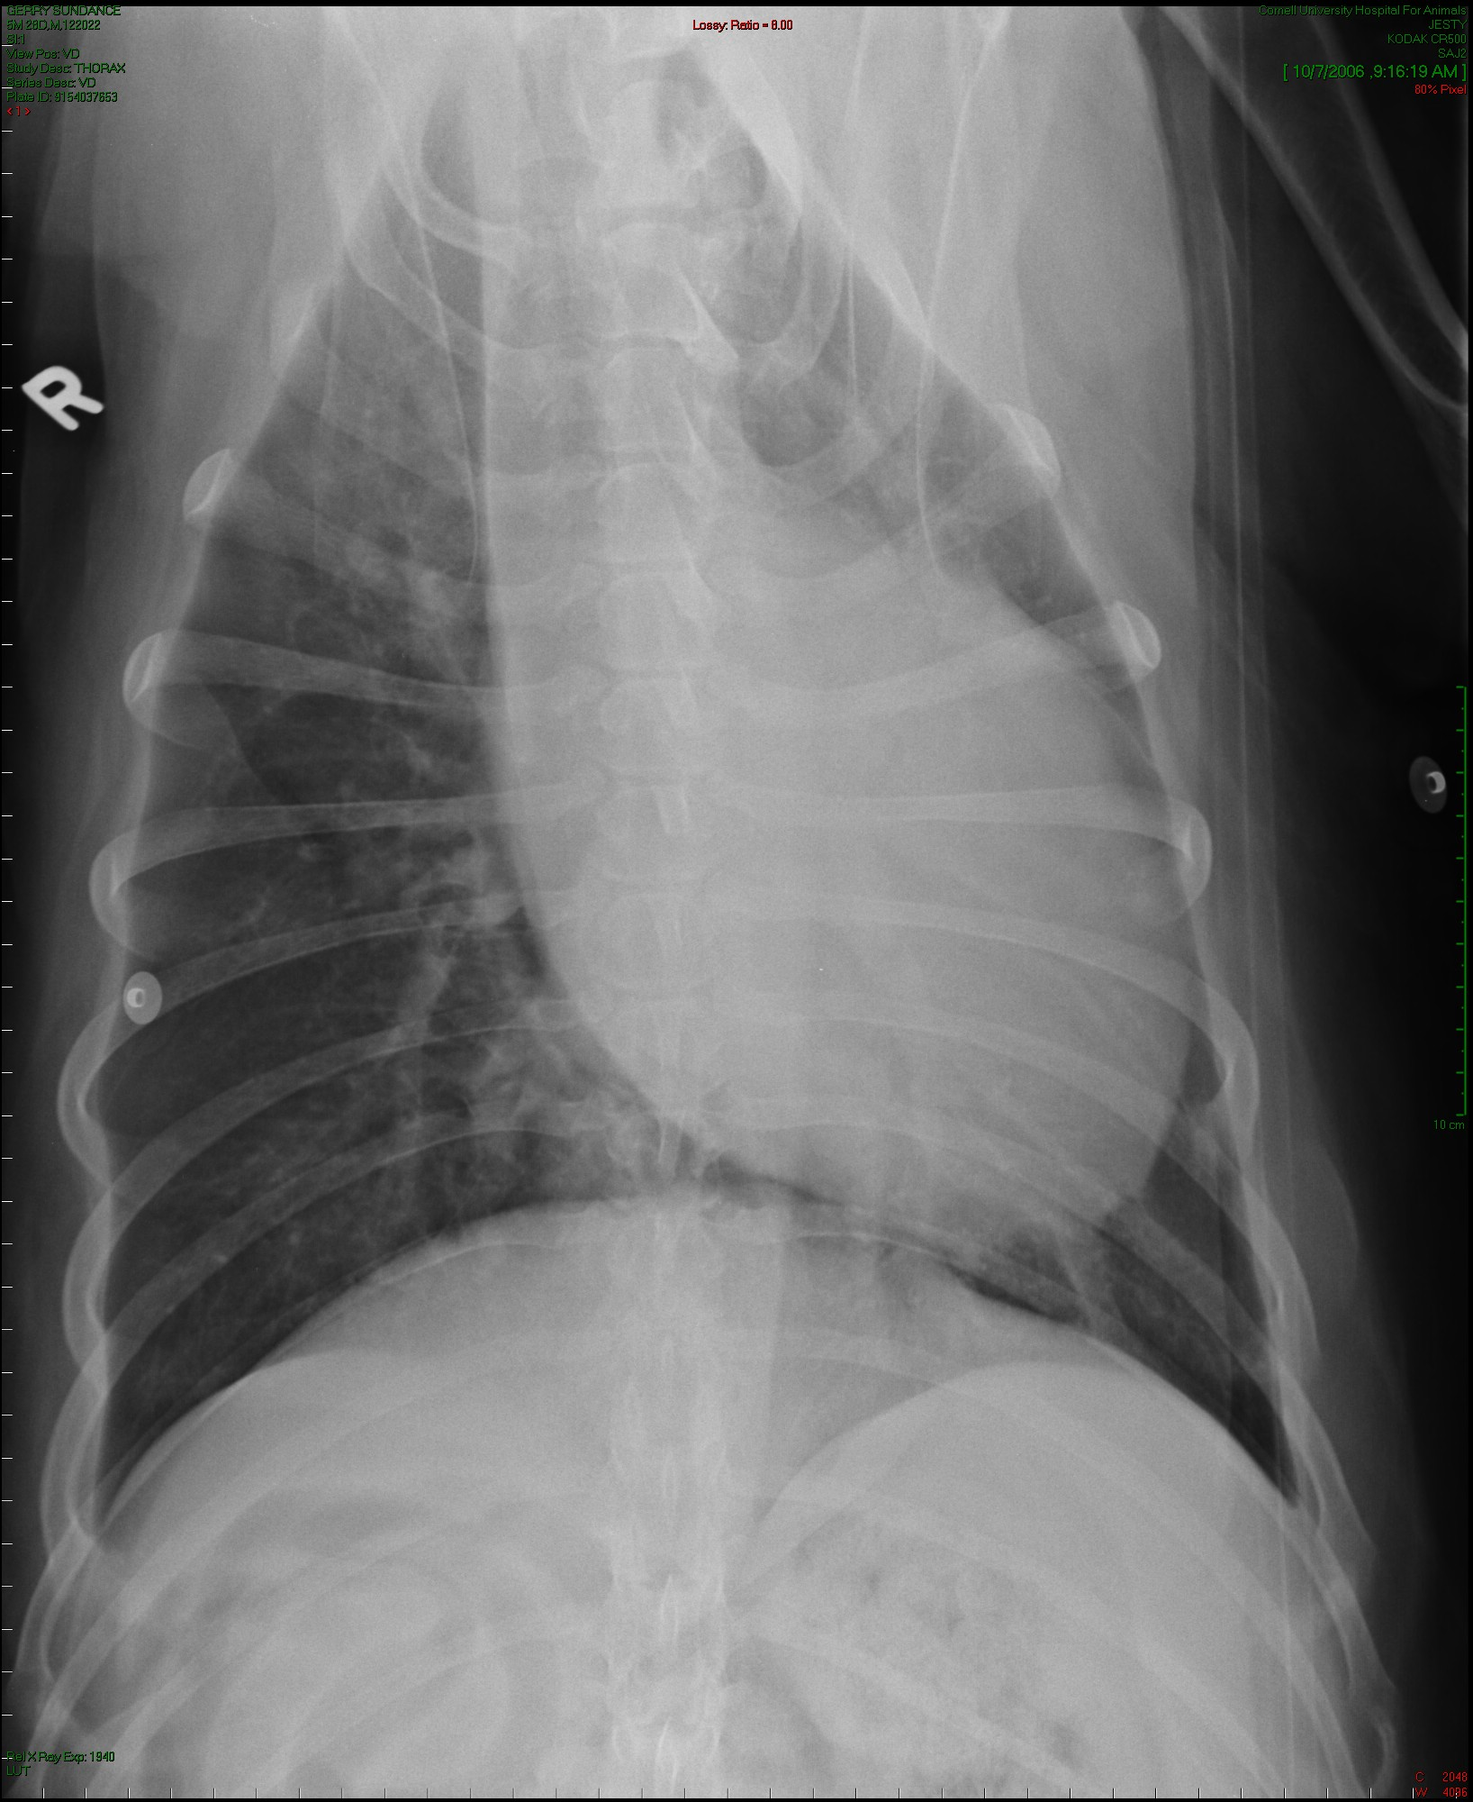
Thoracic radiographs
10.5y MI GRT
Dyspnea
Aortic valve endocarditis
Caudodorsal alveloar pattern

Slide 63
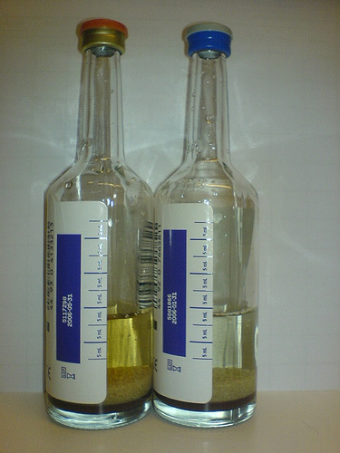
Blood cultures
Before antibiotics if possible
2-3 samples, 30min-1 hour apart
When patient is febrile
Aseptically collected
Ideally 5-10mls each depending on laboratory recommendations
Cultures are negative in 60-70% of IE cases
  Bartonella unlikely to grow

Slide 64
Infectious disease testing
4Dx snap – Lyme, Anaplasma, Ehrlichia, Heartworm
Serology
  JAVMA 2006 –
  All dogs seropositive for Bartonella were also positive for Anaplasma
  1 dog seropositive to Bartonella, Anaplasma, E. canis, and Borrelia
  1 dog for R. rickettsii, 2 low for Borellia
PCR – Ehrlichia, Bartonella, RMSF

Slide 65
Bartonella
Gram-negative, aerobic, fastidious intracellular bacteria
Not often identified on traditional blood cultures
JVIM 2004 – Bartonella sp most common bacterial cause of IE in California
Aortic valve
Patients may seroreact to other organisms
  Anaplasma phagocytophilum
  Rickettsia rickettsii
  Ehrlichia canis
  Borrelia burgdorferi
  Coxiella burnetti

Slide 66

Bartonella
JAVMA 2006
  More likely to be afebrile
  Predominately aortic valve involvement
  Higher prevalence of congestive heart failure
  Shorter survival times

Slide 67
Bartonella
Serology
  High seroreactivity may be considered as a minor criteria for diagnosis of IE
PCR blood
  Humans – insensitive, but specific for IE due to Bartonella
PCR postmortem (gold standard)
Culture (BAPGM)

Slide 68
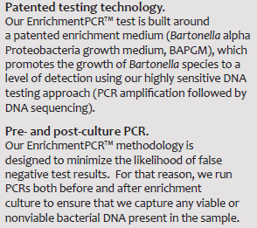
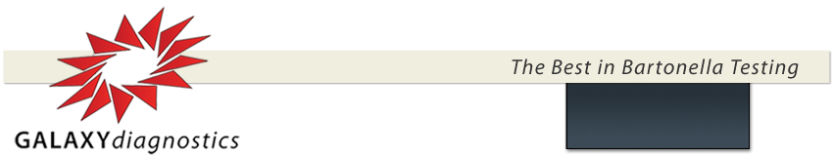
Bartonella testing
Bartonella alpha Proteobacteria growth medium (BAPGM)

Slide 69
Histopathology
JAVMA 2006
  Valvular mineralization in ~1/3 of cases
  Inflammation
    Chronic – lymphoplasmacytic, histiocytic and granulation tissue
    Acute - suppurative, fibrinous
    Subacute – neutrophilic-histiocytic and fibrinous infiltrates
    Chronic-active – neutrophil infiltrates on granulation tissue bed
  Intralesional organisms in ~1/3 of cases
  Bartonella seen in one dog with electron microscopy only

Slide 70
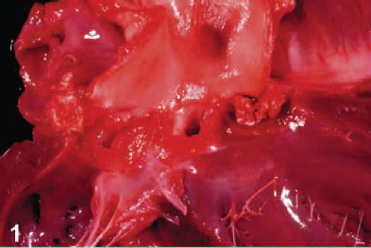
Aortic valve
Valvular erosion
Mineralized nodules
White plaques on aorta and endocardium

Slide 71
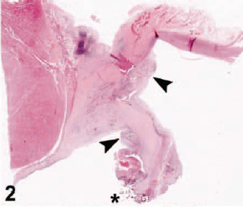
Aortic valve
Mineral deposits (star)
Endothelial-lined clefts (arrow)

Slide 72
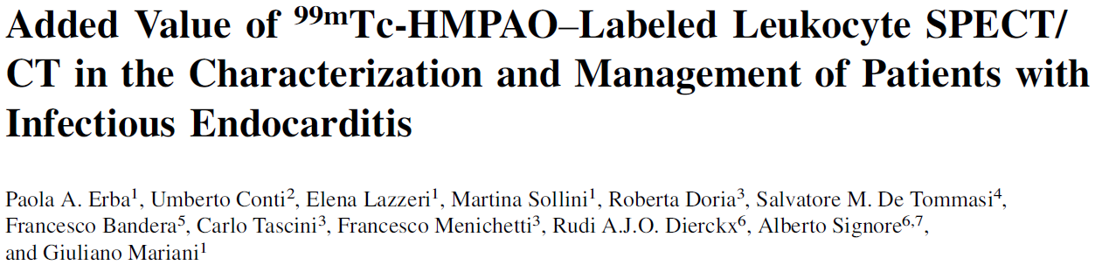
State of the Art
Use of SPECT/CT (single photon emission computed tomography) or PET/CT (positron emission tomography) to aid in diagnosis
99Tc-hexamethylpropylenamine oxime (HMPAO) labeled WBC
Detect and localize all sites of infection
Radiopharmaceutical uptake using 3-D reconconstruction of hybird SPECT/CT or PET/CT
Reveal distant sites of infection as result of septic embolization

Slide 73

Radiolabeled SPECT/CT
Mitral valve prosthesis
CT – left
SPECT/CT – middle
SPECT – right
Endocarditis of native tricuspid valve

Slide 74

Septic embolism
CT – left
SPECT/CT – middle
SPECT – right
Septic embolism in the left lung, spleen, spine

Slide 75


Slide 76
Infective Endocarditis
Pathogenesis
Predisposing factors
Causative agents
Clinical presentation
Sequela
Diagnosis
Treatment
Prognosis

Slide 77

Treatment
Long term antibiotics
Empirical broad spectrum pending cultures
IV for 1-2 weeks for aggressive disease
PO for 6-8 weeks longer

Slide 78


Slide 79
Infective Endocarditis
Pathogenesis
Predisposing factors
Causative agents
Clinical presentation
Sequela
Diagnosis
Treatment
Prognosis

Slide 80

Prognosis
Aortic valve involvement – grave prognosis
Mitral valve – fair to guarded
Bartonella – shorter survival times (aortic valve involvement)
JAVMA 2006 – 56% mortality, MST 54 days
Risk factors for early death
  Glucocorticoid administration before diagnosis
  Thrombocytopenia
  High serum creatinine
  Renal complications
  Thromboembolic disease
  Bartonella

Slide 81

Prognosis

Slide 82

Bartonella and survival

Slide 83

Factors significantly associated with outcome

Slide 84
Infectious endocarditis is…
Rare, infectious disease affecting the valvular endothelium
Almost exclusively associated with mitral or aortic valves
Difficult to definitively diagnose
Associated with numerous sequela
Difficult to treat
Associated with a grave prognosis for aortic valve involvement, fair-guarded for mitral valve.

Slide 85
Special thanks
Sarah Miller – echo images
Nedra Holmes – radiographic images/PACS tutorial/Carestream hack

Slide 86

How I feel when Gretchen does math in her head…

