Slide 1
IVECCS 2013

Slide 2
Cardiovascular responses to hypoxemia, anemia and hyperviscosity
Mellema

Slide 3
1. The cardiovascular responses to anemia and hypoxemia are similar, but are not identical in nature.
2. The vascular responses to hypoxemia, anemia, and hyperviscosity are varied and often organ-specific.
3. Polycythemia and colloids/hyperproteinemia both result in hyperviscosity however the cardiovascular responses to each of these states are significantly different.
4. The impact of hyperviscosity on blood flow is highly dependent on shear rate and major differences are found when comparing arterial flow to microvascular flow.
5. Recent studies have highlighted the importance of nitric oxide synthesis by neuronal NOS (nNOS) on adaptation to anemia and survival.

Slide 4
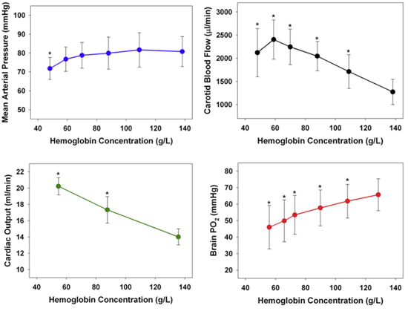
Notes:
As Hg decreases, carotid blood flow is increased to a point of about 15% HCT, MAP remained relatively stable again to about 15%, however despite this and increased CO, brain PO2 steadily decreased.
Apprently in peeps, they begin to experience some delirium at around 15%

Slide 5
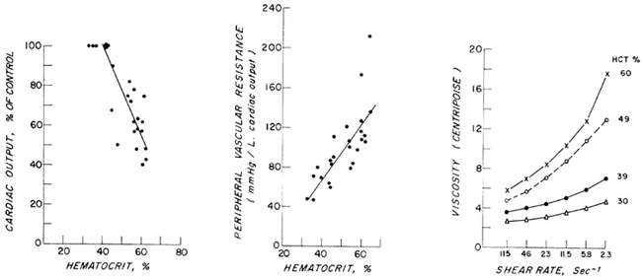

Slide 6
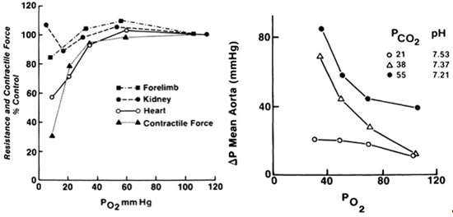

Slide 7
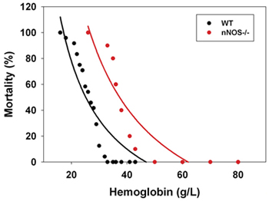

Slide 8
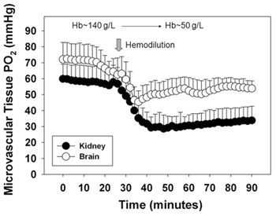

Slide 9
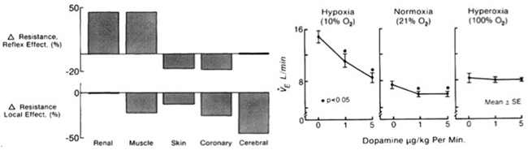

Slide 10
New anti-thrombotics
Brainard

Slide 11
Fondaparinux (Arixtra)
Synthetic pentasaccharide
Inhibitor of Xa
SQ in humans
Excreted unchanged in the kidneys
Similar mech to LMWH
  Requires AT to bind to Xa
  Smaller molecule
  Less fear of heparin-induced thrombocytopenia

Slide 12
Fondaparinux (Arixtra®)
In healthy cats –
“Prophylactic” - 0.06mg/kg – targeted to an anti-Xa activity of 0.1-0.5mg/ml DQ BID
  Remained in the human range for the entire 12 hours
“Therapeutic” - 0.2mg/kg – targeted to an anti-Xa activity of 0.5-1.2mg/ml
  Did not remain in the human range for the entire 12 hours
  May need more frequent dosing
  Higher GFR in cat?

Slide 13
Oral anti-Xa drugs
Rivaroxaban (Xarelto ®)
Apixaban (Eliquis®)
Both direct Xa inhibitors
Do not require AT for activity

Slide 14
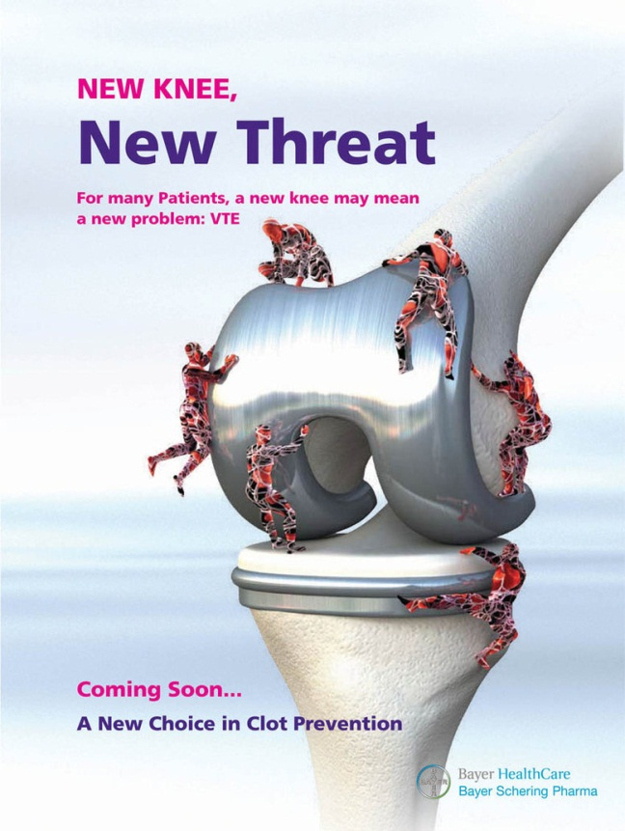
Rivaroxaban (Xarelto®)
Apixaban (Eliquis®)
Demonstrated non-inferiority to warfarin and heparin
  Venous TE prevention in ortho sx
  Fewer thromboembolic events
  Less serious bleeding
Approved for long term therapy of VTE in humans

Slide 15
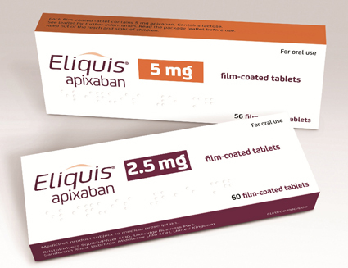
Rivaroxaban (Xarelto®)
Apixaban (Eliquis®)
PK (humans)
  Predictable
Increase in bleeding events with concurrent use of clopidrogrel
Dose dependent prolongation of standard clotting times PT and PTT
  PT more sensitive
  dPT (dilute PT) – may improve sensitivity

Slide 16
Direct thrombin inhibitors
Bind to active fibrin binding site on thrombin
  Action against fibrin bound thrombin (unlike heparin products
  Action against circulating thrombin – no need for AT
  Platelet activation via PAR receptor leads to deficiencies in platelet function and coagulation function
    More potent

Slide 17
Direct thrombin inhibitors
Argatroban
Dabigatran (Pradaxa ®) - PO
Ximelagatran (Exanta ®) – PO
  Recalled bad juju for liver
Lepirudin (Refludan ®)
Bivalirudin (Angiomax ®)

Slide 18
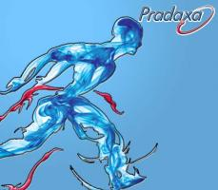
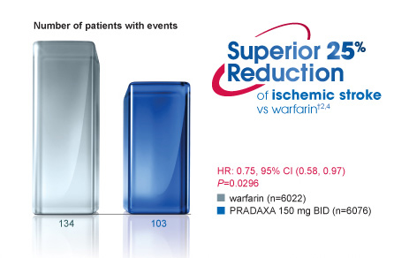
Dabigatran (Pradaxa ®)
Monitoring by thrombin time and PTT
Equivalent to enoxaparin for prevention of postoperative venous TE
Safety superior to warfarin

Slide 19
Appropriate antimicrobial selection
MIC – minimum inhibitory concentration
  Lowest concentration of an antimicrobial that inhibits visible bacterial growth
Breakpoint
  Antimicrobial concentration used to interpret a MIC for a given microorganism
  Each bacteria has established breakpoints
Susceptible
  If the MIC is below the breakpoint for that antimicrobial

