Slide 1


Heartworm Disease
Dr. April Blong
Small Animal Emergency and Critical Care Resident
Cornell University
May 7, 2013
Notes:
Caucasian Shepherd dog -

Slide 2
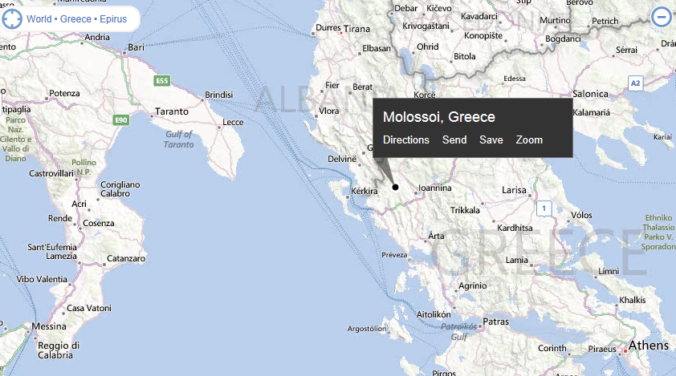
Caucasian Ovcharka (shepherd dog)
Molloser type dog – one of the oldest types
Many sub-breeds
Indigenous to the mountain areas
Historically a herding, guardian, and fighting dog
Are part of the AKC Foundation Stock Service
  Not actually a recognized breed
Notes:
Molloser comes from mollosia where their large shepherd type dogs were called a mollosus – st bernard, newfie, mastiffs etc.

Slide 3
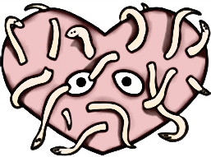
This evening’s plan…
HW lifecycle
  Wolbachia
Canine HW Disease
  Pathophysiology
  Signs
  Diagnosis
  Treatment
  Caval syndrome
  HW-associated shock
Feline HW disease
French HW (Angiostrongylus vasorum)
Cutaneous filariasis (Dirofilaria repens)

Slide 4
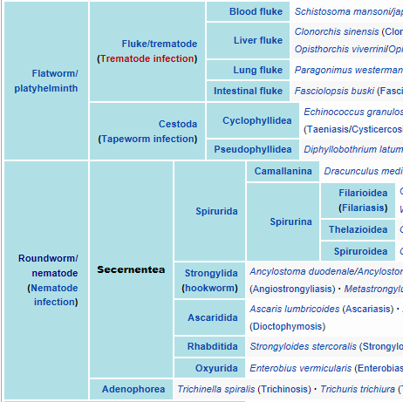
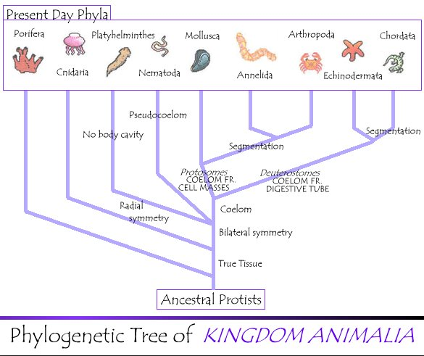
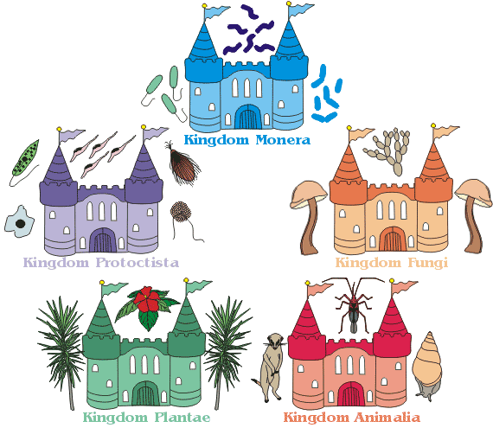
King Phillip’s Court Ordered Fried Green Shrimp
www.oum.ox.ac.uk
danmarkltd.tripod.com
Notes:
Kingdom animalia, phylum nematoda, class secernentea

Slide 5
King Phillip’s Court Ordered Fried Green Shrimp
Kingdom Animalia
Phylum Nematoda
Class Secernentea
Order Spirurida
  Suborder Spirurina
Superfamily Filarioidea
  Family Onchocercidae
    Subfamily Dirofilariinae
Genus Dirofilaria
Species immitis

Slide 6
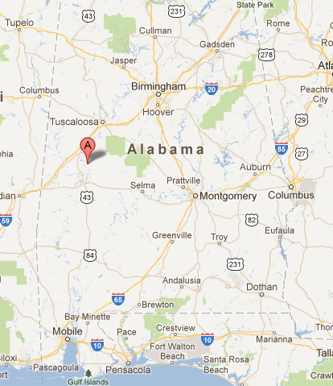
Historical perspectives
Originated in Asia
  Spread through Mediterranean
Reported in the USA in 1847
In 1975 bacteria-like organisms were identified in D immitis
  Rickettsia-like Wolbachia pipientis

Slide 7

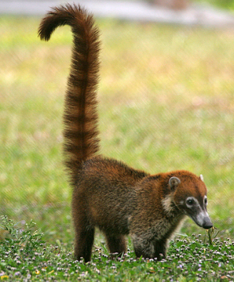

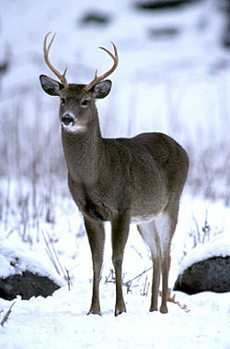



Hosts
Horsebreedsinfo.com
www.kostich.com
www.guardian.co.uk
www.petco.com
raysweb.net
www.fws.gov
www.bite.ca
Canis familiaris is the reservoir host
All Canis species can support patent infection
  Some non-Canis species can also support patent infection
  Some canids do not support long standing patent infection
Can infect many species
  All Felids susceptible but are not reservoirs
Notes:
Reported in primates, deer, beavers, horses, wolverines, coatimundis, red pandas, bears, seals, penguins, domestic ferrets

Slide 8
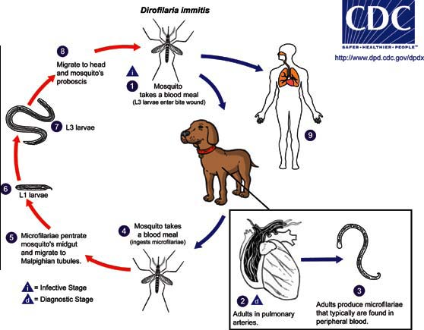
Life Cycle

Slide 9
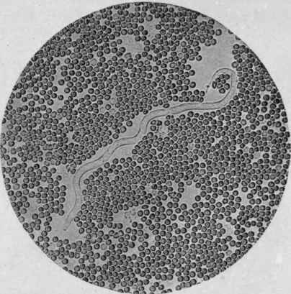
An Infected dog is bitten…
www.chestofbooks.com
Mosquito takes in MF with a blood meal
  Over 60 species of mosquito
  Two molts occur in the mosquito
  Too many MF fatal to mosquito
Daily and seasonal fluctuations in MF numbers
Speed of development is temperature based
  Minimum temperature for development = 57ºF
  Needs about 130 HDU’s
Notes:
Over 60 species of mosquito can transmit HW, also 14 Celsius
Heartworm development units – based on temperature for the day
Can arrest development below 57 degrees and then resume once temp warms

Slide 10

A naïve dog is bitten…
www.alternativeheartwormcure.com
L3 enter subcutis (1 mm)
Molt to the L4
  Remain locally in the muscle
Growth of L4 begins 2 weeks post infection
Migrate into veins to travel to PA (2-3 cm)
Molt into immature adults day 50-58
Grow rapidly in PA
  20-30 cm by 6.5 months post infection
Notes:
MF deposited in saliva over wound and crawl down bite wound into tissues
By 1 month they are 4mm, by 2 months, 1 cm

Slide 11
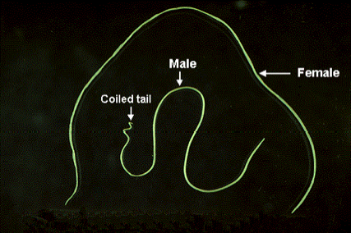
And then they fell in Love…
http://www.stanford.edu/class/humbio103/ParaSites2006/Dirofilariasis/Morphology.htm
Fertilization takes place in PA
Males have corkscrew-shaped tail to aid copulation
MF appear 6-9 months post infection
  Homeostatic control of MF numbers in host
  Transfused MF live up to 2.5 years
Infection can remain patent for 7.5 years
Notes:
Fertilization takes place in PA when females are about 4mo old and 7-10 cm in length

Slide 12
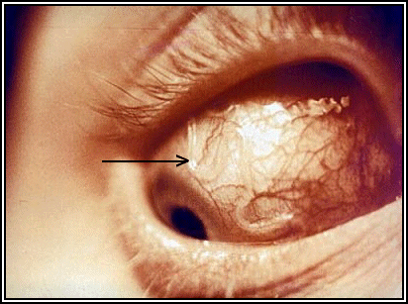
What about Wolbachia?
Wolbachia are obligate symbionts/parasites
Alpha-proteobacteria closely related to rickettsial organisms
  Gram-negative bacteria
Express Wolbachia surface proteins (WSP)
All human/veterinary filarial diseases rely on Wolbachia symbiosis except Loa loa
Kramer, LH. How Wolbachia/Dirofilaria immitis interact? NAVC Proceedings 2006
Notes:
Alpha-proteobacteria are also found in arthropods (up to 70% of species)and are important obligate intracellular mutulaists in plants where they are responsible for nitrogen fixation
Many alpha proteobacteria cause disease in dogs/cats/humans – mostly transmitted by arthropods
Only filarial disease that does not require Wolbachia is Loa loa (African eye worm – travels through SQ but is most notable as it travels through conjunctiva

Slide 13
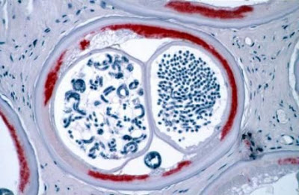
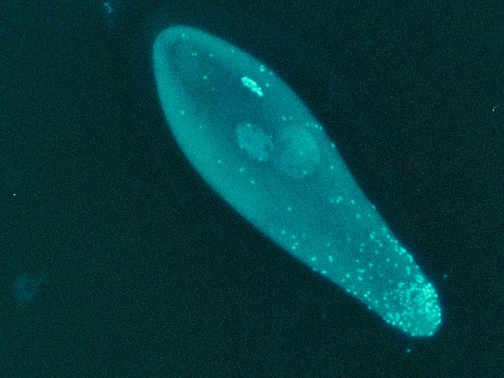
Walachia pipientis
Reside in host derived vacuoles
  Lateral cords, ovarian tissue, oocytes, embryos
Have distinct DNA and ribosomes
Lack many cell wall structures
Worms regulate Wolbachia levels via autophagy
During embryogenesis they are located asymmetrically so they end up in the cords

Slide 14
Wolbachia Surface Proteins (WSP)
Circulating antibodies and antigens in tissues
Stimulates canine neutrophil chemotaxsis and IL8
Stimulates endothelium
  COX-2, VEGf, leukotriene B4, ICAMs, E-cadherin
Illicit a damaging humoral response from canine tissue
  Death of parasites w/o Wolbachia results in less intense inflammation in the host
Notes:
Animals infected with DIM have both wolbachia antigens and antibodies deposited throughout tissues

Slide 15
Wolbachia and HW interdependence
Wolbachia synthesize many metabolites for the nematode
  Vice versa
Death of HW results in large release of organisms
HW cleared of Wolbachia leads to permanent sterilization of females and loss of microfilaria
  Altered gene expression
MF without Wolbachia cannot develop in new host
Notes:
Changes in genes responsible for protein synthesis and the stress response

Slide 16
Heartworms and dogs have lived together a long time…why is this a problem?
HW adults damage the pulmonary arteries and lungs
  Number of worms
  Amount of exercise
  Duration of infection
Eosinophilic pneumonitis can occur
Glomerulonephritis
  Proteinuria and HW ag can be detected in urine
  Progression to kidney disease/injury uncommon
Aberrant migration
Notes:
Glomerulonephritis from ag-ab complex deposition in kidneys is common

Slide 17
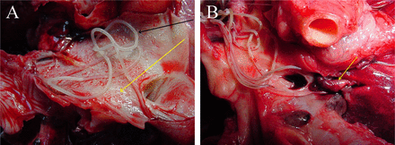
Back in the lungs…
Endothelial damage and sloughing, villous proliferation
  Marked villous proliferation of the intima
Activation/attraction of leukocytes and platelets
  Factors induce smooth muscle proliferation, collagen accumulation, fibrosis
Endothelial swelling → increased permeability
Caudal lung lobes most affected
http://cmr.asm.org/content/25/3/507/F16.expansion.html
Notes:
Endothelial swelling and altered intercellular junctions increase vascular permeability

Slide 18
Vascular occlusion & hypertension
PAs become enlarged, thick-walled, and tortuous with roughened endothelial surfaces
Proliferative lesions encroach on vascular lumen
  Gradual occlusion allows collateral circulation to develop
  Dead worms induce thromboembolic & obstruction
Vasoconstriction caused by vasoactive substances and hypoxia
  Exercise intolerance
  Pulmonary hypertension, remodeling, failure
Notes:
Produced by the endothelial cells
Exercise intolerance b/c vessels cannot respond to increased oxygen demand

Slide 19



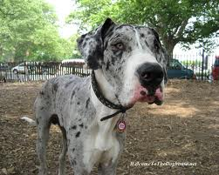
Which one has Heartworm disease?
http://www.123rf.com/photo_10772653_cavalier-king-charles-spaniel-14-months-old-sitting-in-front-of-white-background.html
http://www.doggies.com/Bouvier_des_Flanders
http://www.fanpop.com/clubs/great-danes/images/14115299/title/beautiful-great-dane-wallpaper
http://www.dogtastic.org/dogtastic/index.php?option=com_content&task=view&id=102&Itemid=58

Slide 20
Canine clinical signs
Most dogs show no clinical signs
Primarily vague clinical signs:
  Weight loss, exercise intolerance, lethargy, poor condition
Cough, syncope, dyspnea, ascites
Arrhythmia/conduction disturbance is rare (<10%)
Eosinophilic pneumonitis (14%)
Atypical signs
  Hemoptysis, worms in sputum, monoclonal gammopathy, others

Slide 21

American heartworm society
http://www.heartwormsociety.org/
Class 1: generally asymptomatic
  Occasional cough, mild changes on CXR
Class 2: moderate clinical signs
  Coughing, exercise intolerant, fever, anemia, proteinuria
  Dilated PA with right heart enlargement
Class 3: severe clinical signs
  Increased RE without exercise, frequent cough, ascites, hemoptysis
Class 4: Caval syndrome

Slide 22

Diagnostics
Testing methods
Radiography
Echocardiography
Electrocardiography
Clinical pathologic changes

Slide 23

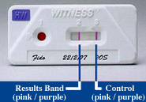
Antigen testing
Do not test any dog <7mo of age
  Test before new product & yearly
  Can detect 5-9 months post infection
Detect protein secreted by female worms
Infection with at least 1 female worm ~100% specificity
  No tests to detect male only infection
Commercial tests are not quantitative
Confirm positive with second test or other test
http://www.nydailynews.com/news/national/cleft-palate-pup-takes-internet-storm-article-1.1290630
http://www.wcvh.com.au/wcvh.php-sec=58.html
Notes:
Earliest detection is 5-6 months, but dogs on macrocyclic lactones may have antigenemia suppressed until 9 months PI
Specificity varies with low worm/antigen levels
False negatives occur with immature female worms, male only, not following directions, light infection
Technically ELISA tests are positive or below detectable limits – never negative
French bulldog puppy with bilat cleft palate

Slide 24
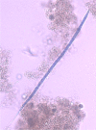
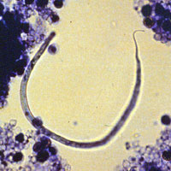
Microfilarial Testing
http://www.parasitesandvectors.com/content/3/1/62
http://cal.vet.upenn.edu/projects/parasit06/website/lab5.htm
<1% of infections are patent but anantigenemic
In areas of high prevalence, 20% of dogs may not become microfilaremic
  Increases with macrocyclic lactone use
May see cell movement on fresh blood
Concentration methods are preferred
  At least 1 ml of blood
  Modified Knott’s test or filter test
Should differentiate Acanthocheilonema reconditum
Notes:
Dim has tapered head and straight tail
A reconditum has hooked tail and blunt head

Slide 25
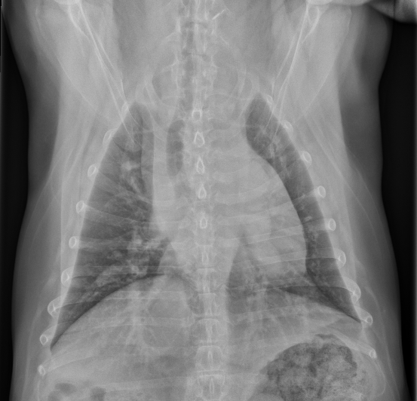
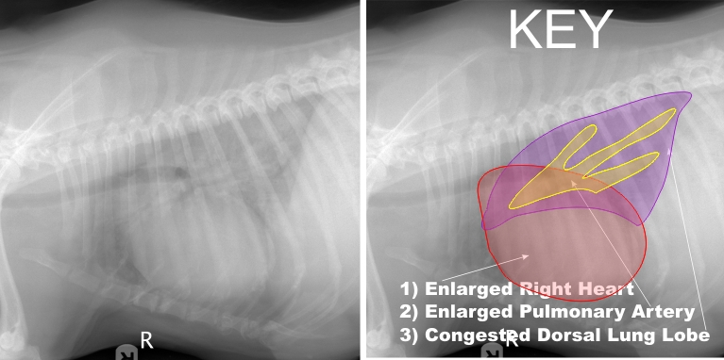
Radiography
http://www.heartworm.com/treatment/dogs
About 85% of dogs with HW have abnormalities
  Prominent main pulmonary artery
  Right ventricular enlargement
  Increased size/density of pulmonary arteries
  Pulmonary artery tortuosity and pruning
DV view is better for imaging caudal vessels
Mild interstitial to alveolar density
  Worst in caudal lung lobes
Eosinophilic granulomatosis
  Interstitial nodules and bronchial lymphadenopathy
Notes:
In order of decreasing frequency

Slide 26
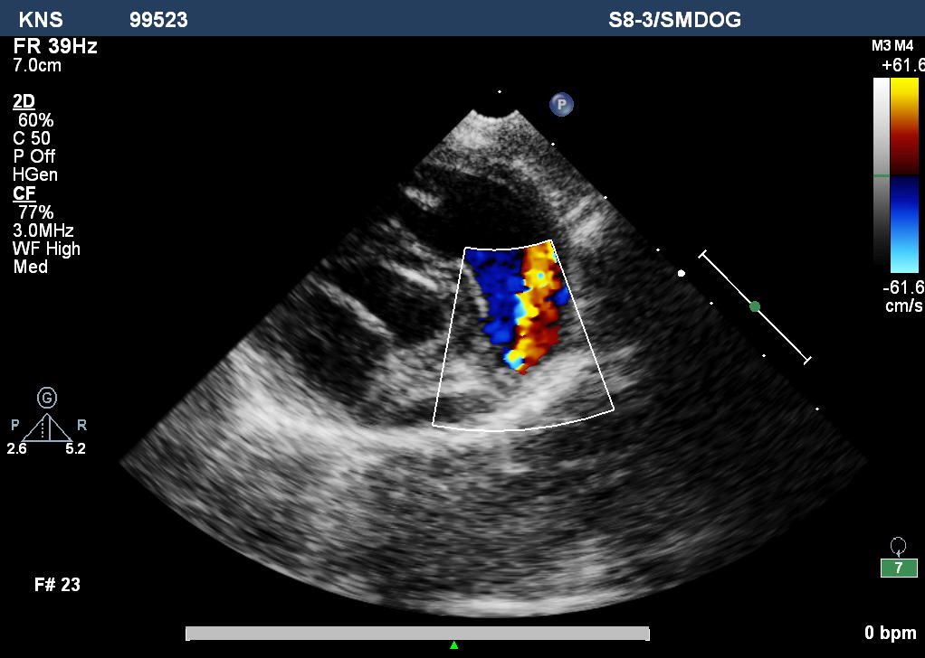
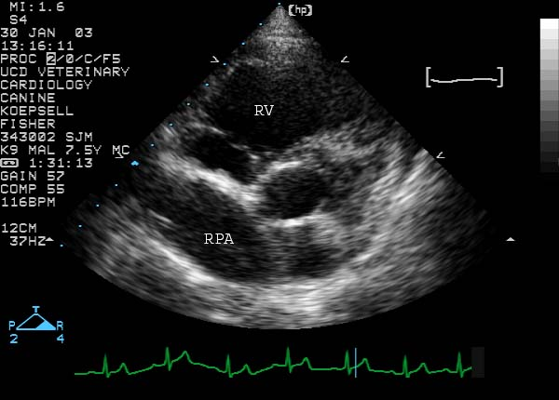
Echocardiography
http://www.vetmed.ucdavis.edu/vmth/small_animal/cardio_kittleson/cases/case33/pa_echoes.htm
http://cardiology.vetmed.lsu.edu/Education/AcquiredCardiacDiseases/HeartwormDisease/tabid/448/Default.aspx
Insensitive for most infections
  Heavy worm burden or Caval syndrome
  If worms seen it is diagnostic
Can be used to assess RVE and function

Slide 27
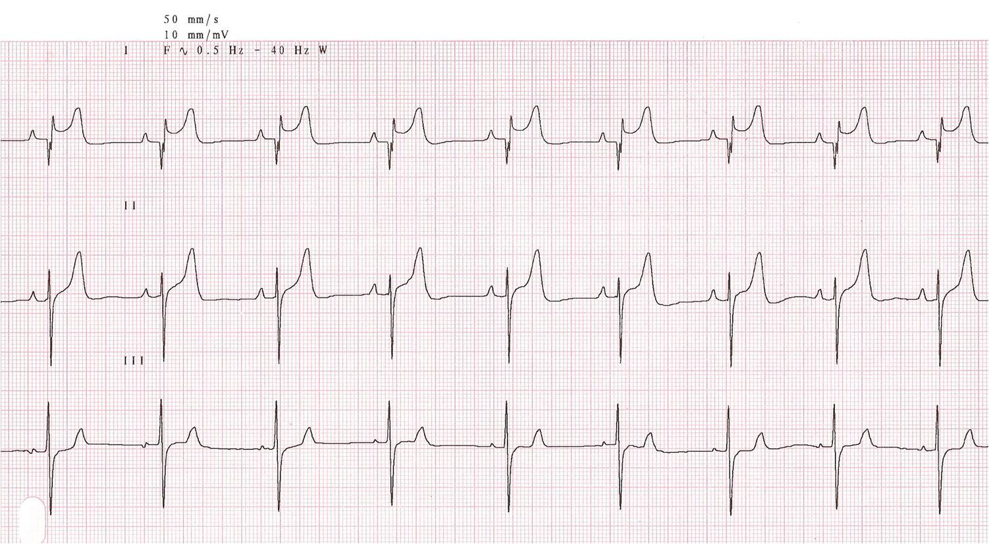
Electrocardiography
http://cardiology.vetmed.lsu.edu/Education/AcquiredCardiacDiseases/HeartwormDisease/tabid/448/Default.aspx
May be normal or abnormal
Right-sided enlargement patterns
  Tall P waves due to RAE
  Deep S waves due to RVE
Arrhythmias are rare (2-4%)
  More common with failure and Caval syndrome

Slide 28
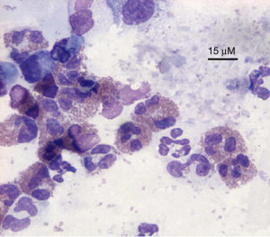
Clinical Pathologic abnormalities
http://www.sciencedirect.com/science/article/pii/S0195561607000605
Mild non-regenerative anemia
  10% of mild/moderate cases
  60% of severe cases
Eosinophilia 85%
  Neutrophilia, basophilia
Albuminuria 10-30%
Increased liver enzymes if right CHF present
Tracheobronchial cytology
  Eosinophilic pneumonitis
  Can be in coughing dogs even without radiographic changes

Slide 29

Prevention
Macrocyclic lactones
  Monthly
  Extended release formulas every 6 months
  Standard preventative doses safe in ALL breeds
  Preventative doses are not 100% microfilaricidal
Start at 8 weeks of age
“Herd immunity”
Loss of efficacy
  Mississippi River Valley strain
    P-glycoprotein alteration, phenotype GG-GG
  MP3 strain from Georgia
    Appears susceptible to multiple doses of preventative
http://www.heartwormsociety.org/think12/
Notes:
1. Macrocyclic lactones - (ivermectin, milbemycin oxime, moxidectin, and selamectin
2. Generally safe to give even to dogs with significant microfilarial burden, monitor known microfilaremic dogs after first dose.
3. Evidence strongly suggests that by reducing the reservoir population through increasing the number of dogs receiving preventives, a disproportionately large decrease in the prevalence of infection among unprotected dogs may occur relative to the percentage of additional dogs receiving preventives.
4. Pglycoprotein polymorphism may decrease susceptibility to macrocyclic lactones
5. Dog from hurricane Katrina adopted in Canada 2008 – MF and ag positive – treated with two courses of melarsomine and multiple doses of ivermectin and milbemycin. Despite being ag negative remains MF positive.

Slide 30
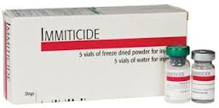
Treating infected dogs
conseilsveterinaire.com
Melarsomine dihydrochloride
  Organoarsenic compound
  Worms must be at least 4 months old
  Efficacy 90% with two doses 24 hours apart
  *Efficacy 98% with one dose then two doses 1-3 months later*
  Given deep in the epaxial lumbar muscles
Safer than thiacetarsamide
Thromboembolic events are expected
  Strict exercise restriction decreases severity
Antigen test should be negative 8-12 weeks later
  Antigen positive 6 months later = treatment failure
Notes:
Package: recommends two dose protocol for class 1 & 2 dogs, three dose protocol for stage 3 dogs
HWS recommends three dose for all dogs b/c of increased efficacy
Efficacy is % of worms killed, not % of dogs cleared which will be less

Slide 31

Treating infected dogs
Normalize dog as much as possible
  Treat congestive failure
  Treat pulmonary signs
Dying worms cause much of the pathology
  Dead worm fragments obstruct capillary beds
  Worm + inflammation + platelets = thromboembolism
  Increased activity → increased flow → delamination → rupture → fibrosis → increased vascular resistance → right heart failure
enlightendogs.com
EXERCISE RESTRICTION
  50 worms/exercise restricted vs. 14 worms/moderate activity
  delayed onset, less vascular resistance

Slide 32
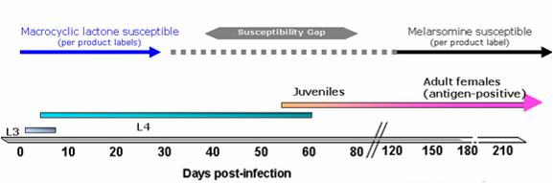
Adjunct therapy
Steroids reduce signs of PTE
  Tapering anti-inflammatory dose
NSAIDS (aspirin) not shown beneficial
Macrocyclic lactones 2-3 months before Immiticide
  Avoids treatment gap
  Also decreases circulating microfilaria
  Decreases female worm mass
Notes:
Pets condition may warrant immediate treatment rather than waiting 3 months.

Slide 33
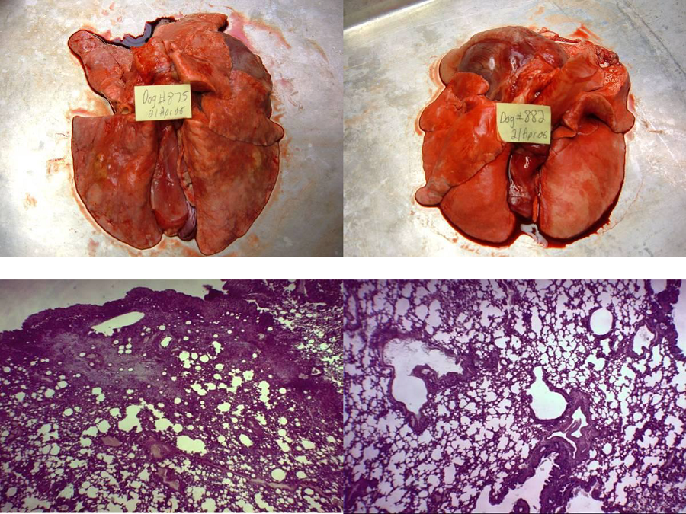
doxycycline
10 mg/kg twice daily for 4 weeks
  Reduces Wolbachia numbers for at least 3 months
  Decreases microfilaria numbers
WSP induces a specific IgG response in the host
  Contributes to pulmonary and kidney inflammation
  Less pulmonary pathology if pretreated with doxycycline and ivermectin before melarsomine
Melarsomine Iver + Doxy + Mel
http://www.heartwormsociety.org/veterinary-resources/canine-guidelines.html

Slide 34
Day | Treatment
Day 0 | Dog diagnosed and verified as heartworm positive. Positive antigen (Ag) test verified with 2nd Ag or microfilaria (MF) test Clinical signs with one positive Ag test and MF test (for status) Begin exercise restriction. The more pronounced the symptoms, the stricter the exercise restriction. If the dog is symptomatic: Stabilize with appropriate therapy and nursing care. Prednisone prescribed at 0.5 mg/kg BID 1st week, 0.5 mg/kg SID 2nd week, 0.5 mg/kg EOD 3rd and 4th week
Day 1 | Administer heartworm preventive. If microfilariae are present, pretreat with antihistamine and glucocorticosteroid if not already on prednisone to reduce risk of anaphylaxis. Observe for at least 8 hours for signs of reaction
Day 1-28 | Doxycycline 10 mg/kg BID for 4 weeks Reduces pathology associated with dead heartworms Disrupts heartworm transmission
Day 30 | Administer heartworm preventive.
Day 60 | Administer heartworm preventive. 1st melarsomine injection 2.5 mg/kg intramuscularly (IM) Rx prednisone 0.5 mg/kg BID 1st week, 0.5 mg/kg SID 2nd week, 0.5 mg/kg EOD 3rd and 4th week Decrease activity level even further. Cage restriction/on leash when using yard
Day 90 | Administer heartworm preventive. 2nd melarsomine injection 2.5 mg/kg IM
Day 91 | 3rd melarsomine injection 2.5 mg/kg IM Rx prednisone 0.5 mg/kg BID 1st week, 0.5 mg/kg SID 2nd week, 0.5 mg/kg EOD 3rd and 4th week Continue exercise restriction for 6 to 8 weeks following last melarsomine injections.
Day 120 | Test for presence of microfilariae. If positive, treat for microfilariae with additional 30-day regimen of doxycycline and retest in 4 weeks. Establish year-round heartworm prevention.
Day 271 | Antigen test 6 months after completion.
American Heartworm Society
Recommended Management Protocol

Slide 35

Alternative therapy
gaza-health.org
Monthly macrocyclic lactones
  Ivermectin for 31 months was 100% effective
  The older the worm at exposure the longer to die
  Continued pathology development
  Risk of resistance
  Lack of control of thromboembolic events
Macrocyclic lactones/doxycycline
  Used when arsenical therapy not available or contraindicated
  Doxycycline cycle one month on, two months off
  Faster than macrocyclic lactones alone
  Ag test every 6 months, treat until two negative tests
Notes:
Since 2011 there has been melarsomine shortage:
Goals are to :Reduce potential pathology from the infection. Maintain the health of the dog until it can be appropriately treated. Prevent additional heartworm infection of the dog
Exercise restriction during this period important.
NO natural remedies to tx heartworm.

Slide 36
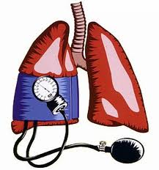
Caval Syndrome
(dirofilarial hemoglobinuria)
ourlifeandsuch.blogspot.com
Adults migrate retrograde into the right heart
  Worms pass through tricuspid valve
    Tricuspid insufficiency – jugular pulses, ↑ CVP, hepatic congestion
    Partial inflow obstruction into right heart
  Often have pulmonary hypertension
Occurs most often in male dogs (75-90% of cases)
Usually have heavy worm burden (>60 worms)
Notes:
Worm burden to create caval syndrome depends on size of patient

Slide 37
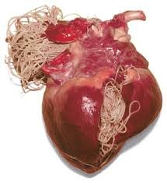
Caval Syndrome
bucknerterraceanimal.com
Sudden onset
  Anorexia, depression, weakness, dyspnea
  Decreased preload and forward output
Hemoglobinuria is pathognomonic in dog with HWs
    Red blood cells get lysed passing through the sieve of HWs
DIC can occur secondarily
    IV hemolysis, metabolic acidosis, diminished hepatic function contribute to impaired removal of procoagulants
Diagnosis confirmed by echocardiogram
  Worms seen in tricuspid orifice and posterior vena cava
Notes:
Decreased preload because of worm mass, decreased CO b/c of worm mass and pulmonary hypertension

Slide 38
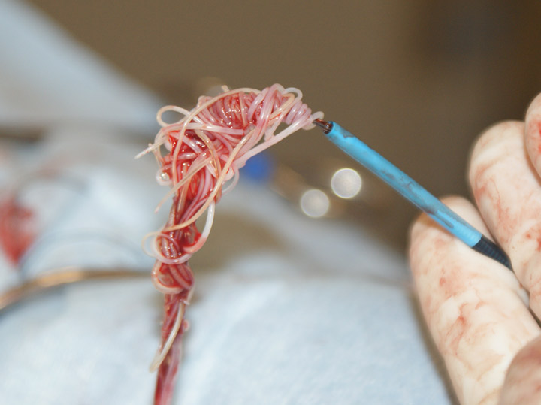
Treatment and Prognosis
Death occurs within 24-72 hours of symptoms
Surgical removal should occur rapidly
  Often done with local or sedation/local only
  Isolate and ligate jugular vein proximally & distally
  Use alligator forceps, basket, etc. to blindly grab worms
  Fluoroscopy may help guidance
  Increased ALT preop associated with worse outcome
  Risks: death within 72 hours, damage to PA or heart, worm breakage and shock
Bove, JAVMA 2010
  67% of dogs with attempted worm extraction had successful procedure and survived to discharge
  10 of 13 dog that had post echo still had worms in PA
Follow with adulticide therapy a few weeks later
http://cuvs.blogspot.com/2011/06/luckys-heartworm-removal-and-orthopedic.html
Notes:
Can do with general anesthesia too
Risks of anesthetic death, DIC, perioperative mortality within first 72 hours, damage to Pas or heart, worm breakage and shock
Cornell university veterinary specialists

Slide 39
ECC Topic of the Day
Heartworm Associated
Shock

Slide 40

HW-Associated Shock
Injection of HW extract will induce shock in 60-90% of dogs
  Dogs with HW negative status may be at lower end
  Dogs with HW positive status may be at higher end
Experimentally fall into one of four categories
  No shock
  Collapse 5-30 min after injection, death within 2 hours
  Collapse 5-30 min after injection, recover spontaneously within 2 hours
  Collapse, recover, collapse with bloody diarrhea and death within 24 hours
auburnpub.com

Slide 41
Signs
Within 5 minutes of injection
  Lethargy, pale mm, tachypnea, vomiting, struggling
Within 5-30 minutes of injection
  Collapse
  Hypotension (systolic BP 30-45mm Hg)
After 30 minutes
  Bloody diarrhea developed and increased to about 2 hours
Secondary collapse in some dogs within 24 hours
  Some have bleeding from venipuncture sites, SQ hematomas

Slide 42
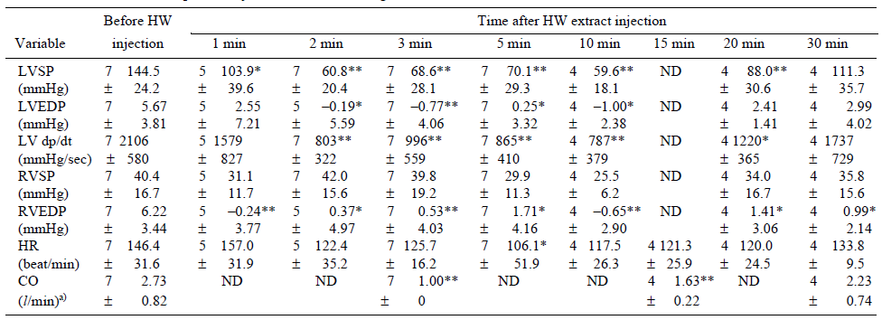
Hemodynamic Alterations
Distributive shock
  Blood pools in liver and GIT
  Liver is the organ of anaphylaxis in the dog
Kitoh, JVetMedSci, 2001
  Decreased RVEDP = venous pressure = ↓ venous return
  LVEDP and LVESP subsequently decreased
  CO dropped to <1L/min 3-5 minutes after injection

Slide 43
Mechanism of Shock
Anaphylactic shock
  IgE mediated – previously sensitized mast cells
  Non-IgE mediated (anaphylactoid) – substance causes direct mast cell degranulation
Histamine levels increase significantly following injection
  .2 mg/ml to 44.6 ng/ml at onset of shock (Kitoh, 2001)
  Histamine increase seen in SPF dogs too
  HW extract degranulates significantly more mast cells in rat mesentary model
HW shock likely occurs independent of IgG or IgE
Kitoh, AJVR, 2001

Slide 44
Pathology Findings
Gross pathology during initial collapse
  Hepatic congestion, congestion or hemorrhage in serous membranes of gallbladder and GIT (especially SI), renal congestion
  Less severe in dogs that recover from collapse
Histopathology
  Neutrophil aggregation in the lumen of vessels of the lungs
  Severe hemorrhage/congestion of the lamina propria of stomach, SI, colon
    Dog that died during secondary collapse had severe hemorrhage in colon

Slide 45
Coagulopathy of HW-associated shock
Occurred in 63% of dogs who developed shock
Markedly increased ALT, ALP, LDH, CK at collapse
Dogs that recovered from shock w/o coagulopathy
  ↓ plt count after collapse (100k), recovered by 30 min
Dogs that had severe PTT prolongation
Dogs that had severe PTT/PT prolongation
  PT severely prolonged for 2 hours but trending normal, normal by 24 hours
    Factors II, V, VII, X decreased slightly from collapse through 2 hours, normal by 24
  PTT severely prolonged at 2 hours, normal by 24
    Factors VIII, IX, XI, XII severely decreased through 2hr, normal by 24 hours
Notes:
Intrinsic factors

Slide 46
Cause of Coagulopathy
Kitoh, AJVR, 1994
Coagulopathy was proportional to degree of shock
Possible causes:
  Deficiency of coagulation factors
  Inhibitory substance in HW extract
  Inhibitory substance made in body
PT could be normalized with addition of at least 80% normal plasma
PTT could not be normalized with normal plasma
Mixing normal plasma with HW extract did not elicit coagulopathy

Slide 47

fanpop.com
CATS!

Slide 48

Prevalence
Knowheartworms.org
Estimated to be 5-20% of the canine population in the same area
Necropsy studies on shelter cats
  Georgia and Florida
  2.1-4.9% of cats had adult worms
Outdoor lifestyle increases exposure to vectors
19-27% of confirmed HW infected cats are indoor only

Slide 49
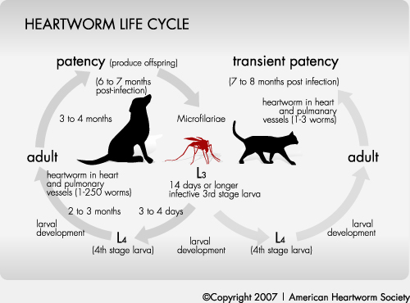
Life Cycle
Similar to dogs
Carried to PA 70-90 days post infection
  Very high mortality rate of worms as they reach the lung
MOST worms are cleared by immune system
  Dogs – 100 L3 injected – almost 100%, 60 worms each
  Cats – 100 L3 injected – 75%, 3-10 adults
  1/3 of infections are same-sex
  Because of size even a few worms is a heavy infection
Adults only live 2-4 years
Microfilaria occur in <20% of cats
  7-8 months PI, only lasts 1-2 months
heartwormsociety.org
Notes:
Microfilaria develop one month later than in dogs

Slide 50
Pathophysiology
Death of immature worms induces a strong parenchymal and vascular inflammatory response
  Activity of pulmonary intravascular macrophages
  Absent in dogs
Adults induce PA pathology
  Villous endarteritis, intimal fibrosis
  Occlusive medial hypertrophy of small pulmonary arterioles
  Thrombosis
IgG against WSP remain high for months after infection
Even WITHOUT adults cats can develop significant lung damage

Slide 51
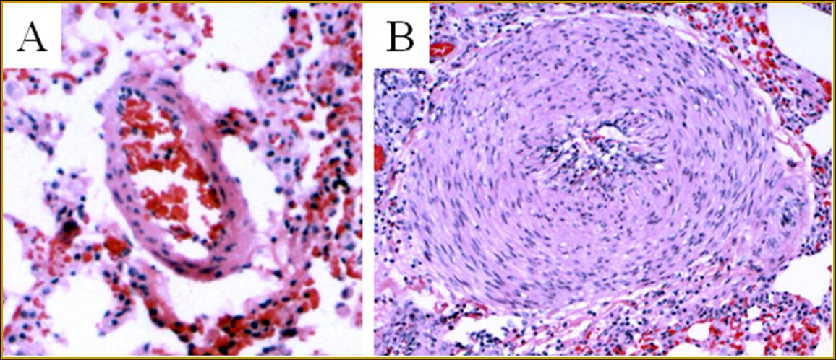
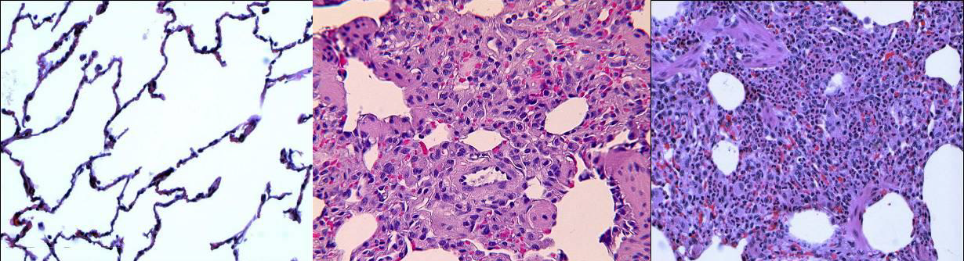
Adult HW negative Adult HW negative Adult HW positive
Antibody negative Antibody positive Antibody positive
Cat antibody negative Cat antibody positive
antigen negative antigen negative
http://www.knowheartworms.org/arteriole.asp

Slide 52
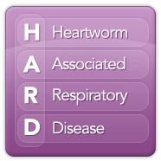
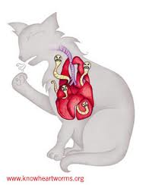
Signs
Heartworm Associated Respiratory Disease
  About 3 months post infection when worms die
  Vomiting, dyspnea, coughing
Adult infections often asymptomatic
  Worms thought to down regulate PIM activity
Chronic HW infection
  Dyspnea/coughing
  Vomiting, neurologic signs
  Acute respiratory distress & sudden death
    Death/deterioration/embolization of worms
    PA infarction and circulatory collapse

Slide 53

Sudden death in cats
Sensitized cats given antigen, whole filariae, fluid from whole filariae, or transected filariae
Clinical signs
  Dyspnea, GI signs – retching, defecation
  Hemorrhage from nostrils and anus, cutaneous swelling
Decreased BP, HR, SpO2, increased Hct
Consistent with acute systemic anaphylaxis
  Antigen and dead worms produced worse signs
  Mild signs with live filariae
  No signs with worm fluid or control
Serotonin mediates acute airway smooth muscle contraction in cats (Type 1)
  Also causes Bezold-Jarisch reflex

Slide 54
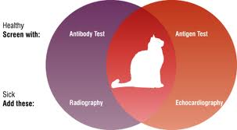
Like Cats…Testing is A Challenge
Require multimodal testing
Antibody test
  Denotes exposure and development to at least L4
  Cat may have mature infection, at risk of HARD
  Does not completely rule out infection
Antigen test
  Positive result is highly suggestive of infection
    PPV of test decreases with prevalence
  Tests look for female worm antigen
    Prone to false negatives
    Male only infection
    Immature infection
Running both increases sensitivity
idexx.com
Notes:
Most cats with adult HW infection are AB positive

Slide 55
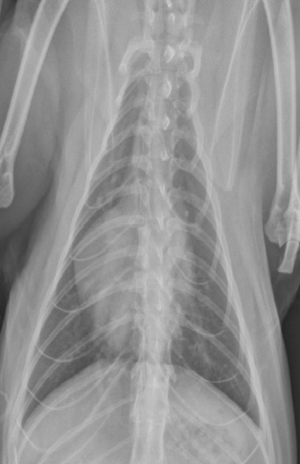
Other tests
Knott’s test rarely fruitful – diagnostic if positive
Radiographs – often nonspecific
  PA wider than 1.6 times the diameter of the 9th rib at the 9th intercostal space
  Bronchointerstitial lung pattern
  Pulmonary hyperinflation
Echo
  Sensitivity ranges from 40-100%
  Higher because pulmonary artery tree is much smaller and worms tend to be more proximal
  Usually only definitive way to diagnose antemortem

Slide 56
Treatment
Adulticide not recommended
  High mortality rate from PTE
  Possibly anaphylactoid reaction to dead worms
Many cats self-cure
  Treat symptomatically with prednisone
  Currently no proven benefit to giving doxycycline
  Preventative to prevent repeat infection
    Safe in infected cats
Surgical extraction
  Cats surviving surgery show marked improvement

Slide 57

Prognosis
visualphotos.com
Two prospective studies
80% of naturally infected cats will self-cure
  68 and 25% of cats developed clinical signs overtime
Other 20% died 8-41 months after diagnosis
  Usually suddenly

Slide 58

An Ounce of Prevention…
Remember even L4’s cause disease
Do not need to be tested before starting preventative
Cats treated with monthly preventative have normal histopathology
  Versus cats who have L4 that reach the lungs but do not become adults
  Versus cats with adult infections

Slide 59
Just a Few More
Odd Balls…

Slide 60
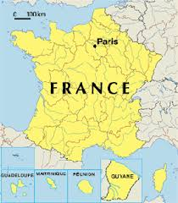
Angiostrongylus vasorum
Fox is reservoir for domestic dogs
Spreading over Europe
Endemic focus in New Foundland
L1 shed in feces of infected animal
  Slug/snail/frog eats L1 →L3
  Dog eats one of the above
  L3 exit GI tract, mature in abd LN, eventually go to PAs
  Worms mate and release eggs which lodge in pulmonary capillaries
  Larva hatch, break into alveolar space, are coughed up, swallowed, passed in feces
  Adults can live for at least 5 years
europa.eu
Notes:
Worms can get to PA in as little as 10 days

Slide 61
A. Vasorum Clinical Disease
Adults are 1-2 cm
Most cases diagnosed in fall/winter
Usually have cardiopulmonary signs
  Interstitial pneumonia and hemorrhage from immature worms
  Alveolar hemorrhage from hatching larvae
  Granulomas develop in response to eggs and larvae
  Overtime fibrosis develops
CNS signs from aberrant migration can occur
Aberrant migration to many other tissues
Can infect cats but they do not shed larva
Notes:
Oct-Feb in Newfoundland

Slide 62
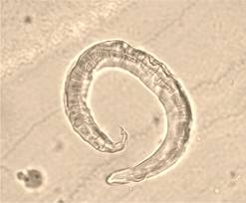
Diagnosis and Treatment
parasitesandvectors.com
Baermann fecal test is the best
  Zn sulfate centrifugation only detects 60%
  If time is critical can perform Baermann after 1 hour (instead of 8-12) of incubation – 92% detection rate
  Can have intermittent shedding
MRI can detect larval migration in CNS
No approved treatment in North America
  Fenbendazole, milbemycin, moxidectin
  Post treatment can develop severe dyspnea and ascites
    Treat with bronchodilators and diuretics

Slide 63
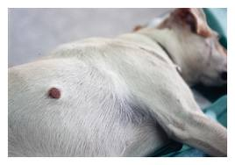
Dirofilaria repens
hindawi.com
Parasite of the SQ connective tissue
  Dogs, cats, wild carnivores, humans

Slide 64
References
Bowman DD, Atkins CE. Heartworm biology, treatment, and control. Veterinary Clinics of North American, Small Animal Practice 2009;39:1127-1158.
McHaffie J. Dirofilaria immitis and Wolbachia pipientis: a thorough investigation of the symbiosis responsible for canine heartworm disease. Parasitology Research2012; 110:499-502.
Dingman P, Levy J, Kramer L, et al. Association of Wolbachia with heartworm disease in cats and dogs. Veterinary Parasitology 2010;170:50-60.
Taylor MJ, Voronin D, Johnston KL, et al. Wolbachia filarial interactions. Cellular Microbiology 2012:Vol;1-7.
Bowman DD. Introduction to the Alpha-proteobacteria: Wolbachia and Bartonella, Rickettsia, Brucella, Ehrlichia, and Anaplasma. Topics in Companion Animal Medicine 2011;26(4):173-177.
Rishniw M, Hess A, Rojas R, et al. Dirofilarial hemoptytic expectoration in 5 dogs – an uncommon manifestation of canine heartworm disease. Journal of Veterinary Internal Medicine 2012;26:1061-1063
Caprariis D, Sasanelli M, Paradies P, et al. Monoclonal gammopathy associated with heartworm disease in a dog. Journal of the American Animal Hospital Association 2009;45:296-300.
Gonzalez-Miguel J, Morchon R, Mellado I, et al. Excretory/secretory antigens from Dirofilaria immitus adult worms interact with the host fibrinolytic system involving the vascular endothelium. Molecular & Biochemical Parasitology2012:181; 134-140.
AHS canine guidelines
AHS Guidance for HW management during adulticide unavailability
McCall JW, Genchi C, Kramer L. Heartworm and Wolbachia: Therapeutic implications. Veterinary Parasitology 2008;158:204-214.
Grandi G, Quintavalla C, Mavropoulou A, et al. A combination of doxycycline and ivermectin is adulticidal in dogs with naturally acquired heartworm disease (Dirofilaria immitis). Veterinary Parasitology 2010;169:347-351.
Bourguinat C, Keller K, Bhan A, et al. Macrocyclic lactone resistance in Dirofilaria immitis. Veterinary Parasitology 2011;181:388-392.
Bazzocchi C, Mortario M, Grandi G, et al. Combined ivermectin and doxycycline treatment has microfilaricidal and adulticidal activity against Dirofilaria immitis in experimentally infected dogs. Journal of Parasitology 2008;38:1401-1410
Garcia-Guasch L, Caro-Vadillo A, Manubens-Grau J, et al. Evaluation of pulmonary function variables by using plethysmography in cats with respiratory disease associated to Dirofilaria immitis. Veterinary Parasitology 2012;187:254-258.
Wooldridge AA, Dillon AR, Tillson DM, et al. Isometric responses of isolated intrapulmonary bronchioles in cats with and without adult heartworm infection. AJVR 2012; 73(3): 439-446.

Slide 65
References
McCall JW, Kramer L, Genchi C. Effects of doxycycline on early infections of Dirofilaria immitis in dogs. Veterinary Parasitology 2011; 176: 361-367.
Blagburn BL, Dillon AR, Arther RG, et al. Comparative efficacy of four commercially available heartworm preventive products against the MP3 laboratory strain of Dirofilaria immitis. Veterinary Parasitology 2011;176:189-194.
Kramer L, Grandi G, Passeri B, et al. Evaluation of lung pathology in Dirofilaria immitis-experimentally infected dogs treated with doxycycline or a combination of doxycycline and ivermectin before administration of melarsomine dihydrochloride. Veterinary Parasitology 2011; 176: 357-360.
Kramer L, Grandi G, Leoni M, et al. Wolbachia and its influence on the pathology and immunology of Dirofilaria immitis infection. Veterinary Parasitology 2008;158:191-195.
Yoon WK, Han D, Hyun C. Catheter-guided percutaneous heartworm removal using a nitinol basket in dogs with caval syndrome. Journal of Veterinary Science 2011; 12(2):199-201.
Bove C, Gordon SG, Saunders AB, et al. Outcome of minimally invasive surgical treatment of heartworm caval syndrome in dogs: 42 cases (1999-2007). Journal of the American Veterinary Medical Association 2010; 236(2):187-192.
Kitoh K, Kitagawa H, Sasaki Y. Pathologic findings in dogs with shock induced by intravenous administration of heartworm extract. Journal of Veterinary Research 1998;59(11):1417-1422.
Kitoh K, Katoh H, Kitagawa H, et al. Role of histamine in heartworm extract-induced shock in dogs. American Journal of Veterinary Research 2001;62(5): 770-774.
Kitoh K, Watoh K, Chaya K, et al. Clinical, hematologic, and biochemical findings in dogs after induction of shock by injection of heartworm extract. American Journal of Veterinary Research 1994; 55(11): 1535-41.
Kitoh K, Mikami C, Kitagawa H, et al. Hemodynamic alterations in dogs with shock induced by intravenous injection of heartworm extract. Journal of Veterinary Medical Science 2001;63(2):179-182.
Kitoh K, Watoh K, Kitgawa H. Blood coagulopathy in dogs with shock induced by injection of heartworm extract. American Journal of Veterinary Research 1994; 55(11): 1542-1547.
AHS Feline guidelines
Litster A, Atkins C, Atwell R. Acute death in heartworm-infected cats: Unraveling the puzzle. Veterinary Parasitology 2005; 158(3).196-203.
Lee ACY, Atkins CE. Understanding feline heartworm infection: disease, diagnosis, and treatment. Topics in Companion Animal Medicine 2010;25(4): 224-230.
Tarello W. Clinical aspects of dermatitis associated with Dirofilaria repens in pets: a review of 100 canine and 31 feline cases (1990-2010) and a report of a new clinical case imported from Italy to Dubai. Journal of Parasitology Research 2011: 1-7.
Conboy GA. Canine angiostrongylosis: The French heartworm: An emerging threat in North America. Veterinary Parasitology 2011;

Slide 66

Questions

