Slide 1
Slings and such
Josh Smith

Slide 2
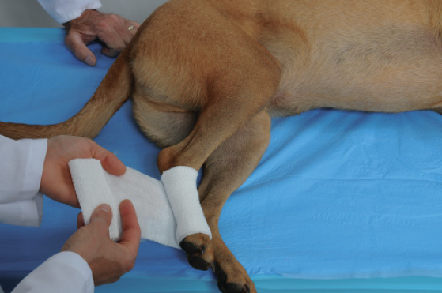
Ehmer Sling
Initial two to three layers of cast padding are placed around the metatarsal area

Slide 3
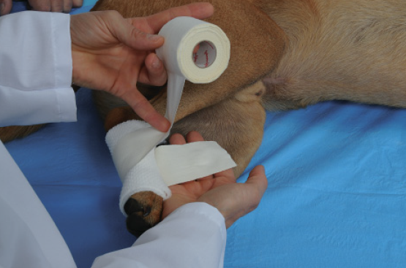
Ehmer Sling
Pass adhesive tape around the padded metatarsal region, coming up the lateral side of the metatarsus

Slide 4
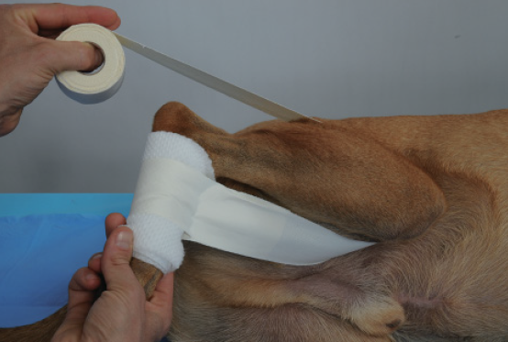
Ehmer Sling
Twist tape 180○ to keep the adhesive side against the skin, and pass medially to the stifle

Slide 5
Ehmer Sling
Pass the tape over the lateral thigh as far proximally into the inguinal region as possible

Slide 6
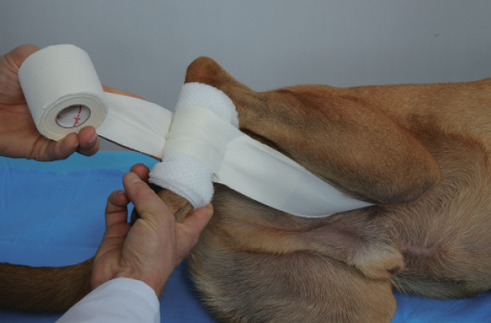
Ehmer Sling
Again twist the tape to keep the adhesive against the skin, and pass distally medial to the hock

Slide 7
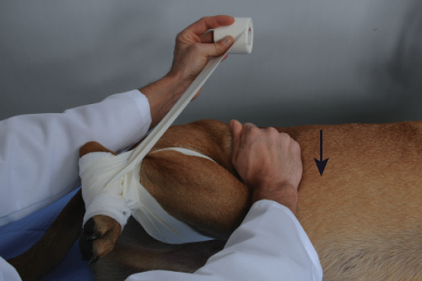
Ehmer Sling
Continue tape back up to the starting point at the lateral side of the metatarsal region

Slide 8
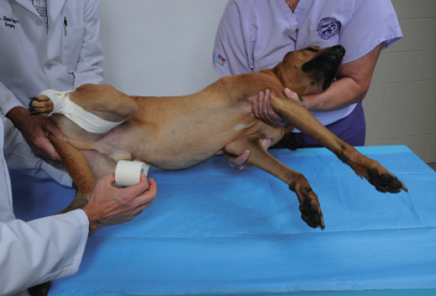
Ehmer Sling
If maintaining hip reduction, following the last pattern, pass the tape over the lateral side of the flexed leg over the back and around the abdomen as a belly band; stick the tape to itself on the abdominal wall

Slide 9
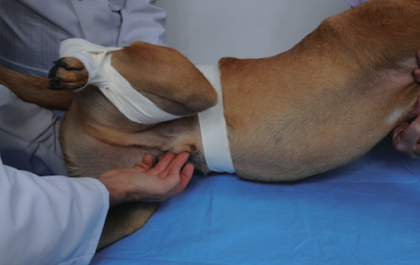
Ehmer Sling

Slide 10
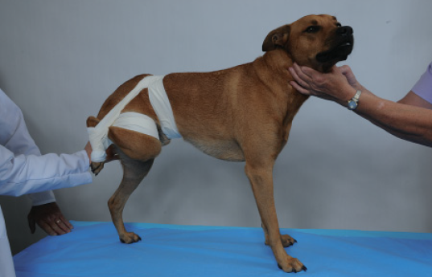
Ehmer Sling

Slide 11
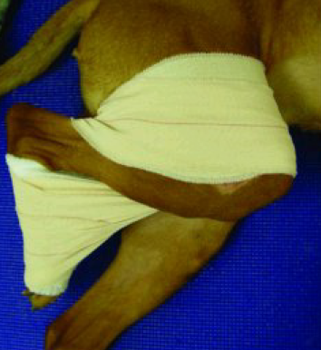
Modified Ehmer Sling

Slide 12
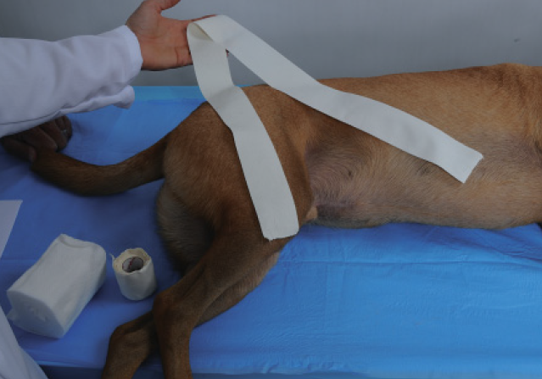
90/90 Sling
Tear a long piece of 2” adhesive tape for later

Slide 13
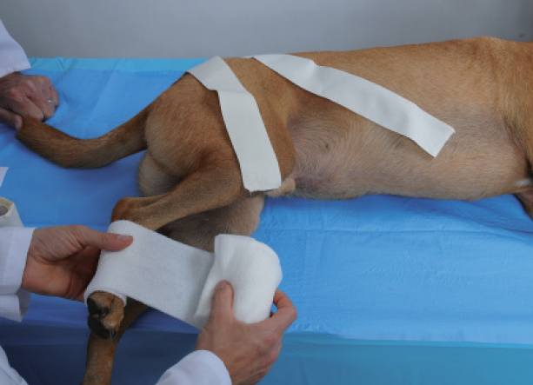
90/90 Sling
Cover of two to three layers of cast padding are wrapped around the metatarsals

Slide 14
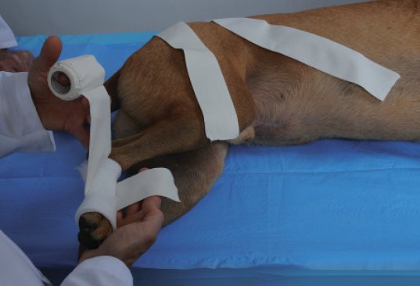
90/90 Sling
Place tape over the metatarsal area by placing it around the caudal surface with the adhesive side against the initial wrap

Slide 15
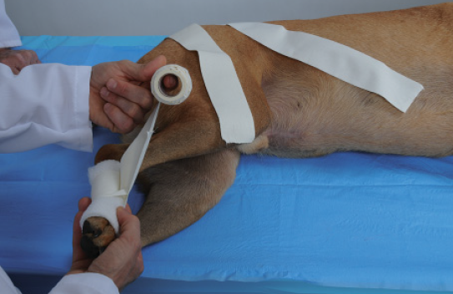
90/90 Sling
Bring tape cranially so that the adhesive sides meet cranially

Slide 16
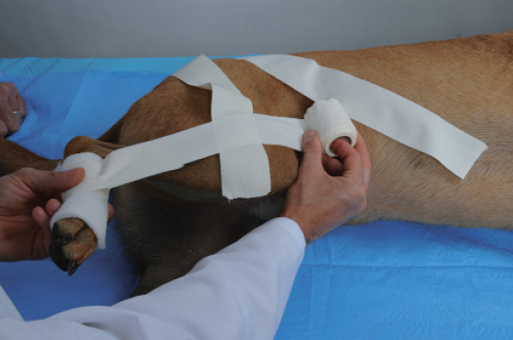
90/90 Sling
The reserved piece of tape is laid adhesive side up along the femoral area with the hock and stifle flexed

Slide 17
90/90 Sling
The tape that began on the metatarsal area is brought up the lateral aspect of the crus and around the cranial aspect of the femoral area, with the adhesive side against the animal

Slide 18
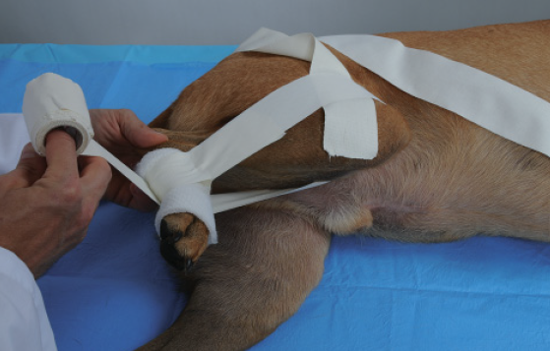
90/90 Sling
The tape that started on the metatarsal area is then brought down the medial aspect of the crus and returned around the caudal aspect of the hock (This layer is repeated)

Slide 19
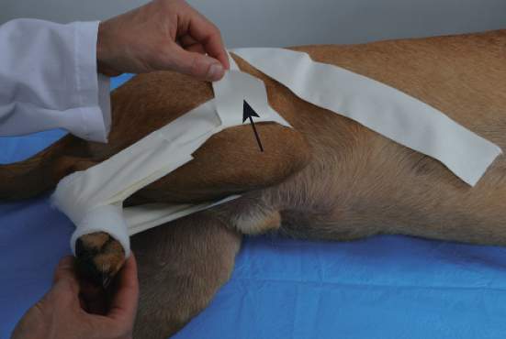
90/90 Sling
The ventral end of the reserved piece of tape is now folded over to secure its attachment to the tape that started on the metatarsal area

Slide 20
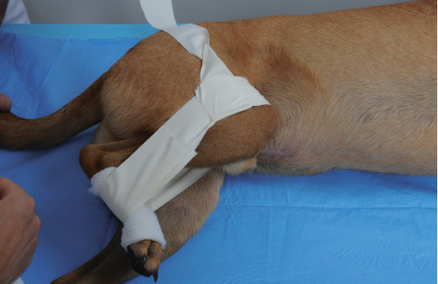
90/90 Sling
The remaining portion of this tape is now twisted to be adhesive side against the patient

Slide 21
90/90 Sling
It is brought up the femoral area for passage around the dorsum of the animal

Slide 22
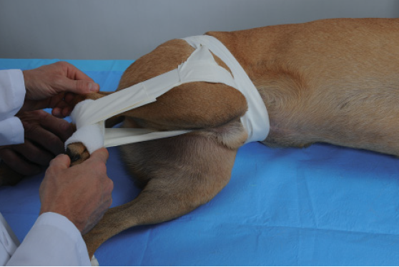
90/90 Sling
It is then brought down the other side and around the abdomen in a manner similar to the Ehmer sling

Slide 23
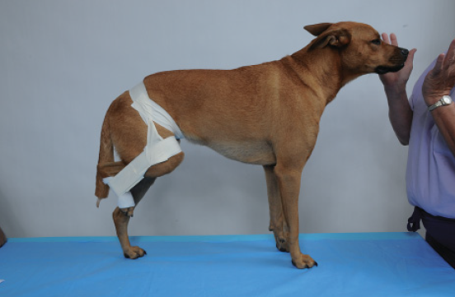
90/90 Sling

Slide 24
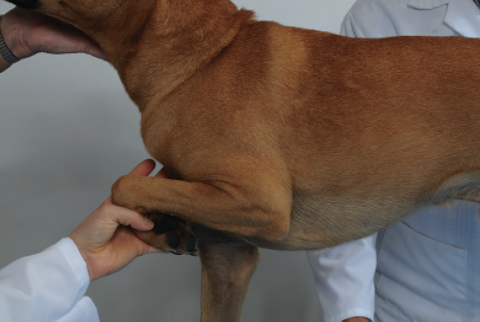
Velpeau Sling
Position the limb

Slide 25
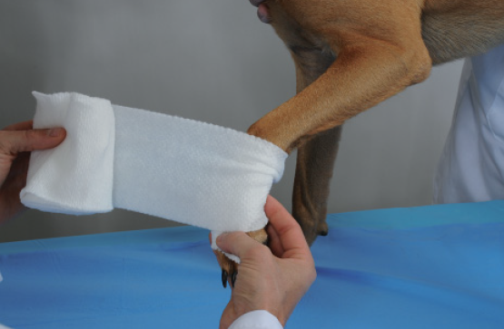
Velpeau Sling
Lightly pad the foot and carpus with cast padding to prevent excessive flexion

Slide 26
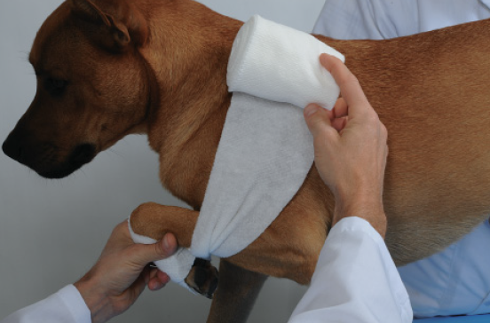
Velpeau Sling
Hold the limb in the desired flexed position and bring the cast padding over the dorsum of the animal and around the thorax back to the limb to hold it in the flexed position against the thorax

Slide 27
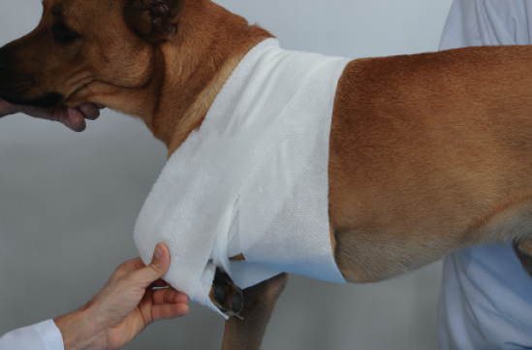
Velpeau Sling
Roll the Cast padding around the limb and thorax, passing caudally to the opposite forelimb to prevent slipping

Slide 28
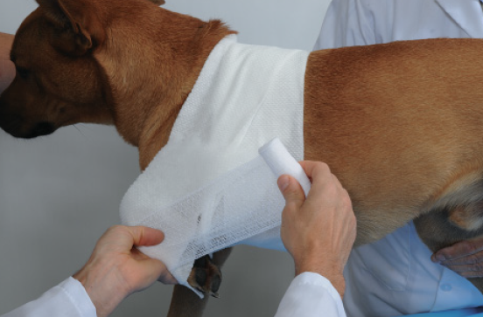
Velpeau Sling
Continue on the same pattern for two to three layers, incorporating the entire carpus and foot

Slide 29
Velpeau Sling
Repeat steps with conforming roll gauze

Slide 30
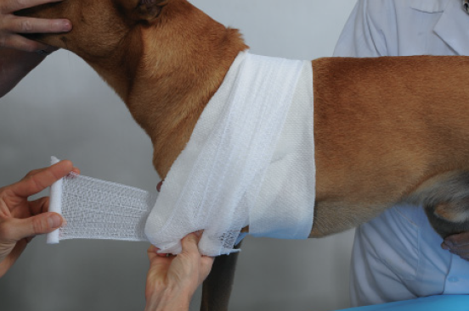
Velpeau Sling
Ensure that it cannot slip cranially as well

Slide 31
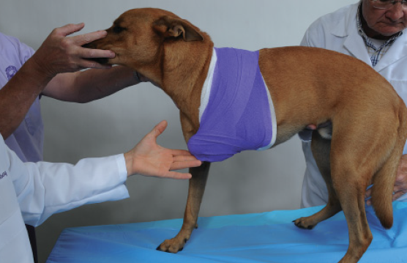
Velpeau Sling
Apply a light tertiary layer of conforming tape over the gauze in the same pattern

