Slide 1
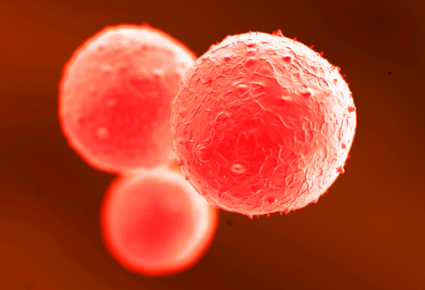
Coagulation Cascade
Joel Green Weltman
10/16/2012

Slide 2
Outline
General principles
Models of coagulation
Members of coagulation
Coagulation inhibitors
Cells participating in hemostasis
Cell based model of thrombin generation
Fibrinolysis

Slide 3
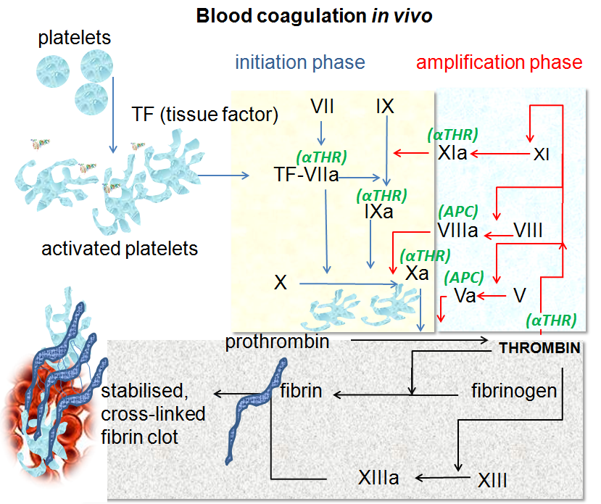
Notes:
Actually is a process of which any colloidal solution is capable, the agglomeration of dispersed colloidal particles, also known as flocculation
Milk is a fairly common colloid, consists emulsified liquid butterfat globules dispersed in water
These globules are capable of coagulation, just as blood is, typically performed by adding an acidifying substance
We manipulate this process to make cheese-my favorite being parmasean arregiano
The process by which blood forms clots
Process by which soluble fibrinogen is converted to solid fibrin gel
Highly conserved process across all mammals
It Is posslbe for any mammalian coagulation factor to “cleave” its equivalent target in any other mammal
Only non-mammalian animal to use serine proteases for blood coagulation is the horseshoe crab

Slide 4
Enzymatic complex
Enzymatic biochemistry
  Inert precursor: zymogen
  Converted into active enzyme via limited proteolysis
  Majority of enzymes are serine proteases
Functional enzyme unit may require complex formation
  Enzyme subunit (serine protease)
  Regulatory subunit (cofactor)
  +/- Procoagulant membrane
Convert a substrate
  Inactive → active form
  Typically involves cleavage of a protein
Notes:
Enzymatic biochemistry
Cascade of enzymatic reactions
Inert precursor: zymogen
Converted into active enzyme
Via limited proteolysis
Majority of enzymes are serine proteases, which cleave after arginine residues
Except for thrombin, most factors have limited ability to act on a substrate protein cofactor and a procoagulant membrane surface
The non-enzymatic factors are predominantly the co-factors, which circulate as procofactors and their proteolysis results in a substance capable of enhancing the enzymatic activity of the cascade
The cascade often involves downstream feedback (both positive and negative) to enhance the production of active enzyme complexes
Majority of enzymes are serine proteases, which cleave after arginine residues

Slide 5
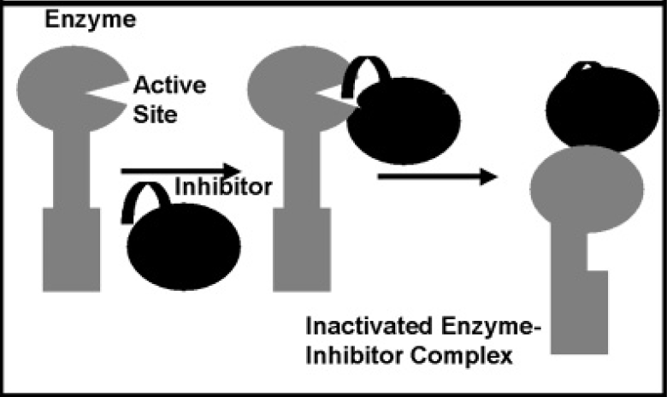
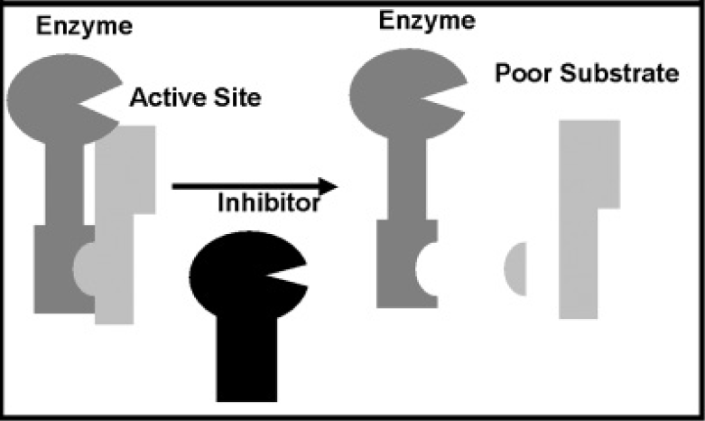
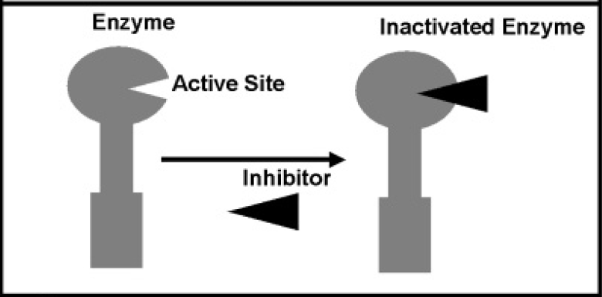
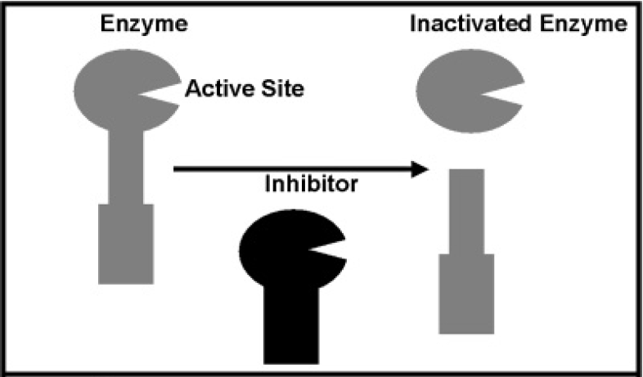
Inhibitors
Several mechanisms
  Enzyme cleavage
  Blockage of active site
  Formation of a stable complex
  Modification of the substrate
Notes:
Inhibition by cleavage of the enzyme itself, which is how APC works on activated factor V
You can block the active site of the enzyme, which is not common in physiologic systems but some pharmacologic interventions use this principle
The inhibitor can bind to the enzyme, altering it is such a way that it is no longer active, and form a complex, this is how the Antithrombin-heparin complex acts on thrombin
And the inhibitor can also alter the enzyme’s substrate in such a way it can no longer be altered by the enzyme, which is how trombin activatable fibrinolysis inhibitor alters fibrin to prevent plasmin from acting upon it and dissolving it.
This of course gets very complicated as we will see, particularly considering most inhibitors also have their own…inhibitors

Slide 6
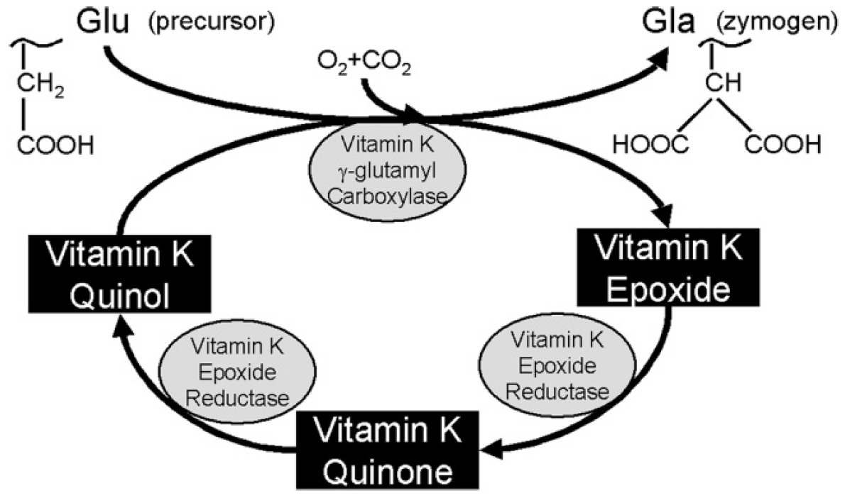
Membrane-Surface Interactions
May enhance cascade activity
Allows for proper alignment of the factors
Gla residues allow for membrane interaction
  Interaction of Ca⁺⁺ and negative phospholipid charge
  Carboxylated via vitamin K pathway
  Factors II, VII, IX, X; proteins C, S, and Z
Factors V and VIII interact with phospholipids by another mechanism
Notes:
Alignment on a membrane may enhances cascade activity of the cascade
Allows for proper alignment of the factors
TF is the only permanently bound protein of coagulation
Gammacarboxyglutamic acid (Gla) residues allow for membrane interaction by Ca++/phospholipid binding
Gla residues must be carboxylated via intra-hepatic post-translational modifications involving Vit K
Gla residues present on factors VII, IX, X, prothrombin (FII), protein C, protein S, and protein Z
Factors V and VIII interact with phospholipids by stereochemical configuration of the phosphatidylserine head group,
allows fully functional enzymatic complexes to assemble on membrane surfaces
So as we go through the various factors of coagulation, we will be discussing how they are altered from an inactive zymogen to active enzyme, identifying whether or not a co-factor is needed and also what mechanisms exist to inhibit activity of such an enzyme.

Slide 7
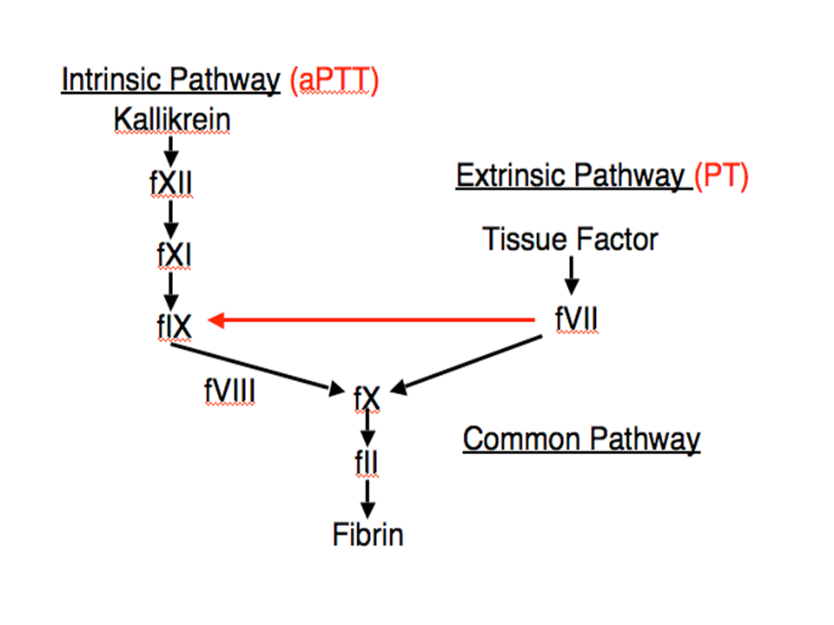
Extrinsic Pathway
Exposure of TF
Factor VII activation
Factor X activation
Notes:
The extrinsic pathway was so named due to TF considered to be outside of the vasculature (not true)
TF exposure leads to activation of FVII which leads to activation of FX
Utilize the PT to test the extrinsic pathway

Slide 8
Intrinsic Pathway
Exposure to surface
FXII activation
FXI activation
FIX activation
FIX-FVIII combo
FX activation
Notes:
Called intrinsic b/c it had appeared to be something in the blood resulted in the activation of this pathway
Overlaps w/ what is now called the contact pathway, which is initiated w/ exposure to many different foreign surfaces
Primarily how blood clots when exposed to plastic or glass surfaces (blood tubes)
Not terribly important for in vivo coagulation
Contact w/ a foreign surface leads to activation of FXII
FXII activation leads to activation of FXI
FXI leads to activation of FIX
FIX (along w/ FVIIIa) leads to FX activation
Utilize the PTT to test this pathway

Slide 9
Common Pathway
Formation of FXa-Fva complex
Thrombin generation
Cleavage of fibrinogen to fibrin
Notes:
Formation of FXa-FVa complex which generates thrombin
Thrombin then cleaves fibrinogen to fibrin

Slide 10
Outline
Notes:
So of course this model has, as mentioned, fallen out of favor
However, still important in the interpretation of bloodwork
Also a nice way to introduce the various factors which we will go into in much greater depth

Slide 11
FXII/FXIIa
Activated by
  Kallikrein or plasmin
  FXIIa when bound to negative charged membrane
Acts upon
  Prekallikrein (PK)
  Kininogen (HK)
  FXI
  Single chain urokinase plasminogen activator (scuPA)
Inhibited by
  C1-inhibitor (C1-INH)
Notes:
Produced by liver
Circulates as single chain molecule with molecular weight about 80 kDa
Cleavage by either kallidrein or plasmin generates a 2-chain active enzyme (FXIIa)
Light chain is a serine protease, heavy chain contains 2 sites binding to negatively charged surfaces
Primarily functions on prekallikrein (PK), kininogen (HK) and FXI
Also acts on complement pathway and cleaves single chain urokinase plasminogen activated (scuPA)
C1-inhibitor (C1-INH) is the major inhibitor of FXIIa
This of course is Hageman factor, which deficiencies in this are not uncommon in cats
This was discovered in 1955 first in a brakeman for the railroad during routine pre-surgical screening
As the only sign is a prolongation in clotting times, no bleeding, it was found incidently
This man’s name was John Hageman
He was sent for further work up to Oscar Ratnoff, who isolated FXII from this man
Sparked a series of tests which culminated in the realization that factors are present as inactive precursors
At some point he joined forces with Earl Davie

Slide 12
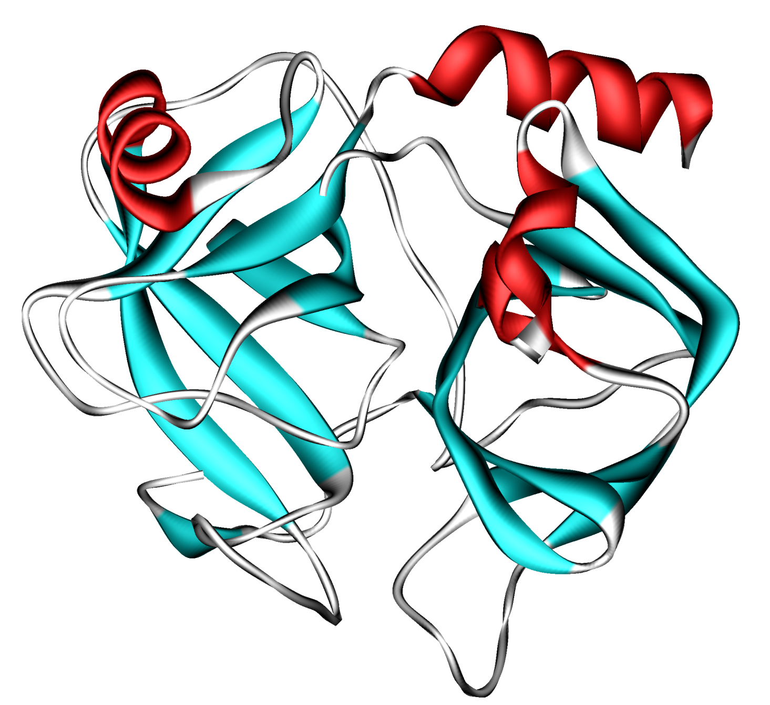
Prekallikrein/Kallikrein
Activated by
  FXIIa on negatively charged surfaces
  Requires cofactor: Kininogen (HK)
  Can undergo autoactivation to beta-kallikrein
Acts upon
  FXII
  HK
  scuPA
Inhibited by
  C1-INH
  α2-macroglobulin
  Protein C inhibitor (PCI)
  Antithrombin-heparin complex
  Tissue Factor Pathway Inhibitor
Notes:
Singe chain, 86 kDa, expressed in many tissues, particularly liver
Primarily circulates bound to HK
Converted to kallikein by FXIIa on negatively charged surfaces when HK is also bound
Autoactivation at different cleavage site results in les active enzyme beta-kallikrein
Predominantly functions on FXII and HK
Also cleaves scuPA
Inhibited by C1-INH and alpha2-macroglobulin
Can be inhibited by protein C inhibitor (PCI) when bound to HK by heparin-AT

Slide 13
Kininogen
Activated by
  Kallikrein
  Zn²⁺ required for membrane binding
Acts upon
  Cofactor to FXIIa
  Calpain-mediated platelet aggregation
  Prevents thrombin binding to platelets
Notes:
Either high-molecular weight or low-molecular weight
Non-coagulation functions: inhibition of ANP, prevent calpain-mediated platelet aggregation, prevent thrombin binding to platelets, production of bradykinin, roles in apoptosis and cell-to-cell interactions

Slide 14
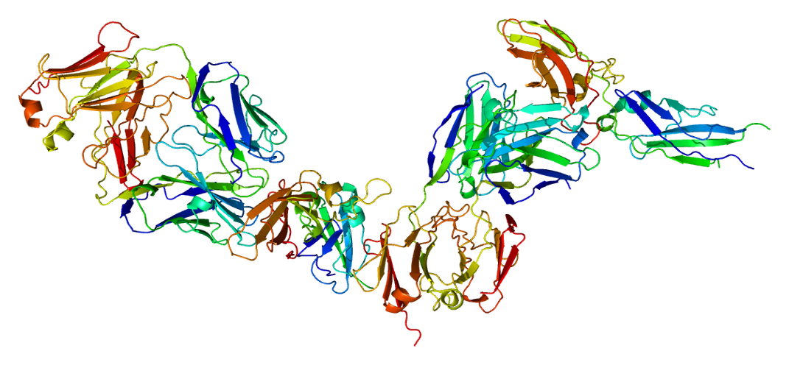
Tissue Factor
Constituent expression within cell membranes
  Adventitial cells surrounding blood vessels
  Skin epithelium
  Mucosa
  Connective tissues surrounding most organs
Induced expression in particular cell types
  Endothelial cells
  Vascular smooth muscle cells
  Monocytes
  Granulocytes
  Cancer cells
Notes:
Aka thromboplastin, CD142 and factor III
Glycosylated, single chain polypeptide, MW about 29.5 kDa
Expressed within cell membrane (contains cytosolic, transmembrane and extracellular domains) by adventitial cells surrounding blood vessels, within skin epithelium, mucosa and connective tissues surrounding most organs
Expression can be upregulated in other cell types by cytokines, viruses, endotoxin, thrombin, immune complexes, phorbol esters and mitogens (platelet derived growth factor, epidermal growth factor, insulin)
Endothelial cells, vascular smooth muscle cells, monocytes, granulocytes, cancer cells
Extracellular domain capable of binding FVII or FVIIa
Regulatory subunit of TF-FVIIa enzymatic complex, the first enzyme in the clotting cascade
This interaction requires calcium
Small amount of blood bourne tissue factor ID’d on microparticles
Involved in thrombus propagation as endothelial and subendothelial TF is rapidly incorporated into the clot
Does not require activation by proteolysis
Predominantly inhibited by tissue factor pathway inhibitor

Slide 15
Tissue Factor/TF-FVIIa
Activated by
  Does not require activation by proteolysis
Acts upon
  Extracellular domain binds FVII or FVIIa
  Regulatory subunit of TF-FVIIa enzymatic complex
  Thrombus propagation (microparticle tissue factor)
Inhibited by
  Tissue factor pathway inhibitor
Notes:
Aka thromboplastin, CD142 and factor III
Glycosylated, single chain polypeptide, MW about 29.5 kDa
Expressed within cell membrane (contains cytosolic, transmembrane and extracellular domains) by adventitial cells surrounding blood vessels, within skin epithelium, mucosa and connective tissues surrounding most organs
Expression can be upregulated in other cell types by cytokines, viruses, endotoxin, thrombin, immune complexes, phorbol esters and mitogens (platelet derived growth factor, epidermal growth factor, insulin)
Endothelial cells, vascular smooth muscle cells, monocytes, granulocytes, cancer cells
Extracellular domain capable of binding FVII or FVIIa
Regulatory subunit of TF-FVIIa enzymatic complex, the first enzyme in the clotting cascade
This interaction requires calcium
Small amount of blood bourne tissue factor ID’d on microparticles
Involved in thrombus propagation as endothelial and subendothelial TF is rapidly incorporated into the clot
Does not require activation by proteolysis
Predominantly inhibited by tissue factor pathway inhibitor

Slide 16
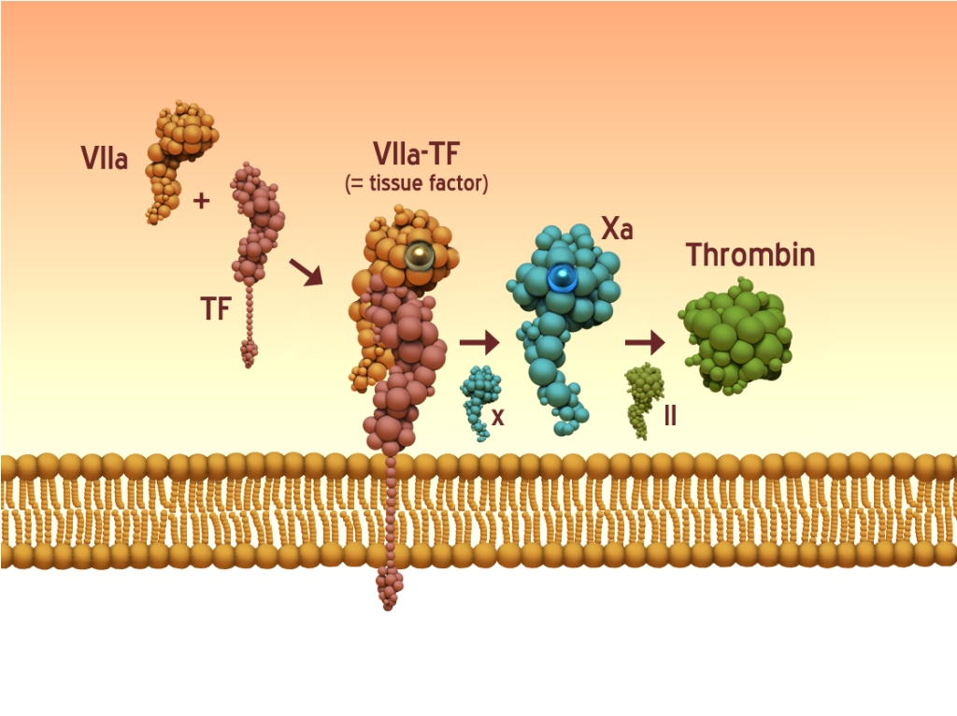
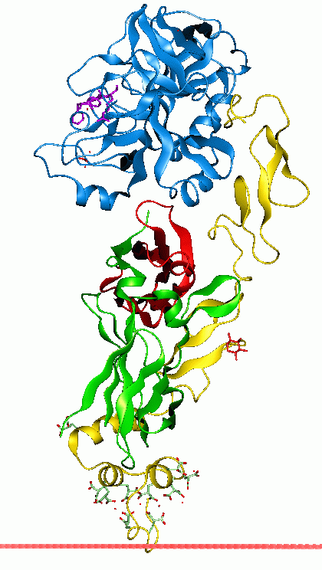
FVII/FVIIa/TF-FVIIa
Activated by
  FIXa
  FXa
  FXIIa
Acts upon (as the TF-FVIIa complex)
  FIX
  FX
Inhibited by (as the TF-FVIIa complex)
  Tissue factor pathway inhibitor
  (TFPI)-FXa complex
  Heparin-Antithrombin complex
  FVII activating protease
  Thrombin
  Plasmin
  TF-FVIIa (autoactivation)
Notes:
Glycosylated, single chain polypeptide, MW about 50kDa
Vitamin-K Dependent
Shortest half-life of the Gla proteins so diminishes the fastest in liver failure or w/ vit K deficiency
Converted to active FVIIa by proteolysis of single peptide bond→two identical chains
Converted by FIXa, FXa, FXIIa, FVII activating protease, thrombin and plasmin
Exposure of blood to TF can form both TF-FVII and TF-FVIIa complexes from circulating FVII
Can also be autoactivated by TF-FVIIa
FVIIa can have a long, circulating plasma half-life, unclear why
Cleave FIX and FX to trigger the clotting cascade
TF-FVIIa complex inhibited by tissue factor pathway inhibitor, (TFPI)-FXa complex and by heparin-AT
When heparin-AT inactivates, it generates a FVIIa-AT complex and regenerate TF
So on picture, TF exposed from injury, active VIIa (or activates VII) and becomes intrinsic tenase, activing X which inturn activates thrombin

Slide 17
FXI/FXIa
Activated by
  FXIIa
  FXIa
  Thrombin
  Platelet membrane interaction
Acts upon
  FIX
  FXI
Inactivated by
  α₁ Protease inhibitor
  C1 inhibitor
  α₂-antiplasmin
  TFPI
  Antithrombin
  Protease necxin 1
  Plasminogen activator inhibitor 1
  Protein C inhibitor
Notes:
Disulfide-linked dimer of 2 identical polypeptide chains, approximately 160 kDa
Circulates complexed with HK, allowing for binding to negatively charged surfaces
Prothrombin may substitute for HK for binding to platelets
Activated by FXIIa, FXIa and thrombin in calcium dependent reactions
Cleavage results in a 160 kDa enzyme w/ two disulfide linked heavy chains and two active site-contianing light chains
FXI binds to the GP Ibα subunit of the platelet GP 1b/IX/V complex allowing for efficient cleavage
Remains surface bound after activation
Activates FIX and FXI
Inactivated by α₁ Protease inhibitor (α₁-PI), C1 inhibitor (C1-INH), α₂-antiplasmin (α₂-AP), antithrombin (AT), protease necxin 1, plasminogen activator inhibitor 1 (PAI-1), and protein C inhibitor (PCI)
If bound to platelets, it cannot be inactivated by α₁-PI
When bound to endothelial cells, protease nexin 2 along w/ heparan sulfate proteoglycans (HSPGs) strongly inhibit FXIa
Of course the deficit of this results in hemophilia C

Slide 18
FIX/FIXa/FIXa-FVIIIa
Activated by
  TF-FVIIa
  FXIa
  Procoagulant surface required
Acts upon (as FIXa-FVIIIa complex)
  FX
  FVII
  Enhanced by binding to endothelium
Inhibited by
  Antithrombin-heparan sulfate proteoglycan
Notes:
Glycosylated, single-chain polypeptide about 55 kDa, requires carboxylation by vitamin K cycle
When bound to a procoagulant surface, activated by TF-FVIIa or FXIa but only the the presence of calcium
Cleaved to 2-chain enzyme, heavy chain responsible for catalytic activity
Functions along with FVIIIa as the FIXa-FVIIIa complex
Activity is enhanced by binding of either FIX, FIXa or FIXa-FVIIIa complex to endothelial surfaces
Activates FX to FXa
FIX along is able to activate FVII in absence of TF
Inhibited by antithrombin-heparan sulfate proteoglycan (AT-HSPG)
A factor IX deficicency results in hemophilia B
One of the more famous people to be afflicted with hemophilia B of course is Tsarevich Alexi of the Romanov empire
At that time, most people died if they had hemophilia as medical care could do nothing for it
It was well recognized to be a disease afflicting primarily royal families and came to be called the royal disease
The romanovs really exhausted many different treatments, eventually took in Gregori Rasputin in attempts to treat their son
Rasputin was an illiterate whose methods of treatment are unclear but have many different theories including hypnosis
His healing capabilities were apparent profound enough for him to garner some influence over the royal family, particular Tsarina Alexandra and developed some influence politically
Although Romanov dynasty fell due to political upheaval and national collapse during WWI, the fall of the Romanovs has become somewhat mystified
Has led to a few fictional depictions, particularly that by Disney in which Rasputin has magical powers and attempts to kill the Romanovs

Slide 19
FVIII/FVIIIa/FIXa-FVIIIa
A complex, single chain with multiple domains
Post-translational processing
  Makes a heavy chain and a light chain
    Connected by vWf
    Degrades rapidly when not associated with vWf
Stored in Weibel-Palade bodies of endothelial cells and α granules of platelets
Notes:
Synthesized as complex, single chain w/ 3 A domains, 1 B domain, and 2 C domains
Post-translational processing results in cleavage at 2 sites making a heavy chain (160-200 kDa) and a light chain (80 kDa) which are connected by vWf
When not associated w/ vWf, degrades rapidly
vWf deficiency associated with low FVIII levels as well
stored to some degree in Weibel-Palade bodies of endothelial cells and α granules of platelets

Slide 20
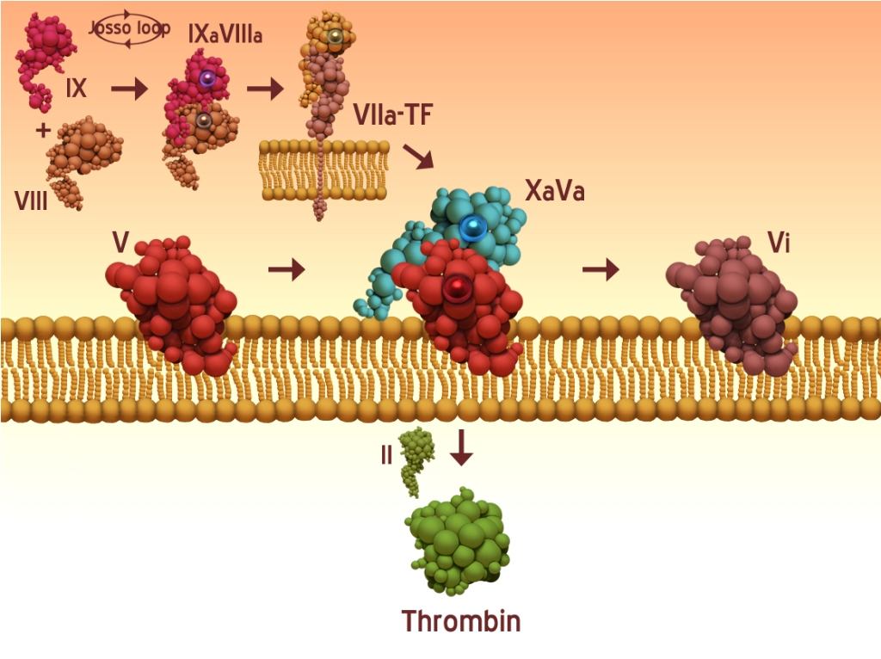
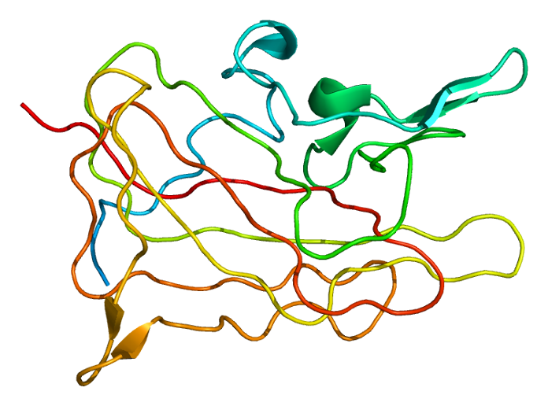
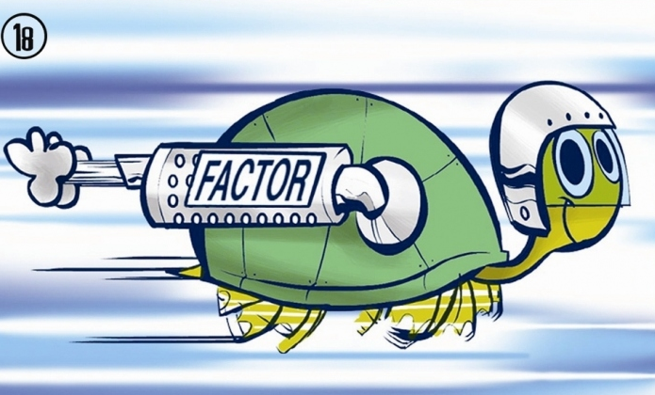
FVIII/FVIIIa/FIXa-FVIIIa
Activated by
  Thrombin
  FXa
Membrane interaction
  Enhances activation and action
  Binding to phophotidylserine
  GP Ib and α_{IIb}β₃ receptors of platelets
Acts upon (as FIXa-FVIIIa)
Inhibited by
  Activated protein C
  FXa
Notes:
Activated by thrombin (predominantly) or FXa
FVIIIa has multiple potential actions
Binding to phophotidylserine
Interaction w/ platelets via GP Ib and α_{IIb}β₃ receptors
Inhibited by vWf
Complexes w/ FIXa to make FIXa-FVIIIa complex, which activates FX to FXa
Inhibition
Inherently labile due to its propensity to dissociate into subunits
Binding to FIXa stabilizes this
Cleared from the circulation by lipoprotein receptor related protein
Cleavage by activated protein C (APC) or Fxa
A factor VIII deficiency results in hemophilia A
TF-VIIa can also activate IX to complex with Acive VIII (which typically gets activated by thrmobin)
This complex enhances the tenase effect and activates more factor X, propagating the thrombin generation

Slide 21
FX/FXa/FXa-FVa
Activated by
  TF-FVIIa (aka extrinsic tenase)
  FIXa-FVIIIa (aka intrinsic tenase)
Acts as prothrombinase complex with FVa
Inhibited by
  AT-HSPG
  TFPI
  Protein Z-dependent protease inhibitor
Notes:
Glycosylated, single-chain polypeptide, about 59kDa, requires post-translational carboxylation by vit K pathway
Activated by TF-FVIIa or FIXa-FVIIIa in presence of calcium
When cleaved forms the prothrombinase complex w/ FVa
Inhibited by
AT-HSPG
TFPI
Protein Z-dependent protease inhibitor: ZPI/PZ
Calcium and phospholipid dependent

Slide 22
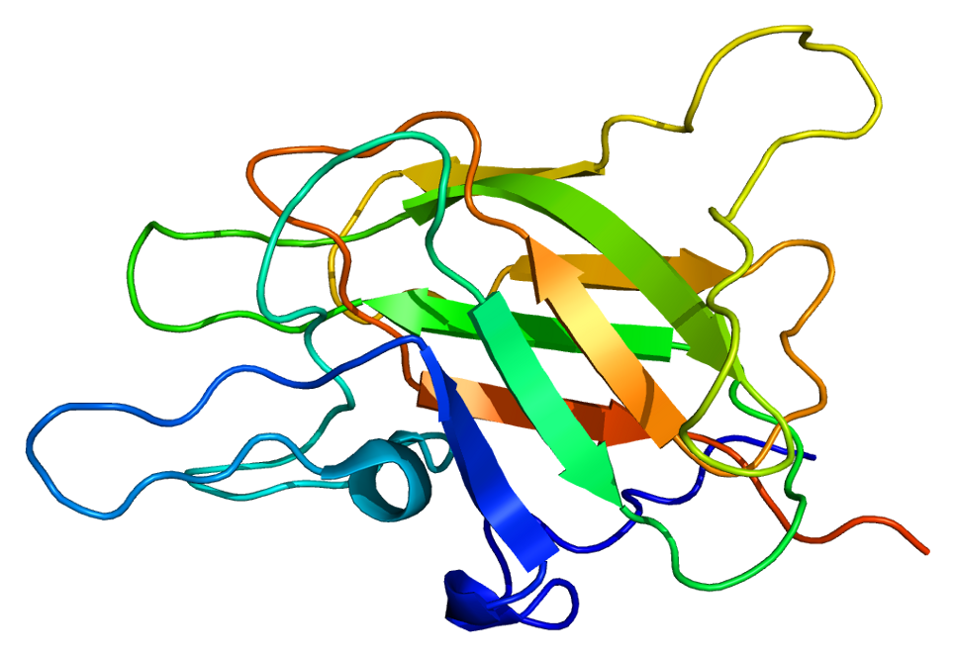
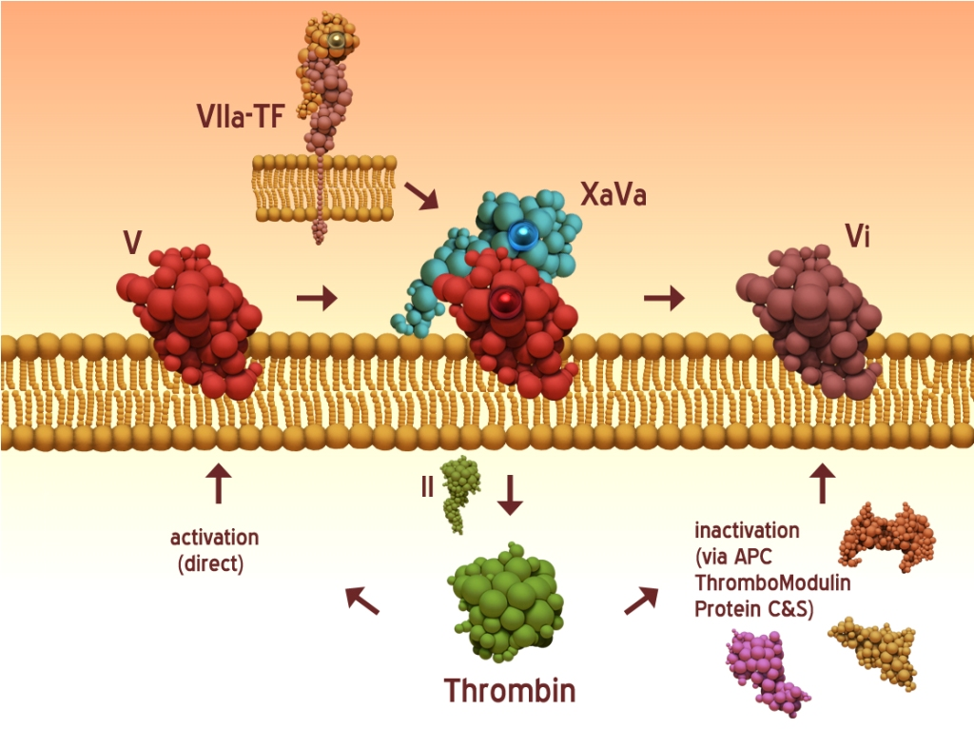
FV/FVa/FXa-FVa
Activated by
  Thrombin
  FXa
Acts upon (FXa-FVa prothrombinase complex)
  Thrombin
  Only on phophatidylserine containing membrane
Inhibition by
  Activated protein C
Notes:
Glycoprotein, approximately 300 kDa
Large portion is contained w/in platelet α granules
Activated by cleavage at two sites by thrombin primarily, also by FXa
Form an enzyme/cofactor complex w/ FXa referred to as the prothrombinase complex
Occurs only in the presence of calcium on phophatidylserine containing membrane surfaces
Binding of FVa to membrane surfaces enhances the affinity of FXa for FVa
Inhibition by proteolysis by APC
So in picture, Active Xa can activeate Va which enhances the activities of Xa

Slide 23
Prothrombin/Thrombin
Prothrombin
  Second most abundant coagulation protein behind fibrinogen
  Activated to α thrombin, by cleavage at 2 sites
Meizothrombin
  Formed from cleavage at one site
  Actions
    Local vasoconstriction by adrenergic activation
    Platelet activation
    Fibrinolysis

Slide 24
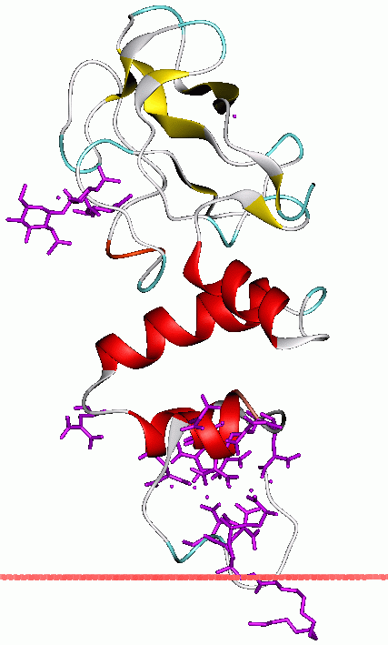
Prothrombin/Thrombin
Contains 4 binding sites
  Na⁺ binding site- structural modification enhances membrane interaction
  Exosite I: binds fibrinogen
  Exosite II: binds heparin and thrombomodulin
  Active site
Acts upon:
  Back-activates FVII, FXI, FVIII, and FV
  Platelet activation
  Fibrin formation
  FXIII activation
Inhibited by
  Antithrombin-heparan sufate proteoglycan complex
Notes:
Produced primarily in the liver
Is a serine protease
Member of the vitamin K-dependent coagulation factor family
Made up of 2 polypeptide chains, A chain-no role
B chain 4 binding sites:
Sodium binding site
Binding of sodium modulates the function of thrombin-creates structure favoring binding w/ procoagulant substrates (fibrinogen, FV, FVIII)
Active site
Exosite I
Binds fibrinogen
Exosite II
Binding site for heparin and thrombomodulin
Very short half-life due to rapid inhibition by AT-HSPG, protected if bound to fibrin clot though
Feedback regulation of coagulation
Back-activates FVII, FXI, FVIII, and FV
Results in further thrombin generation
When bound to thrombomodulin acts to inhibit coagulation by activation of protein C
Also inhibits the interactions between thrombin and fibrinogen
Also promotes activation of TAFI and scuPA
Thrombin also activates platelets
By binding and cleaving protease activator receptor and signaling for platelet activation
Also binds to GP Ib/IX/V complex by binding to GPIbα
Fibrin formation
Thrombin cleaves 2 short peptides from fibrinogen molecule (fibrinopeptide A and fibrinopeptide B)
Exposes binding sites that interact with pre-existing sites on other fibrin molecules
Results in spontaneous polymerization into insoluble fibrin gel
Activation of FXIII
Thrombin very slowly cleaves FXIII unless in the presence of polymerized fibrin
So FXIIIa is generated after the fibrin clot has accumulated
FXIIIa functions as a crosslinkage of fibrin fibrils, critical for normal clot strength and stability
Also crosslinks fibronectin to fibrin and collagen

Slide 25
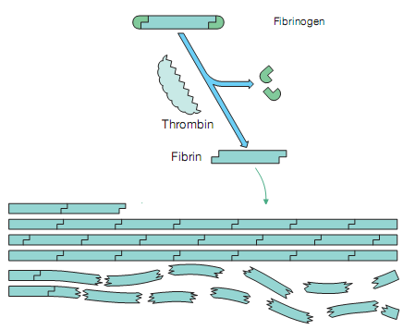
Fibrinogen/Fibrin
Fibrinogen:
  Most abundant coagulation protein in plasma
  Consists of 3 pairs of disulfide-bridge linked polypeptides
  When cleaved releases fibrinopeptide A and B
  Exposes the binding sites allowing for fibrin fiber formation
Notes:
Fibrinogen:
Most abundant coagulation protein in plasma
Consists of 3 pairs of disulfide-bridge linked polypeptides
When cleaved releases fibrinopeptide A and B
Exposes the binding sites allowing for fibrin fiber formation
Calcium is not necessary for this process but it enhances the rate and extent of assembly

Slide 26

Coagulation Inhibitors

Slide 27
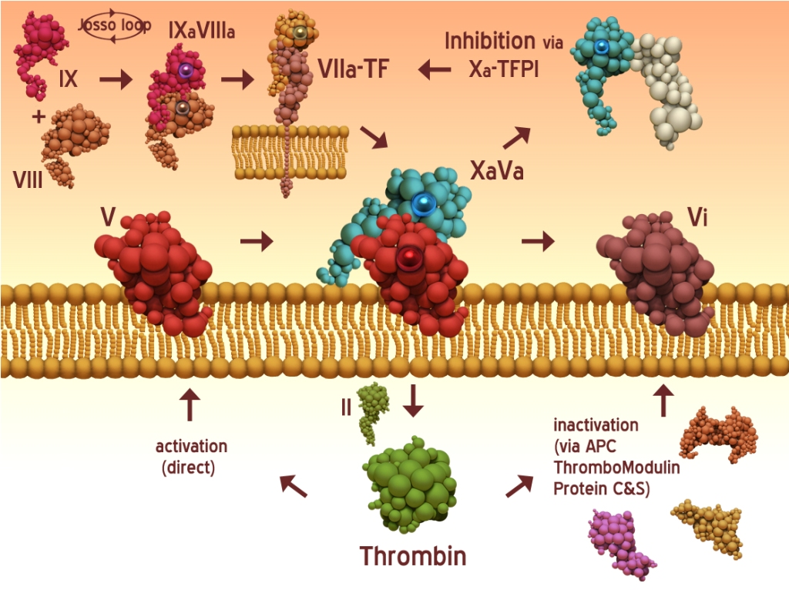
Tissue Factor Pathway Inhibitor
Source
  Bound to the endothelium
  Freely circulating
  Stored in platelets
Two forms
  TFPI-1 inhibits the FXa-TF-FVIIa pathway
  TFPI-2 inhibits trypsin, plasmin, kallikrein and FXIa
2 stage process
  1st TFPI binds & inactivates FXa, requires protein S
  2nd TFPI-FXa forms complex with TF/FVIIa
  Subsequent decrease in thrombin generation
Notes:
Primarily produced in the microvascular endothelium and can be stored in platelets and freely circulating as well as bound to the endothelium
Majority of it is to endothelial cell surface, w/ <10% circulating in the plasma
IV heparin releases bound TFPI
Two forms: TFPIα and TFPIβ (also called TFPI-1 and TFPI-2)
TFPI-1 inhibits the TF pathway
TFPI-2 inhibits trypsin, plasmin, kallikrein and FXIa
Inhibits TF-FVIIa (first domain) and FXa (second domain), a third domain has heparin binding sites
2 stage process:
1st TFPI binds and inactivates FXa
2nd TFPI-FXa forms quaternary complex with TF/FVIIa
then thrombin generation is inhibited
In absence attached of FXa, TFPI only weakly inhibits TF-FVIIa
FXa-FVa complex is protected from TFPI
TFPI also causes monocytes to degrade and internalize TF/FVIIa complexes on their surfaces
On picture Xa activates the TFPI which in turn binds to the VIIa-TF complex and prevents its activity to further propagate X activation

Slide 28
C1-Inhibitor
Causes slow inhibition
Potentiated by glycosaminoglycans
Major inhibitor of FXIIa and kallikrein and downstream protease FXIa
Notes:
Slow inhibitor of target proteases
Potentiated by glycosaminoglycans (ie heparin or heparans)
Major inhibitor of FXIIa and kallikrein and downstream protease FXIa

Slide 29
Thrombomodulin
Interacts with thrombin, altering activity
Production:
  Enhanced by cAMP, thrombin, vascular endothelial growth factor, and platelet factor 4
  Decreased by cytokines, hypoxia, tranforming growth factor β, and neutrophil activation
Actions:
  Inhibits fibrinogen binding to thrombin, slowing fibrin generation
  Enhances thrombin activation of protein C
  Enhances the production of thrombin activatable fibrinolysis inhibitor
Notes:
Endothelial transmembrane molecule
Interacts with thrombin, altering activity
Production:
Enhanced by cAMP, thrombin, vascular endothelial growth factor, and platelet factor 4
Decreased by cytokines, hypoxia, tranforming growth factor β, and neutrophil activation
Actions:
Inhibits fibrinogen binding to thrombin, slowing fibrin generation
Enhances thrombin activation of protein C
Enhances the production of thrombin activatable fibrinolysis inhibitor

Slide 30
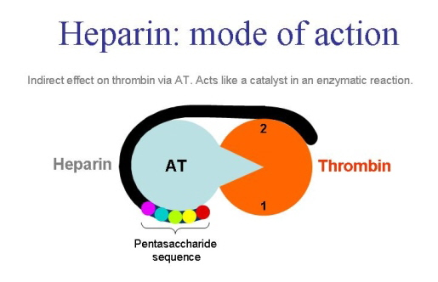
Antithrombin
Activity requires pentasaccharide cofactor
  Heparin
  Heparan suflate proteoglycans
Activity enhanced by thrombomodulin
Activity
  Primarily inhibits thrombin and FXa,
  Also against variety of serine proteases
  FXIIa
  FXIa
  Kallikrein
  FIXa
  FVIIa
Thrombin refractory to AT-heparin if bound to platelets, fibrin clot, or FDPs
/FXa
Notes:
Only acts if bound to a cofactor, which is a pentasaccharide present on several substances including:
Heparin-can enhance AT activity up to 1000 fold
Impact varies w/ heparin structure and the target protease
AT inhibition of thrombin requires heparin molecules of at least 18 sugar units
HSPG
Thrombomodulin-can enhance AT activity 8 fold
When bound to the pentasaccharide, the bait loop becomes available
When active, AT-heparin primarily inhibits thrombin and FXa, also against variety of serine proteases:
FXIIa
FXIa
Kallikrein
Inhibition is potentiated when bound to HK on a cell surface
FIXa
FVIIa
Only if it is bound to TF on a cell surface
Thrombin refractory to AT-heparin if bound to platelets, fibrin clot, or FDPs
Once bound to a target protease it will be cleared by liver by lipoprotein releated proteins

Slide 31
Protein S
Cofactor to activated protein C
Circulates as inactive form bound to C4 binding protein
Inactivated by activated platelets and neutrophils

Slide 32
Enothelial Protein C Receptor
Transmembrane protein on arterial endothelium
Promotes activation of protein C by substituting for negatively-charged phospholipids
Forms a membrane bound complex with APC
Notes:
Complex has no anti-coagulative activity, may contribute to anti-inflammatory effects of APC

Slide 33
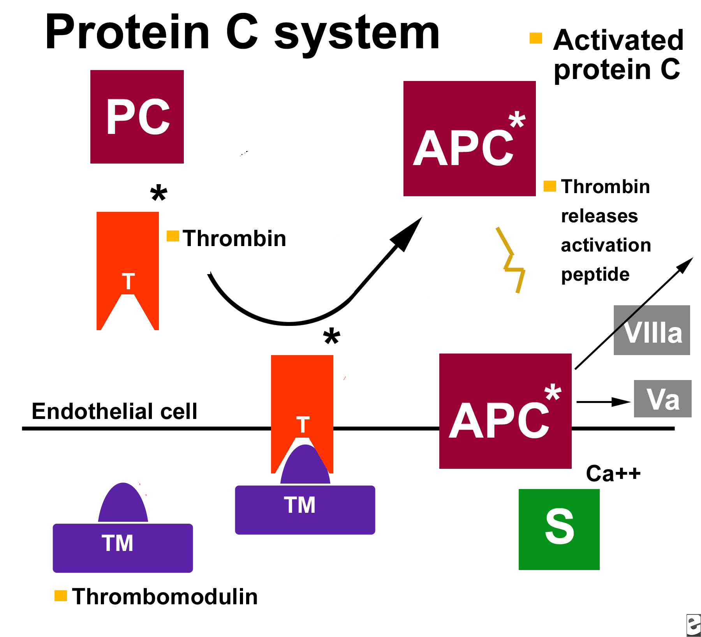
Protein C
Activated by
  Thrombin bound to thrombomodulin
  Meizothrombin bound to APC
  Plasmin activation also produces small amounts of APC
Following activation,
  APC dissociates from EPCR or thrombin-TM complex
  Binds with PS
  APC/PS complex rapidly inactivates FVa, FVIIIa and PAI-1
Inhibited by
  α₁ protease inhibitor
  Protein C inhibitor
  α₂ macroglobulin
Notes:
62 kDa, vitamin K dependent
circulates as a 2 chain zymogen
activated by thrombin (bound to thrombomodulin) or meizothrombin to APC
thrombomodulin inhibits thrombin’s interaction with fibrinogen and protease activated receptors
Thrombomodulin is upregulated by cAMP, thrombin, vascular endothelial growth factor, and platelet factor 4
Thrombomodulin is downregulated by inflammatory mediators (TNF-α, Interleukin-1, endotoxin), hypoxia, transforming growth factor-β, and neutrophil activation
plasmin activation also produces small amounts of APC
calcium dependent and markedly enhanced by negatively charged phospholipid surfaces
Protein S
69 kDa vitamin K dependent protein which interacts w/ membranes
cofactor to APC mediated cleavage of FVa, FVIIIa and for TFPI’s inhibition of FXa
circulates as inactive form bound to C4 binding protein
activated platelets and neutrophils contain proteases that cleave and inactivate PS
Endothelial protein C receptor
Transmembrane protein on arterial endothelium
Can substitute for negatively-charged phospholipids in promoting activation of PC
Forms a membrane bound complex w/ APC
Complex has no anti-coagulative activity, may contribute to anti-inflammatory effects of APC
Upon activation, APC dissociates from EPCR or thrombin-TM complex and binds w/ PS
APC/PS complex rapidly inactivates FVa and FVIIIa and PAI-1 (inhibitor of fibrinolysis)
APC is inhibited by α₁ protease inhibitor, protein C inhibitor and α₂ macroglobulin

Slide 34
Others
Heparin Cofactor II
Protein Z-Dependent Protease Inhibitor
α₁ Protease Inhibitor
Protein C Inhibitor
α₂-macroglobulins

Slide 35
Cells of Hemostasis
Endothelial Cells
Platelets
Tissue Factor Bearing Cells
Microparticles
Cell Surface Membranes

Slide 36
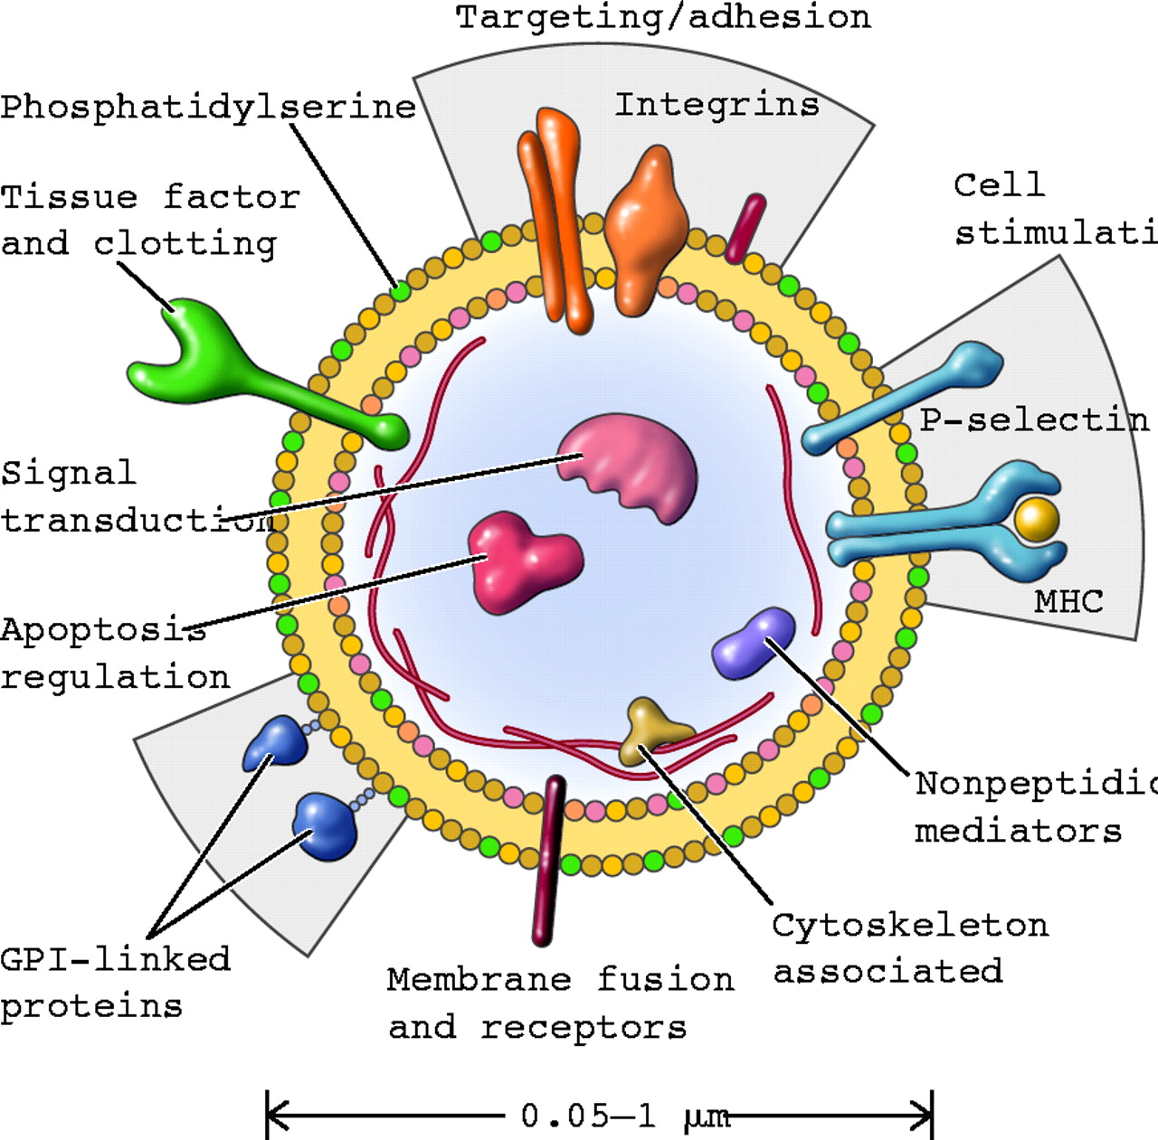
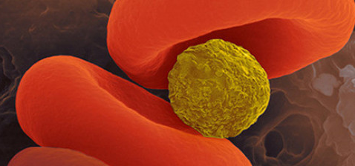
Microparticles
Formation stimulated by cytokines, thrombin, shear stress, and hypoxia
Derived typically from endothelial cells, platelets and monocytes
  When activated or apoptotic cells shed membrane
  In disease may be produced by granulocytes and erythrocytes
Contain cell surface proteins similar to their parent cells
  vWf from endothelial cells
  TF from monocytes

Slide 37
Cell Surface Membranes
Floppase maintains a neutral charged external membrane
  Phosphatidylcholine
Fippase maintains a negatively charged internal membrane
  Phosphatidylserine and phosphatidylethanolamine
Scramblase produced during cell injury and activation stimuli
  Moves phosphatidylserine and phosphatidylethanolamine to the outer membrane
  Phosphatidylserine enhances procoagulant reactions
  Phosphatidylethanolamine enhances phosphatidylserine
Notes:
External membrane normally contains neutral charged substances, particularly phosphatidylcholine
This is maintained by floppase
Internal membrane normally contains negatively charged substances, particularly phosphatidylserine and phosphatidylethanolamine
This is maintained by flippase
Cell injury and or activation stimuli will enhance production of scramblase, which switches phosphatidlserine and phosphatidylethanolamine to the outer membrane
Phosphatidylserine will enhance procoagulant reactions, particularly thrombin activity
Phosphatidylethanolamine enhances the enhancing effects of phosphatidylserine

Slide 38
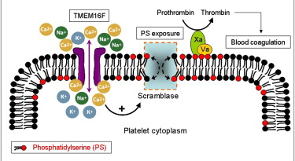
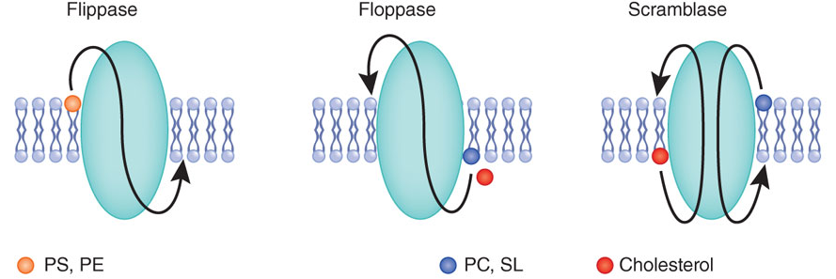
Cell Surface Membranes

Slide 39
Cell Based Model
Initiation
Amplification
Propagation

Slide 40
Initiation
FVIIa/TF complex
  Injury exposes TF in endothelium
  TF activates circulating FVII
  TF-FVIIa complex activates additional TF-FVII to TF-FVIIa
FX activation
  TF/FVIIa complex activates FX
  Freely circulating FXa is inactivated by TFAI
FV activation
  TF/FVIIa/FXa complex activates FVa-very slow
  FXa/FVa/Ca⁺⁺ form prothrombinase complex
  TAFI inactivates TF/FVIIa/FXa complex
FIX activation
  TF/FVIIa complex activates FIX
  FIXa moves to the platelet surface, minimal TFAI inactivation
Thrombin formation (small amounts)

Slide 41
Amplification
Activation of the platelet
  Thrombin binding to surface→procoagulant membrane
  Expression of platelet derived FV on surface
Activation of FV
  Thrombin activates FV to FVa on platelet surface
Activation of FXIII
  Thrombin induced cleavage of FXIII from vWf
  Activation on platelet membrane to FXIIIa
Activation of FXI
  Thrombin mediated activation on platelet surface
Activation of fibrinogen (small amounts)

Slide 42
Propagation
Activation of FIX
  FIXa from initiation phase activates additional FIX to FIXa
Activation of FX
  FVIIIa/FIXa complex mediated, on platelet membrane
Thrombin burst
  FXa/FVa (prothombinase) organizes on platelet surface
  Activation of large amounts of thrombin

Slide 43
Fibrinolysis
Plasminogen
Activation
Inhibition

Slide 44
Plasminogen
Plasminogen
  Normally circulates in the plasma for 2 days after release, synthesized by liver
  Upon activation, transforms to plasmin by cleavage
    Activation is enhanced by fibrin
    Fibrin also localizes the plasminogen to the lysine residues of fibrin monomers
    TAFI removes lysine residues limiting available plasminogen binding sites
Notes:
Plasminogen
Normally circulates in the plasma for 2 days after release, synthesized by liver
Upon activation, transforms to plasmin by cleavage
Activation is enhanced by fibrin
Fibrin also localizes the plasminogen to the lysine residues of fibrin monomers
TAFI removes lysine residues limiting available plasminogen binding sites

Slide 45
Plasminogen/Plasmin
Normally circulates in the plasma for 2 days
Activation enhanced by fibrin
Binding limited by TAFI
Upon activation, transforms to plasmin
  Degrades polymerized fibrin to fibrin degredation products
Notes:
Plasminogen
Normally circulates in the plasma for 2 days after release, synthesized by liver
Upon activation, transforms to plasmin by cleavage
Activation is enhanced by fibrin
Fibrin also localizes the plasminogen to the lysine residues of fibrin monomers
TAFI removes lysine residues limiting available plasminogen binding sites
Free plasmin has a short half-life
Plasmin degrades polymerized fibrin to form heterogenous fragments -fibrin degredation products

Slide 46
Plasminogen Activation
Tissue type Plasminogen Activator
Urokinase plasminogen Activator
Notes:
Tissue type plasminogen activator (tPA)
Serine protease glycoprotein produced and secreted by endothelial cells
Triggered by bradykinin, histamine, acetylcholine, α-adrenergic agonists, and PAF
Primarily bound to PAI-1
Initially secreted as sctPA which has weak enzymatic activity until plasmin cleaves sctPA to form tPA
tPA binds to fibrin and the tPA-fibrin complex cleaves plasminogen to plasmin

Slide 47
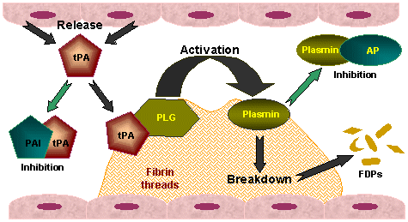
Tissue type plasminogen activator (tPA)
Triggered by bradykinin, histamine, acetylcholine, α-adrenergic agonists, & PAF
Primarily bound to PAI-1
Activated by plasmin
  Initially secreted as sctPA
tPA binds to fibrin and the tPA-fibrin complex cleaves plasminogen to plasmin
Notes:
Tissue type plasminogen activator (tPA)
Serine protease glycoprotein produced and secreted by endothelial cells
Triggered by bradykinin, histamine, acetylcholine, α-adrenergic agonists, and PAF
Primarily bound to PAI-1
Initially secreted as sctPA which has weak enzymatic activity until plasmin cleaves sctPA to form tPA
tPA binds to fibrin and the tPA-fibrin complex cleaves plasminogen to plasmin

Slide 48
Urokinase Plasminogen Activator (uPA)
Made by fibroblast-like cells, epithelial cells, monocytes, and endothelial cells
Activated by plasmin, FXIIa or kallikrein
  secreted as scuPA
uPA able to activate plasminogen in the absence of fibrin
Notes:
Urokinase plasminogen activator
serine protease glycoprotein made by fibroblast-like cells, epithelial cells, monocytes, and endothelial cells
secreted as scuPA w/ little activity until cleaved by plasmin, FXIIa or kallikrein to make uPA
able to activate plasminogen in the absence of fibrin

Slide 49
Fibrinolysis Inhibition
Plasminogen Activator Inhibitor 1
α₂-antiplasmin
Thrombin Activatable Fibrinolysis Inhibitor

Slide 50
Plasminogen Activator Inhibitor 1
Produced by many different cell types
Produced as an unstable, active form in tissues and a latent form in platelets
Stabilized by vitronectin complex
Targets sctPA, tPA and uPA
Also inhibits thrombin, which is enhanced by HSPG

Slide 51
α₂-antiplasmin
The primary plasmin inhibitor
synthesized in liver w/ long half life
Also binds plasminogen and interferes w/ activation
Binds to fibrin making it more resistant to lysis

Slide 52
Thrombin Activatable Fibrinolysis Inhibitor
Activated by thrombin and plasmin
Activation enhanced by thrombin-TM complex
Action
  Inhibits fibrinolysis by removing c-terminal lysines of polymerized fibrin
No known inhibitors

Slide 53
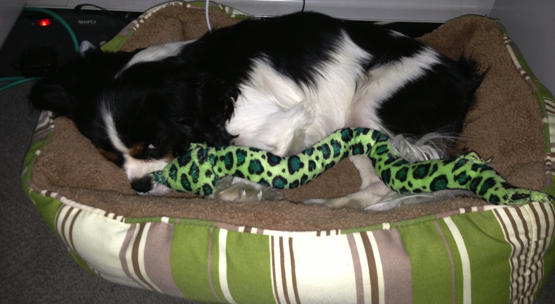
The End
Brisket doesn’t like it when I’m working
Notes:
Brisket, while I was writing this presentation.

