Slide 1
Blood Dyscrasias and Hemotoxins
Josh Smith

Slide 2
Overview
Adverse Drug Reactions
Toxicities

Slide 3
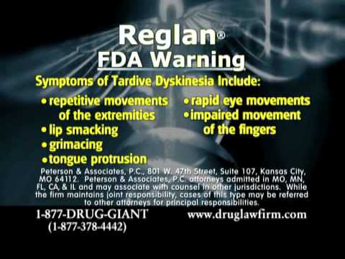
Adverse Drug Reaction
Type A Adverse drug reaction
  Dose dependent
  Preventable
Type B ADR
  Idiosyncratic
  Multifactorial
  Underlying disease (kidney or liver dysfunction)

Slide 4
Adverse Drug Reactions : Hematologic Dysfunction
The most common drug-induced hematologic complications are cytopenias
These cytopenias can be separated into two broad categories
  1. Decreased production in the bone marrow
  2. Increased cell destruction (eg, drug-associated immune-mediated cytopenias).

Slide 5
Adverse Drug Reactions : Hematologic Dysfunction
Pancytopenia
  Drug results in suppression at the level of the pluripotential hematopoietic stem cell
  Generally more complex
Isolated cytopenias
  Specific hematopoietic cell lineage
  Destruction in the circulating pool

Slide 6
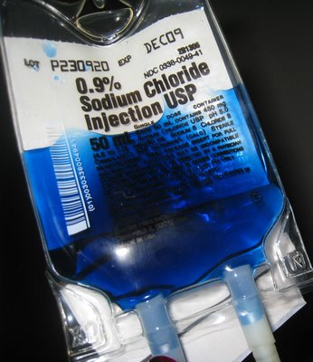
Chemotherapeutics/ Anti-neoplastics
Targets rapidly dividing cells
Rapidly proliferating progenitor and proliferative cells in bone marrow
Type A ADR
Neutrophil and platelet counts usually return to baseline values within 72 – 96 hours after discontinuing therapy

Slide 7
Chemotherapeutics/ Anti-neoplastics
Neutropenia 5 – 7 days after myelosuppression
Thrombocytopenia 9 – 14 days after myelosuppression.
Anemia lags
  Dogs- Neut:8-12 hours Plt: 6-9 days RBC: 100-115 days
  Cats- Neut:8-12 hours Plt:6-9 days RBC: 73 days

Slide 8
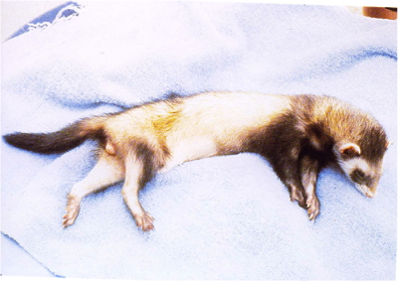
Estrogens
Dog and ferret bone marrow susceptible
Type A ADR and Type B ADR

Slide 9

Estrogens: MOA
Poorly understood
Serum inhibitors of hematopoiesis produced by T cells have been identified
Thymus produced factor that inhibited BM granulocyte-macrophage progenitor cell replication

Slide 10
Estrogens
Therapeutic doses of estradiol or diethylstilbestrol can cause dyscrasia
Doses for mammary tumours cause a transient ↓ in platelet count and neutropenia 10 – 20 days after administration
Administration of a single large dose of estradiol results in dyscrasias

Slide 11
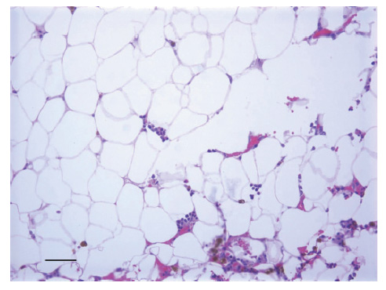
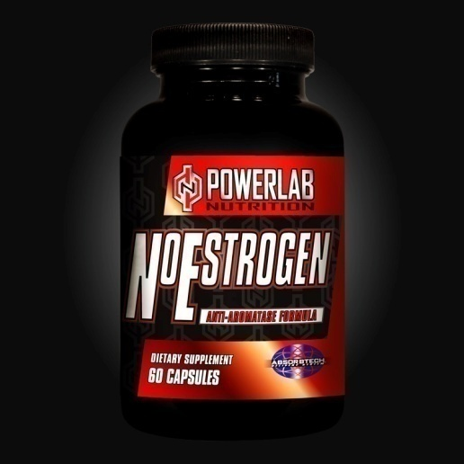
Estrogens
↑ WBC↓RBC, Plt 3 weeks after injection of 1 – 3 mg/ kg estradiol.
Bone marrow aplasia between 3 and 4 weeks after injection
Dogs begin to recover after 4 weeks
Notes:
Leukocytosis, thrombocytopenia, and mild but progressive nonregenerativeanemia develop in the first 3 weeks after injection of 1 – 3 mg/ kg body mass of estradiol.
Pancytopenia with bone marrow aplasia develops between 3 and 4 weeks after injection and most dogs begin to recover after 4 weeks

Slide 12
Sulfonamides
Reported for sulfadiazine, sulfamethoxazole, and sulfadimethoxine
Idiosyncratic syndrome
  Neutropenia
  Thrombocytopenia
  Hemolyticanemia
  Polyarthropathy
  Hepatopathy

Slide 13
Sulfonamides: MOA
Hypersensitivity reaction most likely
Sulfonamideisbioactivated to reactive metabolite
Haptenize tissue proteins and cells
Antigen presentation and T-cell proliferation

Slide 14
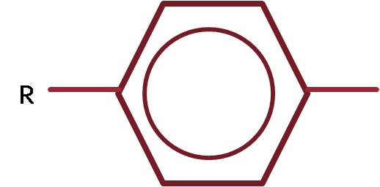
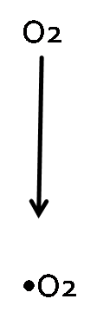
NH2
P450
NHOH
NO
Nitroso Metabolite
Notes:
Directly cytotoxic
Hapten formation

Slide 15
Sulfonamides: MOA
Also immune mediated
Drug dependent anti-platelet antibodies
  GP IIb/IIIa
Positive Coomb’s test
Anemia may also be related to folate deficiency
Notes:
No ANA

Slide 16
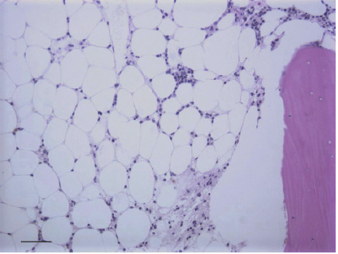
Sulfonamides
Doberman pinschers appear to be at a greater risk
Notes:
TMS for 15 days

Slide 17
Sulfonamides
Incidence of 0.25%
20% are Thrombocytopenic
27% are Neutropenic
Owners report a 25% adverse reaction rate

Slide 18
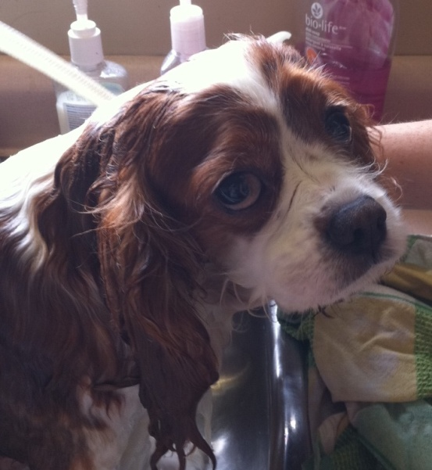
Sulfonamides
Usually resolves within 2 weeks after discontinuing treatment
Recovery 90% of non – thrombocytopenic dogs
Only 63% of thrombocytopenic dogs

Slide 19
Cephalosporins
High dose or prolonged use
  Cefonicid (2nd)
  Cefazedone (1st)
All cell lines can be affected
Can result in aplasticanemia

Slide 20
Cephalosporins: MOA
Immune mediated reaction
Anti-RBC
Anti- Neutrophil
Anti- Platelet
Granulocytic and erythroid maturation arrest

Slide 21
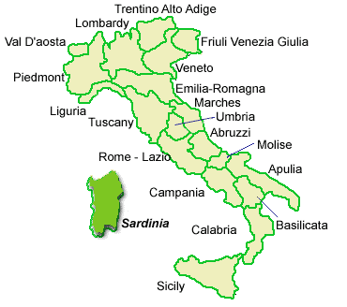
Cephalosporins
Uncommon in our routine use of cephalosporins
History: GiusseppeBrotzu discovered cephalosporins in sewer water off the coast of Sardinia in 1945

Slide 22
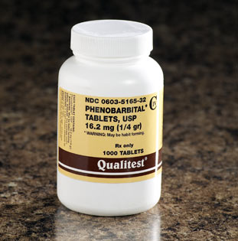
Phenobarbital
May cause only transient, mild thrombocytopenia and neutropenia
Can result in myelofibrosis or myelonecrosis

Slide 23
Phenobarbital: MOA
Direct drug induced myleotoxicity
Presence of granulocyte hyperplasia in bone marrow indicates that the neutropenia is due to destruction of mature granulocytes
Myelonecrosis often resulting in bicytopenia

Slide 24
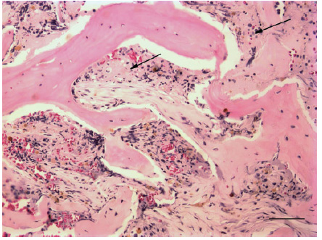
Phenobarbital
Myleonecrosis may lead to myelofibrosis with a non regenerative anemia

Slide 25
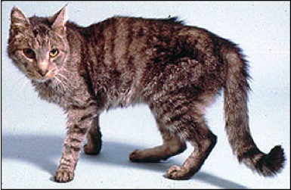
Methimazole
Severe Type B ADR in 3.8% of cats
Agranulocytosis and severe thrombocytopenia
Mild leukopenia in 16.4%
Occur within 1-2 months of beginning treatment

Slide 26
Methimazole: MOA
Immune mediated destruction
True mechanism unknown
Positive Coombs’
Positive fluorescent ANA

Slide 27

Methimazole
Will resolve within 2 weeks of discontinuing treatment
No breed predisposition

Slide 28
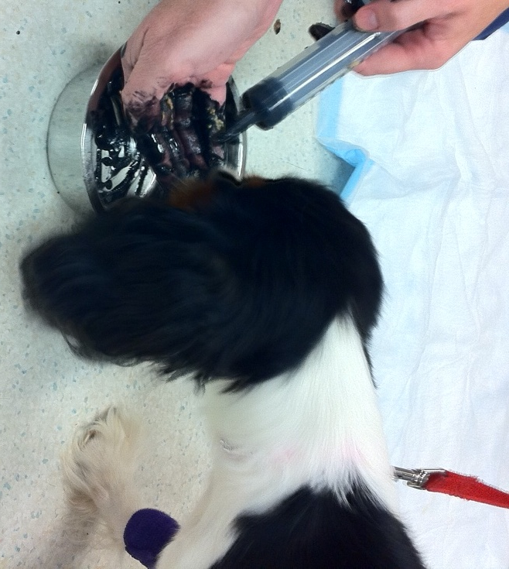
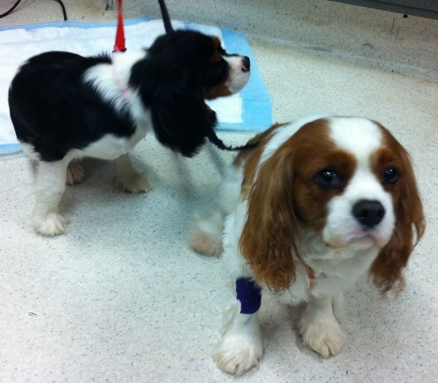
Toxicology: AKA I should not have eaten that

Slide 29
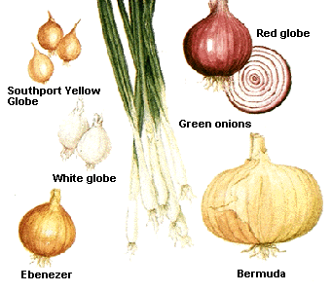
Allium spp.
Onions, garlic, chives, and leeks
Contain propyldisulfides
Can cause Heinz body anemia

Slide 30

Allium spp.: MOA
Onions and garlic readily absorbed through GIT
Contains two toxic compounds
  Disulfides
  Thiosulfates
Metabolism results in free radicals

Slide 31
Allium spp.
Free radicals cause direct cell membrane damage
  Eccentrocytes
Free radicals assault Hgb
  Heinz body
Oxidizes iron associated with heme
  MetHgb

Slide 32

Allium spp.

Slide 33
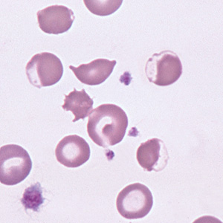
Allium spp.
Metabolism occurs in the liver through multiple oxidase pathways
Results in:
  Eccentrocytes, Heinz bodies, decreased blood oxygen transportation ability, impaired delivery of oxygen to tissues, intravascular and extravascularhemolysis

Slide 34
Allium spp.
Damaged RBCs scavenged by reticuloendothelial system
Excretion through:
  GIT
  Kidneys
  Lungs

Slide 35
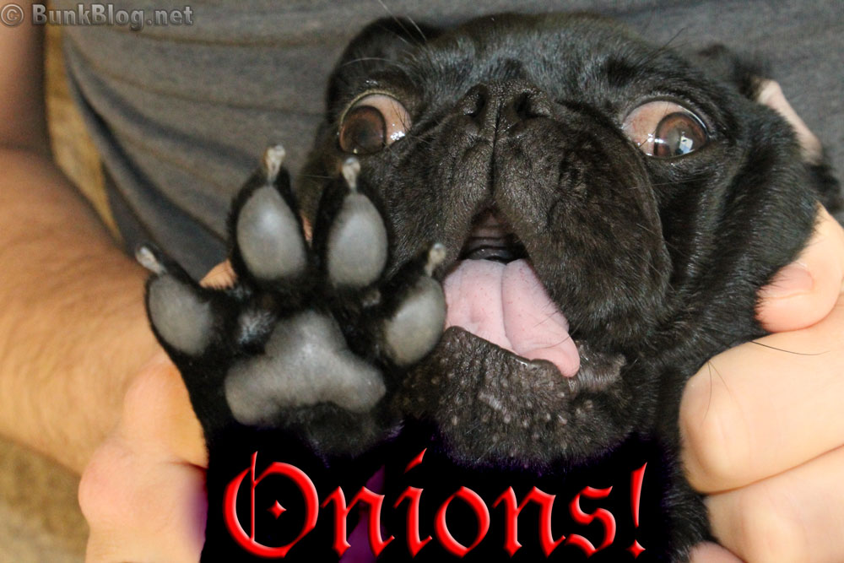
Allium spp.
Can be cooked or raw
Decontamination if ingestion is ≥ 0.5% BW
Toxicity when body’s antioxidants overwhelmed
Notes:
Onions and garlic also contain compounds that are antithrombotic agents,
cardiac and smooth muscle relaxants, vasodilators, and hypotensives, exacerbating
the effects of the anemia

Slide 36
Allium spp.
Cats are more susceptible to oxidative damage of Hgb
  Cats have 8 sulfhydryl groups on hemoglobin , dogs have 4
Dogs have low catalase antioxidant activity in RBC
  More susceptible to oxidative damage from Allium toxicity

Slide 37

Allium spp.
Reduced glutathione concentrations in certain breeds of may predispose them to oxidative damage.
  Akita
  Shibainu

Slide 38
Allium spp.
Signs may not appear for several days
May take 14 days to normalize
Supportive care and standard decontamination recommended

Slide 39
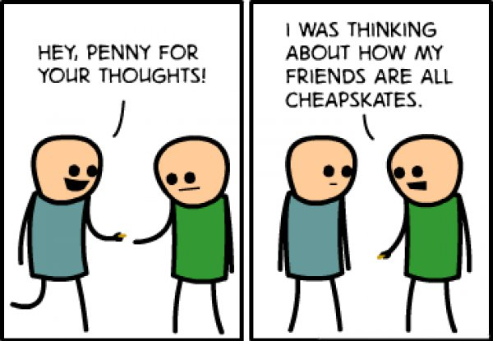
Zinc

Slide 40
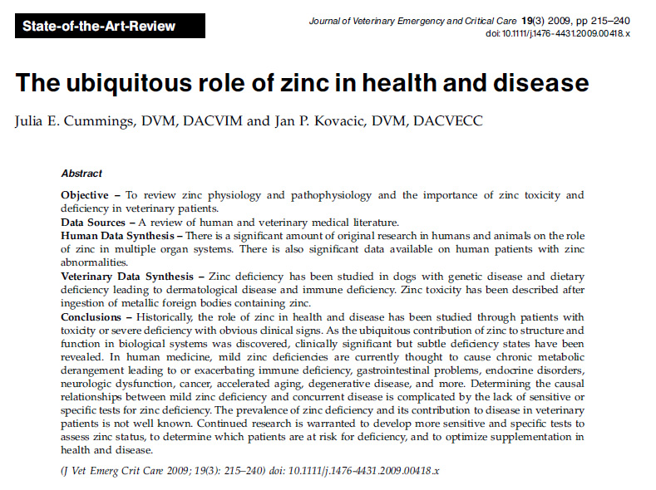
Zinc
An important cofactor for synthesis of over 200 enzymes
Many, many important roles in health and disease
  26 pages worth...

Slide 41
Zinc
An uncommon toxicity but an important differential for acute anemia
The most common cause of Zn toxicity is penny ingestion
U.S. pennies minted after 1982 contain 97.5% Zn
Canadian pennies minted from 1997 through 2001 contain 96% Zn

Slide 42
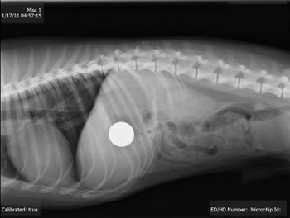
Zinc
Zinc oxide diaper cream rarely causes a problem
Most common exposure is ingestion

Slide 43
Zinc: MOA
Largely unknown
Heinz body formation and spherocytes noted inconsistently
Hemolysis may be associated with zinc inhibition of erythrocyte antioxidant pathways
RBC membrane oxidative damage

Slide 44
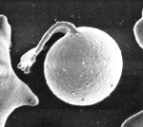
Zinc: MOA
A zinc-induced secondary IMHA hypothesized
  Spherocytosis and positive direct Coomb’s test
Pyknocytes from oxidative damage may also resemble spherocytes

Slide 45
Zinc: MOA
Other systems may be affected:
  Hepatic dysfunction/necrosis
  Pancreatitis
  Coagulopathies
  Acute kidney injury associated with renal tubular injury may occur
Notes:
direct zinc inhibition of FVII, FIX, FXI,
and FXII.234 Renal tubular epithelial necrosis may occur
due to the direct toxicity of zinc ions, intratubular obstruction
with heme pigments, tissue hypoxia

Slide 46
Zinc
Zinc is metabolized in the liver by metallothionein redox cycle
Excreted primarily in feces
Small amount excreted in urine
Urinary excretion enhanced by chelation

Slide 47
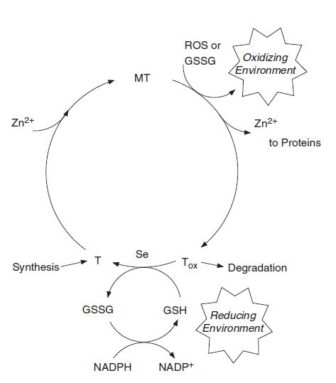
Zinc
Notes:
Metallothioneinredox cycle. Intracellular zinc distribution
is controlled by the coupling of the MT/T and GSH/
GSSH redox cycles. In an oxidizing environment, zinc is released
to proteins such as transcription factors and metalloenzymes
Oxidized T may undergo degradation, or in a reducing
environment such as with an elevated GSH/GSSG ratio, it may
be reduced to T in a reaction enhanced by Se catalysts. MT is
rapidly regenerated with high zinc concentrations. T synthesis
may also be induced by high zinc levels.

Slide 48
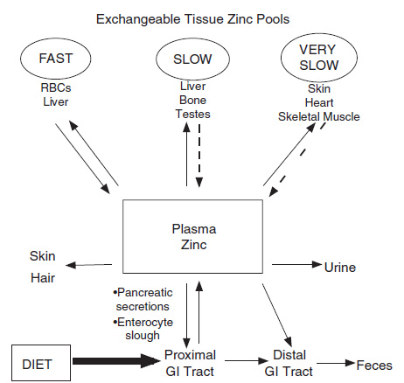
Zinc

Slide 49
Zinc
Toxic dose of Zn salt = 100 mg/kg
~1 penny in a 25 kg dog (2.5g)
Zinc released through degradation by gastric acids
Signs will occur in less than 2 hours

Slide 50
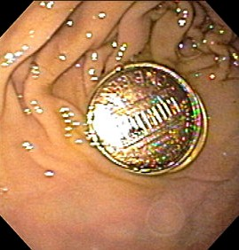
Zinc
Radiography is key
Often note hemolysis on QuATS
Rapid removal of Zn source
  Emesis
  Endoscopy
  Surgery

Slide 51
Zinc
Supportive care afterwards
May require blood transfusion
Ca EDTA therapy controversial
Zn levels should rapidly drop after removal of source
Notes:
Famotidine, metoclopramide
Confounding issues

Slide 52
Zinc
Ca EDTA chelation
100 mg/kg divided into four SC doses per day
Diluted in 5% dextrose in water to reduce local irritation at the site of injection
Enhanced renal excretion
Can directly measure blood Zn levels and trend through hospitalization

Slide 53
Zinc
Prognosis depends largely on response to therapy and confounding illness
Typical hospitalization is 48-72 hrs
Recheck bloodwork in 1-2 weeks after discharge

Slide 54
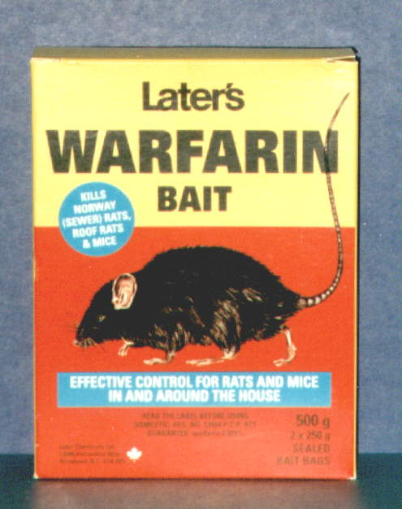
Anticoagulant rodenticide
The development of AR stems from the causative agent of sweet-clover poisoning in cattle- dicoumarol
Warfarin is named after the Wisconsin Alumni Research Foundation(WARF)
It is the first compound marketed as an anticoagulant rodenticide

Slide 55
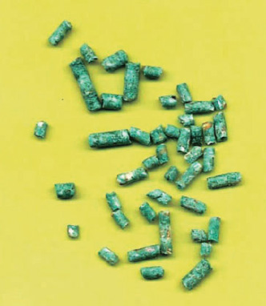
Anticoagulant rodenticide
Second generation anticoagulant rodenticides
  Brodifacoum
  Difethialone
  Bromadiolone
  Developed as rodents developed resistance to the first-generation anticoagulants

Slide 56
Anticoagulant rodenticide
1st generation: <24 hours half life
2nd generation: ~6 days
Generally no clinical signs for 3-5 days
During first 36-72 hours coagulation factors are slowly depleted

Slide 57
Anticoagulant rodenticide
Exposure from environmental ingestion
Malignant poisonings
Ingesting animals who have ingested rodenticide
Concentrates in:
  Plasma
  Liver
  Milk
  Placenta

Slide 58
Anticoagulant rodenticide: MOA
Interfere with the production of the clotting factors II, VII, IX, and X
Works in the liver
Vitamin K1 is converted to vitamin K1 epoxide
Vitamin K1 epoxide reductase converts vitamin K1 epoxide back to the active form of vitamin K1
Repeats over and over to create active clotting factors

Slide 59
Anticoagulant rodenticide: MOA
The anticoagulants inhibit vitamin K1 epoxide reductase
Uncarboxylated clotting factors do not bind calcium sufficiently to participate in clot formation.
Carboxylated clotting factors decline with time after anticoagulant rodenticide exposure to a point after which coagulation function is inadequate.

Slide 60
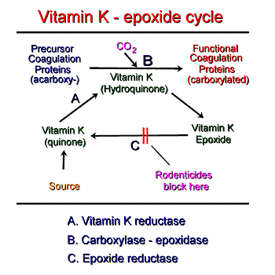
Anticoagulant rodenticide: MOA
Notes:
During the activation of these coagulation factors, vitamin K cycles between quinone, hydroquinone and epoxide forms, in the vitamin K-epoxide cycle (see image below). Vitamin K quinone (the form in which vitamin K is absorbed and stored) is reduced by vitamin K reductase to the vitamin K hydroquinone. This form of vitamin K is used as a cofactor in the gamma-glutamyl carboxylasereaction and is converted in this reaction to the vitamin K epoxide. A vitamin K epoxide reductase then reduces this epoxide to the vitamin K quinone, thus cycling vitamin K back into a form in which it can be used as a cofactor for activation of coagulation proteins. Lack of vitamin K or absence of cycling of vitamin K due to inhibition by rodenticides prevents activation of the vitamin K-dependent factors. The inactive factors increase in the circulation and are called Proteins Induced by Vitamin K Antagonism or Absence (or PIVKAs).

Slide 61
Anticoagulant rodenticide
Many patients present with vague clinical signs
Bleeding from traumatic sites, the gastro- intestinal (GI) tract, or orifices
Abdominal distention, exophthalmia, lameness, bruising, hematomas, or muffled heart sounds are also possible

Slide 62
Anticoagulant rodenticide
Bleeding into the brain or spinal cord may result in severe central nervous system (CNS) disturbances, seizuring, paresis, paralysis, or acute death
Tracheal constriction due to thymic, peritracheal, or laryngeal bleeding may result in severe dyspnea

Slide 63
Anticoagulant rodenticide
Factor VII has the shortest half-life
Leads to an elevation of the PT
PIVKA also becomes increased
PT may be elevated within 36 to 72 hours
As other factors become depleted, elevations in APTT and activated clotting time (ACT) will develop

Slide 64
Anticoagulant rodenticide
Assays can be run to diagnose anticoagulant rodenticide ingestion
Plasma half-life:
  Factor VII – 6.2 hours
  Factor IX – 13.9
  Factor X – 16.5

Slide 65
Anticoagulant rodenticide
Emesis should be induced within 4-8 hours of ingestion
A baseline PT should be run and checked again in 48 hours
Activated charcoal administration

Slide 66
Anticoagulant rodenticide
If clinical then FFP may be administered @ 10-20 mL/kg
SC Vit K1 @ 2.5mg/kg q12 or 5mg/kg once followed by oral Vit K1 @ 3-5 mg/kg divided q12
Give with fatty meal
Treat for 4-6 weeks
Recheck PT 48 hr after last dose

Slide 67
Anticoagulant rodenticide
Difethialone (D - Cease) LD 50 = 4 mg/kg
Brodifacoum: LD 50 = 0.25 – 2.5 mg/kg
Bromadiolone: LD 50 = 11 – 20 mg/kg
Chlorophacinone: LD 50 = 50 – 100 mg/kg
Warfarin: LD 50 = 20 – 50 mg/kg
Diphacinone: LD 50 = 3 – 7.5 mg/kg

Slide 68
Anticoagulant rodenticide
Prognosis is generally good
Up to 90-95% success rate
Nobody like to bleed into their heart, brain or lung

Slide 69
Acetaminophen
Tylenol, Paracetamol
Cox-3 inhibitor
Increases pain threshold by inhibition of chemical mediators that sensitize pain receptors
Antipyretic effects are centrally mediated at the level of the hypothalamus (inhib PG)

Slide 70
Acetaminophen
Toxic dose in cats: as little as 10mg/kg
Dogs: hepatoxicity may be seen with doses from 75 to 100 mg/kg
MetHb may be seen with doses ≥ 200 mg/kg
Rapidly absorbed via oral route within 30 minutes

Slide 71
Acetaminophen: MOA
Metabolism in the liver is completed by three pathways:
  Glucuronidation
  Sulfation
  Cytochrome P -450 mediated oxidation
Small amount is excreted unchanged in the urine

Slide 72
Acetaminophen: MOA
The major pathway converts acetaminophen through conjugation to inactive glucuronide and sulfate
Minor pathway is via p450
Under normal circumstance this minor route produces little NAPQI
In acetaminophen toxicity, the pathway becomes saturated and metabolism shifts to the production of NAPQI

Slide 73
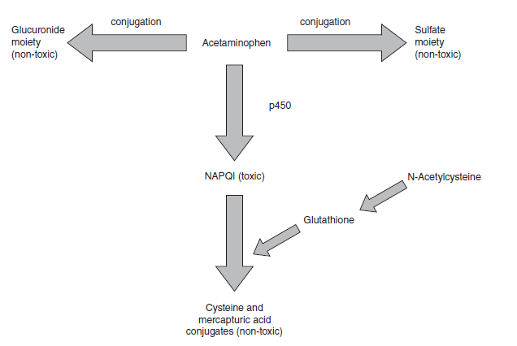
Acetaminophen: MOA

Slide 74
Acetaminophen
Under nontoxic conditions, glutathione is conjugated to NAPQI, which effectively detoxifies it
In toxic conditions, glutathione stores quickly become depleted, leaving NAPQI free to bind to lipid in the hepatocyte membrane and causing hepatocellular necrosis
NAPQI also causes severe oxidative damage to red blood cells by causing the oxidation of hemoglobin to metHb

Slide 75
Acetaminophen
Oxidation of hemoglobin also causes the formation of Heinz bodies
Cats lack glucuronyl transferase, which decreases the amount of metabolism through the major pathway

Slide 76
Acetaminophen
Feline hemoglobin is also unique and contains eight sulfhydryl groups
Feline hemoglobin is more sensitive to oxidation and can form metHb more rapidly with smaller amounts of acetaminophen
In cats, methemoglobinemia may happen rapidly and become fatal before they show signs of hepatotoxicosis.

Slide 77
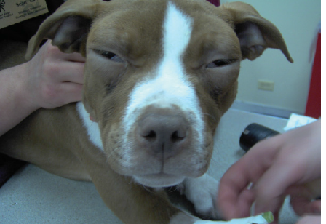

Slide 78
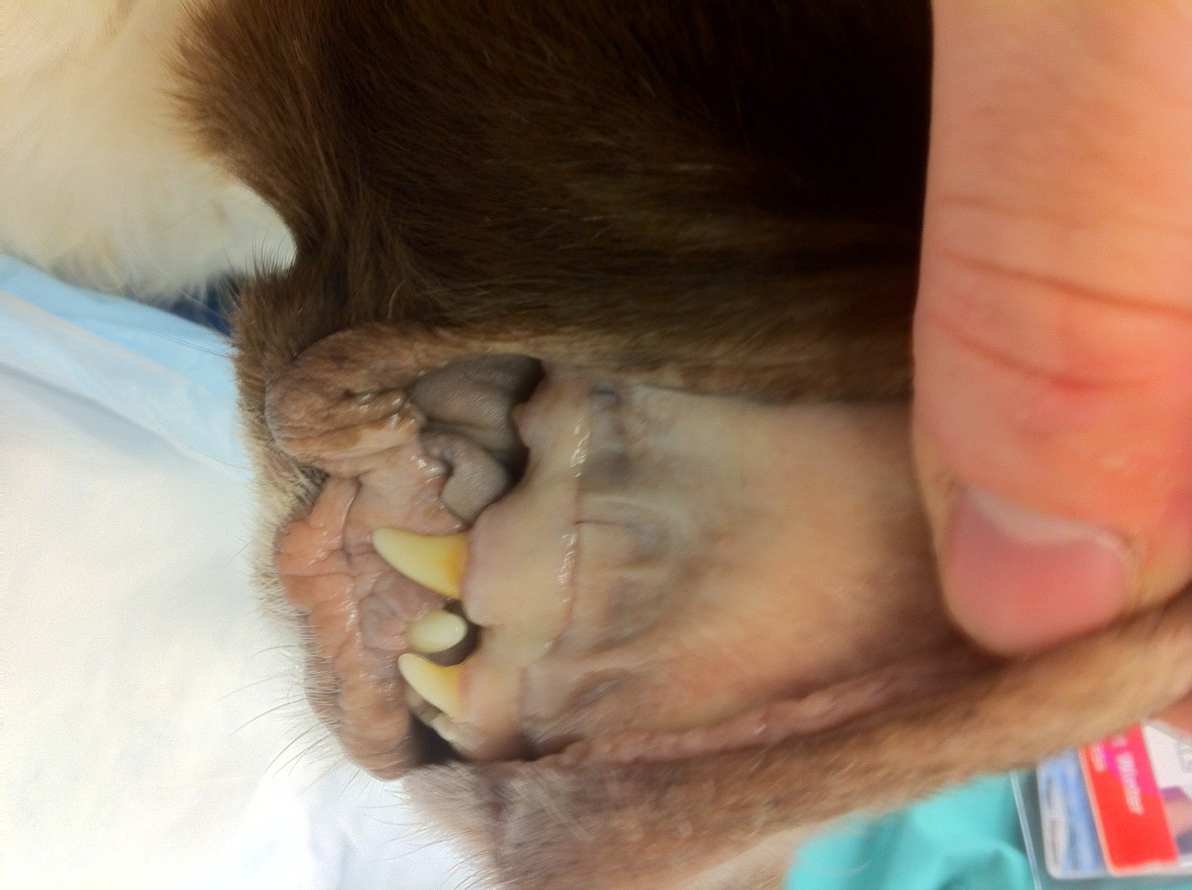

Slide 79
Acetaminophen
Estimate metHb: Place a drop of blood on white filter paper; it looks brown if metHb is > 15 %
Highest level occurs 1 to 3 hours after ingestion

Slide 80
Acetaminophen
Induce vomiting within 2 hours of ingestion if the patient is asymptomatic
Administer activated charcoal with a cathartic once, if ingestion occurred <1 hour prior
Continue activated charcoal every 6-8 hours

Slide 81
Acetaminophen
N - acetylcysteine (Mucomyst)
140 mg/kg PO or IV loading dose
70 mg/kg PO or IV every 6 hours for 72 h
Consider giving 240 mg/kg PO or IV as a loading dose in severe cases
Activated charcoal inactivates N - acetylcysteine if it is given PO

Slide 82
Acetaminophen
Vitamin C (ascorbic acid)
  30 mg/kg PO or SQ every 6 hours
  Facilitate conversion of metHgb to reduced hemoglobin
  Questionable efficacy
Cimetidine
  5 to 10mg/kg every 6 to 8 hours IV, IM
  Reduces metabolism of acetaminophen by the cytochrome p - 450 oxidativesystem in the liver
Feed cats kitten food due to increased sulfhydryl group substrates
S - adenosyl methionine (sAMe; denosyl)
  18 mg/kg PO every 24 hours on an empty stomach

Slide 83
Acetaminophen
Methylene blue (1 mg/kg IV of a 1% solution given every 2 to 3 hours for two to three treatments) can be administered to reduce methemoglobin to hemoglobin
Use with understanding in cats that it can also also cause Heinz body anemia

Slide 84
Acetaminophen
Top prognostic factors
1) Amount ingested
2) Time that treatment is initated
3)Response to treatment

Slide 85
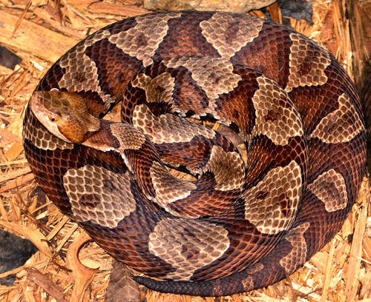
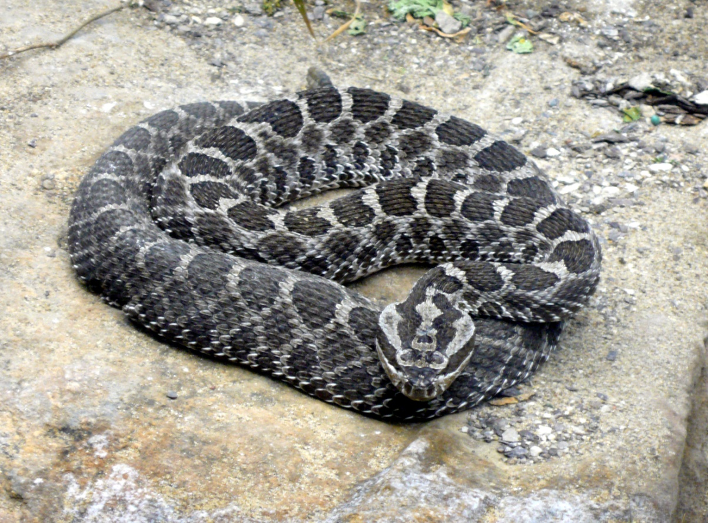
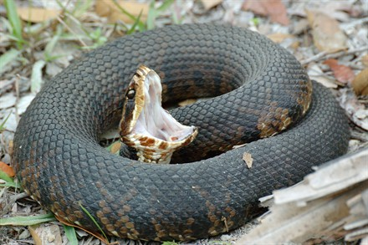
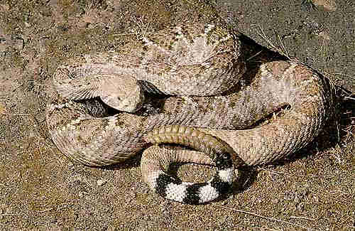
Snake envenomations
Bites from Crotalids (Pit Vipers)
  Copperheads
  Water moccasins
  Massasaugas
  Rattlesnakes

Slide 86
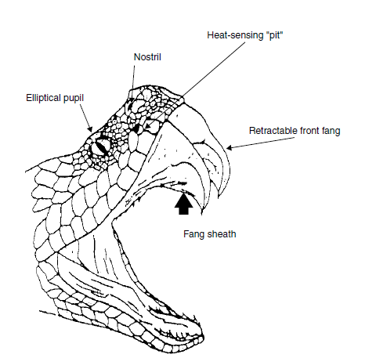
Snake envenomations

Slide 87
Snake envenomations
90% of bites from April to October
Strike at 8ft/sec
2/3 of bites from snakes < 20” in length
1 bite may appear as several
Onset may be delayed up to 6 hours

Slide 88
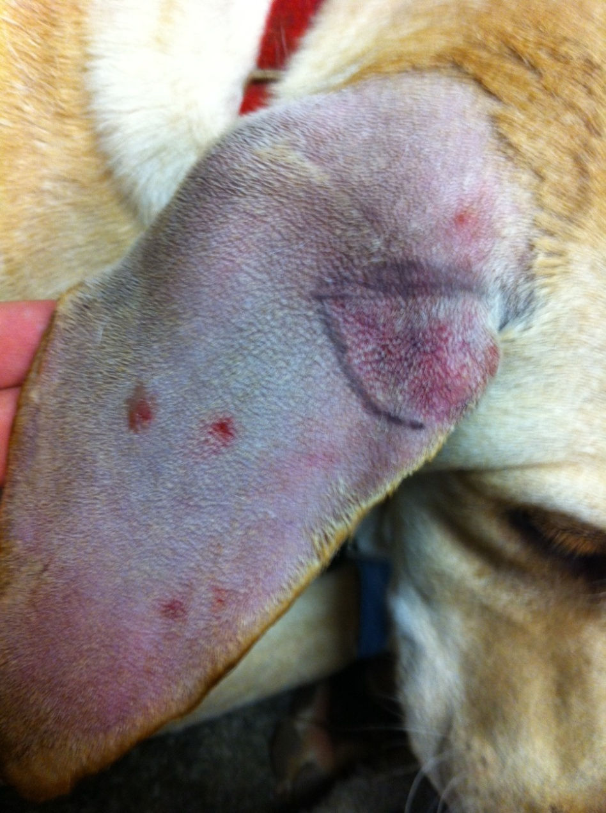
Snake envenomations

Slide 89
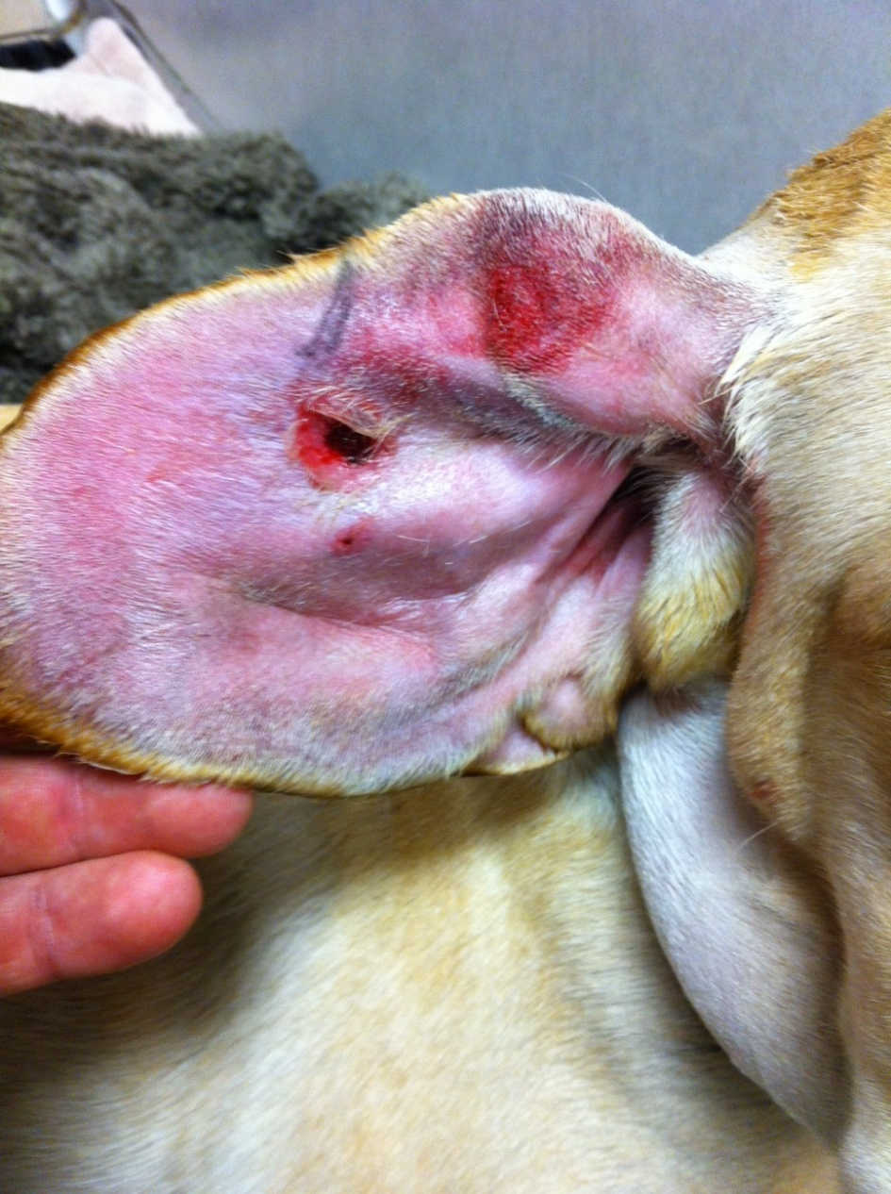
Snake envenomations

Slide 90
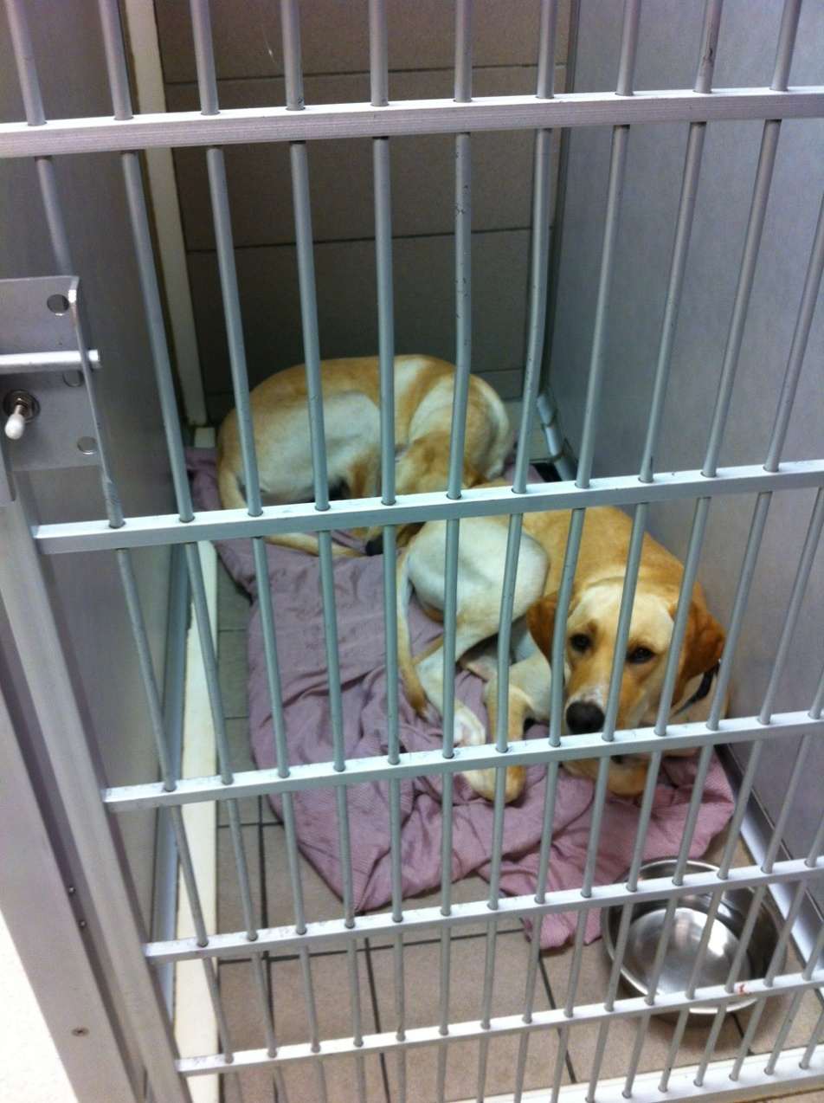
Snake envenomations

Slide 91
Snake envenomations
20-25% of bites will be dry bites
Bite by a juvenile is less likely to be dry
“Agonal bites” more dangerous
Bites in the middle of Summer are more dangerous

Slide 92
Snake envenomations:MOA
VERY Complex
Venom contains over 50 enzymes
Most important:
  Phospholipase A2
  Phosphatases
  Exopeptidase
  Hyaluronidase
  L-amino oxidase

Slide 93
Snake envenomations:MOA
Proteases break down local tissue
RBCs exude into local tissue
Consumption of platelets
  Phospholipase A2 affects RBCs and causes echinocytosis
    89% of cases
  Hemotoxic effect directly on Plt

Slide 94
Snake envenomations:MOA
Rattlesnake and copperhead venoms contain fibrolase that incompletely splits fibrin and degrades fibrinogen without activation of plasminogen
Severe local tissue inflammation and necrosis

Slide 95
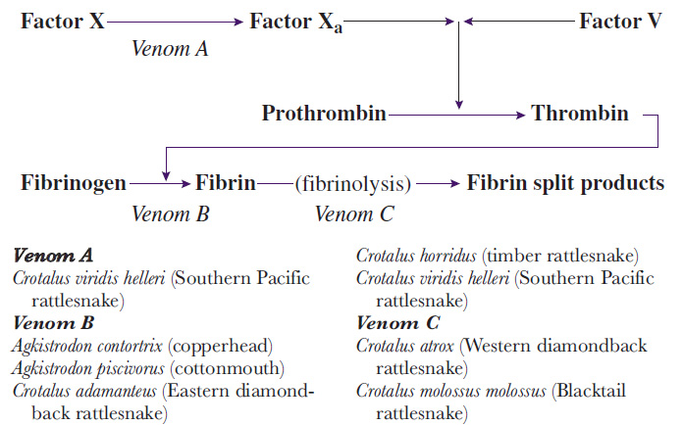
Snake envenomations:MOA

Slide 96

Snake envenomations
The upside:

Slide 97
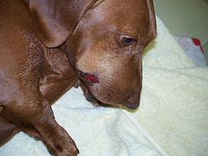
Snake envenomations

Slide 98
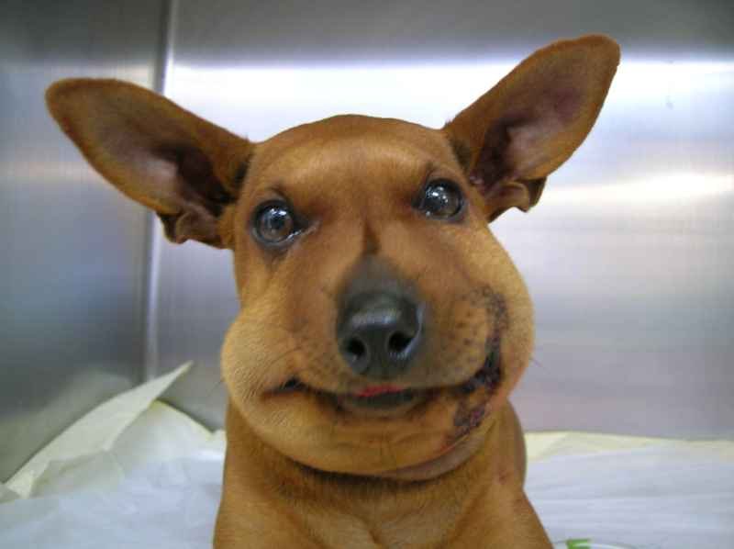
Snake envenomations

Slide 99
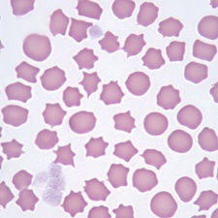
Snake envenomations
CBC + Chemistry
Blood smear
PT/PTT

Slide 100
Snake envenomations
Tx:
Pain medication!
IV fluids
+/- Abx
Hospitalization for at least 8-12 hours
Local wound care

Slide 101
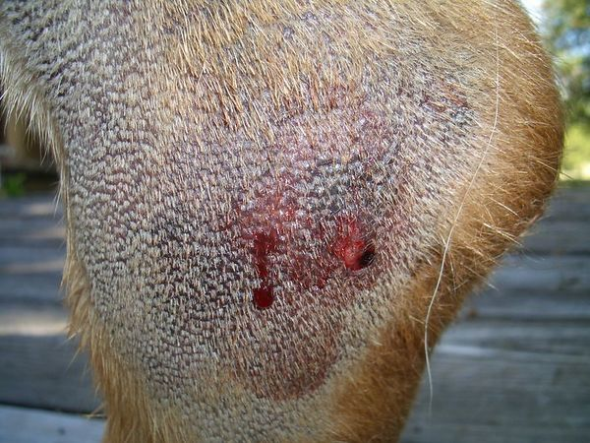
Snake envenomations

Slide 102
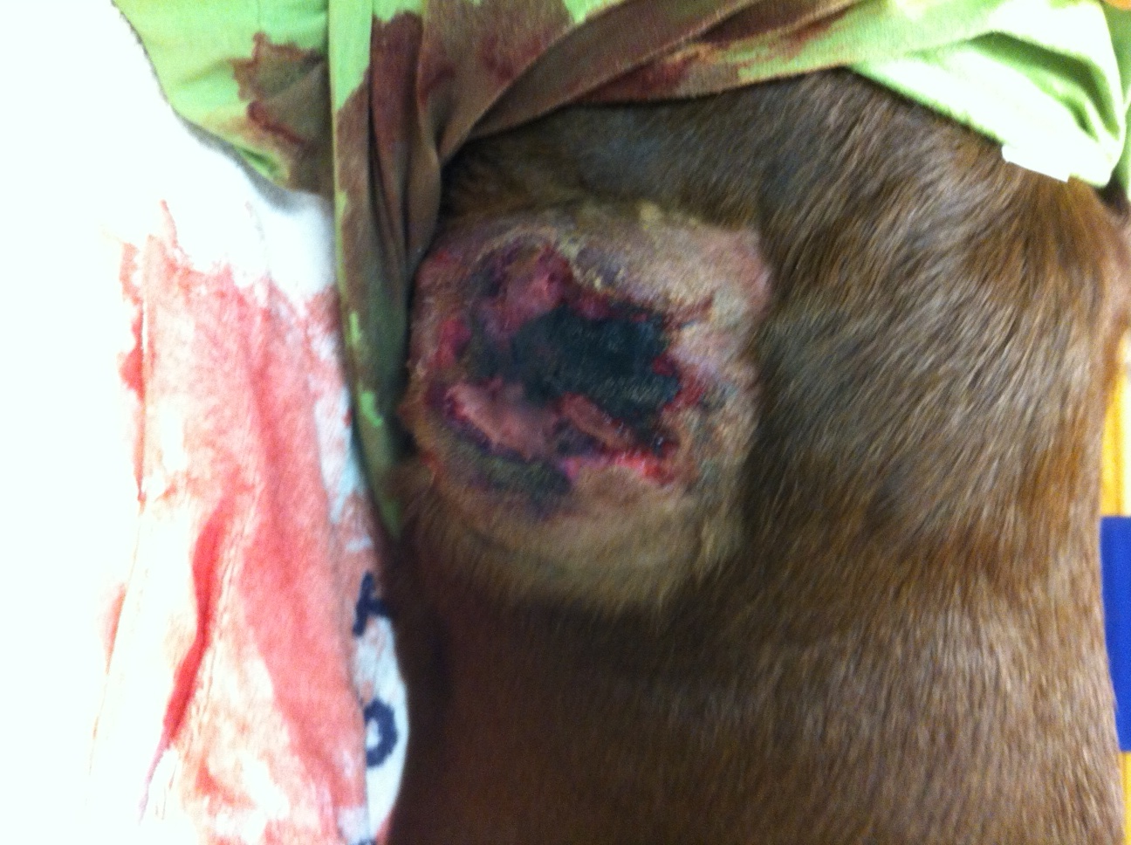
Snake envenomations

Slide 103
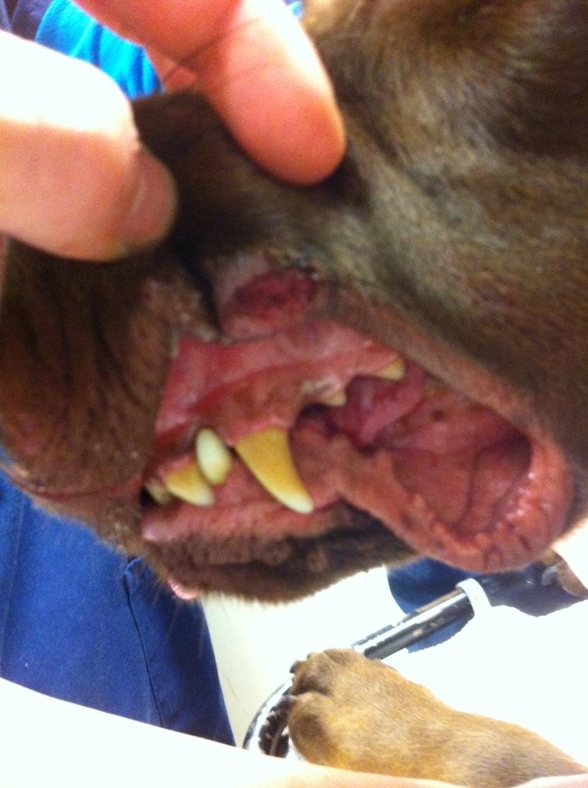
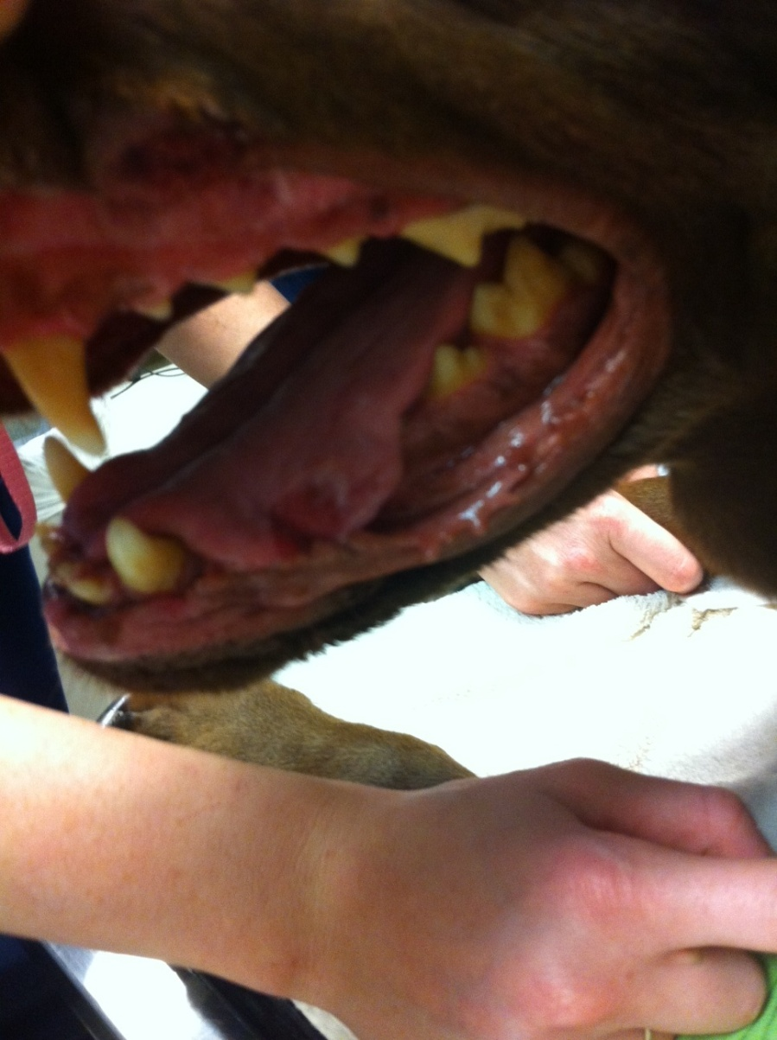
Snake envenomations

Slide 104
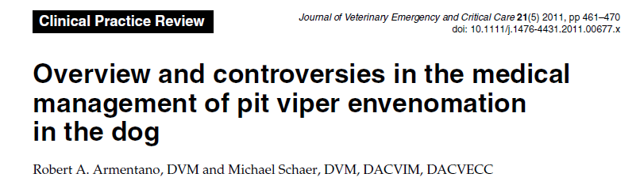
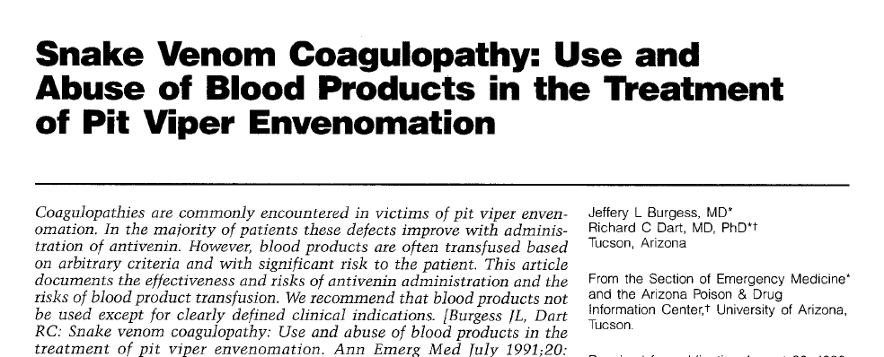
Snake envenomations
To Anti-venin or not to Anti-venin

Slide 105
Snake envenomations
Not necessary for Copperheads
Can use FFP for clotting abnormalities
Rattlesnakes are a different story...
Antivenin is a “true” antidote

Slide 106
Snake envenomations
Diluted antivenom is initially infused slowly
High fraction of equine albumin present
  Anaphylactoid/allergic reactions are a significant concern
Initial vial can be administered in 1-4 hours
Up to 10% reaction
True anaphylactic reactions to antivenin are rare and occur in less than 2%
Serum sickness is a delayed consequence

Slide 107
Snake envenomations
Typically only one vial used/ needed
May require up to 5 vials
Humans receive 4-6
Prognosis is good for Copperhead bites
Overall Crotalid envenomation 1-30% mortality

Slide 108

Fin

