Slide 1
Malt committee
Year END review

Slide 2
Our objective
To identify new technology-based services for the library, especially those technologies that focus on meeting patron needs outside the classroom
Coordinate the implementation of such technologies in specific spaces throughout the library
This year’s focus…the Bissett Space!

Slide 3
Meeting our objectives
What did we need to know?
  Do students use the Bissett Space? How?
  What type of space or environment for collaboration do they prefer? What spaces on or off campus do they currently use and why?
  How do they collaborate with one another on group projects and how would they like to collaborate in an ideal world?
  What do they find difficult about collaborating?
  Are they using any mobile devices for their research or group work?
  What other technology do they currently use and what technology would they like to see in the Bissett Space?
How did we get the information?
  Bissett Space Observations
  Researched Collaborative Software
  Interviewed students about their collaborative study practices and experiences
  Furniture demo
  Survey for TeamSpot & demo’d furniture
  Usability testing for TeamSpot with both students and staff

Slide 4
Results
Staff TeamSpot
Usability Testing
Student TeamSpot
Usability Testing
Steep learning curve
Technical issues – confusing system messages and feedback, lack of mobile device compatibility, PC/Mac compatibility
Better instructions/signage
Lots of little glitches, especially network congestion & PC/Mac compatibility
Steep learning curve
More instruction needed
Confusion with pop-ups and other TeamSpot initiated instructions
Group dynamic issues

Slide 5
Results Continued
Interview & Observation Highlights
  Comfortable furniture
  Whiteboards, whiteboards, & more whiteboards
  2-4 person group size
  They love GoogleDocs (and dropbox)
  LCD screens are crucial for group work and presentation practice
  Noise level too high
  Reservation system
  Presentation practice space
  Like the newness of Mann
  Frequency & type of group project depends of major and college and there are different needs for different types of group work

Slide 6
Survey Responses
TeamSpot Survey
  39 of 61 respondents said yes (some with caveats
  Better instructions/signage needed
  Technical issues including Mac/PC compatibility, non-functionality
  Bissett Furniture Survey
    26 of 29 respondents said yes to the Agati furniture.
    24 of 29 wanted more whiteboards
    Concern over noise and privacy
    Whiteboard markers
    Footrests
    Bissett Space Signage

Slide 7
Summary of Results
More whiteboards!
64% of students were interested in using TeamSpot for their group projects but still highly favored GoogleDocs even though they report issues with GoogleDocs
Comfortable furniture & variety of furniture
Variety of group work spaces
Privacy & noise
Reservation system
Presentation space
Bissett Space?? Where?

Slide 8
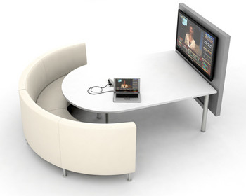
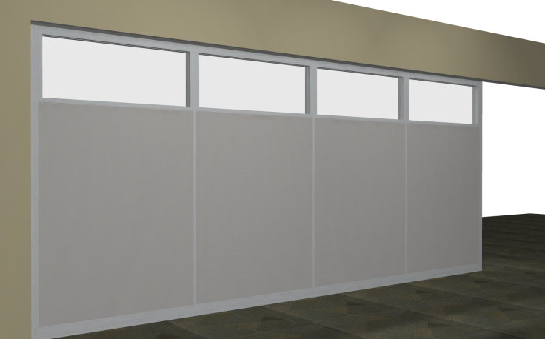
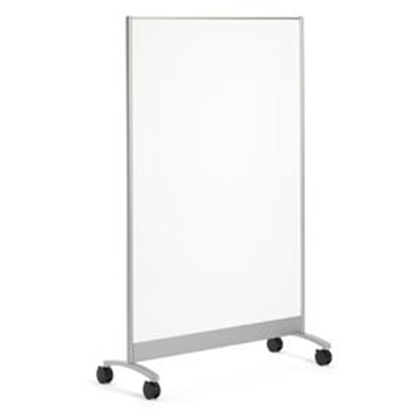


On our wishlist

