Slide 1

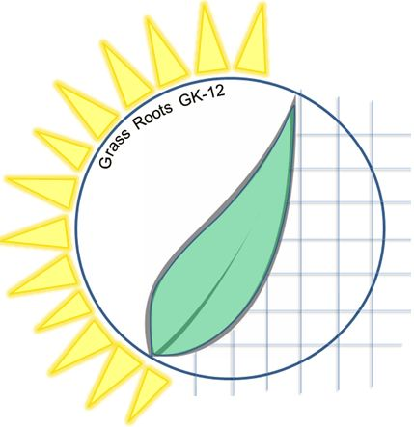
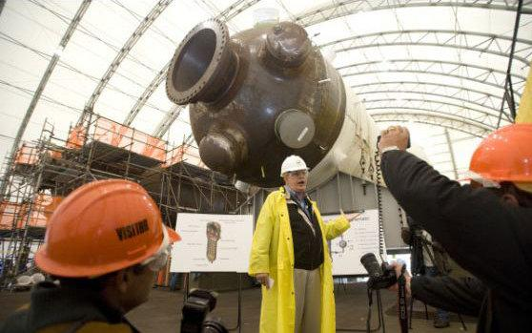
Cornell University Grass Roots GK-12 Program
Advancing Research in Renewable Energy and Cleaner Fuels
Build Me A Grid!
How to Make Electric Power
Ryan Dwyer
Brian Williams

Slide 2
Before We Begin
Cornell University Grass Roots GK-12 Program
Move your cell phone and credit cards to a safe place
The strong magnets you use can damage electronics!!!

Slide 3

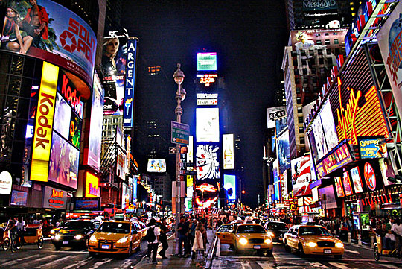
We use electricity every day for
Cornell University Grass Roots GK-12 Program
Computers
Phones
TVs / iPad
Lights
Cars
But we don’t really think about how electricity is made.
Notes:
What do we use electricity for? Brain storm?

Slide 4
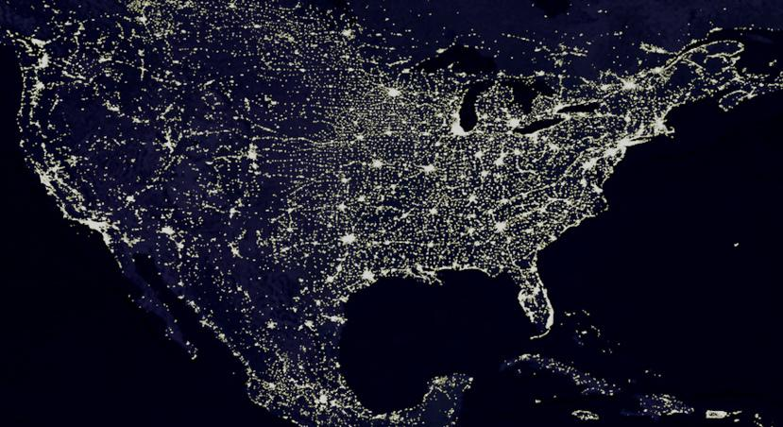
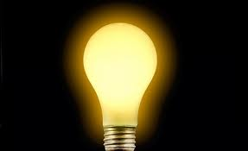
How much electric power does USA need?
Cornell University Grass Roots GK-12 Program
500,000,000,000 Watts
or 500 GigaWatts
A standard lightbulb takes 60W….
Notes:
Just Tell them..

Slide 5
But how do we produce that much electric power?
Cornell University Grass Roots GK-12 Program
Notes:
Wind Turbine : http://diyselfsufficient.com/wp-content/uploads/2012/09/horizontal-wind-turbine.jpg
Diagram : http://deskarati.com/2012/03/01/wind-turbine-design-construction/

Slide 6
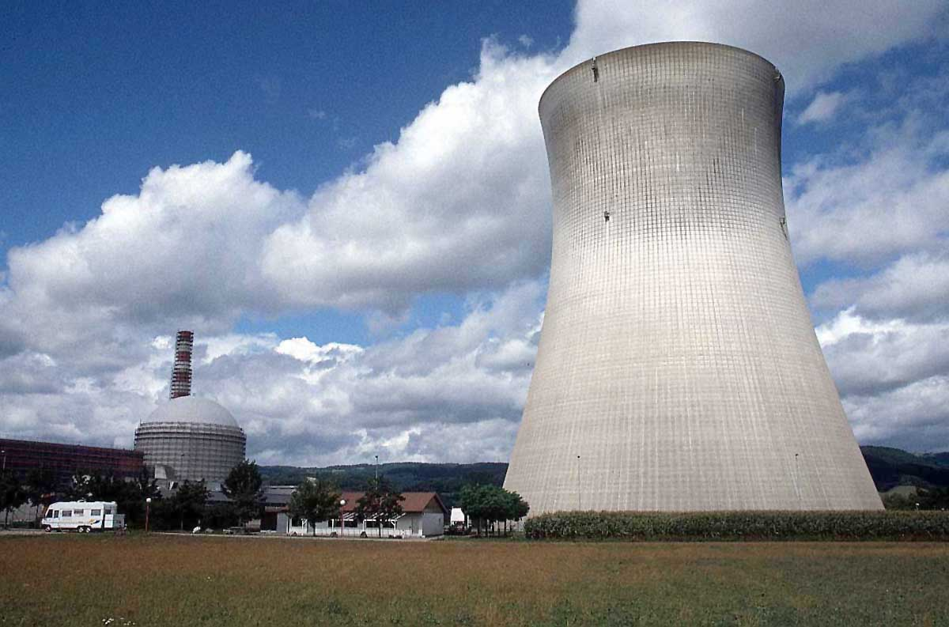
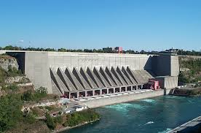
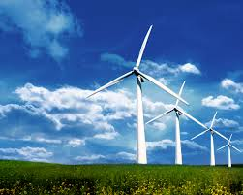
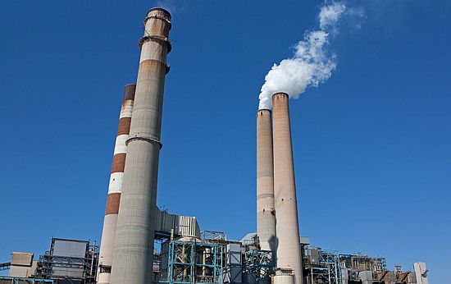
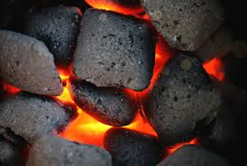
But how do we produce that much electric power?
Cornell University Grass Roots GK-12 Program
What do they have in common?
Notes:
Wind Turbine : http://diyselfsufficient.com/wp-content/uploads/2012/09/horizontal-wind-turbine.jpg
Diagram : http://deskarati.com/2012/03/01/wind-turbine-design-construction/

Slide 7
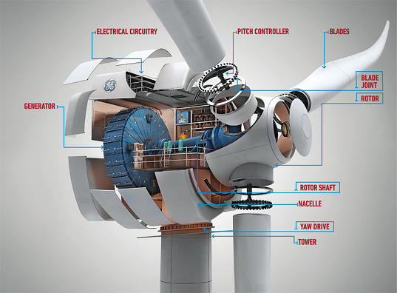
Turbines!
Cornell University Grass Roots GK-12 Program
Water (Hydro power)
Spinning a turbine generates electricity.
Notes:
Wind Turbine : http://diyselfsufficient.com/wp-content/uploads/2012/09/horizontal-wind-turbine.jpg
Diagram : http://deskarati.com/2012/03/01/wind-turbine-design-construction/

Slide 8
Turbines!
Cornell University Grass Roots GK-12 Program
Air (Wind power)
Spinning a turbine generates electricity.
Notes:
Wind Turbine : http://diyselfsufficient.com/wp-content/uploads/2012/09/horizontal-wind-turbine.jpg
Diagram : http://deskarati.com/2012/03/01/wind-turbine-design-construction/

Slide 9

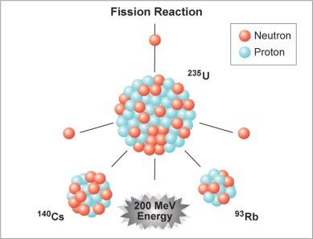
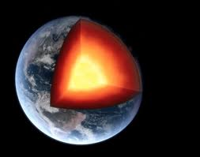
Turbines!
Cornell University Grass Roots GK-12 Program
Boil Water
Steam
Heat
Spinning a turbine generates electricity.
Nuclear
Coal
Geothermal
Notes:
Wind Turbine : http://diyselfsufficient.com/wp-content/uploads/2012/09/horizontal-wind-turbine.jpg
Diagram : http://deskarati.com/2012/03/01/wind-turbine-design-construction/

Slide 10
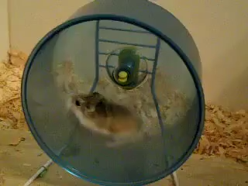
Cornell University Grass Roots GK-12 Program
Renewable energy: Hamster power!?
If we used hamsters to turn the turbines…
USA needs 500,000,000,000 W
One hamster = 0.8 W
USA would need 625,000,000,000 hamsters spinning the wheels that fast, 24/7.
Notes:
http://www.youtube.com/watch?v=C-q9mETKltY

Slide 11
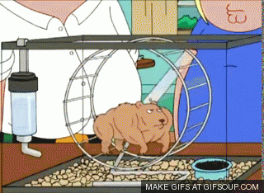
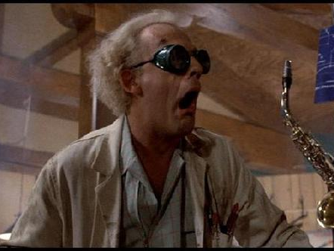
Cornell University Grass Roots GK-12 Program
That’s a lot of hamsters!
Hamsters will be buff…
Notes:
Just changed electricity to electric power. I love this slide (even if they are too young to perhaps get the movie reference….)!

Slide 12
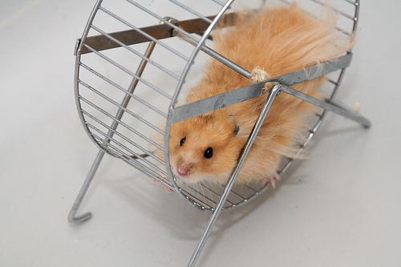
Cornell University Grass Roots GK-12 Program
How many hamsters per person?

Slide 13
Cornell University Grass Roots GK-12 Program
How many hamsters per person?

Slide 14
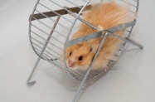
Cornell University Grass Roots GK-12 Program
How many hamsters per person?

Slide 15



Cornell University Grass Roots GK-12 Program
How many hamsters per person?
2000 per person!
Actual Size

Slide 16
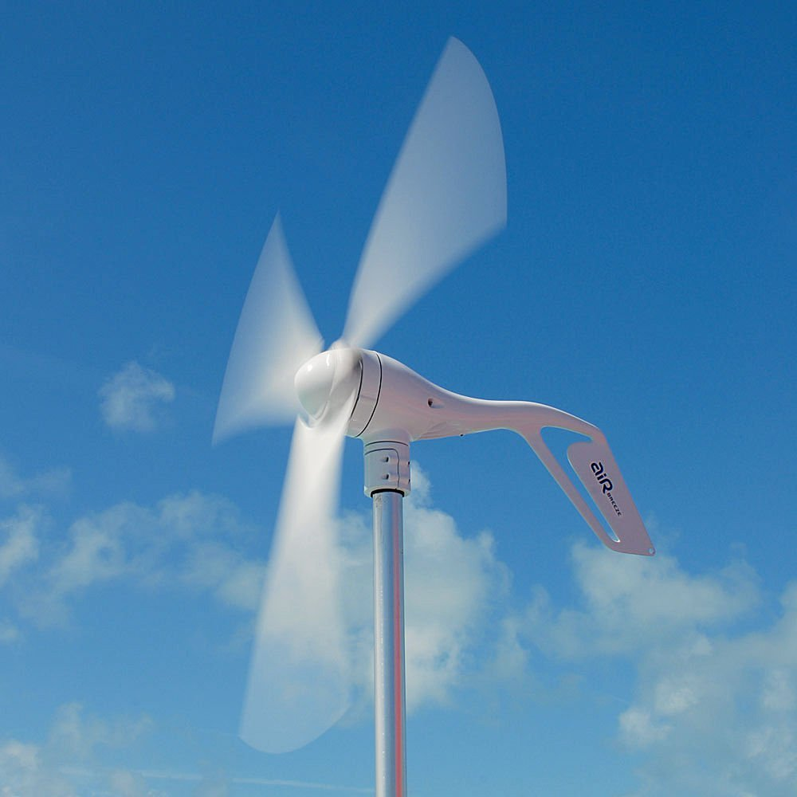
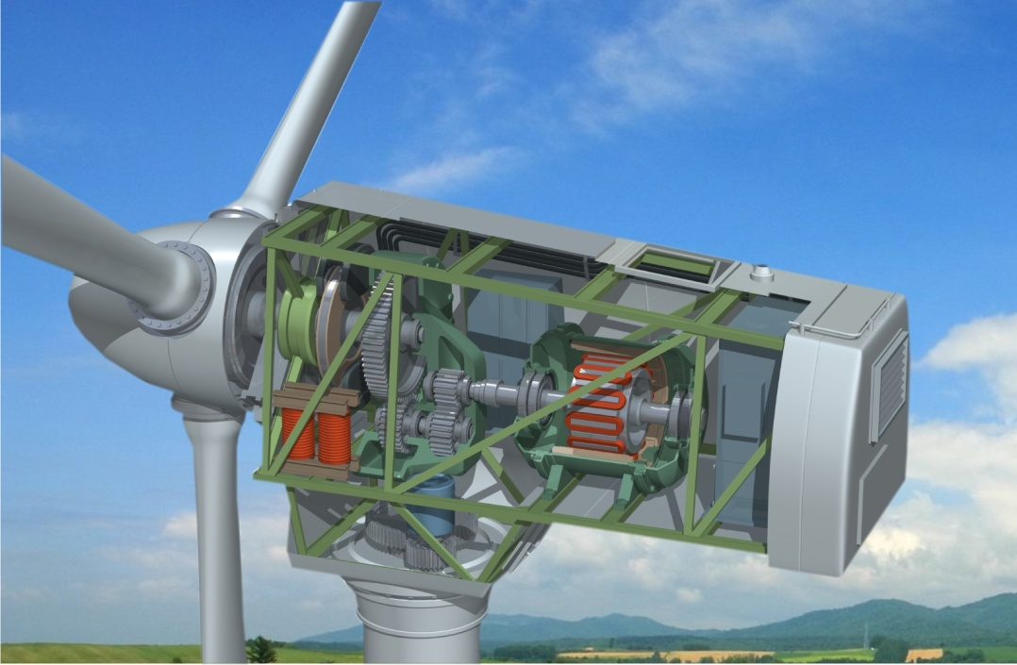
But how does a generator work?
Cornell University Grass Roots GK-12 Program
WIND
?
How?
Hint: Electricity involves moving electrons across a wire (“electrical current”).
Notes:
Wind Turbine : http://diyselfsufficient.com/wp-content/uploads/2012/09/horizontal-wind-turbine.jpg
Diagram : http://deskarati.com/2012/03/01/wind-turbine-design-construction/

Slide 17
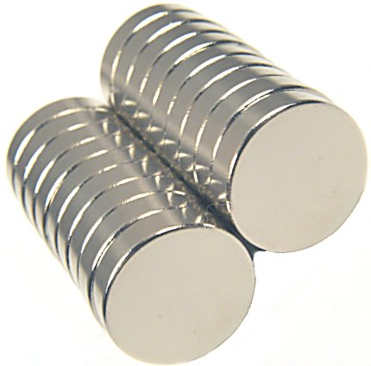
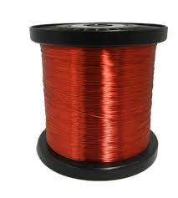
Task 1: Discovering Electricity
Cornell University Grass Roots GK-12 Program
Given a coil of wire that is connected to a multimeter, try to make the voltage readout change using the magnet.
Magnets
Wires
Voltage should fluctuate 0.1 mV
+
→
You Have 10 Min

Slide 18
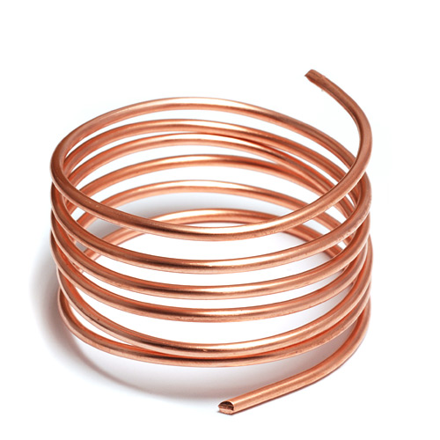
Hint!
Cornell University Grass Roots GK-12 Program
Move magnet across a coil of wire. Which direction works better?
S
N
S
N

Slide 19
Cornell University Grass Roots GK-12 Program
So why does moving a magnet generate electricity?
Electricity is generated by the movement of electrons.
How can you move electrons?
Wire
Nucleus
Electron
cloud

Slide 20
Cornell University Grass Roots GK-12 Program
So why does moving a magnet generate electricity?
S
Move Magnet
N
Move Electron
Notes:
http://www.qrg.northwestern.edu/projects/vss/docs/power/2-whats-electron-flow.html

Slide 21
Cornell University Grass Roots GK-12 Program
So why does moving a magnet generate electricity?
S
Move Magnet
Generate more power
N
Move Electron
Notes:
http://www.qrg.northwestern.edu/projects/vss/docs/power/2-whats-electron-flow.html

Slide 22
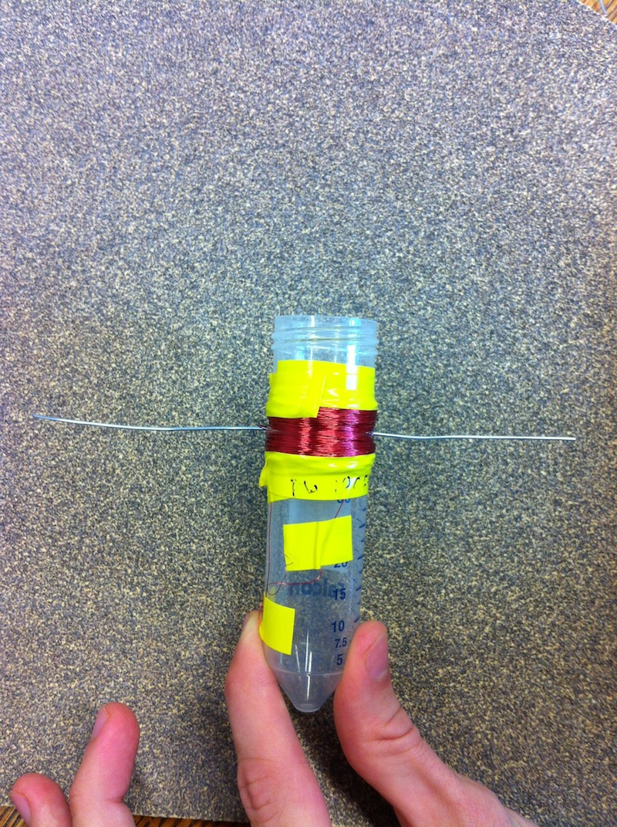
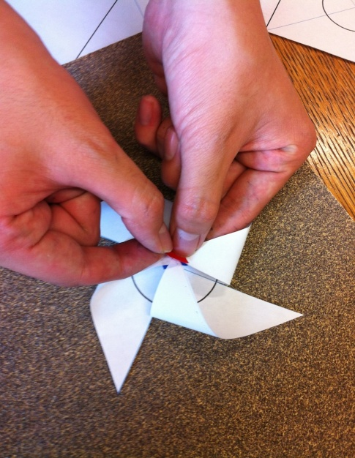
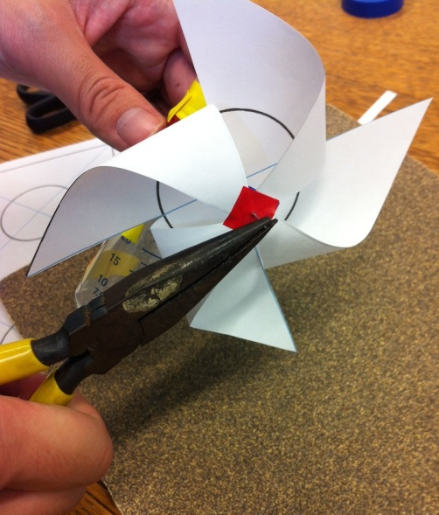
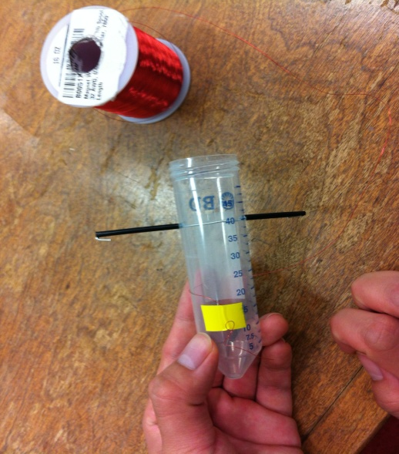
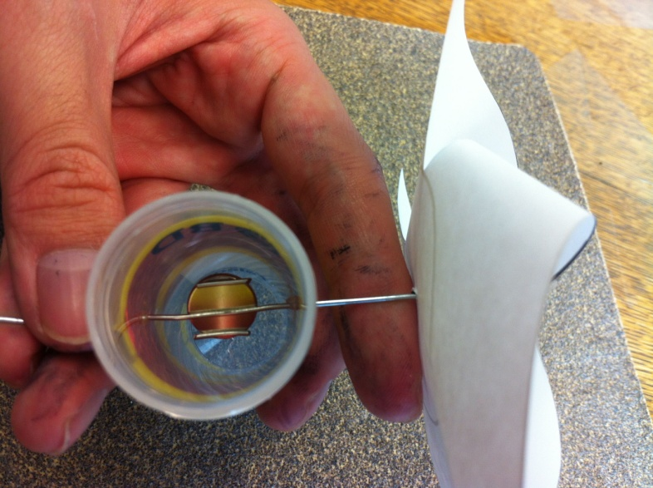
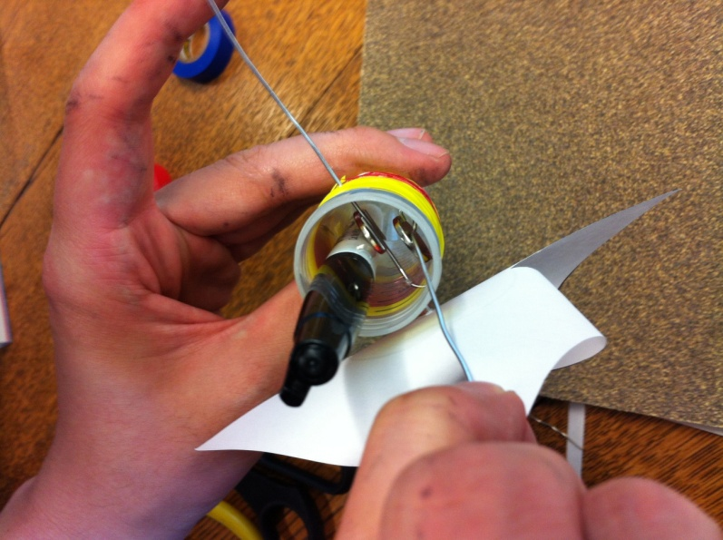
Task 2: Make an Electric Generator!
Cornell University Grass Roots GK-12 Program

Slide 23
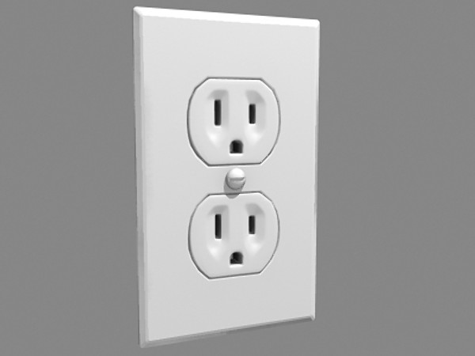
Do you produce an AC or DC voltage?
Cornell University Grass Roots GK-12 Program
AC = alternating current (voltage fluctuates periodically)
DC = direct current (voltage stays constant)
Why are wall power outlets always AC?
What does “60Hz” tell us?
110V AC 60Hz

Slide 24
Task 3: Make an electric motor
Cornell University Grass Roots GK-12 Program
Connect two electric generators at the 2 wire ends. One generator should NOT have a pinwheel.
Spin one generator with the pinwheel and look at the other generator.
Materials: Two electric generators

Slide 25


What if you were stranded on an island?
Could you make electricity with just magnets and wires?
Cornell University Grass Roots GK-12 Program
Magnets
Wires
Need electricity
to send Rescue Signal
Notes:
http://1.bp.blogspot.com/-amRmHS_q27c/TfT7qLqad3I/AAAAAAAADzg/7574odGJ2ls/s1600/coconut-island.jpg

Slide 26

Cornell Grass Roots GK-12 Program
Focus on renewable energy research
Teach science to K-12 grade in fun and effective ways
Improve graduate students’ communication skills
Content created via Cornell University’s NSF GK-12 Grass Roots Program: Award 1045513
2012-2015

