Slide 1


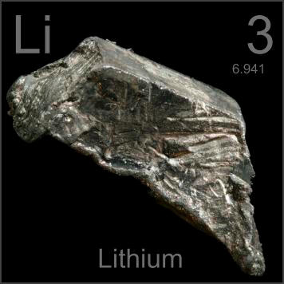
Cornell University Grass Roots GK-12 Program
Advancing Research in Renewable Energy and Cleaner Fuels
Metal-Air Batteries and Corrosion
www.periodictable.com

Slide 2



Why is Energy Storage Important?
United States energy use projected to increase by 8.1% by 2040
Solar panels, wind turbines becoming more common, need to store energy during off-peak production periods
Big demand for batteries in consumer goods and vehicles

Slide 3
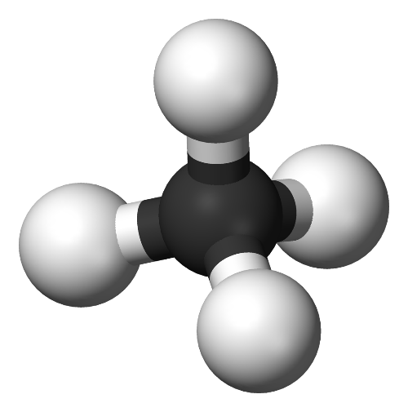
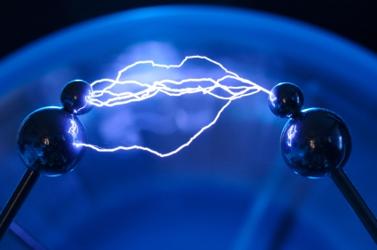
What is a Battery?
Stores chemical energy
  Chemical energy: stored in chemical bonds
Converts it to electrical energy
  Electrical energy: carried by electrons

Slide 4
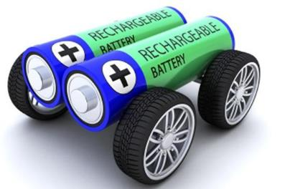



What is Important about Batteries?
Want more energy stored in a battery so our cell phones can last longer
Important concept: energy density
  Energy density = energy/volume
Control pollution via battery use in vehicles
Notes:
add battery on wheels image to corner

Slide 5
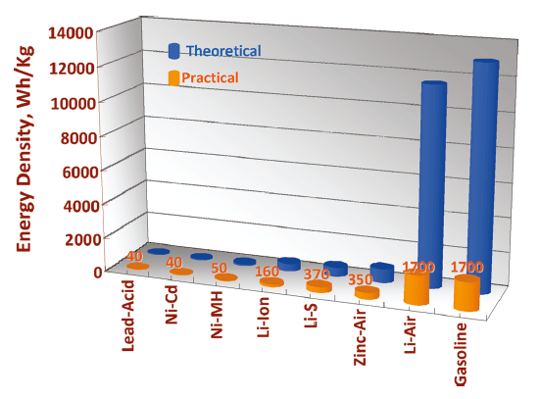
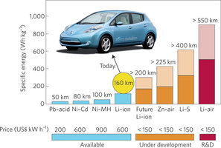
Batteries as Good as Gasoline?
Bruce (2011)
160 km = 100 mi (roughly from Watkins Glen, NY to Syracuse, NY)
550 km = 340 mi (roughly from Watkins Glen, NY to Boston, MA)
Goal: make a cheaper, battery-powered vehicle
Notes:
why? batteries offer better pollution control.

Slide 6
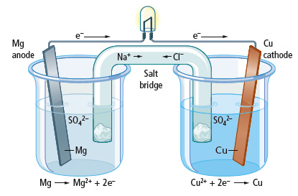
Battery Operation: Electrochemistry
Dependent on transfer of electrons via chemical reactions undergone by reactants.
  Oxidation: reaction at anode to generate free electrons
  Reduction: reaction of free electrons with cathode
Two half-cells connected via salt bridge, metal wire
Charge balance by cation movement
through salt bridge, electron movement
through wire

Slide 7
Battery Separator
Same basic idea implemented here: two electrochemical processes happening in separate regions
  Physical separation of cathode and anode to better control how reaction proceeds
  Need transfer of charge through some medium

Slide 8
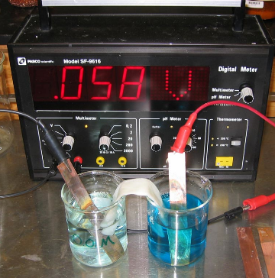

Practically Speaking...
Can’t use beaker setup in real life
Want something more compact
Purpose of separator is to prevent short-circuit in battery

Slide 9
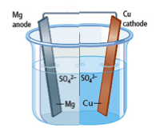
Practically Speaking...
e⁻
Mg
anode
Sep.
Cu
cathode
SO₄²⁻
Notes:
separator allows for electrical insulation of two electrodes

Slide 10
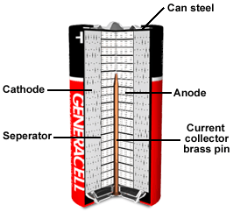
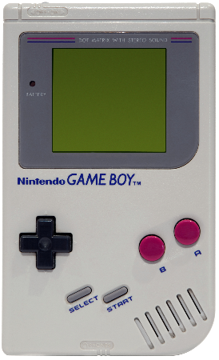

Primary Battery: Single Use
Common type: alkaline battery
Single use because reaction not reversible
(MnO₂)
(Zn)
(polymer
weave)
Notes:
include some of typical anode/cathode materials...?
get more detailed schematic...?

Slide 11

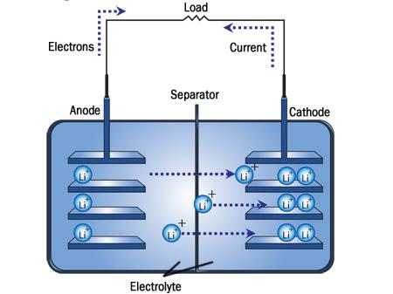
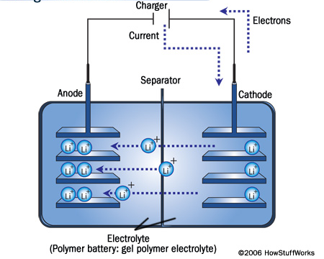
Secondary Battery: Multiple Use
Common type: Li-ion battery
Reversible reaction
  Li⁺ not tightly bound on either
  side
Discharging
Charging
Graphite
CoO₂
electronics.howstuffworks.com
Notes:
Add intercalation schematic

Slide 12
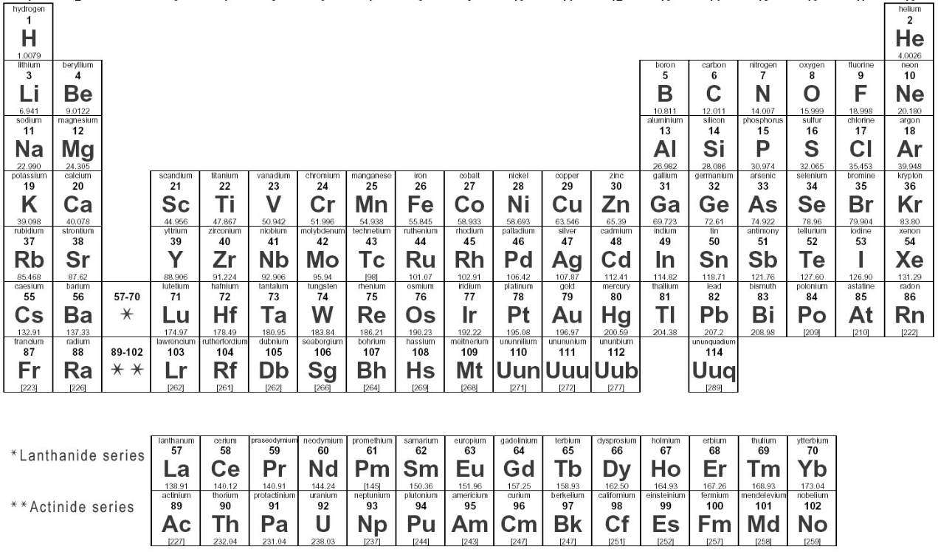
Why Lithium?

Slide 13
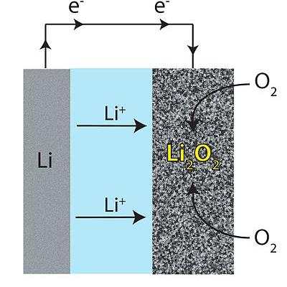
Lithium-Air Battery
Contain only one of the reactants: Li metal
Air is provided by the battery’s environment
  Li provides Li+ via oxidation at the anode
  Oxygen (in air) is reduced by e⁻ to produce OH⁻ at the cathode
Cathode material itself doesn’t change
  Provides a place for the reactions to occur
Lithium Air Battery
Cathode
(Porous Carbon)
Anode
http://en.wikipedia.org

Slide 14


Making a Lithium-Air Battery
What problems do you think a Li-Air battery would encounter?
Notes:
Getting enough oxygen from air and contaniments

Slide 15



Metal-Air Battery
Because Li metal very reactive (important to use caution during handling), let’s use another metal: aluminum
Same basic process:
  Aluminum oxidation at anode
  Oxygen reduction at cathode

Slide 16
Al-Air Battery Schematic
e⁻
e⁻
Mg
anode
Sep.
Cu
cathode
Al foil
anode
Sep.
Carbon
SO₄²⁻
OH ⁻
Notes:
Make reactions bigger

Slide 17

Metal-Air Battery with Iron
2e⁻
2e⁻
O₂ dissolves into the water
Iron
Salt Bridge
Activated Carbon
Na⁺
Cl⁻
Cl⁻
2 OH⁻
Na⁺
2e⁻
Fe²⁺
Cl⁻
Na⁺
Na⁺
Cl⁻
½O₂(g) + H₂O(l) + 2e⁻ -> 2OH⁻(aq)
Fe(s) -> Fe²⁺(aq) + 2e⁻
Notes:
Doesn’t have to be hydroxide or iron ion, any ion to balance the charge would do. Have net consumption of Fe into iron ions.

Slide 18
Metal-Air Battery with Iron
2e⁻
2e⁻
Iron
O₂ dissolves into the water
Fe²⁺(aq) + 2OH⁻(aq) -> Fe(OH)₂(s)
Activated Carbon
Na⁺
Cl⁻
2 OH⁻
2e⁻
Fe²⁺
Na⁺
Cl⁻
Salt Water
½O₂(g) + H₂O(l) + 2e⁻ -> 2OH⁻(aq)
Fe(s) -> + Fe²⁺(aq) + 2e⁻
Notes:
Have net consumption of Fe into iron ions.

Slide 19
Metal-Air Battery Lab Activities
Activity: using Al-air battery to sound a buzzer
  Al-air battery + NaOH (0.1M)
Activity: using Al-air battery to light an LED
  Al-air battery + NaOH (0.1M)
Activity: using Al-air battery to sound a buzzer
  Al-air battery + NaCl (0.1M)
Activity: using Fe-air battery to sound a buzzer
  Fe-air battery + NaCl (0.1M)
Notes:
Questions:
What voltage, current comes from each battery cell?
How can we increase resulting voltage, current?
How can we calculate energy, power of battery?
How can we calculate the energy density of a battery?

Slide 20
All metals have a similar reaction
M(s) -> + M^{x+}(aq) + xe⁻
(x/4)O₂(g) + (x/2) H₂O(l) + x e⁻ -> x OH⁻(aq)
M^{x+}(aq) + xOH⁻(aq) -> M(OH)_{x}(s)
But with different reaction rates
  More reactive metal, the higher the voltage
  Gold: hardly any reaction
  Lithium: needs to be kept under oil
Called galvanic or activity series
Metal | Voltage
Copper | 0.2 V
Iron | 0.4 V
Tin | 0.6 V
Aluminum | 0.8 V
Zinc | 0.9 V
Notes:
Need volunteers to make an iron battery to run the speaker

Slide 21

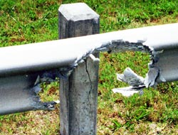
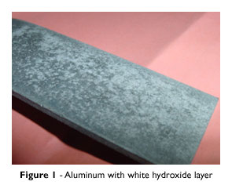

Metal-Air Batteries are Powered by “Rusting”?
M + x O₂ + y H₂O -> M(OH)_{z}
Oxygen from the air oxidize metal ions in an electrolyte
Aluminum “rust” is Al(OH)₃.
But iron rust is iron oxide or Fe₂O₃..
Notes:
Chemically similar process for all metals not stable at room temperature, probably haven’t seen Al corrosion from general use. Al has a thin protective oxide layer that is spontaneous made in air that protects the Al, but given the right conditions you can make it corrode.

Slide 22
Metal Air Battery with Iron
2e⁻
2e⁻
4Fe(OH)₂(s) + O₂(g) -> 2Fe₂O₃ •H₂O(s) + 2H₂O(l)
Iron
O₂ dissolves into the water
Fe²⁺(aq) + 2OH⁻(aq) -> Fe(OH)₂(s)
Activated Carbon
Na⁺
Cl⁻
2 OH⁻
2e⁻
Fe²⁺
Na⁺
Cl⁻
Salt Water
½O₂(g) + H₂O(l) + 2e⁻ -> 2OH⁻(aq)
Fe(s) -> + Fe²⁺(aq) + 2e⁻
Notes:
Have net consumption of Fe into iron ions.

Slide 23
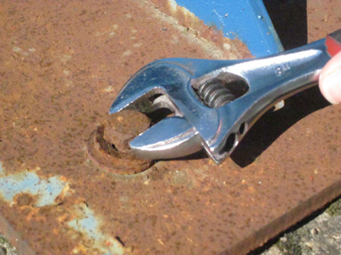
Generic Piece of Iron Rusting
Where’s the electrodes and electrolyte?
Notes:
But this isn’t the setup you see everyday. I don’t see two electrodes, activated carbon, or even water.

Slide 24
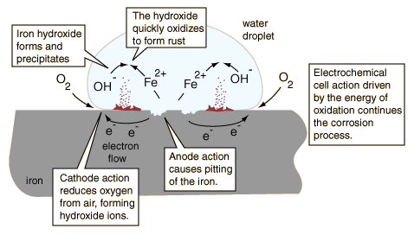
Generic Piece of Iron Rusting
Fe²⁺(aq) + 2OH⁻(aq) -> Fe(OH)₂(s)
4Fe(OH)₂(s) + O₂(g) -> 2Fe₂O₃ •H₂O(s) + 2H₂O(l)
Real iron is not perfectly symmetrical
Aluminum’s protective oxide layer prevents this (poor electrolyte)
Notes:
The carbon doesn’t participate directly in the reaction, just provides a surface. The reactions can happen on the iron’s surface. The iron is itself own cathode and anode. Since the electricity passes straight to the cathode, the electricity isn’t used. The hydroxides form the familiar red orange deposits. Water is necessary for corrosion. Iron can rust in just air though due to the humidity in the air.

Slide 25

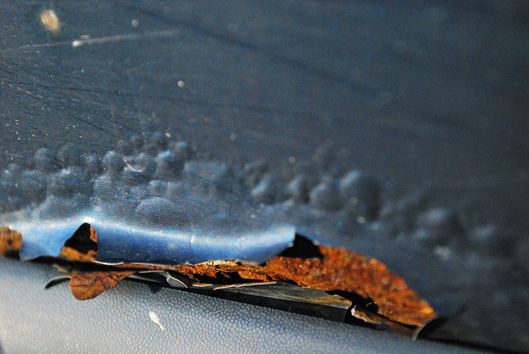

Protective Coatings Prevent Rust
Iron expands when it rusts
Small scratches grow when the rust’s expansion causes the paint to peel
Steel/Iron
Salt Water
Iron expands when it rusts causing the paint to peel.
Notes:
If there’s no metal liquid contact then there’s no iron ions

Slide 26
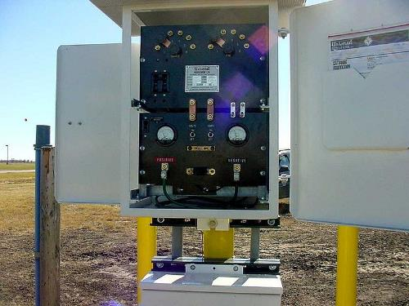
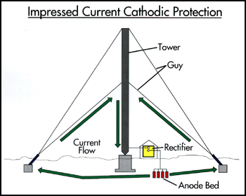
Can Electrochemistry Help Prevent Corrosion?
What about applying a voltage?
Complex since you need to monitor the corroding voltage
Fe + ½ O₂ + 2H₂O -> Fe(OH)₂
Creates electrons with ~0.4eV of energy to flow
An outside voltage source counters that electron flow with -0.4eV
- the reaction does not proceed
Notes:
chart and counterbalance that voltage, charge battery while trying to discharge

Slide 27
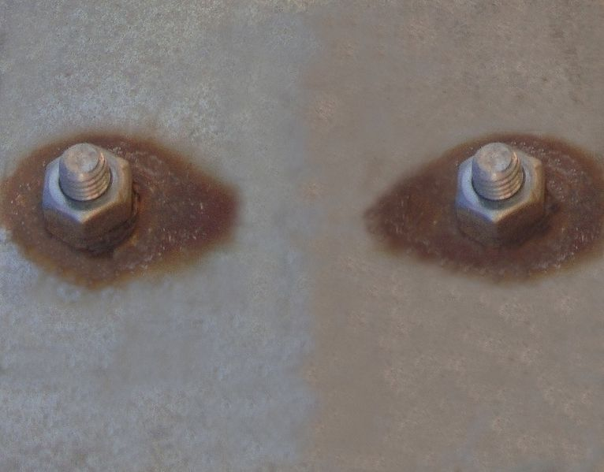
What Happened in this Picture?
Stainless Steel Nuts and Bolts
Zinc is a more reactive metal and gives the steel its unwanted electrons so it form ions and start the redox reaction
Galvanized (Zinc coated) Steel Plate
Don’t mix metals/alloys in construction
Notes:
Not corroding evenly, zinc by itself corroding slowly due to its own protective layers, stainless steel provides a place for zinc to put unwanted electrons since the stainless steel is more willing to accept them compared to other parts of the zinc

Slide 28

Can Electrochemistry Help Prevent Corrosion?
Can we take advantage of the chemistry occurring between the zinc coating and iron bolts?
  Use the activity series
If corrosion is going to happen…
Make the structural iron a cathode
  Like the activated carbon
Sacrifice some other metal
  Non-structural and reactive
Notes:
chart and counterbalance that voltage, charge battery while trying to discharge

Slide 29
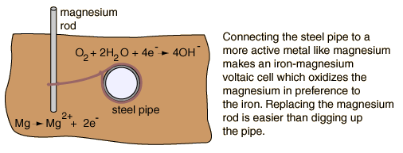
Cathodic Protection from Corrosion
Fe(s) -> + Fe²⁺(aq) + 2e⁻
Only works if the soil is wet
With Mg “forcing” extra electrons onto the steel pipe, no Fe ions can leave
Notes:
Fe ion reaction and too many electrons on surface already

Slide 30
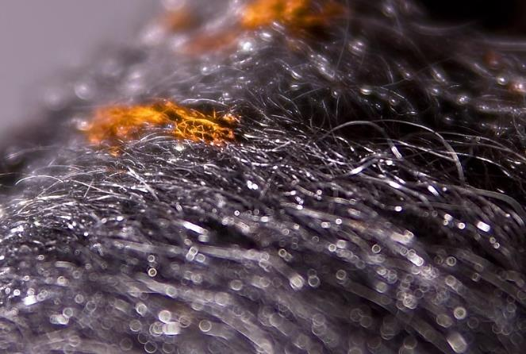
A Simple Corrosion Experiment
Steel wool
Salt water
Aluminum Foil
Some wire
Time
Steel wool in air
Steel wool in deionized water
Steel wool in salt water
Steel wool connected to Al foil in salt water
Steel wool and Al foil in salt water
Steel wool connected to Al foil in separate salt water containers

Slide 31


Cornell Grass Roots GK-12 Program
Focus on renewable energy research
Teach science to K-12 grade in fun and effective ways
Improve graduate students’ communication skills
Content created via Cornell University’s NSF GK-12 Grass Roots Program: Award 1045513
2012-2015

