Slide 1

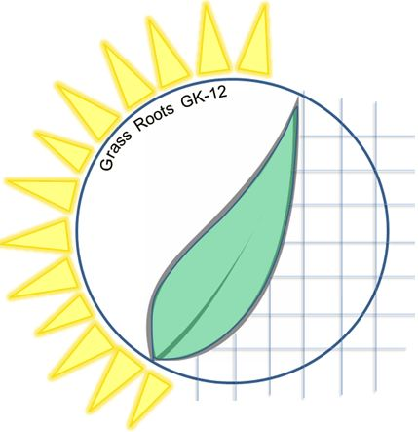

Cornell University Grass Roots GK-12 Program
Advancing Research in Renewable Energy and Cleaner Fuels
Harnessing Wave Power
Corinne Issac
Erik Huber
Angela Stelson

Slide 2
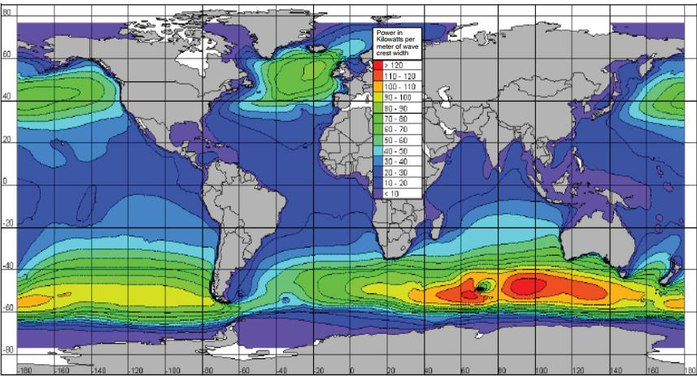
How much energy do waves have?
Cornell University Grass Roots GK-12 Program
http://waveenergyconsortium.com/worldwide/

Slide 3
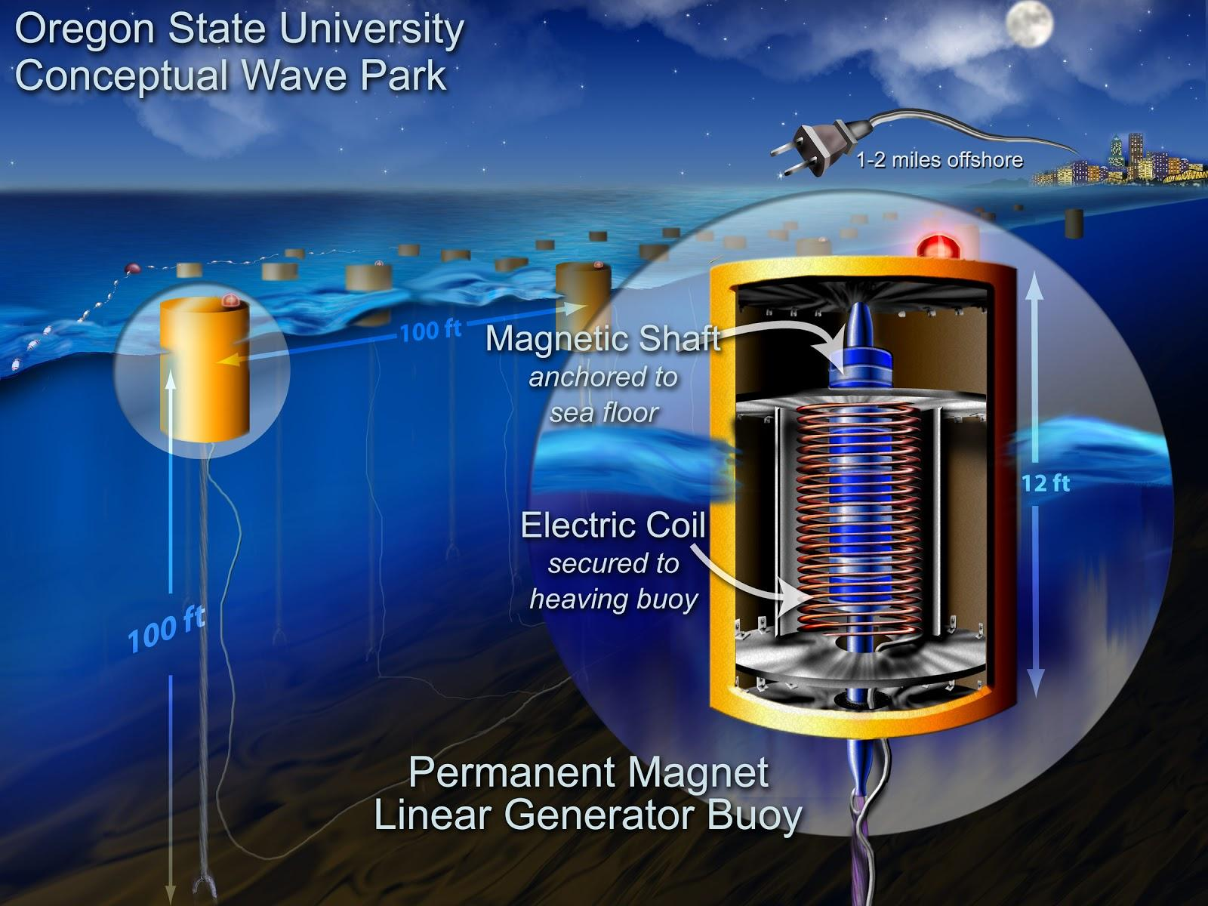
Cornell University Grass Roots GK-12 Program

Slide 4
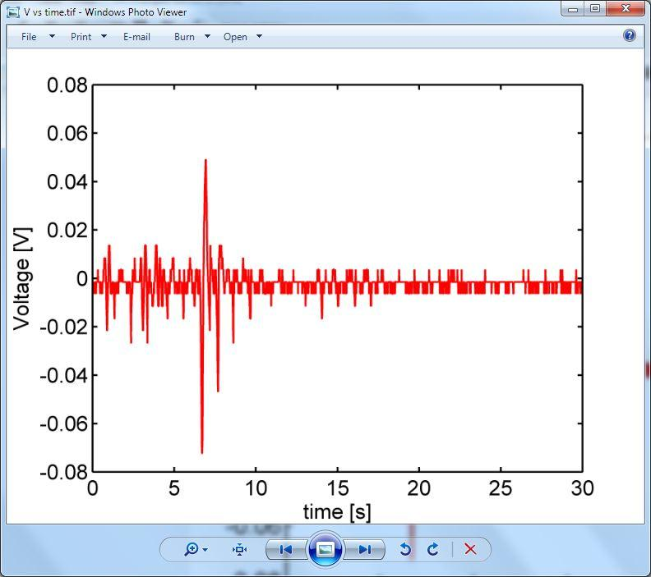
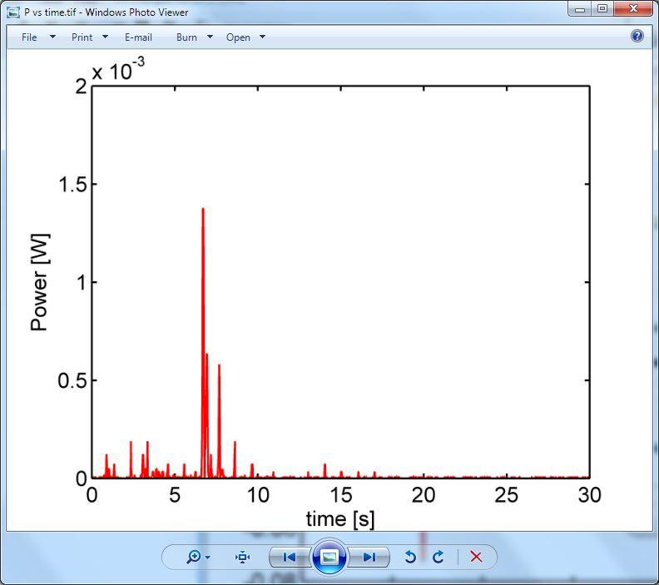
Cornell University Grass Roots GK-12 Program

Slide 5
Why is the efficiency so low?
Cornell University Grass Roots GK-12 Program

Slide 6
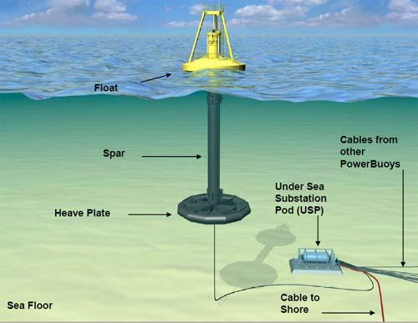
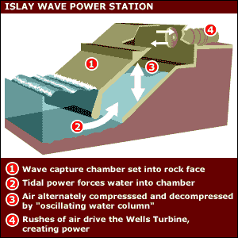
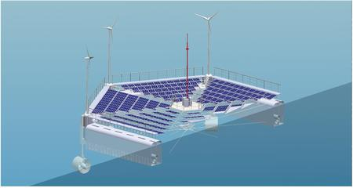
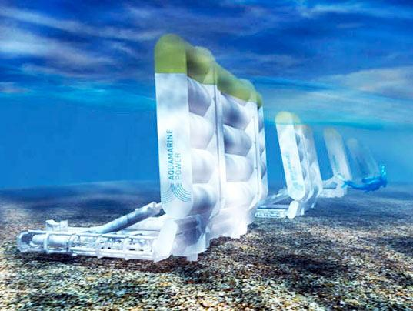
Alternate Designs for Wave Generators
Cornell University Grass Roots GK-12 Program

Slide 7

Cornell Grass Roots GK-12 Program
Focus on renewable energy research
Teach science to K-12 grade in fun and effective ways
Improve graduate students’ communication skills
Content created via Cornell University’s NSF GK-12 Grass Roots Program: Award 1045513
2012-2015

