Slide 1

Floc Sed Optimization
Sarah Bolander
Marianne Collard
Mary John

Slide 2

Floc Recycle: Main Idea
The snowball effect
Starting up a snowball can be tricky, but once you already have a decent sized compact snowball, making it bigger becomes much easier!

Slide 3
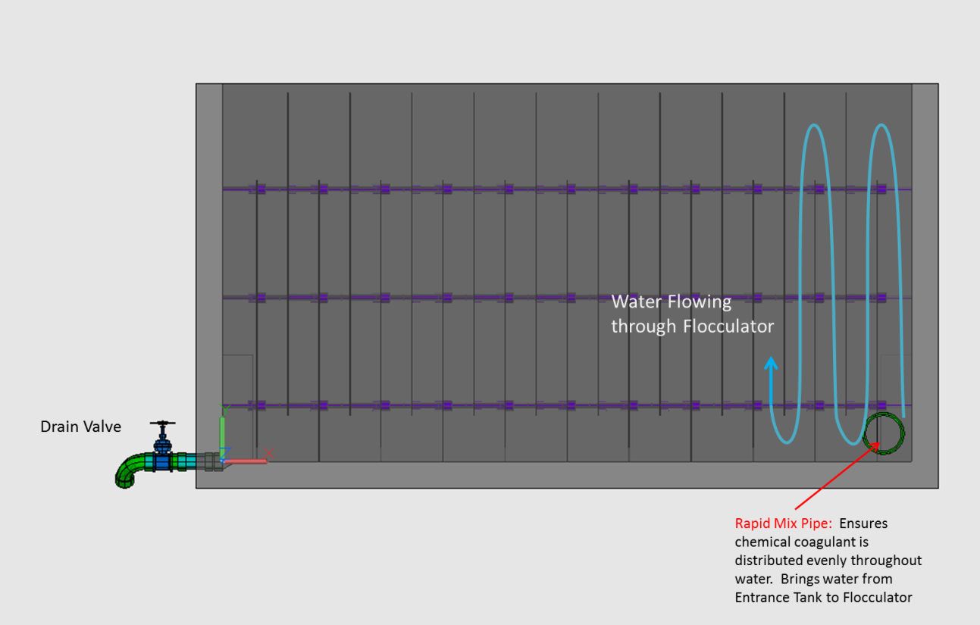
Flocs
When turbid water enters the flocculator, flocs are not yet present and the pollutants are dispersed as tiny particles

Slide 4
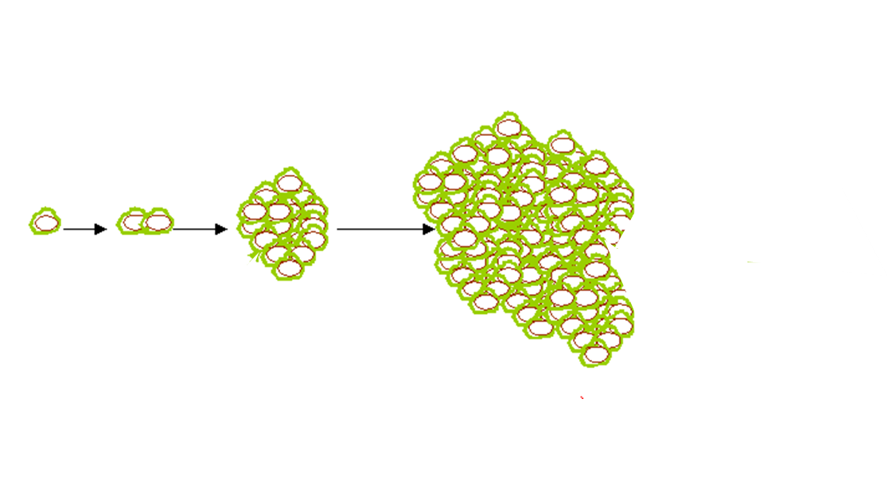
Flocs
As turbid water flows through plant, flocs are created and continue to get bigger throughout sedimentation

Slide 5

Floc Recycle!
“Recycle” already formed flocs from the floc weir, and place them in the floccualator entrance with tiny incoming particles

Slide 6
Hypothesized Benefits
Flocs will be more easily formed and a floc blanket will be easier maintained at low flow rates
  Higher floc volume increases collisions between flocs
Less coagulant will be needed -> more cost effective!
  Floc volume fraction will reduce coagulant lost to walls of tube flocculator
  Reusing “sticky” flocs that have already been dosed with coagulant

Slide 7
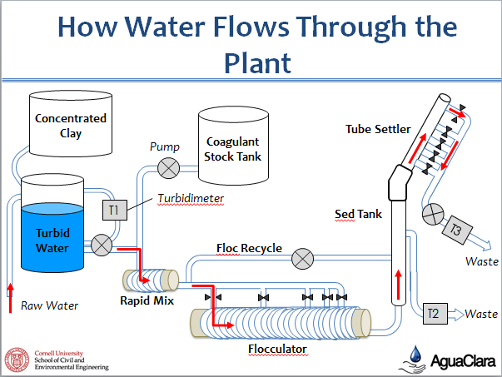

Slide 8
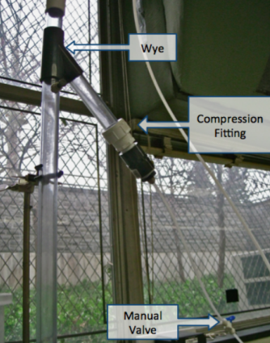
Placement of Floc Recycle
Currently the floc recycle is placed at the end of the floc weir, but other positions, such as at the top of the sedimentation tank, are being considered as an alternative position to take out flocs for recycle
Floc Recycle Outlet

Slide 9
Current Testing
We are currently running controls in order to have data to compare with when we add in the floc recycle. Our first test goes as follows where the plant is run at:
100NTU influent turbidity, 45mg/L alum dose with no floc recycle and the waste valve on (to build up a floc blanket)
15NTU influent turbidity, 6.5mg/L alum dose with no floc recycle and the waste valve on
15NTU influent turbidity, 6.5mg/L alum dose with floc recycle and the waste valve off
The first test of floc recycle is run as a continuation of the control in order to be more productive

Slide 10
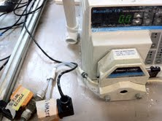
Switching to the Floc Recycle State
When switching from no floc recycle to floc recycle, the upflow velocity is changed from 1 mL/L to .9 mL/L, the floc recycle valve is opened, and the recycle is pumped at .1 mL/L to maintain the upflow velocity

Slide 11
Current Testing
So far, we have found that at 15 NTU influent turbidity, the floc blanket is not maintained and as result it is hard to see the effects of floc recycle

Slide 12
Future Work
Continuing running similar tests but with varying alum doses
to study the affects of a lower coagulant dose and floc recycle
100NTU influent turbidity, 15mg/L alum dose with no floc recycle and the waste valve on (to build up a floc blanket)
15NTU influent turbidity, 2.25mg/L alum dose with no floc recycle and the waste valve on
15NTU influent turbidity, 2.25mg/L with floc recycle and the waste valve off
100NTU influent turbidity, 30mg/L alum dose with no floc recycle and the waste valve on (to build up a floc blanket)
15NTU influent turbidity, 4.5mg/L alum dose with no floc recycle and the waste valve on
15NTU influent turbidity, 4.5 mg/L alum dose with floc recycle and the waste valve off

Slide 13
Future Work
We may need to adjust alum dose in our experiments to find the optimal dosage for floc recycle to be successful
Additional testing of a similar set up will be required, alum dose will be the varying factor

Slide 14
Future Work-Placement of Recycle
Possible floc recycle position
Current floc recycle position
Varying where floc recycle enters and exits the plant may be necessary to see the full potential of floc recycle.

Slide 15
Conclusion
Our experimentation this semester is working to see how beneficial floc recycle is to our floc blanket and sedimentation tank.
We are looking to optimize cost and efficiency in our system through minimizing alum dose but still produce water with low effluent turbidities.

