Slide 1
Floc Sed Optimization Team
Summer Teach-In
July 25th, 2012
Mary John
Kaditya Naidu
Elizabeth Henderson

Slide 2
Challenges
Run tests varying the following conditions: turbidity, flocculator length, alum dose, flow rate, capture velocity and rate of floc recycle flow
Collect and format data in Mathcad
Maintain floc blanket throughout experiments
Ultimate goal: best performance at lowest cost
Notes:
-

Slide 3
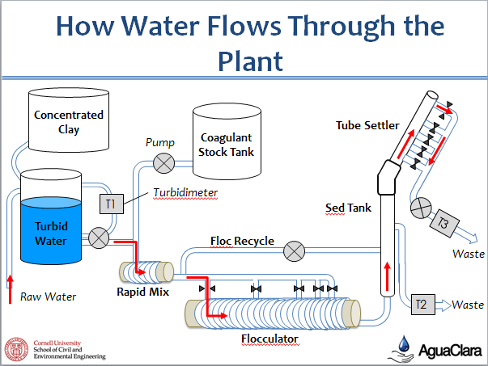

Slide 4
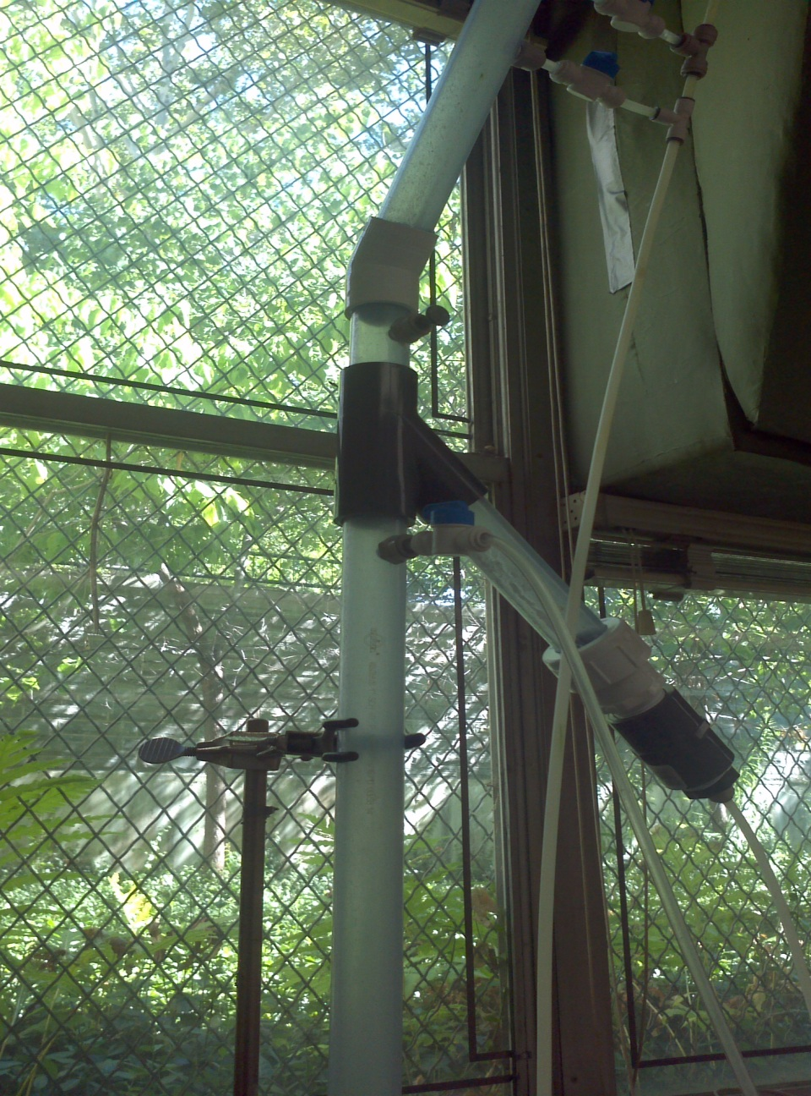

Slide 6
Problems Encountered
Cleaning out the flocculator
Flooding our working space
Calibrating the pump (old-fashioned way)
Nested codes on Mathcad (Slow in rendering results)

Slide 7
Remember
What happens in the lab stays in the lab!

Slide 8
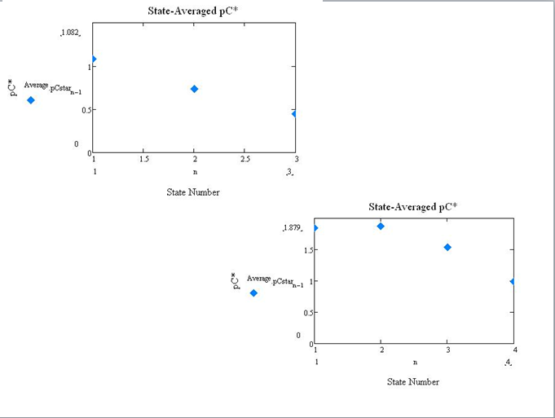
Analysis
20 m flocculator control
20 m flocculator with floc blanket

Slide 9
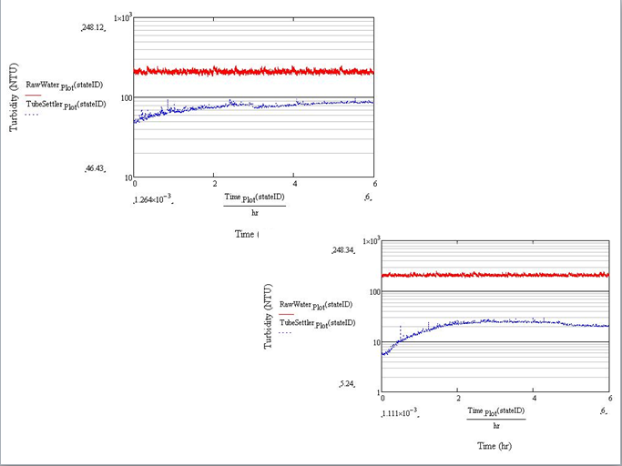
Influent Turbidity
Effluent Turbidity
Notes:
Turbidity is the cloudiness or haziness of a fluid caused by individual particles (suspended solids) that are generally invisible to the naked eye, similar to smoke in air. The measurement of turbidity is a key test of water quality.

Slide 10
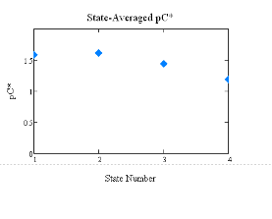
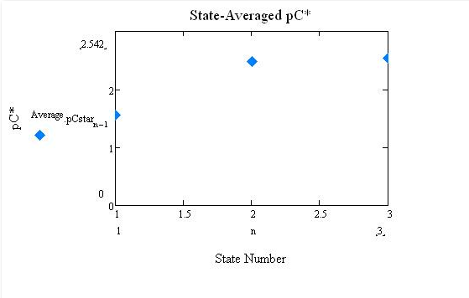
15 m flocculator control
15 m flocculator with floc blanket

Slide 11
Summary of Results
Experiment | Influent Turbidity | Effluent Turbidity | pC* (State 3-35mg/L)
21: 20m flocculator control | 200 | 90 | 0.45
22: 20m flocculator with floc blanket | 200 | 4 | 1.55
23: 15 m Flocculator control | 200 | 8-9 | 1.45
24: 15 Flocculator with floc blanket | 200 | 0.5 | 2.4

Slide 12
Results
Floc blankets work!!
Water is less turbid after passing through a floc blanket
Lower alum doses yield similar results as higher alum doses
Possible to reduce flocculator length and alum dose
Notes:
-

Slide 13
Future Work
Determining the smallest flocculator length that will still form a floc blanket
Continuing to change variables including flow rate, capture velocity and rate of floc recycle flow
Use this data to determine optimal performance at lowest cost

