Slide 1
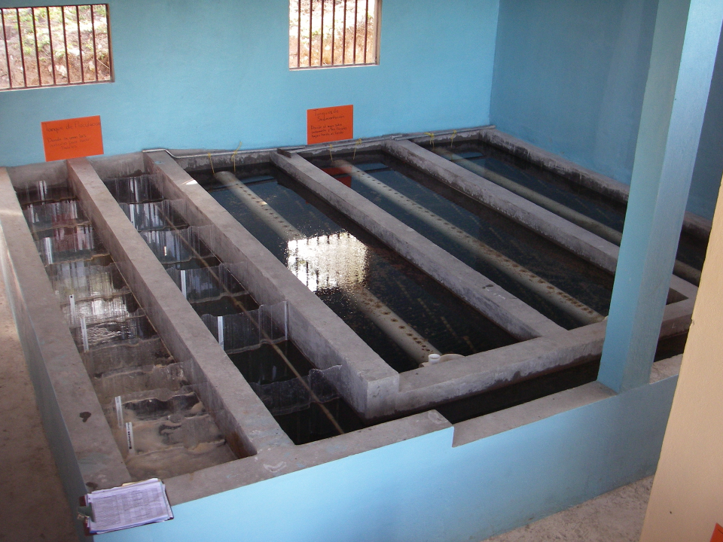
Flocculation – Sedimentation
Felice Chan, Eriko Inagaki, Mary John

Slide 2
Goals
Create a large diameter rapid mix chamber with hydraulic jets to completely mix raw water and coagulant
Reliably make a floc blanket with PACl
Set up back lighting to measure floc blanket height
Install an interactive webcam to detect the height of the floc blanket automatically
Incorporate floc recycle into system

Slide 3
Major Changes
Previously, Alum was used as coagulant but we are experimenting with PACl this semester.
To prevent coagulant from sticking to the walls of the rapid mix chamber, we created a new rapid mix chamber with two jets: one for raw water, one for coagulant

Slide 4
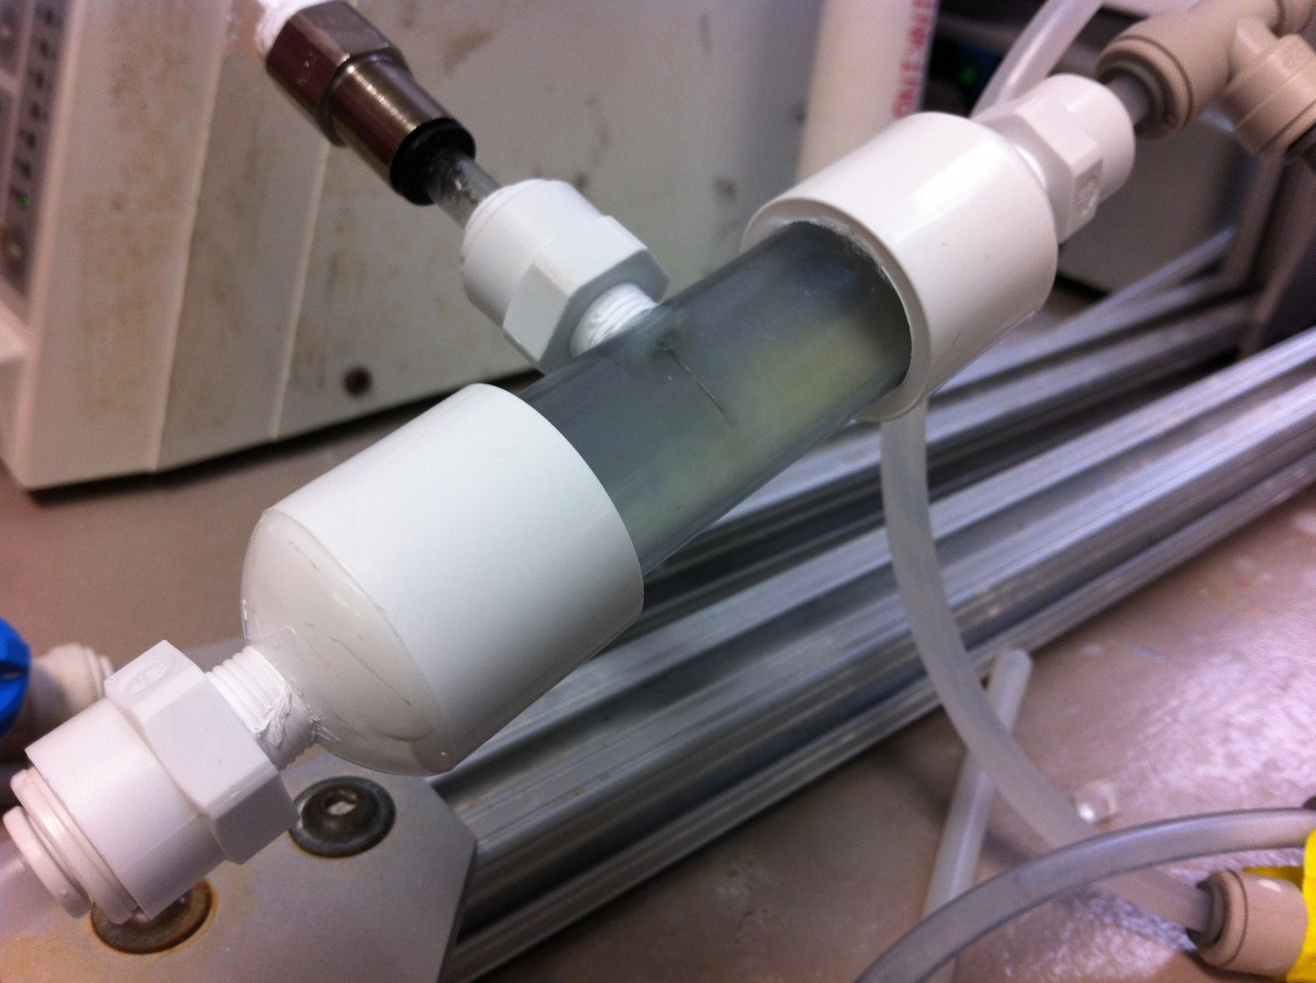
New rapid mix chamber
Stainless steel tubing
Raw water + Coagulant to flocculator
Coagulant jet
Hydraulic jet with diameter = 0.394 mm
Raw water jet

Slide 5
Experiments
Influent turbidity did not adjust to 100 NTU and gradually decreased, but effluent turbidity did not change.
Removed the hydraulic jet of the raw water inlet because clay was too large to flow through it.
Influent turbidity still did not adjust after removing the jet, but after testing the pinch valve, influent turbidity began adjusting correctly.

Slide 6
Experiment 1
Coagulant Storage Tank
Concentrated Clay
Tube Settler
Raw Water
Pinch Valve
NTU
Turbid Water
Turbidimeter
Sed Tank
Turbid Water
NTU
Rapid Mix
Waste
Pump
Flocculator

Slide 7
Experiments now
Coagulant Storage Tank
Concentrated Clay
Tube Settler
Raw Water
Pinch Valve
NTU
Turbid Water
Turbidimeter
Sed Tank
Turbid Water
NTU
Rapid Mix
Waste
Pump
Flocculator

Slide 8



Back lighting
Place back lighting for the sedimentation tank to detect the height of the floc blanket in process controller.
Two options:
  1. Solid back fluorescent light with diffuser
  2. Row of LEDs with detectable pattern

Slide 9
Future Work
Fix rapid mix chamber; clay particles were getting stuck in the stainless steel tubing.
Resolve influent water turbidity measurements.
Test apparatus with varying coagulant doses and measure time to build a floc blanket.
If we can reliably build a floc blanket we will begin to experiment with floc recycle.

Slide 10

Questions?

