Slide 1

Floc Sed Optimization Team
Marion Alberty
Ju Khuan Pan
Kester Wilkening
May 12, 2012
Notes:
Goals
How we planned a system to meet those goals
What we needed to do to make the system work
What we ended up with
How we thought we were going to meet those goals (the old diagram)
What we did to meet those goals (The new diagram, explain important experiments)
What we learnt (Results, Discussion and Conclusions)
What next?

Slide 2
Our Optimization Goals
500 or 3 NTU Influent Turbidity
Increase Upflow Velocity
Floc Recycle Ratio
Decrease Coagulant Dose
Decrease Capture Velocity Ratio
Reduce Flocculator Length
<3 NTU Effluent Turbidity
Notes:
In order to optimize the processes of flocculation and sedimentation this listed variables needed to be optimized and most have a direct correlation to plant costs.
-Influent Turbidity-Turbidity of the raw water in the raw water storage tank. This will be the starting turbidity in the system which we wish to reduce to less than 3 NTU at the effluent. This is the only variable that cannot be controlled in the plants, however within the course of a year a plant can experience a wide range of influent turbidities and thus we needed to be certain another optimized variable can perform adequately over the range of 500 NTU to 3 NTU.
-Floc Recycle Ratio- The ratio of flow rate from the sedimentation tank back into the flocculator to the total flow rate of the system. Floc recycle could increase collision potential and thus reduce coagulant dose, flocculator length, and capture velocity ratio. Addition of floc recycle does however create an additional procedure to be implemented into design and construction.
-Flocculator length-The length of the path traveled in the flocculator by the raw water-coagulant mixture. A reduction in flocculator length will reduce construction costs.
-Upflow Velocity- The flow rate up through the sedimentation tank. This is equivalent to the flow rate of the system and is controlled by the first pump. An increase in upflow velocity corresponds to a decrease in sedimentation tank cross-sectional area and thus construction costs.
-Capture Velocity Ratio- Firstly capture velocity is the velocity of the slowest settling particle that the sed tank can reliably capture. Capture Velocity Ratio is the ratio of capture velocity to upflow velocity. A current AguaClara plant functions at a capture velocity ratio of approximately 0.1. An increase in capture velocity ratio is equivalent to shortening the lengths of the plate settlers. Reducing plate settler length shortens the sedimentation tank height, resulting in reduced construction costs.
-Coagulant Dose- The mass of coagulant, in our case Alum, per L of raw water that the coagulant will be mixed into. Mass of coagulant dosage directly effects the daily operational costs of an AguaClara plant.

Slide 3
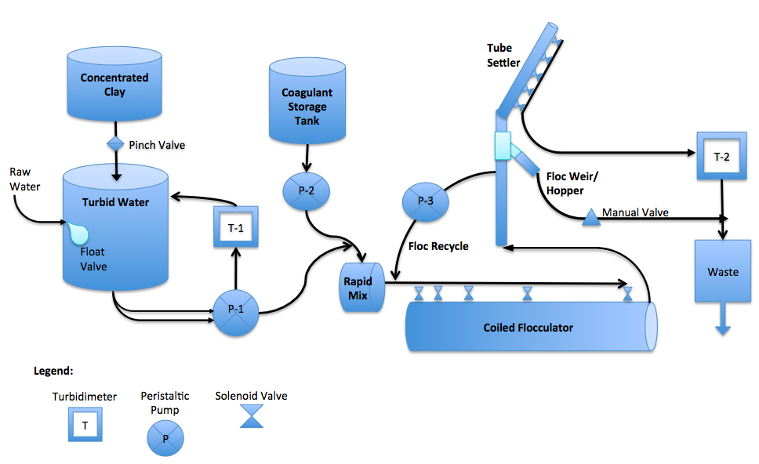
How Do We Meet Those Goals?
Capture Velocity Ratio
500 or 3 NTU Influent Turbidity
Upflow Velocity
Floc Recycle Ratio
<3 NTU Effluent Turbidity
Flocculator Length
Coagulant Dose
Notes:
The system was designed to allow for flocculator and sedimentation tank parameters to be easily varied:
-Turbidimeter 1 and the pinch valve work together to reach and maintain the desired Influent Turbidity
-Pumps 1 and 2 to some extent control the plant flow rate and thus the upflow velocity through the sedimentation tank
-Pump 3 controls the floc recycle ratio by operating at a flow rate of the ratio times the plant flow rate
-Pump 2 and the concentration of Alum in the Coagulant Stock Tank control the Alum Dose in the system
-The solenoid valves connected to the tube settle control the Capture Velocity Ratio
-The solenoid valves connected to the coiled flocculator control the flocculator length
-The entire system with the presence of a floc blanket works to produce >3 NTU water

Slide 4
What Are The Constraints?
Build & Maintain Floc Blanket
  Dense
  Durable
Prevent Floc Rollup
Prevent Floc Settling
Stock Tanks Capacities
Raw Water vs. System Turbidity
Time
Notes:
-A healthy floc blanket was required for all experiments and all results are only relevant with the presence of a floc blanket
-Cannot have flocs rolling up the tube settler into the effluent
-Flocs can settle in the flocculator or in the floc recycle line, velocities in those lines must be sufficient to prevent settling
-Design experiments such that stock tanks do not empty over the course of an experiment or if that is not possible they can be refilled at a reasonable time
The turbidity in the system right before entering the rapid mix may no longer be the same as the turbidity measured in the Raw Water Stock Tank depending upon the concentration of Alum in the Coagulant Stock Tank and the Coagulant Flow Rate. For high Alum flow rates at low concentrations, Raw Water Stock Tank turbidity may need to be altered to account for the difference
Experiments should occur over a time scale such that important observations can be made during reasonable working hours. Thus the floc blanket building state and transition state were brought to reasonable time scales. Also Raw Water Stock Tank size was reduced to decrease residence time in tank

Slide 5
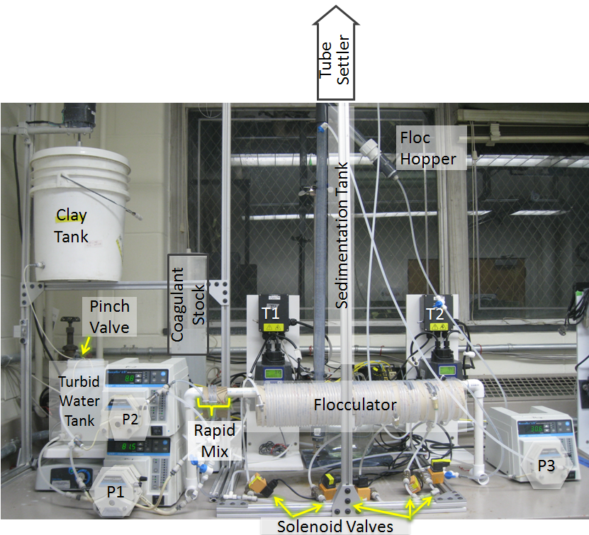
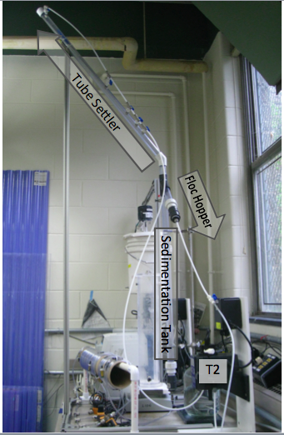
What We Ended Up With
Notes:
System is basically as planned except:
-Manual valves for now on tube settler outlets because of number of stamp box plugs

Slide 6
Original Order of Experiments

Slide 7

New Approach
Less than 3 NTU!
Notes:
7

Slide 8
Our Progress
Less than 3 NTU!
Notes:
8

Slide 9
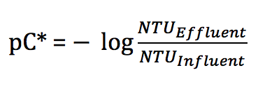
What We Are Interested In
Effluent Turbidity
Measure of Removal Efficiency:
Notes:
* Why not interested in pc* so much
9

Slide 10
What We Did: Upflow Velocity
Build and Maintain A Floc Blanket
  Build at 200 NTU
  Decrease Influent NTU
  Maintain at 3 NTU
200 NTU
3
NTU

Slide 11
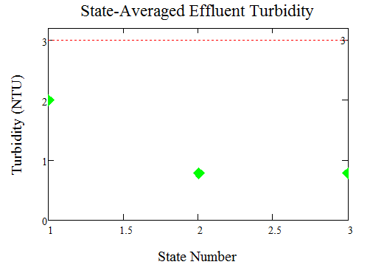
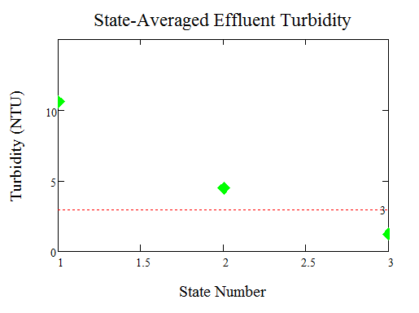
What We Learnt
Upflow Velocity of 2 mm/s Works!
V.SedUp = 2 mm/s
V.SedUp = 2.25 mm/s
Less than 3 NTU!
Notes:
What are the green and red lines?
“Learnt” is spelled Learned : ) – Kester
State-averaged over 0.5 hours to 2 hours
Get rid of the lines, just dots
11

Slide 12
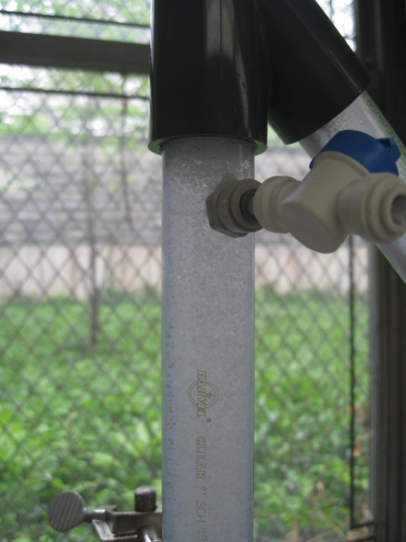
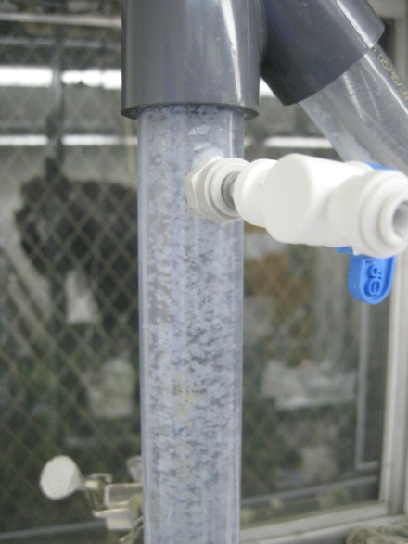
What We Learnt
Upflow Velocity affects Floc Blanket Density
V.SedUp
= 1.5 mm/s
V.SedUp = 2 mm/s
Notes:
Mention influent of floc recycle
12

Slide 13
What We Did: Floc Recycle
Potential of Floc Recycle
  Decrease Coagulant Dose
  Decrease Flocculator Length
V.SedUp
1.5 mm/s
10%
Q_{Plant}
Notes:
Motivation for this experiment:
With Floc Recycle
10% was chosen because we were able to keep flocs from settling inside the floc recycle line
V.SedUp of 1.5 mm/s offered a thicker floc blanket
13

Slide 14
What We Did: Floc Recycle
Floc Recycle Effects on Coagulant Dose
  Build Floc Blanket at 200 NTU
  Decrease Influent NTU
  At 3NTU, begin floc recycle
  Decrease Coagulant Dose every 2 hours:
    15 , 10 , 5 , 3.5 mg/L
Notes:
Effluent turbidity data was not reliable due to system errors, so only qualitative data presented
14

Slide 15
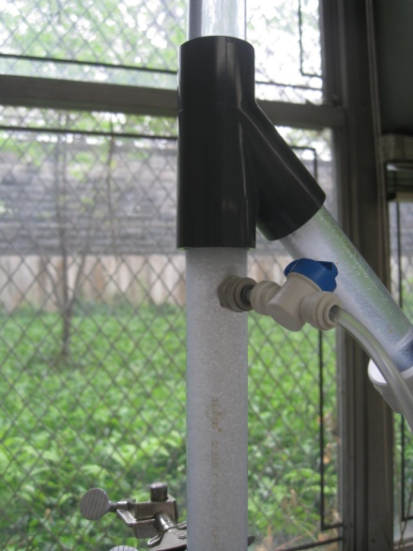
What We Learnt
Floc Recycle Does Not Harm Floc Blanket
Before
During
Notes:
Maintainence of Floc Blanket
15

Slide 16
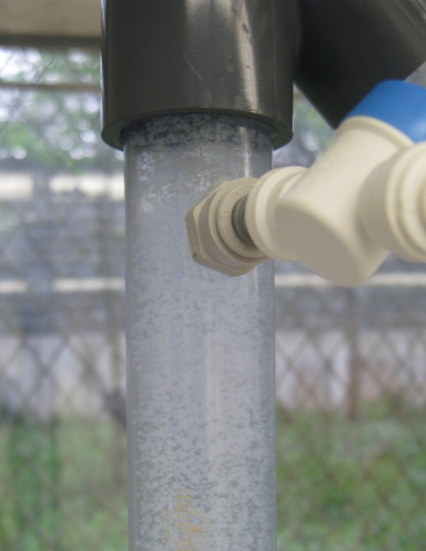
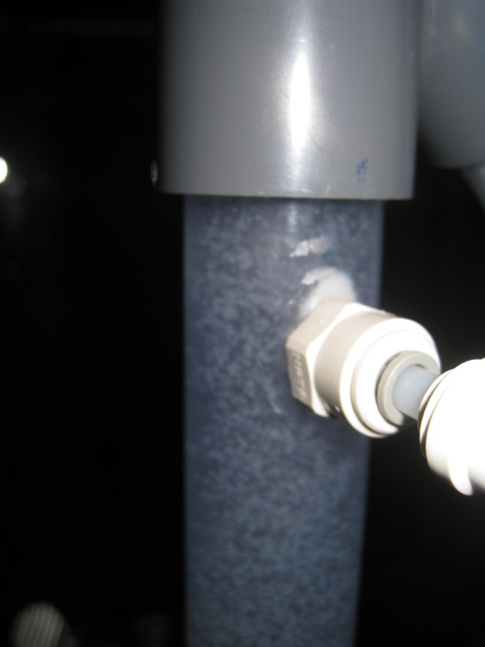
What We Learnt
As Coagulant Dose dropped, Floc Blanket Thinned
15 mg/L
10 mg/L
5 mg/L

Slide 17
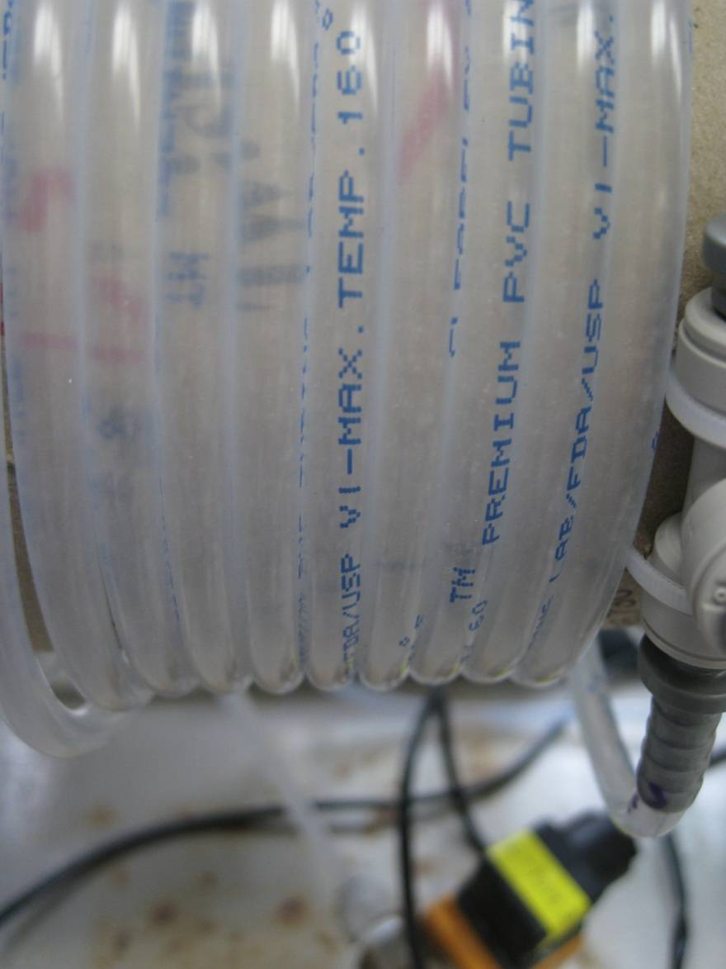
What We Learnt
Floc recycle improves flocculator performance
  Influent : 3 NTU
  Flocculator : 105 NTU
Important:
  Presence of thick blanket
Notes:
Possibly the flocculator length can be decreased
17

Slide 18
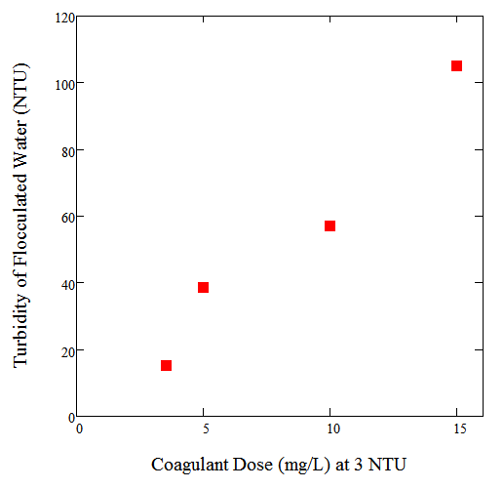
What We Learnt
Flocculated Water NTU decreases with decreasing coagulant dose
Notes:
Floc Recycle: Possibly the coagulant dose is causing floc blanket to thin, but the experiment should definitely be repeated to verify the observation
18

Slide 19
What does all this mean?
With a floc blanket…
  50% smaller sed tank plan view area
With floc recycle, potential for:
  Decreased alum dosage
  Decreased flocculator length
Leads to… more affordable AguaClara plants!
Notes:
In other words…How does this relate to physical AguaClara plants?
Increased VsedUp- 2mm/s works in the lab, so without a safety factor, 2mm/s is the maximum Vsed up
If we increase Vsed up by 100% (from 1mm/s to 2mm/s), this means we can decrease the plan view area of sed tanks by 50% (How large are sed tanks currently?) OR increase the flow rate for a current plant by 100% (What are the current plant flow rates of AguaClara plants?)
Alum Dosage is a significant percentage of operating costs (do we know how much?) (What is the current Alum Dosage for AguaClara plants?)
19

Slide 20
What’s Next?
Less than 3 NTU!
Notes:
Use cost analysis to prioritize which processes to optimize
The location of the floc recycle influent line could also be optimized. Currently the line pulls flocs out of the top of the sedimentation tank, and this increases the V{}_{SedUp} below the floc recycle influent line. This could be detrimental to the formation of floc blankets, but if floc recycle ratio is decreased to .05, then this effect also decreases. It would be valuable to vary the location of the floc recycle influent line to see if this affects plant performance.
Currently Vcapture is 0.1 mm/s, with our new Vsed up of 2mm/s, same capture velocity ratio (0.1) , Vcapture= 0.2 mm/s
We showed that a higher capture velocity ratio works, so the capture velocity can also be increased, which will decrease the needed size of the plate settlers
The order of experimentation is driven by costs (prioritize)
Since the system has multiple degrees of freedom, it is not possible to have every parameter exactly optimal. In order to make decisions about which parts of the plant to optimize, the team recommends prioritizing parameters based on cost. It will be helpful to develop some preliminary cost criteria that illustrates which parts of the plant are the most expensive based on both construction and maintenance costs. With these costs as a guideline, the next team can then identify the processes that will have the most significant impact if they are reduced. Once this is developed, decisions can be made as this project goes forward about which parameters to keep constant at optimal values.
20

Slide 21
Thank You!
Questions?

