Slide 1

Flocculation/Sedimentation Optimization
Felice Chan,
Mary John, Eriko Inagaki

Slide 2

Semester Goals
Design and build a new rapid mix chamber.
Install a web camera and sedimentation tank backlighting to observe experiments.
Evaluate the performance floc recycle in AguaClara plants.

Slide 3

Floc Recycle
Recycle already wasted flocs into the beginning of the flocculation and coagulation process
Addition of already formed flocs will increase collision potential in flocculator
Literature suggests floc recycle can improve effluent water quality

Slide 4
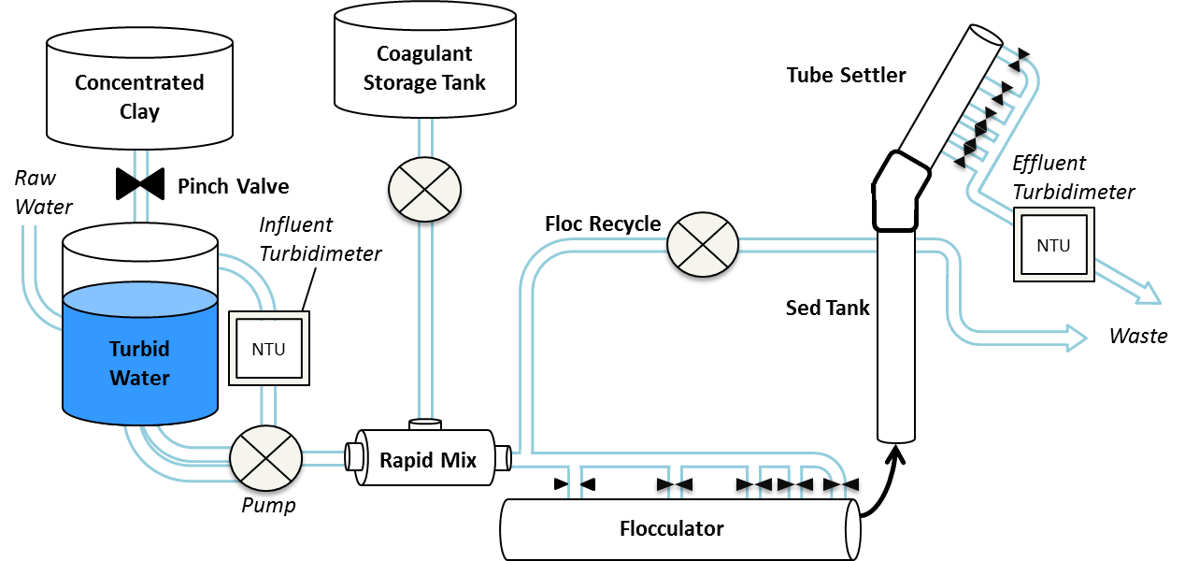
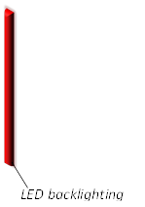
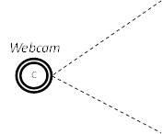
Changes in the Experimental Setup

Slide 5
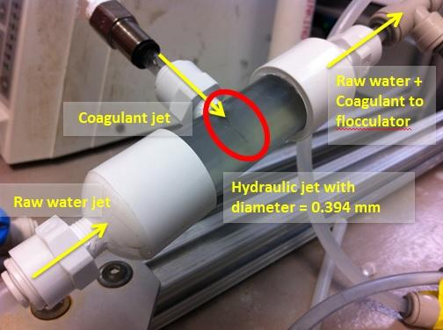
New rapid mix chamber
The rapid mix chamber mixes coagulant and raw water before it enters the flocculator.
Notes:
thought that too much coagulant was being lost on the walls of the flocculator and not adhering to dirt particles, poor floc formation
previous rapid mix was 3 more loops of the flocculator.
Designed with two jet valves, one for raw water and one for coagulant, 1 m of headloss.
Glued stainless steel tubing into solid plastic connectors, inner diameter 1/3 mm
Jet valve for raw water quickly clogged, design constraint was not 1 m headloss, it is the inner diameter being large enough to let a dirt particle pass through.
Removed jet valve from raw water entrance and the rapid mix chamber has been creating great flocs!

Slide 6
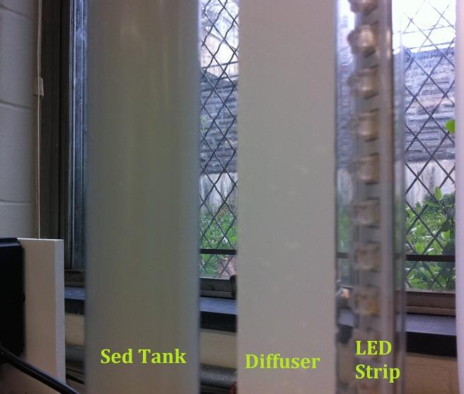
Back lighting for the sedimentation tank
The LED strip allows the camera to detect the height of the floc blanket.
The low density polyethylene diffuser smooths the light.

Slide 7
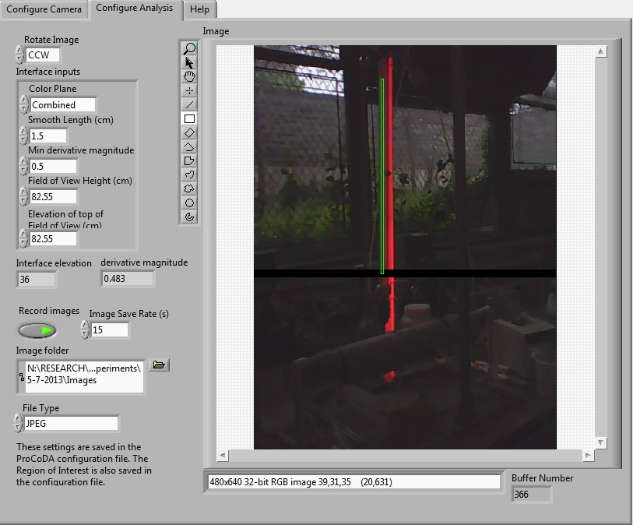
Camera Configure

Slide 8
Floc blanket video
http://www.youtube.com/watch?v=qnuw7dtrSrc

Slide 9
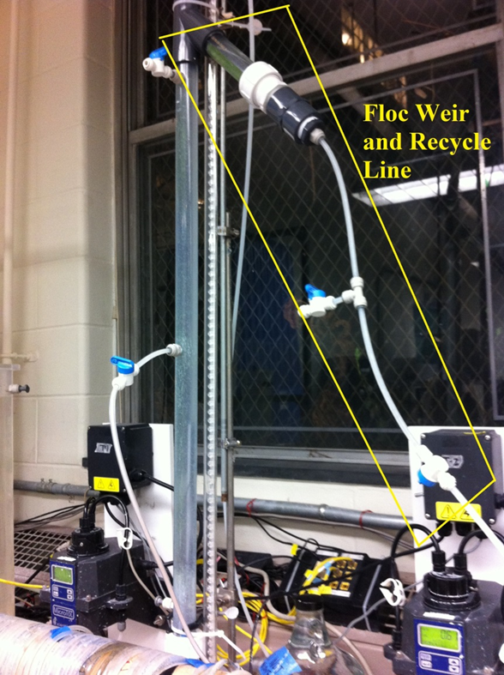
Experiments
The experiments we ran had two stages:
  Building a floc blanket using PACl as the coagulant.
  Incorporating Floc Recycle to see if it further reduced the effluent turbidity.
    Drew flocs from bottom of the floc weir.
    Experimented with floc recycle at different upflow velocities

Slide 10
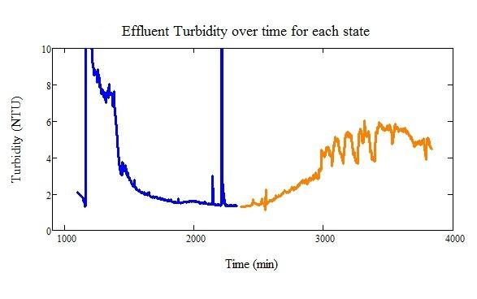
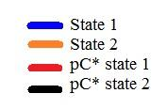
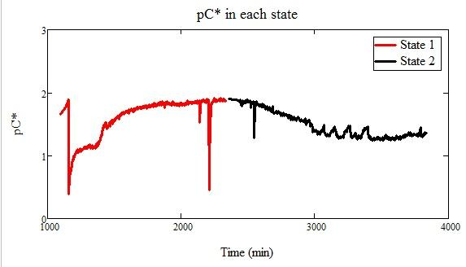
10 mg/L experiment + floc recycle
100 NTU
10 mg/L PACl
1.2 mm/s upflow
Floc Recycle at 10% of upflow velocity
Notes:
Say something about why we chose 3 different coagulant doses?
10 mg/L PACl is the average dose being used in atima for 100 NTU water-looked up on data monitoring site
5 mg/L and 20 mg/L are the extremes

Slide 11
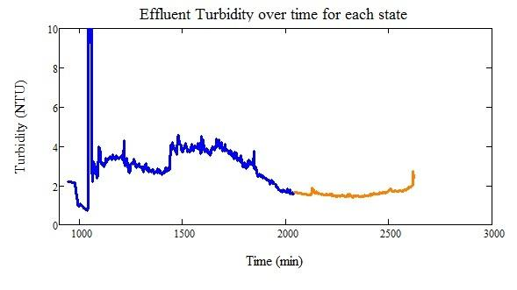
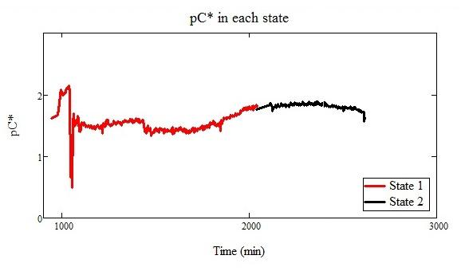
20 mg/L experiment + floc recycle
100 NTU
20 mg/L PACl
1.2 mm/s upflow
Floc Recycle at 10% of upflow velocity

Slide 12
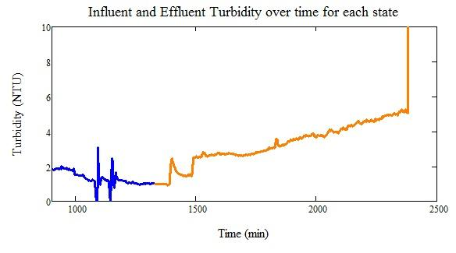
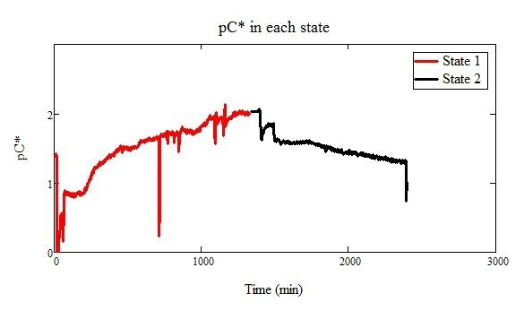
5 mg/L experiment + floc recycle
100 NTU
5 mg/L PACl
1.2 mm/s upflow
Floc Recycle: 10% of upflow velocity

Slide 13

Conclusion
The addition of floc recycle in the AguaClara plants is not improving effluent water quality.
Water quality is getting worse, not better!
We obtained good effluent turbidity and floc blanket with very high upflow velocity, but this high upflow velocity is unrealistic in real plants
Notes:
Mary-state 1 before floc recycle is started, the effluent NTU and pC* was very good already (Below 1NTU)
addition of floc recycle immediately made effluent NTU and pC* worse as can be seen by the graphs above
Same conclusion drawn about all coagulant doses.

Slide 14
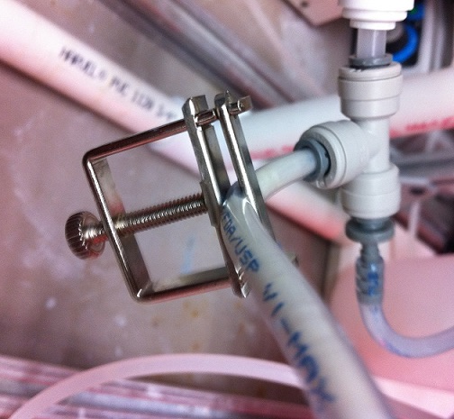
Future work and considerations
Are the recycle flocs too big or too small?
Introduce and experiment with more plant optimization measures.
Notes:
Mary-Why doesn't floc recycle produce better results in the AguaClara lab? Literature suggests recycling flocs does improve effluent water quality (although at very low influent NTUs, the same principle should hold true at higher clay doses)
Possible that the flocs being recycled have reached their maximum size, shear force is too great for smaller dirt particles to adhere to the flocs anymore. Also possible that by running them through a peristaltic pump, flocs are breaking up too much...and its essentially adding more dirt to the system, making influent water NTU higher.
We thought the former and installed a clamp right before the recycle line enters the flocculator to try to break the flocs up and did not see a change in our results (although could use more comparisons)
Is floc recycle possible at lower, more realistic plant up flow velocities? We found 1 mm/s up flow to be too low to fluidise the floc blanket well.
Move on the next optimization ideas.

Slide 15

Questions?

