Slide 1

Venturi and Low Flow Flocculator
Ryan Anthony, Elyssa Dixon and Zac Edwards

Slide 2

The Venturi:
Investigating the Potential of Floc Recycle
Brief Background
What is Floc Recycle? | Return flocs from the floc blanket in the sedimentation tank to the flocculator
Why Floc Recycle? | Recycling improves efficiency of flocculator: decrease length of flocculator, lower costs
How Can We Floc Recycle? | Integrate a Venturi into the Rapid Mix Pipe
Put on your helmet,
This will be a wild ride,
Down Venturi Lane.

Slide 3
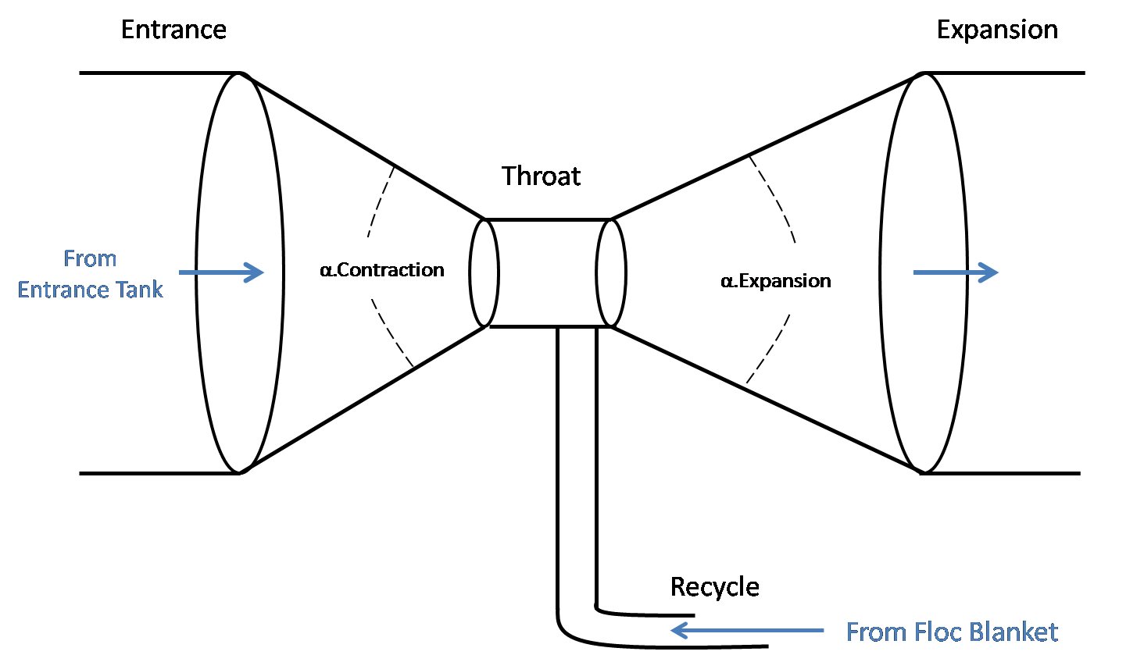
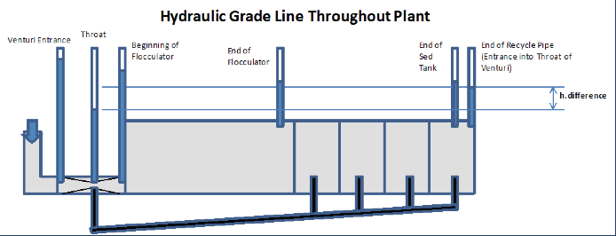
How Will A Venturi Solve the Problem?
Notes:
Zac – Describe diagram

Slide 4

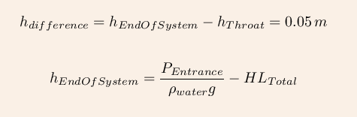
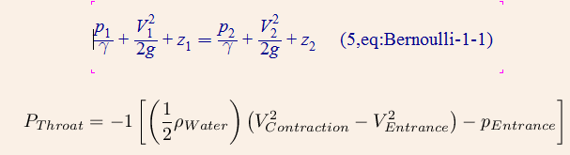
Key Equations
1. Recycle Flow Rate
2. Difference in Head
3. Total Head Loss
4. Pressure in Throat
Notes:
Elyssa – smaller throat = increase in head loss through venturi, which is why we want to find the maximum throat diameter that will still provided enough difference in head to transport flocs.

Slide 5
The Program
12 L/s Plant With Working Venturi
VARIABLE | DESCRIPTION | VALUE
d_{EntranceNominal} | Nominal Diameter of Rapid Mix Pipe | 8 in
d_{Throat} | Diameter of Throat in Venturi | 9.86 cm
DiameterRatio | Ratio of Entrance Pipe Diameter to Venturi Throat Diameter | 2.055
L_{Venturi} | Length of Venturi | 1.046
α_{Expansion} | Angle of Expansion in Venturi | 7
α_{Contraction} | Angle of Contraction in Venturi | 60
L_{Recycle} | Length of the Recycle Pipe | 8.83 m
d_{Recycle} | Diameter of the Recycle Pipe | 3 in
Coding this program
Was a formidable task,
But we did prevail.
Notes:
Zac - transition

Slide 6
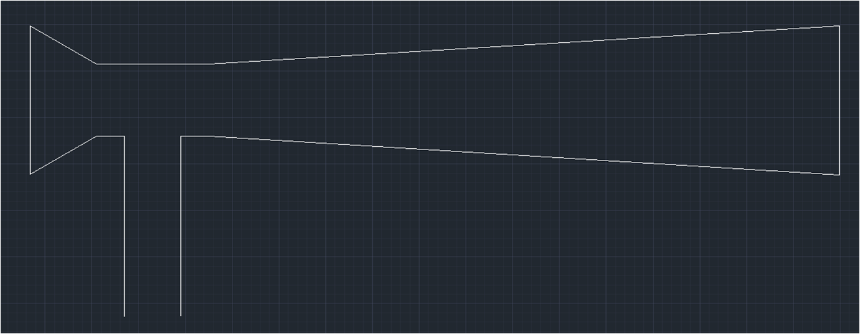
Visual Representation
L.Venturi = 1.05 m
L.Throat = 6 in
α.Contraction = 60°
α.Expansion = 7°
d.Throat = 3.88 in
d.EntranceNom = 8 in
d.Recycle = 3 in
See our venturi,
Flamboyant and majestic:
It recycles flocs.
Notes:
Zac

Slide 7
Intermission
Put our flocs curbside
Place them next to the trash can
They are recycled.
We make venturis,
But if we get frustrated,
We look at ram pumps.
3 Liters Per Second
Needs better water treatment
People are thirsty.
Notes:
Zac

Slide 8
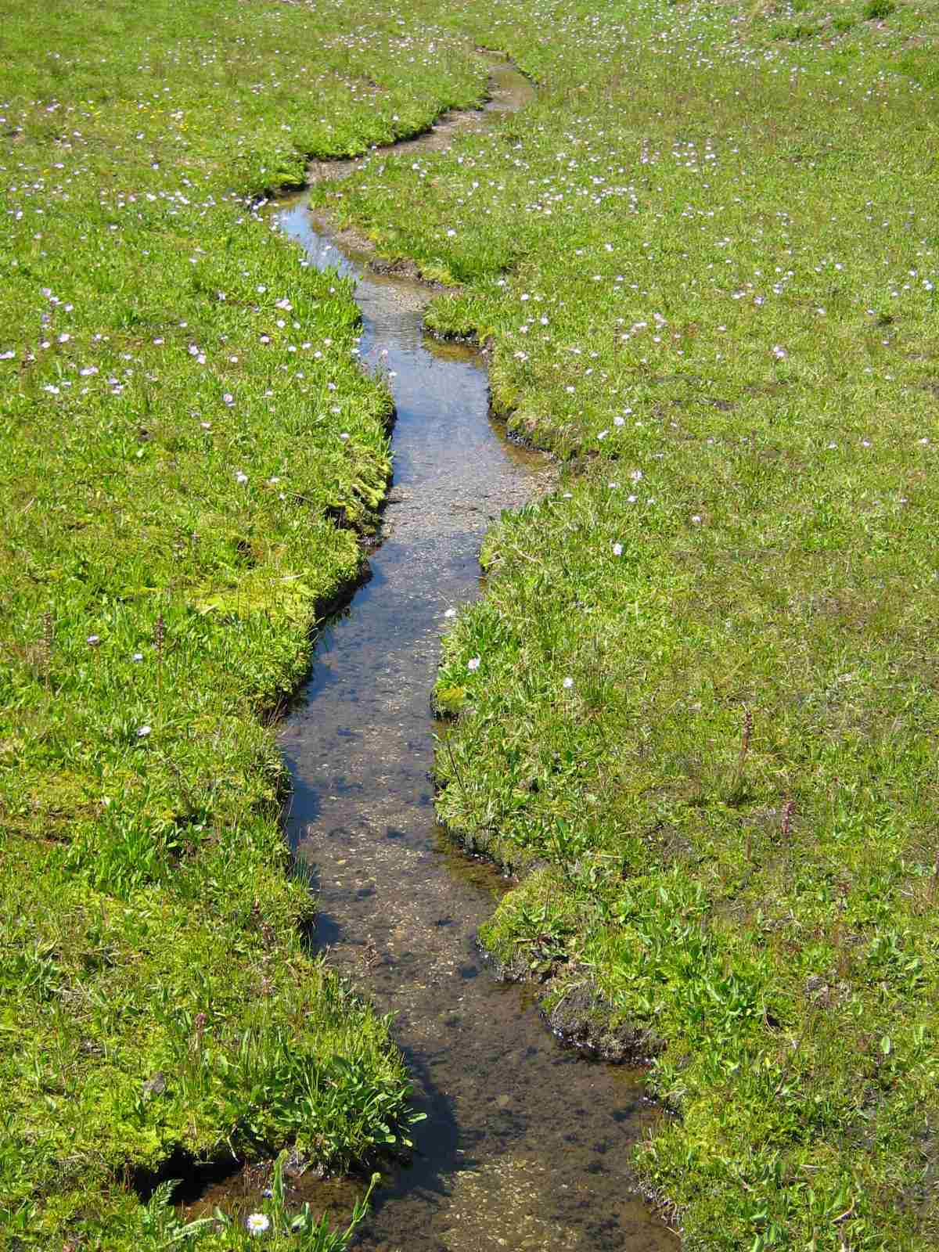

Low Flow Flocculator
Obstructions in a Pipe
  Remove geometric constraints
  Baffles and Balls
Utilize current AguaClara knowledge
In plants with low flows
Flocculation is no good
We shall overcome
Notes:
Elyssa

Slide 9
Assumptions
H/S = 4
Collision Potential
Efficiency = 0.95
e_{Max} = 10 mW/kg
Energy Dissipation
Uniformity = 2
e_{Avg} = 5 mW/kg
We made assumptions.
They were real big assumptions.
But do they hold true?
Notes:
Elyssa

Slide 10
Baffles
Current plants maintain cross-sectional area of flow
Modify to pipe
  Distance Correlation
  Area Correlation
Dimensions
  H = Pipe Diameter
  S = Spacing
  W = Average Chord Length
What’s our favorite word?
Flocculation. Flocculate.
Floc. Floc. Floc. Floc. Floc.

Slide 11
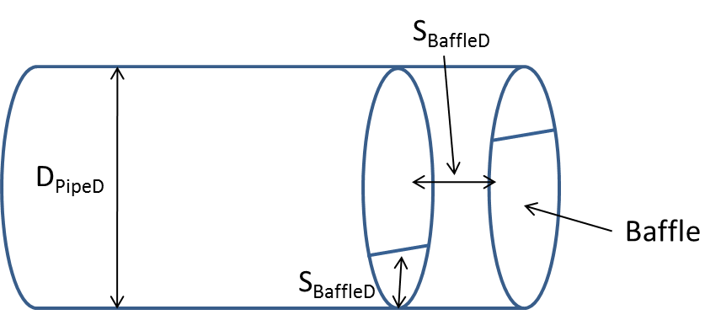
Baffles – Distance Correlation
Maintain Spacing
  Current AguaClara Flocculators
  Loss due to flow expansion
Our Balls and Baffles
Could revamp AguaClara
Can they really work?
Notes:
Elyssa

Slide 12
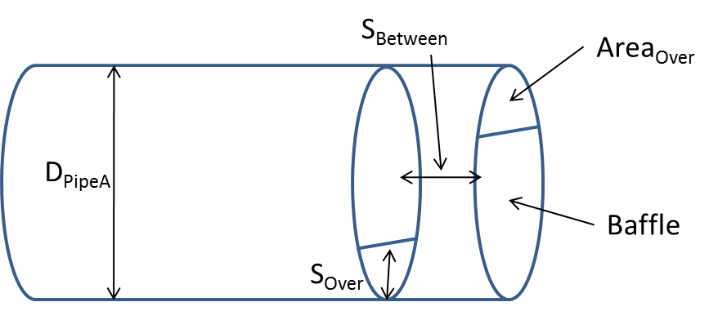
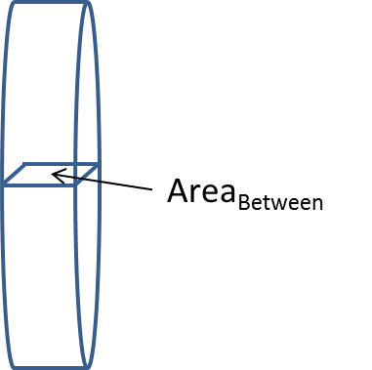
Baffles – Area Correlation
Maintain Area
  Eliminate loss due to flow expansion
Notes:
Elyssa

Slide 13
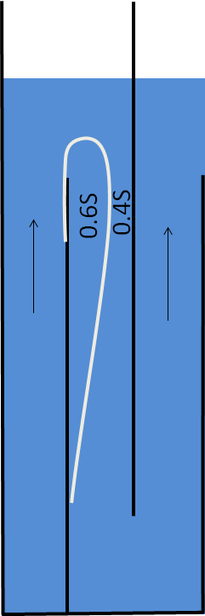
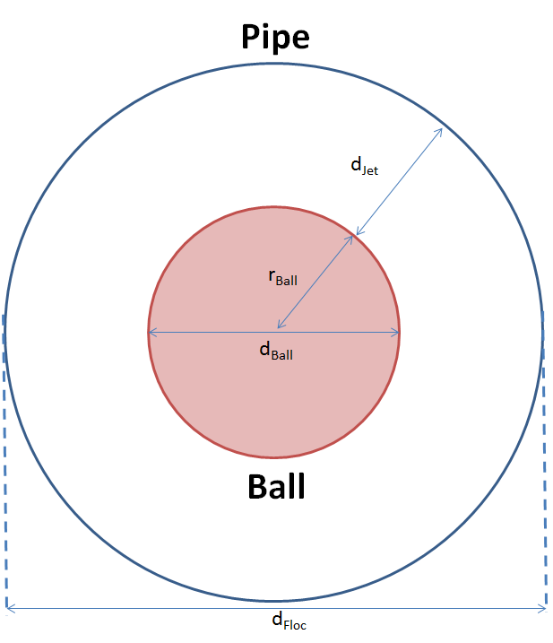


Balls in a Pipe
$$A_{Ball}=Π_{Ball}A_{Floc}$$
$$Π_{Ball}≈0.6$$
Notes:
Zac
H = d.Floc

Slide 14
Balls in a Pipe
d_{Jet}
r_{Ball}
“Dead Zone”
L_{Balls}
L_{Balls} is a geometric property based on the expansion of jets
Notes:
Zac
S=L.Balls

Slide 15
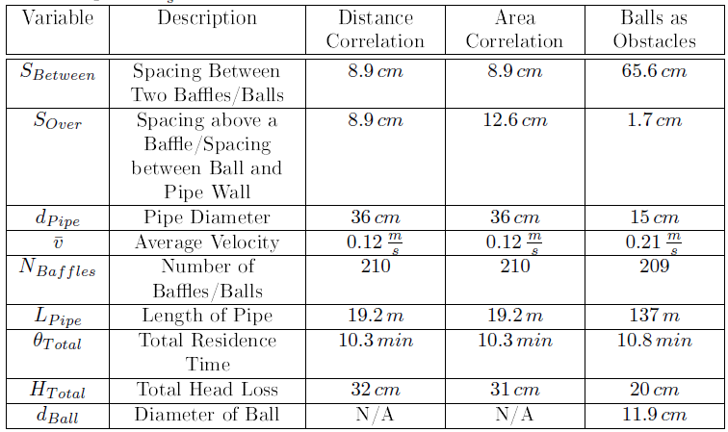
Summary and Comparison for 3 L/s
Both options can work.
Only one can be the best.
We find it baffling.
Notes:
Zac

Slide 16
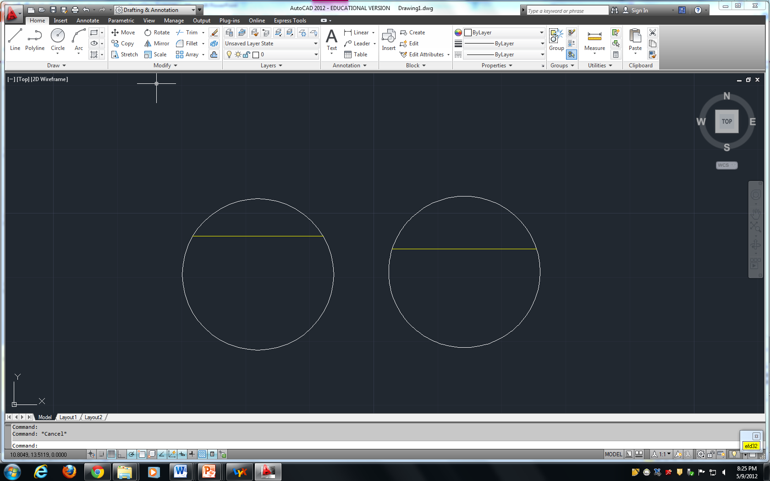
Baffle Spacing Comparison
Distance Correlation
Area Correlation
8.9 cm
12.6 cm
Top of Baffle
Top of Baffle
36 cm
36 cm
Notes:
Elyssa

Slide 17
Uncertainty
Sensitivity to Assumptions
Baffles
Balls
  Assumptions:
    a_{e}=2
    e_{Max}=10 mW/kg
  Recalculation Yields:
    a_{e}=10
    e_{Max}=20 mW/kg
If Monroe were king,
All the water would be clean.
Instead, we do work.
Notes:
Zac
Baffles – ensure that calculations are current for converting AguaClara stuff into pipes

Slide 18
Future Work
Venturi
Low Flow Flocculator
Fix Balls
Price comparison
Constructability
Method to observe flocculation
Prototype to compare to calculated values
Notes:
Elyssa
BUILD

Slide 19
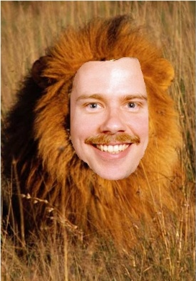
Questions?
I like burritos.
I think most people do too.
Let’s make clean water.
We stay up all night
Writing MathCad documents
And then we revise
Would you like to have
A refreshing glass of mud?
I prefer water.
Venturis are cool
We wanted to construct one
‘Twas not meant to be
We provide water.
We might also save the world.
We do what we can.

