Slide 1

Venturi and
Low Flow Flocculator
Ryan Anthony, Elyssa Dixon and Zac Edwards

Slide 2
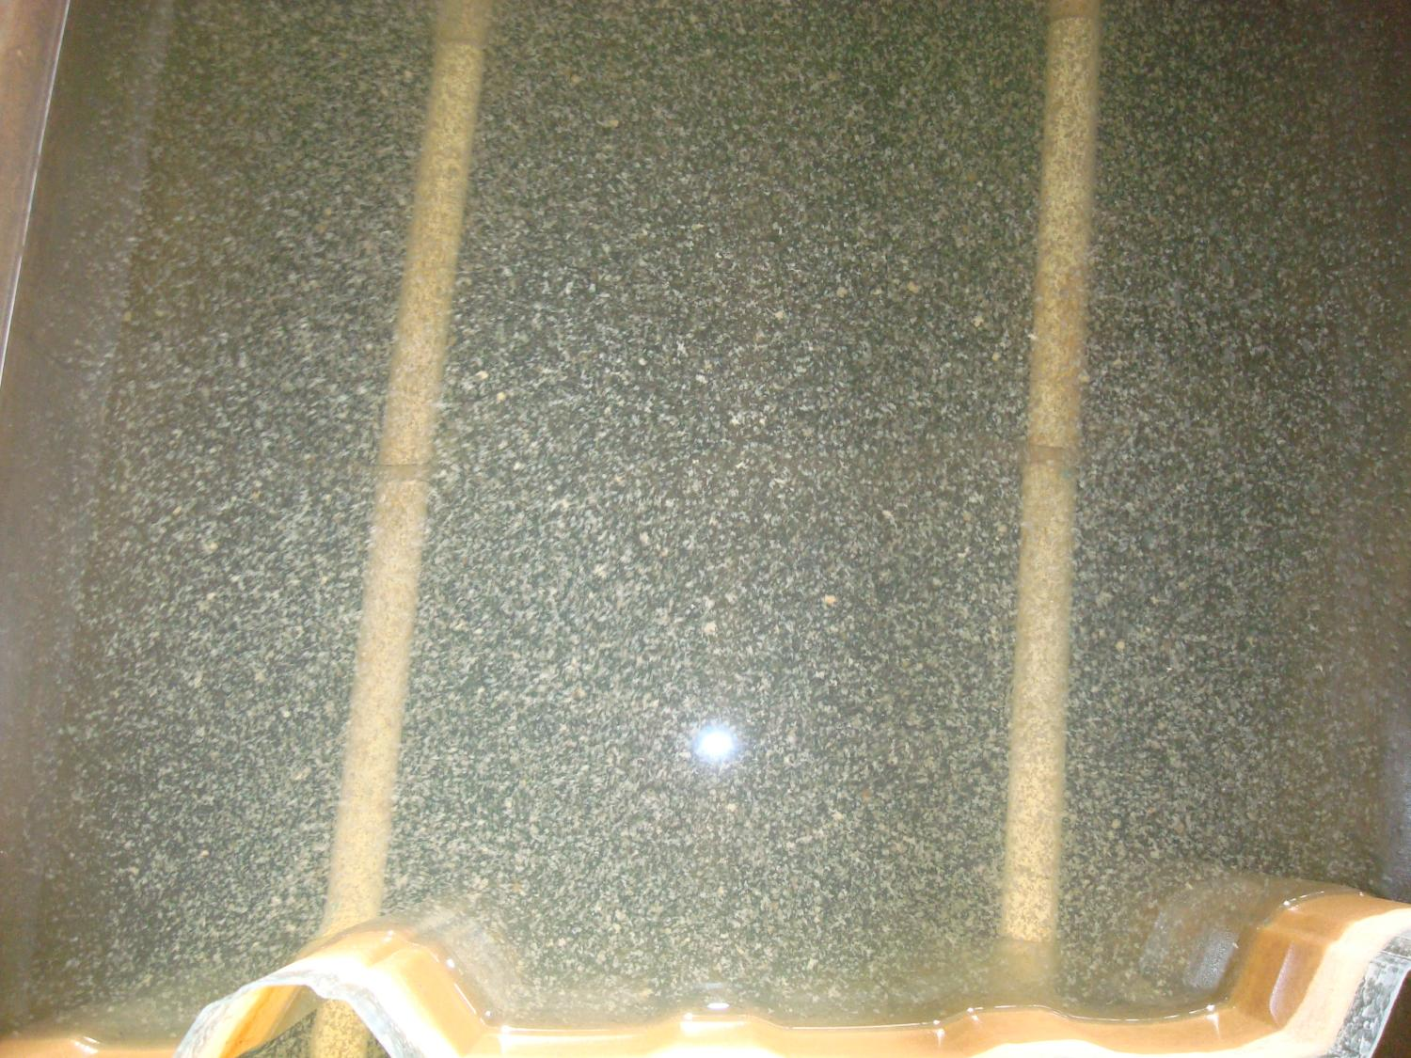

Flocculation Overview
Turn smaller particles into larger particles
  Large particles are removed more easily in sedimentation and filtration
  Needs: “Sticky particles” and Collisions

Slide 3
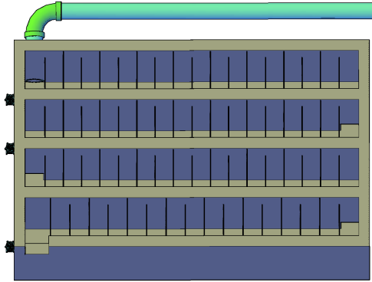
Flocculation Overview
Entrance
Channels
Ports between channels
Upper Baffles
Exit
Lower Baffles

Slide 4
Flocculation Overview
H = Water depth
L = Length of the flocculator channel
S = Space between baffles (and between the bottom of the tank and bottom of the upper baffles)
Exit to the sedimentation tank entrance channel
Minimum water level
S
Lower baffle
H
S
Upper baffle
Port from previous channel
S
L

Slide 5
Collision Potential
Ability to Provide Collisions Between Flocs
Characteristic of the Flocculator
  Increase Size of Floc (to a point)
  Make it Easier for Flocs to Settle Out In Sed Tank
  Lower Residual Turbidity in Effluent

Slide 6
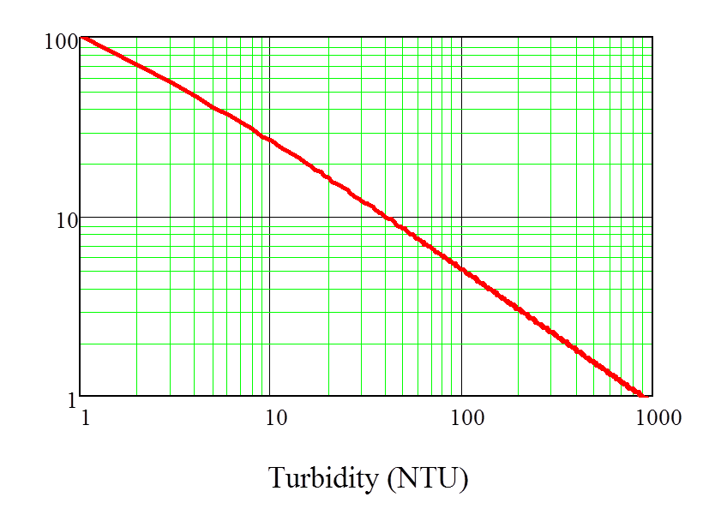

Why Would We Recycle Flocs?
Collision Potential Required for Varying Influent Turbidities

Slide 7
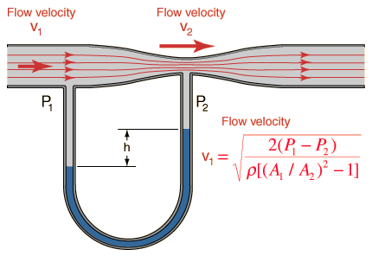

What is a Venturi?
Venturi In Action
Notes:
-Reduction in fluid pressure from a contraction in pipe cross-sectional area
-Venturi effect is based upon the Bernoulli Equation
-Low Pressure created by the increased velocity creates a vacuum in the contraction

Slide 8
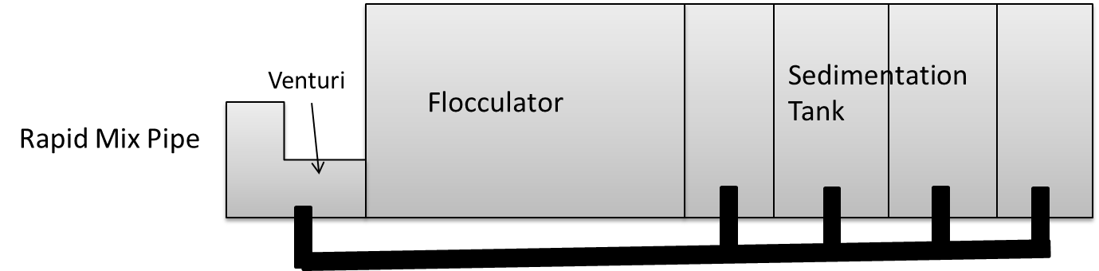
How Would a Venturi Be Used in an AguaClara Plant?
Recycle flocs from the floc blanket in the Sedimentation Tank
Notes:
Venturi must overcome head loss through plant (expansion of venturi, flocculator, sed tank is negligible and recycle pipe) – this determines how much head the vacuum needs to overcome

Slide 9
What Have We Done?
Notes:
Make assumptions about turbidities, and do mass balance to size Recycle pipe (3%) – can improve with others research
Linked dimensions into source code (thanks design team), program sizes recycle, contraction, angles based on plant flow rate
We plan to: improve based on new research, iterate the code to get a table of necessary constrictions for different flows, test construction techniques/performance of our geometry (smushed pipe)

