Slide 1

Stacked Rapid Sand Filtration-Full Scale
Michelle Wang
Steph Lohberg
Chris Holmes

Slide 2

Stacked Rapid Sand Filter
Filtration Cycle
Backwash Cycle
Valve
Inlet Box
Outlet Box
Siphon
Pipe
Air Trap
Sand Bed

Slide 3
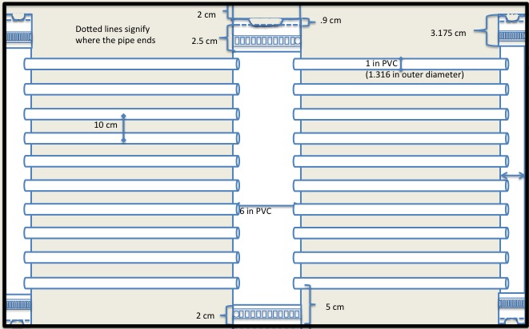
Model Dimensions

Slide 4
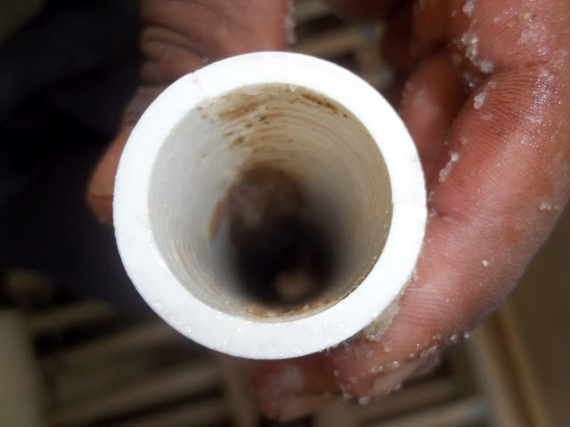
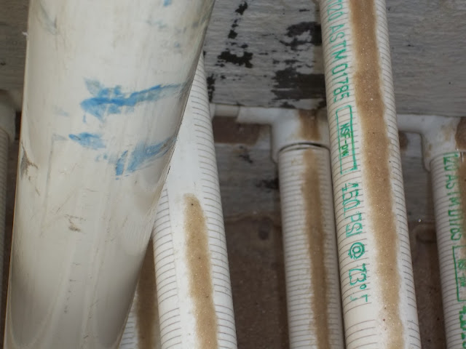
SRSF in Tamara-Issues
Pipe Connections

Slide 5
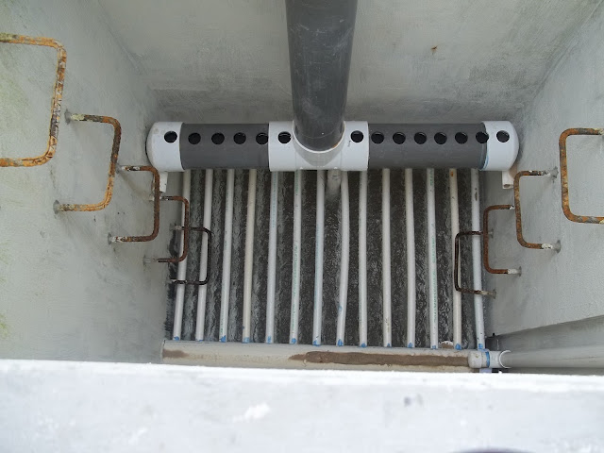
SRSF in Tamara-Issues
Pipe Connections

Slide 6
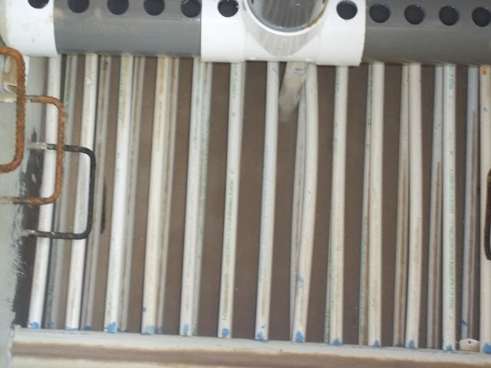
SRSF in Tamara-Issues
Pipe Connections

Slide 7
Molding Process
Boiling Water
  Did not work
    Water was at a full boil
    Added salt
    Considered other additives
Heat Gun
  Works very efficiently
  Less than a minute
Types of Molds
  Tapered Mold
    Too much of a Taper
    Loose when connected to pipe
  Straight Mold
  Curved Cylindrical Mold

Slide 8
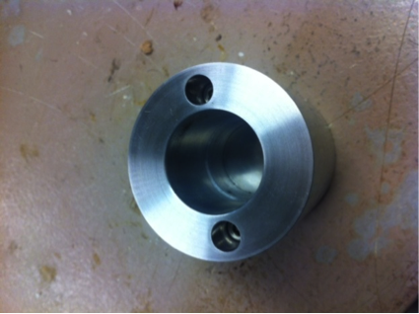
Different Molds
Mold for the 6’’ pipe

Slide 9
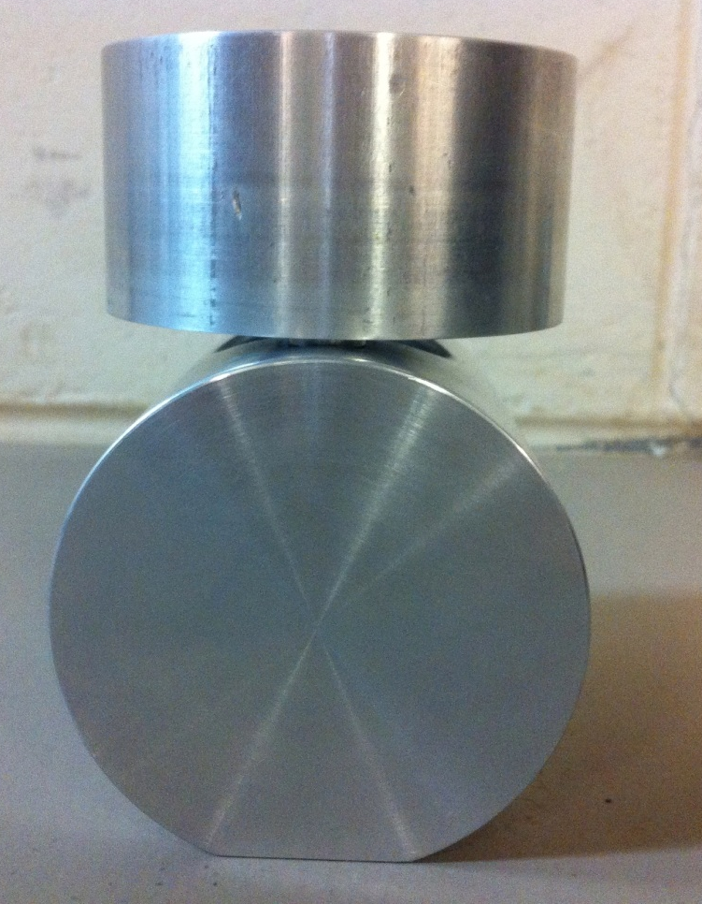
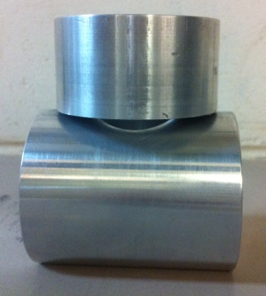
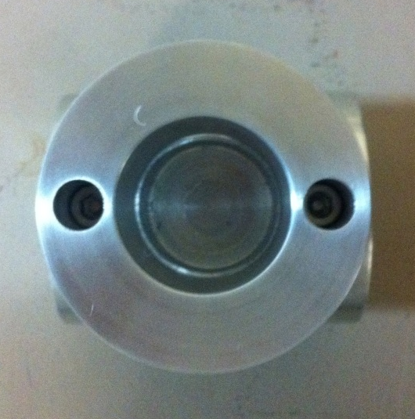
Different Molds
Mold for the 2’’ pipe

Slide 10
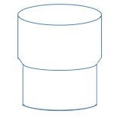
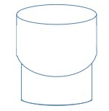
Different Molds-Diagrams
Straight Mold Curved Mold

Slide 11
Molding Video Process
http://www.youtube.com/watch?v=Bl-fKro20Ec

Slide 12
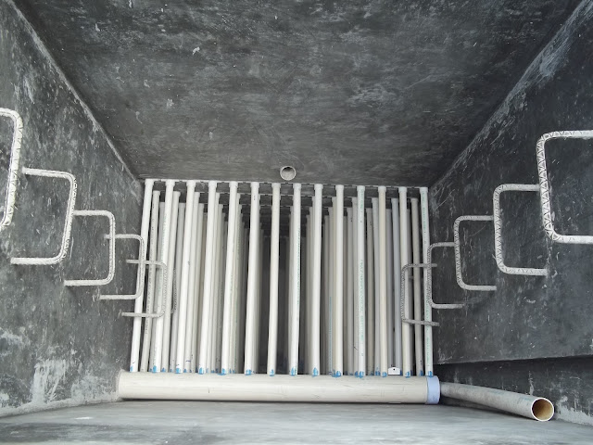
Assembly Process
Pipes are directional
Construct outside of box
Still able to exchange individual pipes when necessary
Also, no sealants or epoxies

Slide 13
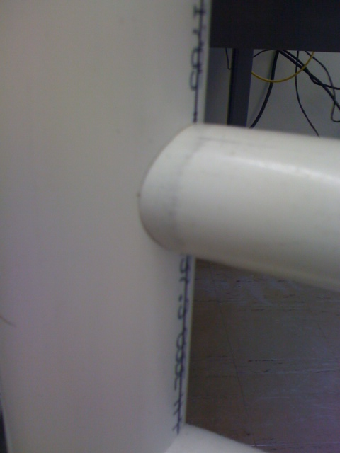
Weaknesses
Pipes connection gaps
  Fixed by enlarging the mold
Flexing
  Fixed by using cables

Slide 14
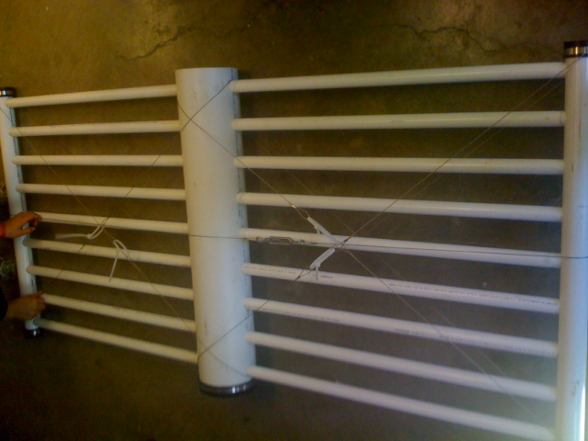
Cables
Different design strategies
  Lateral design doesn’t give enough horizontal flex support
  Creating an X gives stability in all directions
  Adding a single lateral cable gives vertical stability

Slide 15
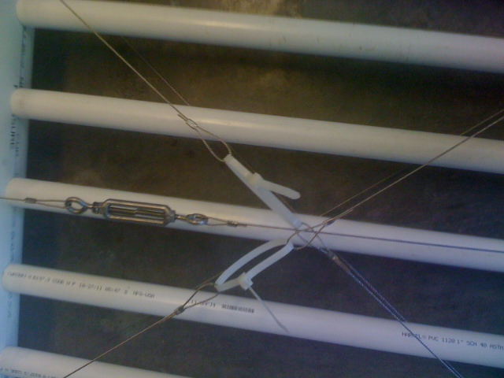
Zip Ties and Turnbuckles
Zip ties vs. Turnbuckles
  Initial idea used turnbuckles which could get tighter
  Then zip ties were cheaper and created a default strength

Slide 16
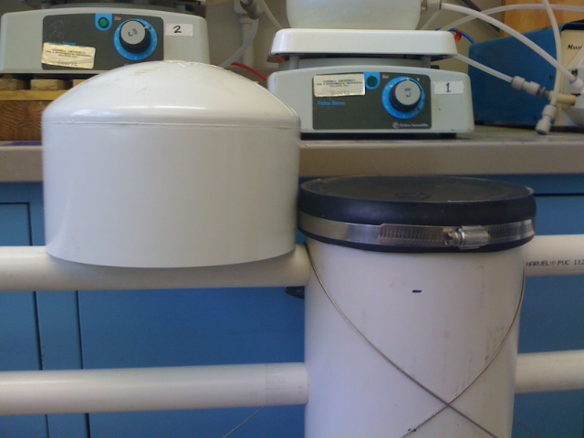
Assembly Problems
Caps and Couplings (Fernco vs. PVC)
Consistency with creating holes
Stacking

Slide 17
Assembly Video Process
http://www.youtube.com/watch?v=oTHYG9axKW

Slide 18
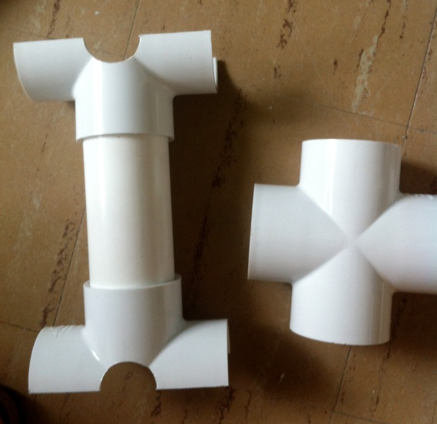
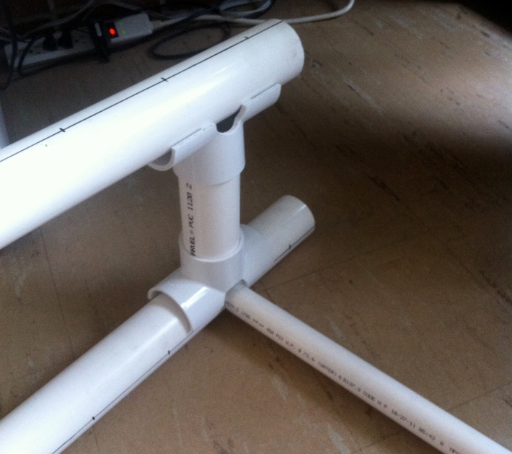
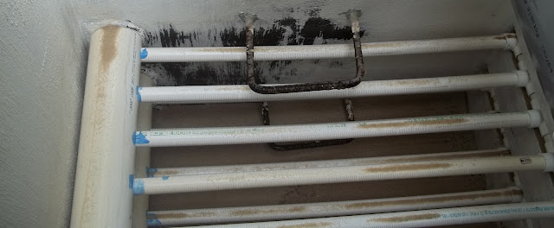
Stacking Layers
Alternative method - no T connections
Zip-ties as a viable option
Functions in backwash
Easy to manufacture
Easy removal

Slide 19
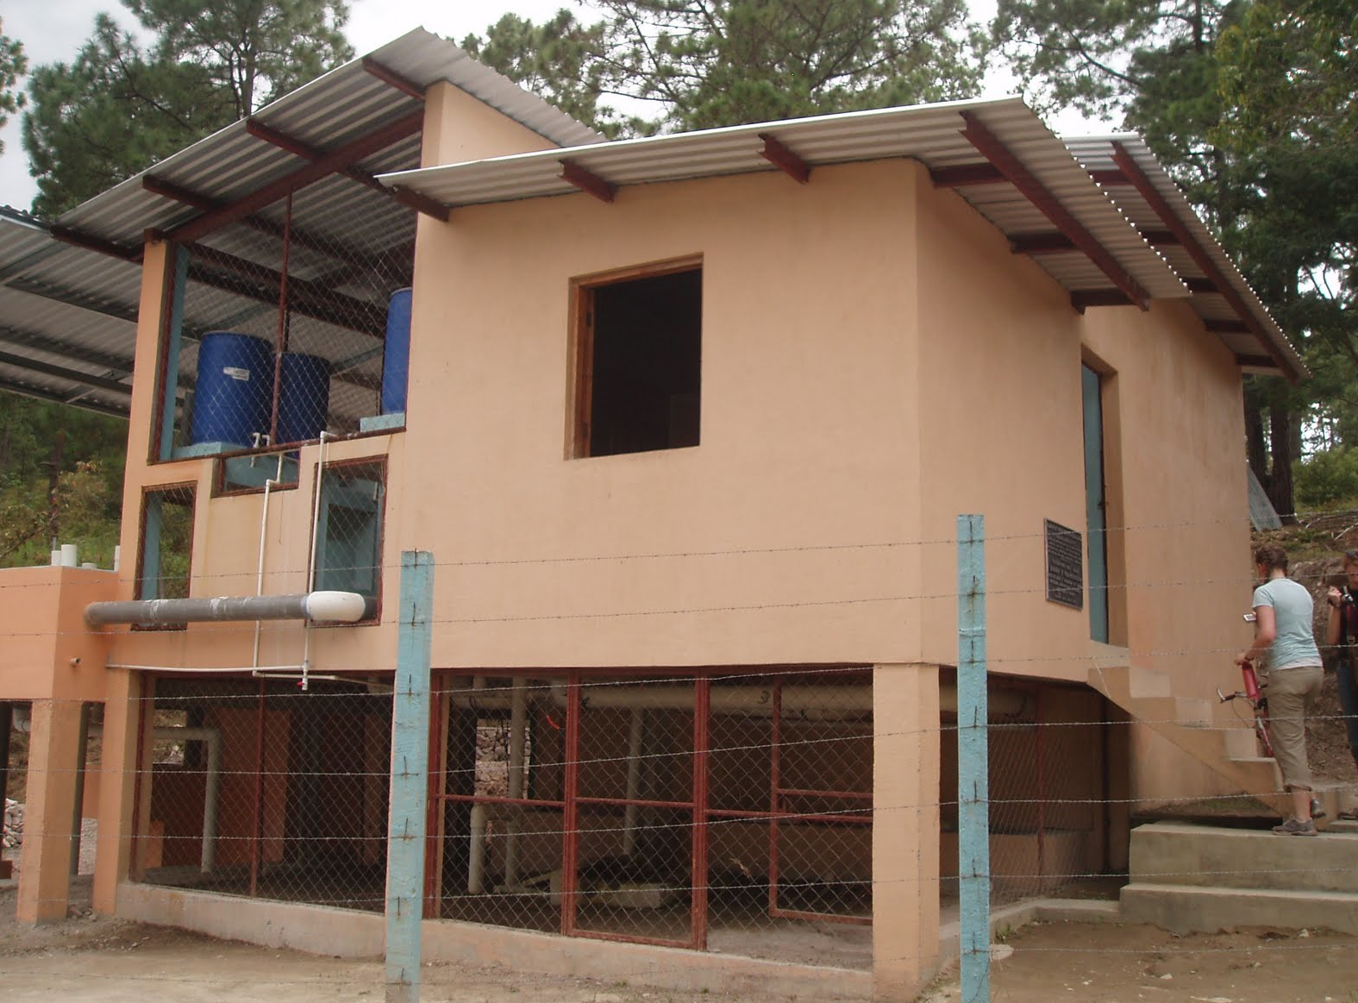
Future Work
Test stacking methods
Cable fastening
Low-Flow plant

