Slide 1

Stacked Rapid Sand Filtration-Full Scale
Michelle Wang
Steph Lohberg
Chris Holmes

Slide 2

Stacked Rapid Sand Filter
Filtration Cycle
Backwash Cycle
Valve
Inlet Box
Outlet Box
Siphon
Pipe
Air Trap
Sand Bed

Slide 3
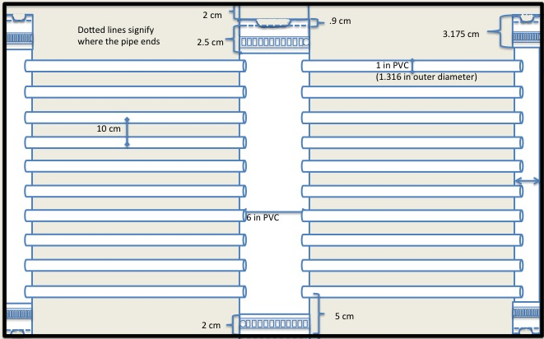
Model Dimensions

Slide 4
Molding Process
Boiling Water
  Did not work
    Water was at a full boil
    Added salt
    Considered other additives
Heat Gun
  Works very efficiently
  Less than a minute
Oil
  Crisco Pure Canola Oil
  Smoke point around 400°F
Types of Molds
  Tapered Mold
    Too much of a Taper
    Loose when connected to pipe
  Straight Mold
  Cylindrical Mold
  Curved Guide Cylindrical Mold

Slide 5
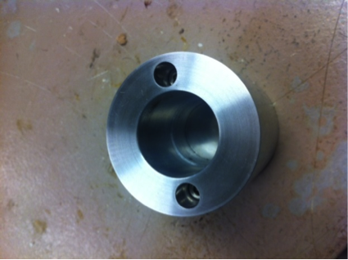
Different Molds
Mold for the 6’’ pipe connection (Straight Mold)
  Does not work for the 2” pipe connection
    Curvature of the 2” pipe
    Not a secure fit

Slide 6
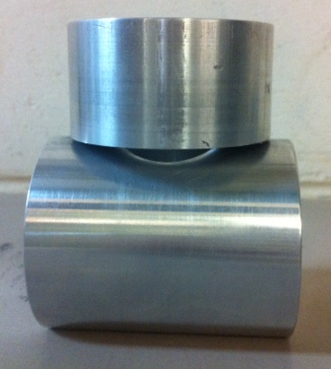
Different Molds
Previous mold (Cylindrical Mold) for the 2’’ pipe
  Worked well for regular pipes
  Issues arose with slotted pipes
    Pipe kept getting caught between the guide section and the mold
    Difficult to work with

Slide 7
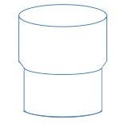
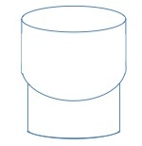
Different Molds-Diagrams
Straight Mold Curved Mold

Slide 8
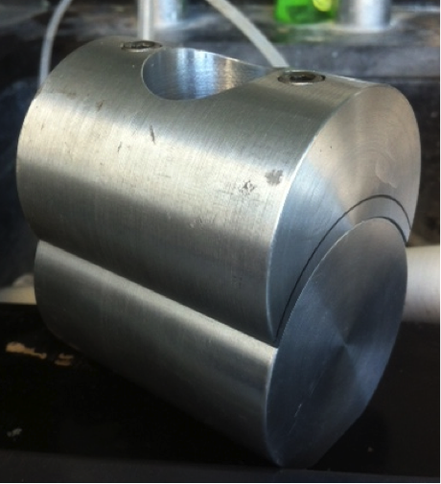
Different Molds
Curved Guide Cylinder Mold
  Eliminates the space between the guide and the mold
  Gives better and more consistent results
  Pipe no longer flares outward
  Bottom few slots still compress slightly
  Directionality

Slide 9
Molding Video Process
http://www.youtube.com/watch?v=wN5Sh7aN8ao&feature=plcp

Slide 10
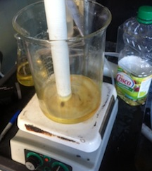
Experimental Oil Set Up
Hot plate (or other heat source)
Oil (Pure Canola Oil)
240°F-270°F
  Monitor using thermometer
Submerge for 1 minute
Remove from oil
Wipe away oil on the outside of the pipe
Insert into mold
Transfer to cold water

Slide 11
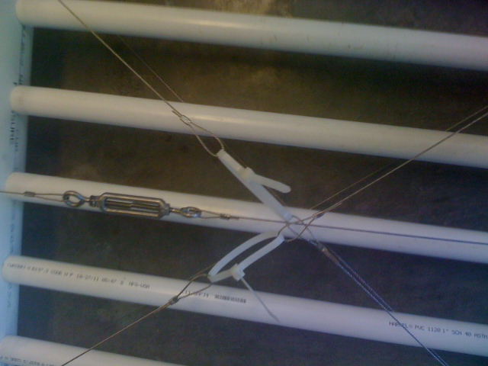
Cables vs. Glue and other options
Zip ties are unprofessional
Cables lead to slotted pipes flexing
Glue problems
  Couldn’t remove single pipe
  Need to glue at the same time
Kevlar
  Longevity issue
  Also unprofessional
Steel wire
  Couldn’t get a clean twist

Slide 12
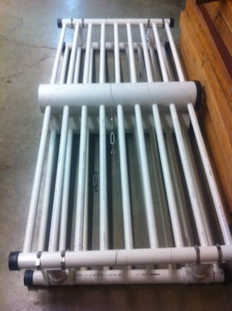
Assembly Run Down
Cut all the pieces to correct size
Drill the holes as precise as possible
Insert the molded PVC into the trunk and end pipes
Wrap steel cable and tighten the turnbuckle
Put on the Fernco caps, and cut 6” connections to correct size
Put the 2” stackers on with hose clamps
Glue the 6” stacker into place
Manifold is now ready to be stacked

Slide 13
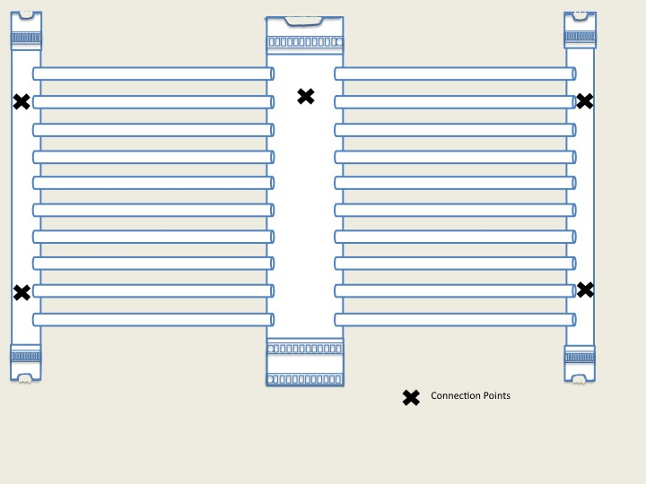
Stacking Placement

Slide 14
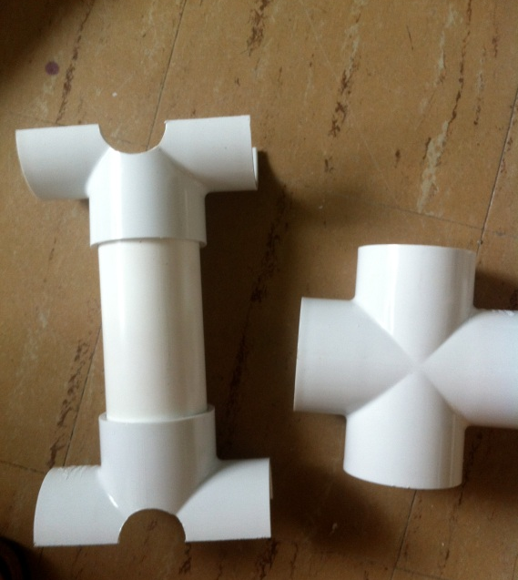
2” Stacking
Used 2” cross tees
  Regular tees are also an option
Drilled 1.5” hole in the center
Cut the cross tee in half
13.5 cm length 2” pipe to separate the layers
Use hose clamps to secure the stacking piece to each layer

Slide 15
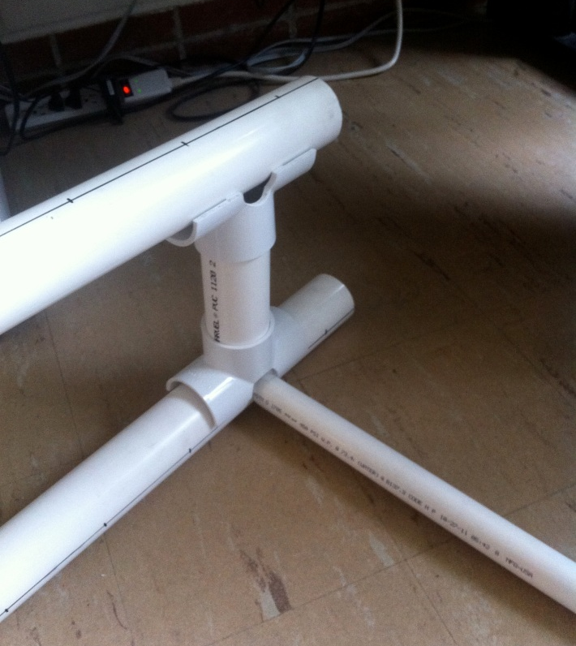
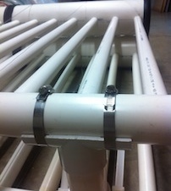
2” Stacking

Slide 16
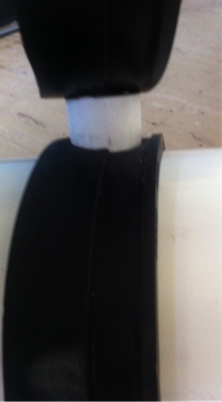
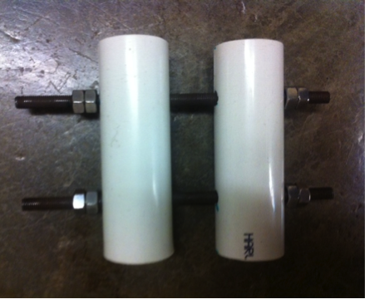
6” Trunk Stacking
Failures
  Cutting curved PVC
    Hard to match curvature
    Not enough glue area
  Fernco coupling
    Could not easily stack
1” PVC solution
  2 pieces connected with nuts and threaded rod
  Adjustable

Slide 17
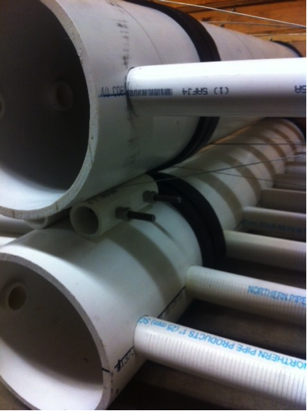
6” Trunk Stacker

Slide 18
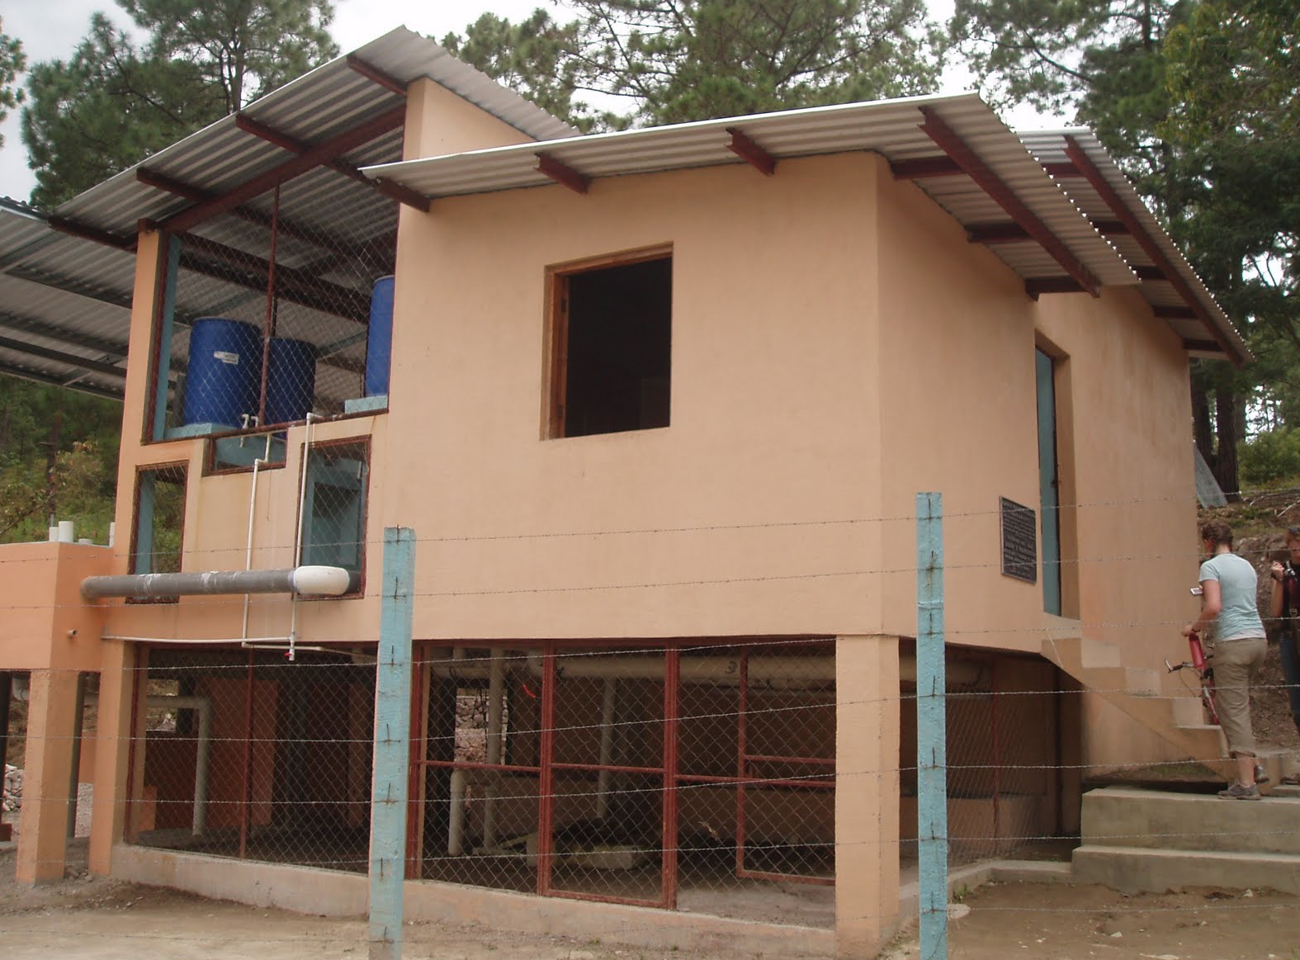
Next Step: Filter Box Anchoring
Layers will shift during backwash
Need a way to secure layers without having layers connected to each other
Option still being researched

Slide 19

Questions?

