Slide 1
Stacked Rapid Sand Filtration Pilot Scale
Final Presentation, Spring 2012
Jordanna Kendrot · Bill Kuzara · Eva Johnson
Most thanks to Michael Adelman

Slide 2

The Plan
Introduction
  Quick review of SRSF
  What we “learned” last time
Experiments
  500 NTU cycle results
  4-layer vs. 6-layer
    Is it better?
Future work

Slide 3
Introduction:
Review of SRSF & Hydraulics
Flow Exit
No Flow
Air Trap
Flow Exit
No Flow
Siphon Flow
Filtration cycle
Backwash cycle
Notes:
Jeff

Slide 4
Introduction:
Review of SRSF Variables
Water Level Log
Important Time Variables
  Fall
  Flush
  Rise
  Rinse
Backwash Cycle
Filtration Cycle
Rinse Time = Time for 90% particulate removal (pC* = 1)

Slide 5

Introduction:
What we “learned” last time
Long tests (5+ hours) are hard to run “flawlessly” due to random errors
  Bubbles
  Server Failure
  Reservoir Failure
  Human Failure
500 NTU High Load Tests = AWESOME
  Shortens on-site time
  Allows multiple tests to be run per day
  Errors can be spotted quickly and fixed
  The best backwash flush time is between 2 minutes to 4 minutes, with a total backwash cycle <6 minutes

Slide 6
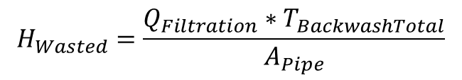
Experiments:
500 NTU Cycle Results
$$H_{Wasted}=\frac{Q_{Filtration}∗T_{BackwashTotal}}{A_{Pipe}}$$
From the data it seems like a 2-minute flush time is the best because it has the lowest wasted height
BUT:
Consistently had 4-8cm of head buildup immediately entering filtration after backwash ended
Meaning there is a higher chance of the filter overflowing sooner!

Slide 7
Experiments:
500 NTU Cycle Results
Graph of how much water is wasted during each section of the backwash cycle.

Slide 8
Experiments:
500 NTU Cycle Results
Flush times of 2, 3, and 4 minutes all have a similar height of wasted water getting to 90% NTU removal (i.e. if influent = 23NTU, the time it takes for effluent to become = 2.3NTU).
Results indicate 3 minutes is the best flush time.
Even though it wastes more water than 4 minutes, it is minimal and a shorter total backwash (over a minute shorter) outweighs the <1m saved by using the longer flush.

Slide 9
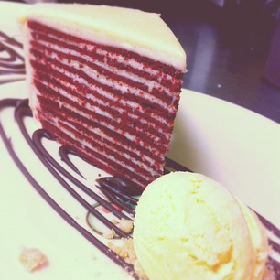
Experiments:
4-Layer Introduction
Why do we even want to try?
4 layers at 20 cm (80cm) vs. 6 layers at 20 cm (120cm)
  “A 80 cm filter bed would be soooo attractive.” –Monroe 2012
  $ave$ $and
  It would be silly for us to assume our first setup was the best.
6 layers?
Or 4 layers?

Slide 10
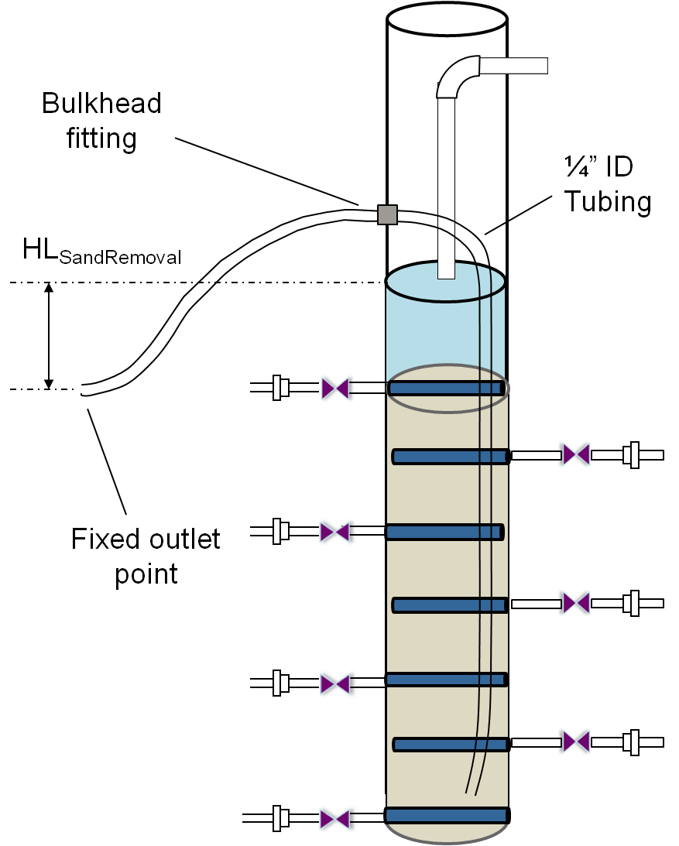
Experiments:
4-Layer Tests
How do we make four layers?
Need to remove 40cm of sand, but:
  Keep each layer at 20cm
  Can’t remove sand during filtration (sand is packed)
  Have to remove sand while the bed is fluidized!
Things to remember when removing sand:
Can’t just “take out” 40cm of sand, since the bed is fluidized to approx. 130% in height
Each inlet/outlet add 4cm each to the total height of the sand (when settled)
Need to make sure the top outlet is covered

Slide 11

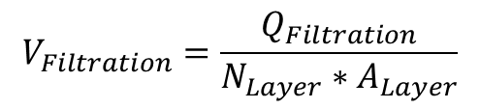
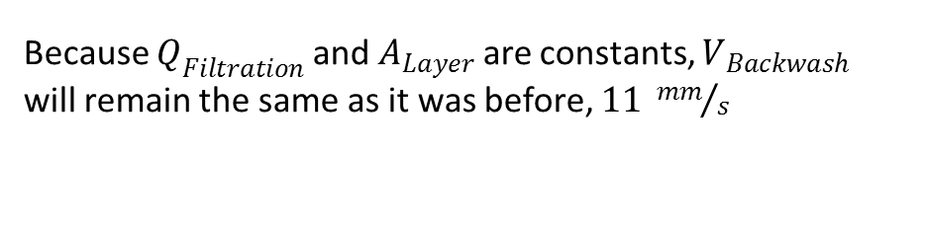
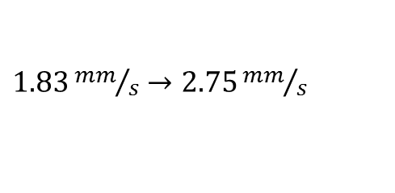
Experiments:
4-Layer Tests; Our concerns and speculations
$$V_{Filtration}=\frac{Q_{Filtration}}{N_{Layer}∗A_{Layer}}$$
Decreasing the amount of layers from 6 → 4 will result in an increase in the normal filtration velocity
$1.83{mm}/s→2.75{mm}/s$
Increasing filtration velocity = Increases scouring! Meaning poor performance because high turbidity water is FORCED through layers, and contaminants cannot be easily trapped/filtered out.
$$V_{Backwash}= N_{Layer}∗V_{Filtration}$$
Because $Q_{Filtration}$ and $A_{Layer}$ are constants, $V_{Backwash}$ will remain the same as it was before, $11 {mm}/s$

Slide 12
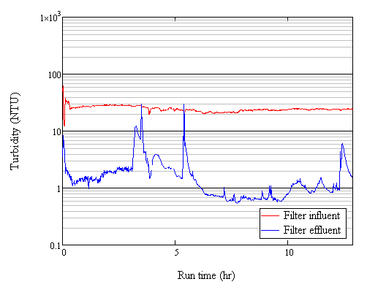
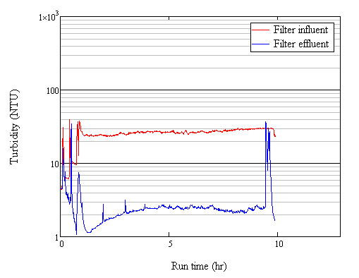
Experiments:
4-Layer Tests Results
Ran filter at 10 NTU until it began to “overflow” in inlet box, meaning that the tests would all have the same amount of headloss buildup and thus could be comparable
Inconsistencies in the 4-layer head accumulation (how long to overflow)
First run = 5.5 hours
Second run = 8 hours
Third run = 9.5 hours
Obviously the filter is never truly “cleaned” by using the known best B.W. cycle time

Slide 13
Experiments:
4-Layer Tests Results
LOOK AT THE EFFLUENT
In no test does it ever get below 0.5NTU, and most of the time it is over 1NTU: Bad News.
Effluent NTU starts to climb almost immediately during filtration, very steeply and doesn’t seem to ever really “stop”, unlike previous tests that show effluent dropping after B.W. rinse cycle is over and staying down

Slide 14
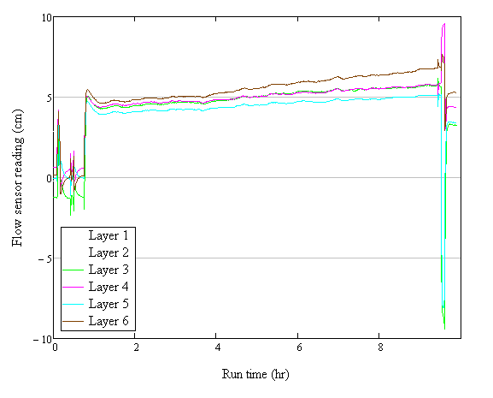
Experiments:
4-Layer Tests Results
Flow in the sensors is fairly linear, which is how it was in other experiments, but then during backwash layers 3 and 5 have a huge change in flow reading
Usually each sensor has a similar “dip” during backwash, a change of around 10cm.
Layers 3 & 5 are balancing the overall flow in the system during backwash, dropping 15cm compared to layers 4 & 6 which only drop 5cm

Slide 15

Experiments:
4-Layer Tests vs. 6 Layer
Horrible idea!
Everything that makes a SRSF good and wonderful was destroyed by the 4-layer filter!
  The filter built head much, much, quicker = faster to failure
  Effluent never stayed <1NTU for long periods of time
  NEVER reached US H2O standards!
  High filter velocities = More scour
  Uneven flow through outlets during backwash
  What’s the point of a filter that doesn’t filter?
Even I couldn’t save this

Slide 16
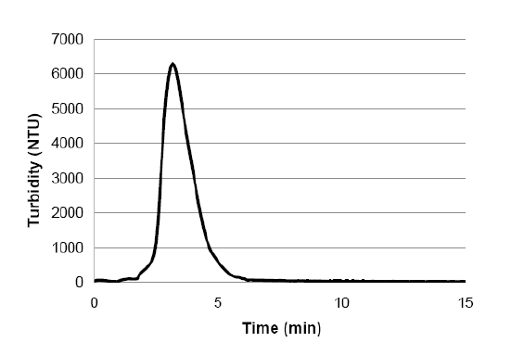
Future Work for Summer/Fall Semesters
Create an UTD Particulate Matter Removal Curve
  Figure to the right created by Fall 2011
  Using new total B.W. time, show how much turbidity is handled by system
Headloss buildup
  Graph headloss in the filter system as a function of influent turbidity and velocity
This will then allow theoretical headloss in a system to be evaluated from known values (like the Tamara filter!)

Slide 17
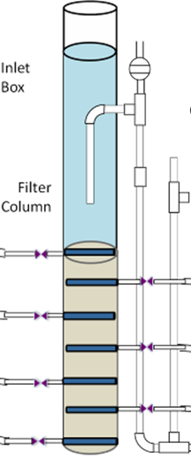
Future Work for Summer/Fall Semesters
Start using pressure sensors
  Able to determine how much particulate matter in the filter bed during tests
  Two pressure sensors- one at the base of the filter bed and one at the top
  Find out what “clean”-filter bed pressure is, then can make sure the filter is actually cleaned (it takes longer for particles at base of filter to fluidize upwards)

Slide 18

Future Work for Summer/Fall Semesters
Man, this water is so dirty.
With graphs of pressure vs. time
  How particulate matter builds up in the filter bed over time
  How much particulate matter is removed after different backwash cycles
  Compare results with previous methods of effluent turbidity/wasted water observations

Slide 19
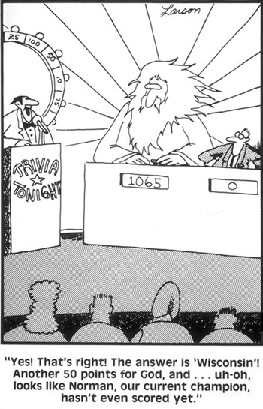
?uestions

