Slide 1

Stacked Rapid Sand Filtration
Bench Scale
Huifei Wu
Weiling Xu
Danhong Luo

Slide 2

Introduction
Goal
  Understand the hydraulic characteristics
  Test our hypothesis
    Uneven sand gradation: lead to coarser and finer layers of the filter; take time for sand to correct itself
    If there is surface removal exist in the system, it dominates the filtration process
    Different energy dissipation rate will affect the filter performance
Notes:
As we all know that, Stacked Rapid Sand Filtration technique is invented by AguaClara, it requires less water to backwash, as well as a smaller footprint to achieve the same level of filtration.
For our bench scale team, our goal is to try to understand the hydraulic characteristics of the filter.

Slide 3
Introduction
Past Work
  Flow is distributed unevenly, filter 2 in which we loaded the fine grain receives most of the flow.
Notes:
Blue: fine sand
Red: coarser sand

Slide 4
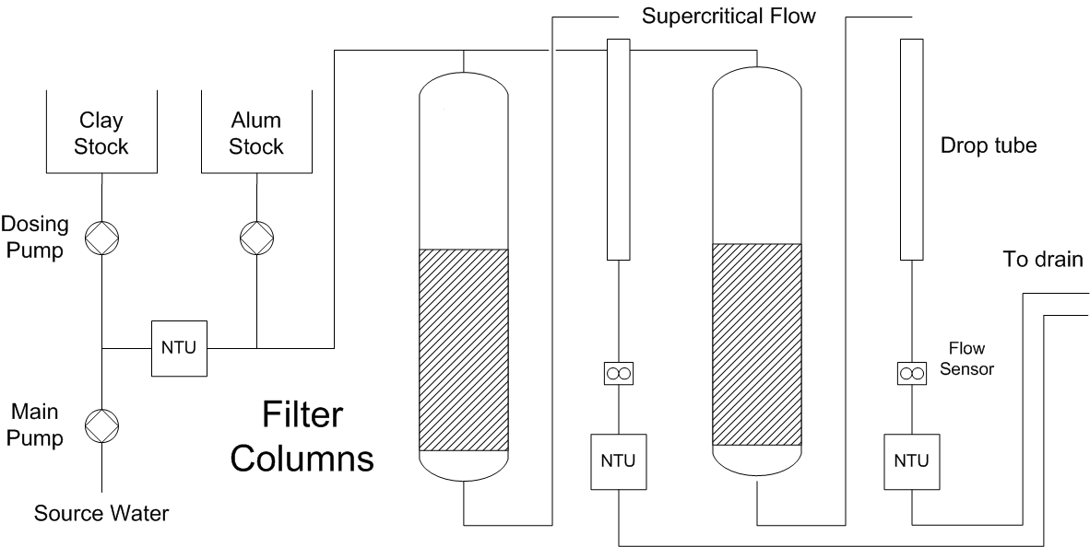
Experimental setup
Filtration Mode
Notes:
- Two 2.5cm diameter liter columns with full process control for chemical feed, backwash, and turbidity measurements

Slide 5
Experimental setup
Backwash Mode

Slide 6
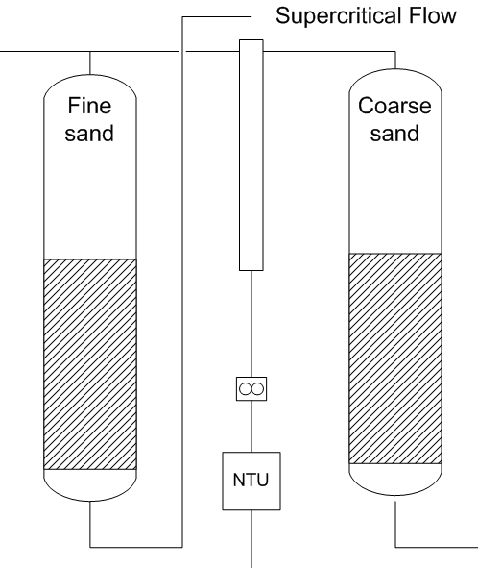
Self-healing study
Objective
  Verify the flow conditions (flow distribution, head loss etc.) in the two columns
Methods
    Equal Sand Tests
      Perturbation Test
Notes:
Fine sand

Slide 7
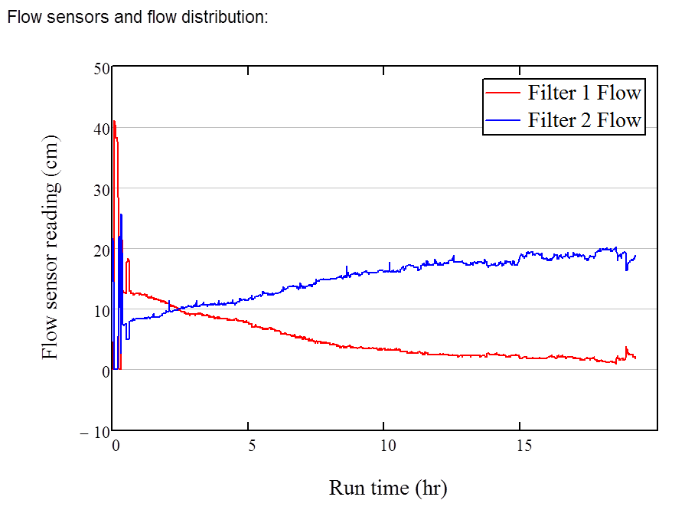
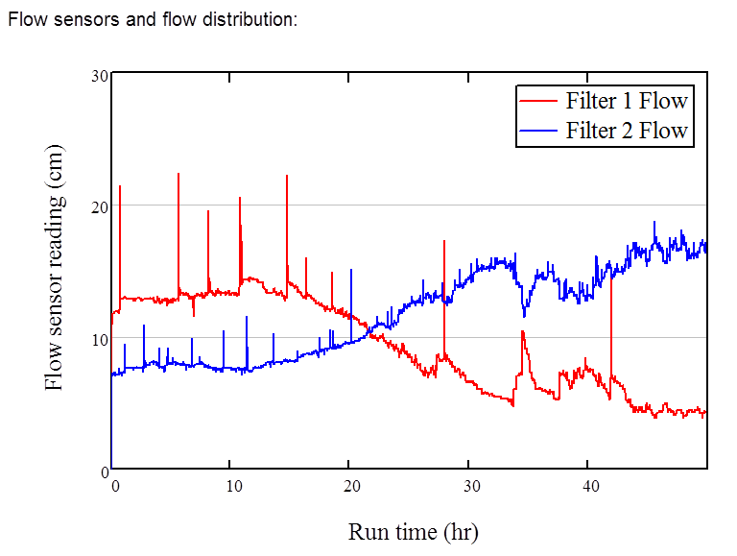
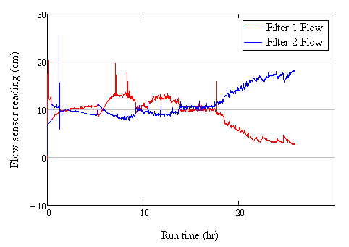
Self-healing study
Result
  Even flow distribution is hard to do if just let the sand bed to control.
Clean water
Clay
Clay + Alum

Slide 8
Self-healing study
Result
  Surface removal dominated.

Slide 9
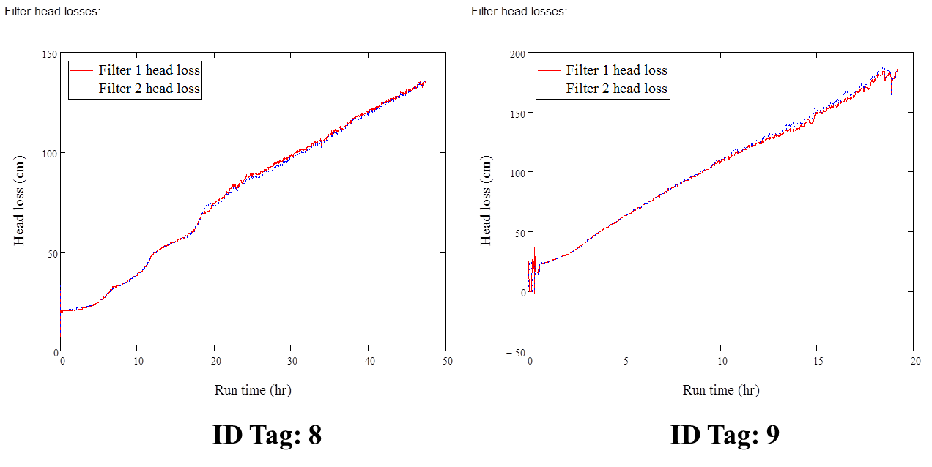
Self-healing study
Result
  Head loss display increasing trend.

Slide 10
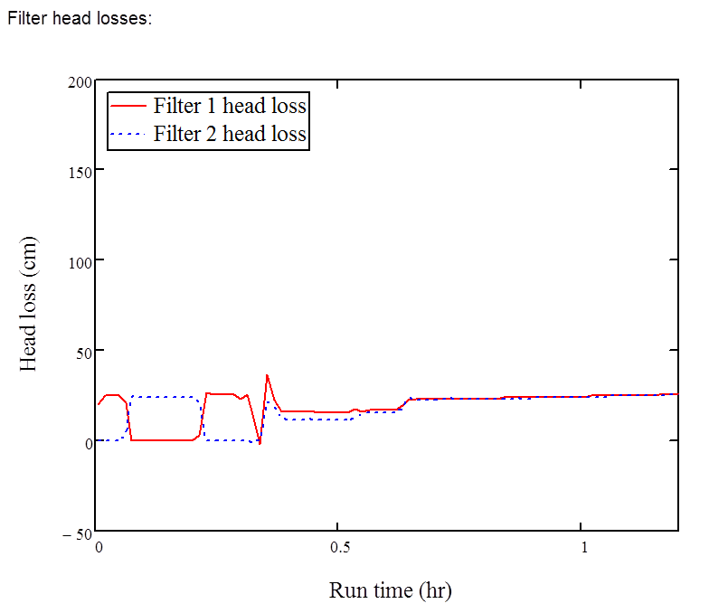
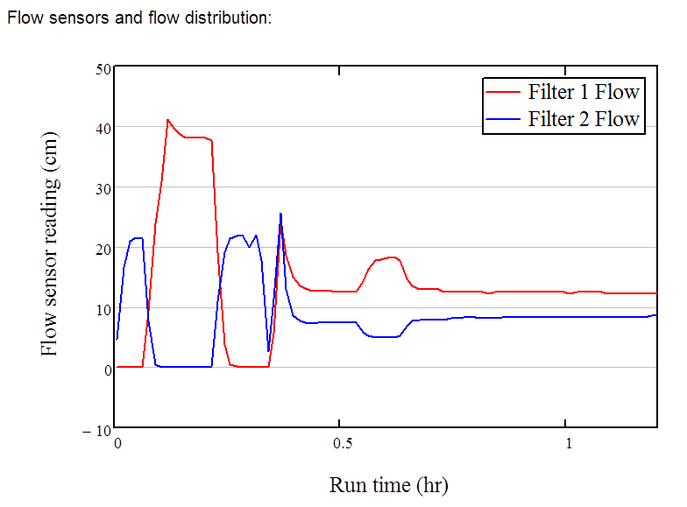
Self-healing study
Result
  Perturbation Test: Flow rate and head loss Correspond to each other.

Slide 11
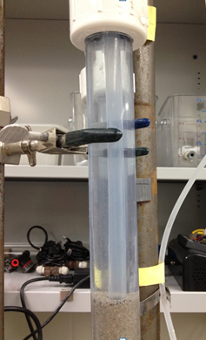
Depth filtration study
Objective
Eliminate the surface removal effect
Apparatus
Incoming pipe was inserted
about 2 cm deep into the
sand layer.
Notes:
This depth filtration test used the modified apparatus whose incoming pipe was inserted about 2 cm deep into the sand layer.
The experiment ran 24 hours with clean water, and another 24 hours with 20 NTU raw water and alum as coagulant.

Slide 12
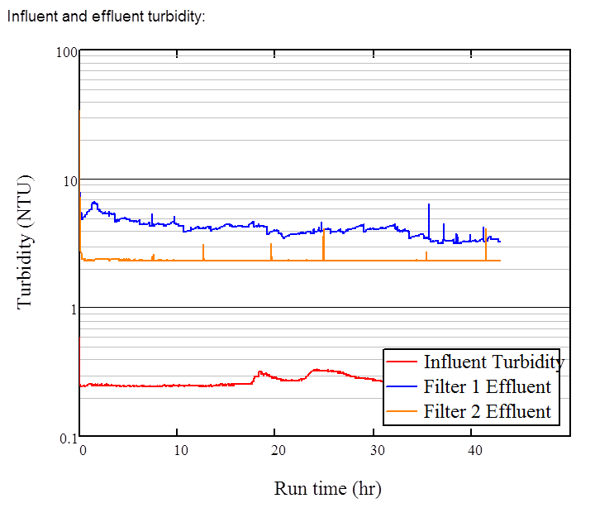
Result
Result:

Slide 13
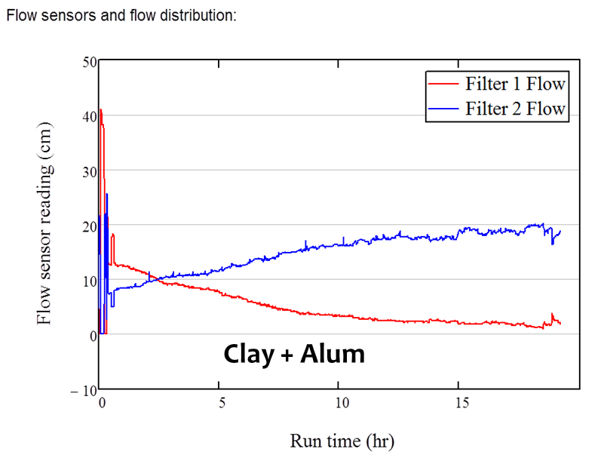
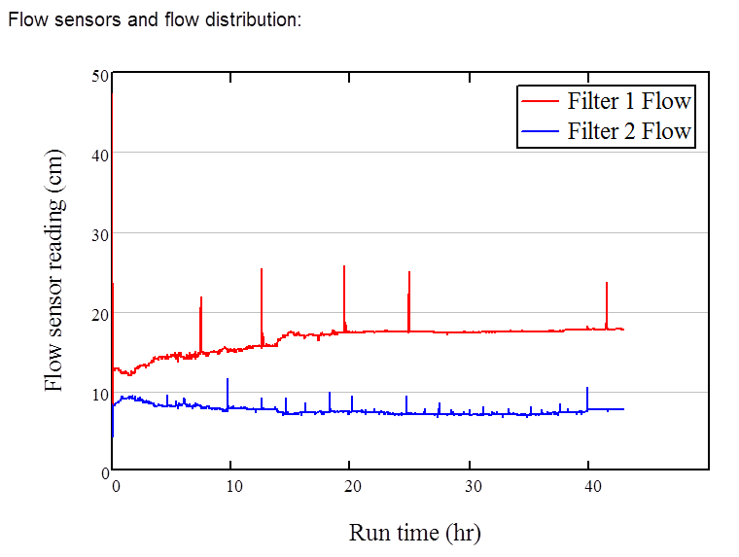
Depth filtration study
Result: Flow distribution
Before:
After:

Slide 14
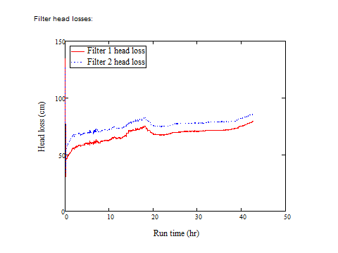
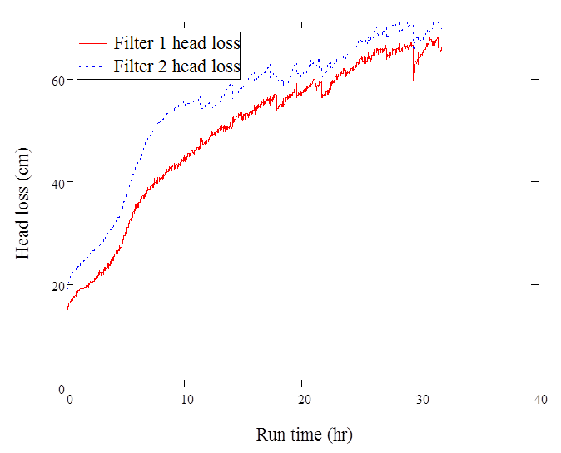
Depth filtration study
Result: Head loss
Before:
After:

Slide 15
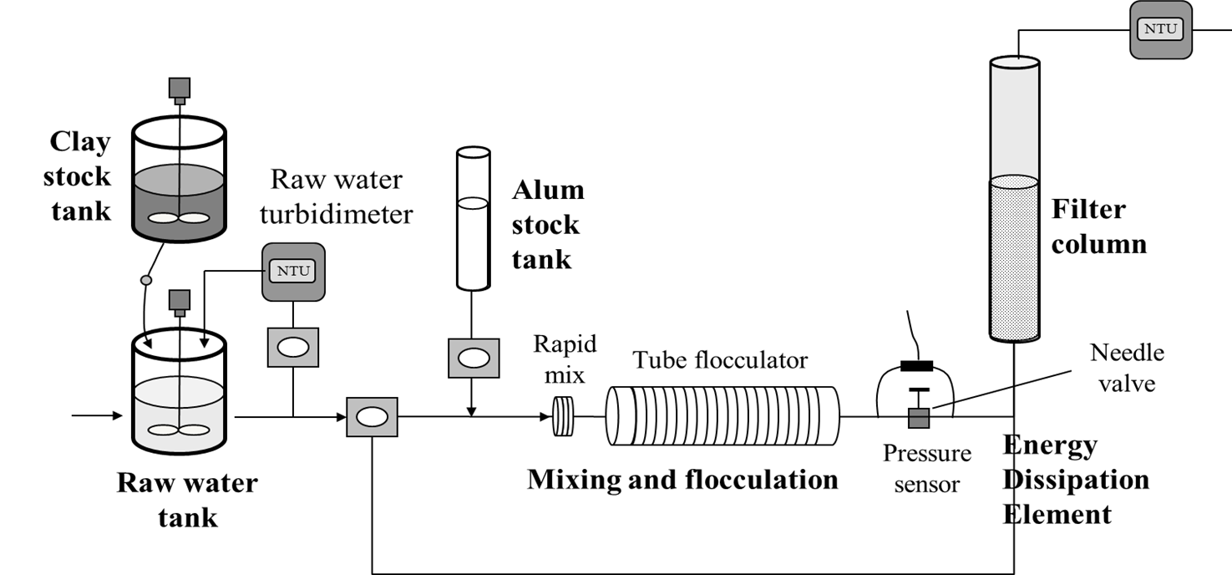
Future work
Add a flocculator and "variable energy dissipation element" to bench-scale system.
  Study how flocculation performance affects filters
  Figure out why the Tamara SRSF works so well.

Slide 16

Thank you!

