Slide 1
Project Teams
Spring 2012

Slide 2
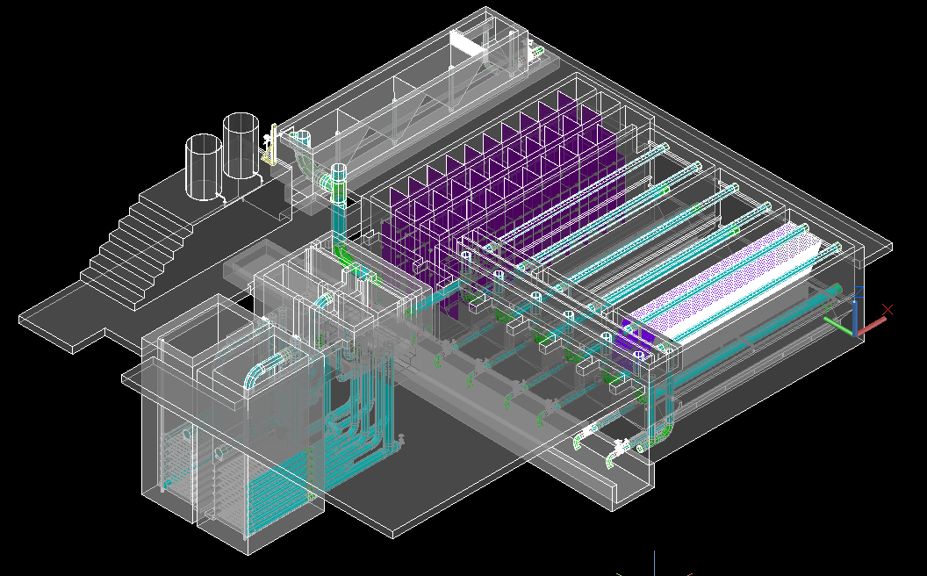
Design Team
Helpful (but not necessary) skills: Mathcad, AutoCAD, CEE 4540, Spanish fluency

Slide 3
Automated Design Tool
User Inputs
Plant
Design
LabVIEW
AutoCAD
Mathcad
Calculations
MS Word
Mathcad
Drawing Files

Slide 4
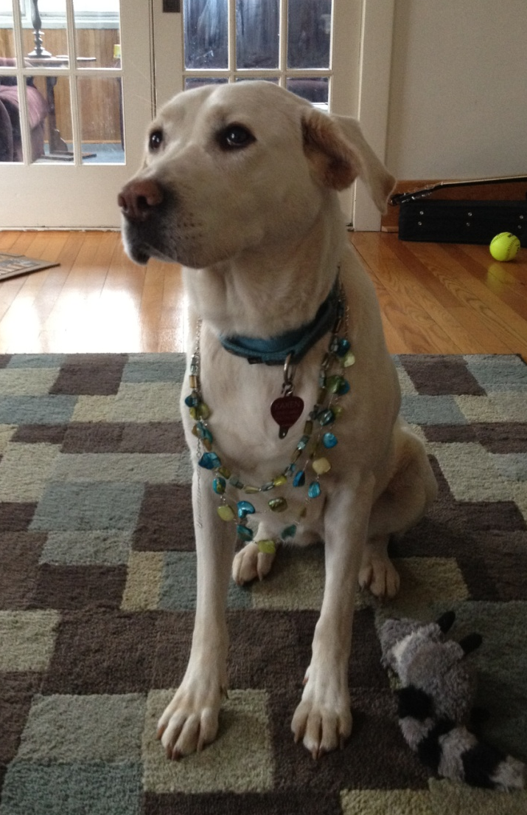
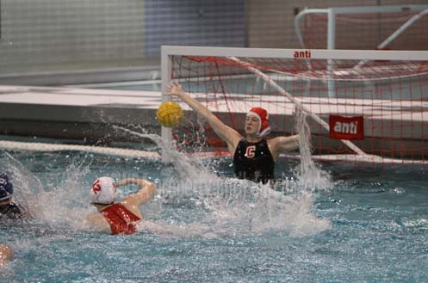
Karen
Research Team Leader
3rd year PhD student
Goalie for Cornell Women’s
Water polo
Notes:
4

Slide 5
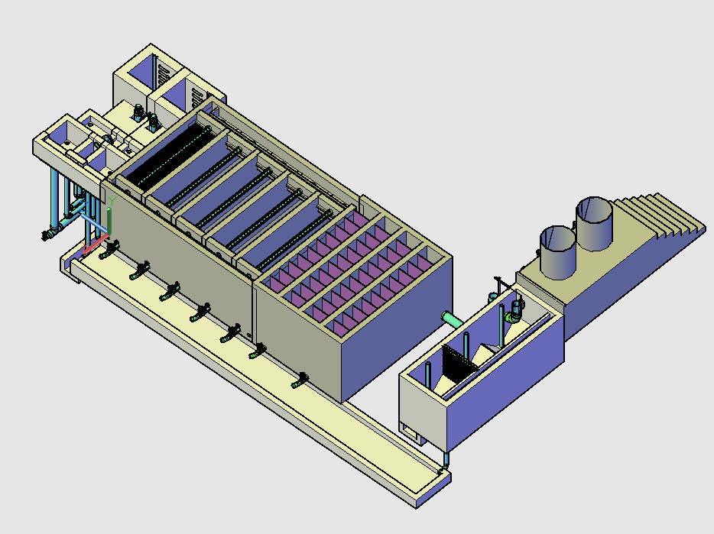

Slide 6
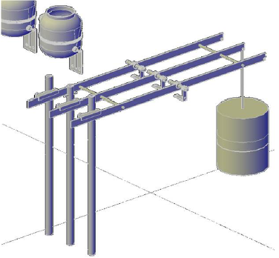
Linear Chemical
Dose Controller
Perform select experiments to finish a journal article
Existing design – adapt to triple doser configuration
Fabrication & Documentation:
  parts, assembly, calibration, and maintenance
Notes:
6
6

Slide 8
Low-flow Flocculator
Design and build a low flow pipe flocculator with a series of obstacles to prompt mixing
Fabrication, fluid mechanics
Notes:
8
8

Slide 10
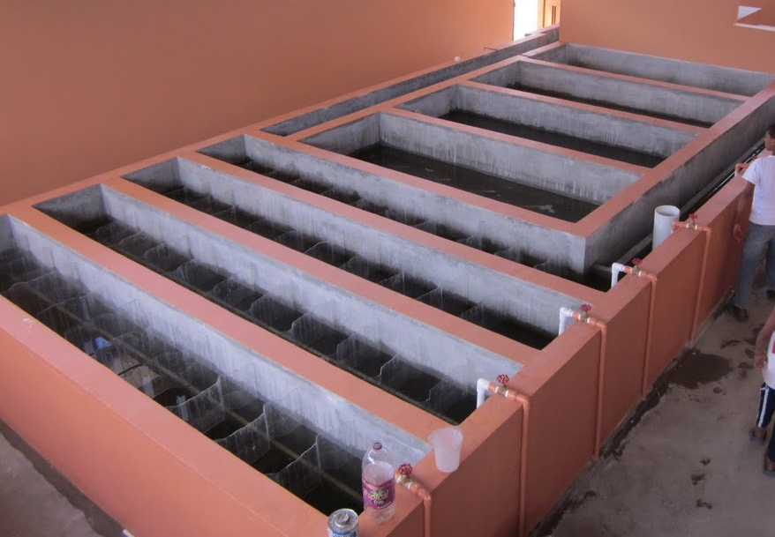
Floc-Sed Optimization
Systems optimization of the AguaClara plant design using a bench scale plant
Should have a detailed knowledge of AguaClara plant design
Lab Experiments, Data Analysis, Research!
Notes:
10
10

Slide 12
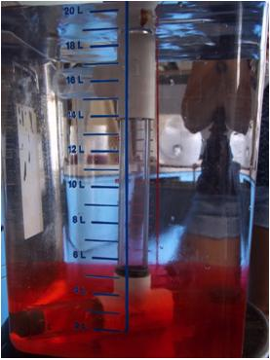
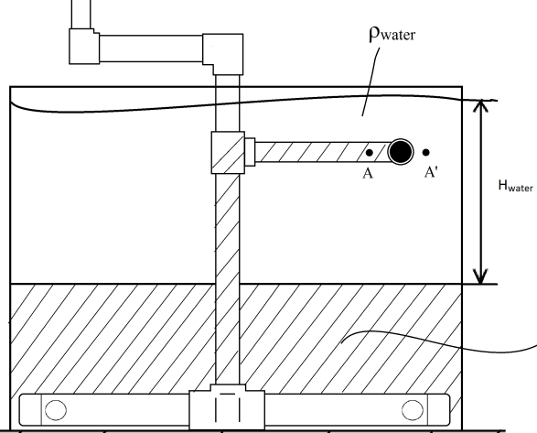
Stock Tank Mixing
Provide a mechanical advantage to operators as they try to create a homogeneous stock tank
Provide a way for operators to check for uniform concentration
Fabrication,
creativity
Notes:
12
12

Slide 13
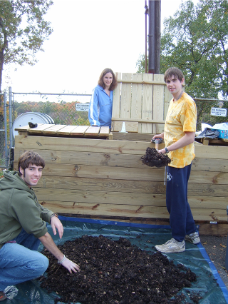

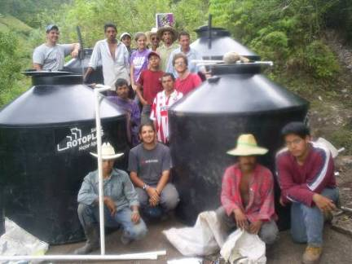
Mickey
2nd-year MS in Environmental Engineering
CEE 4530 TA and AguaClara research assistant
“Moving up in the world” from years of municipal solid waste composting and smaller water projects
Notes:
13

Slide 15
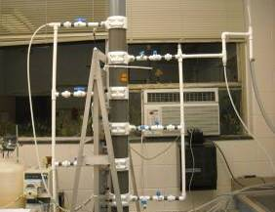
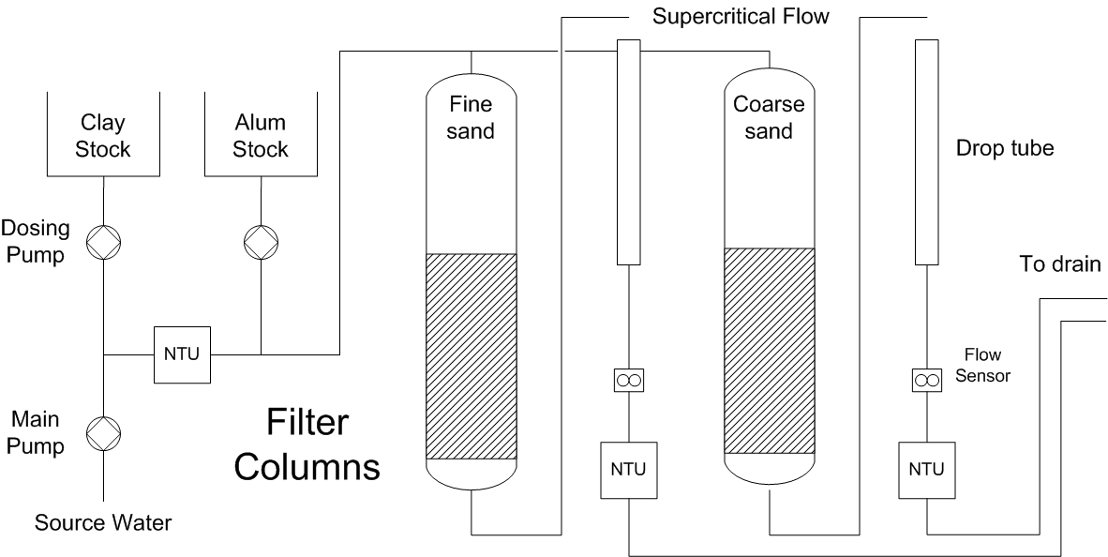
Stacked Filter:
Bench and Pilot Scale
Pilot-scale research
  Operational experiments with filter and backwash cycles
  Layer flow distribution
  Four-layer system tests
Bench-scale research
  Sand media specs: size / gradation requirements
  PACl/filter interaction
  Filter bed capacity
Notes:
15

Slide 16
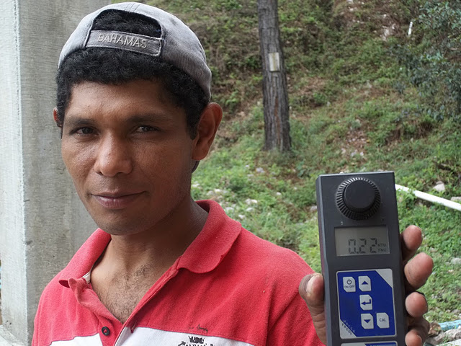
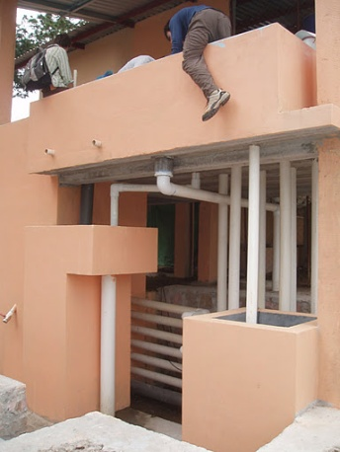
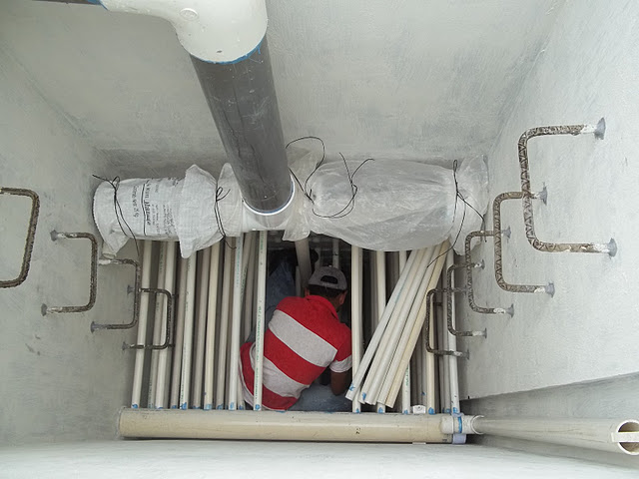
Stacked Filter:
Full-scale / Fabrication
Fabrication tasks
  Inlet and outlet manifold assembly
  Sourcing slotted pipe and sand for future filters
Design issues
  Modifying design for a low-flow filter
  Coordinate with the Design Team and APP in Honduras
Notes:
16

Slide 18
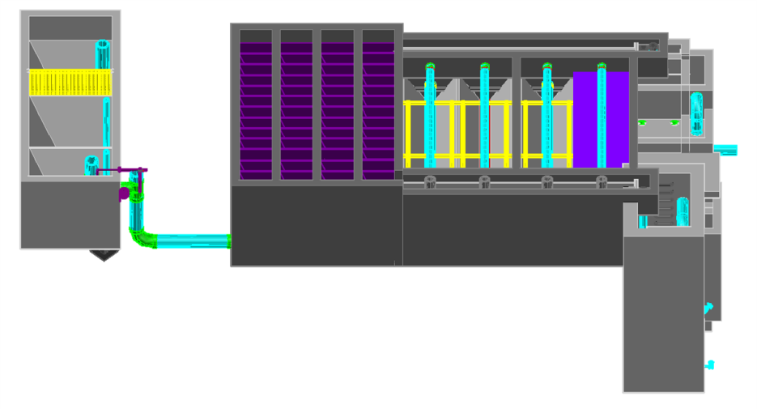
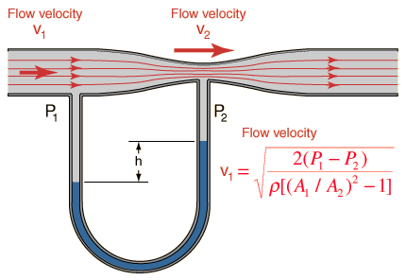
Floc Recycle / Venturi
Flocs
Floc recycle for AguaClara plants???
  Recycle flocs from the floc blanket to the flocculator
  Reduce the required size of the flocculator
This will require fabricating a Venturi system to transport flocs back to the flocculator
Notes:
18

Slide 19
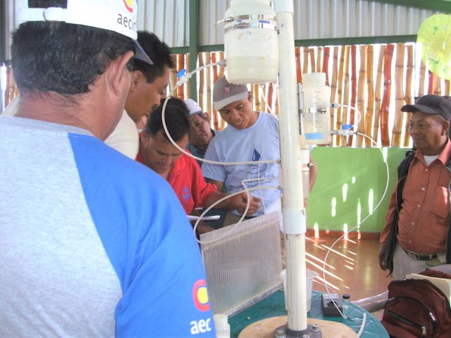
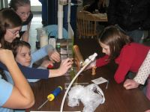
Demo Plant
Objective: bring AguaClara demo plant up to date
  Chemical dosing system
  Sed tank / floc blanket
  Stacked rapid sand filter
Important educational benefits of the demo plant
  Operator training in Honduras
  Public presentations and conferences in the USA
Notes:
19

Slide 20
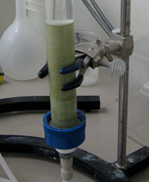
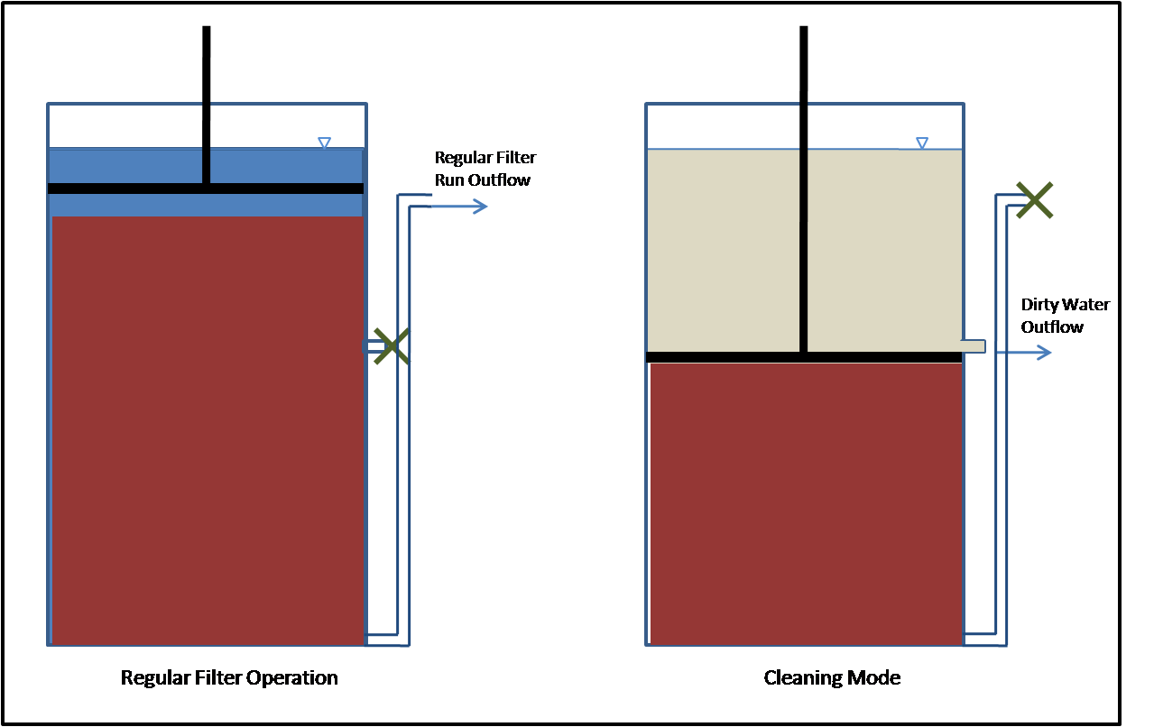
Foam Filtration
Polyurethane foam for water treatment
  Has been shown to be effective for depth removal
  Multi-stage filtration can produce potable water
Current focus: POU treatment unit for emergency engineering / disaster relief
Notes:
20

Slide 21
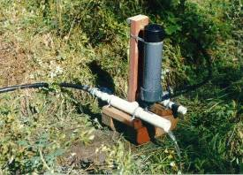
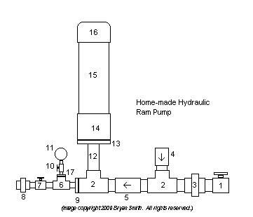
Ram Pump and
Hydraulic Test Facility
Ram pump: use a lot of flow to pump a little
  Application – pump treated water for plant service
  Semester goal – fabrication and testing
This team will employ a hydraulic test facility
  System for high-flow tests outside the AguaClara labs
Notes:
21

Slide 22
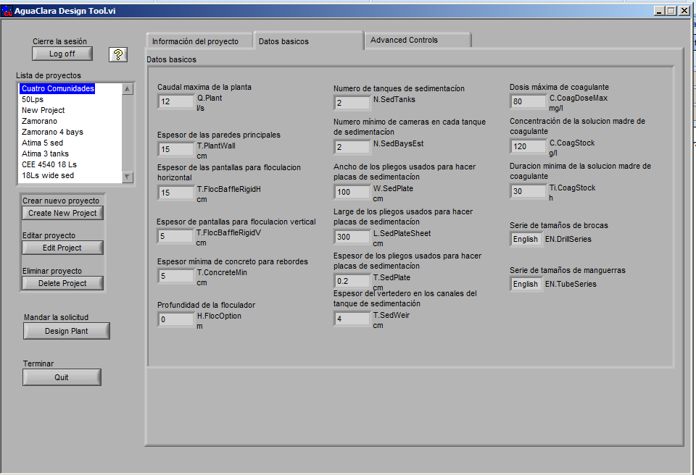
Web Browser UI for ADT
UI is user interface
Eliminate need to download software to submit design request
Switch to a web browser
Increase visibility of AguaClara design tool
Develop interface for design of individual components

Slide 23
Public Relations
Possible activities include:
Making presentations to administrators & potential students;
Representing AguaClara at conferences and campus events;
Poster/brochure/website design;
Need to be willing to work outside of designated class time
Notes:
23
23

