Slide 1
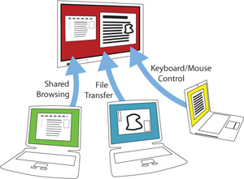
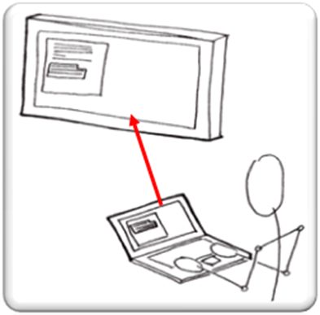
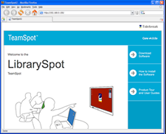
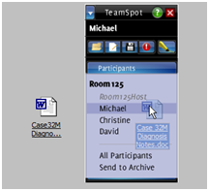
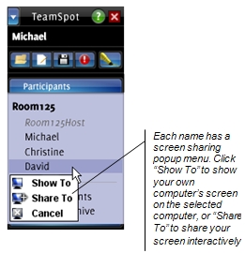
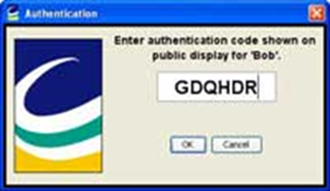
Tired of crowding around one laptop?
Find yourself doing most of the work on group projects?
Tidebreak "TeamSpot" is your answer to group project blues:
Share the work, not your laptop
TeamSpot, currently located in this group study room only, allows multiple laptops to share the
same screen to enhance collaboration.
This is a trial run, so any feedback you can provide us is much appreciated!
With TeamSpot, groups can:
Collaborate through shared desktop displayed on a large plasma screen, visible to all group members
Easily share or move files, online materials and real-time data between computers via drag and drop
Edit documents across computers by copying text from one computer and pasting it in on another.
Setup
Host (group room computer)
Check-out the keyboard and mouse for this room at the Circulation Desk.
Turn on the computer in the group study room and log in using your library computer account.
Client (personal or library laptop)
Go to this URL (also posted beneath the LCD screen: location.tidebreak.cornell.edu
Click to “download software” and choose your operating system
Run the installation file and follow the instructions on the screen.
When the license agreement appears, select “I accept” and then
Click “Continue”.
Personalize your settings in the control panel.
The Tidebreak Client Control Panel will appear.
Change the machine name to be something that
uniquely identifies you (e.g. a nickname).
Then click “New Location” to join into the Host.
Enter the url one more time
Enter your unique code
Controlling the Big Screen (Host)
Move beyond the top of your laptop screen
Move your mouse until the pointer is at the very top of your screen. Then keep going, past the top of your own computer screen.
You are now controlling the public screen.
Your mouse controls the pointer on the public screen. And your keyboard types into it. To return, just go down beyond the bottom.
Sharing Files
It’s easy to move digital objects (a file, folder or a URL from your browser's address bar) from your laptop to another computer (or all computers) connected in the TeamSpot.
Drag and drop a file, folder, or a URL from your browser’s address bar to a name within the Participants list in the Mini-Panel.
To share with everyone, drag and drop an item onto "All Participants“.
A copy of the file, folder or URL will be sent to the recipient’s computer and, for common document types, opened automatically. Files and folders are saved to the “Received” folder on the target computer.
A copy of the file, folder or URL will be sent to the recipient’s computer and, for common document types, opened automatically. Files and folders are saved to the “Received” folder on the target computer.
Putting Your Desktop on the Big Screen (Host)
Open the Participants list in the Mini-Panel.
Right-click on the name where you wish to show your desktop; this is typically the public screen, but could be another user’s computer instead.
From the pop-up menu, choose “Share To” or “Show To,” depending on whether or not you want others to be able to interact with your computer.
After the sharing session has been approved by the recipient, a window will open on the receiving computer showing your computer’s desktop. The Mini-Panel on the sending computer will turn white to visually distinguish it from the Mini-Panel on the receiving computer.

