Slide 1

MAE 4700/5700: ANSYS Section
Fridays 1:25-2:15 pm
Rajesh Bhaskaran
Cornell University

Slide 2
Co-ordinates
Dr. Rajesh Bhaskaran
Swanson Director of Engineering Simulation
Mechanical & Aerospace Engineering
E-mail: bhaskaran@cornell.edu
Office: 102 Rhodes Hall
Office hours in the Swanson Lab (163 Rhodes)
  TBA

Slide 3
471 Rhodes Temporary Account
username: monday
password: 0ri3Temp
(zero - r - i - three - capital T - e - m - p)

Slide 4
471 Rhodes Temporary Account #2
username: tuesday
password: 0ri3Tues
(zero - r - i - three - capital T - u - e - s)

Slide 5
Computer Labs with ANSYS
CIT public labs
  B7 Upson
  318 Phillips
  ACCEL lab in Carpenter Hall
471 Rhodes
Swanson Lab (163 Rhodes)
  16 workstations
  2 quad-core processors
  30 GB of RAM

Slide 6
ANSYS Software
Leading commercial FEA software
Founded by Cornell alum Dr. John Swanson in 1970
Can solve structural, thermal, flow and electro-magnetic problems
Student version available for $25/year
  Instructions to be provided by e-mail
  Version 13
    Labs are using Version 14. V14 files cannot be read into V13.

Slide 7
Friday Sections
Purpose:
  Learn to apply FEA to engineering problems using ANSYS
  Prepare for project
Plan:
  Initially solve some HW problems using ANSYS
    Compare MATLAB and ANSYS solutions
  Move on to more complex problems.

Slide 8
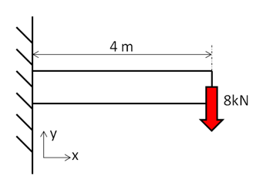
ANSYS Exercise 1
Cantilever Beam
Truss elements are available in ANSYS
  Need to use scripting (advanced feature)
  Not used widely in practice

Slide 9
ANSYS Exercise 1
Cantilever Beam
Beams will appear in HW3
One problem will be on ANSYS solution of cantilever beam
  Save work from this section for submission with HW3

Slide 10



Cantilever Beam: Degrees of Freedom
Consider 2-element mesh
$$u_{y_{1}}=0$$
$$θ_{z_{1}}=0$$
$$u_{y_{2}}$$
$$θ_{z_{2}}$$
$$u_{y_{3}}$$
$$θ_{z_{3}}$$
Reaction force at node 1
Reaction moment at node 1

Slide 11
SECTION MEETING #2
9/7/2012

Slide 12
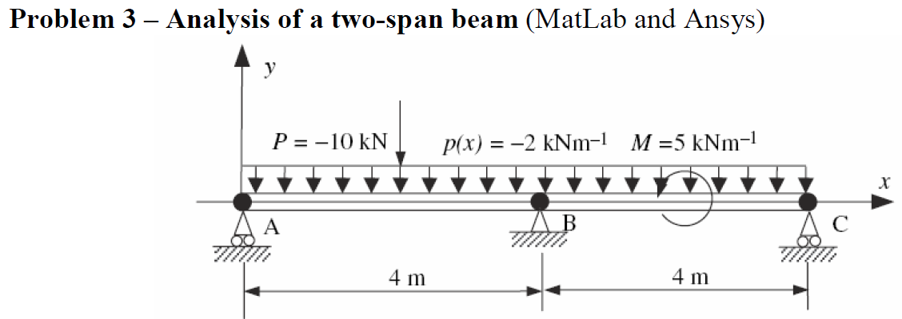
Cantilever Beam
First ANSYS exercise
  Can do trusses but need to use scripting (advanced functionality)
  Pin-jointed trusses rarely occur in practice
ANSYS beam problem will appear in HW3

Slide 13
Cantilever Beam: Degrees of Freedom
Consider 2-element mesh
$$u_{y_{1}}=0$$
$$θ_{z_{1}}=0$$
$$u_{y_{2}}$$
$$θ_{z_{2}}$$
$$u_{y_{3}}$$
$$θ_{z_{3}}$$
Reaction force at node 1
Reaction moment at node 1

Slide 14

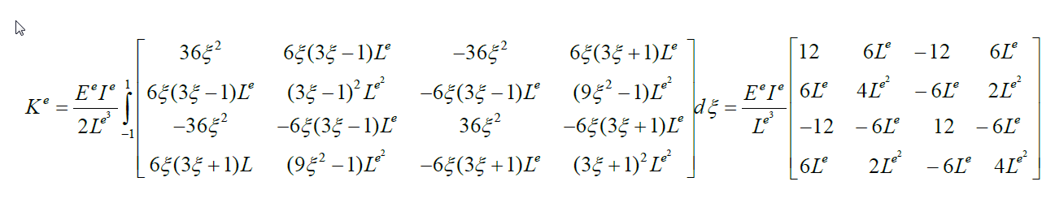
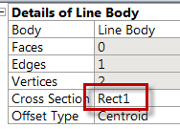
Cantilever Beam
Beam element stiffness matrix
K^{e} : see page 24 of
Lecture 4: Finite element formulation of beam problems
Poisson ratio doesn’t appear in K^{e}

Slide 15
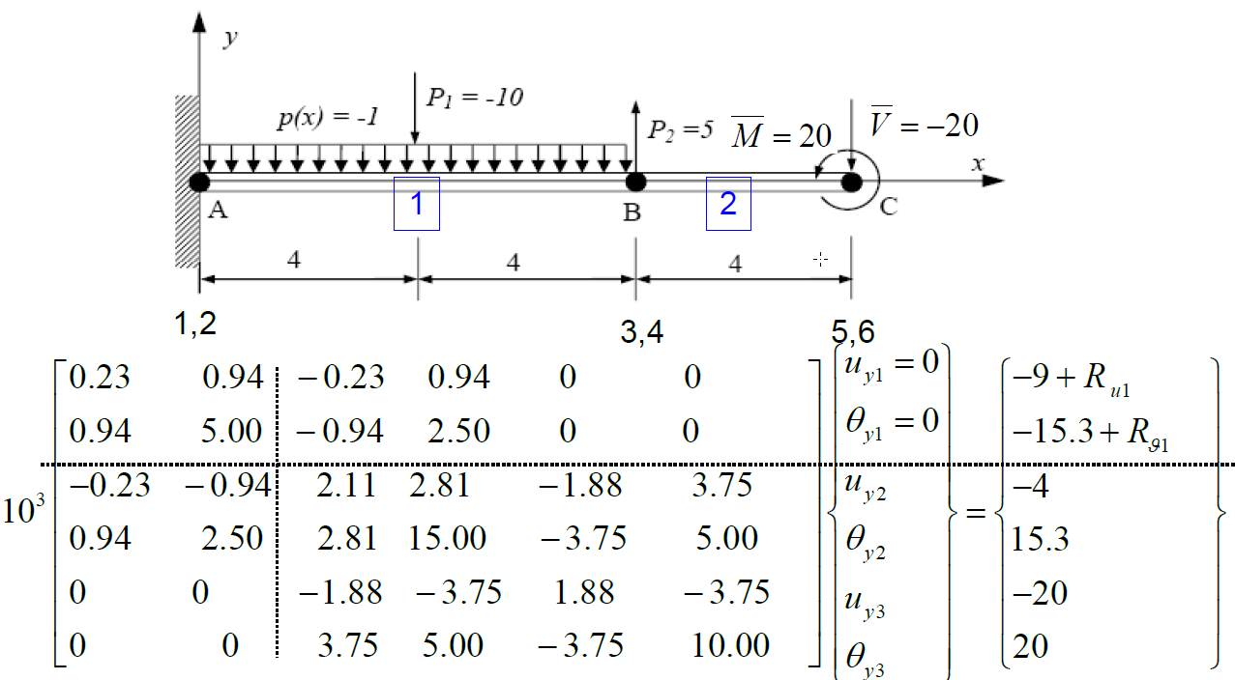
Solve Step
Beam Lecture, Page 43

Slide 16
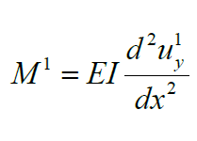
Bending Moment and Shear Force
General FEM Procedure (see next slide):
  Calculate unknown degrees of freedom
  Calculate reactions at known degrees of freedom (for instance, at fixed nodes)
ANSYS then uses reactions to calculate bending moment and shear force:
  More accurate than differentiating displacement

Slide 17
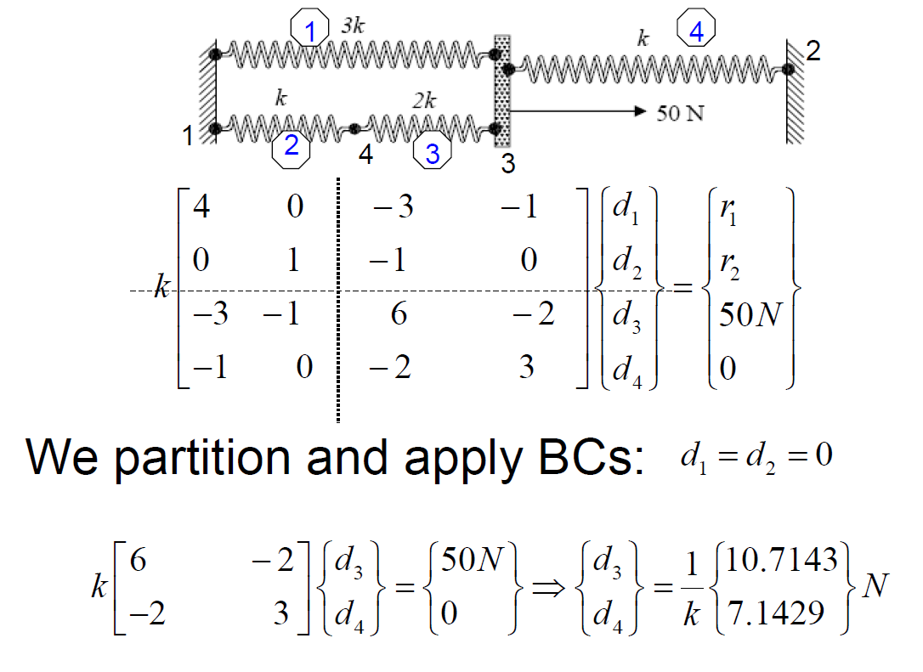
Calculation of Reactions
See Lecture 2: Direct approach, page 32

Slide 18
HW3 Tips
Model the geometry using four lines
Apply distributed load using Line Pressure
Simply Supported boundary condition sets u_{x} and u_{y} to zero but leaves θ_{z} free
Frictionless support in this case will set u_{y} to zero but leaves u_{x} and θ_{z} free

Slide 19
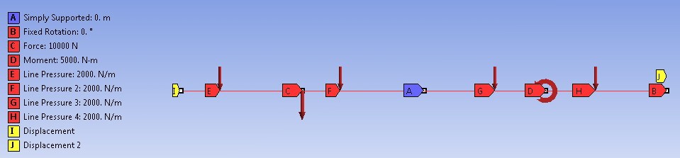
HW3 Tips
You have to add a BC by fixing the rotations about x and y axes as in the snapshot below. Otherwise you might get a solver pivot error. This is because ANSYS is using a 3D beam element with these additional rotations as dof's.

Slide 20
SECTION MEETING #4
9/21/2012

Slide 21
HW3 Comments
Need additional BC for beam problem (#2)
  Fix the rotations about x and y axes
Otherwise might get a solver pivot error
  ANSYS is using a 3D beam element formulation with these additional rotations as dof's.

Slide 22

HW Comments
Degrees of freedom in ANSYS’ beam element
$$\left\{\begin{aligned}u_{x} \\ u_{y} \\ u_{z} \\ θ_{x} \\ θ_{y} \\ θ_{z}\end{aligned}\right\}$$
Additional constraint ensures that these DOF’s are identically zero
Otherwise might get rigid body motion (structure flying off)

Slide 23
HW3 Comments
You generally apply loads to geometry
  Transferred to nodes and elements during Solve
Saving files
  File > Save
  You need both frame.wbpj file and frame_files folder to restore project
  File > Archive
  ANSYS saves entire project in one file frame.wbpz

Slide 24
SECTION MEETING #5
9/28/2012

Slide 25
Updated Office Hours
My office hours (held in Swanson Lab, 163 Rhodes):
  M 3:30-4:30 pm
  R 3:30-4:30 pm
  F 2:30-3:30 pm
Please come during these times for help with ANSYS modeling

Slide 26
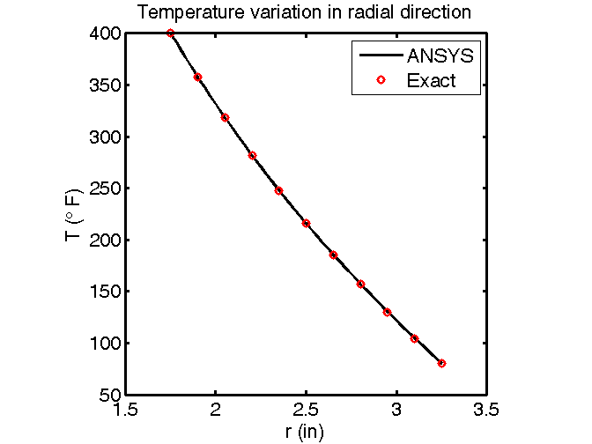
Axisymmetric Heat Flow (HW4, #3)
Comparison of ANSYS Result with Exact Solution

Slide 27
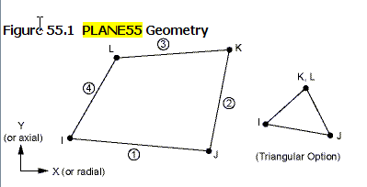
Axisymmetric Heat Flow (HW4, #3)
Element type used:
  Look under Solution > Solution Information
    PLANE55
  Help page for PLANE55
    2D Conduction
    Plane or Axisymmetric
    Relevant material properties: KXX, KYY (=K in our case)
4 Nodes/Element
Single d.o.f. per node: Temperature

Slide 28



Axisymmetric Heat Flow (HW4, #3)
  Help page for PLANE55
    Switch to go between plane and axisymmetric: KEYOPT(3)
    PLANE55 Assumptions and Restrictions
    Element must lie in an X-Y plane
    Y-axis must be the axis of symmetry for axisymmetric analyses
Shape Function (follow link to Mechanical APDL Theory Reference)
Lecture 6. page 7

Slide 29
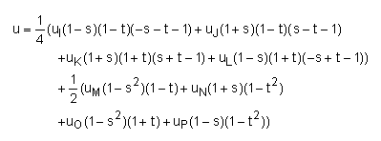
Axisymmetric Heat Flow (HW4, #3)
  Help page for PLANE55
    A similar element with midside node capability is PLANE77
PLANE55
PLANE77

Slide 30

Important Takeaway
Need to dig into the element manual to understand key things such as
  Governing equations
  Assumptions and restrictions
  Element formulation
    Number of nodes/element
    Degrees of freedom at each node
    Shape functions etc.
INCLUDE SUCH INFORMATION IN YOUR PROJECT PRESENTATION/REPORT

Slide 31
Mapped Meshing
Valid in 2D and 3D
Generates regular meshes that generally lead to increased accuracy
Can be used only in “regular” regions
For 2D, works on areas with 3 or 4 sides
  4 sides: Opposite sides have equal number of divisions
  3 sides: All sides must have an equal, even number of divisions

Slide 32
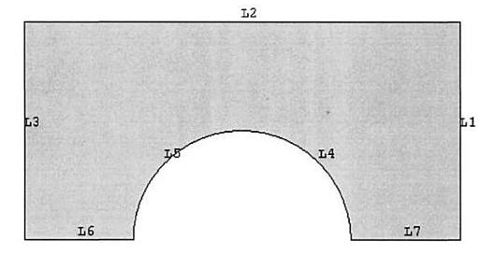
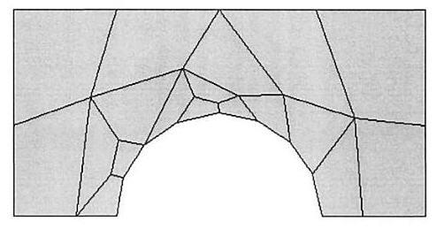
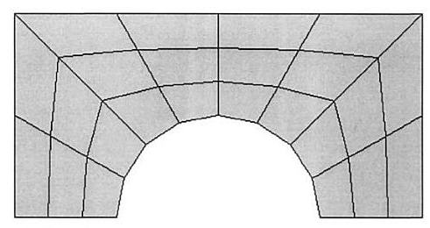
Mapped Meshing
Example from “The finite element method and applications in engineering using ANSYS” by Madenci & Guven
Mapped Mesh
Free Mesh
Mapped mesh
Free mesh

Slide 33
Mapped Meshing
Why the “mapped” in name?
  A four-sided area with equal number of divisions on the opposite edges can be mapped to a regular mesh on a square

Slide 34
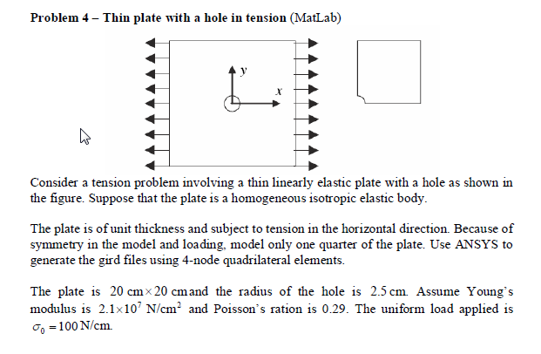
Upcoming HW

Slide 35
Plate with a Hole
Degrees of freedom per node: ux, uy
Element formulation:
  Derived from weak form of elasticity equation
    Solves the elasticity equation

Slide 36
SECTION MEETING #6
10/5/2012

Slide 37
Updated Office Hours (Reminder)
My office hours (held in Swanson Lab, 163 Rhodes):
  M 3:30-4:30 pm
  R 3:30-4:30 pm
  F 2:30-3:30 pm
Please come during these times for help with ANSYS modeling

Slide 38
Swanson Lab (163 Rhodes)
16 Dell T5500 workstations
  2 quad-core Intel Xeon 2.26GHz processors
  30 GB of RAM
  Extensive software suite
    ANSYS including FLUENT
    MATLAB
    CAD software: Solidworks, Creo/ProE
Suitable for large finite-element models
(> ~200k elements)
Contact me if you have access problems
Notes:
Resource available to MAE students for advanced FEA and CFD

Slide 39
Plan for Today
Sources for project ideas
  Verification manual in ANSYS
  Slides from ANSYS Tech Days
Project approach
  Novice vs. expert framework
  Incremental build-up of FEA model
Meshes for HW 6
Plate with a hole in ANSYS (continuation)

Slide 40
Project Ideas: Verification Manual
Search for “verification manual” in ANSYS help
  Look through list of verification problems
  Example:
    VM14 Large Deflection Eccentric Compression of a Column
  Can also sort by element number
    Choose Index by Element Number

Slide 41
Project Ideas: Slides from ANSYS Tech Days
ANSYS Tech Days was held on campus in March 2012
  Several presentations from ANSYS engineers on industrial applications
  These slides have been sent to you via dropbox
Stay away from fluid flow applications
    Uses finite-volume solver (FLUENT or CFX), not finite-element solver
    Not appropriate for MAE 4700/5700

Slide 42
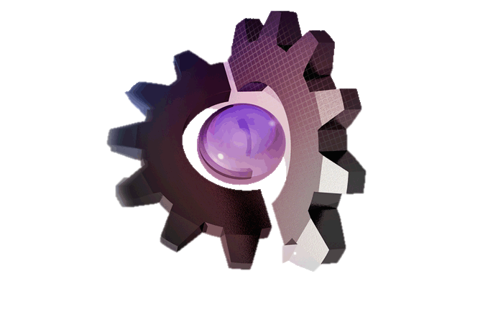
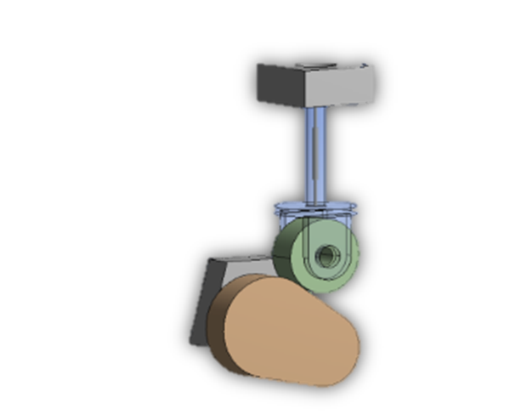
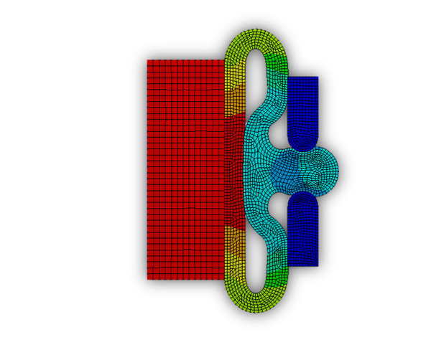
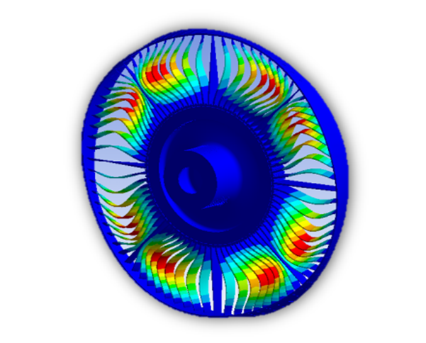
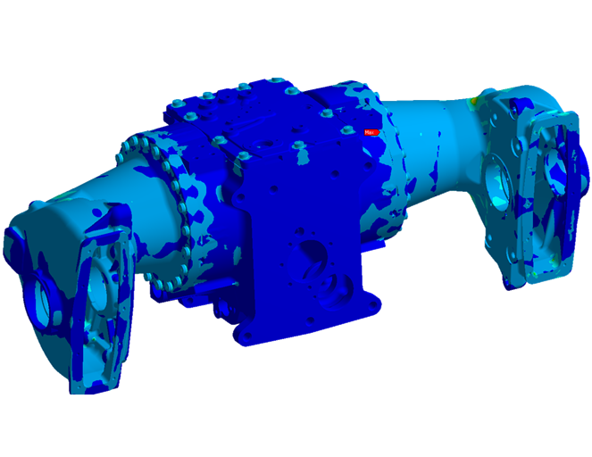
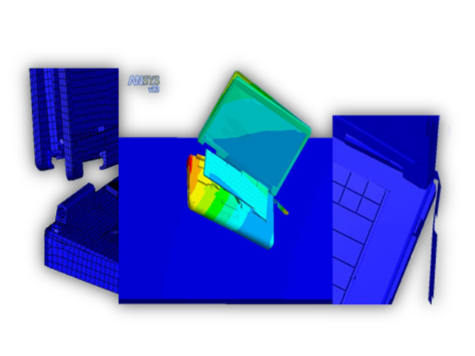
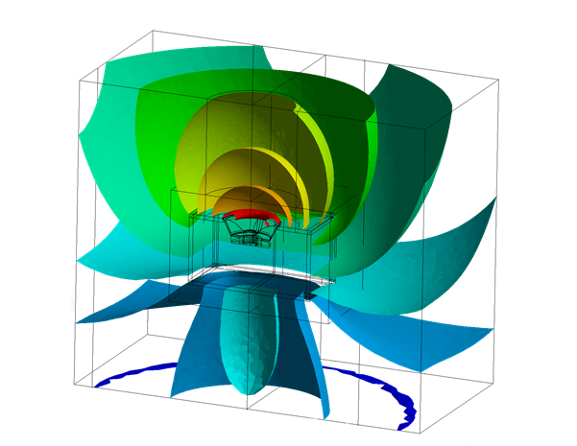
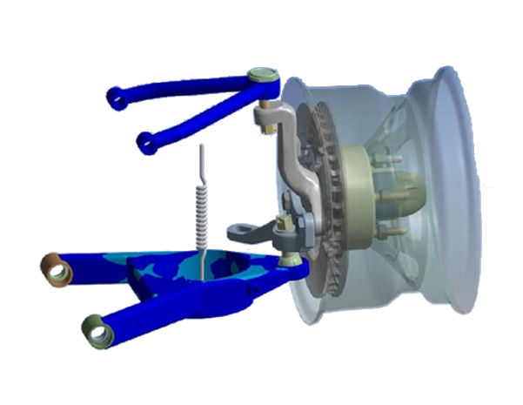
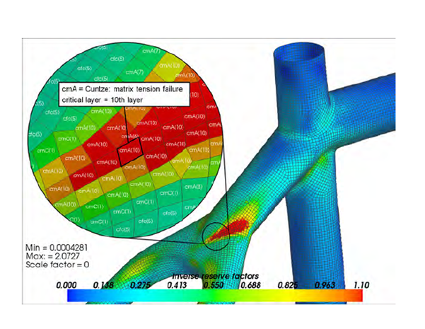
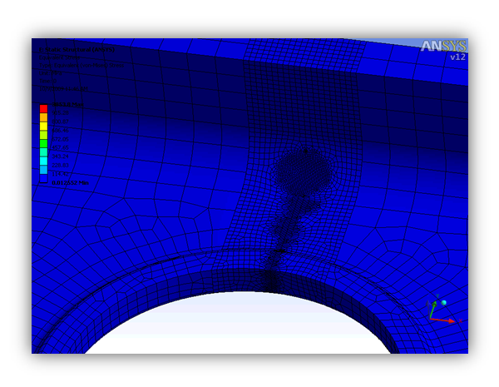
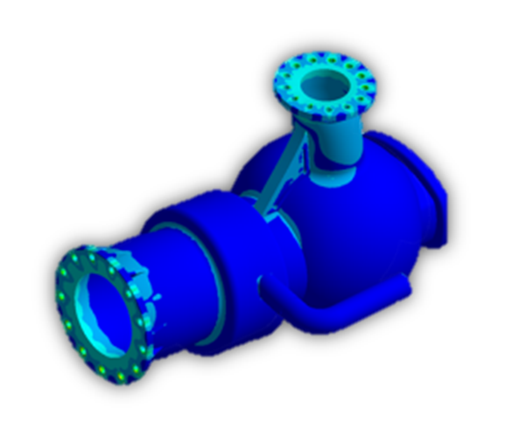
ANSYS in Structural Mechanics
Nonlinear Analysis
Fracture Mechanics
Linear Static
Instabilities
Acoustics
Contact
Explicit
Dynamics – Modal
Dynamics – Spectral
Dynamics – Harmonic
Dynamics – Transient
Rigid/Flexible Mechanisms
Notes:
Overall Portfolio Advantages and Focus
Predictability is paramount:
We provide robust and fast contact capabilities. A carefully selected set of default settings and advanced convergence tools such as contact stabilization ensure the convergence of most of the models, even the most complex ones. Contact capabilities are applicable for structural, thermal and multi-disciplinary contact applications
In order to minimize the assumptions made on the material behavior, we offer a comprehensive library of nonlinear materials covering all needs from basic linear isotropic materials, bilinear plasticity to advanced rubber models or complex damage modeling. This includes also models for failure analysis of composites materials.
Performance is required to solve more variations of always larger models.
We provide fast solutions for all disciplines by implementing distributed parallel computing techniques as well as taking advantage from GPU boards. All these techniques are part of our cross-physics HPC offering
Additional advanced techniques like component mode synthesis (CMS), submodeling techniques as well as proprietary acceleration techniques are also available to handle large models efficiently.
Productivity is key to deliver faster solutions to the market.
We provide a highly productive user environment. The mechanical simulation interface based on the ANSYS Workbench platform enables users to model all applications, from very simple to very complex. The interface can take days out of a computer-aided engineering process by eliminating manual file transfer, and result-translation and reanalysis time.
The parametric capabilities provided by the Workbench environment allow users to create a single simulation model and perform automated variations of the design for physical parameters such as materials or boundary conditions as well as for geometric parameters such as CAD dimensions.
Specific Capability Advantages
Advanced and specialized models are also available for composites structures modeling, Analysis of rotating machines (rotordynamics), Mechanism analysis mixing rigid and flexible bodies, Linear and nonlinear buckling, Cyclic Symmetry models, Fracture Mechanics
ANSYS structural mechanics solutions offer a range of products that help users meet current requirements and plan for a seamless upgrade path for future needs
Customization through user-defined elements and user materials provides the flexibility to extend the capabilities of ANSYS structural mechanics solutions for a wide range of applications. Advanced users can also benefit from ANSYS Parametric Design Language (APDL) provides a rich set of scripting capabilities to perform entire simulations from pre-processing to post-processing, automate processes or access advanced features and solver settings

Slide 43
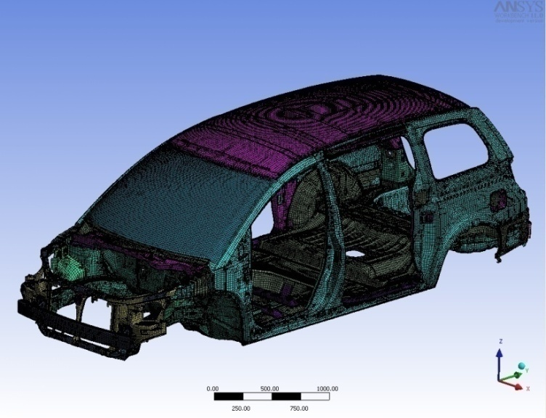
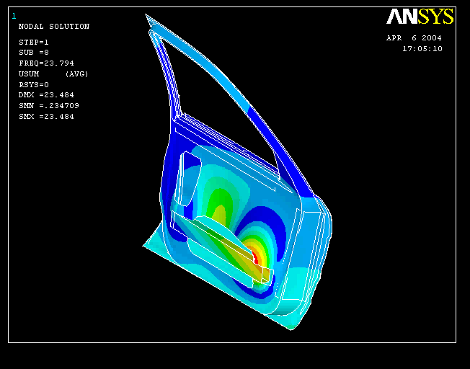
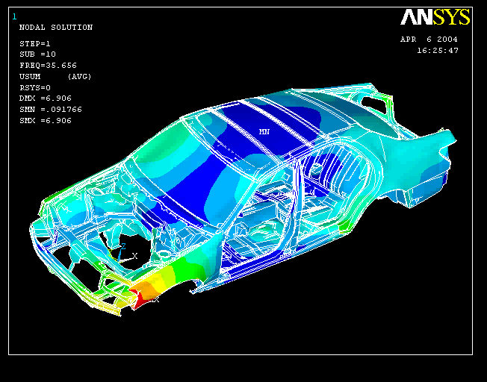
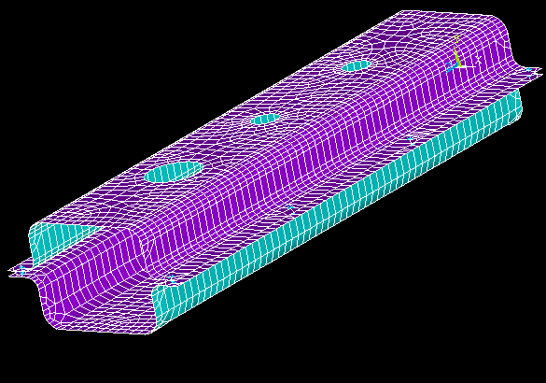
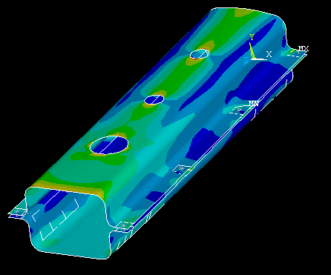
BIW & Component Modeling
Comprehensive Structural capability
Efficient Mid surfacing, Automatic Contact Detection
Non linear analysis of Door Assembly
Spot Welds
Dynamic Structural analysis

Slide 44
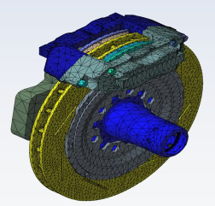
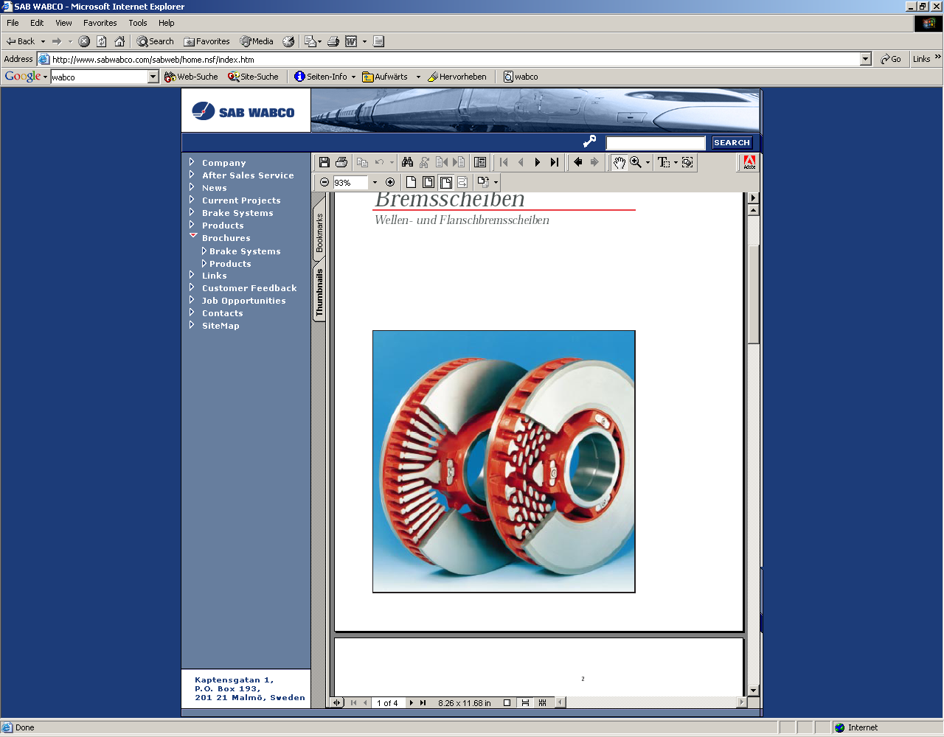
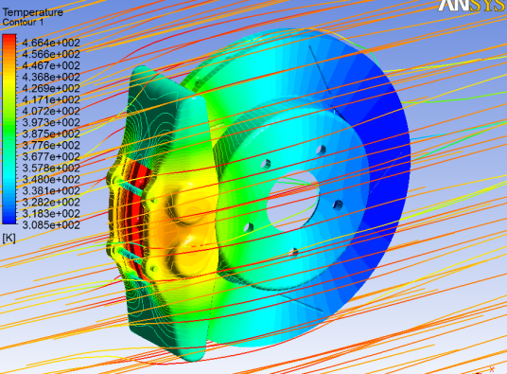
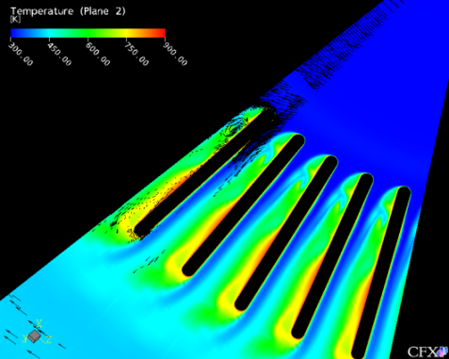
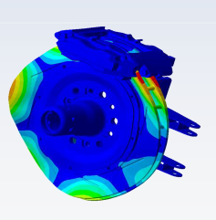
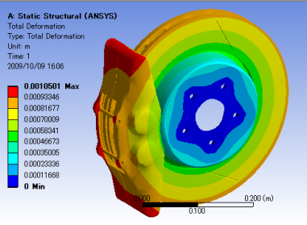
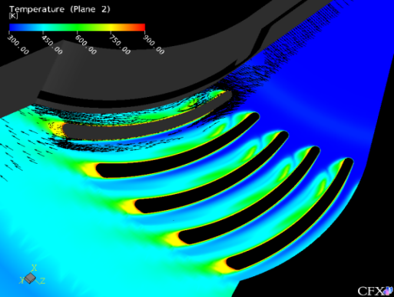
Brakes Examples
Estimation of Unstable Modes
Thermal management

Slide 45
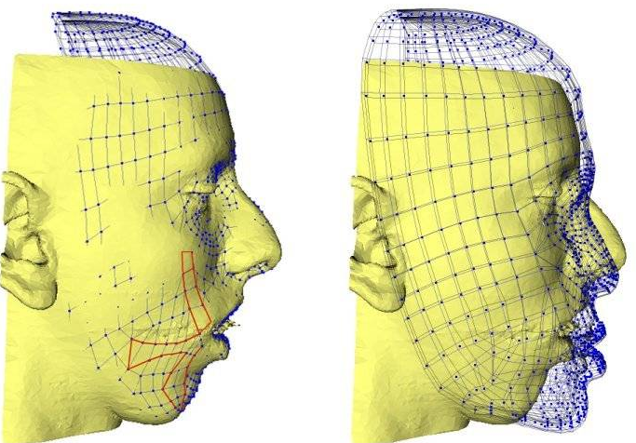
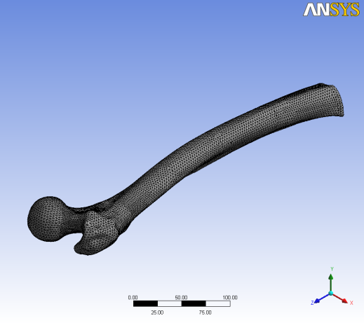
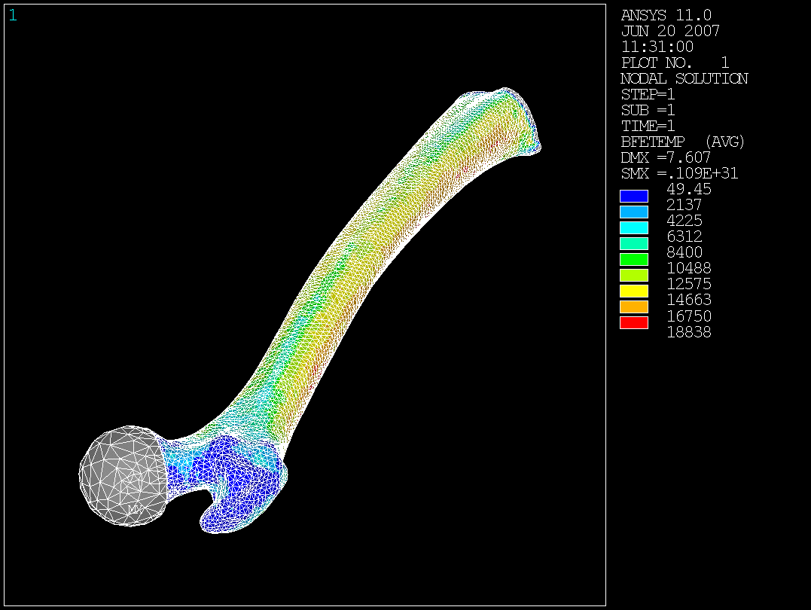
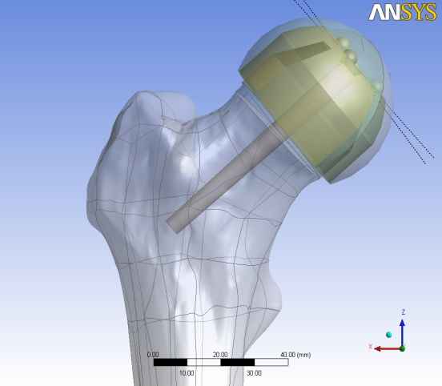
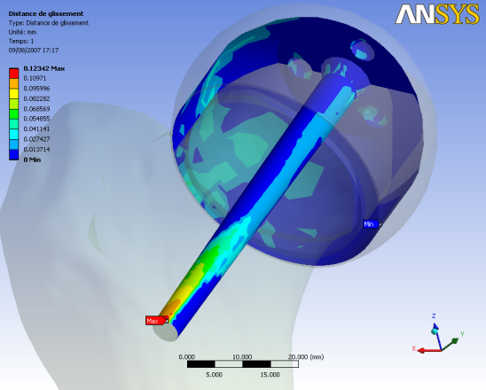
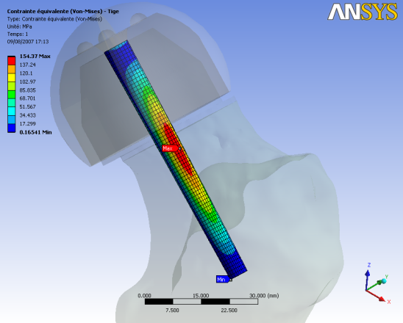
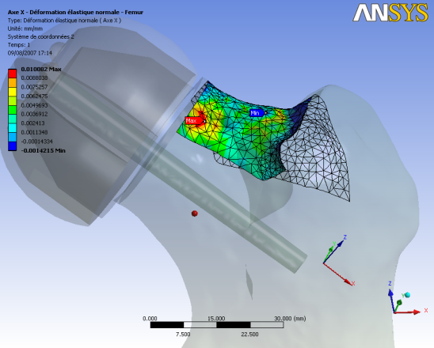
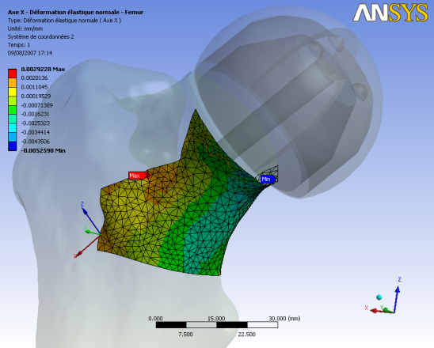
Application Area
- Orthopaedics
Prosthetics
  Hip, spine, knee, elbow, shoulder, wrist
  Cement injection
Soft tissues
  Maxillofacial (re)modeling
  Advanced prostheses (arms, legs)
  Tumor withdrawal (electromagnetic)
Surgical planning
Maxillofacial surgery modeling by TIMC-IMAG
(courtesy of TIMC-IMAG Laboratory, CNRS/UJF)
Sliding distance
Femur mesh
Interpolated Ym
Parametric model - 2 rotation parameters of the prosthesis
Von Mises stress in the prosthesis
  Trabecular tensile and compressive strain

Slide 46
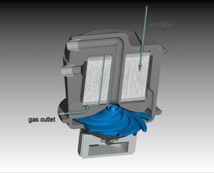
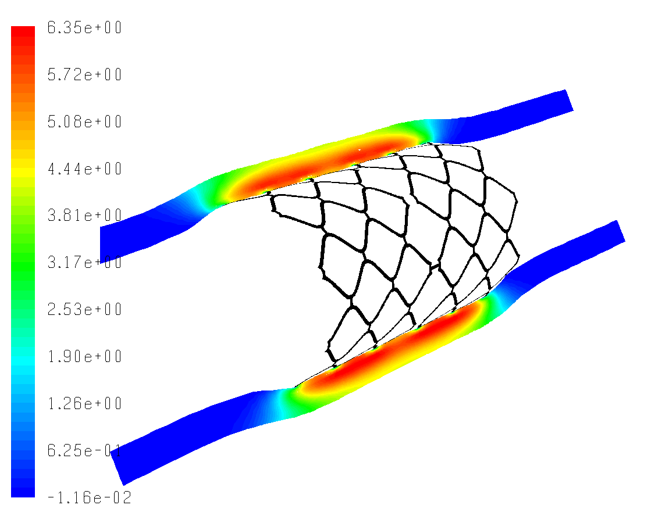




Application Area
- Cardiovascular
oxygenation
section inlet
Stents, heart valves, catheters, transcutaneous treatments, blood pumps, oxygenators, artificial hearts
Design, testing (mechanical testing, in-vivo testing)
blood inlet
blood outlet
pump
section
Drug eluting stent, species distribution in the artery wall
  * Fill et al., ASAIO Journal (2008).
Arterial/Plaque Stresses for Calcified (top) and Cellular (lower) Plaque

Slide 47
Project Idea: Wind Turbine Blade Design
Incomplete introductory tutorial on this on SimCafe
Several advanced FEA and ANSYS concepts
  Shell elements
  Advanced meshing
  Scripting
  Design optimization

Slide 48
Plan for Today
Sources for project ideas
  Verification manual in ANSYS
  Slides from ANSYS Tech Days
Project approach
  Novice vs. expert framework
  Incremental build-up of FEA model
Meshes for HW 6
Plate with a hole in ANSYS (continuation)

Slide 49


Novice vs. Expert Framework

Slide 50
What to Cover in Project Report and Presentation?
Cover all items in the “expert” framework
In the process, you will come across as an FEA expert!
More discussion in the coming weeks

Slide 51
Incremental Build-Up of FEA Model
Physics
Acceptable
Acceptable
Complex
Not Acceptable
Simple
Simple
Complex
Geometry

Slide 52
Plan for Today
Sources for project ideas
  Verification manual in ANSYS
  Slides from ANSYS Tech Days
Project approach
  Novice vs. expert framework
  Incremental build-up of FEA model
Meshes for HW 6
Plate with a hole in ANSYS (continuation)

Slide 53
Meshes for HW6
HW6, problem 4, Convection heat transfer:
  Download from
    https://confluence.cornell.edu/display/SIMULATION/Files
HW6, problem 6: To be posted

Slide 54
SECTION MEETING #7
10/12/2012

Slide 55
ANSYS in Structural Mechanics
Nonlinear Analysis
Fracture Mechanics
Linear Static
Instabilities
Acoustics
Contact
OK for project but should go well beyond the cases covered in class
Explicit
Dynamics – Modal
Dynamics – Spectral
Dynamics – Harmonic
Dynamics – Transient
Rigid/Flexible Mechanisms
Notes:
Overall Portfolio Advantages and Focus
Predictability is paramount:
We provide robust and fast contact capabilities. A carefully selected set of default settings and advanced convergence tools such as contact stabilization ensure the convergence of most of the models, even the most complex ones. Contact capabilities are applicable for structural, thermal and multi-disciplinary contact applications
In order to minimize the assumptions made on the material behavior, we offer a comprehensive library of nonlinear materials covering all needs from basic linear isotropic materials, bilinear plasticity to advanced rubber models or complex damage modeling. This includes also models for failure analysis of composites materials.
Performance is required to solve more variations of always larger models.
We provide fast solutions for all disciplines by implementing distributed parallel computing techniques as well as taking advantage from GPU boards. All these techniques are part of our cross-physics HPC offering
Additional advanced techniques like component mode synthesis (CMS), submodeling techniques as well as proprietary acceleration techniques are also available to handle large models efficiently.
Productivity is key to deliver faster solutions to the market.
We provide a highly productive user environment. The mechanical simulation interface based on the ANSYS Workbench platform enables users to model all applications, from very simple to very complex. The interface can take days out of a computer-aided engineering process by eliminating manual file transfer, and result-translation and reanalysis time.
The parametric capabilities provided by the Workbench environment allow users to create a single simulation model and perform automated variations of the design for physical parameters such as materials or boundary conditions as well as for geometric parameters such as CAD dimensions.
Specific Capability Advantages
Advanced and specialized models are also available for composites structures modeling, Analysis of rotating machines (rotordynamics), Mechanism analysis mixing rigid and flexible bodies, Linear and nonlinear buckling, Cyclic Symmetry models, Fracture Mechanics
ANSYS structural mechanics solutions offer a range of products that help users meet current requirements and plan for a seamless upgrade path for future needs
Customization through user-defined elements and user materials provides the flexibility to extend the capabilities of ANSYS structural mechanics solutions for a wide range of applications. Advanced users can also benefit from ANSYS Parametric Design Language (APDL) provides a rich set of scripting capabilities to perform entire simulations from pre-processing to post-processing, automate processes or access advanced features and solver settings

Slide 56
Incremental Build-Up of FEA Model
Physics/
Numerics
Acceptable
Acceptable
Complex
Not Acceptable
Simple
Simple
Complex
Geometry

Slide 57
What to Cover in Project Report and Presentation?
Cover all items in the “expert” framework
In the process, you will come across as an FEA expert!
More discussion in the coming weeks

Slide 58
Upcoming HW

Slide 59


Slide 60

Plate with a Hole in Tension
Boundary value problem
  Governing equation
  Domain
  Boundary conditions

Slide 61

Modal Analysis
 | Spring-mass system | FEA
Static | $$k d=f$$ | $$\left[K\right]\left\{d\right\}=\{f\}$$
Forced vibration | $$m\ddot{d}+k d=f(t)$$ | $$[M]\left\{\ddot{d}\right\} +\left[K\right]\left\{d\right\}=\{f\}$$
Free vibration (Modal analysis) | $$m\ddot{d}+k d=0$$ | $$[M]\left\{\ddot{d}\right\} +\left[K\right]\left\{d\right\}=0$$
Modal Analysis
  No forces are applied, only displacement constraints
  Eigenvalue problem
  Eigenmodes are undetermined to a constant
  Material density is needed to form mass matrix

Slide 62
SECTION MEETING #10
11/02/2012

Slide 63


Crank Arm Experiment
MAE 3272: Mechanical Properties and Performance Laboratory
Courtesy: Rei Suzuki
Notes:
MAE 3272 is a Junior level course - taken in the spring.
It emphasizes the intersection between theory, simulation and experiment.
The Crank Arm Experiment is the final experiment in the class, a culmination of experiment, theory and simulation- we utilize ANSYS to identify locations of uniform stress / stress concentrations on a bike crank. Then we glue 2 strain rosettes to these locations. We perform an initial static loading test (using a strain measuring device - 100Ib load). Next we perform a dynamic test - in which we attach the crank arm to an actual bike, wire it in and ride the bike while gathering data using Labview. We measure 6 gauges, bicycle pedal angular position and the angular rotation of the bicycle pedal (both relative and absolute).

Slide 64



ANSYS Model
Static test
Boundary conditions
Courtesy: Jason Hsieh

Slide 65


Results & Validation
Treat the bike crank like a beam with rectangular cross section:
Stress at a point is compared:
Beam Theory
ANSYS simulation
 | Beam Theory | ANSYS simulation
Sigma xx | -12279 psi | -12399 psi
Notes:
Courtesy Jason Hsieh

Slide 66



SOLID186 Element Type
Lecture 16: 2D Linear Elasticity

Slide 67
Mesh convergence
Mesh Convergence
Young’s Modulus = 1 x 10^7 psi
 | ANSYS (0.05 inch mesh) | ANSYS (0.075 inch mesh) | ANSYS (0.1 inch mesh) | Beam Bending Theory
Sigma xx (psi) | -12399 | -12396 | -12392 | -12279
Strain xx (micro-strain) | -1239.9 | -1239.4 | -1239 | -1227.9

Slide 68
SECTION MEETING #11
11/09/2012

Slide 69
Announcement
Two ANSYS summer internships available
  Incorporate ANSYS repository of industry problems into the SimCafe wiki
  Will be mentored by ANSYS experts from the “Tech Functions” group
  Location: Lebanon, NH
    Can also work remotely part of the time
  On return to Cornell, function as “simulation consultant”
  Compensation: TBD
  Send me your resume if interested

Slide 70


Strain Gauge Modeling
Need to extract average strain over a strain gauge Create a single shell element to model a strain gauge
  Bond shell to the surface using “bonded contact”
  Element type assigned through script (“APDL command”)
    et, matid, 181
    keyopt, matid,1,2
Strains are evaluated using the local element coordinate system
Notes:
Create shell element 181, model thin to thick element with 4 nodes and 6 degrees of freedom: xyz translation, xyz rotation
Shell element stiffness is not included in the solution, only stress and strain are evaluated.
Sean

Slide 71


SHELL181 Element Type

Slide 72


Comparison to experiment and theory
Strain gauge | Beam theory | ANSYS | Experimental | % difference between ANSYS and experiment
Rosette 1 Right | 12 | -6 | -10 ± 4 | 40
Rosette 1 Center | 317 | 311 | 351 ± 6 | 11
Rosette 1 Left | 172 | 206 | 274.5 ± 4. | 25
Rosette 2 Right | -29 | -42 | -47.75 ± 4 | 12
Rosette 2 Center | 6 | 6 | 7.75 ± 2 | 22
Rosette 2 Left | 15 | 30 | 35.5 ± 2 | 15
Strains are reported in micro-strains

