Slide 1


A Menu of SOA Integration Options
November 5th, 2011 DRAFT
Service Oriented Architecture &
Useful Design Patterns for Enterprise Applications
Prepared for:

Slide 2
Overview
Cornell’s enterprise architecture is moving towards an SOA design (Service Oriented Architecture).
This document cover’s two topics:
An overview of what SOA is.
A “menu” of useful design options for system to system integration.

Slide 3
What is SOA?
What is SOA?

Slide 4
What is SOA?
Overview
SOA is short for Service Oriented Architecture
It is considered to be the industry best practice for enterprise software development.
It is a formalized approach for incorporating:
Web Services
XML
Enterprise wide multi-tiered design

Slide 5
What is SOA?
Goals
Compatible with current systems
New applications should be able to communicate with existing systems.
Minimal changes should be required to existing applications / systems.

Slide 6
What is SOA?
Goals
Support Multiple Document Formats
Legacy Formats
  PeopleSoft
  Kronos
Current Formats
  WorkDay XML v14
Future Formats
  WorkDay XML v100

Slide 7
What is SOA?
Goals
Ease of Maintenance & Enhancements
Maintenance & Enhancements account for well over 50% of typical software cost.
In long lived environments, like universities, the costs jump much higher.

Slide 8
What is SOA?
Goals
Ease of Maintenance & Enhancements (continued)
  “Hewlett-Packard estimates that … 40% to 60% of production costs were directly related to maintenance. There was a rule of thumb that eighty percent of a Department of Defense (DoD) system's cost is in maintenance; older Cheyenne Mountain Complex systems may have surpassed ninety percent.”
  Software Engineering Institute (SEI)

Slide 9
What is SOA?
Goals
Organize our Units of work into Enterprise Services
Allows reuse of:
  Low level data retrieval services
  High level data processing such as reports
Easier Development
Simplified Maintenance
Makes replacement of individual components possible.

Slide 10
What is SOA?
Design
A good SOA design can be described in this simple way:
“If you can do it through the user interface, then a program can do it through a web service.”

Slide 11
What is SOA?
Design
Software design is the most important ingredient to building an effective SOA environment.
This is the basic SOA principal for software design:
Group (encapsulate) the programs into logical business processes.
Allow access to each business process by a web service.
Business processes are designed to meet the needs of the entire enterprise, not just the current application.

Slide 12
What is SOA?
Design
In an ideal SOA environment applications do not exist as independent silos.
Instead each new business process joins the pool of available “enterprise services”.
New application projects reuse or if needed extend existing business processes.
Only where a business process hasn’t been created yet is a new program created.

Slide 13
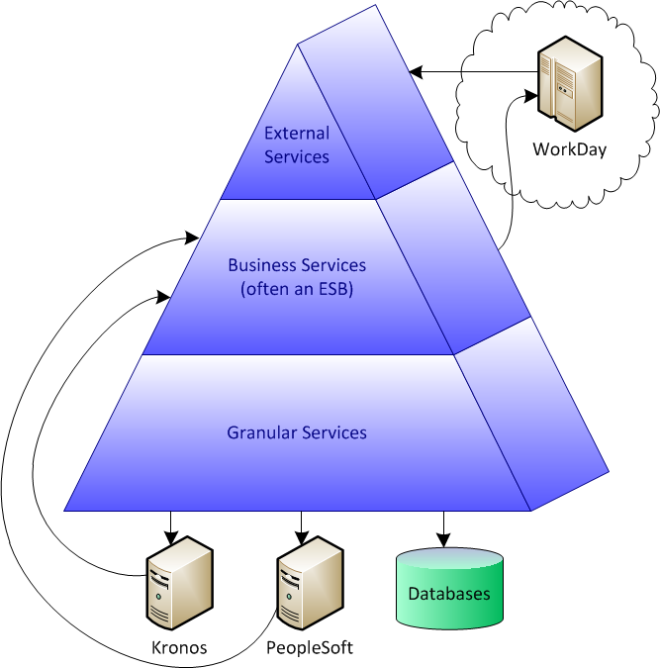
What is SOA?
Multi-Tier
Multi-Tier = Division of labor
in our software
Provides:
Industry best practice
Simplifies maintenance
Promotes code reuse
Stability
Manageability of
complex applications

Slide 14
Important Integration
Concepts
Integration Types

Slide 15
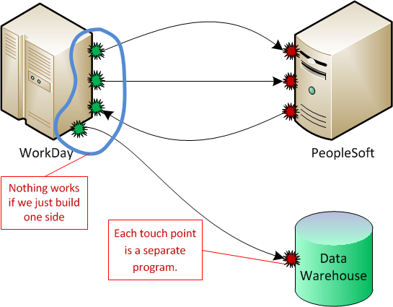
Integration Types
Touch Points
All integrations
are made up
of 2 or more
touch points.
Each is a
separate program or
configuration effort.

Slide 16
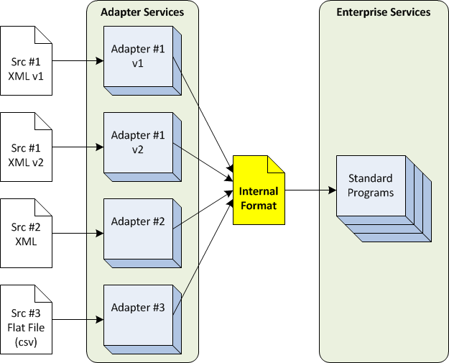
Integration Types – Queues
Standardized Internal File Format
Benefits:
Allows maximum reuse of programs.
Simplifies addition of future programs.

Slide 17
Technically, how are applications communicated with?
Integration Types

Slide 18
Integration Types
Not long ago, the text book answer was that the only valid SOA communication is SOAP based web services.
In practice this is not realistic.
Not all systems support web services.
HTTP communication usually has a time limit of 30 seconds. What happens when a transaction takes longer to process?
Web services put the error handling burden on the client. This is not always acceptable.
A transaction must complete before the client can continue or another transaction can be sent.
Technology jumped forward with a new “better” web service technology called REST.
Notes:
REST is in a lighter simpler version of web services. It keeps XML and rejects the overhead and complexities of using the SOAP wrapper. Without the complexities of SOAP, many organizations report that their development time is faster and the end product is much more stable. However, the cost is that the wide variety of technologies that rely on SOAP do not work with rest. In practice REST seems to be a good option for internal communication, but SOAP gives more options when communicating outside of the enterprise.
In enterprise transactions it often not desirable to have errors “bubble up” through the current transaction. This is because there is often no person involved to handle the error. Also, just because a database is down there is not reason to stop receiving new records. Instead input can be queued and saved to disk. And errors routed to a separate workflow or queue for handling later.

Slide 19
Integration Types
In practice there are a number of communication systems that are commonly used.
Oracle SOA will support all of these as well as other’s that are less common.
Web Services (SOAP or REST)
Queues
File Drops (FTP communication and directory monitoring)
Notes:
REST is in a lighter simpler version of web services. It keeps XML and rejects the overhead and complexities of using the SOAP wrapper. Without the complexities of SOAP, many organizations report that their development time is faster and the end product is much more stable. However, the cost is that the wide variety of technologies that rely on SOAP do not work with rest. In practice REST seems to be a good option for internal communication, but SOAP gives more options when communicating outside of the enterprise.
In enterprise transactions it often not desirable to have errors “bubble up” through the current transaction. This is because there is often no person involved to handle the error. Also, just because a database is down there is not reason to stop receiving new records. Instead input can be queued and saved to disk. And errors routed to a separate workflow or queue for handling later.

Slide 20
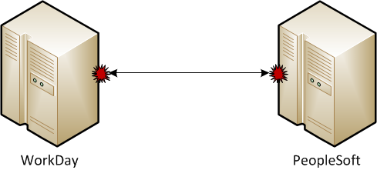
Integration Types – Web Services
Web Services
(SOAP or REST)
Benefits:
Client knows if the transaction was successful or failed.
Simplest to develop in a real time transaction situation.
Considerations:
Client blocks.
Errors must be handled by the client.
Can become a bottle neck if the client needs to send faster than the server can process.

Slide 21
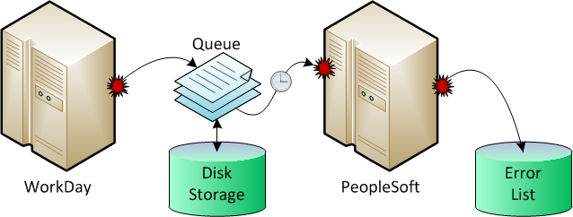
Integration Types – Queues
Queues
Benefits:
No timing dependency
Guaranteed Delivery
Buffers input during high volume periods
Considerations:
Client does not block
No built in reporting of processing errors

Slide 22
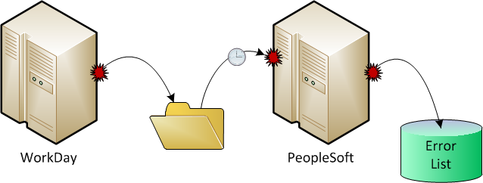
Integration Types – Queues
File Drop
Network Drive
or FTP
Benefits:
Many legacy systems can only output data as file based reports.
Can handle VERY large documents
Considerations:
Hard to secure
Tends not to perform as well as queues

Slide 23
Integration Types
Since each is better suited for a particular need, I recommend the following best of bread approach:
Use SOAP web services for all communication outside of the enterprise.
Standardize on either REST or SOAP for web services within the enterprise.
Most communications will be quick with reasonable sized documents. Use your web services for these.
For very large documents use files.
For batch processing of records use queues.
If there are heavy spikes of transactions use queues.
If there are timing differences between sender and receiver use queues.
Do not hesitate to hide a queue behind a web service if it simplifies reuse or keeps the environment “clean”.

Slide 24
What does
Oracle SOA provide?
Integration Types

Slide 25
Integration Types
Oracle SOA is an Integration Suite. These are often referred to as an Enterprise Service Bus.
Any SOA Integration Suite will provide the following general tools:
Adapters to communicate with applications. (The higher priced tools tend to offer more and more adapters.)
A workflow for guiding a transaction though multiple steps. Each step is generally a call to a service.
Tools for monitoring the transactions. (The higher priced tools tend to offer better monitoring.)
A centralized place to organize your SOA environment.

Slide 26
Some Advanced
Design Patterns
Integration Types

Slide 27
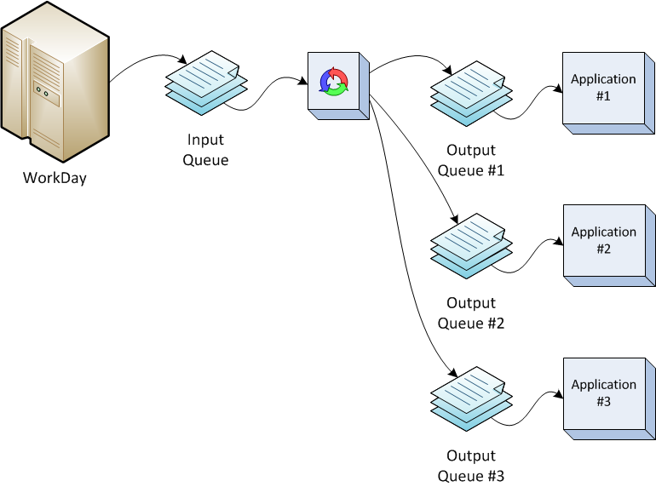
Design Patterns
Publish / Subscribe with Queues
Solves:
1 feed needs to go to multiple destinations
Timing is different between publishes and the destinations.
Timing is different between the destinations.

Slide 28
Design Patterns
XML Transformation (XSLT)
&
Code Translation
Solves:
XSLT only changes XML tag names and order.
Translation system translates code values from the sender’s format to the receiver’s format.

Slide 29
Questions?

